Slide 1
Project 8 Feedback System for UCI Library Help Section
Dastyni Loksa
Dawei Wang
Linus Siska
Devin Pigera
Client : Christopher Davis

Slide 2
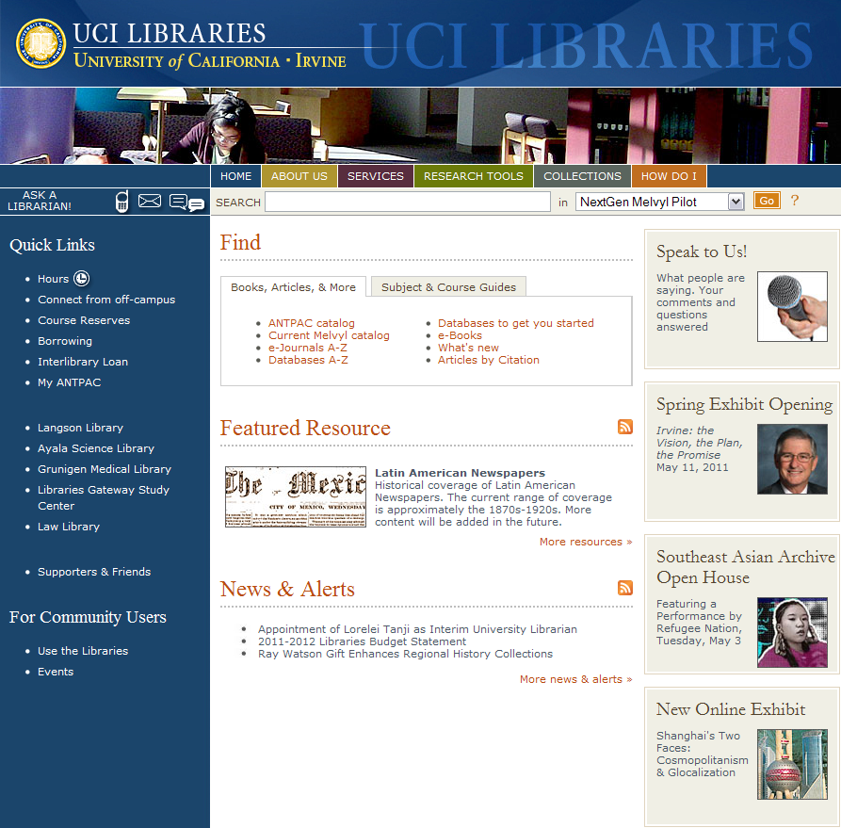
Intro to Product
UCI Library Website: http://www.lib.uci.edu
Connects 5 UCI Libraries and Research Resources together
Averages 30,000 page hits a day (Google Analytics)

Slide 3
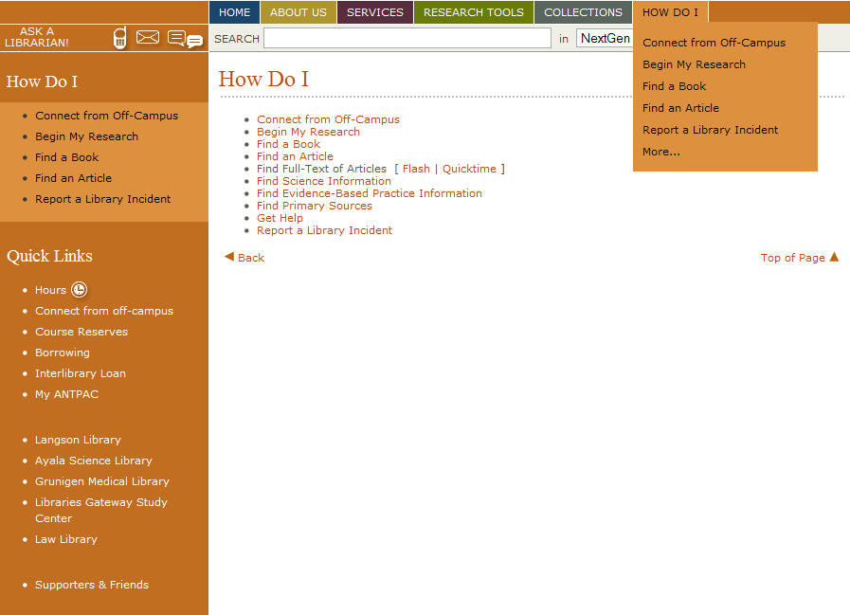
Client’s Goals
Focus on improving the ‘How Do I’ section
No existing method to collect user feedback
Goal : Design an effective & easy to use component to gather user comments and feedback

Slide 4
Our Game Plan
Understand Client Requirements
Design 3 prototype Feedback systems
Test Run 1 Test each prototype with users
Fine-tune best solution based on user thoughts
Test Run 2 Test chosen / fine-tuned solution with users
Present solution to client

Slide 5
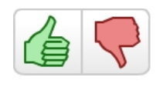
Our Chosen Prototypes
Selections based on careful study of top-rated
User feedback systems currently in use on other websites
5-star rating system
Thumbs-Up / Thumbs-Down
Response List

Slide 6
5-Star Rating System
Located at the top or bottom of every page
1-5 rating along with brief statistics displayed
Immediate feedback and record of rating (AJAX)
Accordion-style drop down of additional comment box
Fold back up after submit of comment
Alternatively, clicking the X will remove the drop down

Slide 7
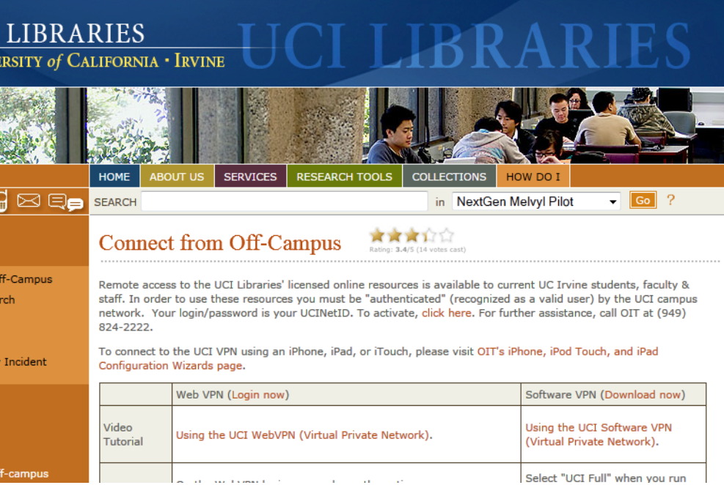
5-Star Rating System

Slide 8
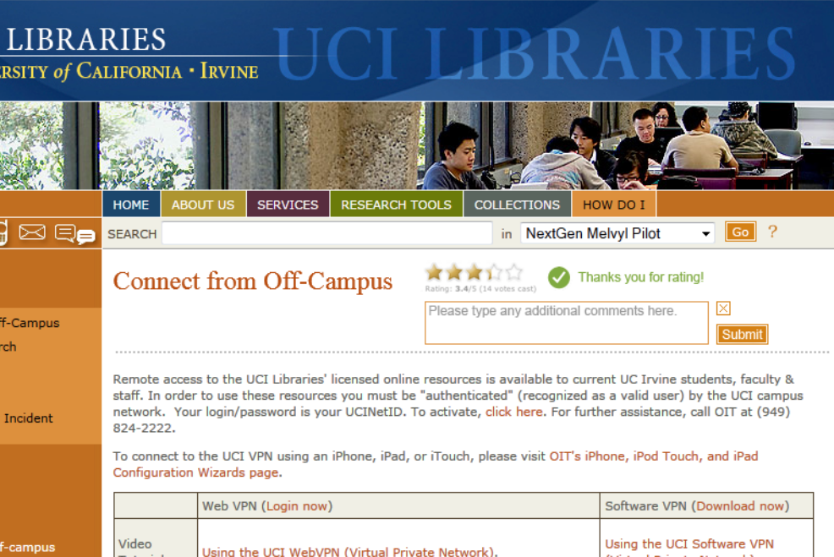
5-Star Rating System

Slide 9
Thumbs up/down selection
Located at the top or bottom of every page
Polarized Thumbs up or Thumbs down response
Accordion-style drop down for additional "Why wasn't this helpful" information provided if page was rated down:
Didn't answer my question
Information is incorrect
Instructions are confusing
Other
Immediate feedback and record of rating (AJAX)
Fold back up after submission of additional information

Slide 10
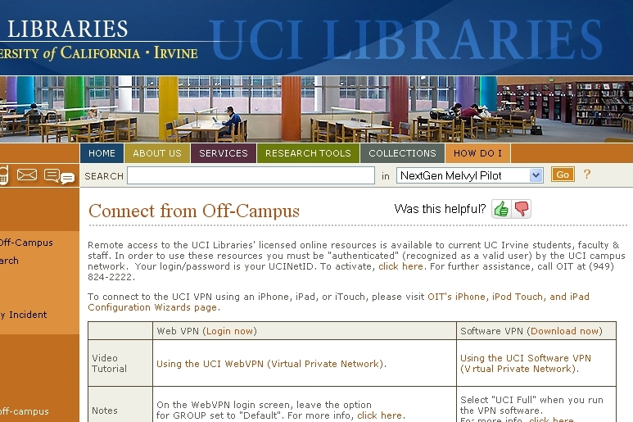
Thumbs up/down selection

Slide 11
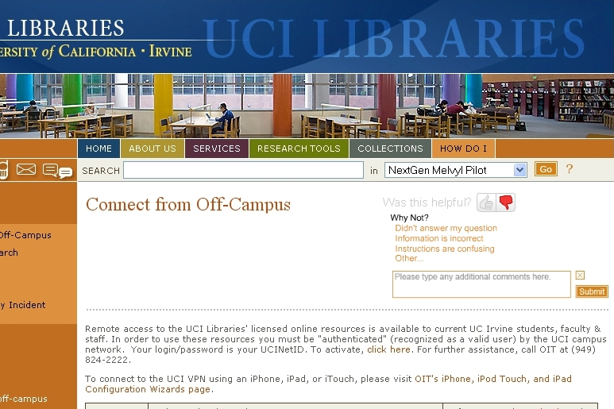
Thumbs up/down selection

Slide 12
Response List
Located at the top or bottom of every page
Clicking a "Was this helpful?" button presents a list of preset responses
Available responses provided via accordion drop menu
Yes
No
Didn't answer my question
Information is incorrect
Instructions are confusing
An "Other..." option could allow freeform user comments
Immediate feedback and record of rating (AJAX)
Clicking a list item submits response, and closes list.
Clicking the "X" button beside the list closes the list.

Slide 13
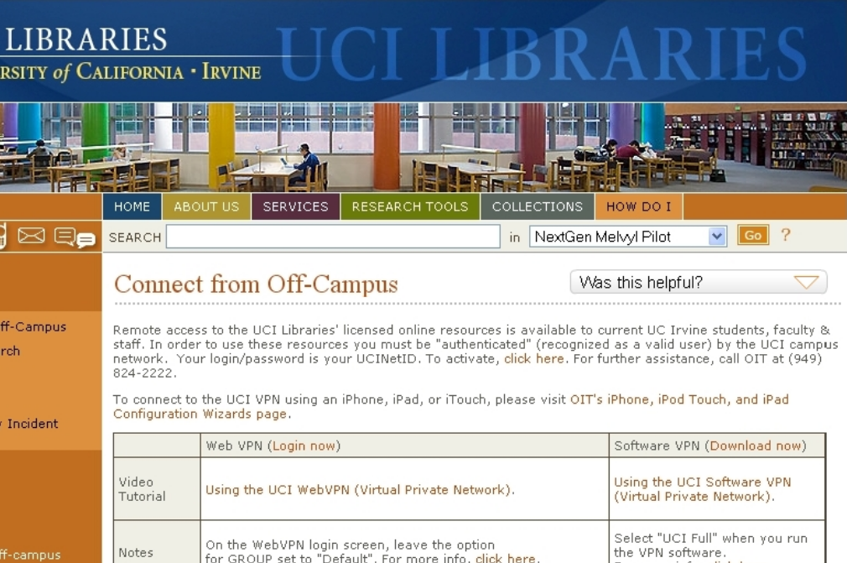
Response List

Slide 14
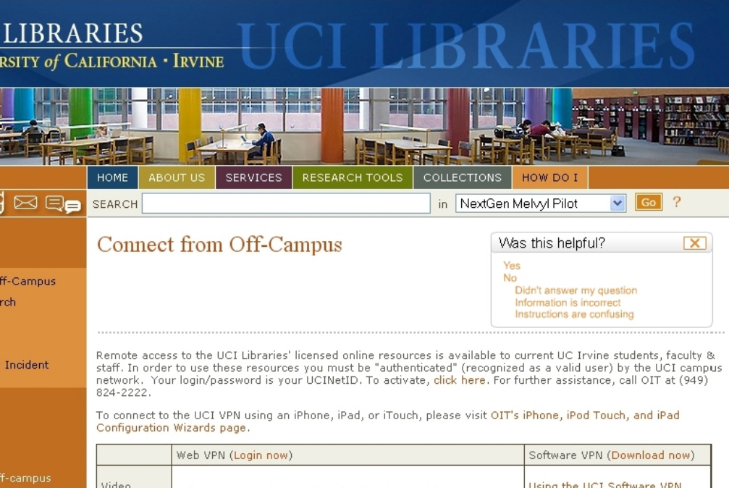
Response List

Slide 15
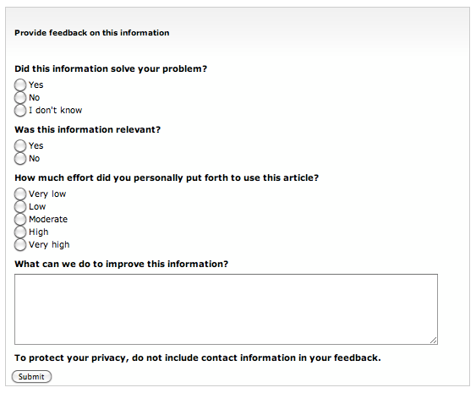
Response List (Style adapted from MSKnowledgeBase)

Slide 16
Choosing Test Users
Test-users selected to cover ‘college-audience’ demographic
Age Group : 19-50 (covers 64.9% of age groups)
Distribution of majors (non-ICS) -> Grad, Undergrad & Professors
2 sets of test-user groups:
Phase 1 : Test each prototype, choose best one ( 10 users)
Phase 2 : Test decided / fine-tuned prototype (5 users)
Our group will meet users at a place of convenience (a UCI Library Probably)
Expected Duration: about 20 minutes
Users will be requested to interact with system and provide feedback on UX

Slide 17
Tentative Schedule
Task | Start Date | Assignments
Initial Presentation | April 25th | Introduction, Schedule Planning, Test Design – Devin 5-star rating system – Dawei Thumbs Up/Thumbs Down – Dastyni User Survey System – Linus
Implement 3 prototypes to specification | April 26th | 5-star rating system – Dawei ThumbsUp/ThumbsDown – Dastyni User Survey System – Linus
Test Phase 1 : Select Best Prototype | May 1st | Survey Design, Test Plan structuring – Devin Test Study Control – Dawei, Dastyni
Fine-Tune Chosen Prototype based on user feedback | May 5th | Feedback Analysis – Devin + whole team Fine-tuning decided system – Respective team member of chosen system
Interim Presentation | May 13th | Presentation Design & Planning – Devin
Test Phase 2 : Test Final Prototype | May 28th | Survey Design, Test Plan structuring – Devin Test Study Control – Devin, Linus
Analyze Findings |  | Feedback analysis, Final Tuning – Devin
Final Presentation Preparation | June 4th | Assignment Breakdown (to each member of team) Final aggregation / content design - Devin
Final Report Preparation | June 9th | Assignment Breakdown (to each member)

Slide 18
Thanks for Listening :-)
Comments? Thoughts? Questions?

