Slide 1
Project 8 Interim Presentation Feedback System for UCI Library Help Section
Dastyni Loksa
Dawei Wang
Linus Siska
Devin Pigera
Client : Christopher Davis

Slide 2
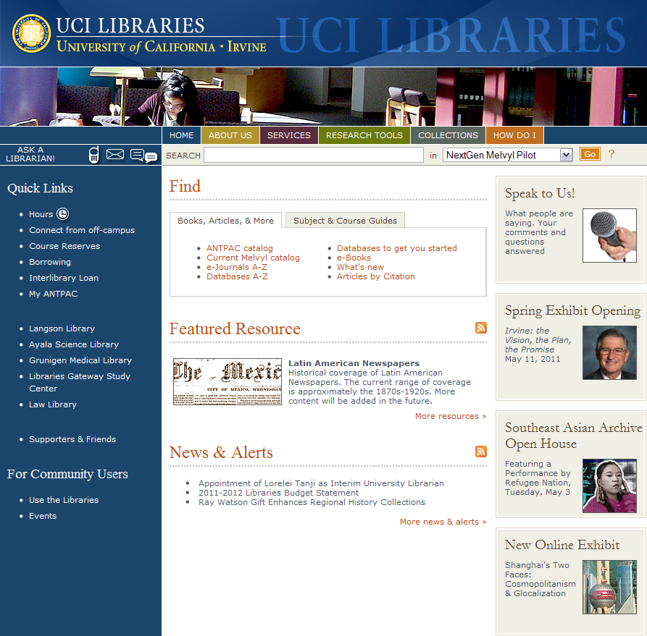
Recap of our Client
Project: UCI Library Website: http://www.lib.uci.edu
Connects 5 UCI Libraries + Research Resources together
Averages 30,000 page hits a day (Google Analytics)
Representative: Chris Davis

Slide 3
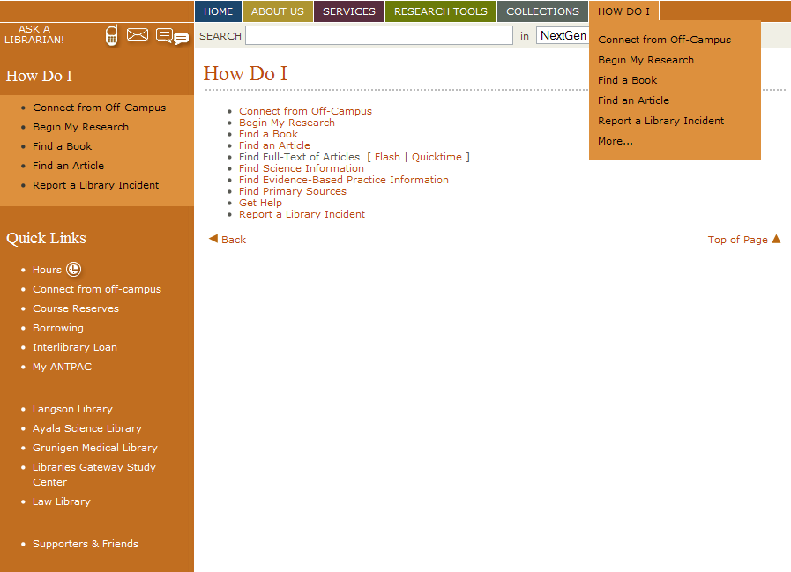
Recap of our Focus Area
Focus on improving the ‘How Do I’ section
No existing method to collect user feedback on a help section
GOAL: Design & Implement an easy to use component to gather user feedback

Slide 4
Reminder: Non-Traditional Approach!
WHY? 1. No extensive study of existing system was needed 2. Client provided exact requirements for new component
Required us to design & test our own components

Slide 5
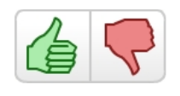
Recap of intended designs
3 designs (based on studies of top-rated rating systems) including NetFlix, Facebook, Microsoft & Reddit.com
5-star rating system
Thumbs-Up / Thumbs-Down
Survey Styled Form

Slide 6
5 Star Rating System
Enables user to select any number from 1 to 5 stars
On click, user star rating registered in system
Display in Browser

Slide 7
Thumbs Up/Down System
Implemented in JavaScript 1.81
Detects Mouse Click event
If user selects Thumbs Up: Records User Selection
If user selects Thumbs Down: Provides options via Radio button
Display in Browser

Slide 8
Survey Styled Form
Designed & Embedded via Flash 10 Player
3 parts
Question 1: Radio Button (single selection)
Question 2: Checkbox (allows multiple selection)
Question 3: Textbox (Add user comment)
Submit button
Display in Browser

Slide 9
Pre-Test Changes
Goal: Fine-Tune 3 systems before actual user testing (tested on 8 users)
Planned Revisions before Round 1 of User-Testing:
Model | Fine-Tuning to do
Star-Rating | Change mouse pointer to hand on Mouse.Over()
Thumbs Up/Down | Change mouse pointer to ‘hand’ on Mouse.Over() If Thumbs-Up selected, add ‘Thank-you for rating’ If Thumbs-Down selected, add message on radio button selection
Survey | Add ‘Thank-you for response’ message on ‘Submit’ button

Slide 10
User testing Round 1 (Revisions)
Immerse user in actual experience
Embed components
Guide user to use all 3 components
Screen + Audio recording
Remove influencing variables
Identical tests materials for each user
Order permutation
Multiple Tests (15-20 min. each)
Careful Demographic
Non-ICS/CS majors
Multiple disciplines
Multiple age groups (students & professors)
7-8 test users

Slide 11
Breakdown of Sample Test
Display Library HomePage
Direct User to Select ‘How do I’ link Provide user 1st task e.g. “Select ‘How do I find a book’, read contents & rate the article” Provide 2nd & 3rd tasks (Each page has a different rating component) Present all 3 interactive components Get Feedback (via Structured & Un-Structured Questions)

Slide 12
Post-Testing Game Plan
Gather all feedback
Analyze Results
Choose best system based on user-feedback
Fine-Tune system based on user suggestions
Conduct Final Round of testing (4-5 users)
Present to client

Slide 13
Revised Schedule
Week | Plan
Week 7 | Interim Presentation Fine-Tune Mockups (Star: David, Thumbs: Dastyni, Survey: Linus) Finalize Test Plan + structured/unstructured questions (Devin) Submit Material
Week 8 | Conduct Round 1 Testing (All) Analyze all results & Choose component (All)
Week 9 | Fine-Tune chosen Component (Respective Designer) Conduct Round 2 Testing (All)
Week 10 | Final Presentation : Finish Final Report (All)
Week 11 | Final Report Submission (All)

Slide 14
Thanks for Listening :-)
Comments? Thoughts? Questions?

