Slide 1
Project 8 Final Presentation Feedback System for UCI Library Help Section
Dastyni Loksa
Dawei Wang
Linus Siska
Devin Pigera
Client : Christopher Davis

Slide 2
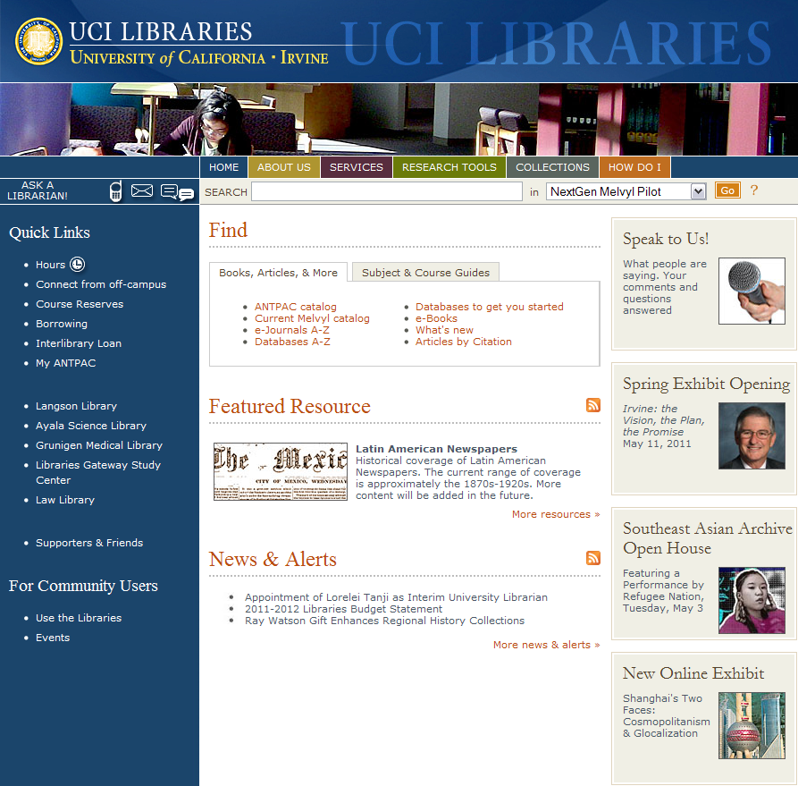
Recap of our Client
Project: UCI Library Website: http://www.lib.uci.edu
Connects 5 UCI Libraries + Research Resources together
Averages 30,000 page hits a day (Google Analytics)
Representative: Chris Davis

Slide 3
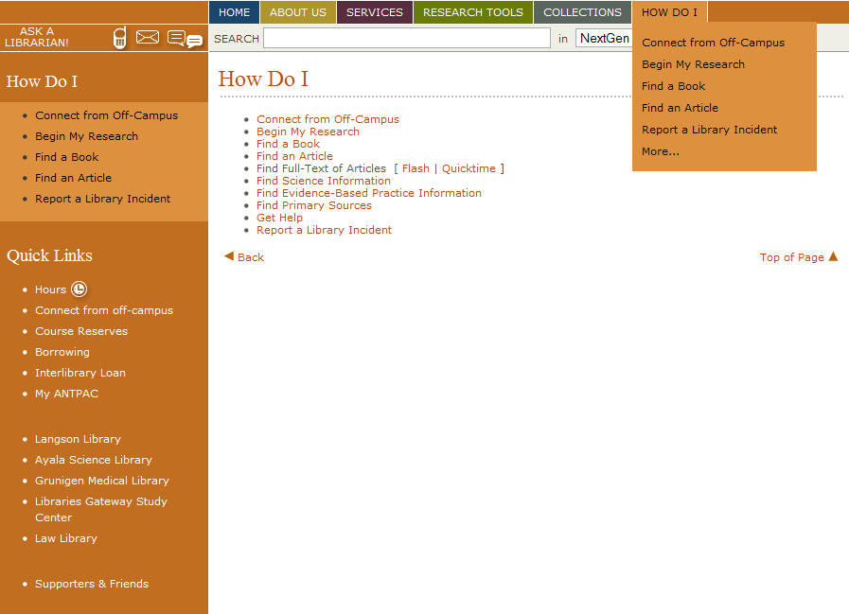
Recap of our Focus Area
Focus on improving the ‘How Do I’ section
No existing method to collect user feedback on a help section
GOAL: Design & Implement an easy to use component to gather user feedback

Slide 4
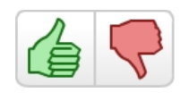
Recap of intended designs
3 designs (based on studies of top-rated rating systems) including NetFlix, Facebook, Microsoft & Reddit.com
5-star rating system
Thumbs-Up / Thumbs-Down
Survey Styled Form

Slide 5
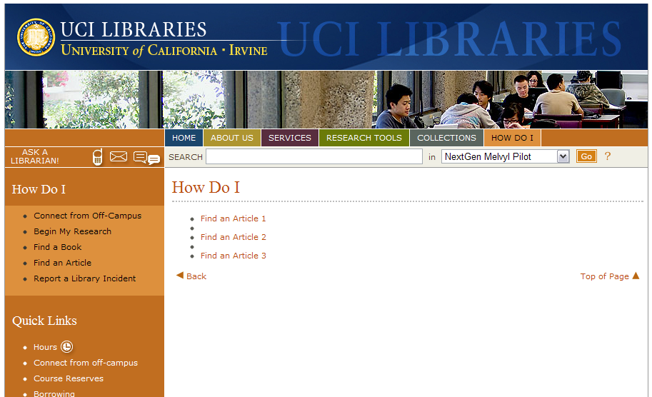
Test Plan Implemented
Welcome Screen presented to user. Asked to complete 3 specific tasks.
Each link corresponds to a page + rating system. Order permutated

Slide 6
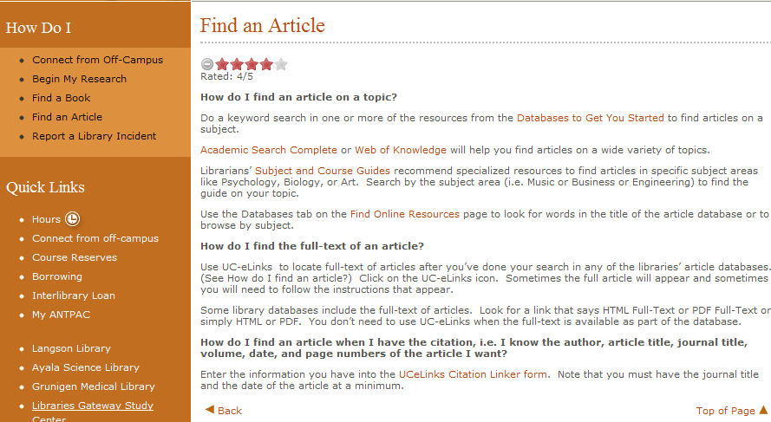
5 Star Rating System
Star System
Identical Article maintained

Slide 7
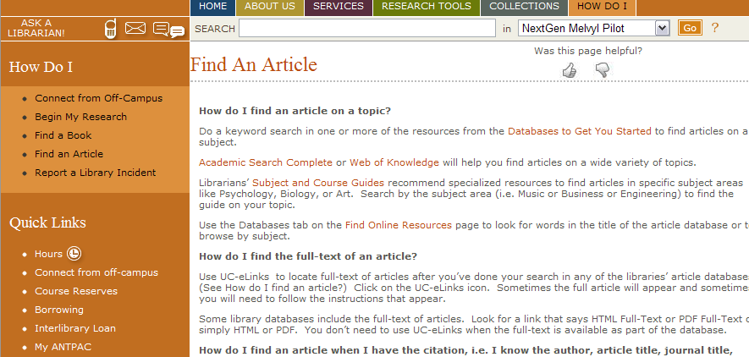
Thumbs Up/Down System
Thumbs Up/Down

Slide 8
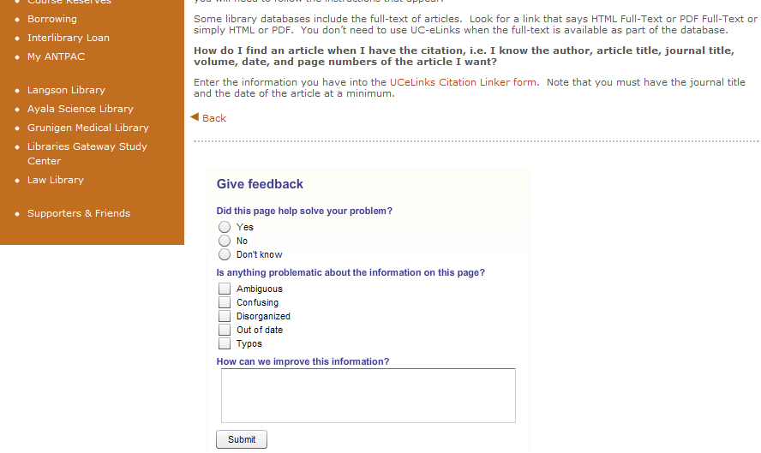
Survey Styled Form
Survey System

Slide 9
Sample Test Subjects:
Subject # | Age | Gender | Major
1 | 23 | F | Psych/Social Behavior
2 | 25 | M | Japanese
3 | 21 | M | Biology
4 | 20 | M | English
5 | 33 | M | Political Science
6 | 37 | F | Staff (UCI Alum)

Slide 10
Test Results:
Subject # | Thumbs | Stars | Survey
1 | Dislike | Like
2 | Dislike |  | Like
3 | Dislike | Like | Like (Lesser)
4 | Dislike | Like
5 | Like |  | Dislike
6 |  | Like | Dislike

Slide 11
Chosen System For Fine-Tuning:
5 Star Rating System
Added Preset Selections variant taken from the Thumbs prototype
Added Title (For more impact / visibility)
Testing 2 locations of rating system on page (top/ bottom of article)
Test Subjects : Similar criteria as before + Attempting to use previous users again
5-6 test users

Slide 12
Schedule (Last 2 weeks)
Week | Plan
Week 10 | Final Presentation : Finish Final Report (All) Testing of Fine-Tuned Star Rating System (Dastyni, David, Linus) (Completed)
Week 11 | Final Report Submission (All)

Slide 13
Thanks for Listening :-)
Comments? Thoughts? Questions?

