Slide 1
Causality Project
David Conley
Byung Lee
Jennifer Stoneking
Vijay Hattiangadi

Slide 2
Summary of Issues to Address
Primary
Organizations & Navigation
Correct terminology
Linking between Wikipedia & website
Lack of instructions/guide for users
Secondary
Color/Size for fonts and images
Grouping mechanisms
Page loading
Notes:
Byung

Slide 3
Methods
1. Initial, Individual Heuristic Evals.
2. Usability Experiment
- Pilot test
- Giving out some tasks
- Note taking and Screen recording
3. Pre and Post Questionnaires
Notes:
Byung

Slide 4
Summary of User Tasks
Make a login username & password
Try to find the page for making relationships
Make a relationship
Try to find the visualization
Complete the post-test questionnaire
Notes:
Byung

Slide 5
What We Have Done So Far
Prepared the experiment materials
Sent out welcome letters to 12 participants
Posted pre questionnaires on Survey Monkey
Ran a pilot test to ensure stability of procedure
Started stage 1 of the user experiment
Notes:
Jennifer

Slide 6
New Insights
General interest from users about the site
No overwhelming flaws
Nothing made the website unusable
Creating relationships were simple for users
Finding the page was not as simple
If users are willing to show up, users are willing to do as much as possible to help out
Notes:
Jennifer

Slide 7
Issues During Testing
Video recording lost
People unresponsive to requests to set up time for testing
Fell behind schedule as a result
Starting the test according to protocol
Telling users too much about the purpose of the site
Notes:
Jennifer

Slide 8
Interface Problems
Home page is necessary for user to quickly grasp the purpose of the site
Pilot test user thought it was a global-warming awareness site
Wording causes confusion
"Sun causes Ultraviolet"
"Temperature causes beetle"
Notes:
DC

Slide 9
Interface Problems (cont.)
Links don't look like links
Users had difficult time finding link to individual relationships. Favored Wiki link. (see below)
Same problem arose when trying to view individual issues.
Notes:
DC

Slide 10
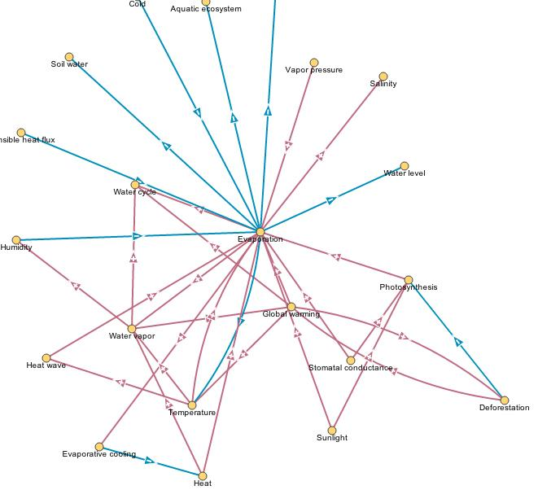
Interface Problems (cont.)
Visualization is very complicated
Dense / Lines too close together
No key
Notes:
DC

Slide 11
Possible Improvements
Resolving issues discussed in previous slides.
Forward/Back button on pages
Zoom on the visualization
Perhaps leave visualization to more experienced users?
Design team currently working on home page to be implemented. Further tests will determine how much it helps.
Notes:
DC/Vijay

Slide 12
Decisions to be Made
Where are the rest of the subjects going to come from? (e.g. new pool of students, etc.)
What interface issues that we have found can be realistically fixed in our time frame?
Who are we going to re-test?
How are we going to divvy up the responsibilities for the final report?
Notes:
Vijay

Slide 13
Future Plans
Continue testing students that respond to requests
Provide suggestions for re-design, mock-up?
Re-test users with new designs (provided the design team has enough time)
Testing high school students (Vijay)
Write-up the final report & presentation
Notes:
Vijay

Slide 14
Updated Timeline
Time Frame | Plans & Task Assignments
Week 7 | - Continue user testing - All members, teams of 2 - Begin work on final report (responsibility allocation, write-up, etc.) - All members - Determine status of Causality design/programming team (for re-designs, etc.) - David
Week 8 | - Continue/Finish user testing - All members, teams of 2 - Draft possible mock-ups - All members? - Re-test users (if applicable) - Team of 2, TBD - Continue work on final report - All members working on separate parts.
Week 9 | - Same as week 8? - Deadline to finish testing: 5/30.
Week 10 | - Finish all user-related activities (re-testing, drafting, etc.) - All members - Finish report/final presentation - All members
Notes:
Vijay

