Slide 1
Informatics 132
Initial Presentation
Group 4

Slide 2
Current Map interface
- Maps are in the form of floorplans available on the UCI Library website.
Notes:
Cherrie

Slide 3
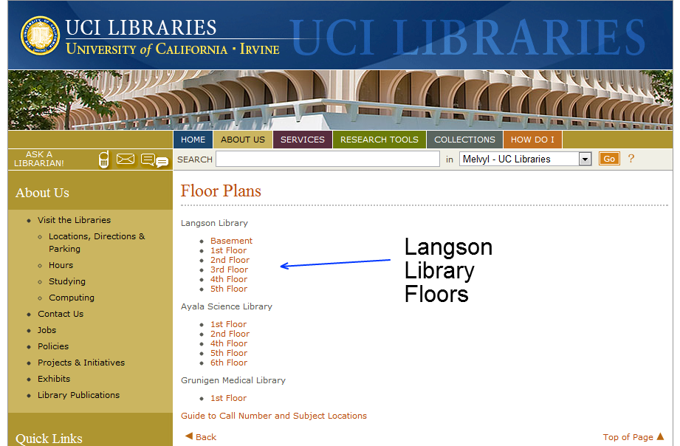

Slide 4
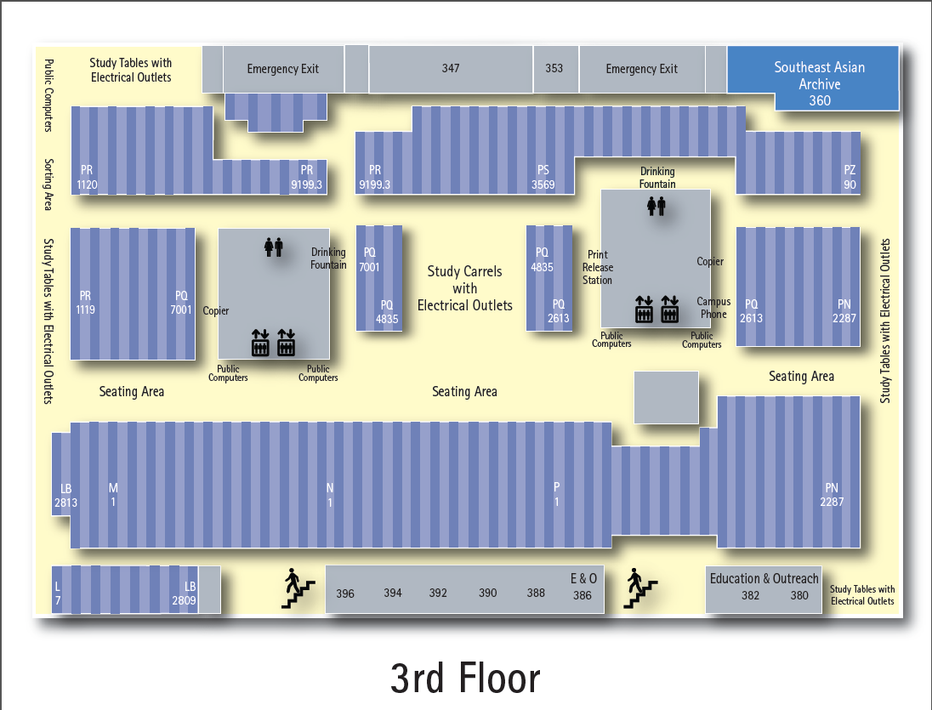

Slide 5
Current Usability Problems
- Based on google maps.
- No details about individual levels.
- Too much data flow.
- Simple maps without user interaction
- No quick links to often searched objects
- Search function with call #'s.
- Separate link for call numbers
and subject location
- Mobile implementation.
Notes:
-Cherrie

Slide 6
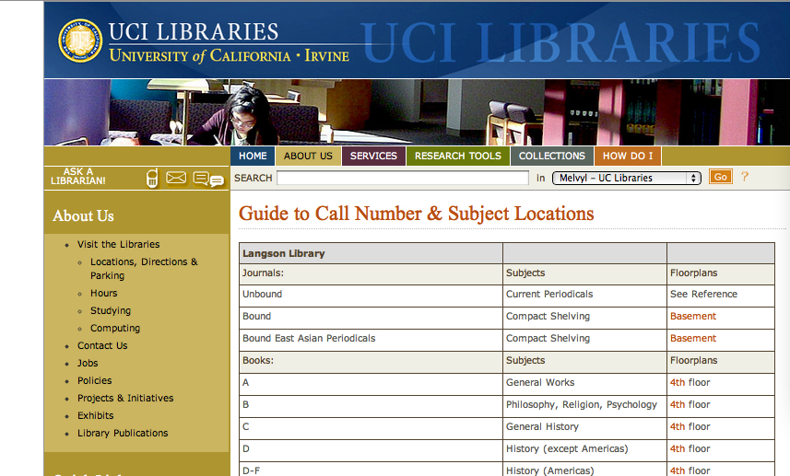

Slide 7
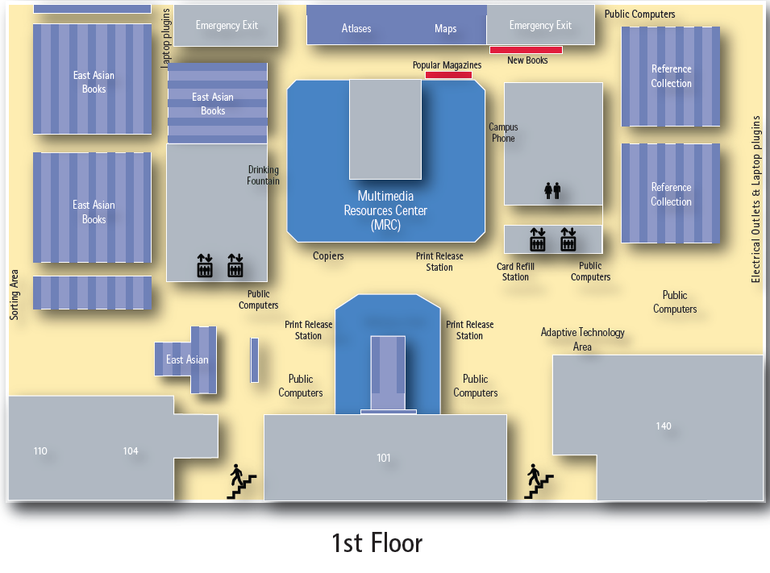

Slide 8
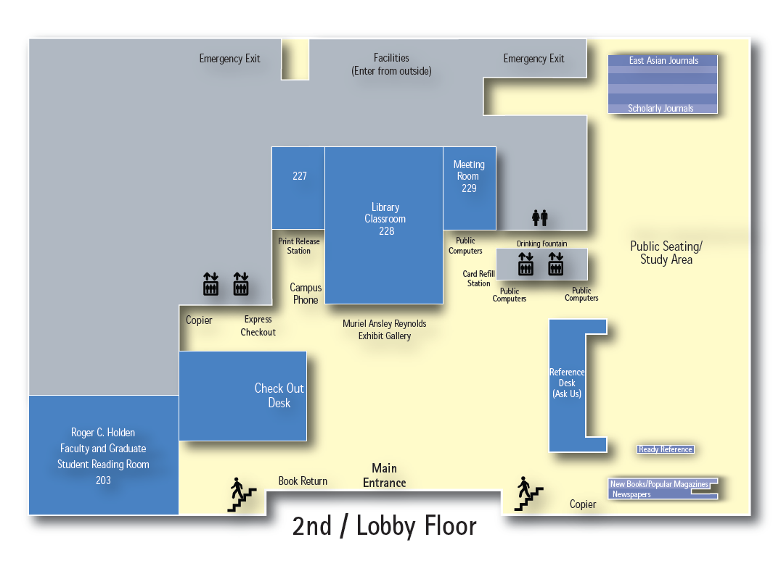

Slide 9
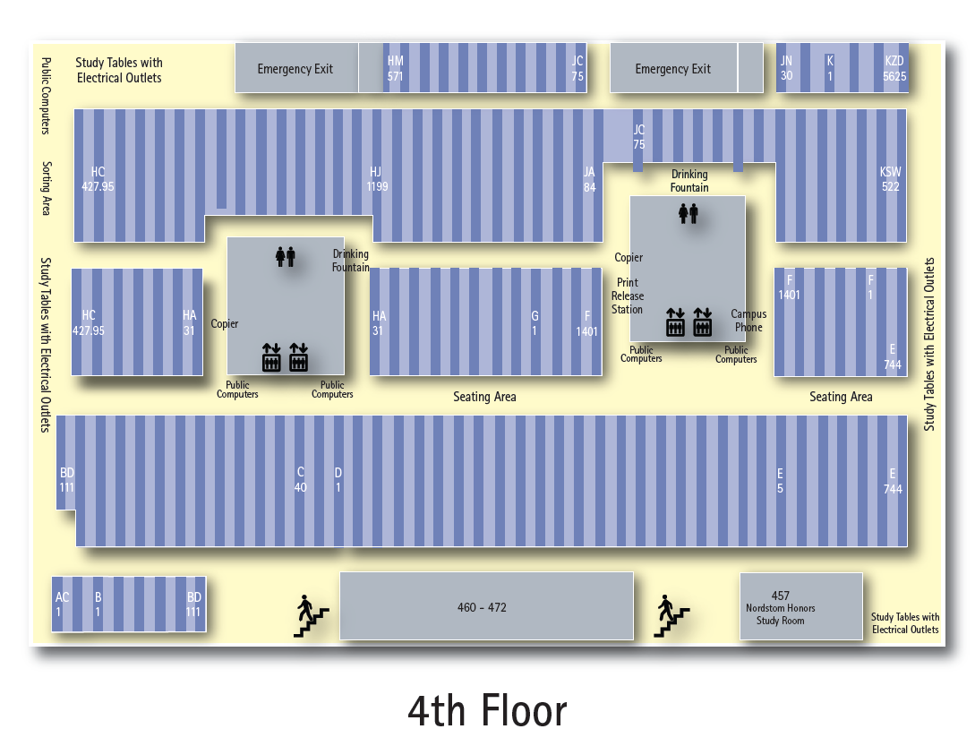

Slide 10
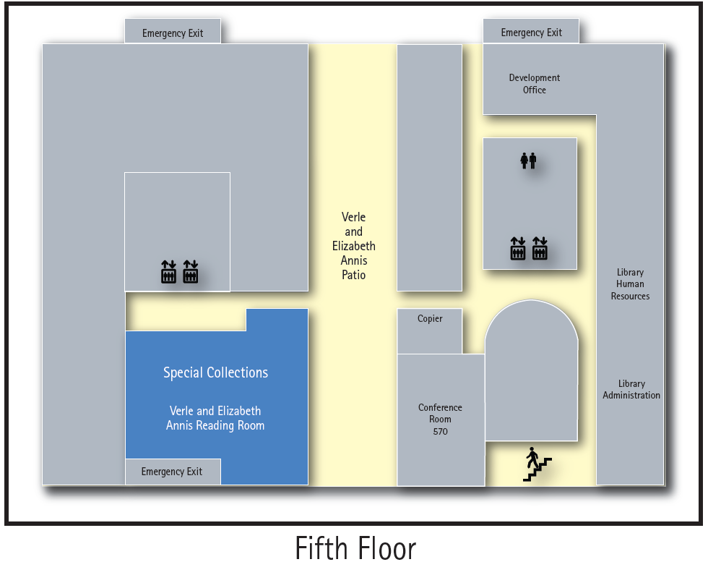

Slide 11
Phases of Research
- Planning phase (already met with customer, gathered problems and viewpoints)
- initial design
- Preparing for User Testing
- Ask people that don't come the library as often.
- Interviewing (user testing)
- Find book with call number.
- Find restroom.
- Find another item listed on our maps.
- redesign
-restest

Slide 12
Initial interface
Designed to show an implementation of a different type of map, probably html based.

Slide 13
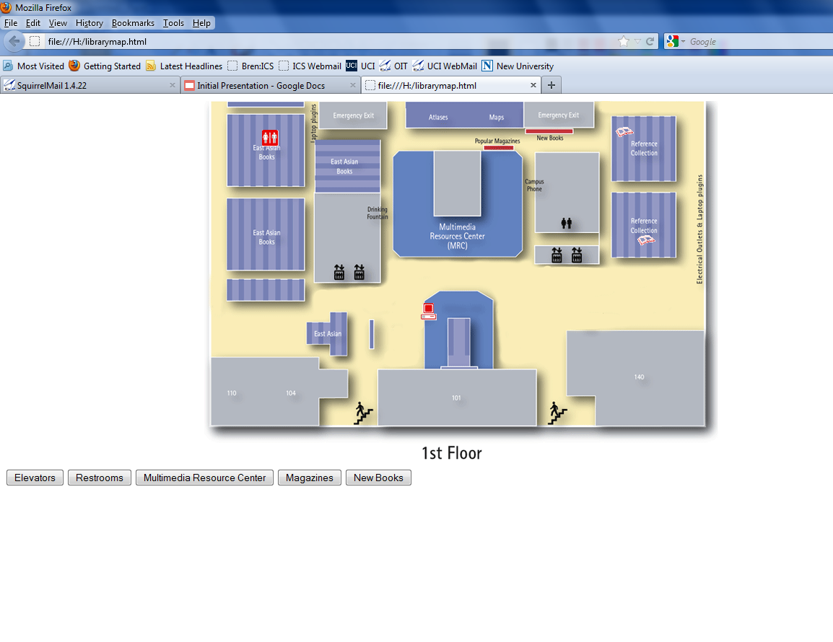
It will look something like this ...

Slide 14
Methods for Testing
- We will use interviews from various majors and test their practical use with the interfaces.
- We will conduct 8 - 10 interviews with people outside of Langson Library.
- There will be no subgroups.
- We will user test the current and a new implementation.
- The actual testing will be done using scenarios that will be audio/video recorded.

Slide 15
Interview Plans
- How comfortable did you feel using it?
- How does the current implementation compared with the new one?
- Was it easy to find what you were looking for, compared to the previous one?
- How can we improve this system?
Notes:
- Freddie

Slide 16
Redesign and Retesting
Redesign will be based off observations from recordings. All HCI components that are relevant to the library map will be considered during redesign.
It will be retest toward the end of the quarter, to see how effective the changes were.

Slide 17
Information
- Their contact information will be collected for further questioning and updates if necessary.
- The information that we collect from the interviews will be used to improve the system and re-tested it later.
-***Possible implementation***
http://htmledit.squarefree.com//
Notes:
- Brandon

Slide 18
Schedule
- Week 4
4-26 Thursday
`finish designing the first phase user interface,
- Prepare the user test.
- Prepare questions.
- Week 5
- Gather subjects and run the user test.
- Gather information.
- Week 6
- Report to customer and plan out the next phase.
Notes:
- Freddie

Slide 19
Questions?

Slide 20
Thank You

