Slide 1
Interim Presentation
Group 4 - May 14th, 2012
Langson Library Redesign

Slide 2
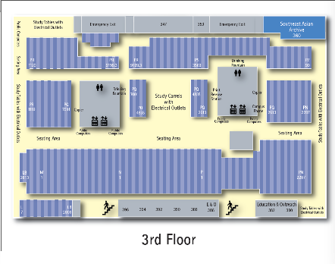
Project
Help infrequent patrons navigate Langson Library
Original Map on the library website

Slide 3
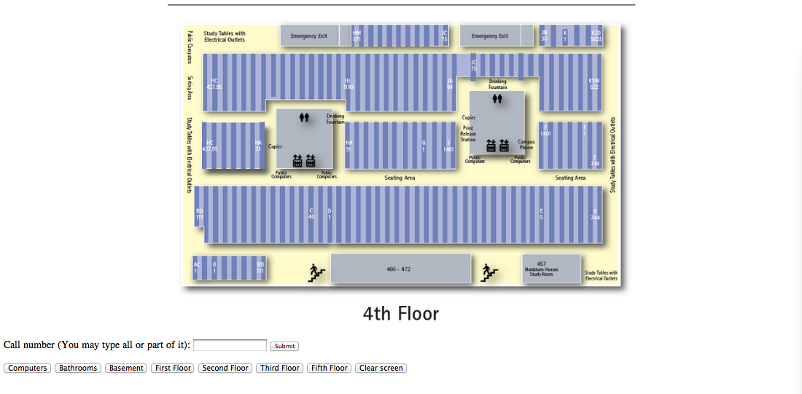
Project
Help infrequent patrons navigate Langson Library
Redesigned user interface

Slide 4
Current Status
- Primary implementation and design
- Materials document
- Questionnaire created
- Tools analysis and gathering
. Recording software - audio / video
. Time Logbook
. Questionnaire
- Ten (10) User Successful Tests as a result

Slide 5
Usability Conducting
Collect information from users (Questionnaire Part 1)
name, email, major, etc.
Perform user study tests
Test 1 (Original PDF Map)
Test 2 (New Implementation)
Collect users' opinions on both user studies (Questionnaire Part 2)
Data is stored on Excel Sheet

Slide 6
Insights Gained Thus Far
Many Test Users liked :
- The ability to search for call numbers
- The buttons that swap between floors
- The buttons that display certain icons on the map and make it instantly visible to the user

Slide 7
Issues Raised
HCI refinement needed
- Buttons: small size; button placement
- User attention on the center of the screen, lead to the unawareness of the buttons at the bottom of the page
* No clear instruction about functions of the buttons

Slide 8
Issues Raised
- Call number search
* Vague information about how it works and the function it provides
* Many of the users bypassed the call number column and kept searching through the map

Slide 9
Issues Raised
- Map layout and design
* Map size too small, should adjust to original map and with the screen size
* Text size too small, needs better radio compare to the items on the map
* Text color adjustment(shallow contrast with white on light blue)

Slide 10
Scenario Tasks
Should some of the tasks be merged into one scenario?
There are currently 4 different sets of tasks that include combinations of finding bathrooms, computers, books, and floor switching.

Slide 11
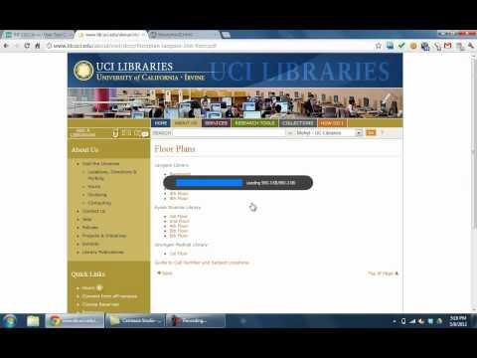
Example of user difficulties
- difficulty seeing smaller text
- bypassing buttons

Slide 12
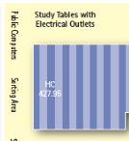
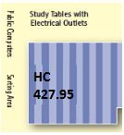
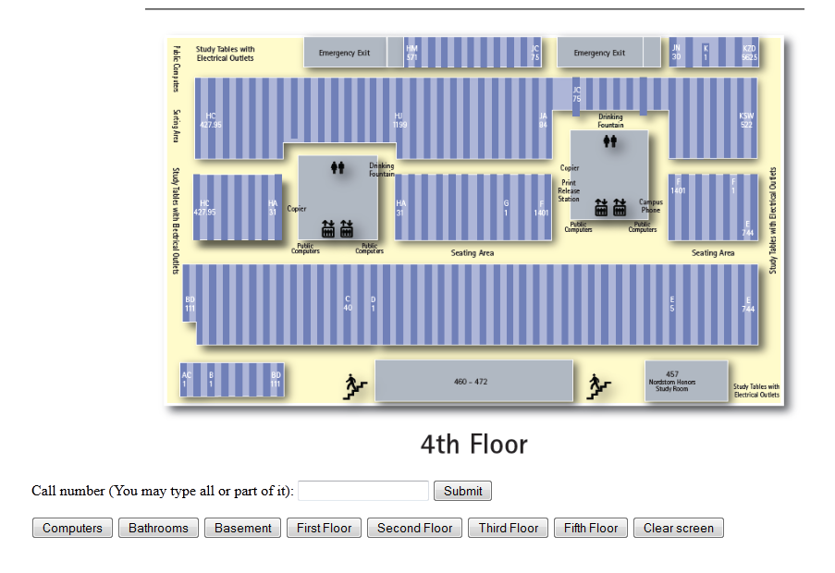
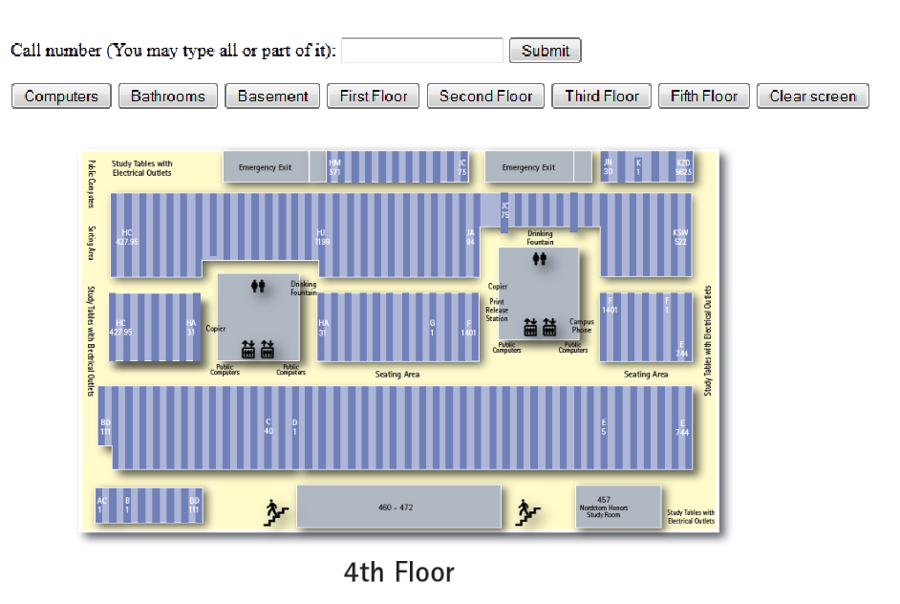
Interface redesign
Size of labels on map
old new
old

Slide 13
Schedule Weeks 1-6 Completed
- Week 1 - Week 4 -
Held meetings with customer (April 6, April 20)
April 6 - We discussed the concerns with the map.
April 20 - We proposed a prototype for a new interface and plans for user testing
April 23 - Initial presentation
- Week 5 -
- Gathering materials (materials document)
- Start user testing
- Week 6 -
- User testing completed, begin analysis

Slide 14
Proposed Schedule
Week 7
May 14 - Interim presentation (Team 4 Members)
Focus on refining the redesigned interface (Brandon)
Week 8
Discuss new redesign with customer (everyone)
Conduct final user testing (everyone)
Week 9
Manage video (Steven)
Complete and Analyze round 2 user test videos (everyone)
Week 10
Final Evaluation (presentation June 4)
Final report (June 10)

Slide 15
Roles Within User Testing
Cherrie
. Reads the script and watches the user's progress, as in when it's time to change browser tabs
Steven
. Handles the recording software and hardware; provides the laptop
. Monitors the experiment itself as it's underway
Brandon
. Determines the current scenario to test; writes call numbers on whiteboard
. Ensures the interface is functioning correctly, and further oversees the experiment
Freddie
. Track start and end times during experiment
. Manages questionnaire XML Document

Slide 16
Remaining Closure
We hope that these changes will bring greater user satisfaction in the second round of user testing. We ultimately hope to create an interface that can improve navigation and convenience within the UCI Libraries.

Slide 17
Questions?

Slide 18
Thank You

