Slide 1
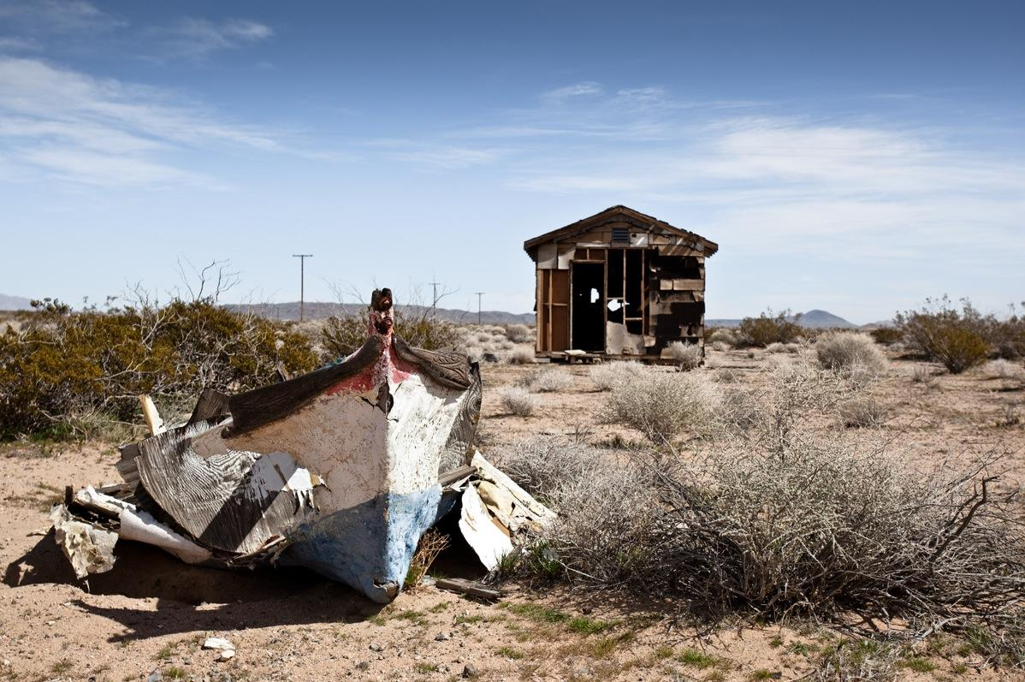
A Mobile Guide to California's High Desert
Van Erick Custodio
Sohrob Raja
Rachel Rose Ulgado
images photographed by James Mann
Notes:
Erick

Slide 2
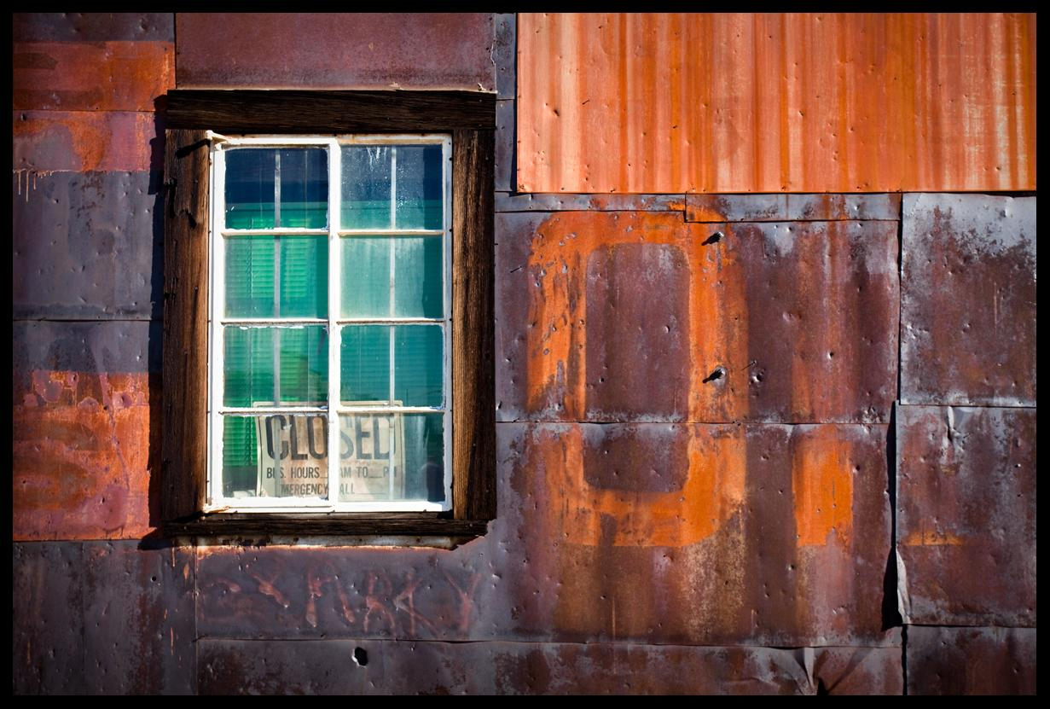
Objectives
Create a mobile application for tablet devices
Foster interest in preservation and nostalgia for the high desert and its history
Emphasize and highlight artistic elements
Provide an immersive environment for end users
Notes:
Erick

Slide 3
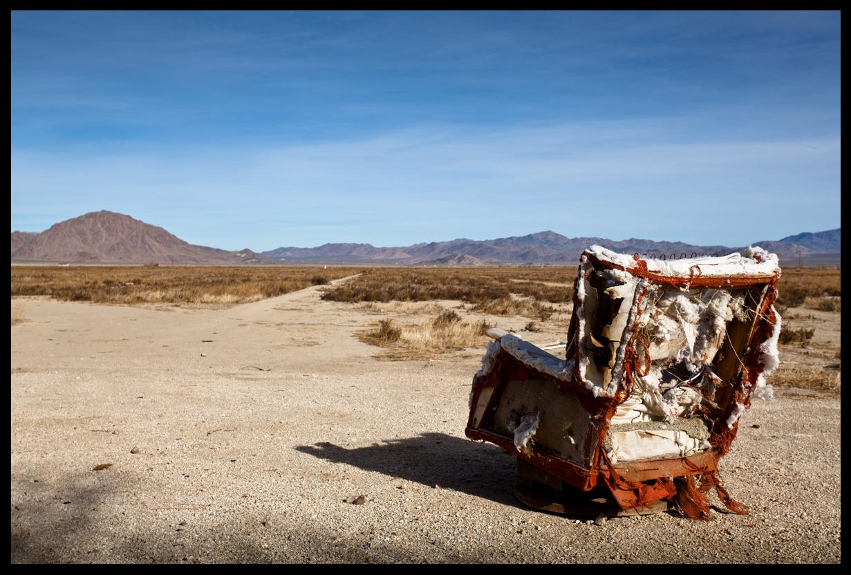
Methods
Sketching and Storyboarding
Medium fidelity Balsamiq prototyping
Peer Reviews, User Tasks, Usabilla software
Pilot Test
User Study and Redesign
Notes:
Rachel

Slide 4
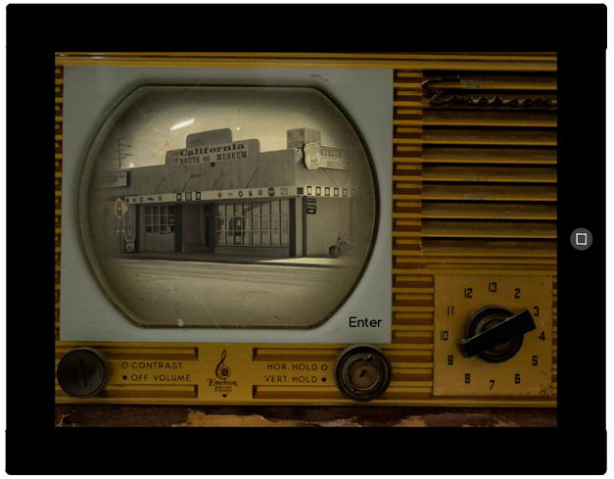
Balsamiq Prototypes
Notes:
Rachel

Slide 5
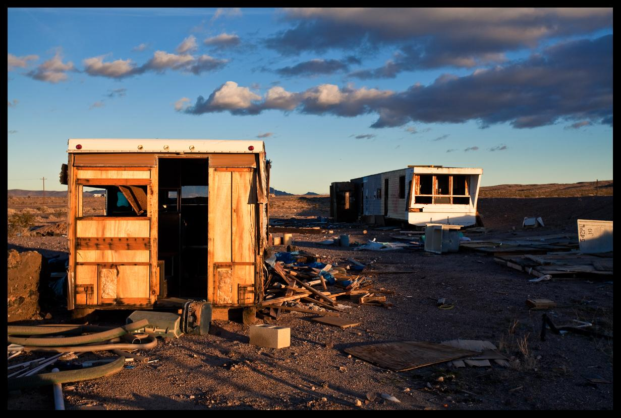
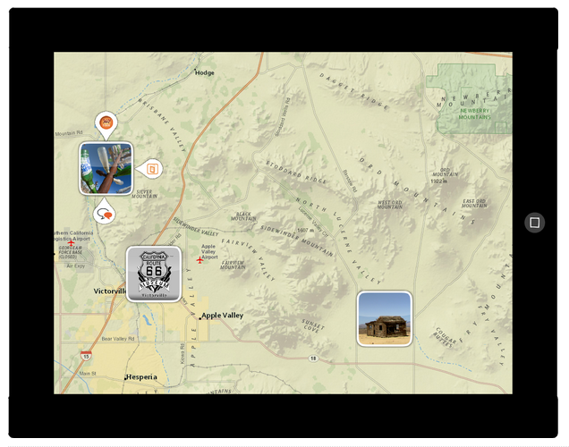
Balsamiq Prototypes

Slide 6
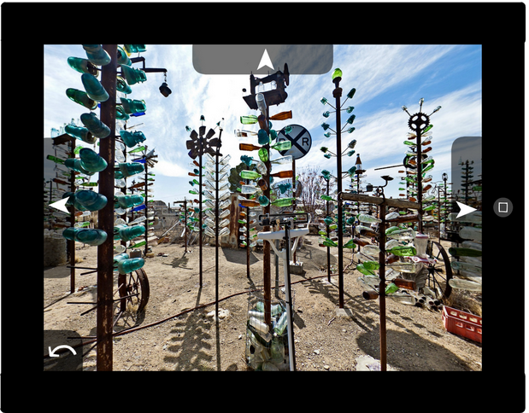
Balsamiq Prototypes
Notes:
Rachel

Slide 7
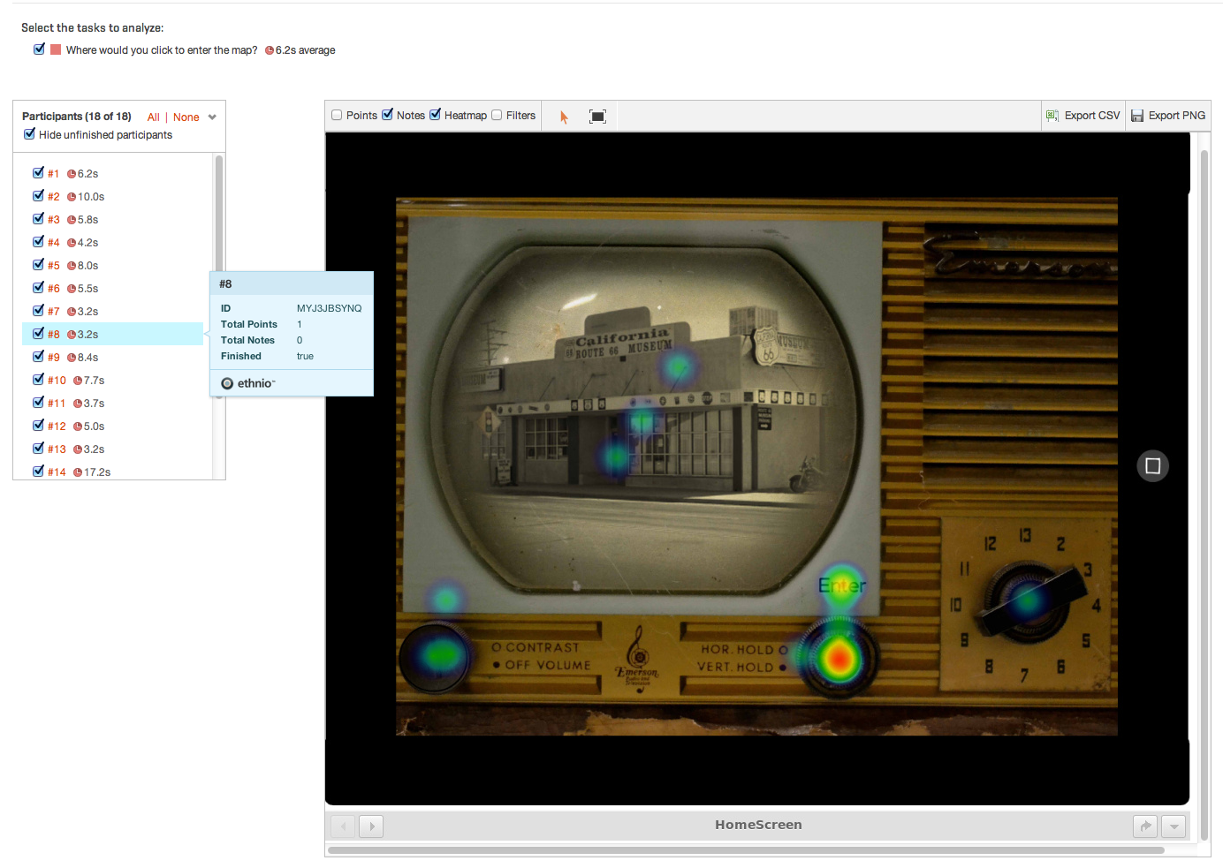
Usabilla
Notes:
Erick

Slide 8
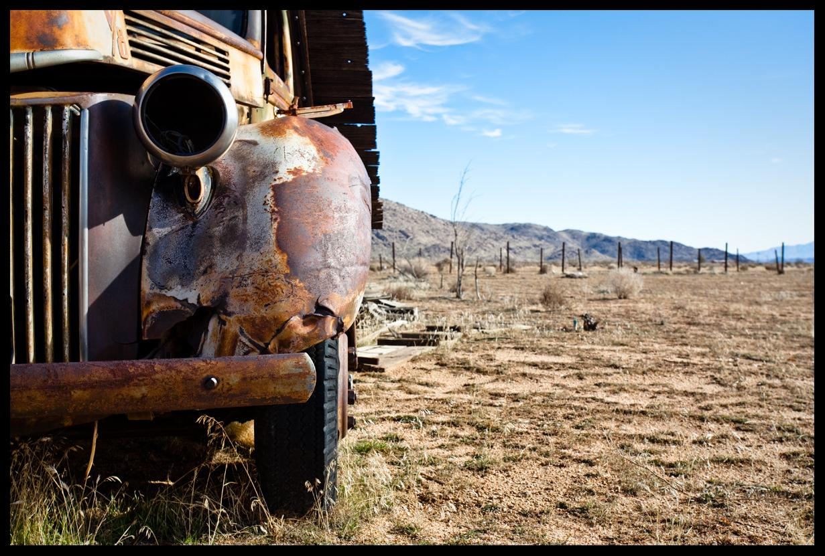
User Tasks
While using the test application or Usabilla:
  Post a blog to the social area
  Find the audio recording about the abandoned houses
Notes:
Sohrob

Slide 9
Peer Review
Four peers participated
General feedback
  Mostly positive feedback as far as the artistic aspects of the prototype
  More negative feedback in terms of the overall functionality
  Areas of confusion: what buttons are clickable vs what is not
Notes:
Sohrob

Slide 10
Insights
Wireframe vs Art
Form vs Function
Demographics & Stakeholders
Collaboration & Tools
Notes:
Erick

Slide 11
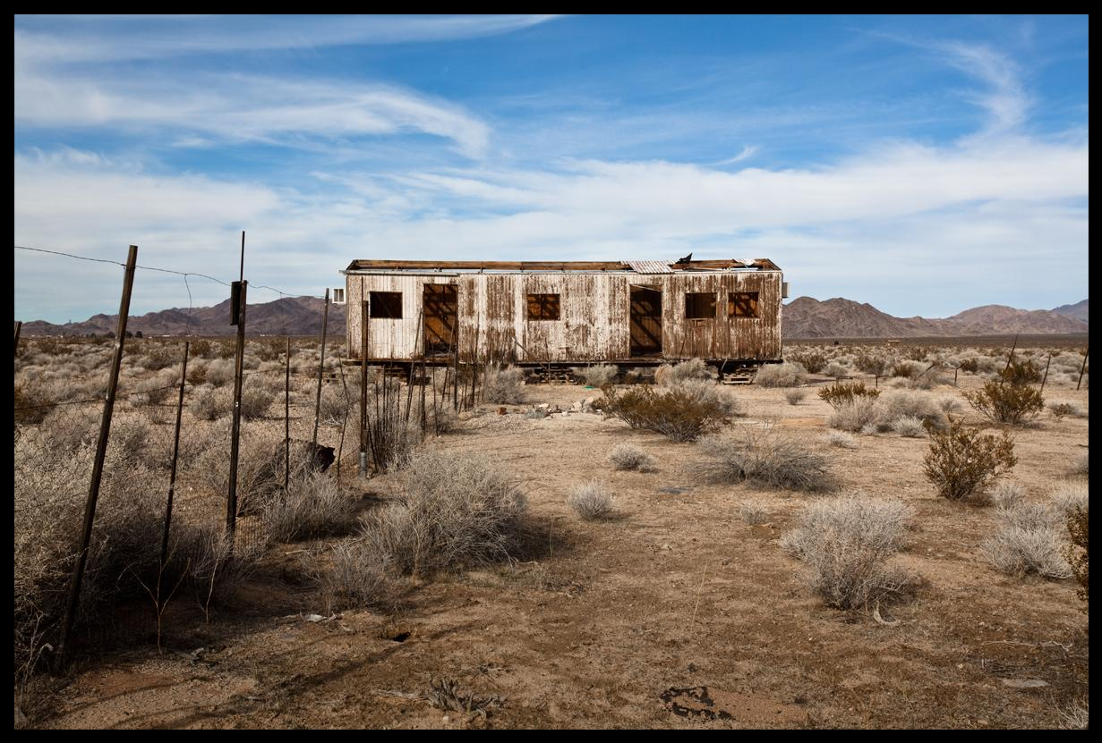
Problems
Initial ideas of augmented reality proved to be difficult to prototype
Collaborative prototyping
Setting up meetings with interviewees
Mockup limitations with Multimedia
  e.g., 360 view, audio/video
Notes:
Erick

Slide 12
Future Steps & Timeline
Pilot test with project mentors - TODAY
Finish first round of usability testing and redesign - week 8
Finish second round of usability testing - Week 9
Final presentation and project report - Week 10/Finals Week
Notes:
Rachel

