Slide 1
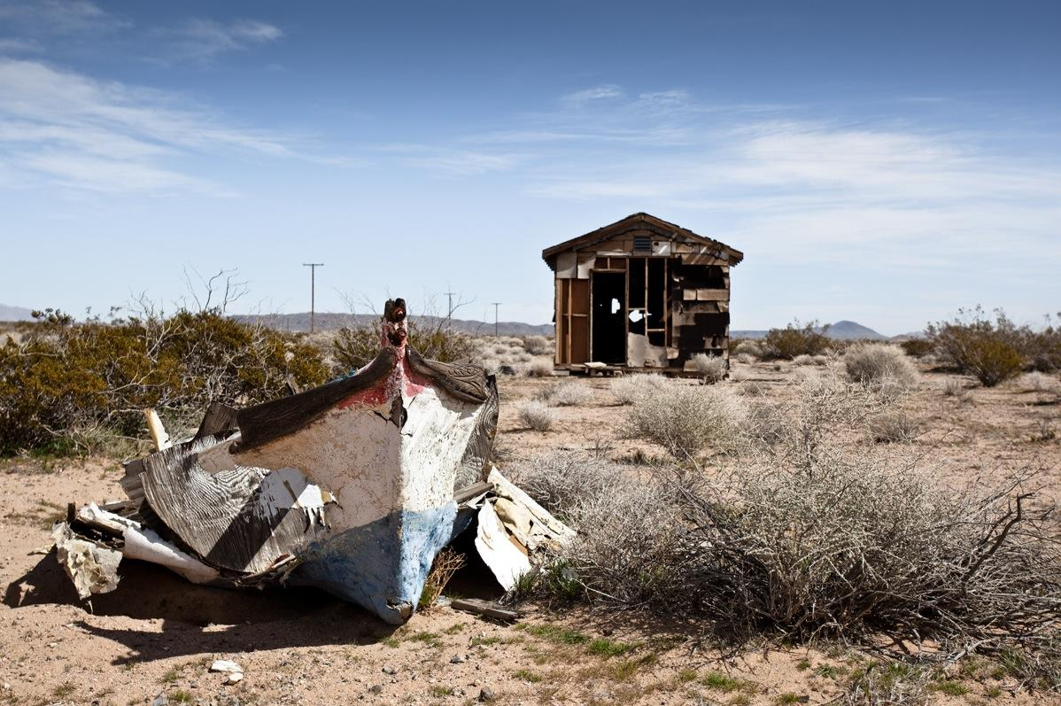
A Mobile Guide to California's High Desert
Van Erick Custodio
Sohrob Raja
Rachel Rose Ulgado
images photographed by James Mann

Slide 2
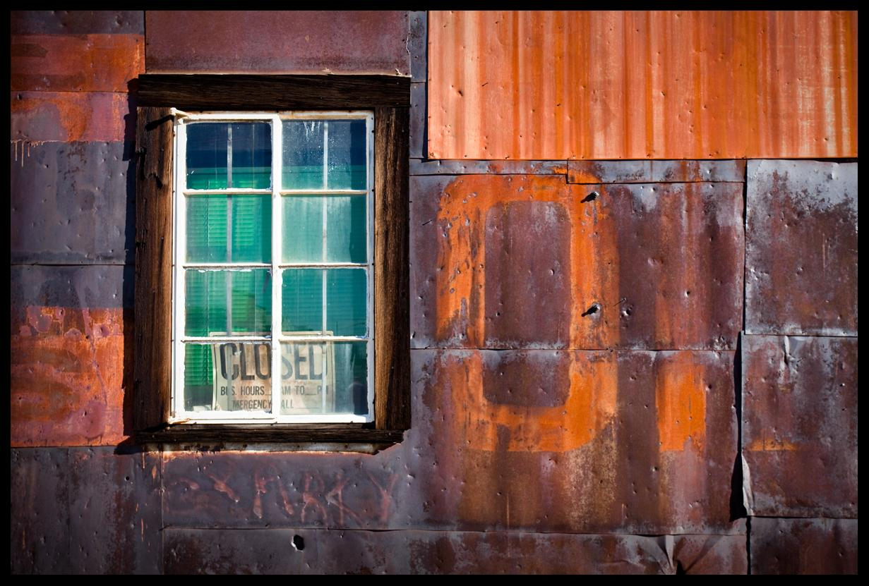
Objectives
Create a mobile application for tablet devices
Foster interest in preservation and nostalgia for the high desert and its history
Emphasize and highlight artistic elements
Provide an immersive environment for end users

Slide 3
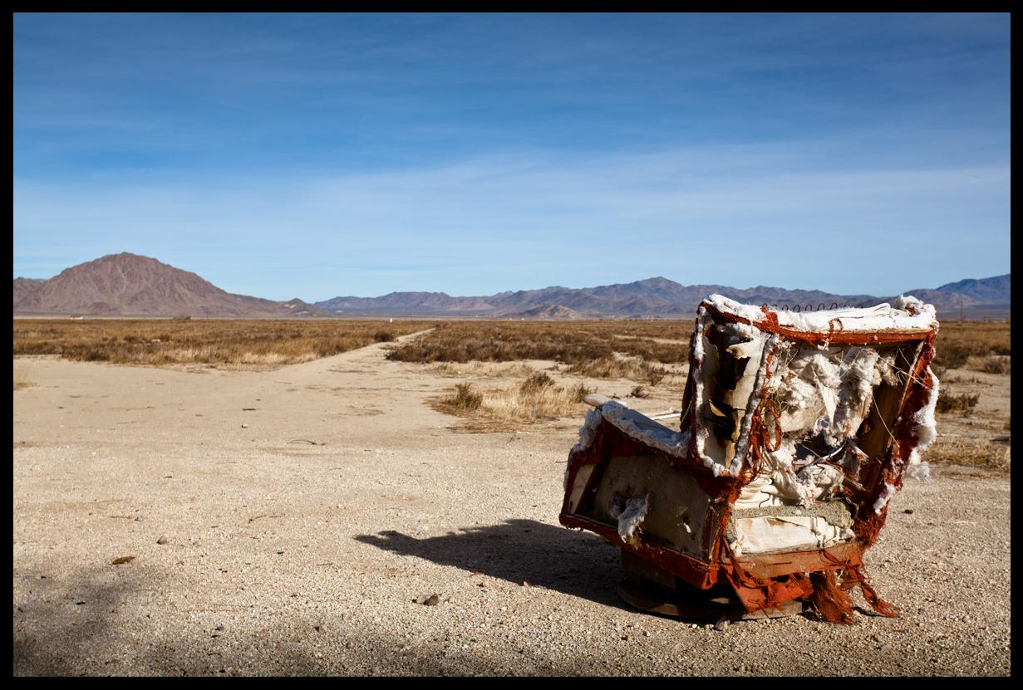
Methods
Sketching and Storyboarding
Medium fidelity Balsamiq prototyping
Peer Reviews, User Tasks
User Study and Redesign

Slide 4
Feedback - Peer Review
Generally positive feedback on aesthetics and artistic qualities of the prototype
Some confusion, ex: figuring out what could be clicked and what could not be clicked
Found that younger users responded positively to the demo and that they expressed interest in the high desert

Slide 5
Feedback - Client
Younger Demographic
Change Centerpiece
Affordance

Slide 6
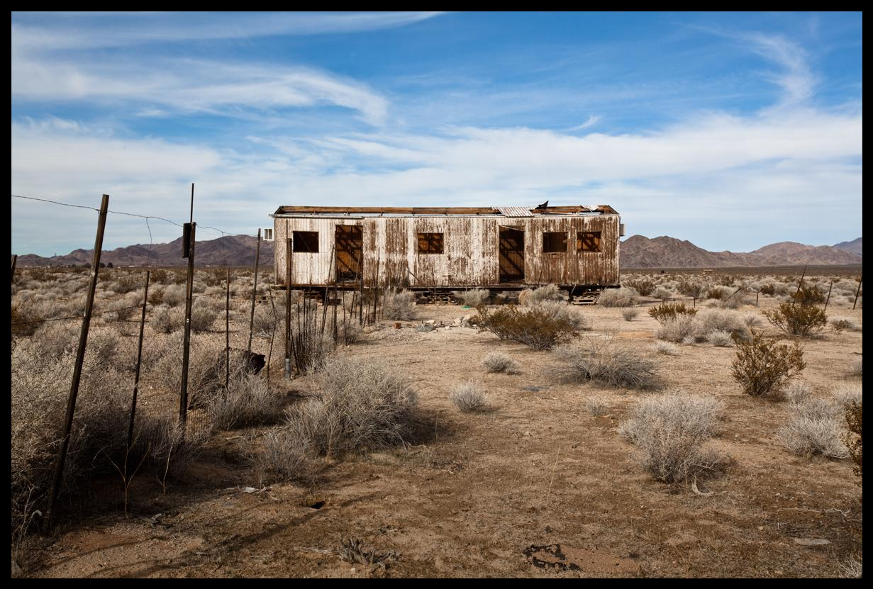
Progress
Conducting user testing
  Evaluating aesthetics and artistic components
  Testing overall usability
Iterative redesign
  Comparison of first prototype and most current prototype

Slide 7
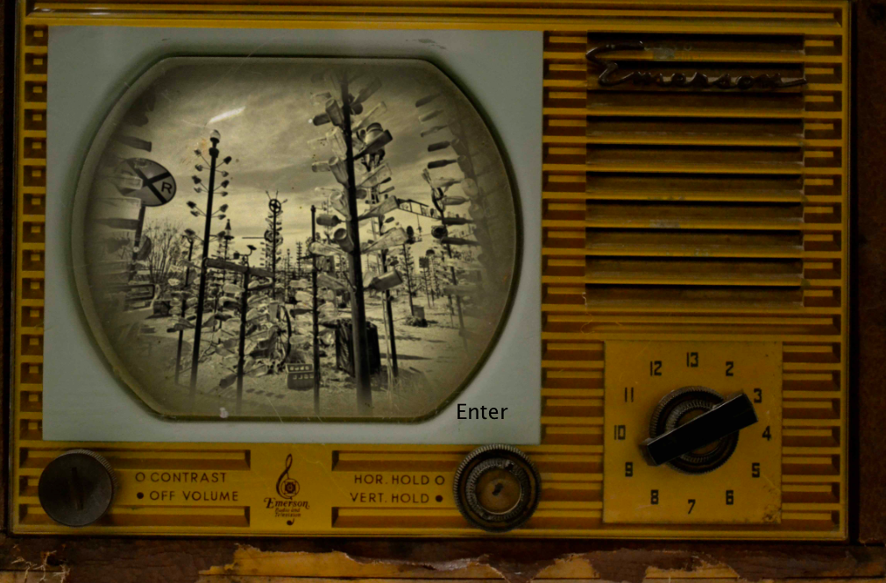
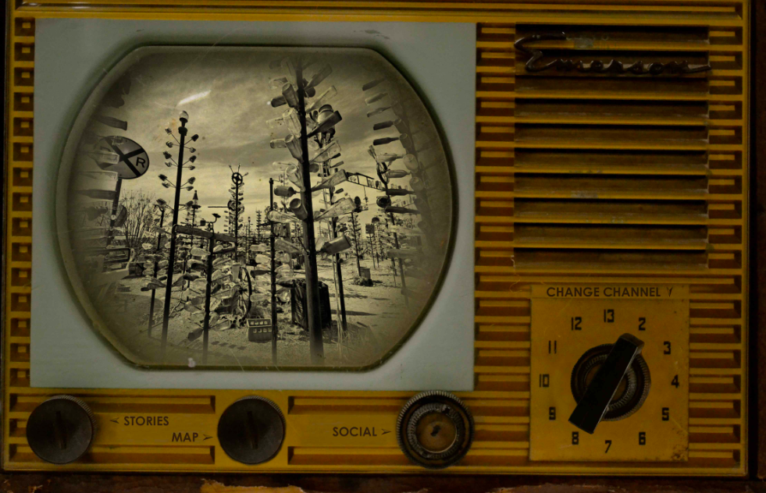
Redesign

Slide 8
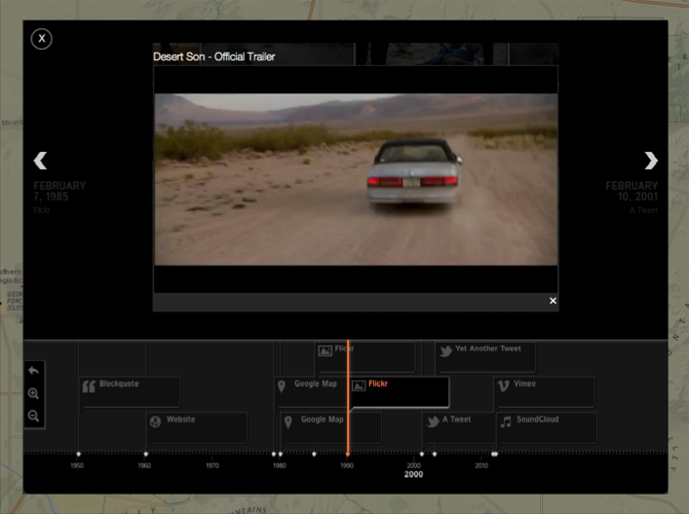
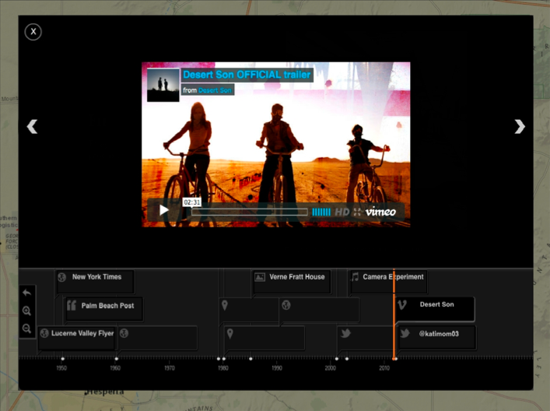
Redesign

Slide 9
Balsamiq Prototypes - Demo

Slide 10
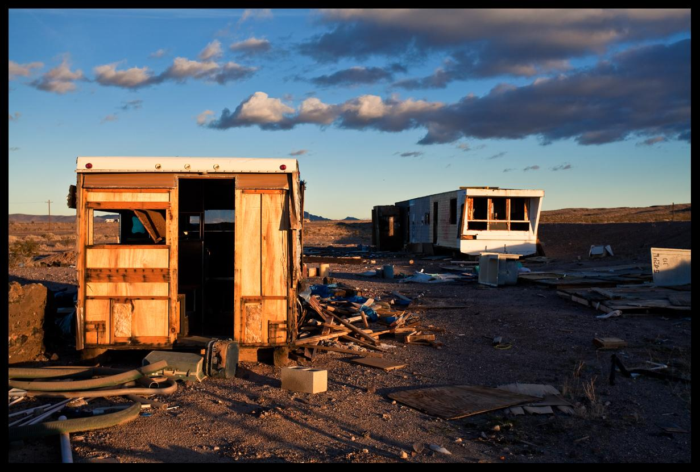
Feedback - User Testing
  cancel button for blog
  include a blurb about the High Desert
  broken link
  timeline was confusing
  difficult to see stories icon
  audio recording was least usable
  include a legend on map

Slide 11
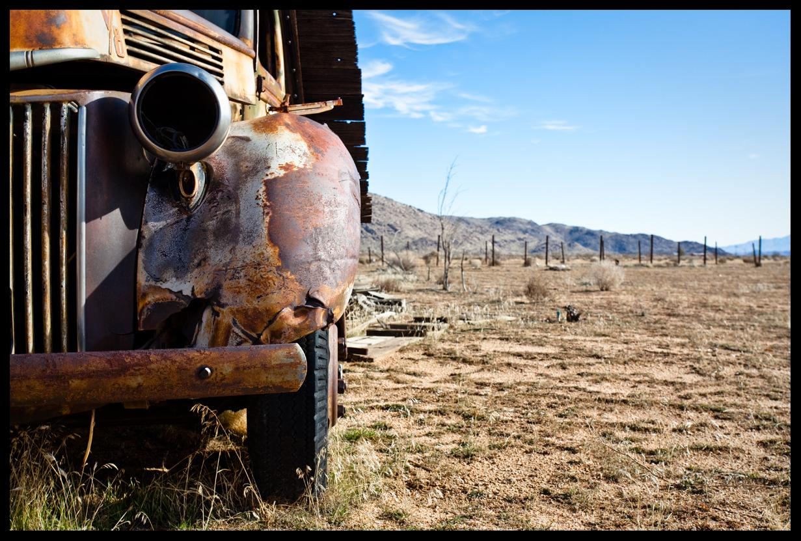
Schedule - Week 10 & Finals
Complete user testing
Finish final report by Saturday/Sunday
Submit final redesign to client

Slide 12
Thank you!
Special thanks to:
Professor Kobsa
Arden Stern
James Mann
Katherine Nguyen
Danny Lam
Our participants

