Slide 1
Project 6: Calico
Saad Ahmad Jola Bolaji Melvin Chien Maxwell Taylor

Slide 2
Calico
Aids in sketching out and using various diagram techniques early in development
Helps to provide for an overall layout of how they will go about implementing their system
Designed to aid in the initial design phases of software development
Wide variety of functionalities and tools that make completing these tasks easier, collaborative, and interactive for all users.

Slide 3
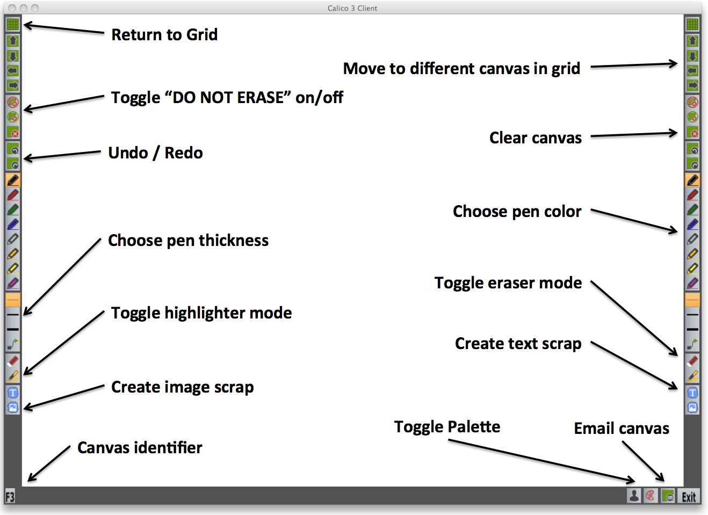

Slide 4
Issues Targeted
Negative surprises brought upon by the various functionalities of the system
How easy it is for users to navigate about the interface and use the functionalities and tools offered
Whether or not users quickly pick up and adapt to the different functionalities of the system
Whether or not Calico's interface encourages users to experiment with the system
How helpful Calico is in aiding the overall software design process

Slide 5
Methods
Heuristic Evaluation: Completed
Program generally followed usability guidelines, but the large amount of icons and some of the functions of the program were unclear/potentially confusing to users.
Pilot Testing
To be conducted by member of our team and a participant to ensure that the tasks prepared for user testing don't contain any flaws

Slide 6
Methods
Usability Testing
Users will model the structure/design of an e-commerce website, then be asked to adapt it to the form of a social networking website, with the help of Calico's features, including scraps, palette, and navigation interface
Surveys: Completed
Pre/post surveys to be e-mailed out to participants
Pre-survey will aid in gaining more insight about users and pairing participants with similar skill level
Post survey will obtain feedback from users that will be used when analyzing data and creating final report

Slide 7
What's Been Done So Far
Heuristics study
User acquisition
Documents for testing (mostly)
Pre and post testing surveys

Slide 8
Insights Gained So Far
Calico is (seemingly) well designed
But it has some flaws which can make it frustrating to users
Calico is still evolving and is experimental
Study should focus more on general Calico issues rather than trying to make it "ready to market"

Slide 9
Problems Encountered
Test candidates not responding to emails
Scheduling conflicts among test users
Complexity of User Testing
Figuring out how to test Calico properly
Movie tickets not enough of an incentive?
Occasionally lopsided team member involvement
Calico pallet does not save all the data desirable for user task scenario setup

Slide 10
Decisions Needed to be Made
Who does what in the actual user test
Finding more users
Test scenario/questions need to be reviewed before being used

Slide 11
Updated Timeline
Task | Time Estimate | Group Member
Interim Presentation | 4 hours, May 14 - 16 | Maxwell
Develop testing plans | 6 hours, May 16 - 18 | Everyone
Pre-testing survey | 2 hours, May 17 - 22 | Saad, Melvin
User Testing | 1 week, May 20 - 26 | Maxwell
Post-testing survey | 2 hours, May 24 - 29 | Jola
Develop analysis and recommendations | 1 week, May 27 - June 2 | Everyone
Final presentation | 6 hours, June 3 - 6 | Jola
Final report | 8 hours, June 1 - 10 | Melvin

