Slide 1
Project 6 Calico
Pre-Final Presentation
Saad Ahmad Jola Bolaji
Melvin Chien Maxwell Taylor
Notes:
Jola

Slide 2
Calico
Aids in sketching out and using various diagram techniques early in development
Helps to provide and overall layout of how they will go about implementing their system
Designed to aid in the initial design phases of software development
Wide variety of functionalities and tools that make completing these tasks easier, collaborative, and interactive for all users.
Notes:
Jola

Slide 3
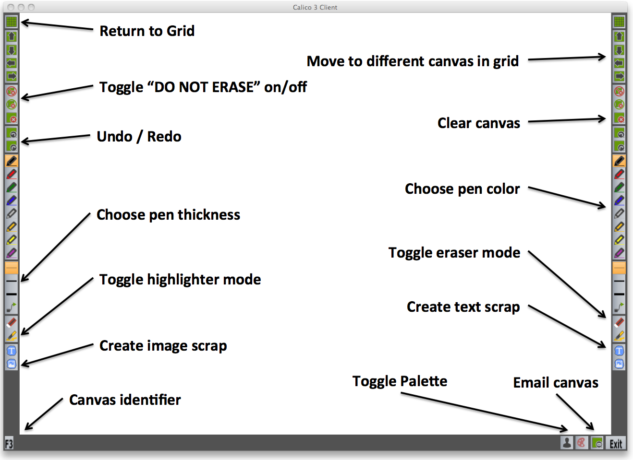
Notes:
Jola

Slide 4
Methods
Heuristic Study
Pilot Test
Pre-Survey
User Test
Post-Survey
Notes:
Max

Slide 5
Heuristic Study
Various issues related to program stability
Anticipated that users needed training
Calico is well tested, but still needing improvements
Notes:
Max

Slide 6
Heuristic Study
Issues
  Redo and undo
  Delete canvas
  Icons not clear
  Confusing scraps with non-scraps (for dragging, etc)
Notes:
Max

Slide 7
Pilot Test
Found bugs in Calico
Spent time refining user tasks and scenarios
Worked with project sponsor to revise experimental materials
Became more comfortable with carrying out user studies
Notes:
Melvin

Slide 8
Pre-Survey
13/14 participants took survey
Average software development experience
  1.5 years
11/14 participants have taken a software engineering class
  9 took INF 43/ICS 52: Intro to Software Engineering
11/14 participants draw or use diagrams when developing software
Notes:
Jola

Slide 9
User Study Task
Before the main task, users were given a short introduction to Calico
  Users had a whiteboard to themselves, while the instructor used a tablet
  Users could follow along on their whiteboards during the tutorial
Users also had about 5 minutes to get familiar with the system, as a practice time
  Designed a basic homepage for a company
Notes:
Melvin

Slide 10
User Study Task
Users took on the role of a web developer
Designed an e-commerce website for a company in their choice of one of seven industries
  Users were given pre-loaded images
  Asked to allow users to browse and compare items
Users were given 20 minutes to complete task
Notes:
Saad

Slide 11
User Study
Almost all users found that Calico was an excellent collaboration tool for design
  Users often worked on other's board, reaching over to point something out or add something.
  As opposed to when sketching
  Assumed boards were multi-touch
Most users found that the icons were not intuitive enough
  Difficulty remembering which features corresponded to which icons
  Short-time activity: possibly with more time, users could better navigate and use Calico's features.
Notes:
Saad

Slide 12
User Study
All users found the eraser very helpful
  Erases the entire stroke
Many forgot that they were in an "eraser mode"
  Tried to continue work without realizing
  Tried to erase scraps
Most users forgot that they could use text scraps rather than writing out text
Notes:
Saad
In forgetting text scraps: sometimes both users would completely forget them. Sometimes one would remember and remind the other that they didn't need to write everything out and could just use text scraps

Slide 13
User Study
Most users found the board was too sensitive
  Many accidental marks
  Some users were bothered by accidental marks and wanted to erase all of them
Few users had difficulty reaching icons due to the height of the board
  Board is mounted on wall and is not adjustable
Notes:
Saad
One user in particular wrote in the comments section of her post survey that writing on the board was hard, because she usually writes in a notebook aka tablet..but we were testing whiteboard.

Slide 14
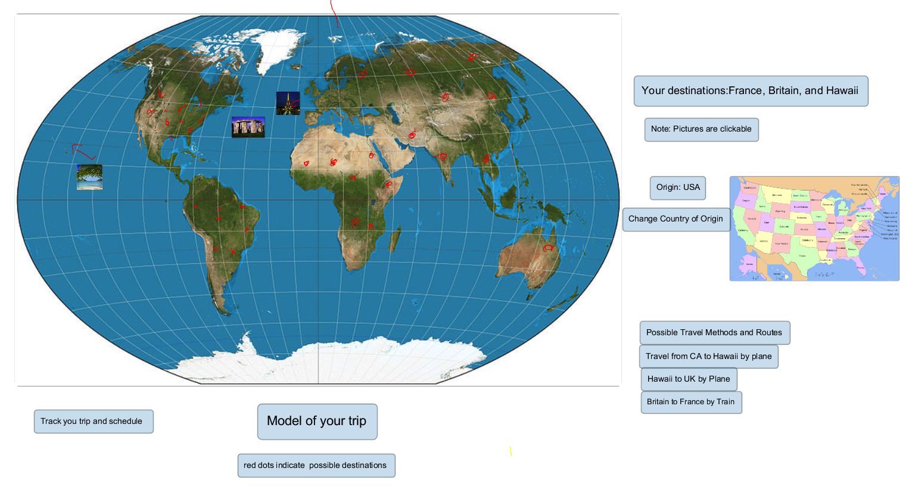
User Study 7
Notes:
Melvin

Slide 15
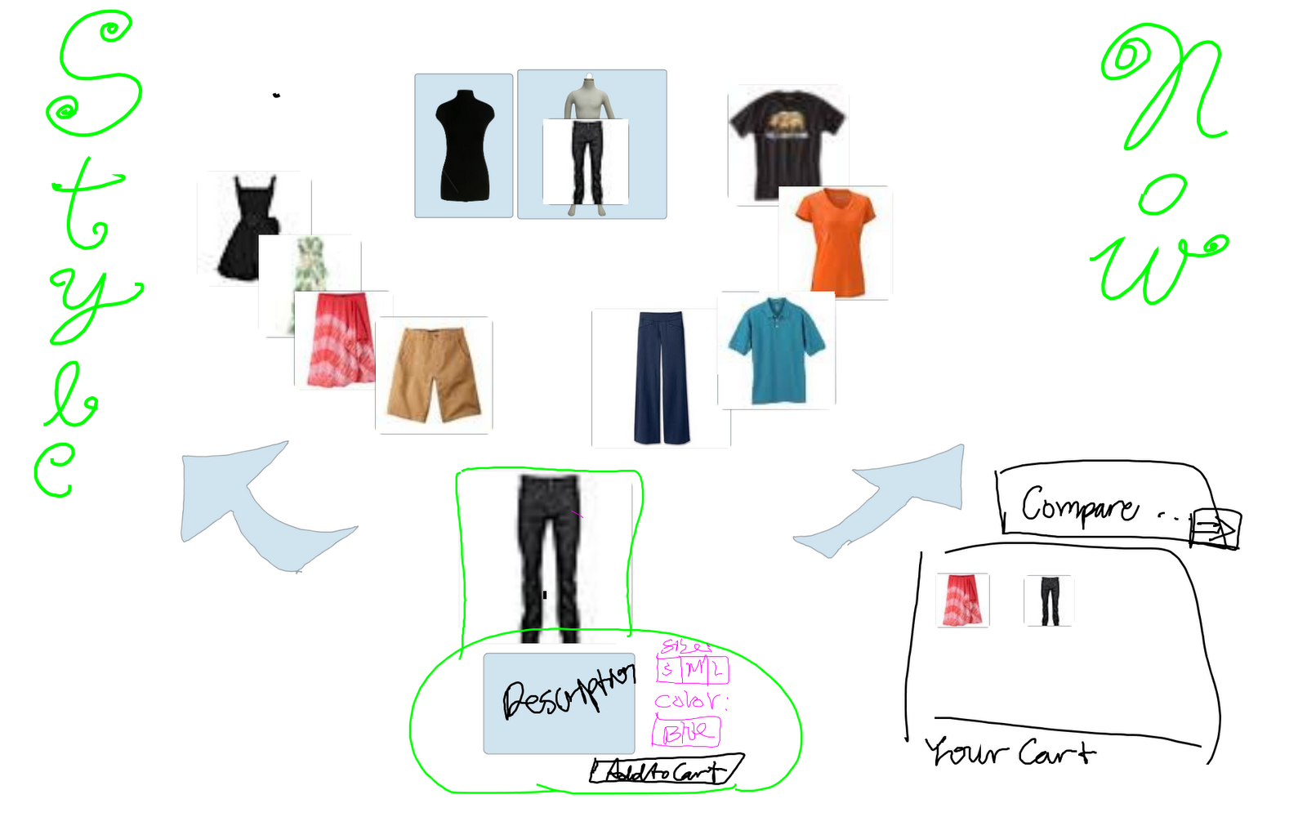
User Study 6
Notes:
Melvin

Slide 16
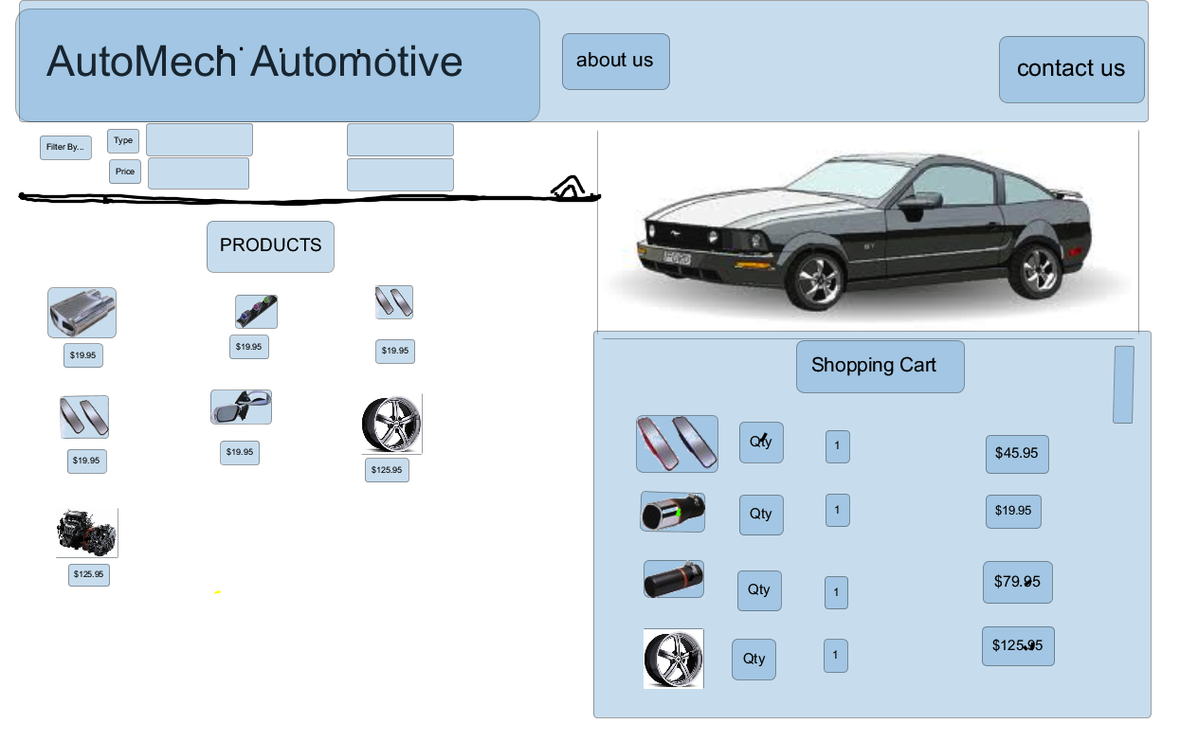
User Study 4
Notes:
Melvin

Slide 17
Post-Survey
How helpful were scraps in completing your tasks?
  10/14 Very Helpful
How helpful were intentional interfaces in completing your tasks?
  8/14 Very Helpful
How helpful was Calico in organizing work between you and your partner?
  10/14 Very Helpful
Notes:
Max
Participants only heard the term "intentional interfaces" once at the beginning when they were being introduced to Calico. Many didn't remember what it was and had to ask when completing the survey.

Slide 18
Post-Survey
How intrusive or distracting were Calico's features to the design experience?
  5/14 Somewhat Intuitive, 5/14 Not Intrusive
How helpful was Calico overall in completing your tasks?
  7/14 Very Helpful
Would you recommend Calico to a friend for a future project?
  7/14 Definitely Would, 5/14 Probably Would
Notes:
Max

Slide 19
Updated Timeline
Develop Analysis and Recommendations | 3 Days (June 10) | Group
Final Presentation | 6 Hours (June 6) | Jola and Group
Final Report | 18 Hours (June 10) | Melvin and Group
Notes:
Saad

Slide 20
Special Thanks to:
Nicolas Mangano & Professor Kobsa
Notes:
Jola
WANTED: circle scraps, when clicking away makes mark which users wish to erase, eraser mode, trying to erase scraps

