Slide 1
ACCESS
Alliance for California Computing Education for Students and Schools
Team 5
Scott Betts, Wilbur Chen, Kenny Pham, Kha Tran, Brianna Tu
Notes:
Brianna

Slide 2
Project Overview
Website for ACCESS
Promote Computer Science education in California
Change.org petition
Current website
Not WordPress based
Static
Hard to maintain
Notes:
Brianna

Slide 3
Project Requirements
Make website easy for staff to update content
Make contact page more functional
Notes:
Kenny

Slide 4
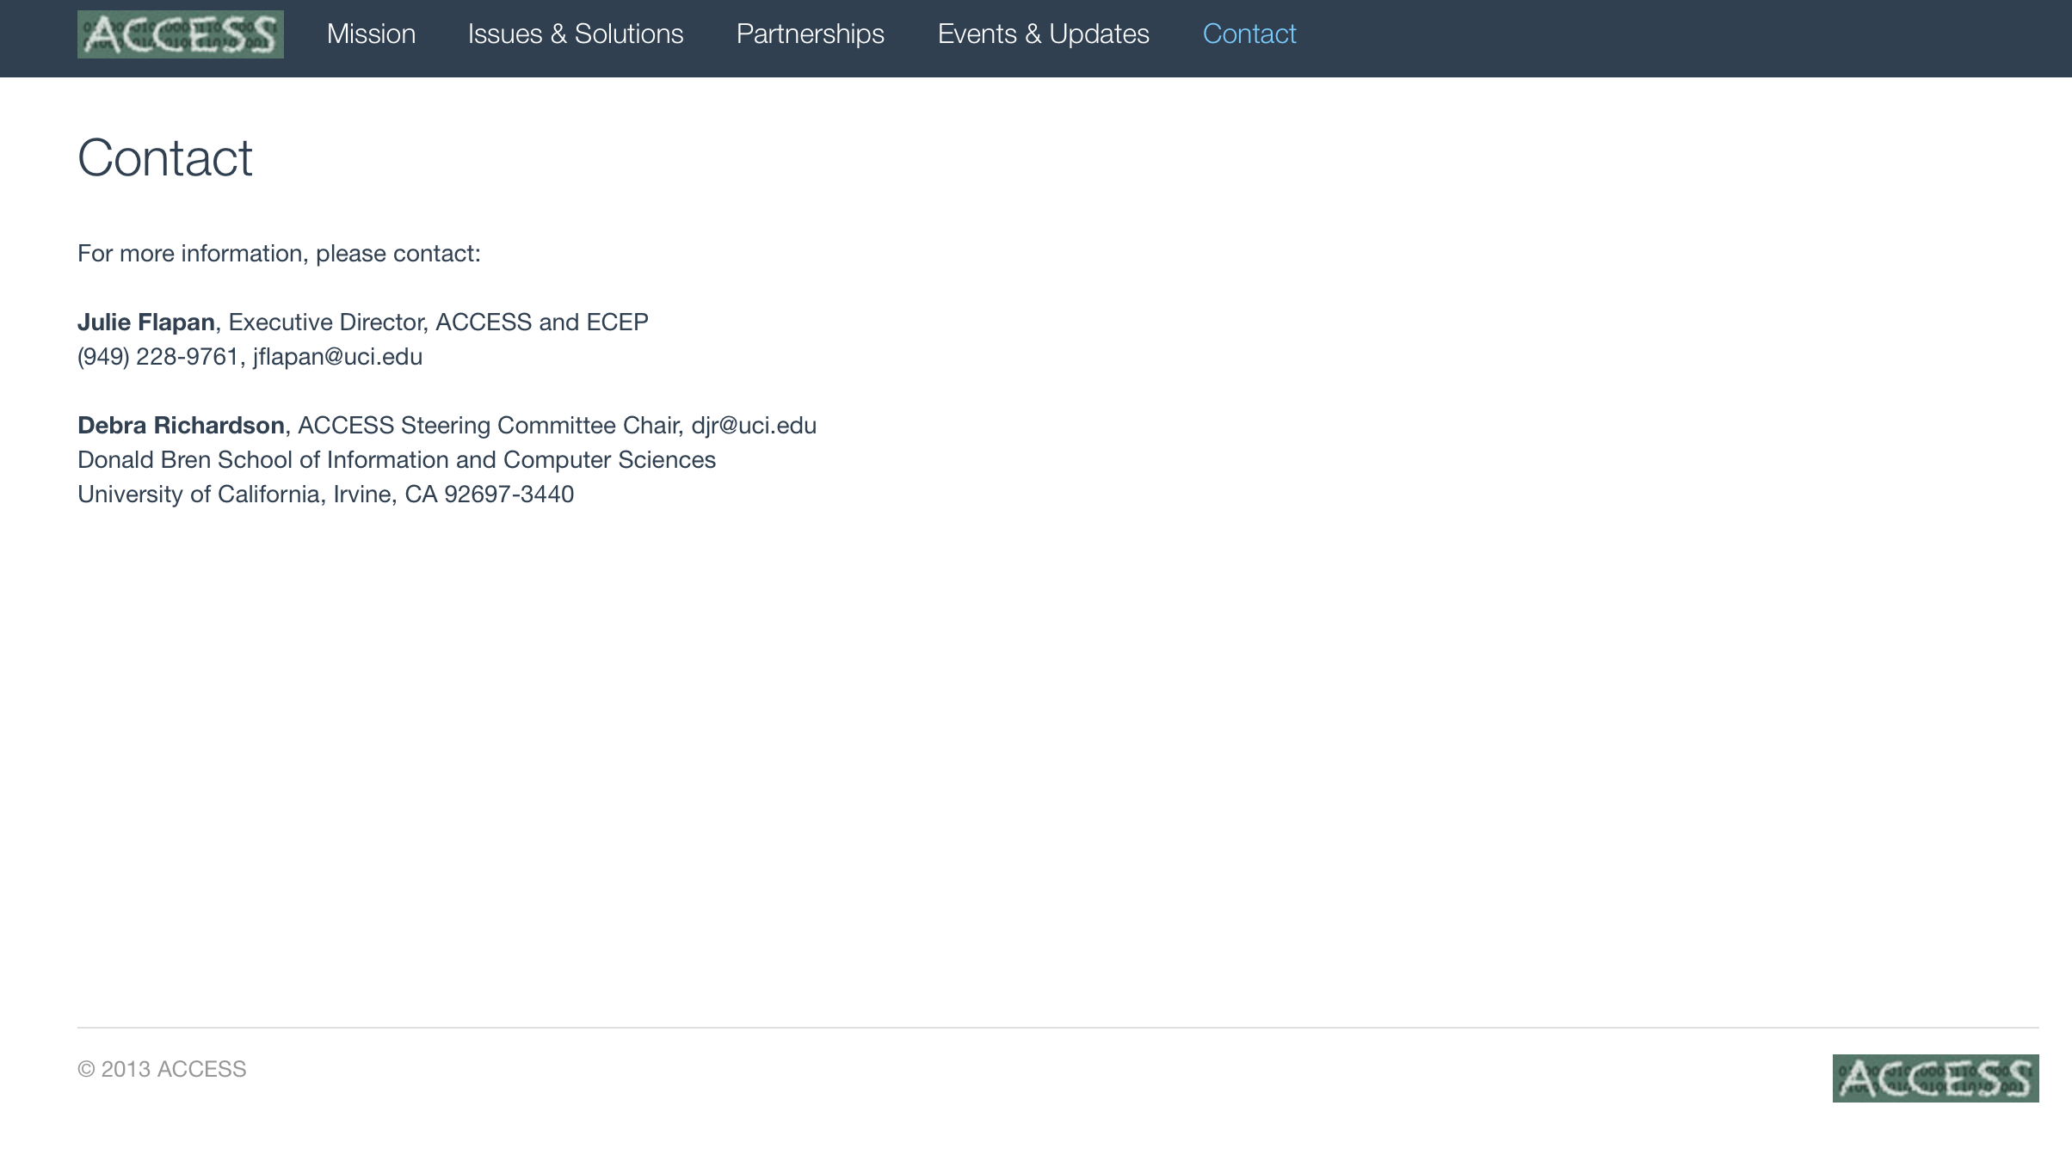
Notes:
Kenny

Slide 5
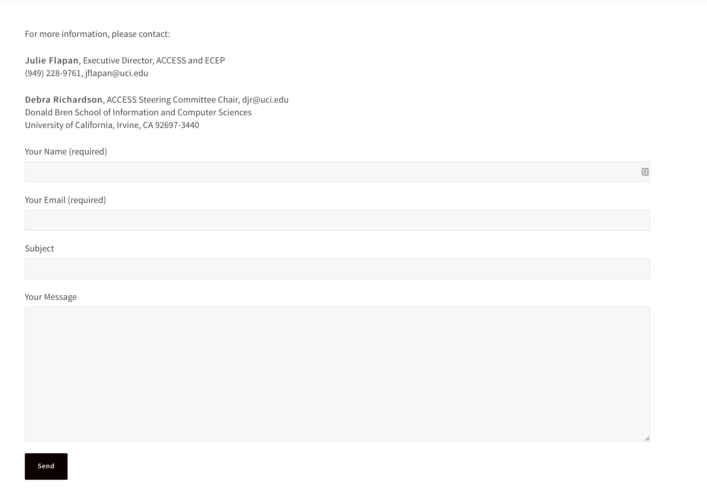
Notes:
Kenny

Slide 6
Project Requirements
Make website responsive
Make website appealing and dynamic
Implement social media connectivity
Notes:
Kenny

Slide 7
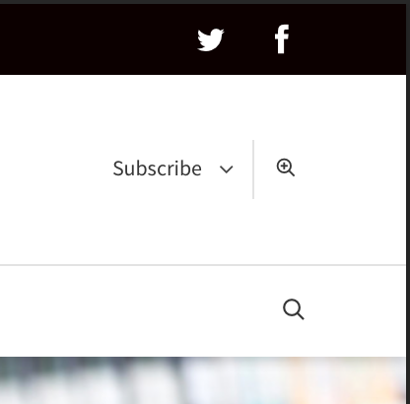
Notes:
Kenny

Slide 8
Project Requirements
Use WordPress
Search Engine Optimization
Increase Change.org petition visibility
Notes:
Kenny

Slide 9
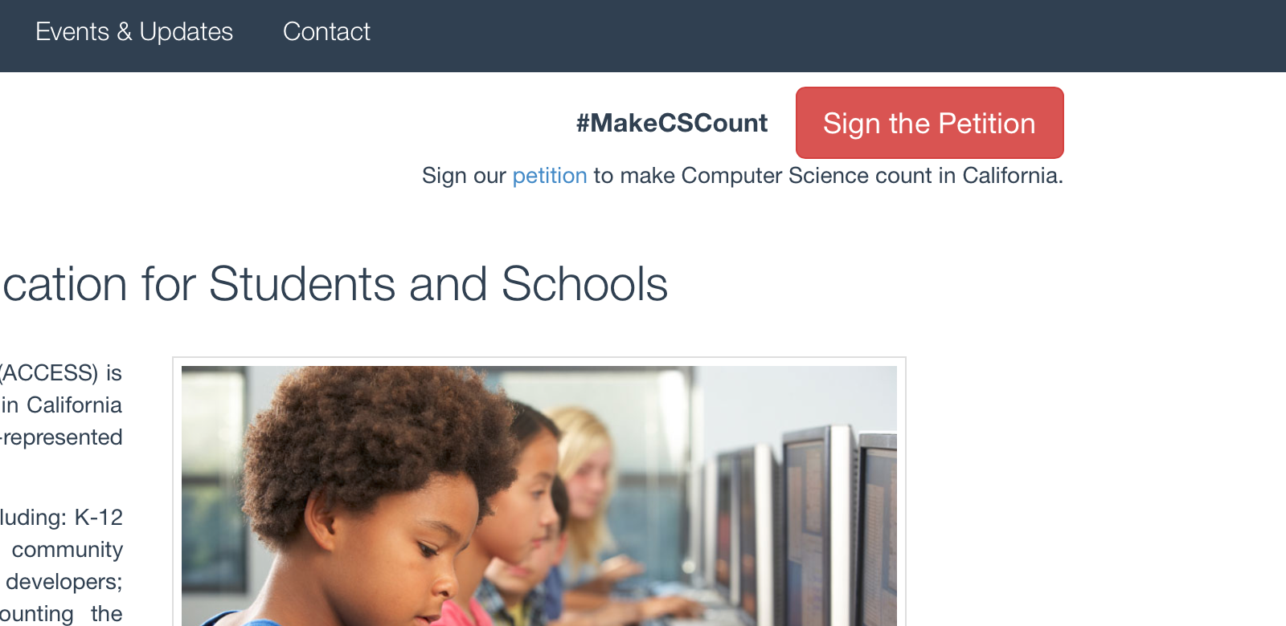
Notes:
Kenny

Slide 10
End Goal
Visually pleasing website
Responsive, interactive website
Change.org petition success
Content for students
SEO
WordPress-based
Well-documented and user-friendly
Notes:
Wilbur

Slide 11
Methods & Solutions
Usability Studies
Stakeholder interviews
Steering Committee Members
Heuristic Evaluation & Cognitive Walkthrough
Think-Aloud testing
Notes:
Scott

Slide 12
Schedule
Week 1-2:
Team forming and meeting client (Prof. Richardson)
Setup admin accounts on WordPress
Week 3:
Choose theme + pitch to client
Install the new template
Transferred existing content
Notes:
Brianna

Slide 13
Week 4:
Elicit detailed requirements from client
Create and incorporate social media
Get contact info for important stakeholders
Contact important stakeholders and set up interviews
Week 5:
Finish interviews with stakeholders
Incorporate initial design changes
Begin planning for usability testing
Notes:
Scott

Slide 14
Week 6-7:
Perform Usability Testing
Cognitive Walkthrough
Heuristic Evaluation
Think-aloud Testing
Continue implementation
Notes:
Kenny

Slide 15
Week 8:
Meet with client, discuss current state of site, review testing feedback
Make changes accordingly
Finalize implementation
Contact ics.uci.edu webmaster for hosting details
Notes:
Kenny

Slide 16
Week 9:
Documentation for website
Create tutorial for ACCESS Staff
Prepare final presentation
Prepare Project Report
SEO
Week 10:
Deployment of finished product
Final presentation
Notes:
wilbur

Slide 17
Preview
http://access.ics.uci.edu
http://team5.kennypham.com
Notes:
Kha

Slide 18
Thank You!

