Slide 1
Team 6
Dillon Gee, Glenn Pittman,
Ronnie Nguyen, Sarah Tracy

Slide 2
The Project
Client: Paula Garb, UCI Center for Citizen Peacebuilding
Goals:
Connect/Integrate content from several existing sites
Restructure navigation bar
Provide feedback on two other websites
Notes:
Ronnie
a) Summarize very briefly the problems that you want to address and the methods that you plan to use for this purpose
(i.e., condense your first presentation into 2-3 slides :-)

Slide 3
Our Progress
Redesign
Navigation
Pages
High Fidelity Mockups of landing pages
Axure
Usability Tests
Heuristic Evaluations
Think Alouds
http://49w8db.axshare.com/home.html
Notes:
Dillon
b) Describe what you have done so far

Slide 4
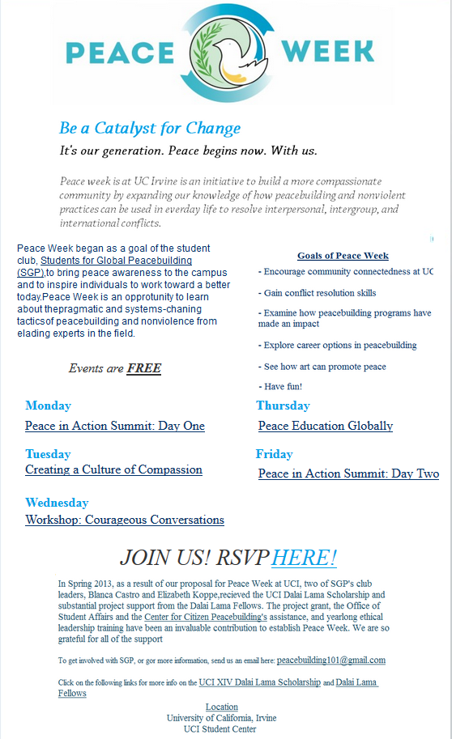
Our Methods
Client Requirement Interview
Heuristic Evaluation of the original site
Performed by our team
User testing of mockups
Groups
1 Pilot Test
3 Board Members
2 Staff Members
5 Students
Participants did a think aloud study while performing
set tasks
Notes:
Sarah

Slide 5
Insights
Users expected Students for Global Peace to be under “Nonviolence Programs” rather than “Get Involved” (6 of 11 testers)
Users do not think of the Peace in Action Summit as a program.
4 found it without problems
4 looked under “Events”
1 additional tester looked at the “Events” section on the homepage.
2 did not complete the task
2 looked under “Get Involved”
Users do not necessarily think of “giving” as meaning “donating”
but most users were still able to easily “make a donation” (7 of the 11)

Slide 6
Problems
Changing requirements
Faulty software
Our original mockups were lost by faulty software
Expanding navigation didn’t work quite right on the mockup tool
Getting test subjects
Staff and Board Members were extremely busy and often unable to meet with us
Client’s desire for more deliverables and less testing
After testing, Paula changed her mind about the necessity of user testing!
Notes:
Ronnie
d) Describe problems that you encountered

Slide 7
Decisions
Page Implementation
which pages need to be edited or created
Changes to designs
In order for them to be easier for the client to update
Navigation
Test to make sure that the update navigation labels make more sense
Notes:
Dillon
e) Discuss any decisions that will still need to be made

Slide 8
Timeline
Week 10
Finish Final Paper (All)
User testing on updated mockups (Ronnie)
Make sure new navigation labels make sense
Create remaining pages in Drupal (Dillon)
Finals Week and Beyond
Turn in final deliverables and take the final (All)
Create remaining pages in Drupal (Dillon)
As we receive content
Speak with Heather Ashbach to update current site navigation (All)
Enjoy the summer!
Notes:
Sarah
f) Present your updated / more detailed timeline for your remaining project (assign dates and people to each task)

Slide 9
Thank You!
Questions?

