Slide 1
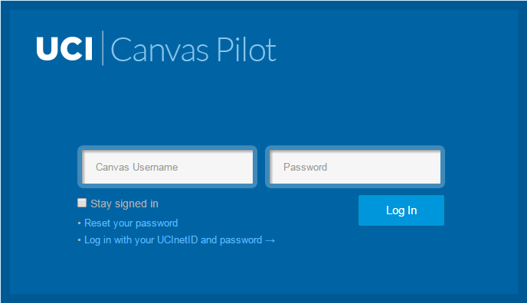
PROJECT GROUP 1A
IN4MATX 132
Group 1A

Slide 2
PROJECT GROUP 1A
MEMBERS ------>
Group 1A

Slide 3
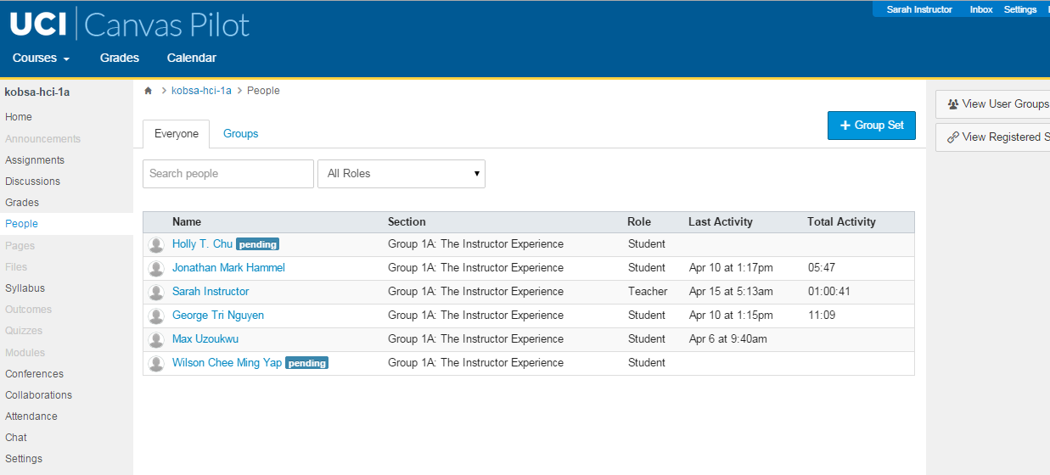
Project 1A by

Slide 4
Overview
Introduction
What is CANVAS?
Customer Needs & Requirements
Customer’s Goal
Usability Focus Areas
Customer’s View
Initial Thoughts
HCI Methodology
Process
Test Methods
Target Users?
Master Schedule

Slide 5
Introduction

Slide 6
What is CANVAS?
Learning Management System (LMS)
Multi-user levels
Instructors
Students
Cloud-based
Platform of course tools & resources
Seamless integration w/100+ apps
Developed by Instructure

Slide 7
Customer Needs & Requirements

Slide 8
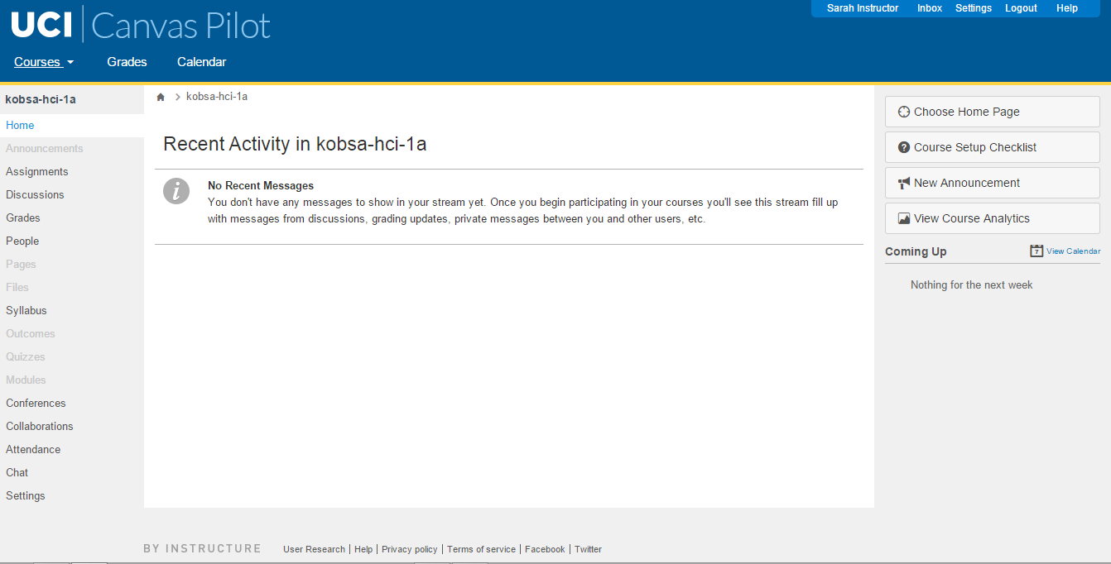
Customer’s Goal
Evaluate usability of CANVAS to determine the possibility of adopting the LMS and scale across campus

Slide 9
Usability Focus Areas
Announcements
Discussions
People
Files
Outcomes
Modules
Collaborations
Chat

Slide 10
Customer’s View
Customer opinion withheld to limit bias

Slide 11
Initial thoughts
No prior assumptions to reduce biases

Slide 12
HCI Methododology

Slide 13
Process
DEPLOY HCI METHODS & TEST USABILITY OF SYSTEM
EVALUATE USABILITY ISSUES
GATHER FINDINGS
RE-TEST NEW DESIGN(s) WITH SOME OF THE EARLIER TEST PARTICIPANTS
DRAFT MOCK-UP WITH RECOMMENDED CHANGES
GATHER FINDINGS
RE-EVALUATE USABILITY ISSUES

Slide 14
Test Methods
Cognitive walkthrough
Interviews
Usability testing

Slide 15
Test Methods
Interviews: will allow us to initially gauge the user experience, identify possible pain points, capture and refine the scope of the problem areas
Cognitive walkthrough
Usability testing

Slide 16
Test Methods
Interviews: will allow us to initially gauge the user experience, identify possible pain points, capture and refine the scope of the problem areas
Cognitive walkthrough: development of persona(s) & general list of tasks to discover global problems
Usability testing

Slide 17
Test Methods
Interviews: will allow us to initially gauge the user experience, identify possible pain points, capture and refine the scope of the problem areas
Cognitive walkthrough: development of persona(s) & general list of tasks to discover global problems
Usability testing: to discover more global problems, unique problems and to evaluate the overall usability of the LMS

Slide 18
Test Methods - Tasks & Questions
Tasks?
A list of tasks will be generated based on the usability focus areas
Interviews & cognitive walkthroughs will help us gather tasks and later refine the tasks
flowing into the usability experiment
Questions?
Questions will be open-ended; providing a semi-structured interview flow to gauge UX, paint points and scope of problem area

Slide 19
Test Methods - Usability Metrics
Error rate
# of errors/ # of attempts per user = % of errors
avg % of errors among all users
Task completion rate
# of completed tasks/ # of total tasks attempted = % of tasks complete
Time needed to complete task
avg time of all users per task

Slide 20
Test Methods - Logistics
How will we contact users?
via e-mail
Where will we meet users?
interviews: locations convenient for the user
heuristics & usability testing: locations void of external distractions
Length of meetings?
interviews: 30 minutes to 1 hour
heuristics & usability testing: 30 minutes to 1 hour+
(we do not want testers to get too bored/tired)

Slide 21
Target Users?
Who?
Instructors
Familiar and not familiar
with canvas
TA’s
Professors
How many?
A total of 5 users (currently # of available contact opt-in)

Slide 22
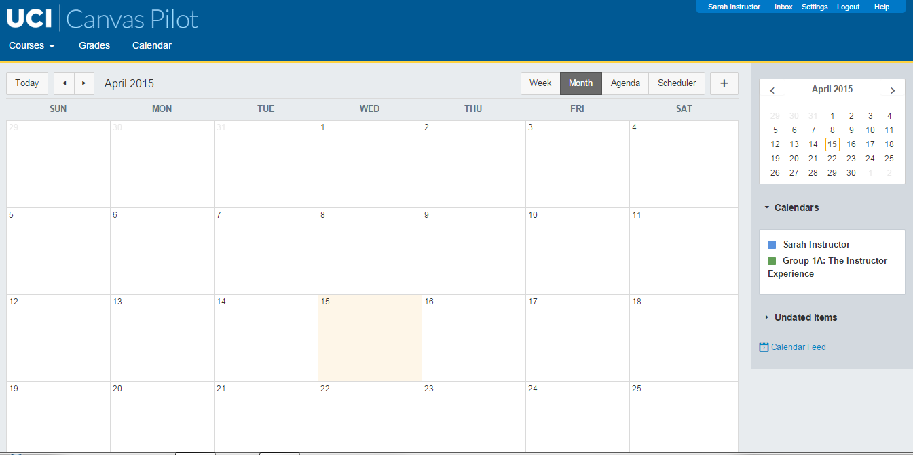
Master Schedule

Slide 23
Master Schedule
Week | Deliverables | Who?
Week 3: | Define schedule Start cognitive walkthrough Draft and finalize Interview Plan Interview instructors Draft Usability Test Plan | Walkthrough (ALL). At least two members per interview. Interview 1 (John and Wilson). Schedule (George & John). Interview TP (George & John). Other TP
Week 4: | Finalize all test plans Continue interviews Start heuristic evaluations Compile list of tasks Prep test materials | At least 2 members/ interview, depend on availability(ALL) Interview 2 (George). Finalize TP, Test Materials (Max & Wilson). List of tasks (Holly). Test

Slide 24
Master Schedule
Week | Deliverables | Who?
Week 5: | Begin usability testing | Everyone, depending on schedule and availability
Week 6: | Finish usability testing Qualitative & quantitative analysis Draft & test mock-up | ALL, Mock-up (George, Max & Jonathan)
Week 7: | Test mock-up Re-evaluate usability issues, analysis Compile findings for Pre-Final Presentation & Project Report Draft Pre-Final Presentation Slide Deck & Project Report | All members of the team will test the mock-up and will participate in the compilation of results. This is to ensure everyone is satisfied with final results.

Slide 25
Master Schedule
Week | Deliverables | Who?
Week 8: | Review & finalize draft of Pre-Final Presentation Slide Deck Presentation practice Review & finalize Project Report | All members of the team will participate in the compilation of results. This is to ensure everyone is satisfied with final results.
Week 9: | Pre-Final Presentation | All members of the team will participate in the compilation of results. This is to ensure everyone is satisfied with final results.
Week 10: | Submit Project Report | George

Slide 26
THANK YOU

