Slide 1
Data Visualization Dashboard (with D3)
Ty, Chape, Franklin

Slide 2
Introduction
We designed and developed a web-based dashboard application for visualizing data
This app is designed for the average person
quick overview of data
no interest in deep data analysis

Slide 3
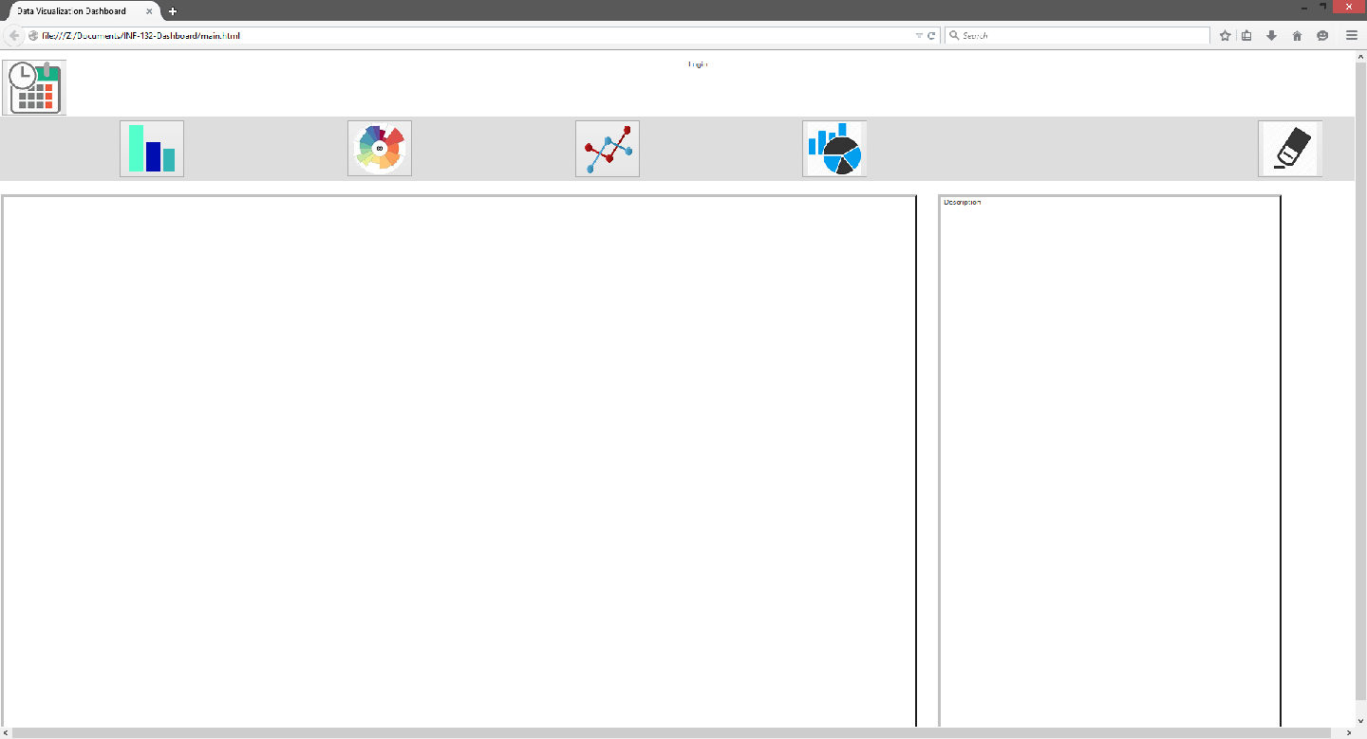
Home Page

Slide 4
Usability Goals / problems
Allow users to easily visualize and understand data
no processing required
Data is diverse
Collected from variety of devices/sensors
Different types of data
UI needs to be clear and intuitive
users may have no technical experience

Slide 5
Methods
Meetings with customers (pre-dev)
Paper prototypes
More meetings with customers (during-dev)
Refine design
User testing
Interviews (7)
Think alouds (3)

Slide 6
What we have done so far
Requirements meetings
Developed a non-complete, working dashboard
User Tests

Slide 7
User Testing
Preliminary questionnaires to assess user qualities and knowledge level
Interview and think-alouds to determine functionality and usability

Slide 8
Insights gained
Questions were out of order
Certain things that we thought about the design, users disagreed on
insights from meetings (during dev)
insights from user testing (so far)
Notes:
data format can be standardized for our purposes

Slide 9
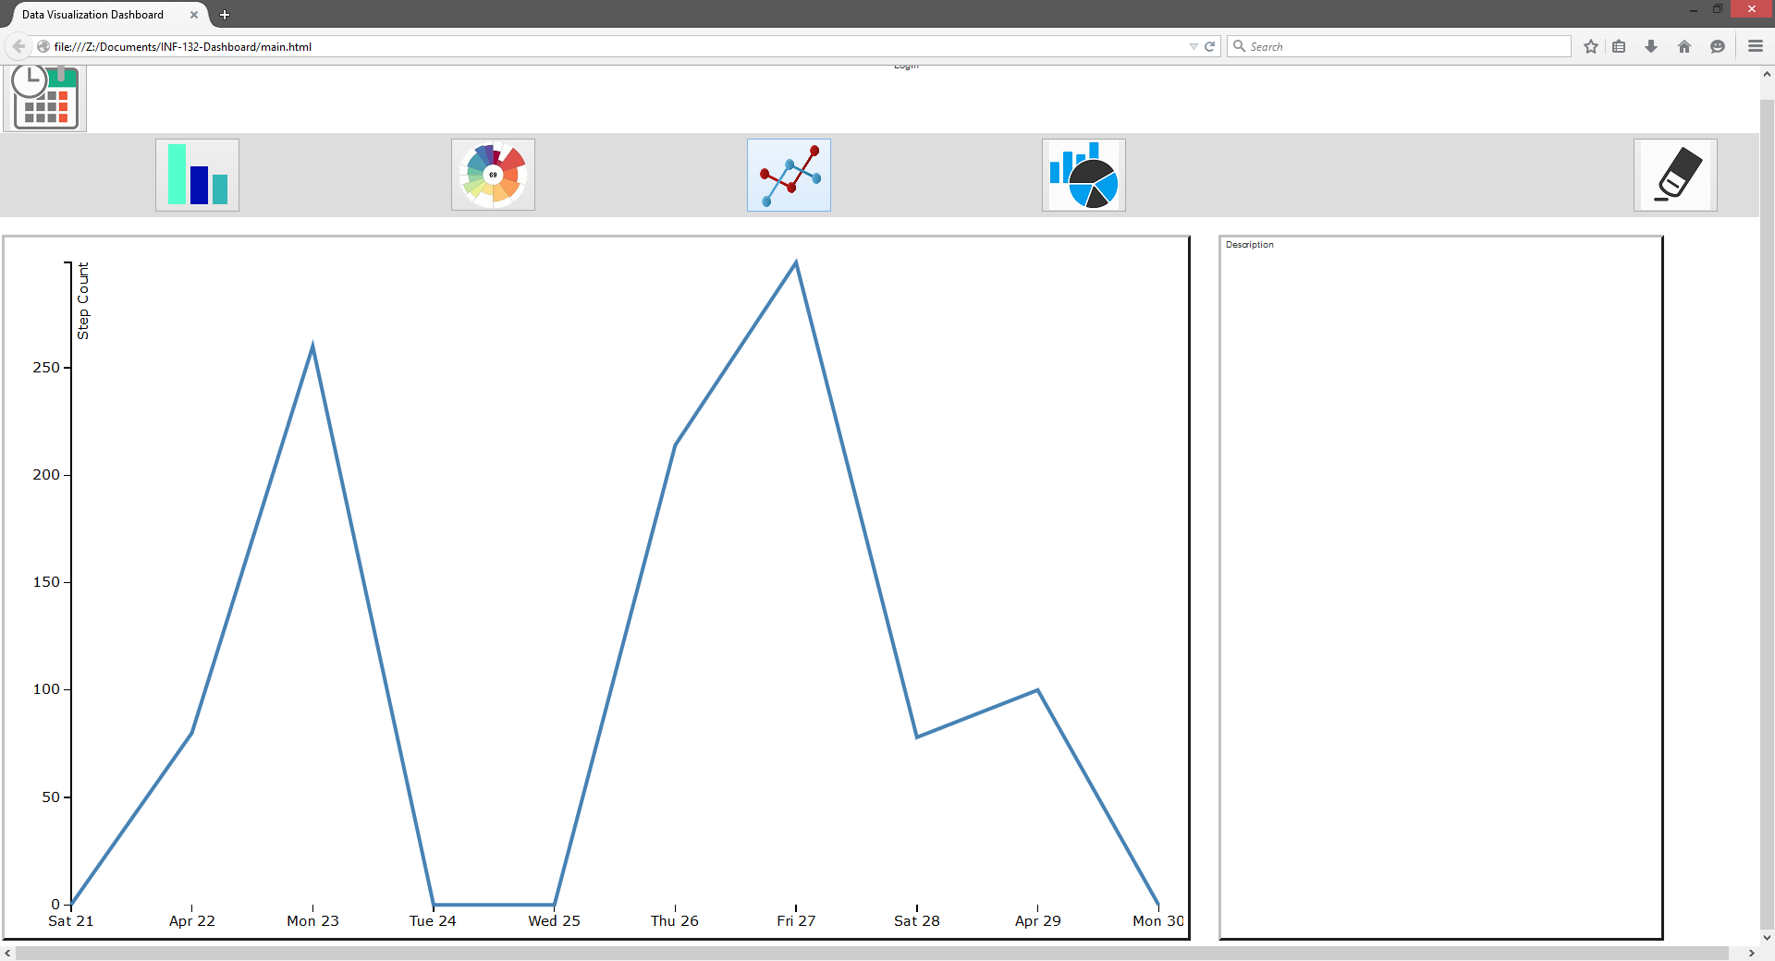
Glamour Shot: Line Graph

Slide 10
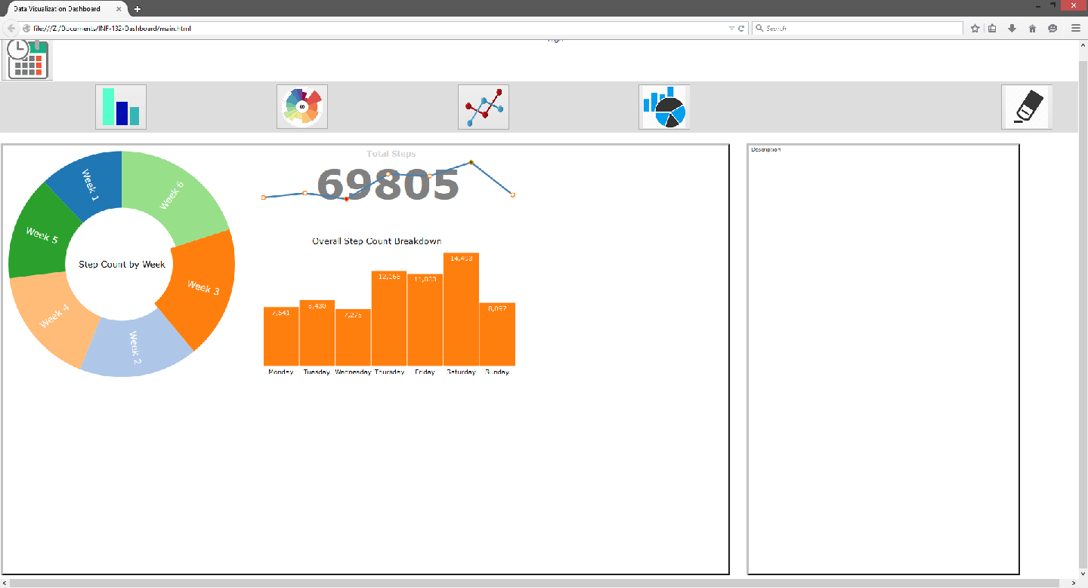
Glamour Shot: Tri-Graph (Bar,Line,Donut)

Slide 11
Difficulties encountered
D3
Must learn how D3 code works, other class helps with this
Could not get all proposed functions to work
Examples: Picking time frame of data to view and login functionality
Keeping customers up to date on progress
Our fault really

Slide 12
Difficulties encountered cont.
Unfinished product (missing features), resulting in difficulties during user testing
Insights from this described earlier
We will deal with these after data analysis

Slide 13
Decisions to be made
How to go about data analysis
After data analysis...
Rank issues by severity (Courage and Baxter)
Fix most severe problems first
Consider lower-ranked problems

Slide 14
Updated Timeline
Week 9
(5/26-5/28) Finish interviews
Franklin, Ty
(5/26-5/28) Think Alouds
Ty, Franklin, Chape
(5/28-5/31) Data analysis
Ty, Franklin, Chape

Slide 15
Updated Timeline
Week 10
(6/1-6/2) Finish Data Analysis
Ty, Franklin, Chape
(6/2-6/4) Refine Design based on data
Ty, Chape
(6/4-6/7) Write Final Report
Ty, Franklin, Chape
(6/5) Present final product to Laleh and Siripen
Ty, Franklin, Chape

Slide 16
Updated Timeline
Finals Week
(6/6-6/9) Collect and prepare project materials
Ty, Chape, Franklin
Collaborate with analyst group

Slide 17
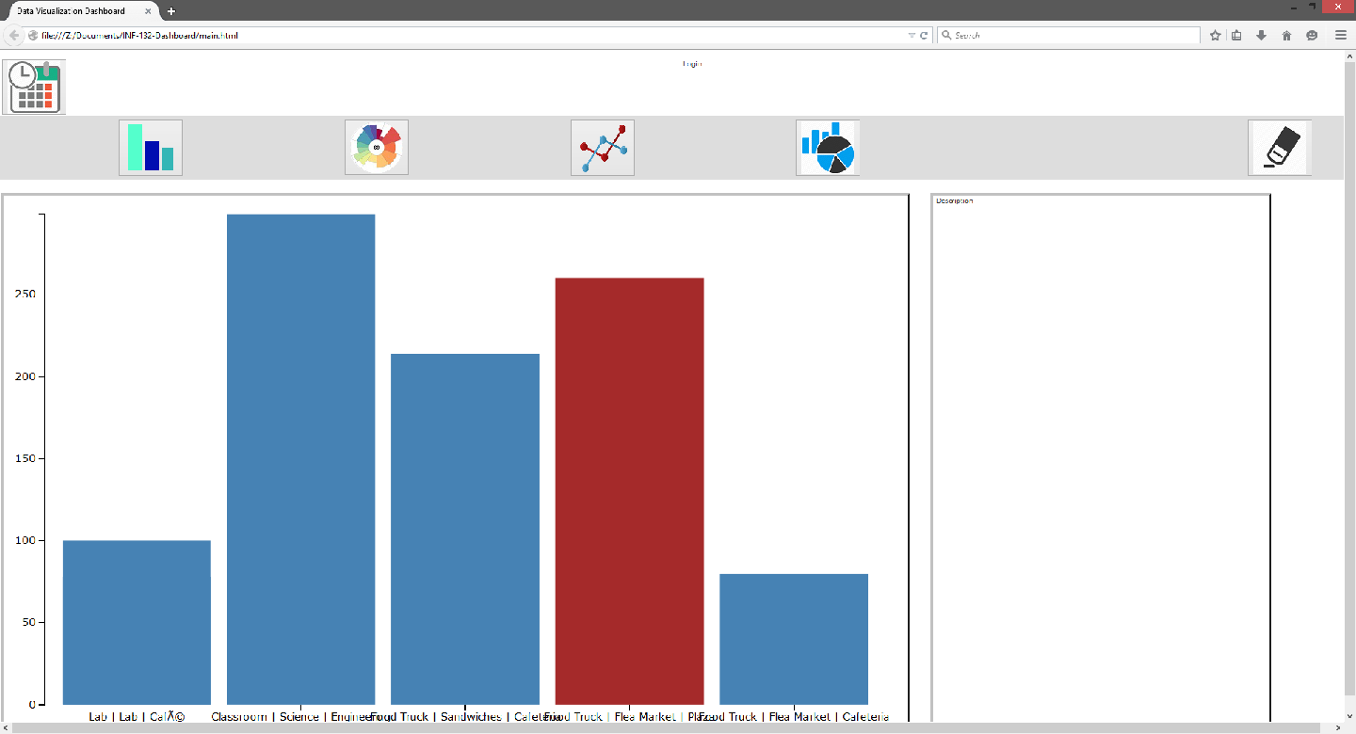
Glamour Shot: Bar Chart

Slide 18
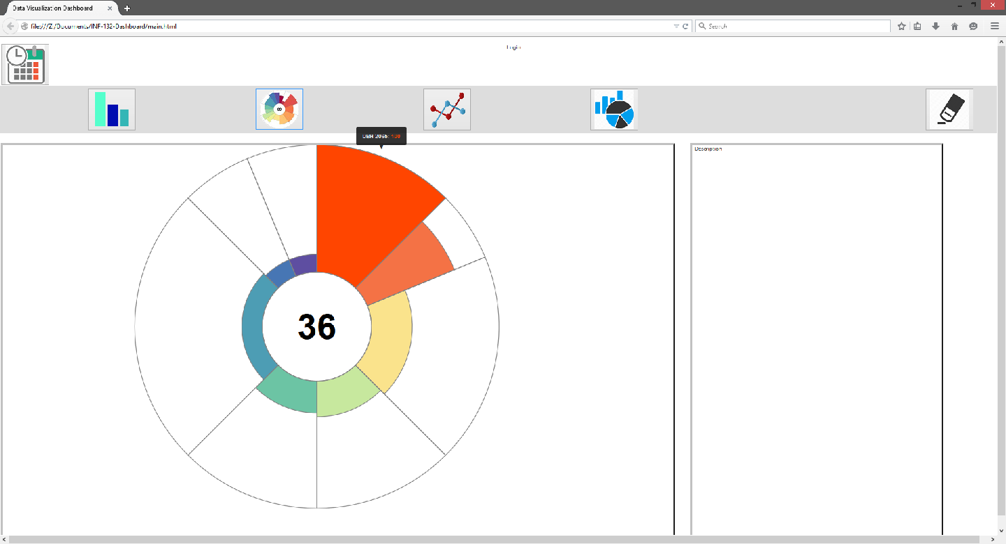
Glamour Shot: Aster Plot

Slide 19
Thank You!
Questions?

