Slide 1
Project Progress
Redesigning the 4 satellite websites of the UCI Center for Citizen Peacebuilding
Amy Nguyen, Cassandra Balbas, Judy Mak, Niko Daza, Tina Bui
Informatics 132 - Spring 2015
Notes:
NIKO

Slide 2
Objective
Revamp websites and blogs for:
Southern California Network for Peacebuilders
Students for Global Peacebuilding
Education for Global Peace
Orange County Peacebuilders’ Network
Notes:
NIKO
Websites - on UCI domain
Blogs - on Blogspot
Introduce clients, background

Slide 3
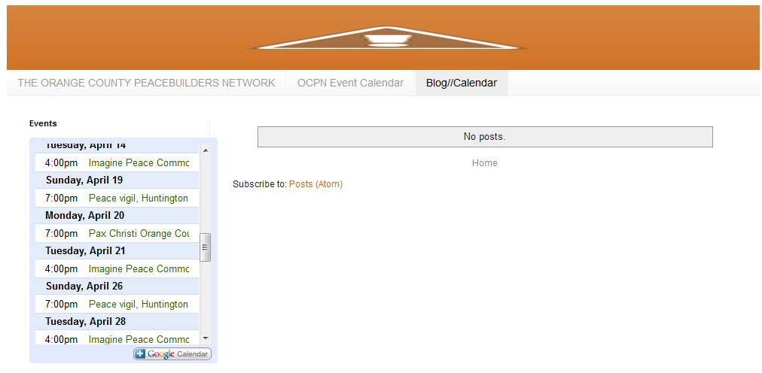
Usability Problems
Blank pages
Broken links
Outdated links
Inconsistencies
Names
Layouts
Usability Issues
i.e. No back button, disappearing links, etc.
Notes:
NIKO
Empty blogs and pages
SCNP/SCPN confusion
Lack of graphics/design
Lack of connectivity between pages

Slide 4
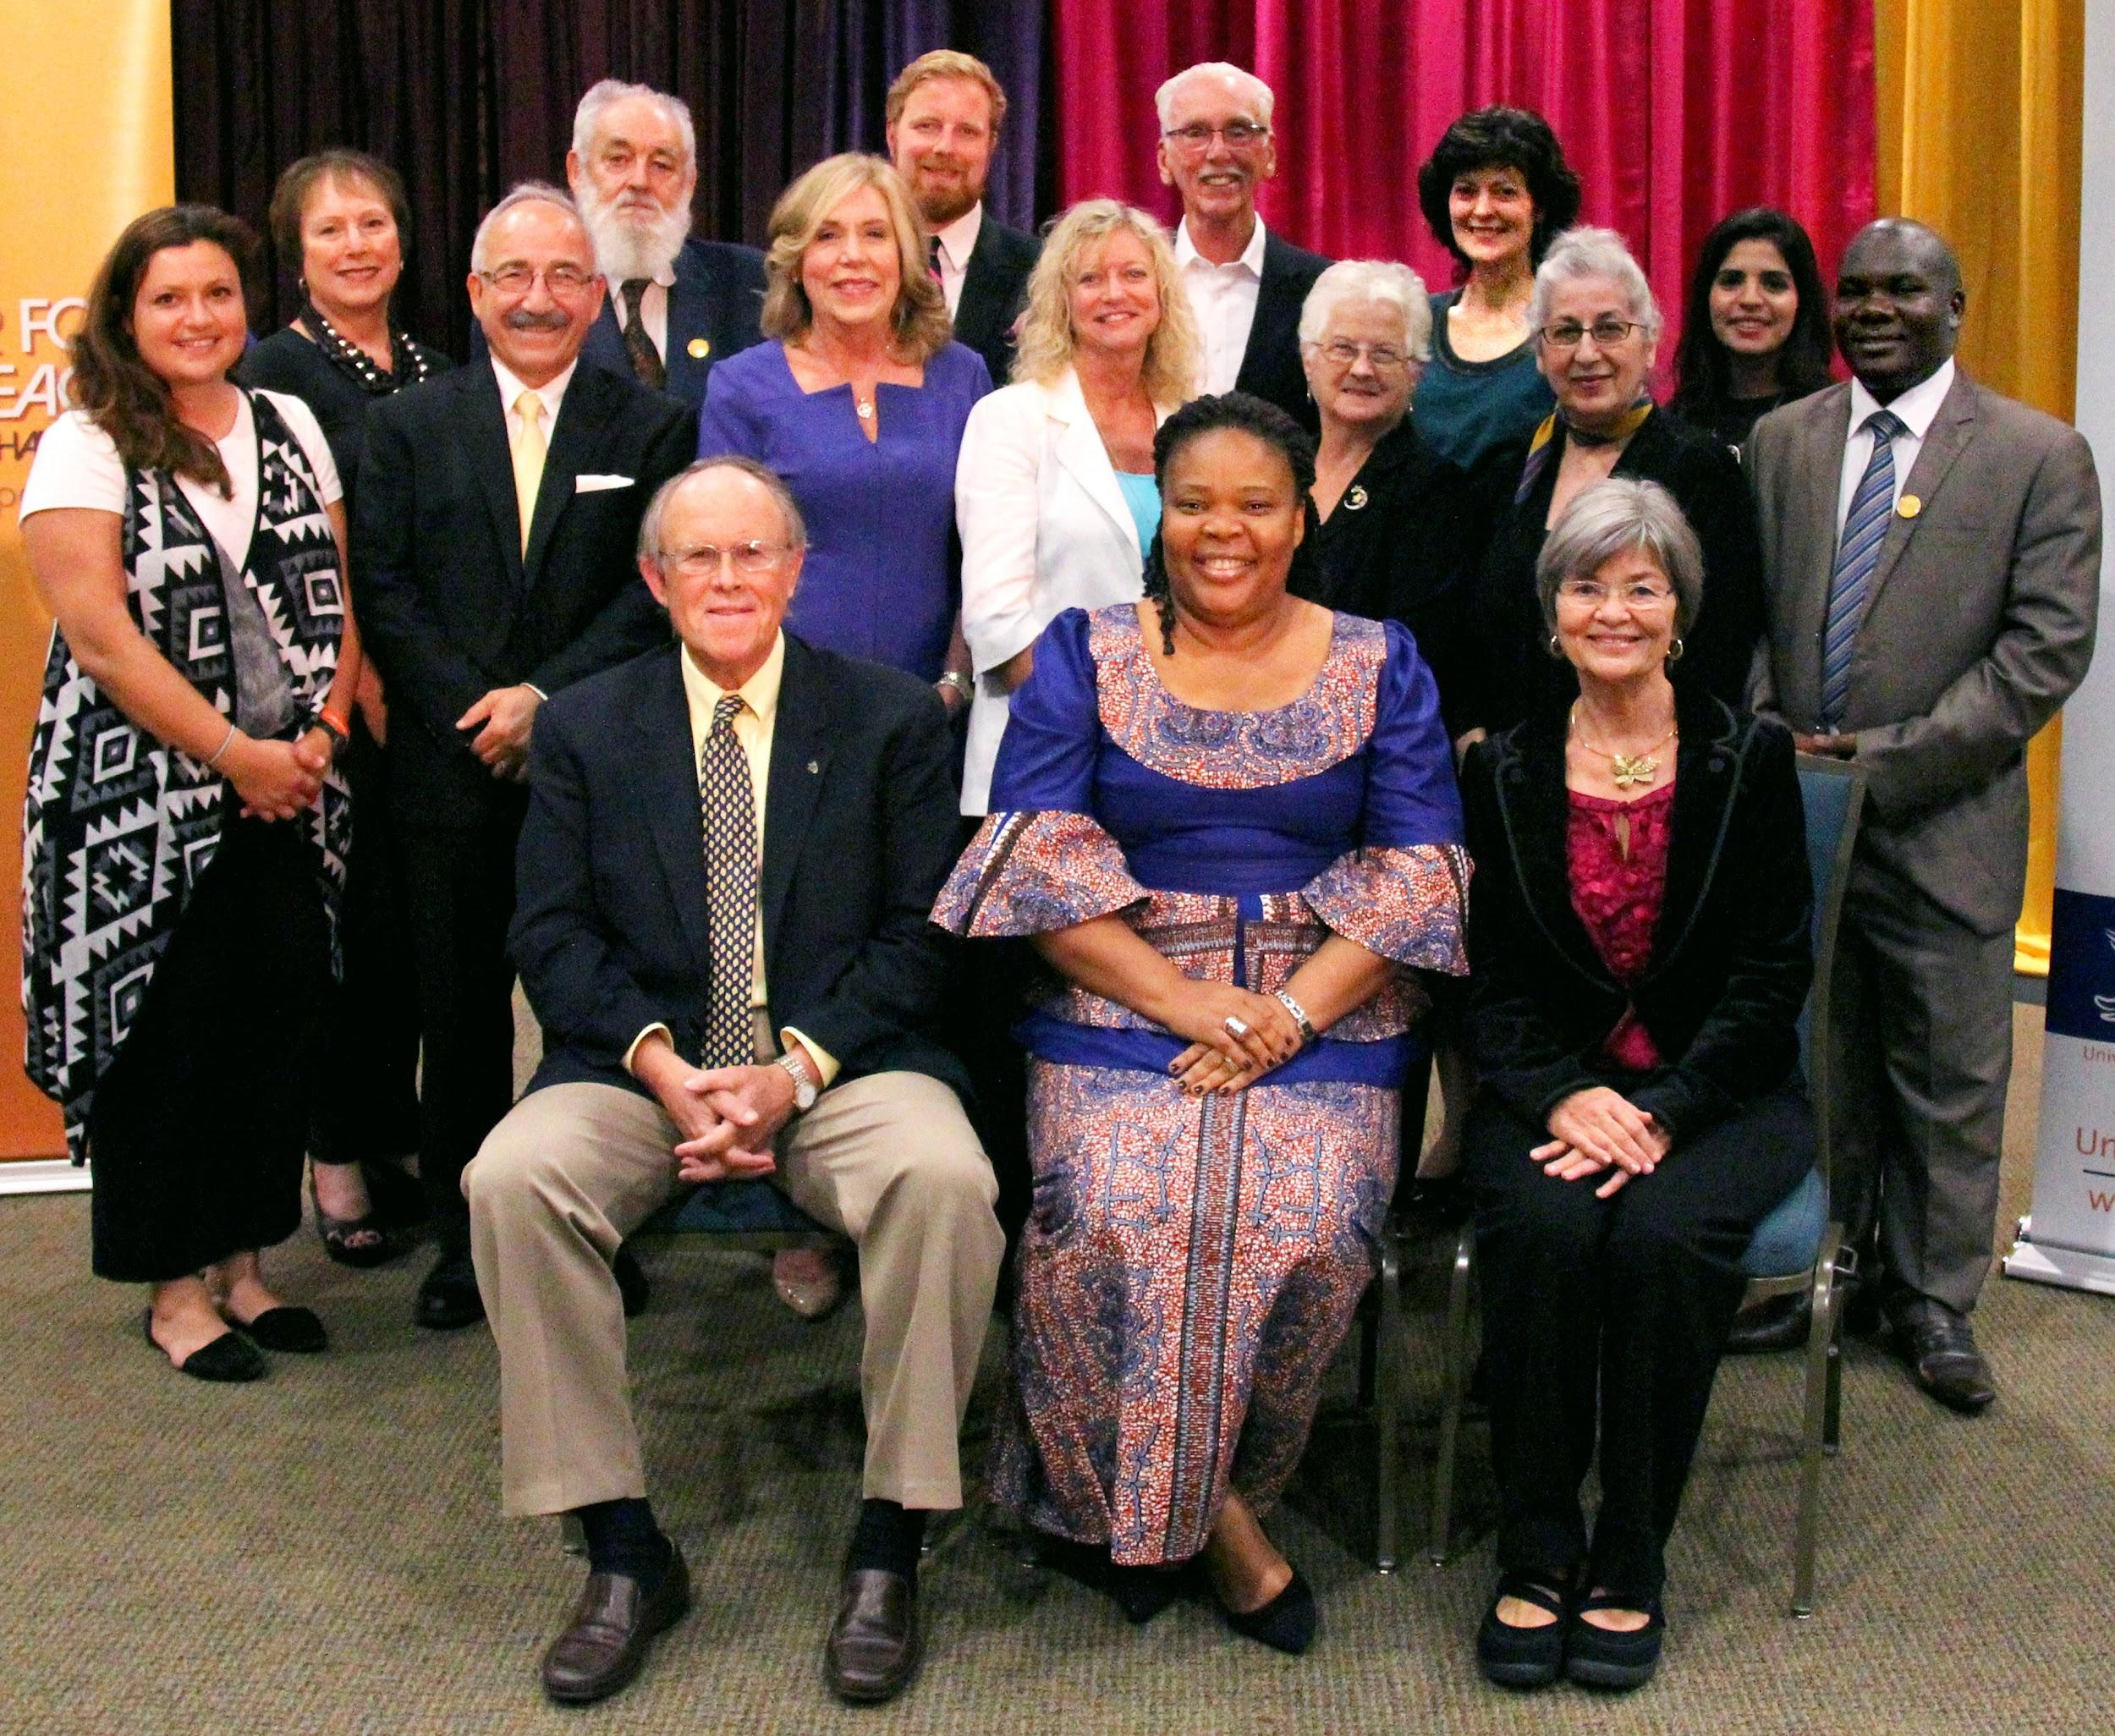
Methods
Heuristics Evaluations
Mockups
Cognitive Walkthroughs
Usability Testing
Think-alouds/interviews
Notes:
TINA
Heuristics evaluation
Cognitive walkthroughs
Usability testing
Interviews/surveys
Surveys: 5-10 minutes to take
Interviews: 20-30 minutes
Paula and Miriam will help bring in people to interview and give surveys

Slide 5
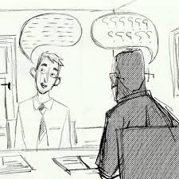
Sample Questions: Interview
When navigating to ____, were there navigation issues when trying to get to this page?
Define current usability issues such as non-functional navigational tools, such as broken/outdate
Please summarize the content of this page.
Determine if the content of these sites is complete and thorough?
Progress: 2 Completed interviews with customer Paula
Notes:
CASSIE
Survey Questions
The website is easy to use
I enjoy using the website
Was there a site that you found the easiest to navigate through than the others?
Focus of interview
Get a better understanding of the customers’/ users’ experience when using the site
Getting genuine feedback about comments/ concerns
Our interview questions doc, for reference: https://docs.google.com/a/uci.edu/document/d/1OEHeck4rLnjUIHJBNBWWyde40T3dvJ084Upir9ojmds/edit

Slide 6
Subgroups of Testers
Peace Educators
3-5
UCI and Non-UCI Faculty
3-5
UCI Students
5
Notes:
AMY
Explain differences in user base between the four sites

Slide 7
Weekly Plan
Week 3 | Meet with client; gather requirements Draft mockups/prototypes of pages | All - Designers
Week 4 | Edit SGP page | All - Editors
Week 5 | Edit SGP page, testing (heuristics evaluation, cognitive walkthroughs, interviews/surveys) Start editing SCNP/OCPN pages | Tina - SGP Editor Amy, Judy - Tester Cassandra, Niko - SCNP/OCPN Editor
Week 6 | Continue testing for SGP page, editing Confirmation for SGP page Edit SCNP/OCPN pages | Tina - SGP Editor Amy, Judy - Tester Cassandra, Niko - SCNP/OCPN Editor
Notes:
JUDY

Slide 8
Weekly Plan (cont.)
Week 7 | Testing for SCNP/OCPN pages Confirmation for SCNP/OCPN pages Start editing EGP page | Niko - SCNP/OCPN Editor Tina, Cassandra - Tester Amy, Judy - EGP Editor
Week 8 | Testing for EGP page Confirmation for EGP page | Amy, Judy - EGP Editor Niko, Cassandra, Tina - Tester
Week 9 | Final edits Final meeting with client Prepare for final presentation
Week 10 | Present
Notes:
JUDY

Slide 9
Thank You
Questions?

