Slide 1
Pre-Final Progress Presentation
Redesigning the 4 satellite websites of the UCI Center for Citizen Peacebuilding
Amy Nguyen, Cassandra Balbas, Judy Mak, Niko Daza, Tina Bui
Informatics 132 - Spring 2015

Slide 2
Summary of Problems
For each of the 3-4 websites:
Broken or non-existent links
Easily fixed, but poor pre-existing coding structure made job repetitive
Lack of graphics
No logo or headers (except for SGP logo)
Lack of information
Additional clients needed to be contacted
Lack of consolidation and consistency
Multiple sites and blogs for the same information, lack of stable layout
Notes:
Tina

Slide 3
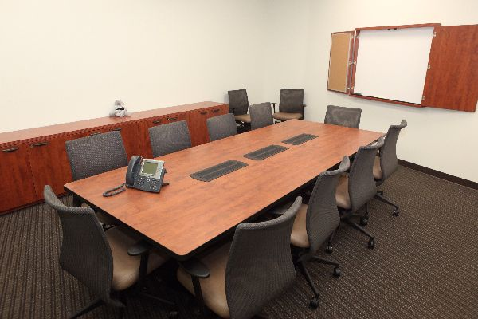
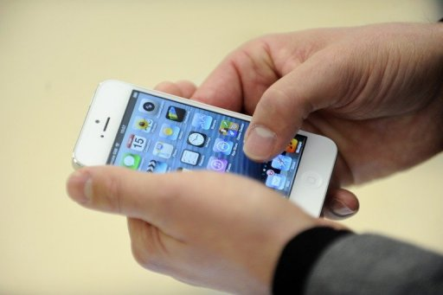
Methods
Usability Surveys, Heuristic Evaluation
Constant communication (GroupMe)
Set up meetings with other clients and with testers in addition to weekly meetings with client
Worked on sites in order
First: most information available (SGP > OCPN > SCNP = EGP)
Second: priority to client (OCPN > SGP > SCNP > EGP)
Notes:
Tina

Slide 4
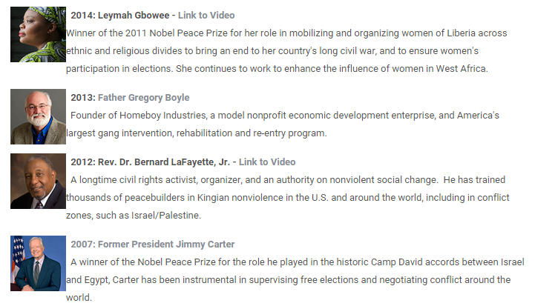
Progress
Following our weekly timeline:
Students for Global Peace
Completed landing page on UCI Peacebuilding website
Completed Blogspot renovation
Tested
Orange County Peacebuilders’ Network
Revamping landing page on UCI Peacebuilding website
Logo
Southern California Network for Peacebuilding
Evaluated current state of website; gathering information
Logo
Miscellaneous fixes to peacebuilding portal, per client request
Revamped Gang Intervention, Peace Awards pages
Education for Global Peace
Client wants to expand this into an independent project
Volunteer, class credit, etc. opportunities for Summer or Fall quarter
Notes:
Judy(?) This goes well with the SGP, OCPN, and SCNP slides, so whoever takes these slides should be someone whose other slide isn’t very info-heavy (or doesn’t have any other slides) -- Judy

Slide 5
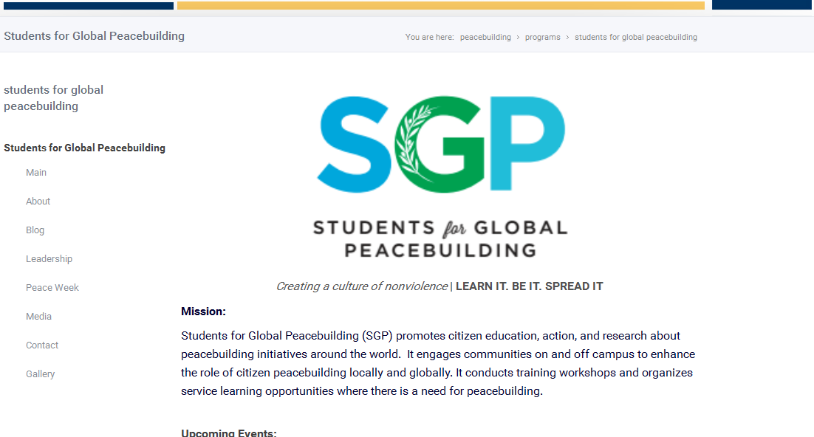
SGP
http://www.peacebuilding.uci.edu/programs/sgp/sgp.php

Slide 6
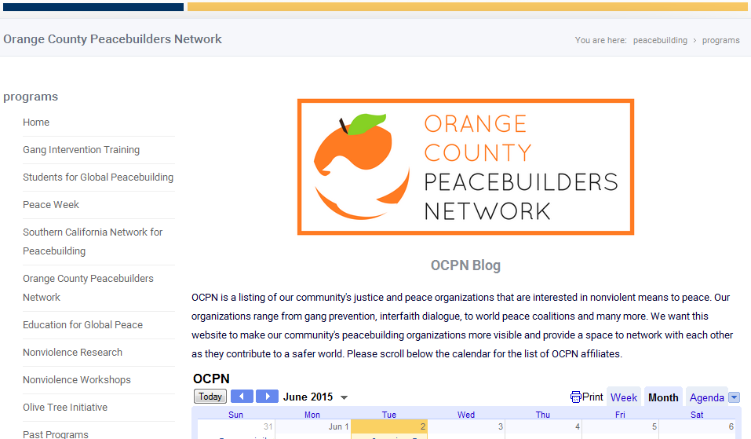
OCPN
http://www.peacebuilding.uci.edu/programs/ocpn.php

Slide 7
SCNP
http://www.peacebuilding.uci.edu/programs/scnp.php

Slide 8
User Testing (SGP)
One session, SGP meeting
Thursday, May 7th at 6:30pm at SBSG 1511; 8 testers
Methods
Pre-/Post-Questionnaires, Guided Site Browsing, Tasks, Feedback
Sample Statistics/Quotations
100% of users reported that they would use site again in future
Average Usability Rating (1 - 5): 3.625
Median Usability Rating (1-5): 4
Most common complaint: simplicity
Compensation: Raffled 2 Gift Cards
Notes:
Judy
Note: Add Median

Slide 9
Insights
Editing sites
Utilizing editor
Fixing broken links: Taught by Heather
User testing helped pinpoint needed changes
Importance of reducing number of clicks
Having multiple versions of the site lead to confusion
Humans are creatures of habit - they prefer layouts that are familiar (Google’s horizontal navigation bar)
Being involved in the organizations; genuinely wanting to help out the peacebuilding networks
Notes:
Cassie

Slide 10
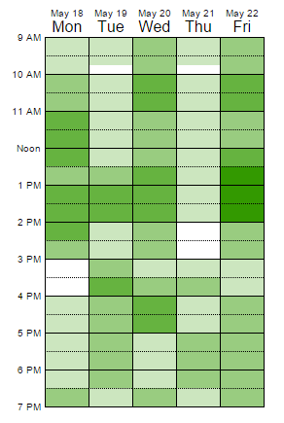
Difficulties
Miscommunication
Teammates
Webmasters
Paula
Students
No information to work with
Particularly for SCNP and OCPN
Scheduling conflicts
Testing
Difficulties finding educators and peacebuilders to test
Notes:
Amy

Slide 11
Remaining Decisions
Fix broken links/minor layout issues
Still need to complete SCNP and OCPN
Obtain missing information for SCNP and OCPN
The Education for Global Peace page
Future Opportunities; contact Dr. Paula Garb
Notes:
Niko

Slide 12
Updated Timeline
Week 10 | Thursday, June 4 | Test OCPN page Write final report | OCPN Testers - Niko, Judy
 | Friday, June 5 | Meeting with SCNP Network Write final report | Tina, Niko, Judy, Cassie, Amy
 | Saturday, June 6 | Edit SCNP page Wrap up final report | SCNP Editors - Cassie, Amy, Tina
Notes:
Niko

Slide 13
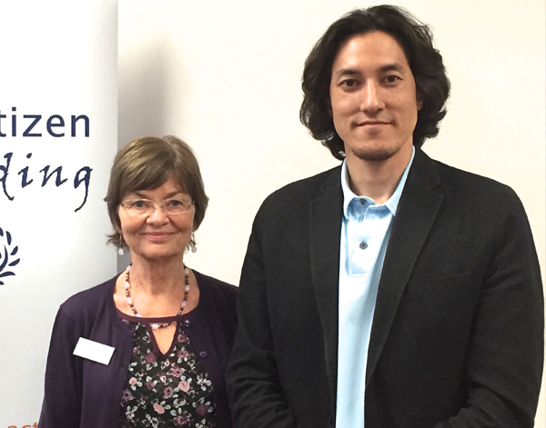
Questions?
Special Thanks to:
Professor Paula Garb
Professor Alfred Kobsa
Monique (OCPN), Heather, Miriam (SGP)
SCNP Fellows (meeting this Friday)
Our test users at SGP

