Slide 1
Evaluating Navigation in Online Courses
James Jiang, Peipei Nie, Raj Parpan,
Lena Wong, William Yang
Group 6
Notes:
William
UCI's online course management system Canvas gives instructors various options to create interface elements that enable learners to navigate the different materials of an online class.
The aim of this project is to find out which navigation devices work and which don’t, and to suggest changes.
Interviews and possibly surveys should be conducted with existing learners of select classes, as well as a longer-term observational study be carried out with team participants who will become learners themselves.

Slide 2
Our Client
Mathew Williams
University of California Irvine Extension
Division of Teaching & Learning
Manager of Learning Technologies
Notes:
William

Slide 3
Our Project
UCI Extension Canvas
A course management system that provides students with online learning experience in professional training
Learning environment allows students to navigate through course homepage, modules, assignments, grades, and discussion sections
Current Concerns
Customer finds it is difficult to find out what they need to be doing
Issue of raising anxiety level of missing information or being confused about information
If information is not presented clearly, then frustration will impair learning
Notes:
Peipei:
Intro about the overall project, goal: and what the customer expects at the end, our general approach of what to do
Problem:
Lot of text, might be okay since this is actually defining what Extension is, but I want to go over it with everyone else
Also want to all agree on the issues

Slide 4
Our Project
Goals
To find out which navigation works and which doesn’t
To suggest changes
What the customer expects at the end
Easy to navigate
Easy to find information that are needed
Won’t miss any information or be confused about the information being presented
Provide an enjoyable, hassle-free online learning environment
Notes:
Peipei
Problems:
Words can be rephrased

Slide 5
Matrix of Modules
Road Map |  | Home Page
 |  | Display Modules | With weekly buttons | Without weekly buttons
 | With links | x | x | x
 | Without links |  |  | x
Notes:
James

Slide 6
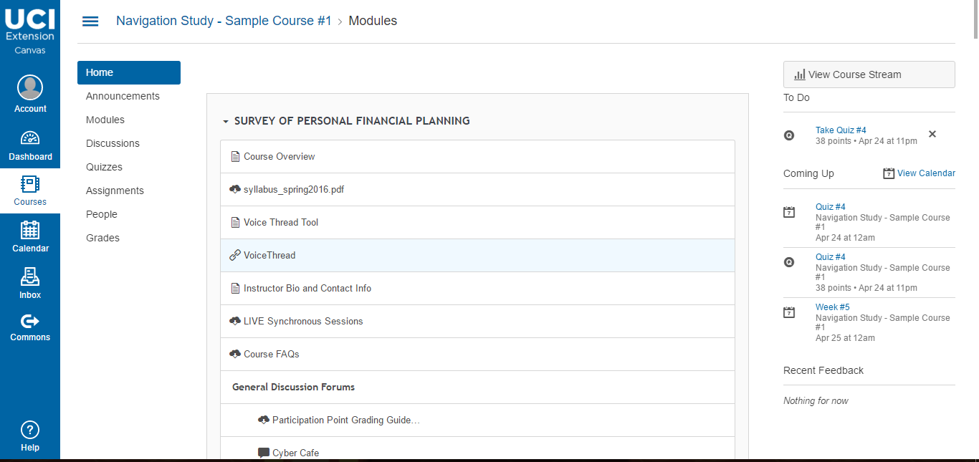
Module View Only
Notes:
James

Slide 7
With Weekly Buttons
Notes:
James

Slide 8
Without Weekly Buttons
Notes:
James

Slide 9
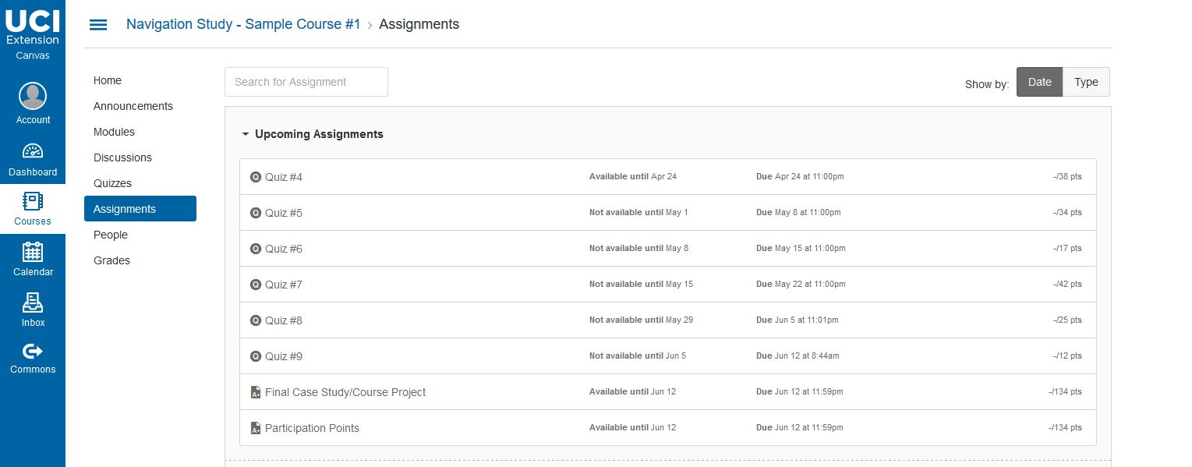
HCI Problems
Multiple Quiz sections not needed
Dashboard and Courses have similar information
Notes:
Raj
Problems that we have or customer
And add that we will find out more through interviews/ users testing/ evaluation based project
Things to Remember:
We are trying to figure out what we can do with the platform to improve navigation for students
We CANNOT change Canvas, only what is given to us in the sandbox
Don’t focus on the usability, focus on the navigation
Problems:
TBH, can probably put slides 5-8 on one-two slides
I don’t really see how changing how grades are presented will fix navigation issues
Going over the other slides,
Dashboard and Courses are duplicate.Dashboard doesn’t display text for everything including discussion, announcements, graded stuff.Courses just lists the names of the classes and links.Remove dashboard to only use courses with links (showing details of discussions, announcements, graded stuff).

Slide 10
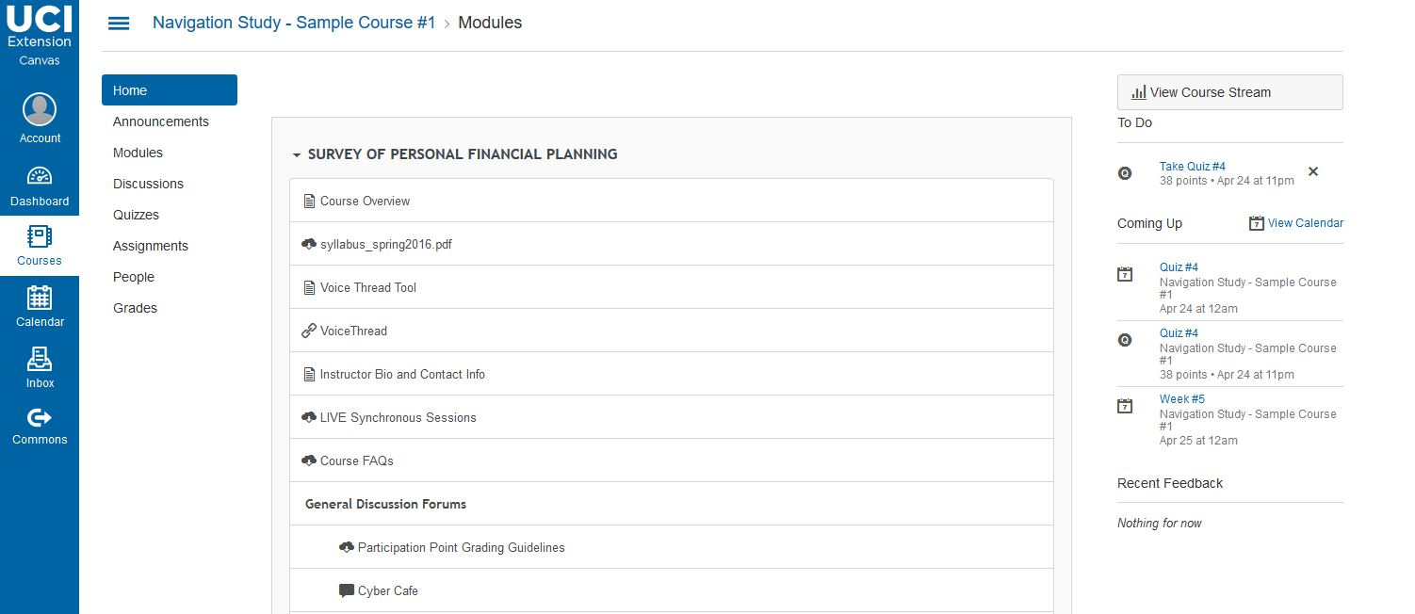
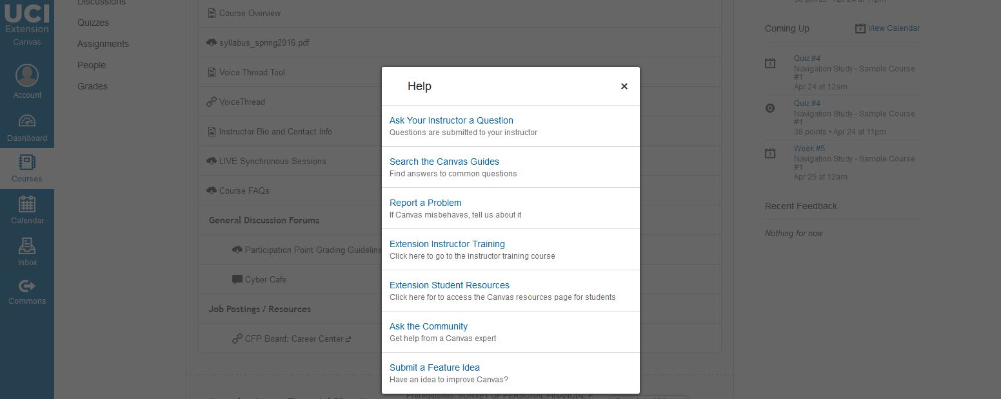
HCI Problems
Help is hard to find
Help options are limited
Notes:
Raj
Participation point grading guidelines needs to be removed from forums increasing the efficiency of information provided upon navigating canvas.
An automated help process for seeking help on issues arising from navigating canvas.

Slide 11
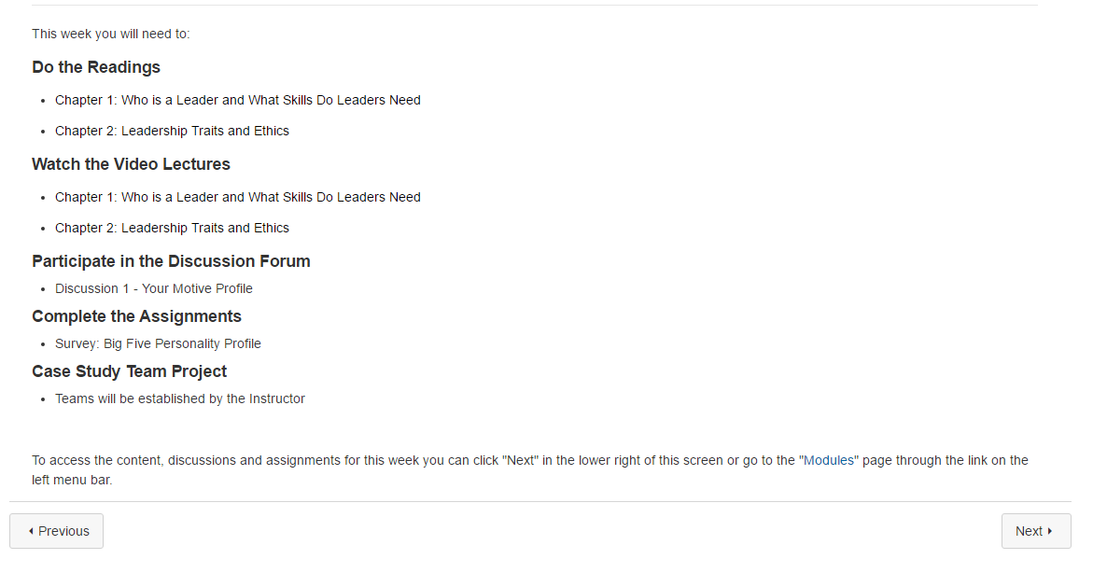
HCI Problems
Lack of redo/undo button
Notes:
Raj

Slide 12
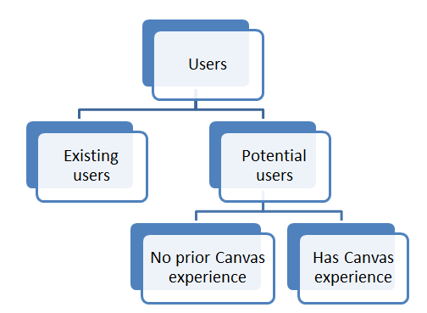
Types of Users
(6-10)
(6-10)
(3-5)
(3-5)
Notes:
Lena
To discover further problems users are experiencing while navigating canvas, a sample group of 12-20 students will be selected. We will divide them into two groups: Existing and potential users. Most of the existing students have a bachelor’s degree and mostly working. For potential users, there are relatively large pool for that group since a large group of population is eligible to become a UCI extension student. So we want to divide them up by looking at their prior experience on Canvas. For existing users, we are looking at around 6-10 users. For potential users, we are also looking at 6 to 10 users while ideally we can have 3 to 5 for people who have experience, and 3 to 5 without experience. Through interviewing with existing users, we can learn their experience of using Canvas so far. And see if they came across any usability and navigation problems. Through interviews and observations with potential users,we can observe users’ first impression of the site and if the interface has any intuitive problems since this will be their first time using it.
Existing: to gauge experience so far
Potential: to see any intuitive problems/ initial impression

Slide 13
Usage Behavior
Extension students who are currently enrolled in selected classes
Experience/habits
Any difficulty with current navigation models
Any U.S. adults who have NO exposure to Canvas
Initial impression
Any intuitive problems
Any U.S. adults who has experience with UCI/ UCI Extension Canvas
Any experience with navigation difficulty
Notes:
Lena
Problems:
Can change first line to just “U.S. adults with (NO Canvas exposure or NO Canvas experience)”
Same with second line
Third line suggestion “Current Extension Students”, if that’s not enough, then “Currently Enrolled Extension Students”

Slide 14
Phases of Research
Heuristic Evaluation
Cognitive Walkthrough
Survey
Usability Testing
Interview
Reevaluation
Notes:
Lena
Problem
This slide is structured differently than other slides, change to bullet point format

Slide 15
Contacting Users
Existing users
Our client will draw students from the sample classes
If not enough, recruit from any extension students
Potential users
We will recruit from fellow students, family, and friends
Notes:
Lena
Problems
30 minutes can be a separate point at the end, also I think we only wanted 15-20 minutes? Will have to re-ask other people
For extension students - can probably combine first two points together
Also, extension students can possibly meet up on campus
That being said, potential users can also have remote interviews…..? Actually that doesn’t make too much sense to me right now, will have to discuss later
Actually

Slide 16
Methods: Screening Survey
2 Surveys
Potential Users
Existing Users
3 Questions
Technical expertise
Experience with Canvas
Interview preferences
Notes:
James

Slide 17
Methods: Usability Testing
Only for potential users
Three sample courses will be assigned
Participants carry out selected tasks with the system as they think aloud
User performance is measured by task success, time on task, error rate, esp. time spent on “unproductive” activities like navigation, recovery after an error
Users satisfaction is measured by System Usability Scale
Notes:
Peipei
Problems
Change to big bullet point format

Slide 18
Methods: Usability Testing cont.
User’s Tasks
Find recent activities in Dashboard
Find current grades
Find out what assignments are assigned and what the due dates are
Navigate through the modules
Find lectures
Find discussions
Notes:
Peipei
Problems:
Is this users tasks for potential users, existing users, or both?
Also should have in bullet point format

Slide 19
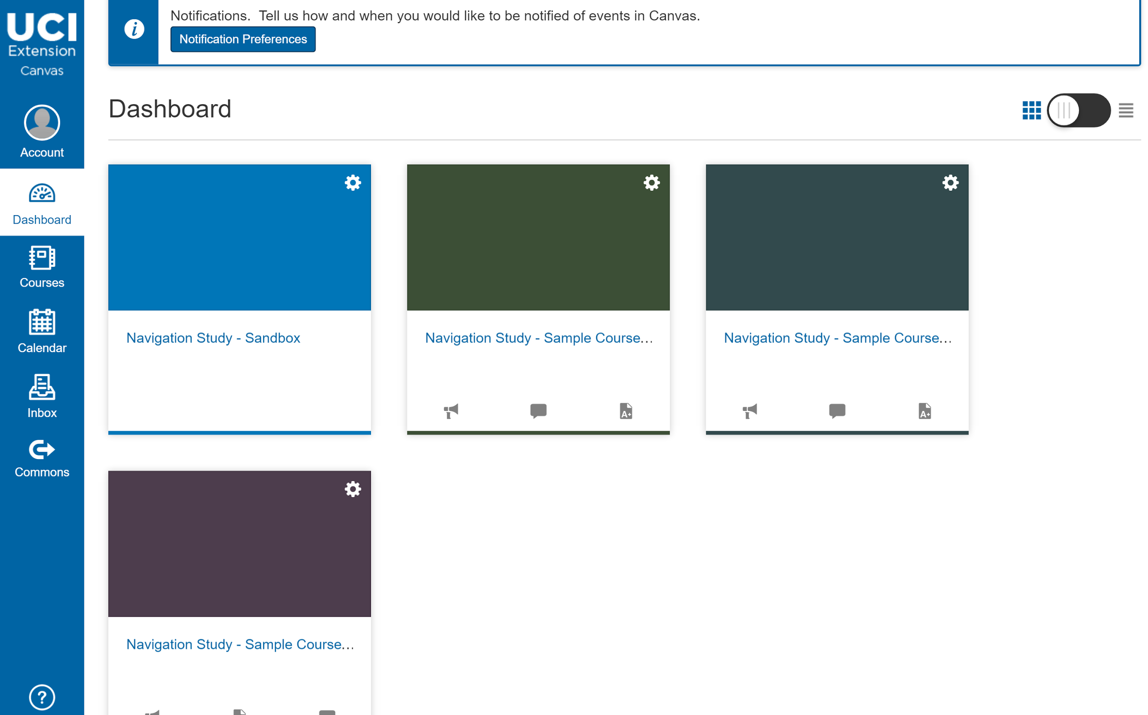
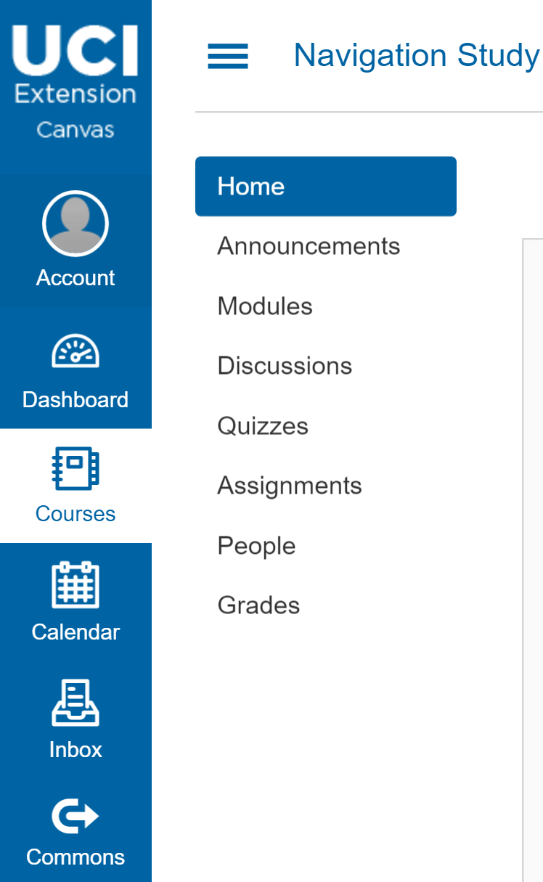
Dashboard Page
Navigation Sidebar
Notes:
Peipei

Slide 20
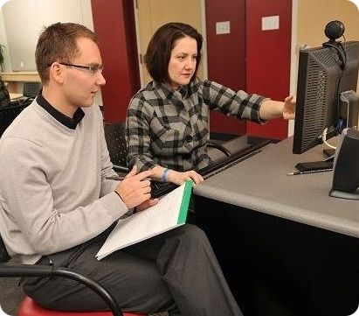
Methods: Interview
Existing users
Possibly phone interviews
Experience
Navigation difficulty
Clarity and ease of use of Canvas
Difficulty in performing daily tasks
Potential users
Follow up interview after usability testing
Related to performing assigned tasks
Notes:
Lena
Our approach
We will be conducting interviews for both user groups. For existing users, we will contact them once we select candidates based on survey responses. Since they are mostly population who are working, it will possibly be a phone interview. Some of the questions that we will be asking are related to their experience, any navigation difficulty, clarity and ease of use of Canvas, and difficulty in performing daily tasks such as looking up weekly assignments, checking grades, and taking quizzes. For potential users, we will conduct interviews after usability testing. The questions will be catered toward the tasks that we assign them.
Interview - A very simple semi-structured Interview which provides a very rich source of insight. Guidelines followed for the Interview-:
Set aside at least 10 minutes for each interview.
Leave atleast 2 mins rest breaks between each interview to revamp questions which were hard to understand for the stakeholder
Limit the interview to 3 or 4 major topics
Be prepared with 20 questions that will effectively help elicit further problems with navigation.
Communicate with the interviewees using remote connection via internet
Do not hesitate to ask the same question to different stakeholders as everyone has their own perception
Assign a note taker primarily responsible to record answers in the form of a rough draft.
We’ll use surveys to filter out the people we want to interview
Primary focus on students
Students have used canvas
Students who haven't
Students who are off campus that have/haven't used canvas
More weight on those who haven't taken a course with us

Slide 21
Timeline
Week 4 (current week)
Release Survey
Week 5
Get survey results & select candidates
Weeks 6 - 7
Conduct interviews, evaluate results, make corrections
Week 8
Conduct observations, make corrections
Week 9
Presentation week, prepare final product
Week 10
Present final product
Notes:
William

Slide 22
Individual tasks
Gathering & Screening Survey Responses
Lena & James
Interviewers & Observers for Potential Users
Peipei, Raj, William
Interviewers for Existing Users
Lena & James
Evaluation of Results
Everyone!
Notes:
William

Slide 23
Thanks for listening!
Any questions?
Notes:
William

