Slide 1
Mobile Learning Project
Pre-Final Presentation

Slide 2
Agenda
Charles: Existing Moodle App
Marcel: Google Analytics
Ian: Student & Commuter Interviews
Justin: Instructor Interviews
Andrew: Survey and Results
Christina: Design and Wireframing
Rohan: Upcoming Milestones

Slide 3
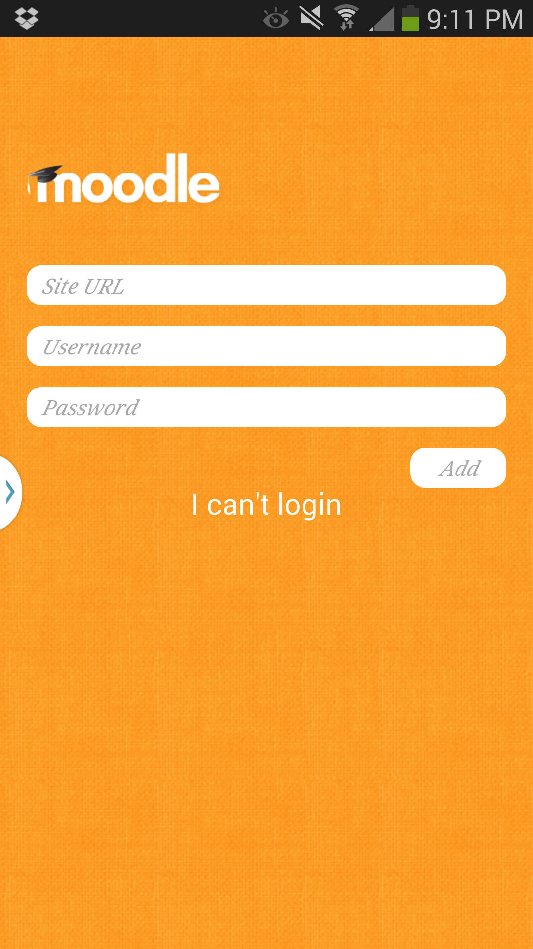
Existing Moodle App
Developers group
Suyash Mishra
Charles Steinschneider
Xuexi Zang
Xin Jin

Slide 4
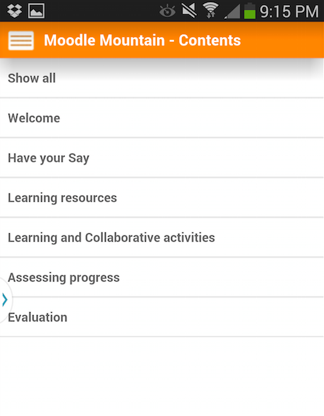
Existing Moodle App
Overview
Supported Features
Limitations
Why not 5 Star App?
Possible Strategies

Slide 5
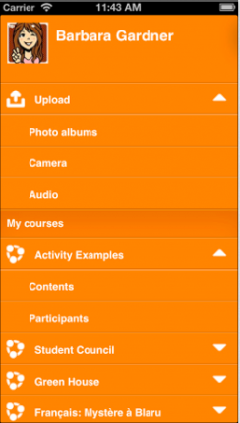
Moodle Mobile
Moodle Mobile
In active development
iOS and Android
  porting to additional platforms possible
Customizable

Slide 6
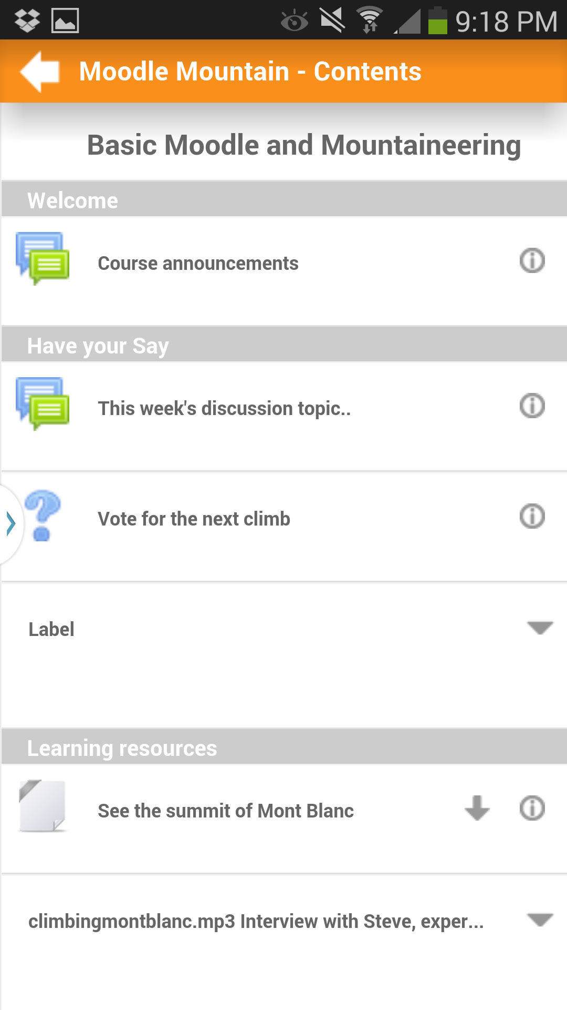
Moodle Mobile - Features
Documents
Required Reading
Syllabus
Lectures Notes
Slides
Can save documents locally

Slide 7
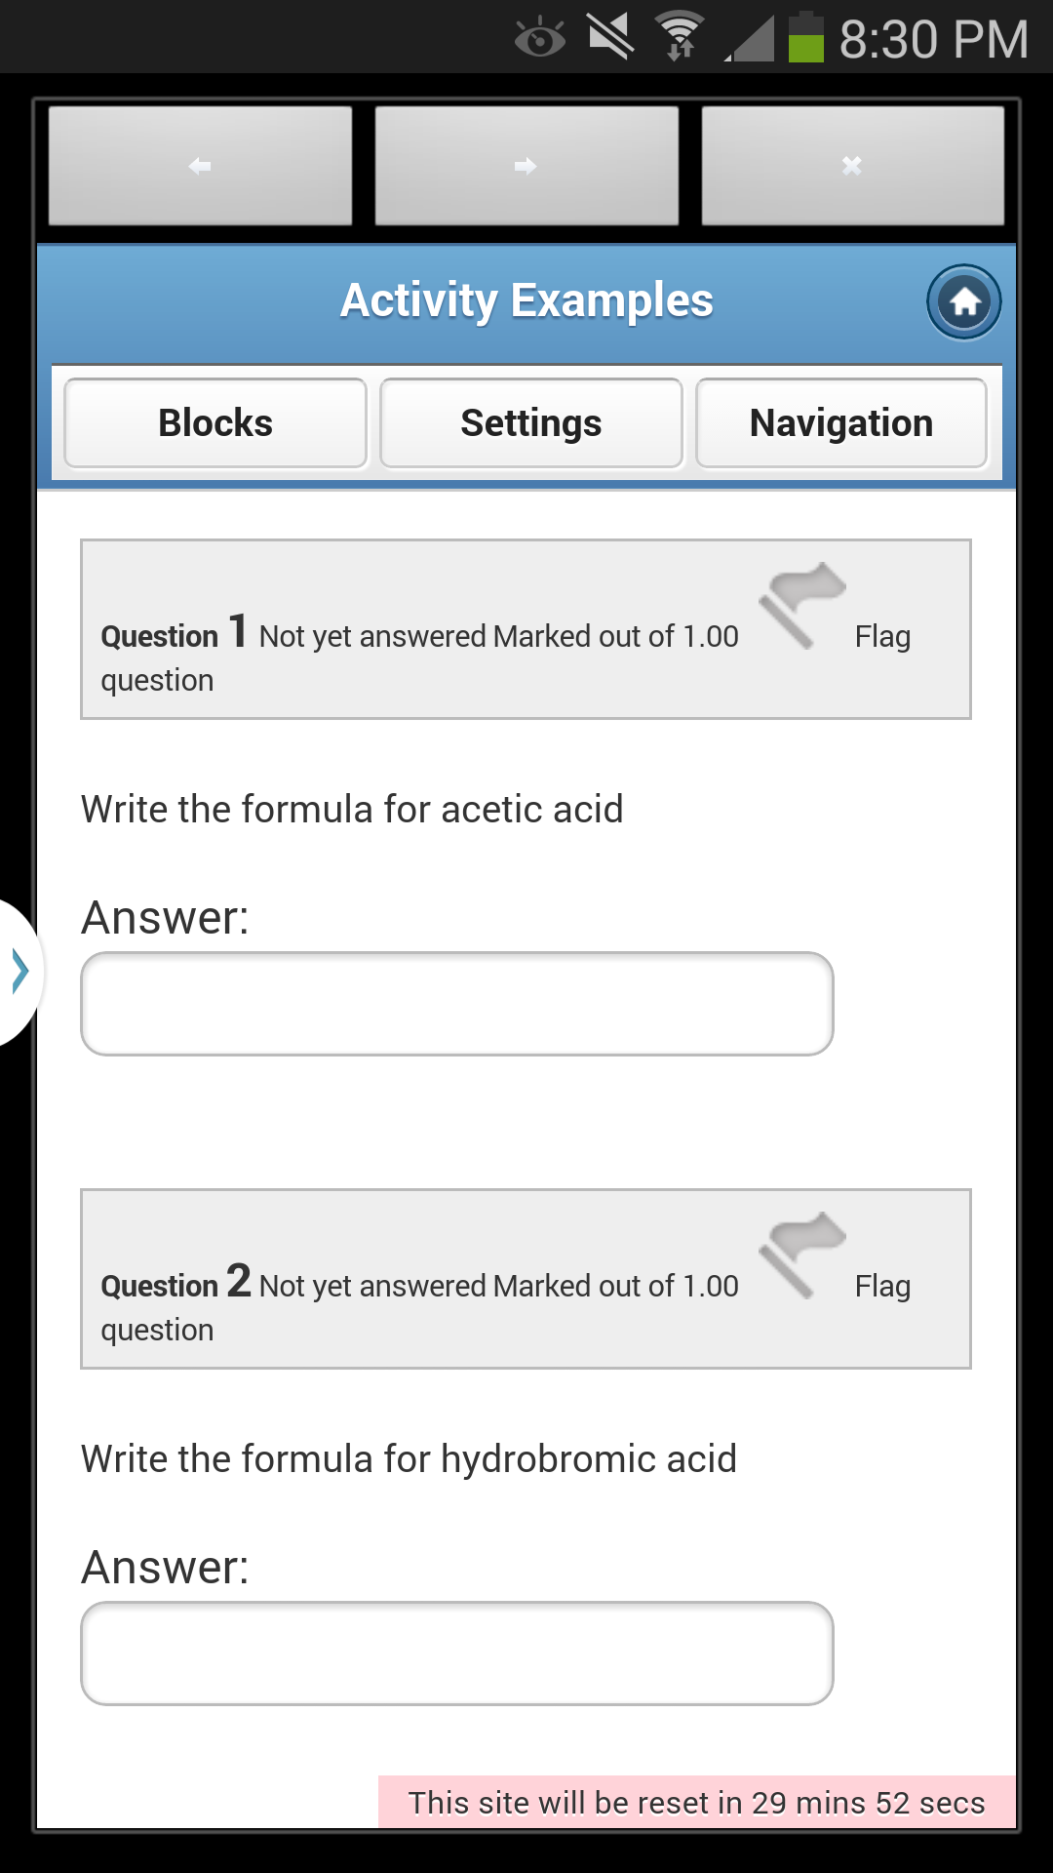
Moodle Mobile - Features
Built in Browser
If a mobile theme is set up properly then the app has access to all moodle desktop content, such as quizzes
effectively means the app does not work without also enabling a mobile theme
awkward transitions
users must sign in twice

Slide 8
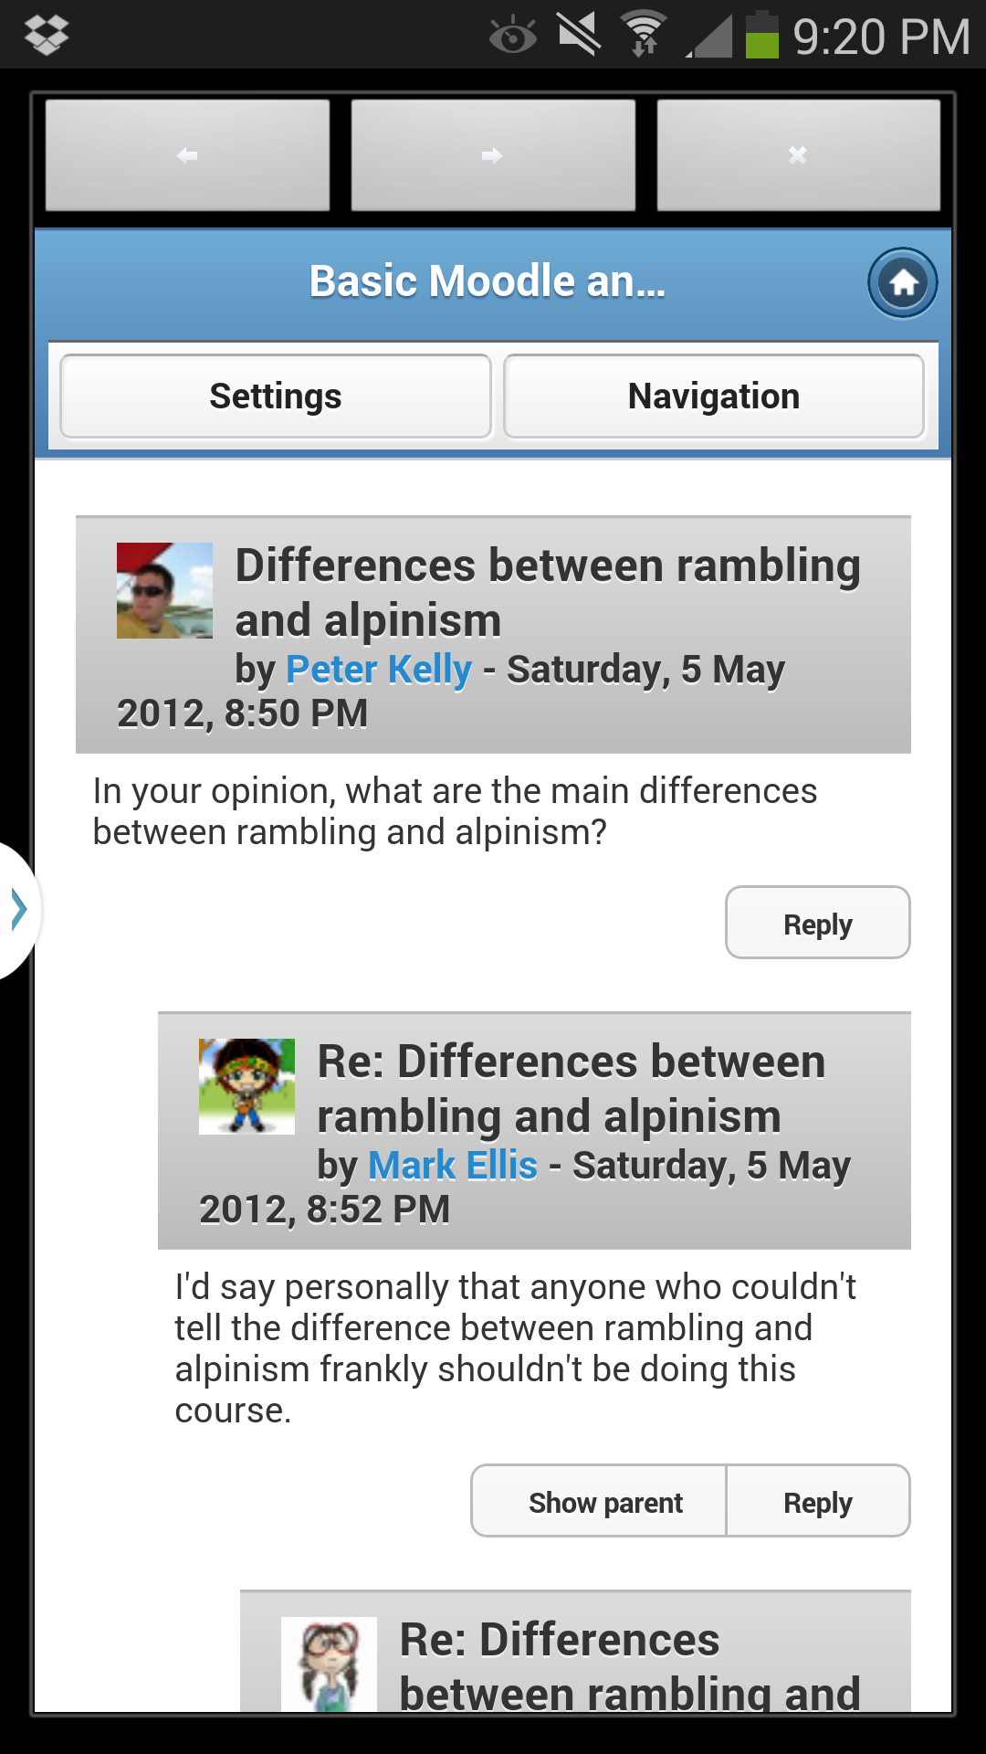
Moodle Mobile - Features
Communication
Discussion Forum
Messaging Students
Chat
Most of these features currently use the in app browser

Slide 9
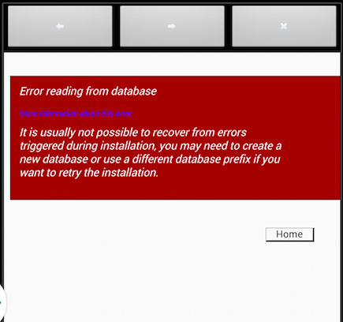
Moodle Mobile - Limitations
Web Browser
users must sign in twice
site must have mobile theme
disconnect between app and browser can lead to poor user experience

Slide 10
Moodle Mobile - Limitations
Assignment Submission
most common assignment in UCI distance learning courses is to upload a file
Students don’t compose papers on mobile devices
Notes
No direct support for Video or Audio
desktop version of moodle does not either
post links to lecture video
Checking Grades

Slide 11
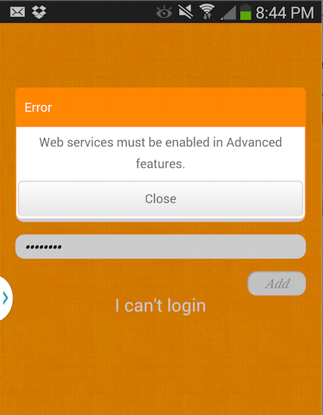
Moodle Mobile - Limitations
Requires moodle web services
disabled by default
disabled at UCI distance learning center
security and stability issues
http://school.demo.moodle.net

Slide 12
Moodle Mobile - Reception
Why isn’t Moodle Mobile a 5 Star App?
Older versions did not properly inform users that Moodle Web Services must be enabled
  instead they got cryptic error messages
Does not work with external authentication services
Users must sign in twice if browser is used
  older versions of moodle did not communicate this clearly, so it may look like the content is not accessible from app

Slide 13
Alternatives
Mobile Theme
re-scales Moodle content for mobile browsers
disabled by default
effectively required by Moodle Mobile to support all features of Moodle
Other Mobile Apps
included in our section of the report
no clear advantage over official moodle app

Slide 14
Possible Strategies
Short Term
Enable Mobile Themes
  simplest way to make website more mobile friendly
  Moodle Mobile requires them to support all Moodle features
Long Term
Enable Moodle Web Services
Consider customizing Moodle Mobile

Slide 15
Future of Developers Group
Only using Moodle Mobile demo site
Assist other Groups
Evaluate ways mobile devices can assist people with disabilities

Slide 16
Google Analytics Demo
Marcel P
learn.uci.edu
primary user access portal
October 8, 2013 to November 20, 2013

Slide 17
Student Interviews
Group Members
  Namrata P, Christina R, Jonathan M, Rohan A, Dinghang Y, Yuwei L
Most students interviewed were in an ICS lab, some were spoken with on Ring Road as well
Most Desired Features:
Realtime Instant-Messaging
Reminders and Alerts for assignments
Quizzes
Schedule & Calendar
Notes:
Remember, these are summaries based on transcribed interviews.

Slide 18
Student Interviews
Reasons for/Benefits from using distance learning app/taking online courses:
Reminders/Schedule anywhere;
Convenience (Learn whenever and however);
Better to take ‘unimportant classes’ online
Notes:
Remember, these are summaries based on transcribed interviews.

Slide 19
Student Interviews
Reasons for not using distance learning app/taking online courses (Concerns for distance learning):
Lack of real-time interaction with professors/TA
Real-time context sensitive help
Environment/atmosphere
Accountability in assignments
Too much text/reading and lots of busy work
The record of Q&A between professor and students should be much more clear
Piazza is annoying because it’s a different site (too many non-integrated services)
Notes:
Remember, these are summaries based on transcribed interviews.

Slide 20
Commuter Interviews
Group Members
  Shriti R, Rohan G, Patricia C, Ian M
Spoke with people on OCTA routes that stop by the campus
Short interview time, only about 5-10 minutes
Interview contained two parts, a series of 5 multiple choice questions, followed by 3 other questions that were free form and intended to discover thoughts that we may have not anticipated previously

Slide 21
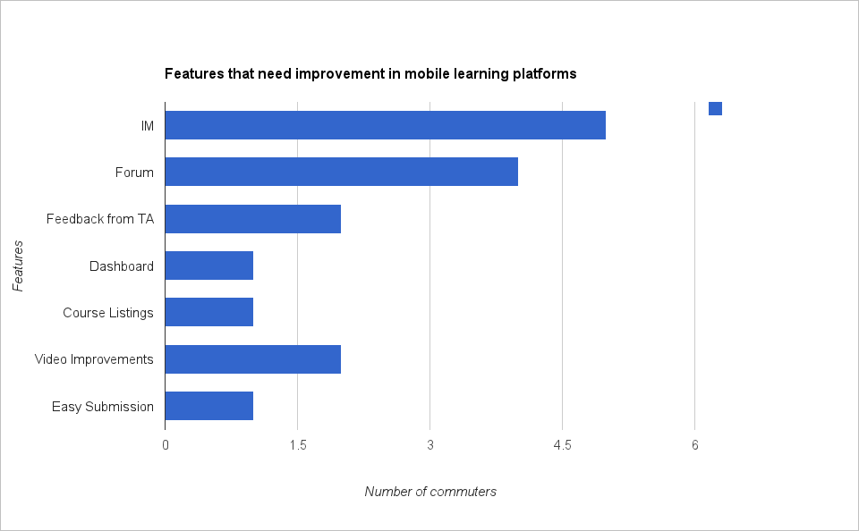
Commuter Interviews
Subjective/Free-Form Questions (summarized)

Slide 22
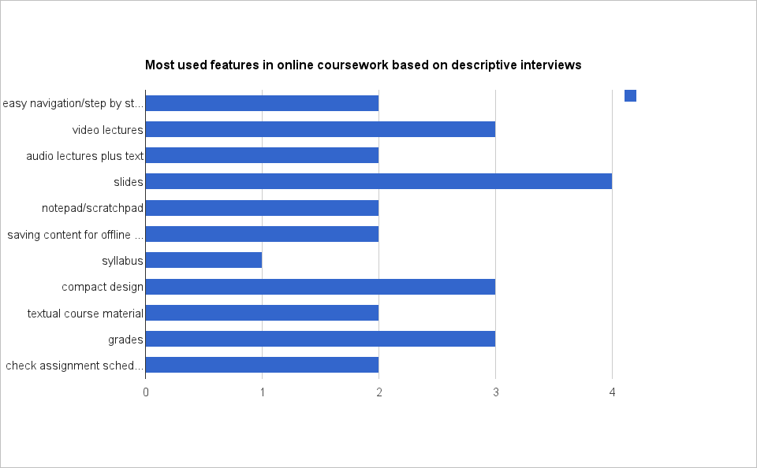
Commuter Interviews
Multiple Choice Questions
Notes:
Extra notes: most people preferred viewing lecture slides over video and audio on their mobile devices. (for commuters) This may be because lectures, once grabbed from the website, do not need to use the network to stream data to their device.
Also, amount of text willing to be entered by individuals varied depending on how often the individual used their phone in general. Individuals who constantly used their mobile phones said they would even be willing to enter entire essays on their phone if they needed to (in an urgent situation). These individuals were rare, however, and most individuals wanted to have to type as least as possible.

Slide 23
Intructor Interviews
Justin Chen, Marcel Pufal, Andrew Maltun, Kristin Roher
15 minute phone interviews with 2 instructors

Slide 24
Instructor Interviews
Course Content
Lectures
  powerpoint slides with audio
  recorded lectures using Camtasia (.mp4)
  A lot of visual content, only audio isn’t enough
Discussion Forums
  Students required to write responses
Uploaded files are usually .ppt or .pdf
Synchronous Webinars

Slide 25
Instructor Interviews
Unnecessary Features
Online office hours
  Can just call or email instructor directly or use discussion boards
Grading or other mobile administration
  Moodle works well enough already
Speech-To-Text could be a useful method for posting responses on discussion boards

Slide 26
Survey Design and Questions
Survey, Survey Analysis, Wire frame group - Jonathan M, Andrew M, Namrata P, Kristin R, Rohan A, Christina R, Justin C
12 questions
609 respondents
  68 - ICS 31
  226 - Summer Extension
  315 - General Extension
Question categories
  Device preferences & technology concerns
  Subject history with online courses
  Feature expectations
  Lecture medium preferences

Slide 27
Survey Design and Questions
Question categories
  Device preferences & technology concerns
    If you own any of the following devices, which would you be most likely to use?
    Would being able to save course materials increase your usage?
    How many paragraphs of text would you be willing to input on a mobile device for an assignment?
    Do you prefer a standalone app or a website?
  Subject history with online courses
  Feature expectations
  Lecture medium preferences

Slide 28
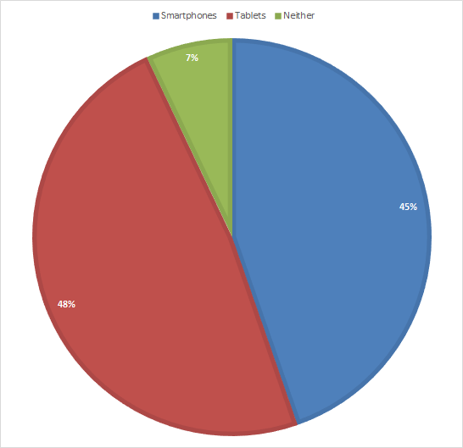
Survey Results
If you own any of the following mobile devices, which would you be most likely to use to take an online course?

Slide 29
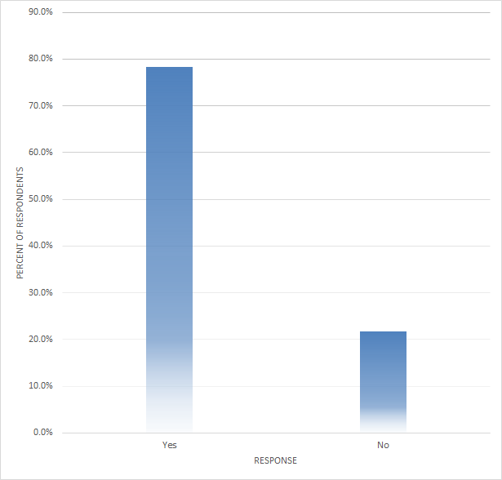
Survey Results
Would being able to save course materials increase your usage?

Slide 30
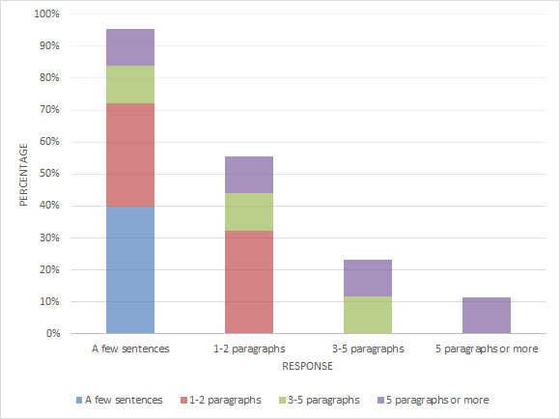
Survey Results
How much text would you enter for an assignment?

Slide 31
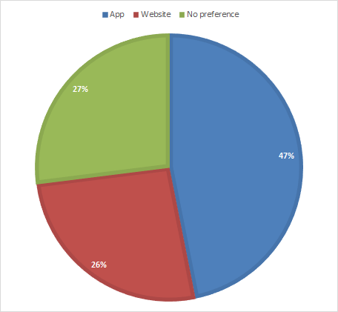
Survey Results
In general, do you prefer using a standalone app or a website (e.g. Facebook’s app or mobile website)?

Slide 32
Survey Design and Questions
Question categories
  Device preferences & technology concerns
  Subject history with online courses
    How many online courses have to taken or are you currently enrolled in?
    Have you used your mobile device to support coursework you did in an online or traditional course? (i.e. checking the course website, watching lectures, checking grades, etc.)
  Feature expectations
  Lecture medium preferences

Slide 33
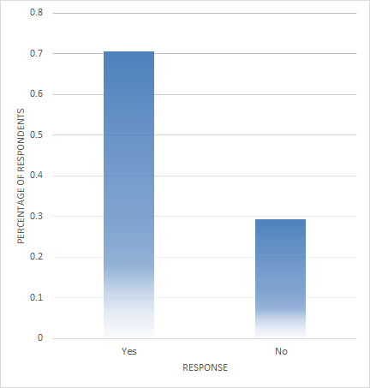
Survey Results
Have you used your mobile device to support coursework you did in an online or traditional course (e.g. checking the course website, watching lectures, checking grades, etc.)?

Slide 34
Survey Design and Questions
Question categories
  Device preferences & technology concerns
  Subject history with online courses
  Feature expectations
    View syllabus? Required reading?
    Post in discussion? Chat in real-time?
    5-point interval scale: allows relative comparison and calculation of mean, standard deviation
  Lecture medium preferences

Slide 35
Survey Design and Questions
Question categories
  Device preferences & technology concerns
  Subject history with online courses
  Feature expectations
  Lecture medium preferences
    Slides only?
    Video?
    Audio from lecture?

Slide 36
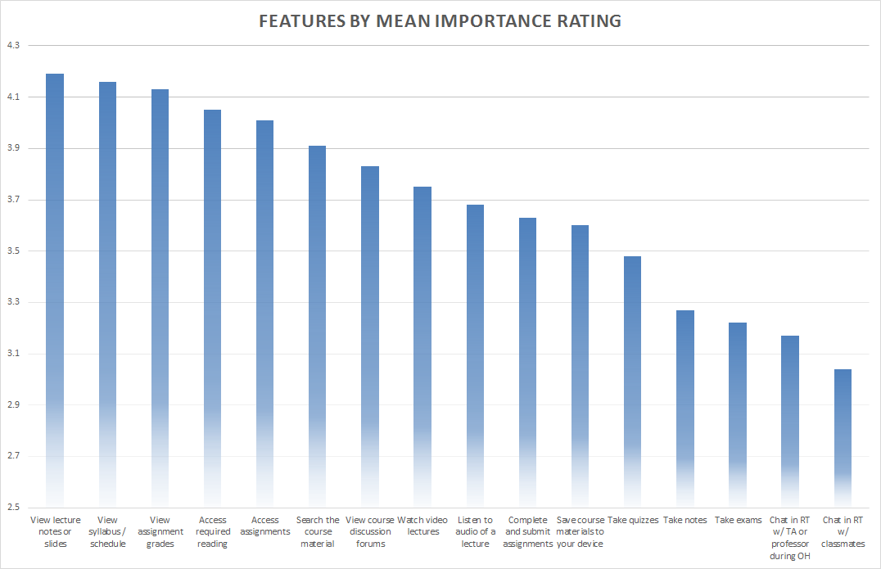
Survey Results

Slide 37
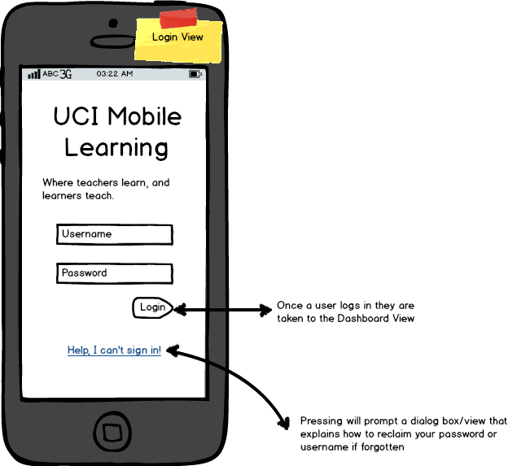
Design and Wireframing
Mobile Learning Project
Mobile Learning Project
Mobile Learning

Slide 38
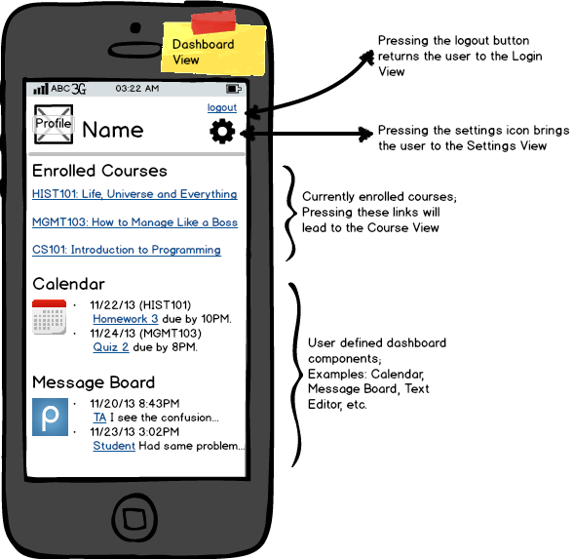
Design and Wireframing
Mobile Learning Project
Mobile Learning Project
Mobile Learning

Slide 39
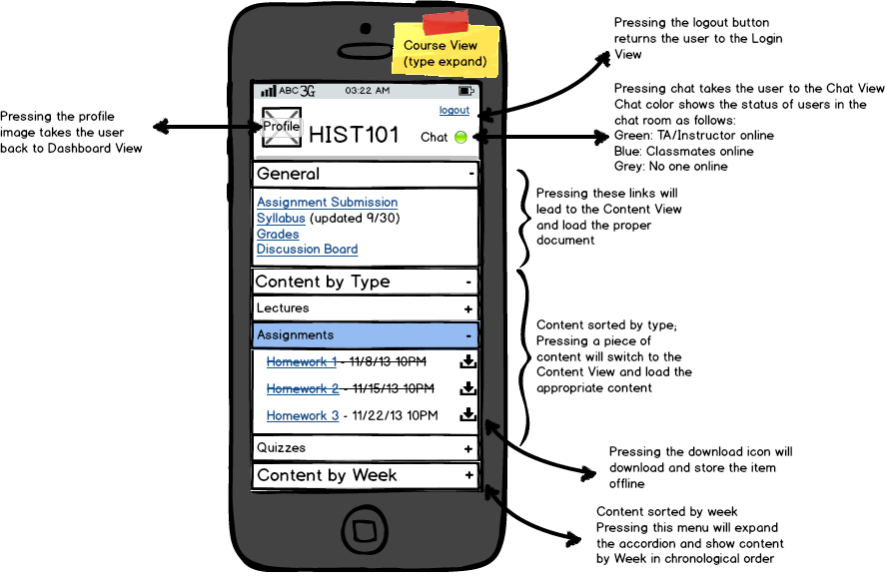
Design and Wireframing
Mobile Learning Project
Mobile Learning Project
Mobile Learning

Slide 40
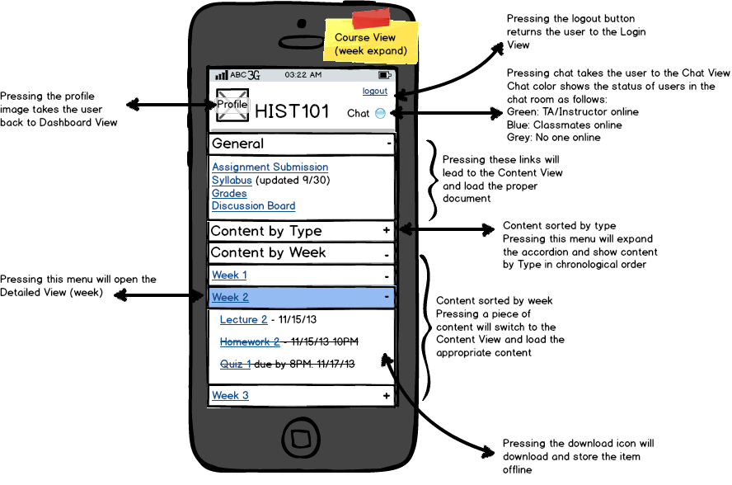
Design and Wireframing
Mobile Learning Project
Mobile Learning Project
Mobile Learning

Slide 41
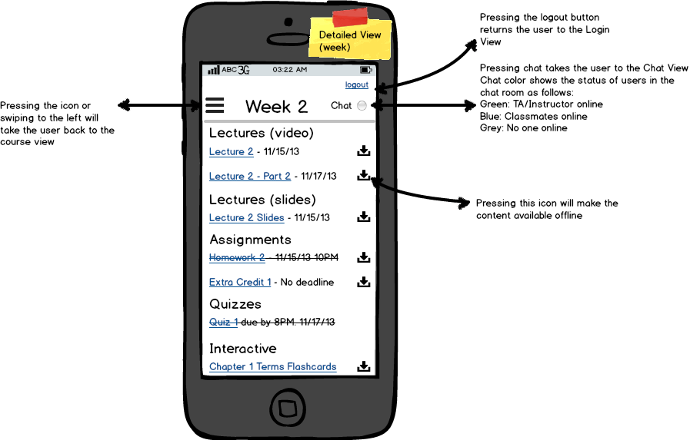
Design and Wireframing
Mobile Learning Project
Mobile Learning Project
Mobile Learning

Slide 42
Upcoming Milestones
next 2 weeks
Interactive design
Ipad design
Focus groups
Changes in wireframes
Report
Focused-group group -
Jonathan M, Andrew M, Namrata P, Kristin R, Rohan A, Christina R, Shriti R

