Slide 1
CAM: Constraint-aware Application Mapping for Embedded Systems
Luis A. Bathen, Nikil D. Dutt

Slide 2
Outline
Introduction & Motivation
CAM Overview
Memory-aware Macro-Pipelining
Customized Security Policy Generation
Related Work
Conclusion

Slide 3
Outline
Introduction & Motivation
CAM Overview
Memory-aware Macro-Pipelining
Customized Security Policy Generation
Related Work
Conclusion

Slide 4
Software/Hardware Co-Design
Given an existing applications, designers can
Design a customized platform
Dedicated logic
Custom memory hierarchy / communication architecture
Take an existing platform and efficiently map the application on it
Data allocation and Task mapping
Start with an existing platform and customize it to satisfy the requirements
Add custom blocks, and reuse components
Application
Mapping
Process
In this presentation we will focus on the application mapping process on CMPs
CPU1 Core
CPU2 Core
CPUn Core
CMP
Off-chip memory
Controller/
Scheduler
CMP
Off-chip memory
CPU1 Core
CPU2 Core
CPUn Core
DMA
CPU1 Core
B
A
CMP
Off-chip memory
SPM1
CPU2 Core
CPUn Core
DMA
SPM2
SPMn
SPM1
SPM2
DC_LS, MCT, …
DMA
Data
Collector
Data
FIFO
BPC/BAC
Data
FIFO
Data
Dispatcher
DWT w/iDMA
SPMn
CPU
Data
FIFO
BPC/BAC
Data
FIFO
SPM1
SPM2
SPMn
Tier2
Data
FIFO
BPC/BAC
Data
FIFO
AMBA 2.0
DWT w/iDMA
Data
Dispatcher
Data
FIFO
BPC/BAC
Data
FIFO
Data
Collector
DWT w/iDMA
Data
Dispatcher
Data
FIFO
Data
FIFO
BPC/BAC
Data
FIFO
BPC/BAC
Data
FIFO
Data
Collector
Image/
Bitstream
Data
FIFO
BPC/BAC
Data
FIFO
Data
FIFO
Data
FIFO
BPC/BAC
Data
FIFO
BPC/BAC
Data
FIFO
A
B
A
B
Controller/
Scheduler

Slide 5
Target Platforms (Chip Multiprocessors)
Multiple low power RISC cores
Well suited for applications with high levels of parallelism
CPU
CPU
DMA and SPM Support
I$
SPM
I$
SPM
DMA
I$
SPM
I$
SPM
RAM
CPU
CPU
Bus based systems – still most commonly used
Notes:
CMPs can have both spms and caches, with more complex memory hierarchies

Slide 6
Motivation
Typical Mapping Process
T1
CMP
Off-chip memory
CPU1 Core
CPU2 Core
C/C++
Platform Definition
DMA
SPM1
SPM2
e.g. iteration partitioning, unrolling, tiling…
Apply loop optimizations
T2.1
T2.2
Generate input task graph to scheduler
T1
T3
T4
Define Task Mapping and Schedule
What do we care about? energy, performance?
T2
CPU1
T1
T2.1
T3
T5
The whole process depends on the available resources
CPU2
T2.2
T4
T5
T3
T4
Task 1 Data Sets
Task 2.1 Data Sets
Task 3 Data Sets
Define Data Placement
Time
T5
Task 2.2 Data Sets
Size
Simulate/Verify
ISS, CMP ISS?

Slide 7
Motivation (Cont.)
CPU1 Core
CPU2 Core
CPUn Core
CMP
Off-chip memory
DMA
Platform Definition
SPM1
SPM2
SPMn
Apply loop optimizations
T1
T4f
T5
T3
This dependence shows the need to evaluate different optimizations, schedules, placements for power and performance in a quick yet accurate fashion
Define Task Mapping and Schedule
CPU1
T1
T2.1
T3
T5
CPU2
T2.2
T4
CPU3
T2.3
CPU4
T2.4
Define Data Placement
Time
Size
Simulate/Verify

Slide 8
Outline
Introduction & Motivation
CAM Overview
Memory-aware Macro-Pipelining
Customized Security Policy Generation
Related Work
Conclusion

Slide 9
CAM: Constraint-aware Application Mapping for Embedded Systems
Efficiently utilize memory resources
Voltage/Frequency scaling affect performance
Limits type of security mechanisms
Power
Data partitioning and distribution
Performance
Task/kernel partitioning
Security
Policy Generation
Macro-pipelining
Data reuse
Memory-aware Scheduling
Selective Enforcement
Early Execution Edges
Very secure might mean very power hungry/slow
Limited multiprocessor support
Solutions are generic
Application
C/C++
Data Placement/Schedule/Policies
Fully utilize compute resources
Increased Parallelism
Increased vulnerabilities

Slide 10
CAM Overview
Front End
Middle End
Application Pre-processing
(CFG extraction, task graph generation, input model generation)
Define CMP
Template
CPU1 Core
CPU2 Core
CPUn Core
CMP
Off-chip memory
DMA
SPM1
SPM2
SPMn
Task Decomposition
End up with massive task graphs
Nope, let’s see if increasing degree of unrolling (in loops) helps, tile size?
C1
K2
K3
Task1
Data Reuse Analysis
Task Graph Augmentation
Early Execution Edge Generation
Task2
C4
K5
C6
Memory-Aware Macro-Pipelining
Back End
Very tightly coupled process!
CPU1
C1
K2
Meet Energy and Performance Constraints?
CPU2
C6
K3
Performance
Model
Generation
CPU3
C4
K5
SPM1
K2D
K3D
CPU1 Core
CPU2 Core
CPUn Core
CMP
Off-chip memory
CPU1 Core
CPU2 Core
CPUn Core
CMP
Off-chip memory
SPM1
SPM2
SPMn
DMA
CMP
Off-chip memory
SPM2
K5D
CPU1 Core
CPU2 Core
CPUn Core
DMA
SPM1
SPM2
SPMn
DMA
SPM1
SPM2
SPMn

Slide 11
Outline
Introduction & Motivation
CAM Overview
Memory-aware Macro-Pipelining
ESTImedia ‘08, ’09
Customized Security Policy Generation
Related Work
Conclusion

Slide 12
Application Domain Example (JPEG2000)
Supports multiple levels
of data parallelism
Task Set (T)
t₁
t₂
t_{n}
t₁
DWT
Quant.
EBCOT
t₂
DWT
Quant.
EBCOT
t₃
DWT
Quant.
EBCOT
t_{m}
t_{mn}
t_{mn}
DWT
Quant.
EBCOT

Slide 13
Inter-kernel Reuse Opportunities
We target our approach to data intensive
streaming applications
Task level parallelism, Data level parallelism
Examples
Macroblock level (H.264)
Component level, Tile level, Code block level (JPEG2000)
Inter-kernel data reuse opportunities are often ignored
Cache based systems are not suitable to meet these types of applications
void dcls()
{
// input: B,G, R
// output: B,G, R
for ( i = 0; i < width; i++) {
for ( j = 0; j < height; j++) {
B[i][j] = B[i][j]
- pow(2, info->siz - 1);
G[i][j] = B[i][j]
- pow(2, info->siz - 1);
R[i][j] = B[i][j]
- pow(2, info->siz - 1);
}
}
}
void mct()
{
// input: B,G, R
// output: Yr, Ur, Vr
for ( i = 0; i < width; i++) {
for ( j = 0; j < height; j++) {
Yr[i][j] =
ceil((float)(R[i][j] + (2*(G[i][j])) +
B[i][j])/4);
Ur[i][j] = B[i][j] - G[i][j];
Vr[i][j] = R[i][j] - G[i][j];
}
}
}
void tiling()
{
// input: Yr, Ur, Vr
// output: n x tY, tV, tU
for( i=0; i<m; i+=tw) {
for( j=0; j<n; j+=th) {
for( k=0; k<tw; k++) {
for( l=0; l<th; l++) {
tY[k][l] = Yr[i+k][j+l];
tU[k][l] = Ur[i+k][j+l];
tV[k][l] = Vr[i+k][j+l];
}
}
yCoeff=dwt(tY);
yQ=quant(yCoeff);
ebcot(yQ);
………………
……………...
Notes:
Standard approaches look only at intra reuse, disregarding inter-kernel reuse opportunities, here data is propagated through a series of kernels.

Slide 14
Access Patterns and Data Requirements
Our proposal: Take kernels that produce large data streams and decompose them into smaller kernels producing smaller data streams
Address
Iteration
The Problem:
Data is read in, and written out by each task. Cannot keep ALL data in SPM, and pass it to the next task.
Task/Kernel Data Requirements:
DCLS: Consumption=Production=3MB
MCT: Same as DCLS, 3MB
Tiling:
Consumption = same as MCT, Production: 3 tiles at a time, 128x128 pixels (16KB), total of 16 x 3 tiles

Slide 15
Task Decomposition Through Transformations
Idea:
Decompose each task into a series of kernels and compute nodes (non-kernels)
Each kernel will ideally operate over a smaller set of data than the task itself
No dependence between array accesses B and R
Can perform loop fission
void dcls()
{
// input: B,G, R
// output: B,G, R
for ( i = 0; i < width; i++) {
for ( j = 0; j < height; j++) {
B[i][j] = B[i][j]
- pow(2, info->siz - 1);
G[i][j] = B[i][j]
- pow(2, info->siz - 1);
R[i][j] = B[i][j]
- pow(2, info->siz - 1);
}
}
}
void dcls()
{
for ( i = 0; i < width; i++) {
for ( j = 0; j < height; j++) {
B[i][j] = B[i][j]
- pow(2, info->siz - 1); }
}
for ( i = 0; i < width; i++) {
for ( j = 0; j < height; j++) {
G[i][j] = B[i][j]
- pow(2, info->siz - 1);
}
}
for ( i = 0; i < width; i++) {
for ( j = 0; j < height; j++) {
R[i][j] = B[i][j]
- pow(2, info->siz - 1);
}
}
}
void dcls()
{
for( ii=0; ii<m; ii+=tw) {
for( jj=0; jj<n; jj+=th) {
for( i=ii; i<min(m, ii+tw); i++) {
for( j=jj+i; j<min(n+i, jj+th+i); j++) {
B[i][j-i] = B[i][j-i]
- pow(2, info->siz - 1);
}
}
}
….
….
…
}
Want to tightly couple the computation with the data
Can tile the loops and generate smaller computational kernels
Each kernel consumes and produces chunks (tiles) of the different image components.
Notes:
Idea is to use code transformations to reduce the amount of computation per data sets, in order to maximize parallelism and reuse opportunities

Slide 16
Inter-task/inter-kernel Dependencies
Inter-Task/Inter-Kernel Dependencies
void mct_tiled()
{
for( ii=0; ii<m; ii+=tw) {
for( jj=0; jj<n; jj+=th) {
for( i=ii; i<min(m, ii+tw); i++) {
for( j=jj+i; j<min(n+i, jj+th+i); j++) {
Yr[i][j-i] =
ceil((float)(R[i][j-i] +
(2*(G[i][j-i])) +
B[i][j-i])/4);
for( ii=0; ii<m; ii+=tw) {
for( jj=0; jj<n; jj+=th) {
for( i=ii; i<min(m, ii+tw); i++) {
for( j=jj+i; j<min(n+i, jj+th+i); j++) {
Ur[i][j-i] =
B[i][j-i] -
G[i][j-i];
for( ii=0; ii<m; ii+=tw) {
for( jj=0; jj<n; jj+=th) {
for( i=ii; i<min(m, ii+tw); i++) {
for( j=jj+i; j<min(n+i, jj+th+i); j++) {
Vr[i][j-i] =
R[i][j-i] -
G[i][j-i];
}
void dcls_tiled()
{
for( ii=0; ii<m; ii+=tw) {
for( jj=0; jj<n; jj+=th) {
for( i=ii; i<min(m, ii+tw); i++) {
for( j=jj+i; j<min(n+i, jj+th+i); j++) {
B[i][j-i] = B[i][j-i]
- pow(2, info->siz - 1);
for( ii=0; ii<m; ii+=tw) {
for( jj=0; jj<n; jj+=th) {
for( i=ii; i<min(m, ii+tw); i++) {
for( j=jj+i; j<min(n+i, jj+th+i); j++) {
R[i][j-i] = R[i][j-i]
- pow(2, info->siz - 1);
for( ii=0; ii<m; ii+=tw) {
for( jj=0; jj<n; jj+=th) {
for( i=ii; i<min(m, ii+tw); i++) {
for( j=jj+i; j<min(n+i, jj+th+i); j++) {
G[i][j-i] = G[i][j-i]
- pow(2, info->siz - 1);
}
K4
K1
Known
Task
Dep.
K2
K5
K3
K6

Slide 17
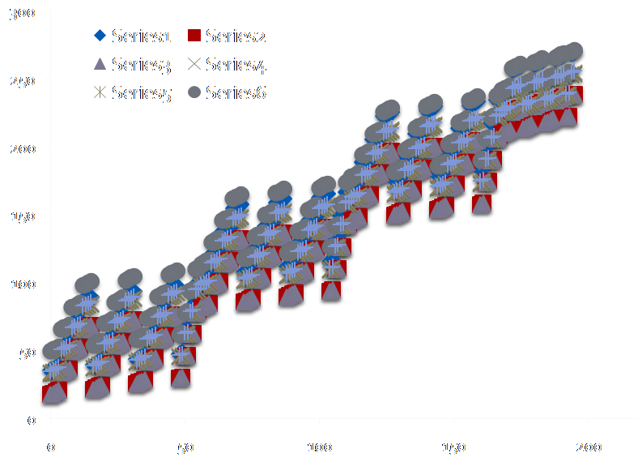
Early Execution Edges Generation and Exploitation
Kernel K1
Kernel K2
Higher Throughput and better memory utilization!
Kernel k2a, can start as soon as its dependencies (Kernel iterations K1a, K1b, K1c finish their execution)
K1
K2
K1
K2
Original Task Graph and Schedule
K1d
K1n
K1c
K2b
K1a
K1d
K1g
K2m
K1b
K1e
K1b
K1c
K1f
K1d
K2c
K2a
K2b
K1c
K2a
K1a
K2b
K1b
CAM’s Augmented Task Graph and Pipelined Kernels
K1a
K2a
Notes:
From the dependence analysis, we can generate a new task graph with a lower level of granularity (from the original task level)

Slide 18
Tradeoff between power and performance
Cost function (power/performance) affect total latency
Need to efficiently walk the search space for the right power/performance combination
Cost function (power/performance) affect off-chip accesses

Slide 19
Exploration Search Space
Each data point represents a configuration considered (pipelined tasks/degree of unrolling, SPM size, number of CPUs)
Performance in billions of cycles
The closer to the center of the spectrum the better the proposed solution on the given platform
In order to find the best solution possible we need a good cost function to differentiate between good and bad candidates
Lines: # of CPUs for the given configuration
Data Point (Axis): Size of SPM and tasks considered for the given configuration
Notes:
Shows the search space, for different data points. Each point represents a tripled <number of tasks pipelined, SPM size, and number of CPUs)

Slide 20
Outline
Introduction & Motivation
CAM Overview
Memory-aware Macro-Pipelining
Customized Security Policy Generation
Embedded Systems Security ‘10
Related Work
Conclusion

Slide 21
Secure Software Execution on Chip-Multiprocessors
Many tasks/applications
Many Cores
Task C
Task D
t1
t2
t1
t2
CPUi
Core
CMP
CPU1 Core
CPU2 Core
CPUn Core
DMA
Many Shared resources
SPM1
SPM2
SPMi
SPMn
Many Memories
CMPs allow applications to run concurrently
Parallelism within applications
Need to run a trusted application (many tasks)
Possible spy processes running in a separate core
Compromised tasks from the same application
Off-chip memory
Notes:
Describe target platform… multiprocessor systems

Slide 22
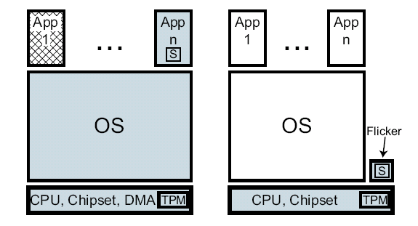
Current Approaches to Guarantee Secure Software Execution
Problems
Trusted execution environment
Side-channel attacks are possible in CMP systems
Through resource sharing
Software exploits leverage use of C legacy code
Most current secure platforms assume single processor models
TPM based models
Example: Flicker Secure Execution Model
eliminate resource sharing during execution of sensible code
Need a means to provide a trusted environment for secure execution without sacrificing performance and power
Context switch, halt and, build trusted environment
Not power efficient, not performance efficient, but secure

Slide 23
Creating a Trusted Environment Through Selective Resource Sandboxing
t1
t2
Task C
Task D
CPUi
Core
CMP
CPU1 Core
CPU2 Core
CPUn Core
SPM1
SPM2
SPMi
SPMn
DMA
Off-chip memory
100
200
300
400
500
600
700
800
900
CPU0
T1 (250)/CX: 25
Task | Traditional Halt Delay (ms)
T1 | 550
T2 | 575
T3 | 550
T4 | 500
DRM | 125
AVG | 460
Task | Sandboxing Delay (ms)
T1 | 150
T2 | 250
T3 | 0
T4 | 0
DRM | 50
AVG | 90 ms
CPU1
T2 (150)/CX: 50
CPU2
T3 (250)/CX: 75
CPU3
T4 (175)/CX: 50
DRM (450)/CX: 100
HALT Approach
CPU0
T1 (250)/CX: 25
T1
CPU1
T2 (150)/CX: 50
DRM (450)/CX: 100
T2
CPU2
T3 (250)/CX: 75
Context switch tasks with minimum CX penalty
T3
Load Policy P
CPU3
T4 (175)/CX: 50
T4
CPU0
Trusted Environment (LOCKDOWN)
T1 (250)/C: 25
DRM (450)/CX: 100
CPU1
T2 (150)/CX: 50
CPU2
Untrusted Environment
T3 (250)/CX: 75
CPU3
T4 (175)/CX: 50
T1
T2

Slide 24
CAM: Security as a constraint
Front End
Middle End
Application Pre-processing
(CFG extraction, task graph generation, input model generation)
Define CMP
Template
Goal: Customize security policies for different system requirements (energy savings, performance, limited CPU/Memory resources)
Nope, let us generate a policy using more/less resources – re-define CMP
CPU1 Core
CPU2 Core
CPUn Core
CMP
Off-chip memory
Done creating policies given power/performance requirements?
DMA
Task Decomposition
SPM1
SPM2
SPMn
Data Reuse
unsec
buf1
sec local buf2.1
Early Execution Edge Generation
Task1
C1
K2
K3
Nope, let’s see if increasing degree of unrolling (in loops) helps, tile size?
t1
t2
Task Graph Augmentation
Security Requirements
sec shared
Buf2.2
sec local var
Task2
C4
K5
C6
Secure Policy Generation
(Schedule + Mapping)
Back End
CPU1
C1
K2
Performance
Model
Generation
Policy 1
Policy 2
Policy 3
P1
P1
P2
P1
P2
P3
P4
CPU2
C6
K3
M1
M2
M1
M2
M1
M2
Meet Energy and Power Constraints?
CPU3
C4
K5
Latency
Latency
Latency
SPM1
K2D
K3D
Power
Power
Power
CPU1 Core
CPU2 Core
CPUn Core
CMP
Off-chip memory
CPU1 Core
CPU2 Core
CPUn Core
CMP
Off-chip memory
SPM1
SPM2
SPMn
DMA
CMP
Off-chip memory
SPM2
K5D
CPU1 Core
CPU2 Core
CPUn Core
DMA
SPM1
SPM2
SPMn
DMA
SPM1
SPM2
SPMn

Slide 25
Policy Enforcement through On-chip Sandboxing
Initial Queue
Initial Load
Executing A₁ : Policy 2
A₃
A₂
A₁
μP
μP
μP
μP
μP
μP
μP
μP
μP
μP
μP
μP
μP
μP
μP
μP
Exec
Exec
Exec
m
m
m
m
m
m
m
m
m
m
m
m
m
m
m
m
Executing A₂ : Policy 2
A₃
A₂
A₁
μP
μP
μP
μP
μP
μP
μP
μP
Policy 1
Policy 1
Policy 2
Policy 3
Policy 1
Policy 2
Policy 3
P1
P1
Policy 2
Policy 3
P1
P1
P2
P4
P1
P1
P2
P1
P2
P3
P4
P1
P2
P1
P2
P3
P2
P1
P2
P3
m
m
m
m
m
m
m
m
M1
M2
M1
M3
M1
M2
M1
M1
M2
M1
M2
M1
M2
M1
M1
M2
M2
Latency
Latency
Executing A₃ : Policy 1
Latency
Latency
Latency
Latency
Latency
Latency
Power
Latency
Power
Power
Power
Power
Power
Power
Power
Power
μP
μP
μP
μP
μP
μP
μP
μP
Policy Selection | High Load | Low Load
On Battery | Policy 1 | Policy 1 /Policy 2
On Power Cord | Policy 2 | Policy 3
m
m
m
m
m
m
m
m

Slide 26
Performance Effects of PoliMakE
Exploration allows us to find right level of sharing and resource partition
No further significant improvement is found after 4 core CMP
After 4 CPUs (2 and 2), performance is not improved as much
Compared to halt approach, PoliMakE can drastically improve performance

Slide 27
Outline
Introduction & Motivation
CAM Overview
Memory-aware Macro-Pipelining
Customized Security Policy Generation
Related Work
Conclusion

Slide 28
Related Work
Data Allocation
Data Reuse Analysis Technique for Software-Controlled Memory Hierarchies [Issein DATE ‘04]
Multiprocessor System-on-Chip Data Reuse Analysis for Exploring Customized Memory Hierarchies [Issenin DAC ‘06]
Memory Coloring: DWT Compiler Approach for Scratchpad Memory Management [Li et al. PACT ‘05]
Efficient Utilization of Scratch-Pad Memory in Embedded Processor Applications [Panda DATE ‘97]
Loop Scheduling
Loop Scheduling with Complete Memory Latency Hiding on Multi-core Architecture [C. Xue ICPADS ’04]
SPM Conscious Loop Scheduling for Embedded Chip Multiprocessors [L. Xue ICPADS ‘06]
Pipelining/Scheduling Heuristics
Integrated Scratchpad Memory Optimization and Task Scheduling for MPSoC Architectures, [V. Suhendra et al . CASES ‘06].
Pipelined Data Parallel Task Mapping/Scheduling Technique for MPSoC [Yang, H. et al., DATE 09]
Exploiting Coarse-grained Task, Data, and Pipeline Parallelism in Stream Programs, [Gordon et al. ASPLOS ‘06]
We exploit the application’s inter/intra kernel data reuse opportunities to minimize data transfers thereby reducing dynamic power consumption
We exploit the application’s parallelism, pipelining, and data-reuse opportunities by applying different source level transformations
Distribute computations with the ultimate goal of reducing unnecessary data transfers and increasing throughput
Notes:
Suhendra et al. [7] propose an ILP formulation that combines task scheduling, SPM partitioning, and data allocation. They show that by combining task scheduling and data placement into a single problem, they can achieve high gains in performance. Szymanek et al. [36] proposed a constructive memory aware scheduling algorithm that builds a schedule around the critical path and progressively schedules tasks in order to balance the memory utilization across processors.

Slide 29
Related Work (Cont.)
Pure software solutions (complementary)
CCured [24], StackGuard [10], Smashguard [25, Pointguard [26]
Hardware Assisted
Patel et al. [27], Zambreno et al. [28], Arora et al. [30]
Platforms (complementary)
ARM TrustZone [33], SECA [8], AEGIS [31]
Halt/Execute
Flickr
Isolation
IBM CELL Vault, Agarwal et al. [12]
Can be complimentary but no side channel protection
To the best of our knowledge, we are the first to propose the idea of customized policy making to guarantee secure software execution for CMPs
Full platform support for secure software execution might be an overkill in cases security is limited to only a few applications
No energy/performance awareness nor a means to map an application to the platform (left to programmer)
Current isolation approaches do not offer efficient (power/performance) means to run applications on multiprocessors

Slide 30
Outline
Introduction & Motivation
CAM Overview
Memory-aware Macro-Pipelining
Customized Security Policy Generation
Related Work
Conclusion

Slide 31
Conclusion
Discussed CAM, a software mapping and scheduling methodology for multimedia and data intensive applications
Progressively transforms the application’s code to discover and exploit
Inter-kernel data reuse
Parallelism opportunities
Tightly couple transformations, with data reuse analysis, scheduling and mapping
Tightly couple computation with its data
Explores, generates and exploits customized policy making to guarantee secure software execution
Current enhancements include
Reliability awareness
Move towards heterogeneous MPSoCs and CGRAs

Slide 32
Thank you!

Slide 33
Power and Performance Improvements over Standard CMP Application Mapping Approaches
Clustering helps reduce number of unnecessary memory transfers as well as improve troughput
In some cases clustering hurts performance
(i.e. 8CPU with 4KB SPMs config.)
There are cases where clustering may lead to less power reduction
(i.e. 4CPU with 32KB SPMs config)
Y-axis: Improvement Percentage
X-axis: Platform Configuration – SPM Size by # CPUs
Notes:
Less power savings are often due to the fact that the clustered kernels limit the data mapping opportunities during exploration steps

Slide 34
Memory-aware scheduling and Early Execution Edge Exploitation
Progressive comparison
Base case
Task partitioning
Early Execution + Task Partitioning
Memory Aware Scheduling
Standard with base case – initial task graph
A
B
C
i
Standard with task partitioning
A
B1
B3
C1
C3
B2
B4
C2
C4
Our approach provides:
Higher throughput
Load balancing
Savings in off-chip memory transfers
After analyzing when tasks can start (early execution edges)
A
B1
C1
C3
B3
B2
B4
C2
C4
Memory aware task scheduling
A
B2
C2
B4
C4
B1
C1
B3
C3
Progressive Performance Improvement

Slide 35
Early Execution Edges
Data is
propagated
through
a series of
filters
HL₁
HL₁
Inter-task
reuse
LL₂
HL₂
HL₁
LL₂
HL₂
HL₁
LH₂
HH₂
LH₂
HH₂
LH₁
LH₁
LH₁
HH₁
LH₁
HH₁
DWT
Quant.
DWT
Quant.
EBCOT
Procedure to obtain early execution edges:
- Obtain list of independent data sets (HH1, etc.)
- Calculate the live range for each data set
- Find split points for tasks and split them
Question:
- What can we do to
improve throughput?
Augmented
task-graph
Quantization operates over
Individual subbands
(HH1, HH2, etc.)
EBCOT operates over
codeblocks from
the same subband
<0, declevel, 3>
Quant. 1
DWT
Quantization2 can
start after DWT produces
subbands LH₁ and HH₁
Standard Approach
Quantization 1
Quant. 2
HL₁
LL₂
HL₂
HL₁
<0, declevel, 1>
Quantization
LL₂
HL₂
LH₂
HH₂
LH₂
HH₂
LH₁
HH₁
Early Execution Edges
Quantization 2
HL₁
<0, declevel, 3>
Quant. 1
LL₂
HL₂
HL₁
LH₁
HH₁
LL₂
HL₂
LH₂
HH₂
Live ranges of HH1,LH1,
and HL1 are up after the
first decomposition level
LH₂
HH₂
Quantization waits for
DWT to finish
LH₁
HH₁
Quant. 2
LH₁
HH₁
<0, declevel, 1>
Quantization can be split
Notes:
Similar to loop based iteration space partitioning

Slide 36
Performance Model Generation and Evaluation
instr | cycle | min_power | max_power | ave_power | switching power
XORI | 4 | 2.48E-03 | 3.66E-03 | 3.07E-03 | 7.19E-04
MULI | 7 | 4.49E-03 | 8.07E-03 | 6.28E-03 | 2.16E-03
MFSPR | 4 | 2.51E-03 | 2.56E-03 | 2.54E-03 | 1.83E-04
CPU LUTs
a=a+3;
#if PERF_MOD
wait(ADD);
#endif
cycles+=ADD;
#if POWER_MOD
uW+=P_ADD;
#endif
if(a<b) {
#if PERF_MOD
wait(SLT+BNE+J);
#endif
cycles+=SLT+BNE+J;
#if POWER_MOD
uW +=P_SLT+P_BNE+P_J;
#endif
d=A[a];
#if PERF_MOD
wait(LW);
#endif
cycles+=LW;
#if POWER_MOD
uW+=P_LW;
#endif
}
Platform DB
Annotated Model
a=a+3;
#if PERF_MOD
wait(ADD);
#endif
cycles+=ADD;
#if POWER_MOD
uW+=P_ADD;
#endif
…………….
Annotated Model
a=a+3;
#if PERF_MOD
wait(ADD);
#endif
cycles+=ADD;
#if POWER_MOD
uW+=P_ADD;
#endif
…………….
Annotated Model
a=a+3;
#if PERF_MOD
wait(ADD);
#endif
cycles+=ADD;
#if POWER_MOD
uW+=P_ADD;
#endif
…………….
GCC &
Annotation
SystemC
Model Generator
Functional Model
a=a+3;
if(a<b) {
d=A[a];
}
Mapping
Info
CPU
CPU
ISS – Initial Profile
Schedule
Info
SystemC
I$
D$
I$
D$

Slide 37
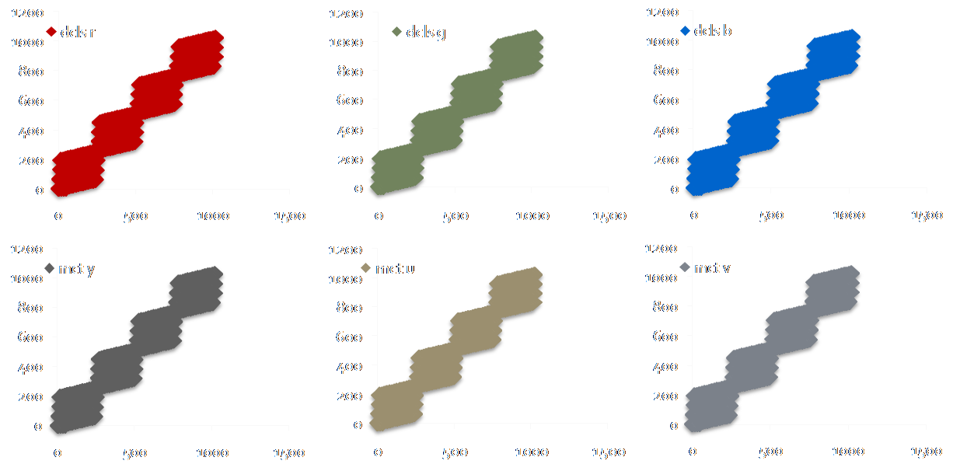
Finding Right Degree of Unrolling
Fully unrolling the execution of each tile can generate maximum amount of parallelism opportunities
Both cases can increase/decrease performance, so we need to explore the design space to find the right combinations (Pareto)
Second case provides less parallelism as well as decreased dependencies
Notes:
Increased parallelism, more inter-kernel reuse opportunities, more dependencies and possible stall cycles due to them

Slide 38
Memory Aware Scheduling and Pipelining
Allows for further
optimizations
Standard task scheduling
P0
P1
DWT
Q1
Q3
EBCOT1
EBCOT3
DWT
Q1
Q3
EBCOT1
EBCOT3
Q2
Q4
EBCOT2
EBCOT4
Q2
Q4
EBCOT2
EBCOT4
After analyzing when tasks can start (early execution edges)
Increases
throughput
P0
P1
DWT
Q1
EBCOT1
EBCOT3
DWT
Q1
EBCOT1
EBCOT3
Q3
Q2
Q4
EBCOT2
EBCOT4
Q3
Q2
Q4
EBCOT2
EBCOT4
Memory aware task scheduling
Minimize Off-chip memory accesses and DMA transfers
P0
P1
DWT
Q2
EBCOT2
Q4
EBCOT4
Q1
EBCOT1
Q3
EBCOT3
Software pipelining (Pipelining with Unrolling and Memory Awareness)
Increased throughput
and reduced memory
transfers
P0
P1
DWT
Q2
EBCOT2
Q4
EBCOT4
Q1
EBCOT1
Q3
EBCOT3
steady state
Notes:
Small boxes represent communication costs due to memory transfers between tasks, idea is that when tasks are scheduled to a given CPU the mapping is done in order to minimize unecessary data transfers (reduce the number of transfers – small rectangular boxes)

Slide 39
Pipelining Considering Unrolling
We need to explore different schedules/mappings in
order to find out the right unrolling/scheduling
combinations (software pipelining)
Scheduling 1 task set at a time (Unrolling degree of 1)
Too many idle slots
P0
P1
P2
DWT
DWT
DWT
DWT
DWT
DWT
DWT
DWT
Q2
Q2
EBCOT2
EBCOT2
Q2
Q2
EBCOT2
EBCOT2
Q2
Q2
EBCOT2
EBCOT2
Q2
Q2
EBCOT2
EBCOT2
Q1
Q1
EBCOT1
EBCOT1
Q1
Q1
EBCOT1
EBCOT1
Q1
Q1
EBCOT1
EBCOT1
Q1
Q1
EBCOT1
EBCOT1
A more compact schedule
(P2 has longer idle slots)
Scheduling 2 task sets at a time (Unrolling degree of 2)
P0
P1
P2
DWT
DWT
Q1
Q1
EBCOT1
EBCOT1
DWT
DWT
Q1
Q1
EBCOT1
EBCOT1
DWT
DWT
Q1
Q1
EBCOT1
EBCOT1
DWT
DWT
Q1
Q1
EBCOT1
EBCOT1
Q2
Q2
EBCOT2
EBCOT2
Q2
Q2
Q2
Q2
EBCOT2
EBCOT2
Q2
Q2
EBCOT2
EBCOT2
Worst performance
and more idle slots
than scheduling 2 tasks
Scheduling 3 task sets at a time (Unrolling degree of 3)
P0
P1
P2
DWT
39
DWT
Q1
Q1
EBCOT1
EBCOT1
Q2
Q2
EBCOT2
EBCOT2
DWT
DWT
Q1
Q1
EBCOT1
EBCOT1
DWT
DWT
Q1
Q1
EBCOT1
EBCOT1
Q2
Q2
EBCOT2
EBCOT2
Q2
Q2
EBCOT2
EBCOT2
DWT
DWT
Q1
Q1
EBCOT1
EBCOT1
Q2
Q2
EBCOT2
EBCOT2
If the mapping is not schedulable within MII,
retiming is done for all possible tasks
Scheduling 4 task sets at a time (Unrolling degree of 4)
P0
P1
P2
DWT
DWT
Q2
EBCOT2
Q1
EBCOT1
DWT
Q1
EBCOT1
Q1
EBCOT1
Q2
EBCOT2
DWT
Q1
EBCOT1
Q2
EBCOT2
Q2
EBCOT2

Slide 40
Policy Generation Runtime
Even if number of task increases by 14x, policy generation runtime is less than 2x

