Slide 1
PoliMakE: A Policy Making Engine for Secure Embedded Software Execution on Chip-Multiprocessors
Luis A. Bathen, Nikil Dutt

Slide 2
Outline
Introduction and Attack Models
PoliMakE Overview
Software Driven Policy Making
PoliMakE Driven On-chip Sandboxing
Related Work
Experimental Results
Concluding Remarks

Slide 3
Outline
Introduction and Attack Models
PoliMakE Overview
Software Driven Policy Making
PoliMakE Driven On-chip Sandboxing
Related Work
Experimental Results
Concluding Remarks

Slide 4
Secure Software Execution on Chip-Multiprocessors
Many tasks/applications
Many Cores
Task C
Task D
t1
t2
t1
t2
CPUi
Core
CMP
CPU1 Core
CPU2 Core
CPUn Core
DMA
Many Shared resources
SPM1
SPM2
SPMi
SPMn
Many Memories
CMPs allow applications to run concurrently
Parallelism within applications
Need to run a trusted application (many tasks)
Possible spy processes running in a separate core
Compromised tasks from the same application
Off-chip memory
Notes:
Describe target platform… multiprocessor systems

Slide 5
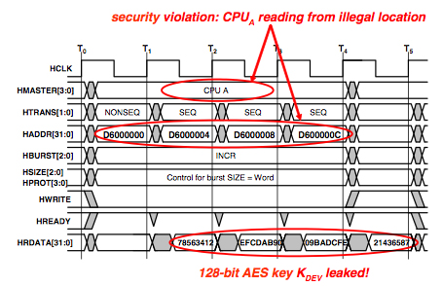
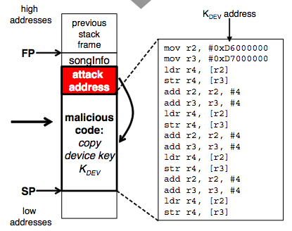
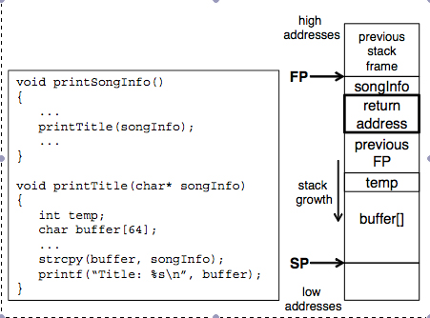
Attack Models
Software based
Buffer overrun attack on legacy C
Side-channel attacks
Inferring (stealing) information though leakage
RSA, Cache-timing attacks
In 2004 alone, the Department of Homeland Security reported 323 buffer overflow vulnerabilities
[Hu et al., VEE ‘06]
When it comes to cryptographic software, side channel attacks are an often overlooked thread [Lawson, ROOT Labs, 2009]
Threat: Spy processes, which can be hijacked tasks through a software exploit or malicious applications installed on the system
AES
Spy
P1
P2
C1
C2
Courtesy: Coburn et al., CASES ‘05

Slide 6
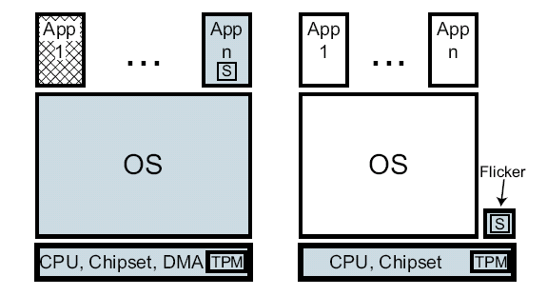
Current Approaches to Guarantee Secure Software Execution
Problems
Trusted execution environment
Side-channel attacks are possible in CMP systems
Through resource sharing
Software exploits leverage use of C legacy code
Most current secure platforms assume single processor models
TPM based models
Example: Flicker Secure Execution Model
eliminate resource sharing during execution of sensible code
Need a means to provide a trusted environment for secure execution without sacrificing performance and power
Context switch, halt and, build trusted environment
Not power efficient, not performance efficient, but secure

Slide 7
Outline
Introduction and Attack Models
PoliMakE Overview
Software Driven Policy Making
PoliMakE Driven On-chip Sandboxing
Related Work
Experimental Results
Concluding Remarks

Slide 8
Creating a Trusted Environment Through Selective Resource Sandboxing
t1
t2
Task C
Task D
CPUi
Core
CMP
CPU1 Core
CPU2 Core
CPUn Core
SPM1
SPM2
SPMi
SPMn
DMA
Off-chip memory
100
200
300
400
500
600
700
800
900
CPU0
T1 (250)/CX: 25
Task | Delay=Actual-Expected (ms)
T1 | (800-250)=550
T2 | (825-250)=575
T3 | (950-400)=550
T4 | (825-325)=500
DRM | (725-650)=125
AVG | 460
Task | Delay=Actual-Expected (ms)
T1 | (400-250)=150
T2 | (500-250)=250
T3 | (400-400)=0
T4 | (325-325)=0
DRM | (700-650)=50
AVG | 90 ms
CPU1
T2 (150)/CX: 50
CPU2
T3 (250)/CX: 75
CPU3
T4 (175)/CX: 50
DRM (450)/CX: 100
HALT Approach
CPU0
T1 (250)/CX: 25
T1
CPU1
T2 (150)/CX: 50
DRM (450)/CX: 100
T2
Context switch tasks with minimum CX penalty
CPU2
T3 (250)/CX: 75
T3
Load Policy P
CPU3
T4 (175)/CX: 50
T4
CPU0
Trusted Environment (LOCKDOWN)
T1 (250)/C: 25
DRM (450)/CX: 100
CPU1
T2 (150)/CX: 50
CPU2
Untrusted Environment
T3 (250)/CX: 75
CPU3
T4 (175)/CX: 50
T1
T2

Slide 9
PoliMakE : Software Driven Policy Generation
Given an application
What are the application’s compute and memory requirements?
Which variables need to be protected (confidentiality)?
Given a CMP platform
What resources should we assign to the application
How should we partition the CMP resources
Need to optimize resource allocation and schedule for power or performance
While providing a trusted execution environment

Slide 10
PoliMakE Methodology Overview
Pre-process application for secure analysis
(Generate CFG and secure task graph)
Extraction of security requirements
Goal is to obtain number of necessary resources to securely execute application
Middle End
Front End
Policy
Secure
Scheduling
Secure Data
Mapping
Policy
Goal is to generate customized policies
(power/performance – aware schedule and resource allocation)
Policy
Task C
Task D
t1
t2
Policy Making Engine
CPU1 Core
CPU2 Core
CPUi
Core
CPUn Core
CMP
DMA
Back End
Goal is to load the right policy and enforce it through selective Sandboxing
SPM1
SPM2
SPMi
SPMn
Policy Enforcement
Off-chip memory

Slide 11
Outline
Introduction and Attack Models
PoliMakE Overview
Software Driven Policy Making
PoliMakE Driven On-chip Sandboxing
Related Work
Experimental Results
Concluding Remarks

Slide 12
Software Driven Policy Making
buf1
Buf2
Need to extract application’s compute and memory requirements in order to efficiently allocate resources for secure execution
t1
t2
unsec
buf1
sec local buf2.1
DRM
C/C++
Initial task graph
t1
t2
t1
t2
var3
Given the underlying platform, customize a schedule (task map), memory mapping, and ACLs for efficient sandboxing
buf2
Buf2.1
sec shared
Buf2.2
sec local var
buf1
t1
t2
Augmented task graph (sec. info)
var3
Policy 1
buf2.2
Policy 2
Policy 3
P1
P1
t1
t2
Task C
Task D
P2
P1
P2
P3
P4
cpu1
cpu2
t1
CPU1 Core
CPU2 Core
CPUi
Core
CPUn Core
CMP
t2
DMA
M1
M2
M1
M2
M1
SPMi
M2
spm1
spm2
SPM1
SPM2
SPMn
Buf2.2
Latency
Latency
Latency
Buf2.1
Power
var1
Power
Power
Off-chip memory
buf1

Slide 13
Outline
Introduction and Attack Models
PoliMakE Overview
Software Driven Policy Making
PoliMakE Driven On-chip Sandboxing
Related Work
Experimental Results
Concluding Remarks

Slide 14
PoliMakE Driven On-chip Sandboxing
Initial Queue
Initial Load
Executing A₁ : Policy 2
A₃
A₂
A₁
μP
μP
μP
μP
μP
μP
μP
μP
μP
μP
μP
μP
μP
μP
μP
μP
Exec
Exec
Exec
m
m
m
m
m
m
m
m
m
m
m
m
m
m
m
m
Executing A₂ : Policy 2
A₃
A₂
A₁
μP
μP
μP
μP
μP
μP
μP
μP
Policy 1
Policy 1
Policy 2
Policy 3
Policy 1
Policy 2
Policy 3
P1
P1
Policy 2
Policy 3
P1
P1
P2
P4
P1
P1
P2
P1
P2
P3
P4
P1
P2
P1
P2
P3
P2
P1
P2
P3
m
m
m
m
m
m
m
m
M1
M2
M1
M3
M1
M2
M1
M1
M2
M1
M2
M1
M2
M1
M1
M2
M2
Latency
Latency
Executing A₃ : Policy 1
Latency
Latency
Latency
Latency
Latency
Latency
Power
Latency
Power
Power
Power
Power
Power
Power
Power
Power
μP
μP
μP
μP
μP
μP
μP
μP
Policy Selection | High Load | Low Load
On Battery | Policy 1 | Policy 1 /Policy 2
On Power Cord | Policy 2 | Policy 3
m
m
m
m
m
m
m
m

Slide 15
PoliMakE Driven On-chip Sandboxing
SPM level ACL
CPU1 Core
CPU2 Core
CPU3 Core
CPU4 Core
ACL
Sec
Arbiter
Minimal changes, per CPU key (hardware)
SPM2
SPM7
SPM3
SPU4
SPM5
SPM6
Lockdown
Untrusted Environment
CPU1 Core
CPU2 Core
CPU3 Core
CPU4 Core
Sec
Arbiter
Sec
Arbiter
SPM2
SPM7
SPM3
SPU4
SPM5
SPM6

Slide 16
Outline
Introduction and Attack Models
PoliMakE Overview
Software Driven Policy Making
PoliMakE Driven On-chip Sandboxing
Related Work
Experimental Results
Concluding Remarks

Slide 17
Related Work (Cont.)
Pure software solutions (complementary)
CCured [24], StackGuard [10], Smashguard [25, Pointguard [26]
Hardware Assisted
Patel et al. [27], Zambreno et al. [28], Arora et al. [30]
Platforms (complementary)
ARM TrustZone [33], SECA [8], AEGIS [31]
Halt/Execute
Flickr
Isolation
IBM CELL Vault, Agarwal et al. [12]
Full platform support for secure software execution might be an overkill in cases security is limited to only a few applications
No power/performance awareness
Current isolation approaches are limited to a (single task/application) and do not go over how to guarantee that applications are executed safely
To the best of our knowledge, we are the first to propose the idea of customized policy making to guarantee secure software execution for CMPs

Slide 18
Outline
Introduction and Attack Models
PoliMakE Overview
Software Driven Policy Making
PoliMakE Driven On-chip Sandboxing
Related Work
Experimental Results
Concluding Remarks

Slide 19
Experimental Results
Testing platform:
Ubuntu Linux 8.04 running on an Intel Quad Core at 2.66 GHz and 4GB memory
Questions that need answering:
How many resources should we allocate to an application
CPUs, memories, etc.
Run-time performance
Time needed to generate policies

Slide 20
Performance Effects of PoliMakE
Exploration allows us to find right level of sharing and resource partition
No further significant improvement is found after 4 core CMP
After 4 CPUs (2 and 2), performance is not improved as much
Compared to halt approach, PoliMakE can drastically improve performance

Slide 21
Policy Generation Runtime
Even if number of task increases by 14x, policy generation runtime is less than 2x

Slide 22
Outline
Introduction and Attack Models
PoliMakE Overview
Software Driven Policy Making
PoliMakE Driven On-chip Sandboxing
Related Work
Experimental Results
Concluding Remarks

Slide 23
Conclusion
Proposed PoliMakE
explores, generates and exploits customized policy making to guarantee secure software execution
Policy enforcement can be done by enhancing existing multiprocessors with Secure DMA/Arbiter and ACLs
Can be supported by platforms such as SECA and potentially TrustZone
We also propose a means to enforcing these policies via on-chip sandboxing, and dynamic policy selections
Our DRM/JPEG case study we observed up to 99% execution cycle reduction over the traditional halt approach
First to propose the idea of policy making to guarantee secure software execution for CMPs
Device-aware run-time policy enforcement
Minimize overhead of resource partition

Slide 24
Thank you!

Slide 25
DRM Policy under Different Utilizations (Static Evaluation)
Exploration allows us to find right level of sharing and resource partition
No further improvement is found after
4 core CMP

Slide 26
Load-aware Policy Selection
After 4 CPUs (2 and 2), performance is not improved as much
Compared to halt approach, PoliMakE can drastically improve performance

Slide 27
Effect of DRM on Small/Large Synthetic Application
The bigger the execution times the higher the ability of PoliMakE to reduce execution overhead vs. halt

Slide 28
Effects of Sharing
Tradeoff between sharing and not sharing

Slide 29
Performance Improvement over Halt Approach

Slide 30
Introduction
Devices
Sales in millions in 2004
Evolution compared to 2003
Year
millions in 2004
Evolution
Mobile phones
650
+ 35 %
2004
934
+ 35 %
Laptops
47
+ 30 %
2006
1070
+ 35 %
PCs
130
- stable
2007
1210
+ 30 %
PDAs
23
+ 26 %
2008
1350
- stable
Sources : www.eetimes.fr / Computer Industry Almanac www.c-i-a.com
and Guy Gogniat, Umass Amherst, May

Slide 31
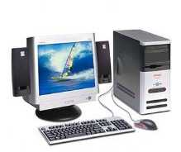
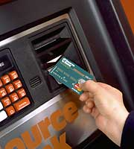
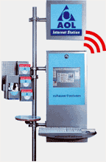
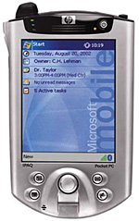
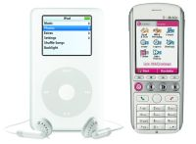
Introduction (Cont.)
Consequences…
laptop
PC
servers
PC
Smart card
Company
network
player
memory
WLAN
terminal
phone
PDA
car

Slide 32
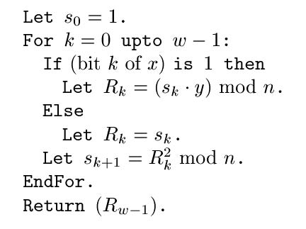
Attack Models
Software based
Buffer overrun attack on legacy C
Side-channel attacks
Inferring (stealing) information though leakage
RSA, Cache-timing attacks
Whether iteration takes a long time
depends on the k^{th} bit of secret exponent
This takes a while
to compute
In 2004 alone, the Department of Homeland Security reported 323 buffer overflow vulnerabilities
[Hu et al., VEE ‘06]
This is instantaneous
Courtesy: Coburn et al., CASES ‘05

Slide 33
PoliMakE Overview
Application
Tasks
Kernel
Extraction
Kernel
Decomposition
Inter-kernel
Data Reuse
Analysis
Clustering
Task Graph
Augmentation
Task Graph
Update
Task Graph
Reduction
Front End
Secure
Scheduling
Secure Data
Mapping
Security
Analysis
Policy
Policy
Policy
Policy Making Engine
Task Graph
Update
Back End
Initial
Requirements
Middle End

Slide 34
Attack Models
Software based
Buffer overrun attack on legacy C
Side-channel attacks
Inferring (stealing) information though leakage
RSA, Cache-timing attacks
Whether iteration takes a long time
depends on the k^{th} bit of secret exponent
This takes a while
to compute
In 2004 alone, the Department of Homeland Security reported 323 buffer overflow vulnerabilities
[Hu et al., VEE ‘06]
This is instantaneous
Courtesy: Coburn et al., CASES ‘05

Slide 35
Increase in memory resources side-effects
Shared memory model
Even multithreading increases vulnerability
AES dependency on table lookups
Cache address = p XOR k
P = known, k = unknown/secret
Goal: get enough information about k so that a brute force is feasible!
Collect histogram of time accesses for a given plaintext
Which values of k give us: cache address = p XOR k?
AES
Spy
AES
Spy
AES
Spy
Access time to spy cache line > known access time, must be table lookup
P1
P2
P1
P2
P1
P2
Populate lines in shared cache and compute access time
When it comes to cryptographic software, side channel attacks are an often overlooked thread [Lawson, ROOT Labs, 2009]
C1
C2
C1
C2
C1
C2

Slide 36
Sandboxing is a possible solution
Eliminate resource sharing during execution of sensible code
Flush state of processors
Context switch
Execute sensitive piece of code
Resume normal execution
This model suffers from performance degradation
Constant halting, flushing, and resuming of execution
Not power efficient, not performance efficient, but secure

Slide 37
Secure Policy Making for CMPs
Goal: Execute an application safely in a multiprocessor environment
Means:
Statically obtain a schedule an a series of policies to follow
Dynamically execute the schedule while enforcing policies

Slide 38
Secure Memory/Channels
Task A - local
Local data only
CPU1 Core
CPU2 Core
CPUn Core
CMP
Off-chip memory
DMA
SPM1
SPM2
SPMn
Concurrent execution limited by resources!
NoCs or Bus Matrix?
Shared
Buffer
Task B
Task C
Shared data + no one else accesses secure channel
CPU1 Core
CPU2 Core
CPUn Core
CMP
Off-chip memory
DMA
SPM1
SPM2
SPMn

Slide 39
Standard Halt, CXS, Execute, Resume
100
200
300
400
500
600
700
800
900
Task | Delay=Actual-Expected (ms)
T1 | (800-250)=550
T2 | (825-250)=575
T3 | (950-400)=550
T4 | (825-325)=500
DRM | (725-650)=125
AVG | 460
CPU0
T1 (250)/CX: 25
CPU1
T2 (150)/CX: 50
CPU2
T3 (250)/CX: 75
CPU3
T4 (175)/CX: 50
DRM (450)/CX: 100
CPU0
T1 (250)/CX: 25
T1
CPU1
T2 (150)/CX: 50
DRM (450)/CX: 100
T2
CPU2
T3 (250)/CX: 75
T3
CPU3
T4 (175)/CX: 50
T4

Slide 40
Policy Enforcement + Task/Data Re-mapping
100
200
300
400
500
600
700
800
900
Task | Delay=Actual-Expected (ms)
T1 | (400-250)=150
T2 | (500-250)=250
T3 | (400-400)=0
T4 | (325-325)=0
DRM | (700-650)=50
AVG | 90 ms
CPU0
T1 (250)/CX: 25
CPU1
T2 (150)/CX: 50
CPU2
T3 (250)/CX: 75
CPU3
T4 (175)/CX: 50
DRM (450)/CX: 100
Policy P
LOCKDOWN
CPU0
T1 (250)/C: 25
DRM (450)/CX: 100
CPU1
T2 (150)/CX: 50
Unsecure Environment
CPU2
T3 (250)/CX: 75
CPU3
T4 (175)/CX: 50
T1
T2

Slide 41
Goal: Secure Policy Making
Given an application, gather:
Data local to task
Data shared by task
Secure vs. unsecure data
Need for a secure compute and memory resources
Policies:
Grant each CPU access to a secure channel when needed
Grant each CPU access to a secure memory when needed
Sandboxing of resources via run-time access control list enforcement
Goal is to obtain number of necessary resources to securely execute application
Define policies to make it possible to safely execute the application

Slide 42
Updating Secure Buffers and Channels
b: <128, 191, 64, w/o, local, unsec>
Secure Buffers
a₂-(a₁∩ a₂):64 – Local (t1)
a₁∩a₂:64 – Shared (t1,t2)
d – Local (t2)
Unsecure Buffers
b:128 – Local (t1)
Secure Channels
a₂-(a₁∩ a₂) to t1
a₁∩a₂:64 to t1
d to t2
Unsecure Channels
b to t2
d: <192, 193,1, r/w, local, sec>
t1
t2
a₂- (a₁ ∩ a₂)=
<64, 127, 64, r/o, local, sec>
a₁ ∩ a₂ :
<0, 63, 64, r/w, shared, sec>
a₂-(a₁∩ a₂):
64
b:128
t1
t2
a₁∩a₂:
64
d:1

Slide 43
Updating Secure Buffers and Channels
b: <128, 191, 64, w/o, local, unsec>
Secure Buffers
a₂-(a₁∩ a₂):64 – Local (t1)
a₁∩a₂:64 – Shared (t1,t2)
d – Local (t2)
Unsecure Buffers
b:128 – Local (t1)
Secure Channels
a₂-(a₁∩ a₂) to t1
a₁∩a₂:64 to t1
d to t2
Unsecure Channels
b to t2
d: <192, 193,1, r/w, local, sec>
t1
t2
a₂- (a₁ ∩ a₂)=
<64, 127, 64, r/o, local, sec>
a₁ ∩ a₂ :
<0, 63, 64, r/w, shared, sec>
a₂-(a₁∩ a₂):
64
b:128
Define secure and unsecure buffer requirements
t1
t2
Define secure and unsecure channel requirements
a₁∩a₂:
64
d:1

Slide 44
Establishing Security
t1:
for i = 0 to 63
if(b[i]>0)
a[i] = b[i]
l_s_lst: Ø
t2:
for j = 0 to 128
d += a[j]
l_s_lst: Ø
g_s_lst: a
t1:
for i = 0 to 63
if(b[i]>0)
a[i] = b[i]
l_s_lst: Ø
t2:
for j = 0 to 128
d += a[j]
l_s_lst: d
g_s_lst: a
Mem Map:
a: 0->127
b: 128->191
d: 192
Compute buffer requirements for each kernel
a₁: <0, 63, 64, w/o, local, sec>
Compute security variables
d: <192, 193,1, r/w, local, sec>
t1
t2
Keep global mem map
a₂: <0, 127, 128, r/o, local, sec>
b: <128, 191, 64, r/o, local, unsec>
Compute inter-kernel reused buffers
b: <128, 191, 64, w/o, local, unsec>
d: <192, 193,1, r/w, local, sec>
Update security if necessary
t1
t2
t1
t2
a₂- (a₁ ∩ a₂)=<64, 127, 64, r/o, local, sec>
a₁ ∩ a₂ : <0, 63, 64, r/w, shared, sec>

Slide 45
Establishing Security
t1:
for i = 0 to 63
if(b[i]>0)
a[i] = b[i]
l_s_lst: Ø
t2:
for j = 0 to 128
d += a[j]
l_s_lst: Ø
g_s_lst: a
t1:
for i = 0 to 63
if(b[i]>0)
a[i] = b[i]
l_s_lst: Ø
t2:
for j = 0 to 128
d += a[j]
l_s_lst: d
g_s_lst: a
Mem Map:
a: 0->127
b: 128->191
d: 192
Compute buffer requirements for each kernel
a₁: <0, 63, 64, w/o, local, sec>
Compute security variables
d: <192, 193,1, r/w, local, sec>
t1
t2
b:128
Keep global mem map
a₂-(a₁∩ a₂):
64
a₂: <0, 127, 128, r/o, local, sec>
b: <128, 191, 64, r/o, local, unsec>
t1
t2
Compute inter-kernel reused buffers
a₁∩a₂:
64
b: <128, 191, 64, w/o, local, unsec>
d: <192, 193,1, r/w, local, sec>
d:1
Update security if necessary
t1
t2
t1
t2
a₂- (a₁ ∩ a₂)=<64, 127, 64, r/o, local, sec>
a₁ ∩ a₂ : <0, 63, 64, r/w, shared, sec>

Slide 46
Secure Policy (Cont.)
Based on target platform
Generate Schedule
Generate Mapping
Need platform support
Dynamic policy enforcement
Secure DMA and Arbiter
sec local buf
unsec
buf
t1
t2
Generate mapping and scheduling (Policy)
sec share
buf
sec local buf
When application runs, enforce policy
t1
t2
Task C
Task D
cpu1
cpu2
CPU1 Core
CPU2 Core
CPUi
Core
CPUn Core
CMP
t1
DMA
t2
SPM1
SPM2
SPMi
SPMn
spm1
spm2
a (0, 63)
a (64, 127)
d
b
Off-chip memory

Slide 47
Run-time Secure Policy Selection
Provide means to customize policies to meet different power and performance requirements
cpu1
cpu2
t1
t2
spm1
spm2
a (0, 63)
a (64, 127)
Task C
Task D
d
t1
t2
b
CPU1 Core
CPU2 Core
CPUi
Core
CPUn Core
CMP
Policy 1 – Low Power
DMA
SPM1
SPM2
SPMi
SPMn
Policy 2 - Performance
cpu1
cpu2
t1
t2
At run-time, device loads policy given the current device load/state (i.e. low battery = low power policy)
Off-chip memory
spm1
spm2
a (0, 127)
b
d

Slide 48
Policy Driven Simplified Sandboxing
SPM level ACL
CPU1 Core
CPU2 Core
CPU3 Core
CPU4 Core
ACL
Sec
Arbiter
Minimal changes, per CPU key (hardware)
SPM2
SPM7
SPM3
SPU4
SPM5
SPM6
Lockdown
Untrusted Environment
CPU1 Core
CPU2 Core
CPU3 Core
CPU4 Core
Sec
Arbiter
Sec
Arbiter
SPM2
SPM7
SPM3
SPU4
SPM5
SPM6

Slide 49
Software Driven Policy Making
Policy 1
Policy 2
Policy 3
P1
P1
P2
P1
P2
P3
P4
M1
M2
M1
M2
M1
M2
Latency
Latency
Latency
Power
Power
Power
Policy 1
Policy 2
Policy 3
P1
P1
P1
P2
P2
P1
P2
P3
P4
M1
M2
M1
M2
M1
M2
M3
Latency
Latency
Latency
Power
Power
Power
Policy 1
Policy 2
Policy 3
P1
P1
P2
P1
P2
P3
M1
M1
M1
M2
Latency
Latency
Latency
Power
Power
Power

Slide 50
Software Driven Policy Making
Policy 1
Policy 2
Policy 3
P1
P1
P2
P1
P2
P3
M1
M1
M1
M2
Latency
Latency
Latency
Power
Power
Power
Policy 1
Policy 2
Policy 3
P1
P1
P1
P2
P2
P1
P2
P3
P4
M1
M2
M1
M2
M1
M2
M3
Latency
Latency
Latency
Power
Power
Power

