Slide 1
Ch 11 Application Issues
Prof. Magda El Zarki
Dept. of CS
Univ. of CA, Irvine
Email: elzarki@uci.edu
http://www.ics.uci.edu/~magda

Slide 2
Overview
Security and Cheating
Geometry and Animation
Thin Clients

Slide 3
Security and Cheating
Security is support within a system to protect against faults and attacks
Prevents unauthorized use of the system
Prevents users from disrupting service
Cheating is the exploitation of some aspect of the system to gain an advantage in an environment
Cheating might exploit security problems – getting unauthorized access to a system
Cheating might be legal from a system’s perspective but illegal from a social angle – virtual money?!?!?

Slide 4
Cheating
Client side: attacker compromises client software
Server side: attacker subverts server software
Network level: attacker accesses the network traffic
Social: players collude or use multiple clients

Slide 5
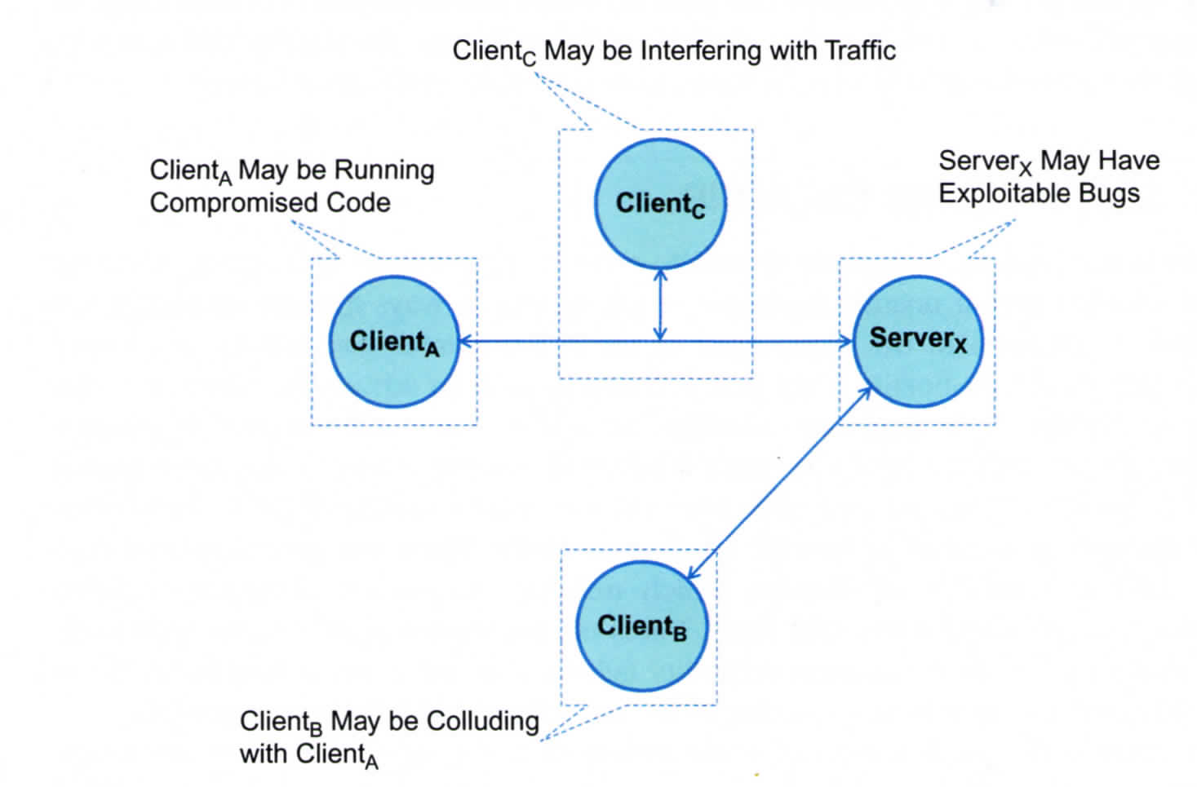
Types of Cheating

Slide 6
Client Side Attacks
Player changes client side software to give some advantage to the player.
Most common attack is to change the software to make walls/objects invisible so that the client can see the enemy. So even though the server filters the data so that it doesn’t send information to that client about objects the client isnt supposed to see (i.e., behind a wall), with invisible walls, the client can still see them, as the server will send that information to all players to maintain state.
Another attack is “lookahead” cheat, where a player’s response is purposefully delayed, thus lying about its latency and so it receives updates from other players in plenty of time to respond (server tries to compensate for the client’s latency).
There are some mechanisms that can detect cheating in dead-reckoning protocols and other delayed response systems

Slide 7
Client Side Cheating – contd.
Another attack is to augment a player’s skill. It does this by changing the control input that the player is sending. E.g., correct the player’s aim or fire when it is the right time. We call this an “aimbot.”
Other variants exist that actually will play for you: complete actions and tasks for example. Even after you have left the persistent world they will continue gathering wealth, assets. They are generally called bots. (see next slide)
Detecting this type of attack is difficult.

Slide 8
An example of a bot – Glider – Taken form Wikipedia
Blizzard Entertainment created and operates a popular online world game known as World of Warcraft (WoW). WoW is a massively multiplayer online role-playing game, in which players control characters and complete a variety of tasks, such as exploring the landscape and performing quests. As players continue to play and succeed in their tasks, their characters gain various talents and skills.
Michael Donnelly, the founder of MDY Industries, LLC, created a software bot called Glider to play WoW for its users. Thus, Glider users were able to advance their WoW characters unattended.
In its ruling on Blizzard's contributory copyright infringement claims, the district court first considered whether purchasers of WoW were legal "owners" of the client software. According to 17 U.S.C. § 117, owners of computer programs are allowed to create copies or adaptations of the computer program if it is an essential step towards utilization of the program.^{[2]}
The Court agreed with Blizzard's arguments that WoW purchasers were not legal owners of the game software but instead licensees. As licensees, players are required to make use of the software within the scope of the End User License Agreement. In the terms of that agreement, Blizzard specifically prohibited "the use of bots or third-party software to modify the WoW experience."^{[1]} Thus, the Court found that players who use the Glider program violated the TOU and were not licensed to use WoW.

Slide 9
From a Player’s perspective (Consalvo 2009):
Developed by Michael Donnelly and MDY Industries, the glider is a small program or mod for WoW that lets the user program one of her avatars to travel along a preset path, killing whatever is found, skinning, looting, and gaining experience points from the looped activity. The makers of the program/mod stress on their Web site that the mod is designed to eliminate the tedious aspects associated with leveling a character (the grind), especially for players who may have already done so with several other characters—in other words, this is for alts or very experienced players to ‘‘fast-forward’’ through undesirable parts of the game.
Fast-forwarding is a common reason people will cheat in a game (Consalvo, 2007), although in multiplayer games such as WoW, the developers usually consider such activities as in violation of the game’s terms of service (ToS). It is thus illegal,and the creators of the glider are currently being sued by Blizzard for their creation (Markee, 2007).

Slide 10
Contd.
We can consider the potential activities associated with the WoW glider in several ways. Some individuals might use the glider to level avatars that they intend to sell to other players for (real) currency and thus profit off the fast-forwarding mod. Some players may wish to level their second, third, or fourth avatar through either some or all of the grind in the game, to achieve higher levels, but keep those avatars as part of their account to play with in the future. Some players (admittedly few) may find the WoW glider before even beginning the game and use it to level their avatar to get to the content they assume is most valuable—such as end game raiding. Although the developers have deemed all those activities as cheating and violations of the ToS, they obviously have different meanings for the players involved. Likewise, they have different meanings and outcomes for players who do not use the WoW glider but who are nonetheless affected by its presence as a mod.
Nonglider using players may consider the opportunity to purchase such a leveled avatar as a bargain, rather than leveling an avatar on their own. Nonglider-using players may feel that avatars running automatically on preset paths in certain areas are unfairly hogging resources in game, which they may need and feel more legitimate claim to, being in actual control of their avatar. Finally, nonglider using players may feel fiscal ramifications of glider-using players, if glider users also gather large amounts of consumable resources to sell via auction houses and either flood markets (driving prices down) or control the sale of certain items (driving prices up).

Slide 11
Controlling Client Side Cheating
The two main types of attack:
Subverting the display of information
Subverting the control input
Two approaches:
Client Verification
Examine client memory and disk to verify the code and data. Not a very popular solution as it infringes on privacy.
Behaviour Tracking
Looks at characteristic patterns in a user and compares it to new patterns such as that generated by bots. Bots tend to do repetitive, monotonously timed actions.
Client/server systems can track this behavior. Some of it in real time – e.g., zero response time that a bot would have. Others might need offline analysis. Some work has shown that 200 secs of game play can be sufficient to detect foul play.
Some bots are intelligent and try to simulate human behavior but turns and movement rate anomalies and frequency and patterns of actions can be detected if long enough traces are collected.

Slide 12
Server Side Attacks
Exploitation of bugs
A bug that lets people enter a privileged location or obtain an object (e.g., money or armor)
A bug, duping exploit, that allows duplication of an object, e.g., duplicating wealth (e.g., Sony’s experience with Everquest II)
Brute force attacks - DoS
SYN flooding – opens many TCP connections and leaves them hanging.
ICMP flooding using ping
Sending messages that cause buffer overflow at receiver (packets larger than IP allows)

Slide 13
Network Level
Eavesdropping on packets
Change the content of the packets – the angle of aim or the timing of an action, or even the target of the aim, etc.
How to protect against it:
Can be tackled by using secure network messages:
IPSec – Done via VPNs and involves gateways/routers – encrypt IP packet content.
Secure sockets (SSL) – both sides (hosts) have to agree. This is transport layer encryption: ftp – ftps, http – https
Application or middleware level security – encryption of game traffic
Disadvantage consumes CPU cycles

Slide 14
Social
Collusion – where players agree to a strategy that allows one player to gain advantage and then split the spoils
Player behavior and ethics – the whole bot usage and the Glider example
What is ethical and what isn’t???

Slide 15
Repercussions
Identify cheaters – beware of false positives
How to police communities
Banning cheaters – ineffective in environments where you can create a new identity
On consoles – identities are tied to the console and so can be tracked. Also harder to hack software on a console – altogether a much safer environment.

Slide 16
Geometry and Animation
Complex animations: character animation
Use keyframe animation – only the keyframe identifier and the time needs to be sent
An action is defined by a number of keyframes describing the action over a period of time.
Interpolation is used to give smooth action. If frames exist for every .1s, then angles are interpolated for the “in between motion”
If bandwidth is low, keyframes can be skipped. Picking which ones is an art to maintain smooth action/motion
Keyframes can also be cached on a client.

Slide 17
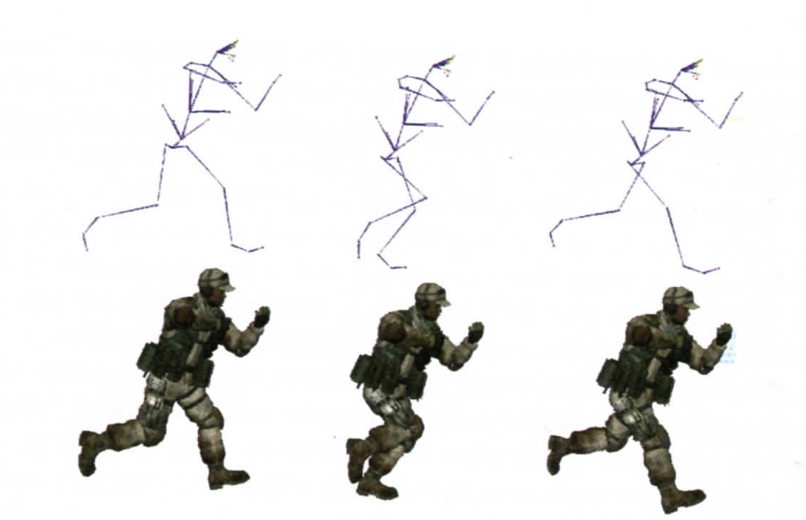
Character Animation

Slide 18
Large complex systems
The models are stored on the server
Downloaded incrementally depending on player interest
Geometry selection phase
Geometry transmission phase
Environments stored in such a way that it is easy to find what next needs to be sent.
Client can decide – pull system
Server decides – push system
Compression of meshes to reduce BW
Progressive meshes (similar to video compression and layers)
Using images of an object instead of a mesh - impostors

Slide 19
Thin Clients
Not a new idea
Has existed for awhile
Proposed for online games because of the increased complexity of the virtual environments
Mostly to keep costs down for clients – graphics cards and high end CPUs not cheap
Drawback – bandwidth requirements – streaming of audio and video – high resolution > 5Mbps
The proposed solution for cloud computing!

