Slide 1
Chapter 2: Review of Important Networking Concepts
Magda El Zarki
Dept. of CS
UC Irvine
elzarki@uci.edu
http://www.ics.uci.edu/~magda

Slide 2
Networking Fundamentals
Basic Internet technologies
Basic networking strategies

Slide 3
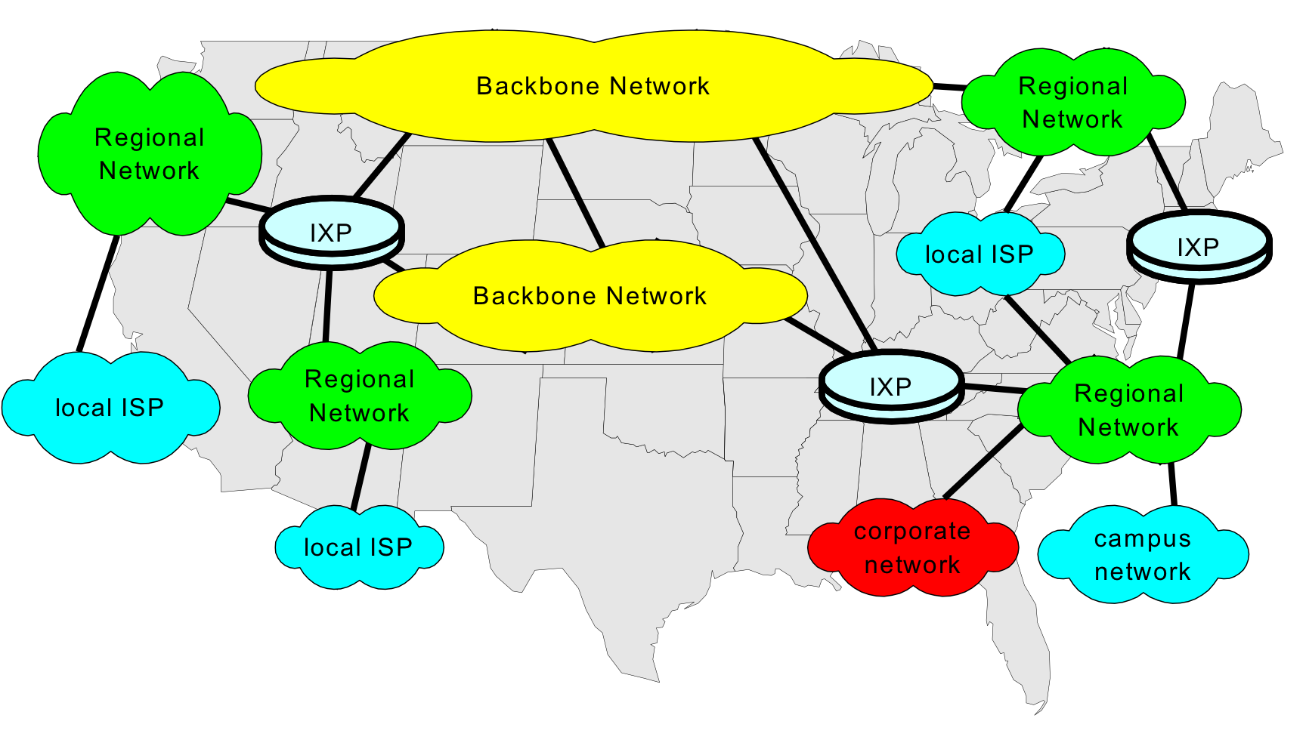
The Internet: A Collection of Networks

Slide 4
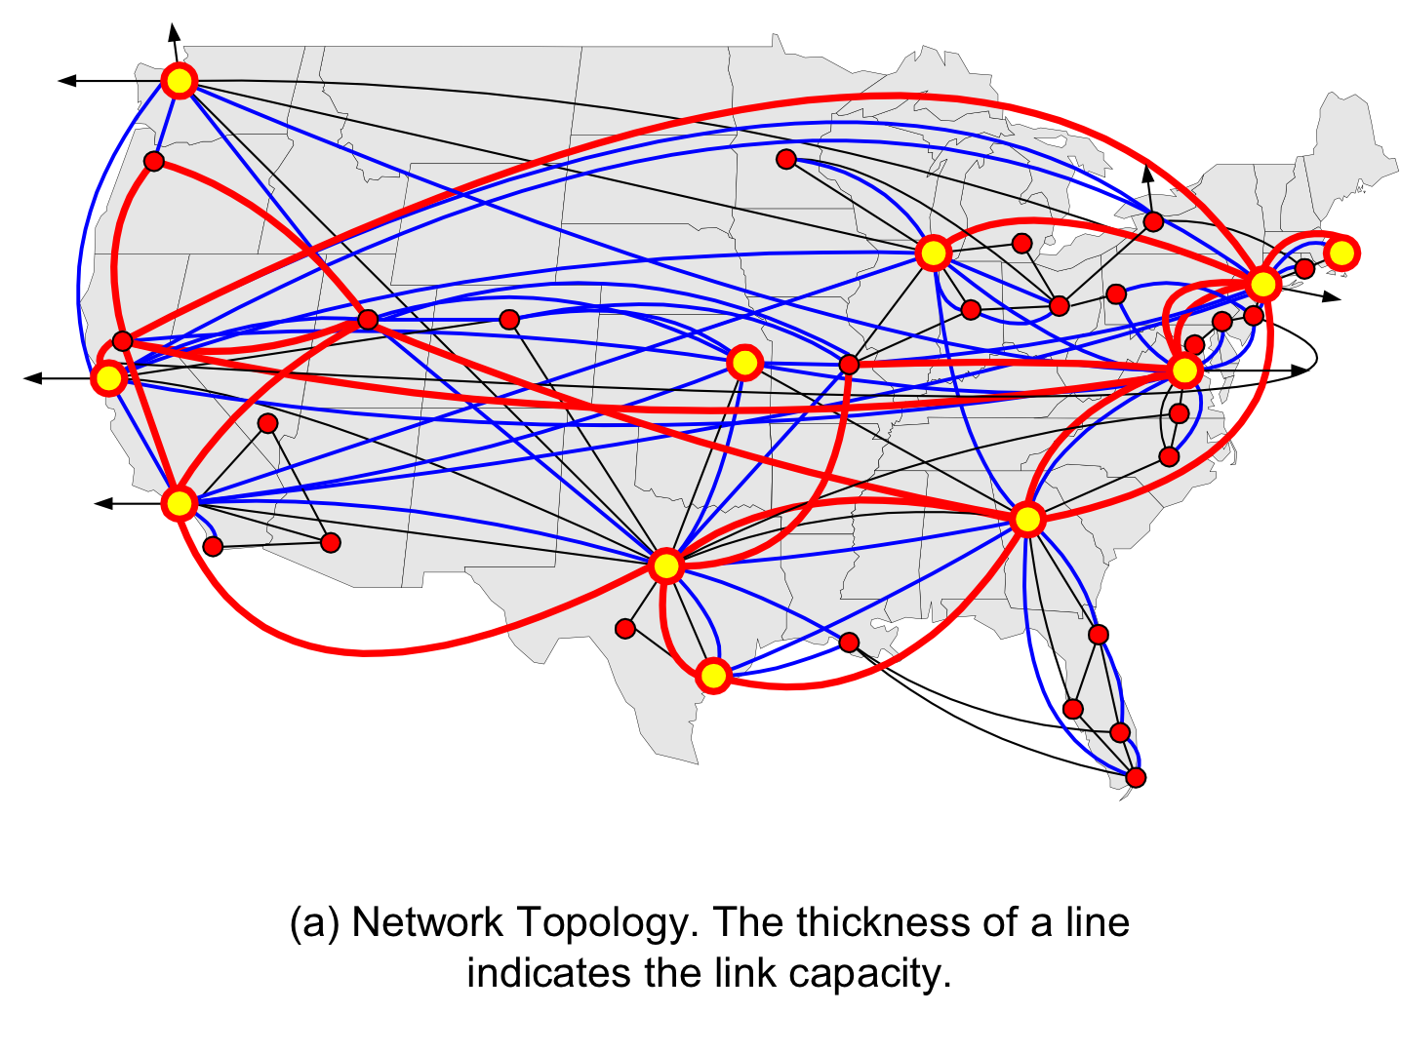
The Internet: A Mesh of Links

Slide 5

What’s the Internet: “nuts and bolts”view
PC
millions of connected computing devices:
  hosts = end systems
  running network apps
Mobile network
server
Global ISP
wireless
laptop
cellular
handheld
Home network
Regional ISP
communication links
  fiber, copper, radio, satellite
  transmission rate = bandwidth
access
points
Institutional network
wired
links
router
routers:
  forward packets (chunks of data)

Slide 6
What’s the Internet: a service view
communication infrastructure
  enables distributed applications:
  Web, VoIP, email, games, e-commerce, file sharing
communication services provided to apps:
  reliable data delivery from source to destination
  “best effort” (unreliable) data delivery

Slide 7
The Network Core
mesh of interconnected routers
the fundamental question: how is data transferred through net?
  circuit switching: dedicated circuit per call: e.g., telephone network
  packet-switching: data sent thru network in discrete “chunks”

Slide 8
Network Core: Circuit Switching
End-end resources reserved for “call”
  Resources: link bandwidth, switch capacity
  Reserved/dedicated resources: no sharing
  Guaranteed performance: your lane, fixed size
  Call setup (reservation) required
Each call gets a dedicated
lane on large highway
Call 1
Call 2

Slide 9
Network Core: Circuit Switching
network resources (e.g., bandwidth) divided into “parts”-> e.g. lanes on a highway
  dividing link bandwidth into “parts”
    frequency division - FDM
    time division - TDM
parts allocated to calls
allocated part idle if not used by owning call (no sharing)

Slide 10
Network Core: Packet Switching
each end-to-end data stream divided into parts called packets
user A, B packets share network resources
each packet uses full link bandwidth for a short duration of time
resources used as needed – no reservations or ownership

Slide 11
Packet Switching: Statistical Multiplexing
100 Mb/s
Ethernet
A
C
statistical multiplexing
1.5 Mb/s
B
One large highway
with only one lane
queue of packets
at switch waiting
for output Link
D
E
Sequence of A & B packets does not have fixed pattern, bandwidth shared on demand ➔ statistical multiplexing.

Slide 12
Networking Concepts
Protocol Architecture
Protocol Layers
Encapsulation
IP Addressing

Slide 13
A Data Transfer Example:
Argon -> Neon
Argon
Neon
The actual path
followed by data

Slide 14
Sending a packet from Argon to Neon
128.143.71.21 is not on my local network.
Therefore, I need to send the packet to my
default gateway with address 128.143.137.1
128.143.71.21 is on my local network.
Therefore, I can send the packet directly.
DNS: What is the IP address
of “neon.tcpip-lab.edu”?
DNS: The IP address of “neon.tcpip-lab.edu” is 128.143.71.21
ARP: What is the MAC address of 128.143.137.1?
ARP: The MAC address of 128.143.137.1 is 00:e0:f9:23:a8:20
ARP: What is the MAC address of 128.143.71.21?
ARP: The MAC address of 128.143.137.1 is 00:20:af:03:98:28
frame
frame

Slide 15
Sequence of events:
1.Web client at Argon starts an HTTP Request.
2.Argon contacts its DNS server to translate the domain name “neon.cerf.edu” into IP address “128.143.71.21” and looks up the well-known port number of the web server (port 80).
3.The HTTP client at Argon requests a TCP connection to port 80 at IP address 128.143.71.21.
4.The TCP client at Argon requests its Internet Protocol (IP) to deliver an IP datagram with the connection request to destination 128.143.71.21.
5.The IP process at Argon decides that it cannot deliver the IP datagram directly, and decides to send the IP datagram to its default gateway 128.143.137.1.
6.The Address Resolution Protocol (ARP) at Argon sends an ARP request for the MAC address of IP address 128.143.137.1.
7.The ARP request is broadcast by the Ethernet device driver at Argon to all devices on the Ethernet network.
8.The router with IP address 128.143.137.1 responds with an ARP Response to Argon which includes MAC address 00:e0:f9:23:a8:20.
9.The IP process at Argon asks its Ethernet device driver to send the IP datagram in an Ethernet frame to MAC address 00:e0:f9:23:a8:20.
10.Ethernet device driver at router with MAC address 00:e0:f9:23:a8:20 unpacks the IP datagram, and passes it to its IP process.
11.The IP process at the router decides that it can deliver the IP datagram with destination 128.143.137.21 directly (without the need of additional routers).
12.The Address Resolution Protocol (ARP) at the router sends an ARP request for the MAC address of IP address 128.143.137.21.
13.The ARP request is broadcast by the Ethernet device driver at the router to all devices on the Ethernet network.
14.Neon (which has IP address 128.143.137.21) responds with an ARP Response to the router which includes MAC address 00:20:af:03:98:28.
15.The IP process at the router asks its Ethernet device driver to send the IP datagram in an Ethernet frame to MAC address 00:20:af:03:98:28.
16.The Ethernet device driver at Neon unpacks the IP datagram contained in the Ethernet frame, and passes it to its IP process.
17.The IP process unpacks the TCP connection request contained in the IP datagram and passes it to the TCP server at port 80.
18.The TCP server at port 80 processes the TCP connection request.

Slide 16
Communications Architecture
The complexity of the communication task is reduced by using multiple protocol layers:
    Each protocol is implemented independently
    Each protocol is responsible for a specific subtask
    Protocols are grouped in a hierarchy
A structured set of protocols is called a communications architecture or protocol suite

Slide 17
Protocol Stack
Application
DHCP, DIS, DNS, FTP, HTTP, IMAP, RTP, SMTP, SSH, Telnet
Transport
TCP, UDP, RSVP
Network
IP, ICMP, IGMP
Link
Ethernet, 802.11, ADSL
Physical
copper wires, fibre-optic cable, radio waves

Slide 18
Protocol Layers at work
Router

Slide 19
Functions of the Layers
Data Link Layer:
  Service: Reliable transfer of frames over a link
  Functions: Framing (timing and synchronization)
      Media access control
      Error checking
Network Layer:
  Service: Direct packets hop by hop from source host to destination host
  Functions: Forwarding
Transport Layer:
  Service: Delivery of data between hosts end to end
  Functions: Connection establishment/termination
  error control
  flow control
Application Layer:
  Service: Application specific (delivery of email, retrieval of HTML documents, transfer of file)
  Functions: Application specific

Slide 20
Layers in action in the Example
Send HTTP Request to neon
Establish a connection to 128.143.71.21 at port 80
Open TCP connection to 128.143.71.21 port 80
IP datagram is a TCP segment for port 80
Send IP data-gram to 128.143.71.21
Send a datagram (which contains a connection request) to 128.143.71.21
Send IP datagram to 128.143.71.21
Frame is an IP datagram
Frame is an IP datagram
Send the datagram to 128.143.137.1
Send the datagram
to 128.143.7.21
Send Ethernet frame to 00:e0:f9:23:a8:20
Send Ethernet frame to 00:20:af:03:98:28

Slide 21
Layers and Services
Service provided by TCP to HTTP:
  reliable transmission of data over a logical connection
Service provided by IP to TCP:
  unreliable transmission of IP datagrams across an IP network
Service provided by Ethernet to IP:
  transmission of a frame across an Ethernet segment
Other services:
  DNS: a network service - translation between domain names and IP addresses
    Maps fully qualified domain names (narok.cs.ucl.ac.uk) to their IP addresses (128.16.5.123)
  ARP: Translation between IP addresses and MAC addresses
    Used by IP to find the physical address of a device on a link

Slide 22
Assignment of Protocols to Layers

Slide 23
Encapsulation
As data is moving down the protocol stack, each protocol is adding layer-specific control information

Slide 24
Encapsulation in our Example
Let us look in detail at the Ethernet frame between Argon and the Router, which contains the HTTP web page request to Neon, the resultant TCP segment to Neon and the IP datagram carrying the network informatio.

Slide 25
Encapsulation:
Ethernet Header

Slide 26
Encapsulation:
Ethernet Header in Hex Format

Slide 27
Encapsulation:
IP Header

Slide 28
Encapsulation:
TCP Header
Option: maximum segment size

Slide 29
Different Protocol Views of Networking
Application (e.g. HTTP) and Transport Layer (e.g. TCP) view of the network
End to End Transmission

Slide 30
IP View of the Network
Concatenation of Networks via Routers

Slide 31
Ethernet view of the network
Single Link

Slide 32
APPLICATION LAYER

Slide 33
Application Layer Protocols
Determine what messages are sent between applications
  Messages defined by syntax and semantics
Various standards for messages, typically set by RFCs (Requests for Comments) hosted by the IETF (Internet Engineering Task Force)

Slide 34
E.G. HTTP Request
If you connect to Host www.cs.ucl.ac.uk at Port 80
And then type in ASCII the following message:
      GET /staff/A.Steed/ HTTP/1.1
      Host: www.cs.ucl.ac.uk
And type two carriage returns
You get …

Slide 35
HTTP/1.0 200 Document follows
MIME-Version: 1.0
Server: CERN/3.0
Date: Sun, 08 Feb 2009 15:25:18 GMT
Content-Type: text/html
Content-Length: 16150
Last-Modified: Wed, 21 Jan 2009 17:42:00 GMT
<?xml version="1.0" encoding="iso-8859-1"?>
<!DOCTYPE html PUBLIC "-//W3C//DTD XHTML 1.0 Transitional//EN" "http://www.w3.org/TR/xhtml1/DTD/xhtml1-transitional.dtd">
<html xmlns="http://www.w3.org/1999/xhtml" lang="en" dir="ltr">
<head>
<meta http-equiv="Content-Type" content="text/html; charset=iso-8859-1" />
<meta name="keywords" content="A. Steed, Anthony Steed, Department of Computer Science, University College London, virtual environments, virtual reality, computer graphics" />

Slide 36
Application Protocol Descriptions
Often ASCII preamble, with binary assets inserted at known or marked positions
Some messages are designed to be carried over a reliable stream and are of unknown length (likely to be over TCP)
Some messages are small and it is not important if they get lost (likely to be over UDP)

Slide 37
Common Application Protocols

Slide 38
E.G. Domain Name Service (DNS)
Maps fully qualified domain names (narok.cs.ucl.ac.uk) to their IP addresses (128.16.5.123)
Is a network service, thus takes time
Time is variable because it’s a hierarchical search
Local DNS servers cache query responses for a fixed time (e.g. 24 hours)
If not in the cache, needs to send query up the hierarchy

Slide 39
TRANSPORT LAYER

Slide 40
Transport Layer Protocols
User Datagram Protocol (UDP)
  Send a message (datagram) and forget about it
  No guaranteed delivery
  No guaranteed ordering
Transmission Control Protocol (TCP)
  Guaranteed, in-order stream of data from one host to another

Slide 41
End to End Principle
Port Number
IP Address
Physical Address
  Only the sender and receiver understand TCP or UDP (or other higher-level protocols). The routers in the Internet do not.

Slide 42
Application Protocols and Port Numbers

Slide 43
Host IP 128.116.22.5
Host IP 128.116.48.10
Application
Application
Application
Source Port = Portxxx
Destination Port = Portyyy
Destination Port = Portzzz
Transport
Transport
Network
Network
Link
Link
Multiplexing of Users and Sessions
Notes:
Figure 3.5

Slide 44
UDP
All hosts on the Internet have an IP address
How does the network know which application program (i.e. process) it needs to reach on a host?
And if it is a shared application, how to distinguish between different users using that same application!
Solution: add a port number to the IP address for use by end-to-end transmission only
  Port numbers are 16 bits numbers, so must lie in the range 0-65535
  Some are reserved, see later
Processes listen for incoming UDP packets
Checksum can be used to check the packet for consistency.

Slide 45
UDP Segment Layout – Header 8bytes
Bits | 0 15 | 16 31
0-31 | Source Port | Destination Port
32-63 | Length | Checksum
64+ | Data
Notes:
Figure 3.4

Slide 46
UDP Checksum
The UDP header field checksum is used to check the integrity of the packet.
It provides a means of detecting errors in the UDP datagram.
The UDP checksum is calculated using a UDP-pseudo header, UDP header and the UDP data.
The UDP pseudo header contains the source IP-address, the destination IP-address, the protocol identifier (UDP in this case), and UDP datagram length taken from UDP header.
The header field checksum is optional. UDP packets with wrong checksums are discarded.
The action taken is that the packet is dropped [RFC 768]

Slide 47
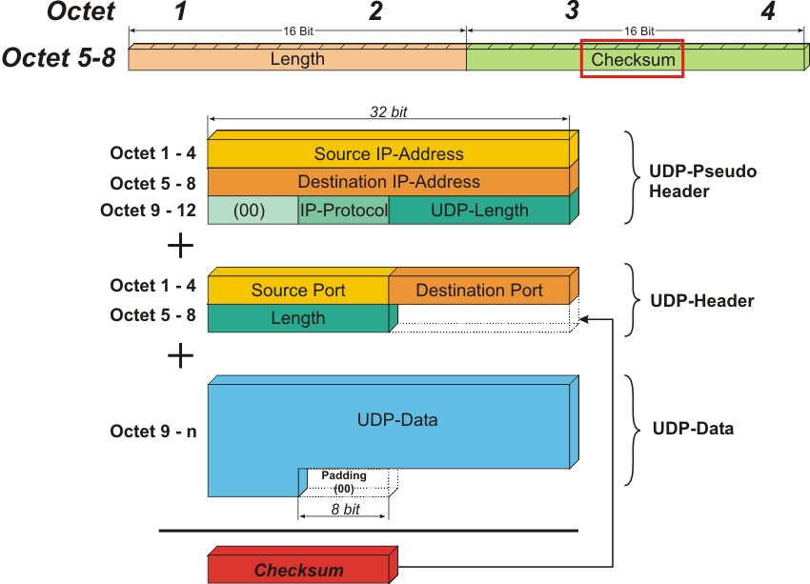
UDP Checksum Calculation
UDP Protocol

Slide 48
TCP
In comparison to UDP, TCP offers:
  A connection-oriented services with bi-directional (full-duplex) communication
  Reliable transmission of messages in each direction
  Congestion avoidance, using variable rate transmission
  In order, and non-duplicate delivery of information
Applications place the data bytes into an outgoing buffer
The buffer is streamed in the form of segments to the receiver
At the receiver, the segments are dismantled and the data is stored in a buffer byte by byte, and pushed to the application.

Slide 49
Application
Msg i – Y bytes
Transport
Data
Buffer
…
Msg i-2
Msg i-1
Header
Data
Segment: “x” data bytes
from buffer + header
Network
Link
Notes:
Figure 3.9

Slide 50
Layout of a TCP Segment – Header 20-40bytes
Bits | 0 15 |  |  | 16 31
0-31 | Source Port |  |  | Destination Port
32-63 | Sequence Number (SN)
64-95 | Acknowledgement Number (ACK)
96-127 | Data Offset | Not Used | Flags | Receive Window
128-159 | Checksum |  |  | Urgent Pointer
160-191 | Options (Optional)
160+ 192+, 224+, etc. | Data
Notes:
Figure 3.10

Slide 51
TCP Checksum
The TCP header field checksum is used to check the integrity of the segment.
It provides a means of detecting errors in the TCP segment.
The TCP checksum is calculated the same way as the UDP-checksum is calculated and therefore also considers a TCP-pseudo header.
The TCP pseudo header contains the source IP-address, the destination IP-address, the protocol identifier (TCP here), and TCP length (calculated from header field and data field. [RFC 793]

Slide 52
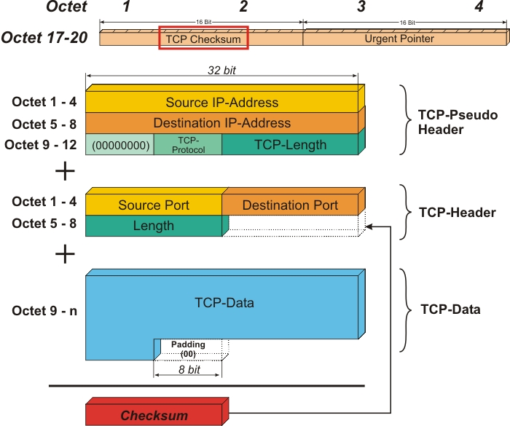
TCP Checksum Calculation

Slide 53
TCP is Bi-Directional
Even if, logically, data only flows one way, in order to ensure reliability, we need to send an empty “data” segment back which, by means of fields in the header, tells the transmitter which data has been successfully received (ACK)
The sender must maintain the buffered data until it receives an ACK

Slide 54
Transport
Next Byte Expected from other side
Received Data
Receive Buffer
Sent Data
Unsent
MSS
Send Buffer
Start Byte No.
Start Byte No. = Start Byte No. of last MSS + Last MSS (message segment size)
Header
Data
Sequence Number = Start Byte
Expected in opposite direction
Acknowledgement Number = Byte Expected
Notes:
Figure 3.11

Slide 55
Header
Data
Transport
Transport
Last Acknowledged
= M
Next Sequence Number
= N
Sequence Number = M
Expected
= N
Acknow-ledged
To Send
Unsent
Received
Just Received
Send Buffer
Receive Buffer
Header
Transport
Acknowledgement Number = N
An empty data packet, solely
used for ACKs in opp. direction
if no data at receiving end.
Last Acknowledged
= N
Acknowledged
Unsent
Send Buffer
Notes:
Figure 3.12

Slide 56
TCP Reliability
How to detect if something has gone missing
  A timeout
  Returning an ACK repeatedly which indicates the buffer hasn’t grown (packets discarded because errors occurred or packets lost in network)

Slide 57
Packet Resent on Duplicate ACK
Out of order reception
Host A
Host B
Scenario for “out of” order
data packet reception
Seq # = 100
Data
Seq # = 200
Data
Ack # = 200
Data
Buffer
Seq # = 300
Data
Packet 1
Ack # = 200
Data
Packet 1 & 3
Seq # = 200
Data
Cumulative ACK (400)
Ack # = 400
Data
Packet 1,3,2
Notes:
Figure 3.15

Slide 58
Packet Resent on Duplicate ACK
In order reception
Host A
Host B
Scenario for “in” order
data packet reception
Seq # = 100
Data
Seq # = 200
Data
Ack # = 200
Data
Buffer
Seq # = 300
Data
Discard out of
order packet
Packet 1
Ack # = 200
Data
Packet 1
Seq # = 200
Data
Request next “in”
order packet
Ack # = 300
Data
Packet 1,2
Notes:
Figure 3.15

Slide 59
Packet Resent on Timeout
Host A
Host B
Seq # = 100
Data
Seq # = 200
Data
Ack # = 200
Data
Timeout
No new data arrival to
Trigger repeat ACK
Seq # = 200
Data
Notes:
Figure 3.16

Slide 60
A Lost ACK Doesn’t Matter if Cumulative ACKs are used
Cumulative ACK
Seq # = 100
Data
Seq # = 200
Data
Ack # = 200
Data
Seq # = 300
Data
Ack # = 300
Data
Ack # = 400
Data
Cumulative
ACK, 400 ACKs
All previous
receptions
Host A
Host B
Notes:
Figure 3.17

Slide 61
TCP Fairness
How does TCP decide when to send packets (with UDP you call “send”)?
It sends packets with increasing frequency but when theythey are delayed or lost (detected via timeouts or repeated ACKs), it halves its rate
There are LOTS of variants of TCP
Protocols are often tested to see if they are TCP-fair, i.e. if N streams share a network link they get 1/Nth of the bandwidth
UDP is NOT fair, sends data whenever available in application buffer

Slide 62
30K
Rate (bytes/s)
20K
10K
Time
Notes:
Figure 3.22

Slide 63
Observations
There are potentially lots of ACK packets in TCP
TCP is slow to start (connection set-up, 3way handshake), UDP is rapid start
UDP protocols need to play fair when there is congestion

Slide 64
NETWORK LAYER

Slide 65
Network Layer
The Internet is a collection of machines that understand IP packets
A network routes packets from one host to another through routers
IP Packet
Router
IP Packet
Route
Table

Slide 66
IPv4
In IPv4 addresses are 32 bits in the form 128.16.13.118
They are running out of addresses.
IPv6 has larger address space, is deployed but not widely.

Slide 67
IP: The waist of the hourglass
IP is the waist of the hourglass of the Internet protocol architecture
Multiple higher-layer protocols
Multiple lower-layer protocols
Only one protocol at the network layer.

Slide 68
The Internet protocol
IP is the highest layer protocol which is implemented at BOTH routers and hosts

Slide 69
IP Service
Delivery service of IP is minimal
IP provide provides an unreliable connectionless best effort service (also called:“datagram service”).
  Unreliable: IP does not make an attempt to recover lost packets
  Connectionless: Each packet (“datagram”) is handled independently. IP is not aware that packets between hosts may be sent in a logical sequence
  Best effort: IP does not make guarantees on the service (no throughput guarantee, no delay guarantee,…)
Consequences:
  Higher layer protocols have to deal with losses or with duplicate packets
  Packets may be delivered out-of-sequence

Slide 70
IP Service
IP supports the following services:
    one-to-one (unicast)
    one-to-all (broadcast)
    one-to-several (multicast)
    one-to-anyone (anycast)
IP multicast also supports a many-to-many service.
IP multicast requires support of other protocols (IGMP, multicast routing)
anycast
multicast
unicast
broadcast

Slide 71
IP Packet Format
Bits | 0 15 |  |  | 16 31
0-31 | Version | Header Length | Type of Service | Total Length
32-63 | Identification |  |  | Flags | Fragment Offset
64-95 | Time to Live |  | Protocol | Header Checksum
96-127 | Source Address
128-159 | Destination Address
160-191 | Options (Optional)
160+ 192+, 224+, etc. | Data
Bits | 0 15 |  |  |  |  | 16 31
0-31 | Version |  | Header Length |  | Type of Service | Total Length
32-63 | Identification |  |  |  |  | Flags | Fragment Offset
64-95 | Time to Live |  |  |  | Protocol | Header Checksum
96-127 | Data Offset | Not Used |  | Flags |  | Receive Window
128-159 | Source Address
 | Destination Address
160-191 | Options (Optional)
Notes:
Figure 3.24

Slide 72
Protocol Types
This is necessary to tell the receiver what the IP packet contains. E.G.:
  1: Internet Control Message Protocol (ICMP)
  2: Internet Group Management Protocol (IGMP)
  6: Transmission Control Protocol (TCP)
  17: User Datagram Protocol (UDP)
  89: Open Shortest Path First (OSPF)

Slide 73
IP Addresses
Structure of an IP address
Subnetting
Classless Inter Domain Routing (CIDR)

Slide 74
IP Addresses

Slide 75
What is an IP Address?
An IP address is a unique global address for a network interface.
  Each device on the Internet has a network interface. Some devices may have more than one! Example: ???
  Each device belongs to a domain. A
An IP address:
  is a 32 bit long identifier
  encodes a network number (network prefix) and a host number

Slide 76
Dotted Decimal Notation
IP addresses are written in a so-called dotted decimal notation
Each byte is identified by a decimal number in the range [0..255]:
10000000
10001111
10001001
10010000
1st Byte
= 128
2nd Byte
= 143
3rd Byte
= 137
4th Byte
= 144
128.143.137.144

Slide 77
Network prefix and Host number
The network prefix identifies a network and the host number identifies a specific host (actually, interface on the network).
How do we know how long the network prefix is?
  The network prefix is implicitly defined (class-based addressing)
  The network prefix is indicated by a netmask/prefix.
network prefix
host number

Slide 78
Example
Example: ellington.cs.virginia.edu
Network id is: 128.143.0.0
Host number is: 137.144
Network mask is: 255.255.0.0 or ffff0000
Prefix notation: 128.143.137.144/16
Network prefix is 16 bits long
128.143
137.144

Slide 79
Example
Example: ellington.cs.virginia.edu
IP address is 128.143.137.144
  Is that enough??? -> No, need netmask or prefix
Using Prefix notation IP address is: 128.143.137.144/16
  Network prefix is 16 bits long
Network mask is: 255.255.0.0 or hex format: ffff0000
  -----> Network id (IP address AND Netmask) is: 128.143.0.0
  -----> Host number (IP address AND inverse Netmask) is: 137.144
128.143
137.144

Slide 80
Subnetting
Problem: Organizations have multiple groups/entities within their organization which are independently managed. Each would prefer to manage their own IT facilities, i.e., own network
  Solution 1: Allocate to each entity their own IP network/domain
    Organization must own multiple IP address domains
    Expensive (each IP domain costs money) and cumbersome to manage
  Solution 2: Add another level of hierarchy to the existing IP addressing structure
University Network
Engineering
School
Medical
School
Library
Subnetting

Slide 81
Basic Idea of Subnetting
Split the host number portion of an IP address into a subnet number and a (smaller) host number.
Result is a 3-layer hierarchy
Then:
    Subnets can be freely assigned within the organization
    Internally, subnets are treated as separate networks
    Subnet structure is not visible outside the organization
network prefix
host number
network prefix
subnet number
host number
extended network prefix

Slide 82
Typical Addressing Plan for an Organization that uses subnetting
In this IP domain, each Ethernet segment is allocated a subnet address.
Network Prefix
Extended Prefix
128.143.0.0/16

Slide 83
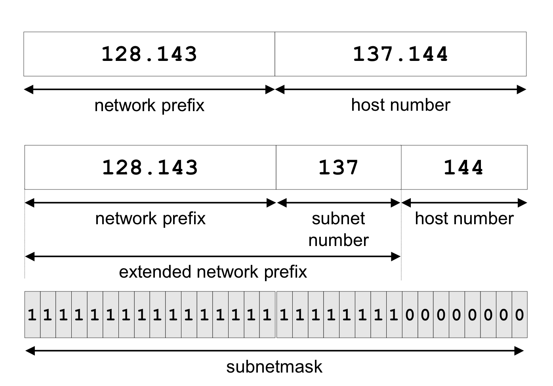
Subnetting Example: Argon

Slide 84
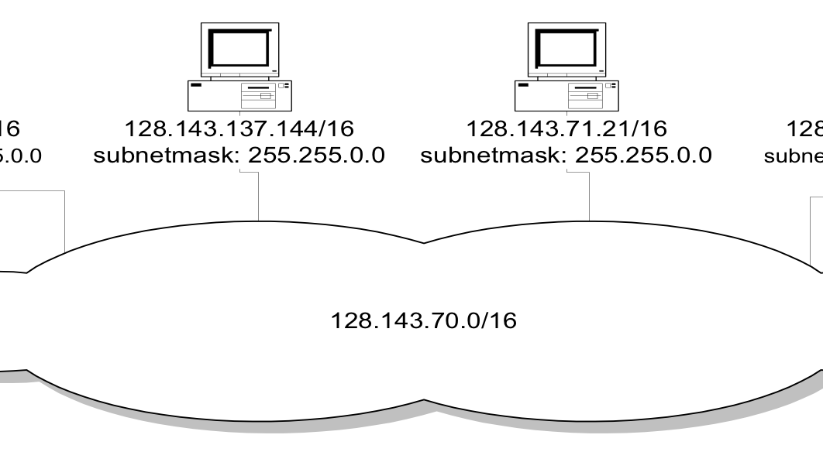
Network without subnets

Slide 85
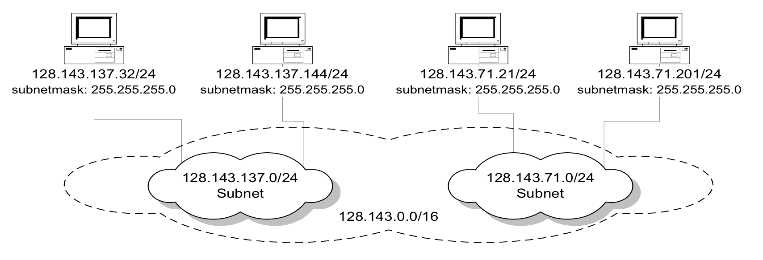
Same Network with Subnets

Slide 86
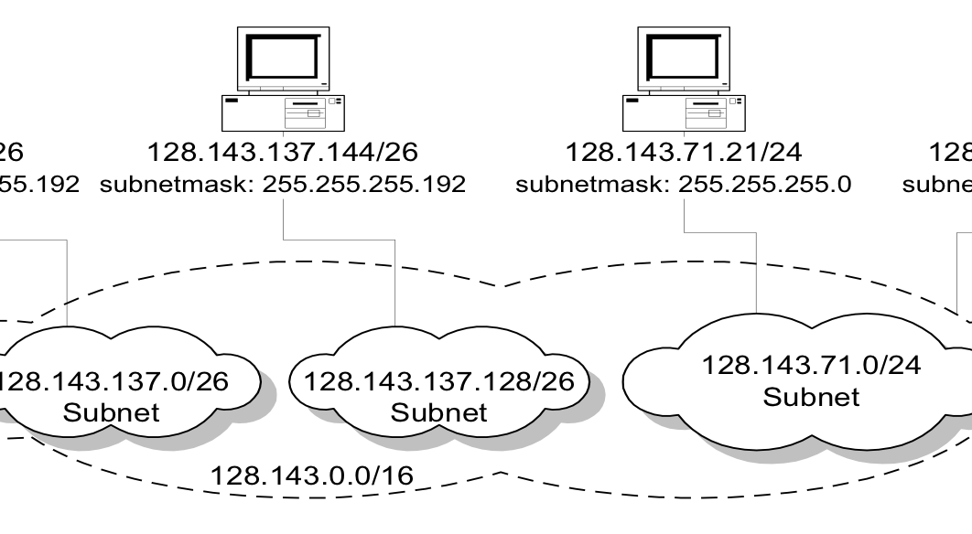
Same network with different subnetmasks

Slide 87
Subnetting Example
An organization with 4 departments has the following IP address space: 10.2.22.0/23. As the systems manager, you are required to create subnets to accommodate the IT needs of 4 departments. The subnets have to support to 200, 61, 55, and 41 hosts respectively. What are the 4 subnet network numbers?
Solution:
  10.2.22.0/24 (256 addresses > 200)
  10.2.23.0/26 (64 addresses >61)
  10.2.23.64/26 (64 addresses > 55)
  10.2.23.128/26 (64 addresses > 41)

Slide 88
CIDR - Classless Inter Domain Routing
Key Concept: The length of the network id (prefix) in the IP addresses is kept arbitrary: 32 - 1
Routers advertise not only reachable IP addresses, but ALSO the length of the prefix for each IP address

Slide 89
CIDR Example
CIDR notation of a network address:
192.0.2.0/18
    "18" says that the first 18 bits are the network part of the address
    32-18 = 14 bits are available for host/device addresses
The network part is called the prefix

Slide 90
CIDR: Prefix Size vs. Host Space
CIDR Block Prefix # of Host Addresses
/27 32 hosts
/26 64 hosts
/25 128 hosts
/24 256 hosts
/23 512 hosts
/22 1,024 hosts
/21 2,048 hosts
/20 4,096 hosts
/19 8,192 hosts
/18 16,384 hosts
/17 32,768 hosts
/16 65,536 hosts
/15 131,072 hosts
/14 262,144 hosts
/13 524,288 hosts

Slide 91
CIDR and Address assignments
Backbone ISPs obtain large blocks of IP address space and then reallocate portions of their address blocks to their customers.
Example:
Assume that an ISP owns the address block 206.0.64.0/18, which represents 16,384 (2³²⁻¹⁸=2¹⁴) IP host addresses
Suppose a client requires 800 host addresses
  512=2⁹<800<1024=2¹⁰ -> 32-10 = 22,
  Assigning a /22 block, i.e., 206.0.68.0/22 -> gives a block of 1,024 (2¹⁰) IP addresses to client.

Slide 92
Subnetting and Classless Inter Domain Routing (CIDR)
Subnetting is done by allocating some of the leading bits of the host number to indicate a subnet number.
  With subnetting, the network prefix and the subnet number make up an extended network prefix.
  The extended prefix can be expressed in terms of a subnetmask or, using CIDR notation, by adding the length of the extended subnetmask after the IP address.
For example, for Argon, the first byte of the host number (the third byte of the IP address) is used to denote the subnet number.
  128.143.0.0/16 is the IP address of the network (network prefix /16),
  128.143.137.0/24 is the IP address of the subnet,
  128.143.137.144/32 is the IP address of the host, and
  255.255.255.0 is the subnetmask of the host (or subnet prefix /24))

Slide 93
CIDR and Routing Information
Company X :
206.0.68.0/22
ISP K owns:
206.0.64.0/18
204.188.0.0/15
209.88.232.0/21
Internet Backbone
ISP Y :
209.88.237.0/24
Organization Z1 :
209.88.237.192/26
Organization Z2 :
209.88.237.0/26

Slide 94
CIDR and Routing Information
Backbone routers do not know anything about Company X, ISP Y, or Organizations Z1, Z2.
Company X :
206.0.68.0/22
ISP K owns:
ISP K does not know about Organizations Z1, Z2.
ISP Y sends everything which matches the prefix:
209.88.237.192/26 to Organizations Z1
209.88.237.0/26 to Organizations Z2
206.0.64.0/18
204.188.0.0/15
209.88.232.0/21
Internet Backbone
ISP K sends everything which matches the prefix: 206.0.68.0/22 to Company X,
209.88.237.0/24 to ISP Y
ISP Y :
209.88.237.0/24
Backbone sends everything which matches the prefixes 206.0.64.0/18, 204.188.0.0/15, 209.88.232.0/21 to ISP K.
Organization Z1 :
209.88.237.192/26
Organization Z2 :
209.88.237.0/26

Slide 95
CIDR and Routing
Aggregation of routing table entries:
  128.143.0.0/16 and 128.142.0.0/16 can be represented as 128.142.0.0/15 at a router.
    ????
Longest prefix match: Routing table lookup finds the routing entry that matches the longest prefix
  Why????
E.g., What is the outgoing interface
For destination IP address:
128.143.137.0?
Prefix | Interface/outgoing link
128.143.128.0/17 | interface #1
128.128.0.0/9 | interface #2
128.0.0.0/4 | interface #5
Routing table

Slide 96
IP Address Allocation
For a specific device interface, we either need to:
  Set IP address manually
  Get an IP address automatically using Dynamic Host Control Protocol (DHCP)
DHCP is a network service protocol, it passes out IP addresses on a subnet, based on a pool of available addresses assigned by network administrator.
Host sends a request to local DHCP for an available IP address,
Each IP address has a lease that needs to be renewed, done automatically so long as device is active

Slide 97
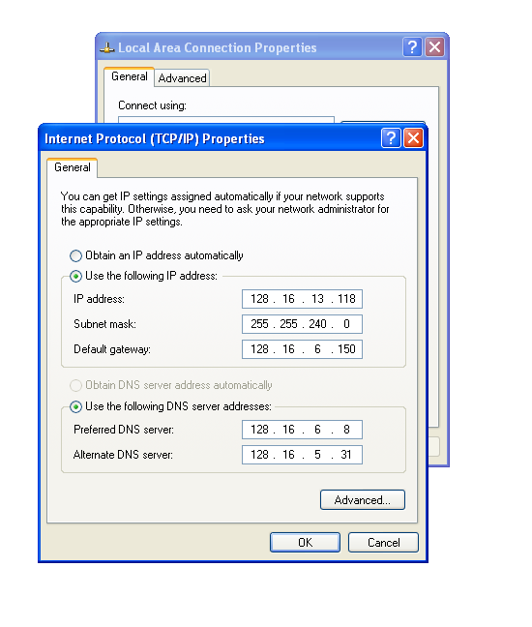
Notes:
Figure 3.31

Slide 98
LINK AND PHYSICAL LAYER

Slide 99
Link and Physical Layer
The one we all have experience with is Ethernet, either wired or wireless
Link Layer deals with communication over a single network segment which could be a point to point link, a radio channel a coax cable, or ……..
To deliver packets we need to have a mapping between the MAC address of the Ethernet adapter (physical device address) and the IP address (network address)
Use Address Resolution Protocol (ARP)

Slide 100
Protocol Layers at work
Router

Slide 101
Address Translation with ARP
ARP Request:
Argon broadcasts an ARP request to all stations on the network: “What is the hardware address of Router with IP address 128.143.137.1?”
Arp Request:
What is MAC address
of 128.143.137.1

Slide 102
Address Translation with ARP
ARP Reply:
Router 137 responds with an ARP Reply which contains the hardware address
Arp Reply:
MAC address of 128.143.137.1
Is 00:e0:f9:23:a8:20

Slide 103
Link Layer Frame Format
Bits | 0 15 | 16 31
0-31 | Destination MAC Address (6bytes) …
32-63 | … Destination MAC Address | Source MAC Address (6bytes)…
64-95 | …Source MAC Address
96-127 | Protocol Type | Data
… | Data
… | CRC Checksum
Bits | 0 15 |  |  |  |  | 16 31
0-31 | Version |  | Header Length |  | Type of Service | Total Length
32-63 | Identification |  |  |  |  | Flags | Fragment Offset
64-95 | Time to Live |  |  |  | Protocol | Header Checksum
96-127 | Data Offset | Not Used |  | Flags |  | Receive Window
Notes:
Figure 3.33

Slide 104
Basic Networking Strategies

Slide 105
Architectures
Peer to Peer
Client/Server
Hybrid

Slide 106
Consider Just Two Machines
What is the relationship between them?
  Peers?
  Master/slave? Client/server?
  Does one have data the other one does not?

Slide 107
Peer to Peer with Two Clients
Need to decide separation of responsibilities
  E.G. Each client simulates one player’s actions
Need to communicate sufficient information to the other that they can get both get the same state
Assumes that they have the same information other than real-time input
Can be achieved simply with sending input to each other

Slide 108
For Example DOOM - P2P
Doom Client_{A}
Doom Client_{C}
Read
Input
Read
Input
Receive
Input
Receive
Input
Simulate
Simulate
Rendering
Rendering
Notes:
Figure 11.6

Slide 109
Master/Slave with Two Clients
One process calculates results of input
Other just waits for rendering information

Slide 110
For Example – Thin Client/Server
Slave
Master
Read
Input
Read
Input
Receive
Input
Simulate
Rendering
Rendering
Notes:
Figure 11.6

Slide 111
More Than two Clients
The same issues exist:
  Who is responsible?
  Who has the necessary data to evolve the state?
  Who can be trusted to evolve the state?

Slide 112
Peer to Peer Architecture
Client
Client
Client
Client
Client

Slide 113
Client-Server Architecture
Server
Client
Client
Client
Client

Slide 114
Implications
Peer to Peer
  Data needs to be sent multiple times on the network, links might vary in bandwidth & latency
  Clients need to manage multiple connections
Client Server
  The Server is a bottleneck
  Clients manage one connection
  Server can have privileged data, and can probably be trusted
  Latency is higher
  Synchronization is easy

Slide 115
Hybrid Architectures
Server pool
Multiple servers serving different regions
Multiple service types & service layers

Slide 116
Summary

Slide 117
Which Protocol to Use?
If there is an application layer protocol that is appropriate use that!
UDP
  Good for fast changing data, and initial start update
  Good for position information
TCP
  Good for reliable data, and bulk data transfer
  Good for data assets and critical information such as score

Slide 118
Which Protocol to Use?
Some people implement “reliability-lite” on top of UDP
Other platforms mix UDP & TCP
  There are many catches with this
Many platforms support application layer protocols such as HTTP or FTP for bulk asset transfer

Slide 119
Conclusions
NVEs & NGs have a long history, but it is in the last 10 years that they have really taken off
The Internet is a best effort network where applications need to deal with latency & loss
There are various architectures that support NVEs & NGs

