Slide 1
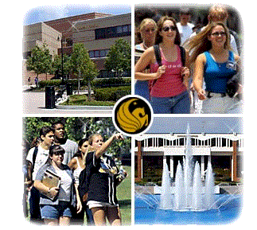
Research & Development Support to DHS
Ronald W. Tarr
Program Director, RAPTER
Institute for Simulation and Training
University of Central Florida

Slide 2
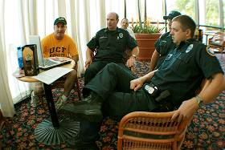
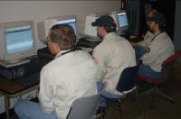
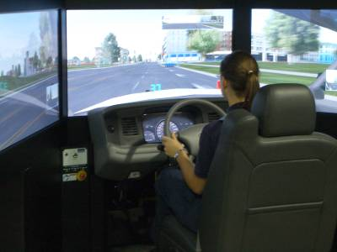
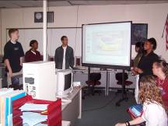
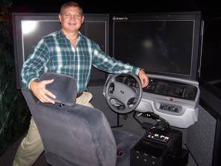
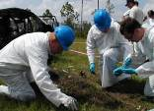
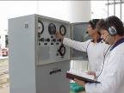
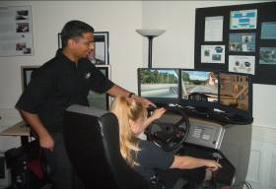
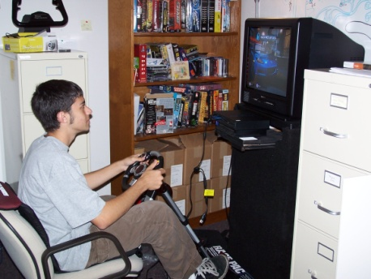
Research in Advanced Performance Technology and Educational Readiness
Enhancing Human Performance
with the Right Technology
Ronald W. Tarr
Program Director
RAPTER-IST
http://rapter.ist.ucf.edu/index.htm
University of Central Florida

Slide 3
Mission Statement
Our mission is to enhance human performance through the use of appropriate technologies and strategies.
These technologies and strategies include: simulation, computer- and web-based training, decision support aids, workshops, and traditional methods.
As human performance technologists we look at how people perform as individuals, in teams, and within organizations.
A Global Approach to Human Performance:
Systematic, Comprehensive, Efficient, Focused,
& Outcome Oriented

Slide 5
Advanced Performance Technology© Model
As illustrated by the Advanced Performance Technology© Model, this R&D process is NOT linear.
Steps are revisited
until success has
been achieved.
The focus is on Outcomes
for the selected Audience
using appropriate Technology
in a Systematic Approach
to Enhance Human Performance

Slide 6
Project Goal
The purpose of this effort is to perform research and development for FLETC, (specifically the Training Innovation Division (TID), to determine the most useful and cost-effective method for using the newly acquired L3-MPRI driving simulators.
To Provide specific recommendations and justifications for a driver simulator integration program and implementation plan.

Slide 7
FLETC Driver Simulation Integration

Slide 8
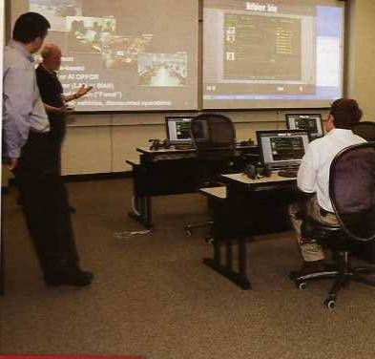
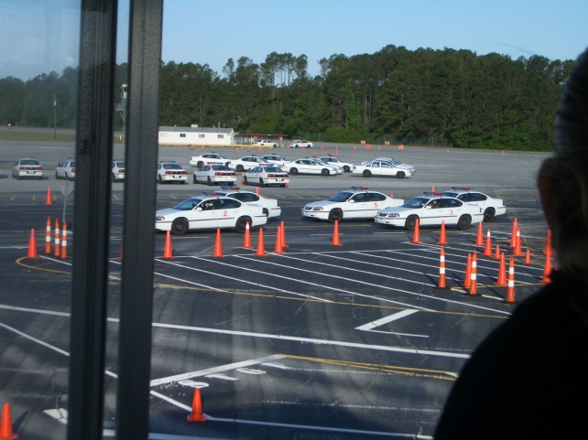
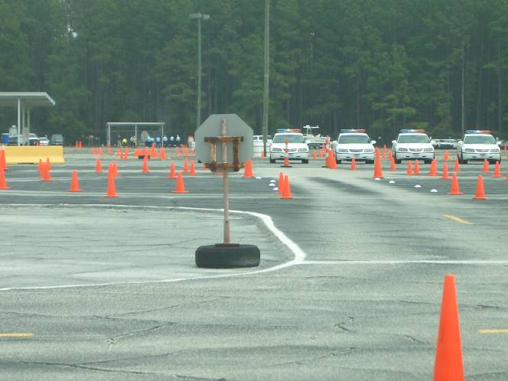
Current Training Model
Classroom
training
Live Driver
Training & Lab
NEVO/ER
Eval

Slide 9
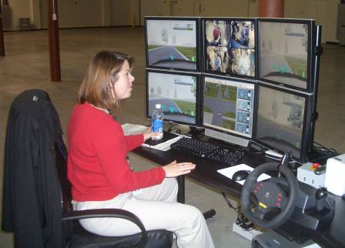
Proposed Training Model
Classroom
training
Live Driver
Training & Lab
Sim Driver
training
NEVO/ER
Eval

Slide 10
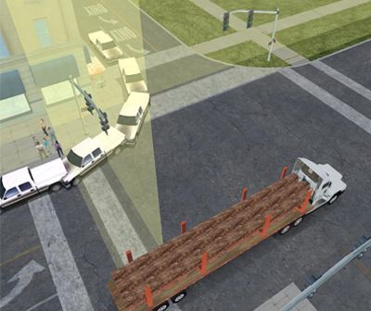
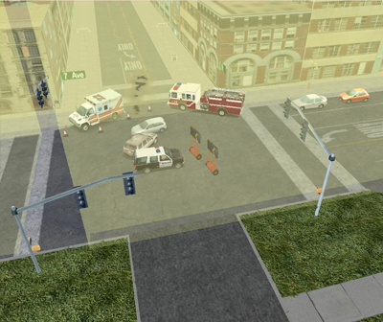
Scenario Strategy
Lots of Traffic Control Device’s
Multiple intersections training scenes
Various pedestrians activities
Night time driving scenarios
Suspicious activities within advanced scenarios
Scenarios designed for scanning techniques
Notes:
These were target areas for scenario development

Slide 11
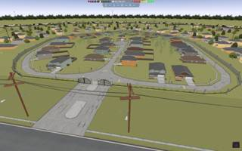
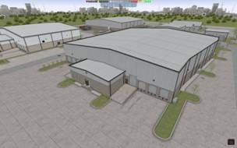
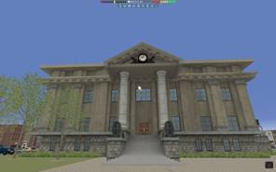
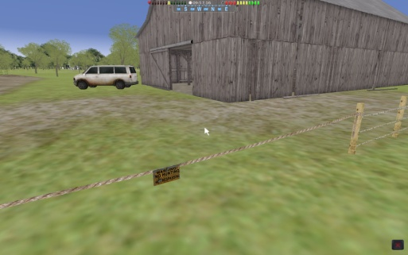
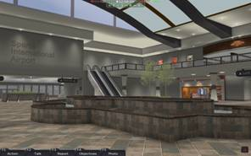
Terrorism Indication and Prevention Simulation (TIPS) Overview
Tasked to develop a virtual training environment in which to teach the importance of situational awareness, reporting, and data analysis on routine missions.

Slide 12
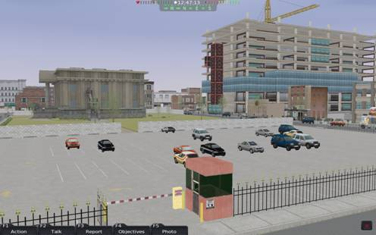
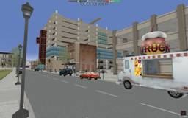
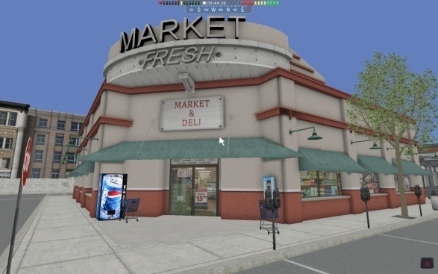
TIPS Scenario Surveillance Detection
Counter Terrorism Division (CTD) has developed a new course for the UPTP program “Surveillance Detection for the Uniformed Officer.”
CTD wanted a scenario in which they could show how to assess vulnerabilities and suspicious activity in and around a courthouse setting.
Reused courthouse database in TIPS and to modify the surroundings to add different levels and types of vulnerabilities.

Slide 13
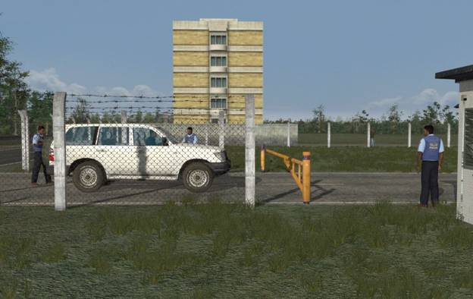
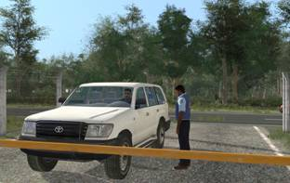
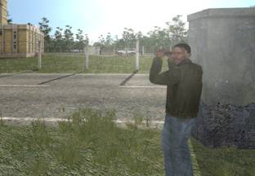
VBS2 Proof-of-Concept
Developed ‘Virtual Cop On Patrol’ Scenario - Surveillance Detection
Conceptual mockup of scenario

Slide 14
Research in Advanced Performance Technology and Educational Readiness (RAPTER)
Enhancing human performance by applying proven adult learning methods through the appropriate intervention of technologies
– often a blend of several.

