Slide 1
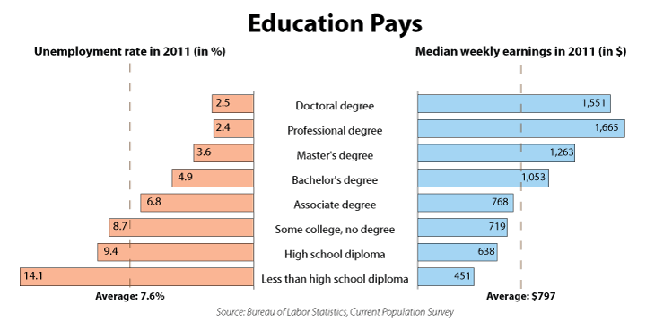
Professional degrees include MD, DDS, DVM, LLB, JD.
(Physicians, dentists, veterinarians, lawyers; the US has not offered the LLB since 1971.)

Slide 2
ICS FACULTY PANEL ON IMPROVING YOUR GRADUATE SCHOOL APPLICATION
10:00-10:50am, Wednesday, 24 Oct., 2012, in DBH-6011
Wondering what to do to improve your graduate school application?
Wondering how the process "really works," and what they look for?
Come to this ICS FACULTY PANEL to hear advice from the ICS faculty.
The very people who admit students into the ICS graduate programs
will give advice and answer questions about graduate school applications.
Sophomores, Juniors, and Masters students are especially encouraged
to attend so that they can begin planning for graduate school now.
This presentation to the ICS Honors Program has been opened to all
interested ICS students because of its broad general interest.

Slide 3
ICS FACULTY PANEL ON IMPROVING YOUR GRADUATE SCHOOL APPLICATION
10:00-10:50am, Wednesday, 24 Oct., 2012, in DBH-6011
ICS Faculty Panelists:
Mike Carey [Computer Science/Vice Chair, Graduate Studies]
Ian Harris [Computer Science/Embedded Systems]
Sandy Irani [Computer Science/former CS Chair/Algorithms]
David Kay [Informatics/Vice Chair for Student Affairs]
Deva Ramanan [Computer Science/AI, ML, Computer Vision]
Amelia Regan [Computer Science/Networks, algorithms]
Debra Richardson [Informatics/former ICS Dean/SW Engineering]
Hal Stern [Statistics/ICS Dean/Statistical theory]
This presentation to the ICS Honors Program has been opened to all
interested ICS students because of its broad general interest.

