Slide 1
Constraint Satisfaction Problems (CSPs) Introduction and Backtracking Search
This lecture topic (two lectures)
Chapter 6.1 – 6.4, except 6.3.3
Next lecture topic (two lectures)
Chapter 7.1 – 7.5
(Please read lecture topic material before and after each lecture on that topic)

Slide 2
Outline
What is a CSP?
Backtracking Search for CSP
Variable selection (ordering)
Minimum Remaining Values (MRV) heuristic
Degree Heuristic
Value selection (ordering)
Least Constraining Value (LCV) heuristic

Slide 3
You Will Be Expected to Know
Basic definitions (section 6.1)
Backtracking search (6.3)
Variable ordering or selection (6.3.1)
minimum-remaining values
degree heuristic
Value ordering or selection (6.3.1)
least-constraining-value

Slide 4
Constraint Satisfaction Problems
What is a CSP?
Finite set of variables X₁, X₂, …, X_{n}
Nonempty domain of possible values for each variable D₁, D₂, …, D_{n}
Finite set of constraints C₁, C₂, …, C_{m}
Each constraint C_{i} limits the values that variables can take,
e.g., X₁ ≠ X₂
Each constraint C_{i} is a pair <scope, relation>
Scope = Tuple of variables that participate in the constraint.
Relation = List of allowed combinations of variable values.
May be an explicit list of allowed combinations.
May be an abstract relation allowing membership testing and listing.
CSP benefits
Standard representation pattern
Generic goal and successor functions
Generic heuristics (no domain specific expertise).

Slide 5
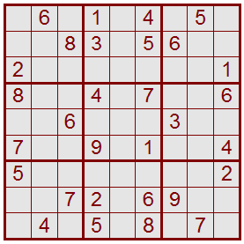
Sudoku as a Constraint Satisfaction Problem (CSP)
1 2 3 4 5 6 7 8 9
A
B
C
D
E
F
G
H
I
Variables: 81 variables
A1, A2, A3, …, I7, I8, I9
Letters index rows, top to bottom
Digits index columns, left to right
Domains: The nine positive digits
A1 ∈ {1, 2, 3, 4, 5, 6, 7, 8, 9}
Etc.
Constraints: 27 Alldiff constraints
Alldiff(A1, A2, A3, A4, A5, A6, A7, A8, A9)
Etc.

Slide 6
Random Binary CSP (adapted from http://www.unitime.org/csp.php)
A random binary CSP is defined by a four-tuple (n, d, p1, p2)
n = the number of variables.
d = the domain size of each variable.
p1 = probability a constraint exists between two variables.
p2 = probability a pair of values in the domains of two variables connected by a constraint is incompatible.
Note that R&N lists compatible pairs of values instead.
Equivalent formulations; just take the set complement.
(n, d, p1, p2) are used to generate randomly the binary constraints among the variables.
The so called model B of Random CSP (n, d, n1, n2)
n1 = p1n(n-1)/2 pairs of variables are randomly and uniformly selected and binary constraints are posted between them.
For each constraint, n2 = p2d^2 randomly and uniformly selected pairs of values are picked as incompatible.
The random CSP as an optimization problem (minCSP).
Goal is to minimize the total sum of values for all variables.

Slide 7
CSPs --- what is a solution?
A state is an assignment of values to some or all variables.
An assignment is complete when every variable has a value.
An assignment is partial when some variables have no values.
Consistent assignment
assignment does not violate the constraints
A solution to a CSP is a complete and consistent assignment.
Some CSPs require a solution that maximizes an objective function.
Examples of Applications:
Scheduling the time of observations on the Hubble Space Telescope
Airline schedules
Cryptography
Computer vision -> image interpretation
Scheduling your MS or PhD thesis exam ☺

Slide 8
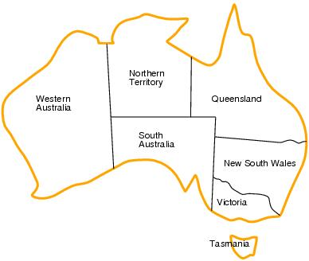
CSP example: map coloring
Variables: WA, NT, Q, NSW, V, SA, T
Domains: D_{i}={red,green,blue}
Constraints:adjacent regions must have different colors.
E.g. WA ≠ NT

Slide 9
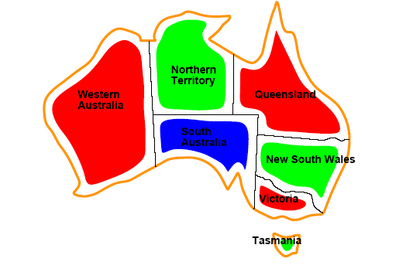
CSP example: map coloring
Solutions are assignments satisfying all constraints, e.g.
{WA=red,NT=green,Q=red,NSW=green,V=red,SA=blue,T=green}

Slide 10
Graph coloring
More general problem than map coloring
Planar graph = graph in the 2d-plane with no edge crossings
Guthrie’s conjecture (1852)
Every planar graph can be colored with 4 colors or less
Proved (using a computer) in 1977 (Appel and Haken)

Slide 11
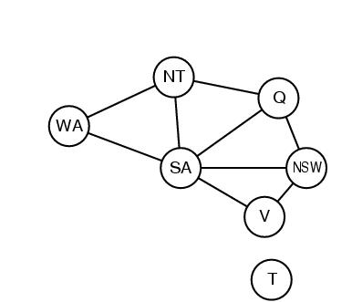
Constraint graphs
Constraint graph:
nodes are variables
arcs are binary constraints
Graph can be used to simplify search
e.g. Tasmania is an independent subproblem
(will return to graph structure later)

Slide 12
Varieties of CSPs
Discrete variables
Finite domains; size d ⇒O(d^{n}) complete assignments.
E.g. Boolean CSPs: Boolean satisfiability (NP-complete).
Infinite domains (integers, strings, etc.)
E.g. job scheduling, variables are start/end days for each job
Need a constraint language e.g StartJob₁ +5 ≤ StartJob₃.
Infinitely many solutions
Linear constraints: solvable
Nonlinear: no general algorithm
Continuous variables
e.g. building an airline schedule or class schedule.
Linear constraints solvable in polynomial time by LP methods.

Slide 13
Varieties of constraints
Unary constraints involve a single variable.
e.g. SA ≠ green
Binary constraints involve pairs of variables.
e.g. SA ≠ WA
Higher-order constraints involve 3 or more variables.
Professors A, B,and C cannot be on a committee together
Can always be represented by multiple binary constraints
Preference (soft constraints)
e.g. red is better than green often can be represented by a cost for each variable assignment
combination of optimization with CSPs

Slide 14
CSPs Only Need Binary Constraints!!
Unary constraints: Just delete values from variable’s domain.
Higher order (3 variables or more): reduce to binary constraints.
Simple example:
Three example variables, X, Y, Z.
Domains Dx={1,2,3}, Dy={1,2,3}, Dz={1,2,3}.
Constraint C[X,Y,Z] = {X+Y=Z} = {(1,1,2), (1,2,3), (2,1,3)}.
Plus many other variables and constraints elsewhere in the CSP.
Create a new variable, W, taking values as triples (3-tuples).
Domain of W is Dw = {(1,1,2), (1,2,3), (2,1,3)}.
Dw is exactly the tuples that satisfy the higher order constraint.
Create three new constraints:
C[X,W] = { [1, (1,1,2)], [1, (1,2,3)], [2, (2,1,3)] }.
C[Y,W] = { [1, (1,1,2)], [2, (1,2,3)], [1, (2,1,3)] }.
C[Z,W] = { [2, (1,1,2)], [3, (1,2,3)], [3, (2,1,3)] }.
Other constraints elsewhere involving X, Y, or Z are unaffected.

Slide 15
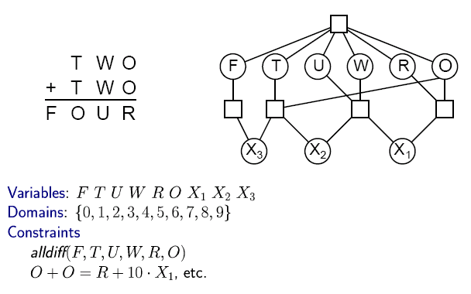
CSP Example: Cryptharithmetic puzzle

Slide 16
CSP Example: Cryptharithmetic puzzle

Slide 17
CSP Example: Cryptharithmetic puzzle
A Solution:
F=1, T=7, U=6, W=3, R=8, O=4,
X1=0, X2=0, X3=1
7 3 4
+ 7 3 4
1 4 6 8

Slide 18
CSP Example: Cryptharithmetic puzzle
Try it yourself at home:
(A frequent request from college students to parents!)
S E N D
+ M O R E
M O N E Y

Slide 19
CSP as a standard search problem
A CSP can easily be expressed as a standard search problem.
Incremental formulation
Initial State: the empty assignment {}
Actions: Assign a value to an unassigned variable provided that it does not violate a constraint
Goal test: the current assignment is complete
(by construction it is consistent)
Path cost: constant cost for every step (not really relevant)
Can also use complete-state formulation
Local search techniques (Chapter 4) tend to work well

Slide 20
CSP as a standard search problem
Solution is found at depth n (if there are n variables).
Consider using BFS
Branching factor b at the top level is nd
At next level is (n-1)d
….
end up with n!d^{n} leaves even though there are only d^{n} complete assignments!

Slide 21
Commutativity
CSPs are commutative.
The order of any given set of actions has no effect on the outcome.
Example: choose colors for Australian territories one at a time
[WA=red then NT=green] same as [NT=green then WA=red]
All CSP search algorithms can generate successors by considering assignments for only a single variable at each node in the search tree
⇒ there are d^{n} leaves
(will need to figure out later which variable to assign a value to at each node)

Slide 22
Backtracking search
Similar to Depth-first search, generating children one at a time.
Chooses values for one variable at a time and backtracks when a variable has no legal values left to assign.
Uninformed algorithm
No good general performance

Slide 23
Backtracking search (Figure 6.5)
function BACKTRACKING-SEARCH(csp) return a solution or failure
return RECURSIVE-BACKTRACKING({} , csp)
function RECURSIVE-BACKTRACKING(assignment, csp) return a solution or failure
if assignment is complete then return assignment
var ← SELECT-UNASSIGNED-VARIABLE(VARIABLES[csp],assignment,csp)
for each value in ORDER-DOMAIN-VALUES(var, assignment, csp) do
if value is consistent with assignment according to CONSTRAINTS[csp] then
add {var=value} to assignment
result ← RECURSIVE-BACTRACKING(assignment, csp)
if result ≠ failure then return result
remove {var=value} from assignment
return failure

Slide 24
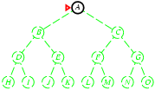
Backtracking search
Expand deepest unexpanded node
Generate only one child at a time.
Goal-Test when inserted.
For CSP, Goal-test at bottom
Future= green dotted circles
Frontier=white nodes
Expanded/active=gray nodes
Forgotten/reclaimed= black nodes

Slide 25
Backtracking search
Expand deepest unexpanded node
Generate only one child at a time.
Goal-Test when inserted.
For CSP, Goal-test at bottom
Future= green dotted circles
Frontier=white nodes
Expanded/active=gray nodes
Forgotten/reclaimed= black nodes

Slide 26
Backtracking search
Expand deepest unexpanded node
Generate only one child at a time.
Goal-Test when inserted.
For CSP, Goal-test at bottom
Future= green dotted circles
Frontier=white nodes
Expanded/active=gray nodes
Forgotten/reclaimed= black nodes

Slide 27
Backtracking search
Expand deepest unexpanded node
Generate only one child at a time.
Goal-Test when inserted.
For CSP, Goal-test at bottom
Future= green dotted circles
Frontier=white nodes
Expanded/active=gray nodes
Forgotten/reclaimed= black nodes

Slide 28
Backtracking search
Expand deepest unexpanded node
Generate only one child at a time.
Goal-Test when inserted.
For CSP, Goal-test at bottom
Future= green dotted circles
Frontier=white nodes
Expanded/active=gray nodes
Forgotten/reclaimed= black nodes

Slide 29
Backtracking search
Expand deepest unexpanded node
Generate only one child at a time.
Goal-Test when inserted.
For CSP, Goal-test at bottom
Future= green dotted circles
Frontier=white nodes
Expanded/active=gray nodes
Forgotten/reclaimed= black nodes

Slide 30
Backtracking search
Expand deepest unexpanded node
Generate only one child at a time.
Goal-Test when inserted.
For CSP, Goal-test at bottom
Future= green dotted circles
Frontier=white nodes
Expanded/active=gray nodes
Forgotten/reclaimed= black nodes

Slide 31
Backtracking search
Expand deepest unexpanded node
Generate only one child at a time.
Goal-Test when inserted.
For CSP, Goal-test at bottom
Future= green dotted circles
Frontier=white nodes
Expanded/active=gray nodes
Forgotten/reclaimed= black nodes

Slide 32
Backtracking search
Expand deepest unexpanded node
Generate only one child at a time.
Goal-Test when inserted.
For CSP, Goal-test at bottom
Future= green dotted circles
Frontier=white nodes
Expanded/active=gray nodes
Forgotten/reclaimed= black nodes

Slide 33
Backtracking search
Expand deepest unexpanded node
Generate only one child at a time.
Goal-Test when inserted.
For CSP, Goal-test at bottom
Future= green dotted circles
Frontier=white nodes
Expanded/active=gray nodes
Forgotten/reclaimed= black nodes

Slide 34
Backtracking search
Expand deepest unexpanded node
Generate only one child at a time.
Goal-Test when inserted.
For CSP, Goal-test at bottom
Future= green dotted circles
Frontier=white nodes
Expanded/active=gray nodes
Forgotten/reclaimed= black nodes

Slide 35
Backtracking search
Expand deepest unexpanded node
Generate only one child at a time.
Goal-Test when inserted.
For CSP, Goal-test at bottom
Future= green dotted circles
Frontier=white nodes
Expanded/active=gray nodes
Forgotten/reclaimed= black nodes

Slide 36
Backtracking search (Figure 6.5)
function BACKTRACKING-SEARCH(csp) return a solution or failure
return RECURSIVE-BACKTRACKING({} , csp)
function RECURSIVE-BACKTRACKING(assignment, csp) return a solution or failure
if assignment is complete then return assignment
var ← SELECT-UNASSIGNED-VARIABLE(VARIABLES[csp],assignment,csp)
for each value in ORDER-DOMAIN-VALUES(var, assignment, csp) do
if value is consistent with assignment according to CONSTRAINTS[csp] then
add {var=value} to assignment
result ← RECURSIVE-BACTRACKING(assignment, csp)
if result ≠ failure then return result
remove {var=value} from assignment
return failure

Slide 37
Improving CSP efficiency
Previous improvements on uninformed search
→ introduce heuristics
For CSPS, general-purpose methods can give large gains in speed, e.g.,
Which variable should be assigned next?
In what order should its values be tried?
Can we detect inevitable failure early?
Can we take advantage of problem structure?
Note: CSPs are somewhat generic in their formulation, and so the heuristics are more general compared to methods in Chapter 4

Slide 38
Backtracking search (Figure 6.5)
function BACKTRACKING-SEARCH(csp) return a solution or failure
return RECURSIVE-BACKTRACKING({} , csp)
function RECURSIVE-BACKTRACKING(assignment, csp) return a solution or failure
if assignment is complete then return assignment
var ← SELECT-UNASSIGNED-VARIABLE(VARIABLES[csp],assignment,csp)
for each value in ORDER-DOMAIN-VALUES(var, assignment, csp) do
if value is consistent with assignment according to CONSTRAINTS[csp] then
add {var=value} to assignment
result ← RRECURSIVE-BACTRACKING(assignment, csp)
if result ≠ failure then return result
remove {var=value} from assignment
return failure

Slide 39
Minimum remaining values (MRV) for next variable
var ← SELECT-UNASSIGNED-VARIABLE(VARIABLES[csp],assignment,csp)
A.k.a. most constrained variable heuristic
Heuristic Rule: choose variable with the fewest legal moves
e.g., will immediately detect failure if X has no legal values

Slide 40
Degree heuristic for next variable
Heuristic Rule: select variable that is involved in the largest number of constraints on other unassigned variables.
Degree heuristic can be useful as a tie breaker after MRV.
In what order should a variable’s values be tried?

Slide 41
Backtracking search (Figure 6.5)
function BACKTRACKING-SEARCH(csp) return a solution or failure
return RECURSIVE-BACKTRACKING({} , csp)
function RECURSIVE-BACKTRACKING(assignment, csp) return a solution or failure
if assignment is complete then return assignment
var ← SELECT-UNASSIGNED-VARIABLE(VARIABLES[csp],assignment,csp)
for each value in ORDER-DOMAIN-VALUES(var, assignment, csp) do
if value is consistent with assignment according to CONSTRAINTS[csp] then
add {var=value} to assignment
result ← RRECURSIVE-BACTRACKING(assignment, csp)
if result ≠ failure then return result
remove {var=value} from assignment
return failure

Slide 42
Least constraining value (LCV) for next value
Least constraining value heuristic
Heuristic Rule: given a variable choose the least constraining value
leaves the maximum flexibility for subsequent variable assignments

Slide 43
Minimum remaining values (MRV) vs. Least constraining value (LCV)
Why do we want the MRV (minimum values, most constraining) for variable selection --- but the LCV (maximum values, least constraining) for value selection?
Isn’t there a contradiction here?
MRV for variable selection to reduces the branching factor.
Smaller branching factors lead to faster search.
Hopefully, when we get to variables with currently many values, constraint propagation (next lecture) will have removed some of their values and they’ll have small branching factors by then too.
LCV for value selection increases the chance of early success.
If we are going to fail at this node, then we have to examine every value anyway, and their order makes no difference at all.
If we are going to succeed, then the earlier we succeed the sooner we can stop searching, so we want to succeed early.
LCV rules out the fewest possible solutions below this node, so we have the most chances for early success.

Slide 44
Summary
CSPs
special kind of problem: states defined by values of a fixed set of variables, goal test defined by constraints on variable values
Backtracking=depth-first search with one variable assigned per node
Heuristics
Variable ordering and value selection heuristics help significantly
Variable ordering (selection) heuristics
Choose variable with Minimum Remaining Values (MRV)
Degree Heuristic --- break ties after applying MRV
Value ordering (selection) heuristic
Choose Least Constraining Value

