Slide 1
The Importance of
A Good Representation
“You can’t learn what
you can’t represent.”
--- G. Sussman

Slide 2
Properties of a good representation:
Reveals important features
Hides irrelevant detail
Exposes useful constraints
Makes frequent operations easy-to-do
Supports local inferences from local features
  Called the “soda straw” principle or “locality” principle
  Inference from features “through a soda straw”
Rapidly or efficiently computable
  It’s nice to be fast

Slide 3
Reveals important features / Hides irrelevant detail
In search:
A man is traveling to market with a fox, a goose, and a bag of oats. He comes to a river. The only way across the river is a boat that can hold the man and exactly one of the fox, goose or bag of oats. The fox will eat the goose if left alone with it, and the goose will eat the oats if left alone with it.
How can the man get all his possessions safely across the river?
1110
0010
1010
1111
0001
0101
Notes:
3

Slide 4
Reveals important features / Hides irrelevant detail
In search: A man is traveling to market with a fox, a goose, and a bag of oats. He comes to a river. The only way across the river is a boat that can hold the man and exactly one of the fox, goose or bag of oats. The fox will eat the goose if left alone with it, and the goose will eat the oats if left alone with it.
  How can the man get all his possessions safely across the river?
A good representation makes this problem easy:
1110
0010
1010
1111
0001
0101
MFGO
M = man
F = fox
G = goose
O = oats
0 = starting side
1 = ending side
Notes:
4

Slide 5
Exposes useful constraints
In logic:
If the unicorn is mythical, then it is immortal, but if it is not mythical, then it is a mortal mammal. If the unicorn is either immortal or a mammal, then it is horned. The unicorn is magical if it is horned.
Prove that the unicorn is both magical and horned.
Notes:
5

Slide 6
Exposes useful constraints
In logic: If the unicorn is mythical, then it is immortal, but if it is not mythical, then it is a mortal mammal. If the unicorn is either immortal or a mammal, then it is horned. The unicorn is magical if it is horned.
  Prove that the unicorn is both magical and horned.
A good representation makes this problem easy (as we’ll see when we do our unit on logic):
( ¬ Y ˅ ¬ R ) ^ ( Y ˅ R ) ^ ( Y ˅ M ) ^ ( R ˅ H ) ^ ( ¬ M ˅ H ) ^ ( ¬ H ˅ G )
1010
1111
0001
0101
Notes:
6

Slide 7
Makes frequent operations easy-to-do
Roman numerals
  M=1000, D=500, C=100, L=50, X=10, V=5, I=1
  2000 = MM; 1776 = MDCCLXXVI
Long division is very tedious (try MDCCLXXVI / XVI)
Testing for N < 1000 is very easy (first letter is not “M”)
Arabic numerals
  0, 1, 2, 3, 4, 5, 6, 7, 8, 9, “.”
Long division is much easier (try 1776 / 16)
Testing for N < 1000 is slightly harder (have to scan the string)

Slide 8
Local inferences from local features
Linear vector of pixels
= highly non-local inference for vision
Rectangular array of pixels
= local inference for vision
… | … | 0 | 1 | 0 | … | … | 0 | 1 | 1 | … | … | 0 | 0 | 0 | … | …
Corner??
Corner!!
0 | 0 | 0 | 1 | 0 | 0 | 0 | 0 | 0 | 0
0 | 0 | 0 | 1 | 0 | 0 | 0 | 0 | 0 | 0
0 | 0 | 0 | 1 | 0 | 0 | 0 | 0 | 0 | 0
0 | 0 | 0 | 1 | 1 | 1 | 1 | 1 | 1 | 1
0 | 0 | 0 | 0 | 0 | 0 | 0 | 0 | 0 | 0
0 | 0 | 0 | 0 | 0 | 0 | 0 | 0 | 0 | 0

Slide 9
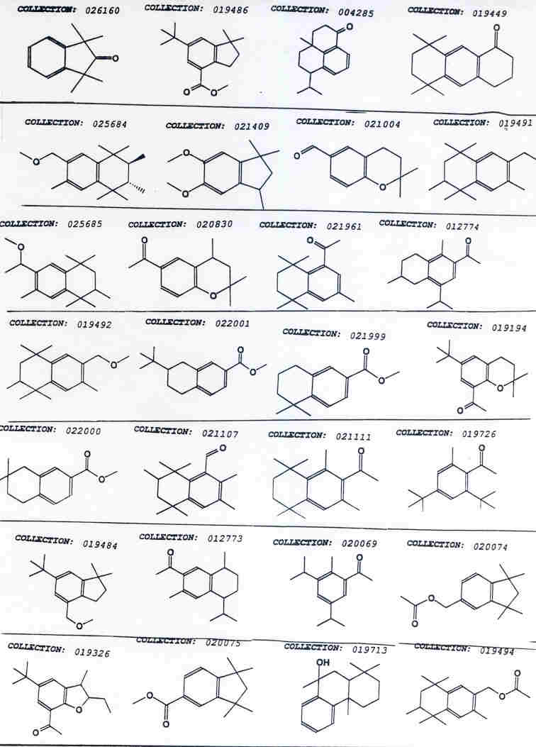

Slide 10
Positive Examples | Negative Examples
*
*
*

Slide 11
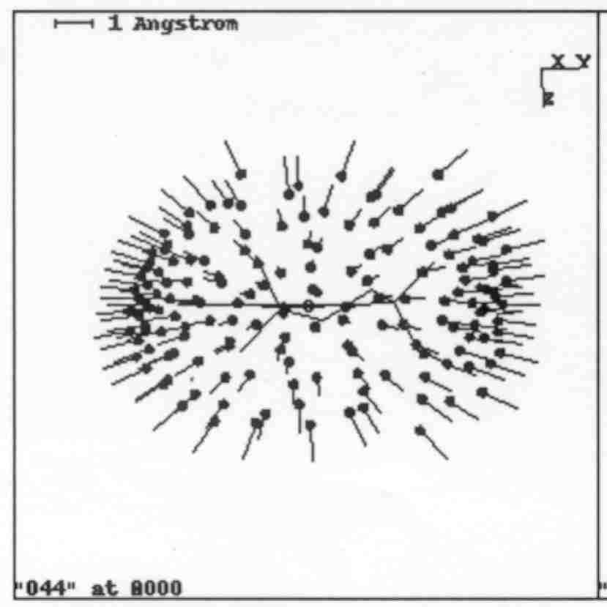
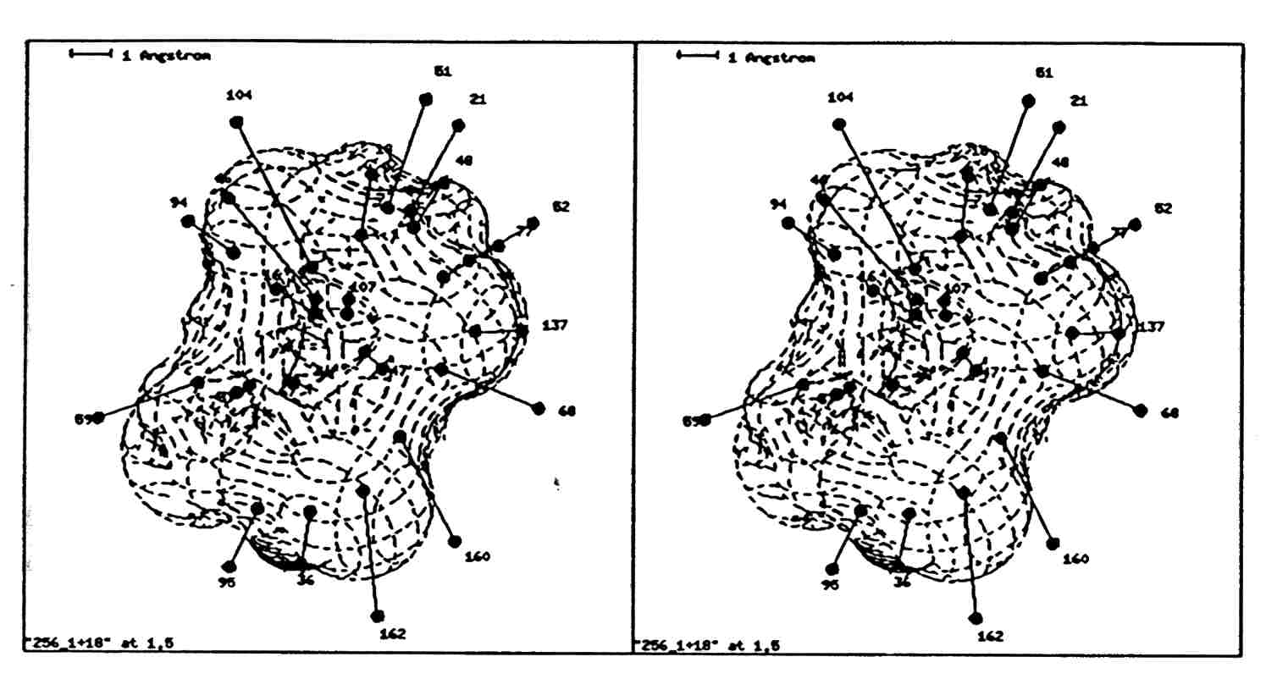
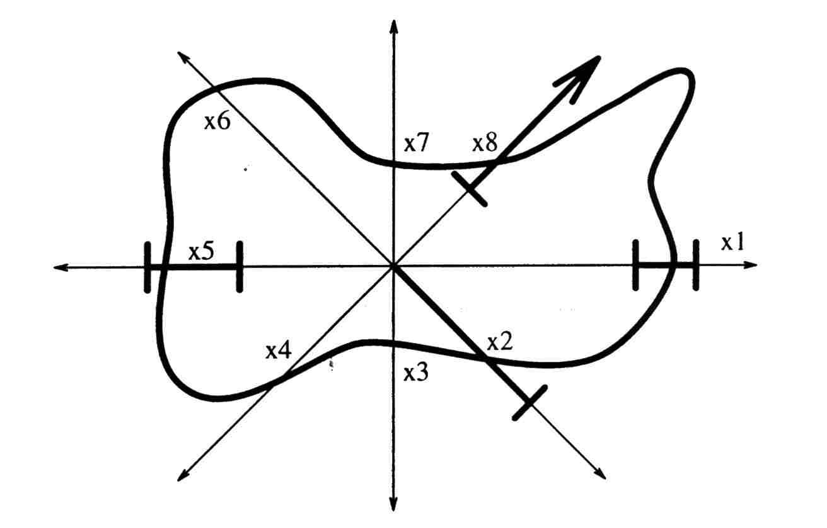
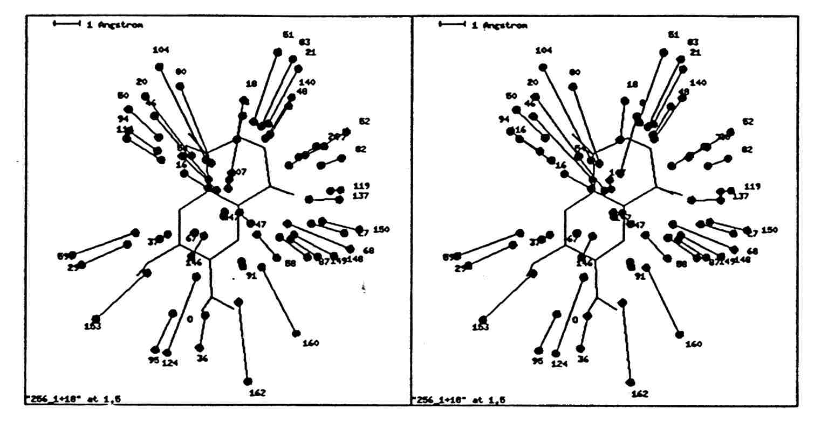
Digital 3D Shape Representation

Slide 12
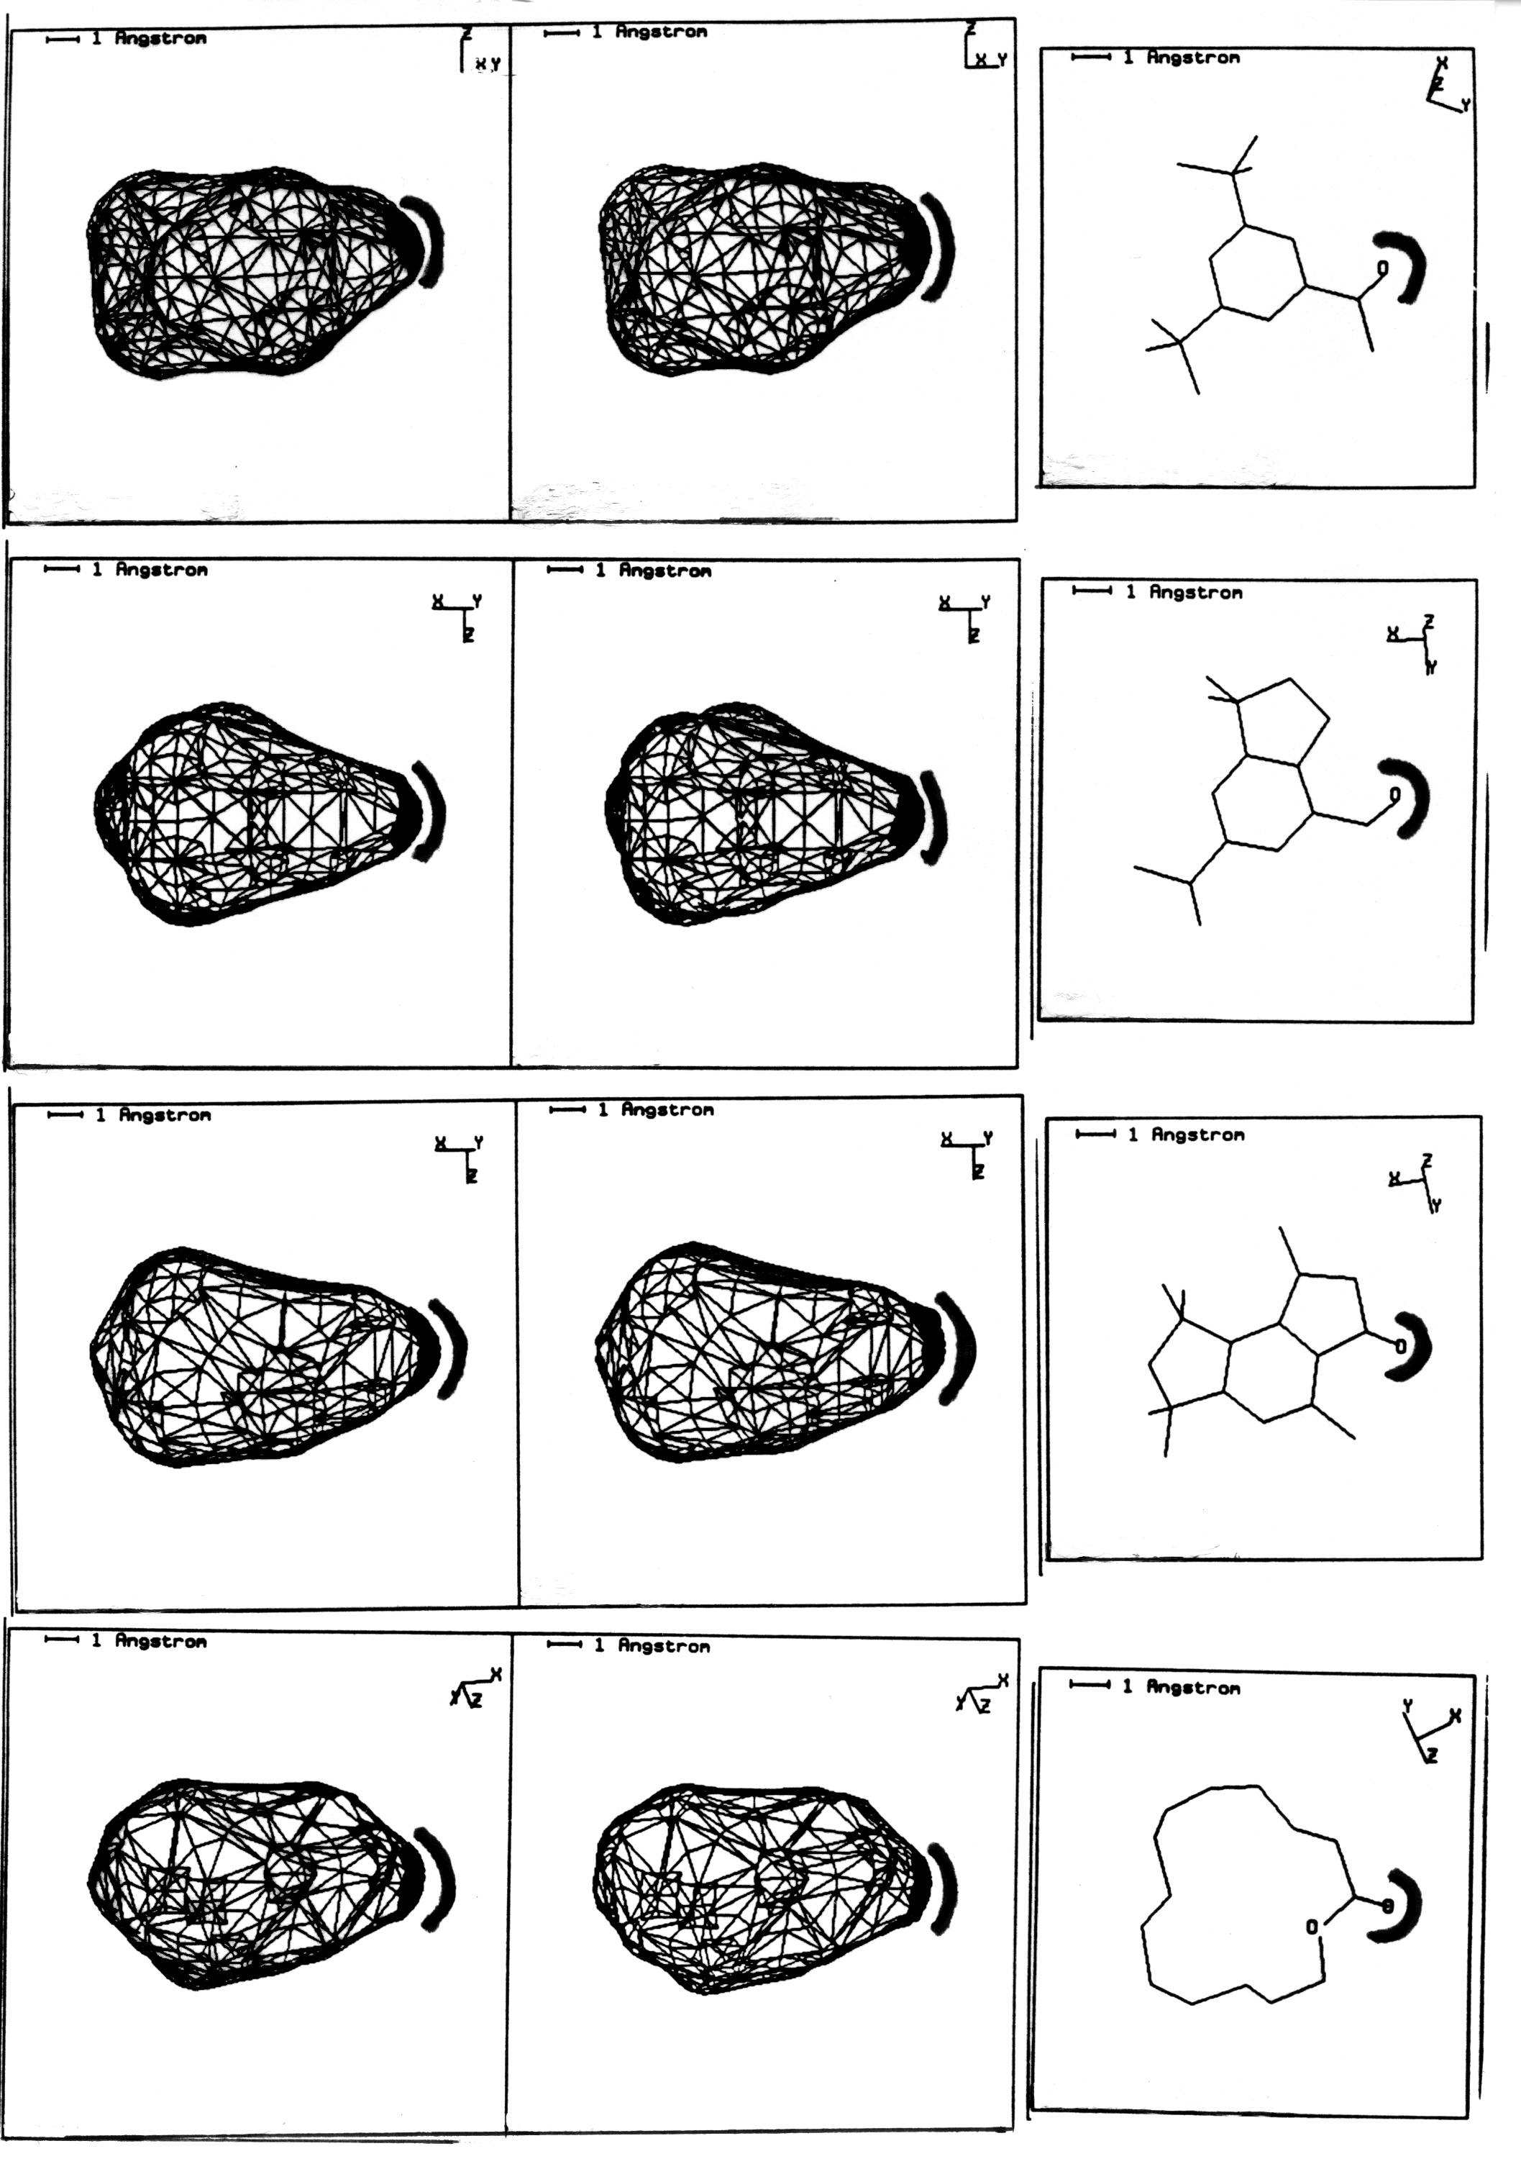
The Power of a Good Representation

Slide 13
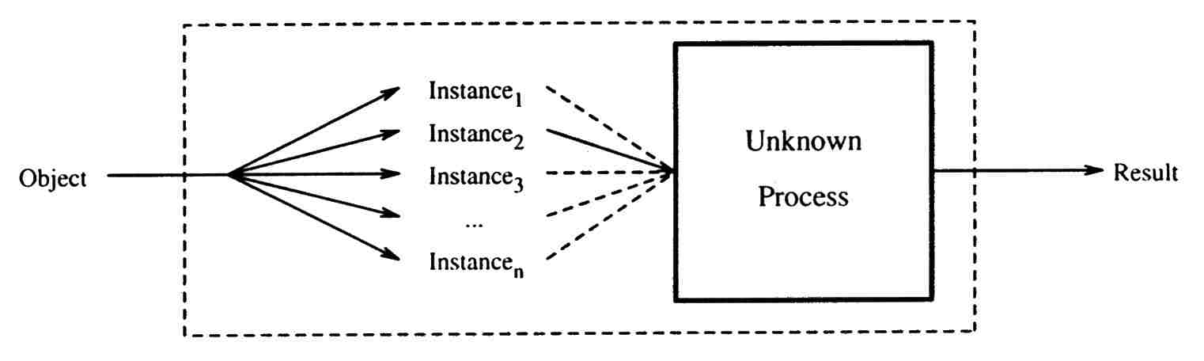
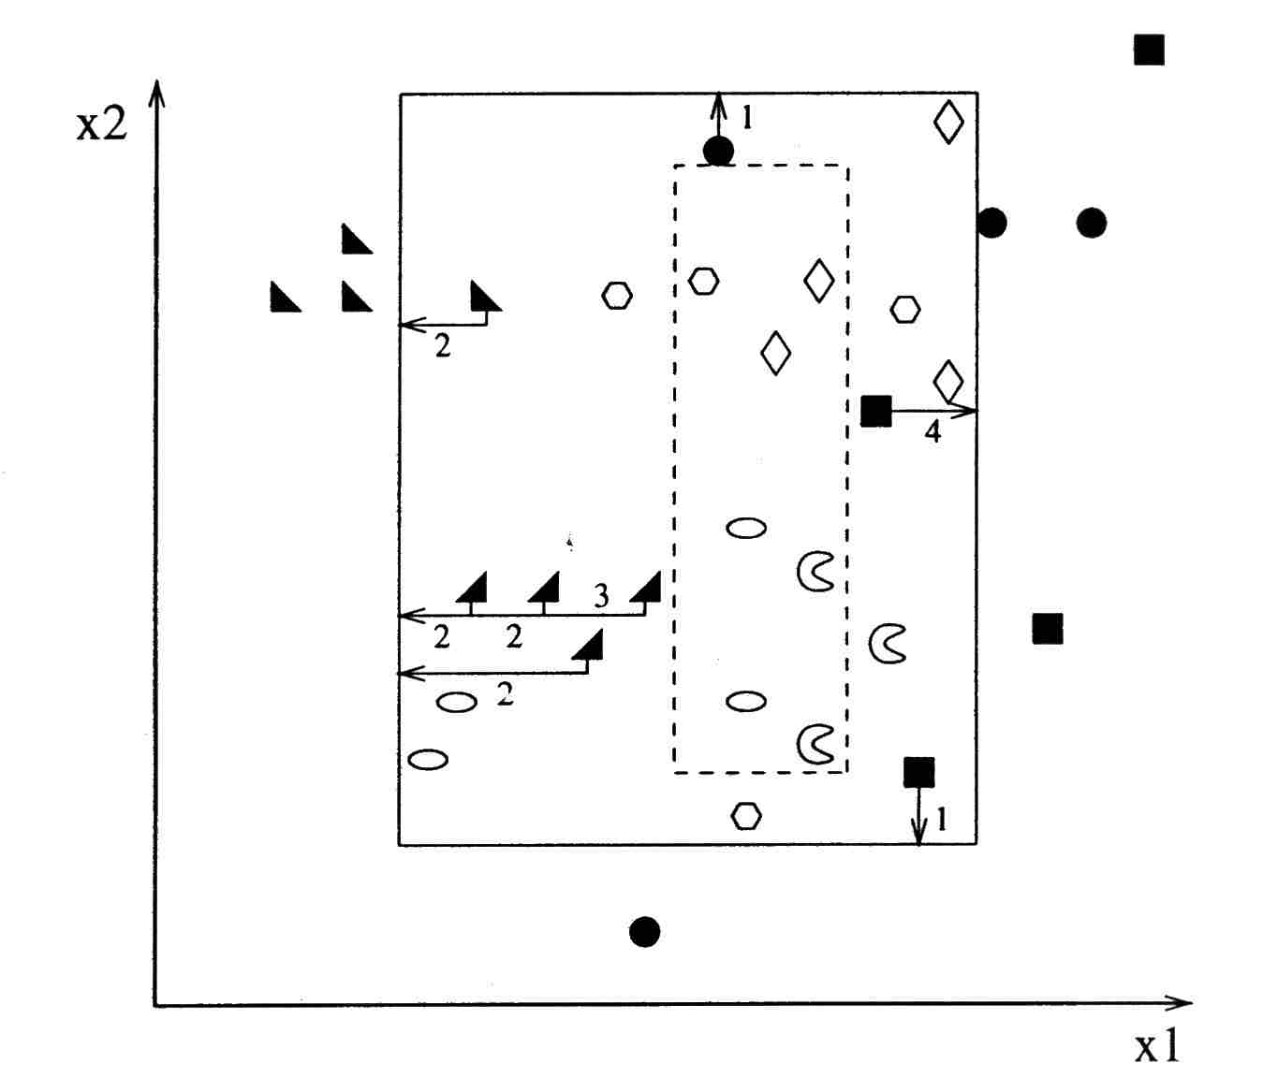
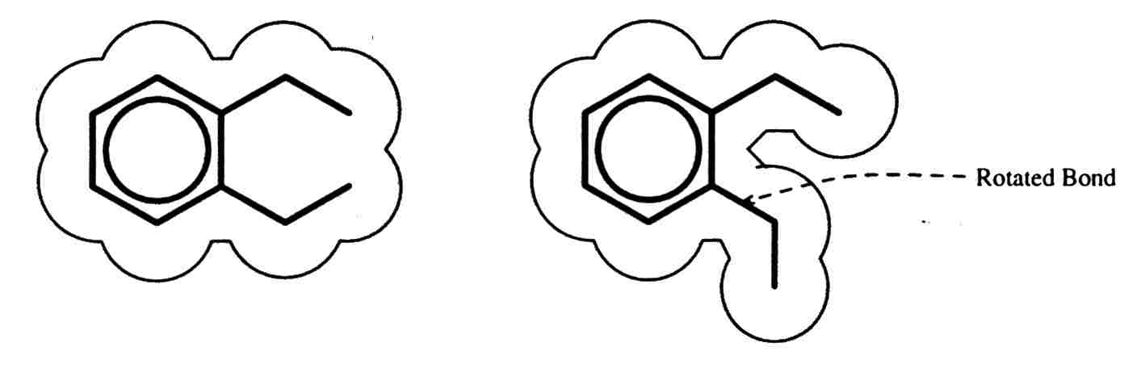
Learning the “Multiple Instance” Problem
“Solving the multiple instance problem with axis-parallel rectangles”
Dietterich, Lathrop, Lozano-Perez, Artificial Intelligence 89(1997) 31-71

Slide 14
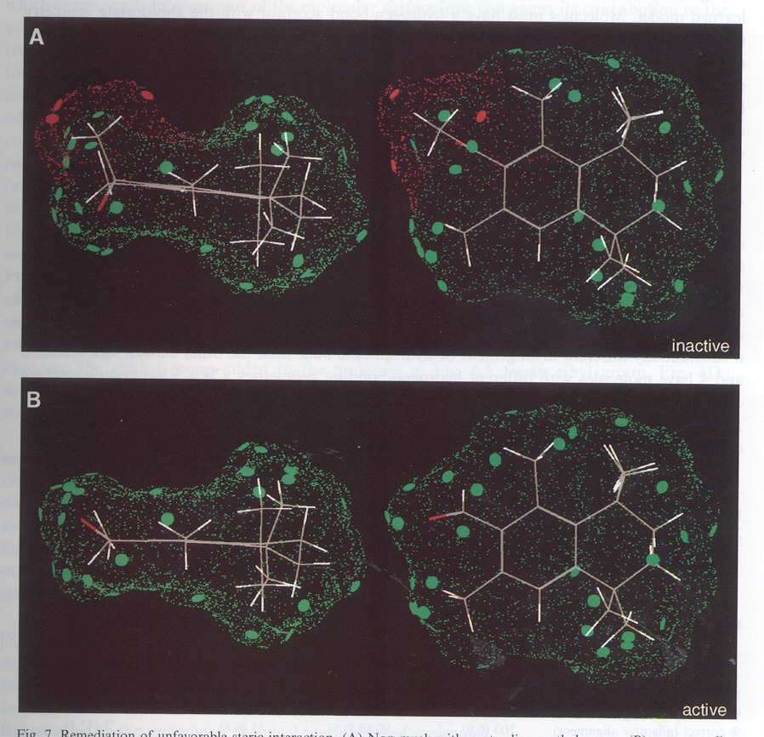
“Compass: A shape-based machine learning tool for drug design,” Jain, Dietterich, Lathrop, Chapman, Critchlow, Bauer, Webster, Lozano-Perez,
J. Of Computer-Aided Molecular Design, 8(1994) 635-652

