Slide 1
Constraint Satisfaction Problems (CSPs)
This lecture topic (two lectures)
Chapter 6.1 – 6.4, except 6.3.3
Next lecture topic (two lectures)
Chapter 7.1 – 7.5
(Please read lecture topic material before and after each lecture on that topic)

Slide 2
Outline
What is a CSP
Backtracking for CSP
Local search for CSPs
(Removed) Problem structure and decomposition

Slide 3
You Will Be Expected to Know
Basic definitions (section 6.1)
Node consistency, arc consistency, path consistency (6.2)
Backtracking search (6.3)
Variable and value ordering: minimum-remaining values, degree heuristic, least-constraining-value (6.3.1)
Forward checking (6.3.2)
Local search for CSPs: min-conflict heuristic (6.4)

Slide 4
Constraint Satisfaction Problems
What is a CSP?
Finite set of variables X₁, X₂, …, X_{n}
Nonempty domain of possible values for each variable D₁, D₂, …, D_{n}
Finite set of constraints C₁, C₂, …, C_{m}
Each constraint C_{i} limits the values that variables can take,
e.g., X₁ ≠ X₂
Each constraint C_{i} is a pair <scope, relation>
Scope = Tuple of variables that participate in the constraint.
Relation = List of allowed combinations of variable values.
May be an explicit list of allowed combinations.
May be an abstract relation allowing membership testing and listing.
CSP benefits
Standard representation pattern
Generic goal and successor functions
Generic heuristics (no domain specific expertise).

Slide 5
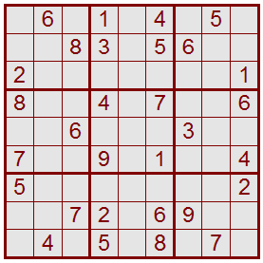
Sudoku as a Constraint Satisfaction Problem (CSP)
1 2 3 4 5 6 7 8 9
A
B
C
D
E
F
G
H
I
Variables: 81 variables
A1, A2, A3, …, I7, I8, I9
Letters index rows, top to bottom
Digits index columns, left to right
Domains: The nine positive digits
A1 ∈ {1, 2, 3, 4, 5, 6, 7, 8, 9}
Etc.
Constraints: 27 Alldiff constraints
Alldiff(A1, A2, A3, A4, A5, A6, A7, A8, A9)
Etc.

Slide 6
CSPs --- what is a solution?
A state is an assignment of values to some or all variables.
An assignment is complete when every variable has a value.
An assignment is partial when some variables have no values.
Consistent assignment
assignment does not violate the constraints
A solution to a CSP is a complete and consistent assignment.
Some CSPs require a solution that maximizes an objective function.
Examples of Applications:
Scheduling the time of observations on the Hubble Space Telescope
Airline schedules
Cryptography
Computer vision -> image interpretation
Scheduling your MS or PhD thesis exam ☺

Slide 7
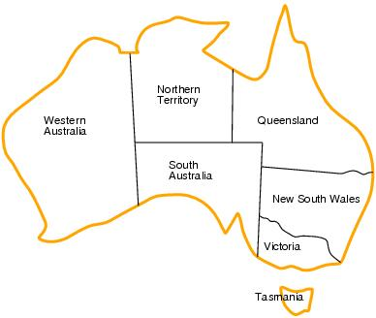
CSP example: map coloring
Variables: WA, NT, Q, NSW, V, SA, T
Domains: D_{i}={red,green,blue}
Constraints:adjacent regions must have different colors.
E.g. WA ≠ NT

Slide 8
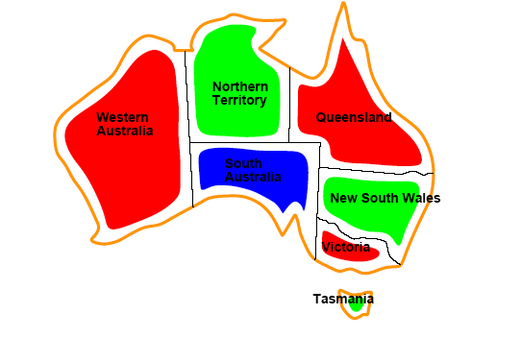
CSP example: map coloring
Solutions are assignments satisfying all constraints, e.g.
{WA=red,NT=green,Q=red,NSW=green,V=red,SA=blue,T=green}

Slide 9
Graph coloring
More general problem than map coloring
Planar graph = graph in the 2d-plane with no edge crossings
Guthrie’s conjecture (1852)
Every planar graph can be colored with 4 colors or less
Proved (using a computer) in 1977 (Appel and Haken)

Slide 10
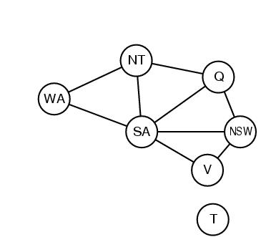
Constraint graphs
Constraint graph:
nodes are variables
arcs are binary constraints
Graph can be used to simplify search
e.g. Tasmania is an independent subproblem
(will return to graph structure later)

Slide 11
Varieties of CSPs
Discrete variables
Finite domains; size d ⇒O(d^{n}) complete assignments.
E.g. Boolean CSPs: Boolean satisfiability (NP-complete).
Infinite domains (integers, strings, etc.)
E.g. job scheduling, variables are start/end days for each job
Need a constraint language e.g StartJob₁ +5 ≤ StartJob₃.
Infinitely many solutions
Linear constraints: solvable
Nonlinear: no general algorithm
Continuous variables
e.g. building an airline schedule or class schedule.
Linear constraints solvable in polynomial time by LP methods.

Slide 12
Varieties of constraints
Unary constraints involve a single variable.
e.g. SA ≠ green
Binary constraints involve pairs of variables.
e.g. SA ≠ WA
Higher-order constraints involve 3 or more variables.
Professors A, B,and C cannot be on a committee together
Can always be represented by multiple binary constraints
Preference (soft constraints)
e.g. red is better than green often can be represented by a cost for each variable assignment
combination of optimization with CSPs

Slide 13
CSPs Only Need Binary Constraints!!
Unary constraints: Just delete values from variable’s domain.
Higher order (3 variables or more): reduce to binary constraints.
Simple example:
Three example variables, X, Y, Z.
Domains Dx={1,2,3}, Dy={1,2,3}, Dz={1,2,3}.
Constraint C[X,Y,Z] = {X+Y=Z} = {(1,1,2), (1,2,3), (2,1,3)}.
Plus many other variables and constraints elsewhere in the CSP.
Create a new variable, W, taking values as triples (3-tuples).
Domain of W is Dw = {(1,1,2), (1,2,3), (2,1,3)}.
Dw is exactly the tuples that satisfy the higher order constraint.
Create three new constraints:
C[X,W] = { [1, (1,1,2)], [1, (1,2,3)], [2, (2,1,3)] }.
C[Y,W] = { [1, (1,1,2)], [2, (1,2,3)], [1, (2,1,3)] }.
C[Z,W] = { [2, (1,1,2)], [3, (1,2,3)], [3, (2,1,3)] }.
Other constraints elsewhere involving X, Y, or Z are unaffected.

Slide 14
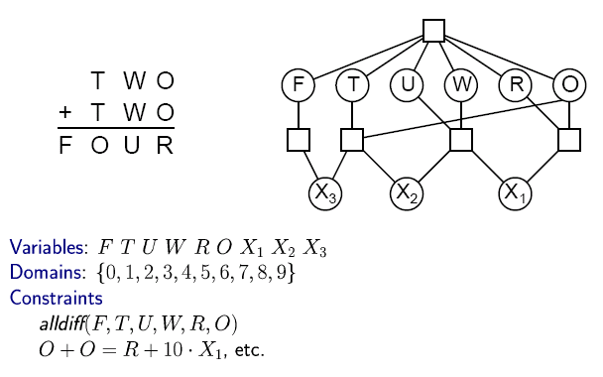
CSP Example: Cryptharithmetic puzzle

Slide 15
CSP Example: Cryptharithmetic puzzle

Slide 16
CSP as a standard search problem
A CSP can easily be expressed as a standard search problem.
Incremental formulation
Initial State: the empty assignment {}
Actions (3rd ed.), Successor function (2nd ed.): Assign a value to an unassigned variable provided that it does not violate a constraint
Goal test: the current assignment is complete
(by construction it is consistent)
Path cost: constant cost for every step (not really relevant)
Can also use complete-state formulation
Local search techniques (Chapter 4) tend to work well

Slide 17
CSP as a standard search problem
Solution is found at depth n (if there are n variables).
Consider using BFS
Branching factor b at the top level is nd
At next level is (n-1)d
….
end up with n!d^{n} leaves even though there are only d^{n} complete assignments!

Slide 18
Commutativity
CSPs are commutative.
The order of any given set of actions has no effect on the outcome.
Example: choose colors for Australian territories one at a time
[WA=red then NT=green] same as [NT=green then WA=red]
All CSP search algorithms can generate successors by considering assignments for only a single variable at each node in the search tree
⇒ there are d^{n} leaves
(will need to figure out later which variable to assign a value to at each node)

Slide 19
Backtracking search
Similar to Depth-first search, generating children one at a time.
Chooses values for one variable at a time and backtracks when a variable has no legal values left to assign.
Uninformed algorithm
No good general performance

Slide 20
Backtracking search
function BACKTRACKING-SEARCH(csp) return a solution or failure
return RECURSIVE-BACKTRACKING({} , csp)
function RECURSIVE-BACKTRACKING(assignment, csp) return a solution or failure
if assignment is complete then return assignment
var ← SELECT-UNASSIGNED-VARIABLE(VARIABLES[csp],assignment,csp)
for each value in ORDER-DOMAIN-VALUES(var, assignment, csp) do
if value is consistent with assignment according to CONSTRAINTS[csp] then
add {var=value} to assignment
result ← RECURSIVE-BACTRACKING(assignment, csp)
if result ≠ failure then return result
remove {var=value} from assignment
return failure

Slide 21
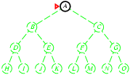
Backtracking search
Expand deepest unexpanded node
Generate only one child at a time.
Goal-Test when inserted.
For CSP, Goal-test at bottom
Future= green dotted circles
Frontier=white nodes
Expanded/active=gray nodes
Forgotten/reclaimed= black nodes

Slide 22
Backtracking search
Expand deepest unexpanded node
Generate only one child at a time.
Goal-Test when inserted.
For CSP, Goal-test at bottom
Future= green dotted circles
Frontier=white nodes
Expanded/active=gray nodes
Forgotten/reclaimed= black nodes

Slide 23
Backtracking search
Expand deepest unexpanded node
Generate only one child at a time.
Goal-Test when inserted.
For CSP, Goal-test at bottom
Future= green dotted circles
Frontier=white nodes
Expanded/active=gray nodes
Forgotten/reclaimed= black nodes

Slide 24
Backtracking search
Expand deepest unexpanded node
Generate only one child at a time.
Goal-Test when inserted.
For CSP, Goal-test at bottom
Future= green dotted circles
Frontier=white nodes
Expanded/active=gray nodes
Forgotten/reclaimed= black nodes

Slide 25
Backtracking search
Expand deepest unexpanded node
Generate only one child at a time.
Goal-Test when inserted.
For CSP, Goal-test at bottom
Future= green dotted circles
Frontier=white nodes
Expanded/active=gray nodes
Forgotten/reclaimed= black nodes

Slide 26
Backtracking search
Expand deepest unexpanded node
Generate only one child at a time.
Goal-Test when inserted.
For CSP, Goal-test at bottom
Future= green dotted circles
Frontier=white nodes
Expanded/active=gray nodes
Forgotten/reclaimed= black nodes

Slide 27
Backtracking search
Expand deepest unexpanded node
Generate only one child at a time.
Goal-Test when inserted.
For CSP, Goal-test at bottom
Future= green dotted circles
Frontier=white nodes
Expanded/active=gray nodes
Forgotten/reclaimed= black nodes

Slide 28
Backtracking search
Expand deepest unexpanded node
Generate only one child at a time.
Goal-Test when inserted.
For CSP, Goal-test at bottom
Future= green dotted circles
Frontier=white nodes
Expanded/active=gray nodes
Forgotten/reclaimed= black nodes

Slide 29
Backtracking search
Expand deepest unexpanded node
Generate only one child at a time.
Goal-Test when inserted.
For CSP, Goal-test at bottom
Future= green dotted circles
Frontier=white nodes
Expanded/active=gray nodes
Forgotten/reclaimed= black nodes

Slide 30
Backtracking search
Expand deepest unexpanded node
Generate only one child at a time.
Goal-Test when inserted.
For CSP, Goal-test at bottom
Future= green dotted circles
Frontier=white nodes
Expanded/active=gray nodes
Forgotten/reclaimed= black nodes

Slide 31
Backtracking search
Expand deepest unexpanded node
Generate only one child at a time.
Goal-Test when inserted.
For CSP, Goal-test at bottom
Future= green dotted circles
Frontier=white nodes
Expanded/active=gray nodes
Forgotten/reclaimed= black nodes

Slide 32
Backtracking search
Expand deepest unexpanded node
Generate only one child at a time.
Goal-Test when inserted.
For CSP, Goal-test at bottom
Future= green dotted circles
Frontier=white nodes
Expanded/active=gray nodes
Forgotten/reclaimed= black nodes

Slide 33
Backtracking search (Figure 6.5)
function BACKTRACKING-SEARCH(csp) return a solution or failure
return RECURSIVE-BACKTRACKING({} , csp)
function RECURSIVE-BACKTRACKING(assignment, csp) return a solution or failure
if assignment is complete then return assignment
var ← SELECT-UNASSIGNED-VARIABLE(VARIABLES[csp],assignment,csp)
for each value in ORDER-DOMAIN-VALUES(var, assignment, csp) do
if value is consistent with assignment according to CONSTRAINTS[csp] then
add {var=value} to assignment
result ← RECURSIVE-BACTRACKING(assignment, csp)
if result ≠ failure then return result
remove {var=value} from assignment
return failure

Slide 34
Comparison of CSP algorithms on different problems
Median number of consistency checks over 5 runs to solve problem
Parentheses -> no solution found
USA: 4 coloring
n-queens: n = 2 to 50
Zebra: see exercise 6.7 (3rd ed.); exercise 5.13 (2nd ed.)

Slide 35
Random Binary CSP (adapted from http://www.unitime.org/csp.php)
A random binary CSP is defined by a four-tuple (n, d, p1, p2)
n = the number of variables.
d = the domain size of each variable.
p1 = probability a constraint exists between two variables.
p2 = probability a pair of values in the domains of two variables connected by a constraint is incompatible.
Note that R&N lists compatible pairs of values instead.
Equivalent formulations; just take the set complement.
(n, d, p1, p2) are used to generate randomly the binary constraints among the variables.
The so called model B of Random CSP (n, d, n1, n2)
n1 = p1n(n-1)/2 pairs of variables are randomly and uniformly selected and binary constraints are posted between them.
For each constraint, n2 = p2d^2 randomly and uniformly selected pairs of values are picked as incompatible.
The random CSP as an optimization problem (minCSP).
Goal is to minimize the total sum of values for all variables.

Slide 36
Improving CSP efficiency
Previous improvements on uninformed search
→ introduce heuristics
For CSPS, general-purpose methods can give large gains in speed, e.g.,
Which variable should be assigned next?
In what order should its values be tried?
Can we detect inevitable failure early?
Can we take advantage of problem structure?
Note: CSPs are somewhat generic in their formulation, and so the heuristics are more general compared to methods in Chapter 4

Slide 37
Backtracking search
function BACKTRACKING-SEARCH(csp) return a solution or failure
return RECURSIVE-BACKTRACKING({} , csp)
function RECURSIVE-BACKTRACKING(assignment, csp) return a solution or failure
if assignment is complete then return assignment
var ← SELECT-UNASSIGNED-VARIABLE(VARIABLES[csp],assignment,csp)
for each value in ORDER-DOMAIN-VALUES(var, assignment, csp) do
if value is consistent with assignment according to CONSTRAINTS[csp] then
add {var=value} to assignment
result ← RRECURSIVE-BACTRACKING(assignment, csp)
if result ≠ failure then return result
remove {var=value} from assignment
return failure

Slide 38
Minimum remaining values (MRV)
var ← SELECT-UNASSIGNED-VARIABLE(VARIABLES[csp],assignment,csp)
A.k.a. most constrained variable heuristic
Heuristic Rule: choose variable with the fewest legal moves
e.g., will immediately detect failure if X has no legal values

Slide 39
Degree heuristic for the initial variable
Heuristic Rule: select variable that is involved in the largest number of constraints on other unassigned variables.
Degree heuristic can be useful as a tie breaker.
In what order should a variable’s values be tried?

Slide 40
Least constraining value for value-ordering
Least constraining value heuristic
Heuristic Rule: given a variable choose the least constraining value
leaves the maximum flexibility for subsequent variable assignments

Slide 41
Forward checking
Can we detect inevitable failure early?
And avoid it later?
Forward checking idea: keep track of remaining legal values for unassigned variables.
Terminate search when any variable has no legal values.

Slide 42
Forward checking
Assign {WA=red}
Effects on other variables connected by constraints to WA
NT can no longer be red
SA can no longer be red

Slide 43
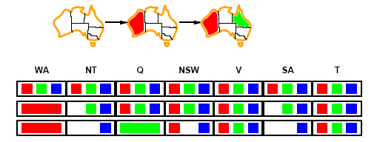
Forward checking
Assign {Q=green}
Effects on other variables connected by constraints with WA
NT can no longer be green
NSW can no longer be green
SA can no longer be green
MRV heuristic would automatically select NT or SA next

Slide 44
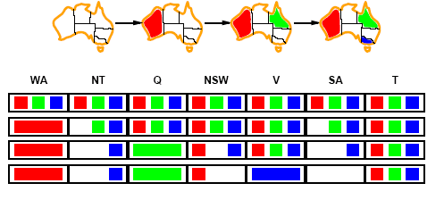
Forward checking
If V is assigned blue
Effects on other variables connected by constraints with WA
NSW can no longer be blue
SA is empty
FC has detected that partial assignment is inconsistent with the constraints and backtracking can occur.

Slide 45
Example: 4-Queens Problem
X1
{1,2,3,4}
X2
{1,2,3,4}
X1
X2
X3
X4
1
2
3
4
X3
{1,2,3,4}
X4
{1,2,3,4}

Slide 46
Example: 4-Queens Problem
X1
{1,2,3,4}
X2
{1,2,3,4}
X1
X2
X3
X4
1
2
3
4
X3
{1,2,3,4}
X4
{1,2,3,4}
Red = value is assigned to variable

Slide 47
Example: 4-Queens Problem
X1
{1,2,3,4}
X2
{1,2,3,4}
X1
X2
X3
X4
1
2
3
4
X3
{1,2,3,4}
X4
{1,2,3,4}
Red = value is assigned to variable

Slide 48
Example: 4-Queens Problem
X1 Level:
Deleted:
{ (X2,1) (X2,2) (X3,1) (X3,3) (X4,1) (X4,4) }
(Please note: As always in computer science, there are many different ways to implement anything. The book-keeping method shown here was chosen because it is easy to present and understand visually. It is not necessarily the most efficient way to implement the book-keeping in a computer. Your job as an algorithm designer is to think long and hard about your problem, then devise an efficient implementation.)
One more efficient equivalent possible alternative (of many):
Deleted:
{ (X2:1,2) (X3:1,3) (X4:1,4) }

Slide 49
Example: 4-Queens Problem
X1
{1,2,3,4}
X2
{ , ,3,4}
X1
X2
X3
X4
1
2
3
4
X3
{ ,2, ,4}
X4
{ ,2,3, }
Red = value is assigned to variable

Slide 50
Example: 4-Queens Problem
X1
{1,2,3,4}
X2
{ , ,3,4}
X1
X2
X3
X4
1
2
3
4
X3
{ ,2, ,4}
X4
{ ,2,3, }
Red = value is assigned to variable

Slide 51
Example: 4-Queens Problem
X1
{1,2,3,4}
X2
{ , ,3,4}
X1
X2
X3
X4
1
2
3
4
X3
{ ,2, ,4}
X4
{ ,2,3, }
Red = value is assigned to variable

Slide 52
Example: 4-Queens Problem
X1 Level:
Deleted:
{ (X2,1) (X2,2) (X3,1) (X3,3) (X4,1) (X4,4) }
X2 Level:
Deleted:
{ (X3,2) (X3,4) (X4,3) }
(Please note: Of course, we could have failed as soon as we deleted { (X3,2) (X3,4) }. There was no need to continue to delete (X4,3), because we already had established that the domain of X3 was null, and so we already knew that this branch was futile and we were going to fail anyway. The book-keeping method shown here was chosen because it is easy to present and understand visually. It is not necessarily the most efficient way to implement the book-keeping in a computer. Your job as an algorithm designer is to think long and hard about your problem, then devise an efficient implementation.)

Slide 53
Example: 4-Queens Problem
X1
{1,2,3,4}
X2
{ , ,3,4}
X1
X2
X3
X4
1
2
3
4
X3
{ , , , }
X4
{ ,2, , }
Red = value is assigned to variable

Slide 54
Example: 4-Queens Problem
X1 Level:
Deleted:
{ (X2,1) (X2,2) (X3,1) (X3,3) (X4,1) (X4,4) }
X2 Level:
FAIL at X2=3.
Restore:
{ (X3,2) (X3,4) (X4,3) }

Slide 55
Example: 4-Queens Problem
X1
{1,2,3,4}
X2
{ , ,3,4}
X
1X
X2
X3
X4
1
2
3
4
X3
{ ,2, ,4}
X4
{ ,2,3, }
Red = value is assigned to variable
X = value led to failure

Slide 56
Example: 4-Queens Problem
X1
{1,2,3,4}
X2
{ , ,3,4}
X
X1
X2
X3
X4
1
2
3
4
X3
{ ,2, ,4}
X4
{ ,2,3, }
Red = value is assigned to variable
X = value led to failure

Slide 57
Example: 4-Queens Problem
X1
{1,2,3,4}
X2
{ , ,3,4}
X
X1
X2
X3
X4
1
2
3
4
X3
{ ,2, ,4}
X4
{ ,2,3, }
Red = value is assigned to variable
X = value led to failure

Slide 58
Example: 4-Queens Problem
X1 Level:
Deleted:
{ (X2,1) (X2,2) (X3,1) (X3,3) (X4,1) (X4,4) }
X2 Level:
Deleted:
{ (X3,4) (X4,2) }

Slide 59
Example: 4-Queens Problem
X1
{1,2,3,4}
X2
{ , ,3,4}
X
X1
X2
X3
X4
1
2
3
4
X3
{ ,2, , }
X4
{ , ,3, }
Red = value is assigned to variable
X = value led to failure

Slide 60
Example: 4-Queens Problem
X1
{1,2,3,4}
X2
{ , ,3,4}
X
X1
X2
3X
X4
1
2
3
4
X3
{ ,2, , }
X4
{ , ,3, }
Red = value is assigned to variable
X = value led to failure

Slide 61
Example: 4-Queens Problem
X1
{1,2,3,4}
X2
{ , ,3,4}
X
X1
X2
X3
X4
1
2
3
4
X3
{ ,2, , }
X4
{ , ,3, }
Red = value is assigned to variable
X = value led to failure

Slide 62
Example: 4-Queens Problem
X1 Level:
Deleted:
{ (X2,1) (X2,2) (X3,1) (X3,3) (X4,1) (X4,4) }
X2 Level:
Deleted:
{ (X3,4) (X4,2) }
X3 Level:
Deleted:
{ (X4,3) }

Slide 63
Example: 4-Queens Problem
X1
{1,2,3,4}
X2
{ , ,3,4}
X
X1
X2
X3
X4
1
2
3
4
X3
{ ,2, , }
X4
{ , , , }
Red = value is assigned to variable
X = value led to failure

Slide 64
Example: 4-Queens Problem
X1 Level:
Deleted:
{ (X2,1) (X2,2) (X3,1) (X3,3) (X4,1) (X4,4) }
X2 Level:
Deleted:
{ (X3,4) (X4,2) }
X3 Level:
Fail at X3=2.
Restore:
{ (X4,3) }

Slide 65
Example: 4-Queens Problem
X1
{1,2,3,4}
X2
{ , ,3,4}
X
X1
X2
X3
X4
1
2
3
4
X3
{ ,2, , }
X4
{ , ,3, }
X
Red = value is assigned to variable
X = value led to failure

Slide 66
Example: 4-Queens Problem
X1 Level:
Deleted:
{ (X2,1) (X2,2) (X3,1) (X3,3) (X4,1) (X4,4) }
X2 Level:
Fail at X2=4.
Restore:
{ (X3,4) (X4,2) }

Slide 67
Example: 4-Queens Problem
X1
{1,2,3,4}
X2
{ , ,3,4}
X
X
X1
X2
X3
X4
1
2
3
4
X3
{ ,2, ,4}
X4
{ ,2,3, }
Red = value is assigned to variable
X = value led to failure

Slide 68
Example: 4-Queens Problem
X1 Level:
Fail at X1=1.
Restore:
{ (X2,1) (X2,2) (X3,1) (X3,3) (X4,1) (X4,4) }

Slide 69
Example: 4-Queens Problem
X1
{1,2,3,4}
X2
{1,2,3,4}
X
X1
X2
X3
X4
1
2
3
4
X3
{1,2,3,4}
X4
{1,2,3,4}
Red = value is assigned to variable
X = value led to failure

Slide 70
Example: 4-Queens Problem
X1
{1,2,3,4}
X2
{1,2,3,4}
X
X1
X2
X3
X4
1
2
3
4
X3
{1,2,3,4}
X4
{1,2,3,4}
Red = value is assigned to variable
X = value led to failure

Slide 71
Example: 4-Queens Problem
X1
{1,2,3,4}
X2
{1,2,3,4}
X
X1
X2
X3
X4
1
2
3
4
X3
{1,2,3,4}
X4
{1,2,3,4}
Red = value is assigned to variable
X = value led to failure

Slide 72
Example: 4-Queens Problem
X1 Level:
Deleted:
{ (X2,1) (X2,2) (X2,3) (X3,2) (X3,4) (X4,2) }

Slide 73
Example: 4-Queens Problem
X1
{1,2,3,4}
X2
{ , , ,4}
X
X1
X2
X3
X4
1
2
3
4
X3
{1, ,3, }
X4
{1, ,3,4}
Red = value is assigned to variable
X = value led to failure

Slide 74
Example: 4-Queens Problem
X1
{1,2,3,4}
X2
{ , , ,4}
X
X1
X2
X3
X4
1
2
3
4
X3
{1, ,3, }
X4
{1, ,3,4}
Red = value is assigned to variable
X = value led to failure

Slide 75
Example: 4-Queens Problem
X1
{1,2,3,4}
X2
{ , , ,4}
X
X1
X2
X3
X4
1
2
3
4
X3
{1, ,3, }
X4
{1, ,3,4}
Red = value is assigned to variable
X = value led to failure

Slide 76
Example: 4-Queens Problem
X1 Level:
Deleted:
{ (X2,1) (X2,2) (X2,3) (X3,2) (X3,4) (X4,2) }
X2 Level:
Deleted:
{ (X3,3) (X4,4) }

Slide 77
Example: 4-Queens Problem
X1
{1,2,3,4}
X2
{ , , ,4}
X
X1
X2
X3
X4
1
2
3
4
X3
{1, , , }
X4
{1, ,3, }
Red = value is assigned to variable
X = value led to failure

Slide 78
Example: 4-Queens Problem
X1
{1,2,3,4}
X2
{ , , ,4}
X
X1
X2
X3
X4
1
2
3
4
X3
{1, , , }
X4
{1, ,3, }
Red = value is assigned to variable
X = value led to failure

Slide 79
Example: 4-Queens Problem
X1
{1,2,3,4}
X2
{ , , ,4}
X
X1
X2
X3
X4
1
2
3
4
X3
{1, , , }
X4
{1, ,3, }
Red = value is assigned to variable
X = value led to failure

Slide 80
Example: 4-Queens Problem
X1 Level:
Deleted:
{ (X2,1) (X2,2) (X2,3) (X3,2) (X3,4) (X4,2) }
X2 Level:
Deleted:
{ (X3,3) (X4,4) }
X3 Level:
Deleted:
{ (X4,1) }

Slide 81
Example: 4-Queens Problem
X1
{1,2,3,4}
X2
{ , , ,4}
X
X1
X2
X3
X4
1
2
3
4
X3
{1, , , }
X4
{ , ,3, }
Red = value is assigned to variable
X = value led to failure

Slide 82
Example: 4-Queens Problem
X1
{1,2,3,4}
X2
{ , , ,4}
X
X1
X2
X3
X4
1
2
3
4
X3
{1, , , }
X4
{ , ,3, }
Red = value is assigned to variable
X = value led to failure

Slide 83
Comparison of CSP algorithms on different problems
Median number of consistency checks over 5 runs to solve problem
Parentheses -> no solution found
USA: 4 coloring
n-queens: n = 2 to 50
Zebra: see exercise 5.13

Slide 84
Constraint propagation
Solving CSPs with combination of heuristics plus forward checking is more efficient than either approach alone
FC checking does not detect all failures.
E.g., NT and SA cannot be blue

Slide 85
Constraint propagation
Techniques like CP and FC are in effect eliminating parts of the search space
Somewhat complementary to search
Constraint propagation goes further than FC by repeatedly enforcing constraints locally
Needs to be faster than actually searching to be effective
Arc-consistency (AC) is a systematic procedure for constraint propagation

Slide 86
Arc consistency
An Arc X → Y is consistent if
for every value x of X there is some value y consistent with x
(note that this is a directed property)
Consider state of search after WA and Q are assigned:
SA → NSW is consistent if
SA=blue and NSW=red

Slide 87
Arc consistency
X → Y is consistent if
for every value x of X there is some value y consistent with x
NSW → SA is consistent if
NSW=red and SA=blue
NSW=blue and SA=???

Slide 88
Arc consistency
Can enforce arc-consistency:
Arc can be made consistent by removing blue from NSW
Continue to propagate constraints….
Check V → NSW
Not consistent for V = red
Remove red from V

Slide 89
Arc consistency
Continue to propagate constraints….
SA → NT is not consistent
and cannot be made consistent
Arc consistency detects failure earlier than FC

Slide 90
Arc consistency checking
Can be run as a preprocessor or after each assignment
Or as preprocessing before search starts
AC must be run repeatedly until no inconsistency remains
Trade-off
Requires some overhead to do, but generally more effective than direct search
In effect it can eliminate large (inconsistent) parts of the state space more effectively than search can
Need a systematic method for arc-checking
If X loses a value, neighbors of X need to be rechecked:
i.e. incoming arcs can become inconsistent again
(outgoing arcs will stay consistent).

Slide 91
Arc consistency algorithm (AC-3)
function AC-3(csp) returns false if inconsistency found, else true, may reduce csp domains
inputs: csp, a binary CSP with variables {X₁, X₂, …, X_{n}}
local variables: queue, a queue of arcs, initially all the arcs in csp
/* initial queue must contain both (X_{i}, X_{j}) and (X_{j}, X_{i}) */
while queue is not empty do
(X_{i}, X_{j}) ← REMOVE-FIRST(queue)
if REMOVE-INCONSISTENT-VALUES(X_{i}, X_{j}) then
if size of D_{i} = 0 then return false
for each X_{k} in NEIGHBORS[X_{i}] − {X_{j}} do
add (X_{k}, X_{i}) to queue if not already there
return true
function REMOVE-INCONSISTENT-VALUES(X_{i}, X_{j}) returns true iff we delete a
value from the domain of X_{i}
removed ← false
for each x in DOMAIN[X_{i}] do
if no value y in DOMAIN[X_{j}] allows (x,y) to satisfy the constraints
between X_{i} and X_{j}
then delete x from DOMAIN[X_{i}]; removed ← true
return removed
(from Mackworth, 1977)

Slide 92
Complexity of AC-3
A binary CSP has at most n² arcs
Each arc can be inserted in the queue d times (worst case)
(X, Y): only d values of X to delete
Consistency of an arc can be checked in O(d²) time
Complexity is O(n² d³)
Although substantially more expensive than Forward Checking, Arc Consistency is usually worthwhile.

Slide 93
K-consistency
Arc consistency does not detect all inconsistencies:
Partial assignment {WA=red, NSW=red} is inconsistent.
Stronger forms of propagation can be defined using the notion of k-consistency.
A CSP is k-consistent if for any set of k-1 variables and for any consistent assignment to those variables, a consistent value can always be assigned to any kth variable.
E.g. 1-consistency = node-consistency
E.g. 2-consistency = arc-consistency
E.g. 3-consistency = path-consistency
Strongly k-consistent:
k-consistent for all values {k, k-1, …2, 1}

Slide 94
Trade-offs
Running stronger consistency checks…
Takes more time
But will reduce branching factor and detect more inconsistent partial assignments
No “free lunch”
In worst case n-consistency takes exponential time
Generally helpful to enforce 2-Consistency (Arc Consistency)
Sometimes helpful to enforce 3-Consistency
Higher levels may take more time to enforce than they save.

Slide 95
Further improvements
Checking special constraints
Checking Alldif(…) constraint
E.g. {WA=red, NSW=red}
Checking Atmost(…) constraint
Bounds propagation for larger value domains
Intelligent backtracking
Standard form is chronological backtracking i.e. try different value for preceding variable.
More intelligent, backtrack to conflict set.
Set of variables that caused the failure or set of previously assigned variables that are connected to X by constraints.
Backjumping moves back to most recent element of the conflict set.
Forward checking can be used to determine conflict set.

Slide 96
Local search for CSPs
Use complete-state representation
Initial state = all variables assigned values
Successor states = change 1 (or more) values
For CSPs
allow states with unsatisfied constraints (unlike backtracking)
operators reassign variable values
hill-climbing with n-queens is an example
Variable selection: randomly select any conflicted variable
Value selection: min-conflicts heuristic
Select new value that results in a minimum number of conflicts with the other variables

Slide 97
Local search for CSP
function MIN-CONFLICTS(csp, max_steps) return solution or failure
inputs: csp, a constraint satisfaction problem
max_steps, the number of steps allowed before giving up
current ← an initial complete assignment for csp
for i = 1 to max_steps do
if current is a solution for csp then return current
var ← a randomly chosen, conflicted variable from VARIABLES[csp]
value ← the value v for var that minimize CONFLICTS(var,v,current,csp)
set var = value in current
return failure

Slide 98
Min-conflicts example 1
h=5
h=3
h=1
Use of min-conflicts heuristic in hill-climbing.

Slide 99
Min-conflicts example 2
A two-step solution for an 8-queens problem using min-conflicts heuristic
At each stage a queen is chosen for reassignment in its column
The algorithm moves the queen to the min-conflict square breaking ties randomly.

Slide 100
Comparison of CSP algorithms on different problems
Median number of consistency checks over 5 runs to solve problem
Parentheses -> no solution found
USA: 4 coloring
n-queens: n = 2 to 50
Zebra: see exercise 6.7 (3rd ed.); exercise 5.13 (2nd ed.)

Slide 101
Advantages of local search
Local search can be particularly useful in an online setting
Airline schedule example
E.g., mechanical problems require than 1 plane is taken out of service
Can locally search for another “close” solution in state-space
Much better (and faster) in practice than finding an entirely new schedule
The runtime of min-conflicts is roughly independent of problem size.
Can solve the millions-queen problem in roughly 50 steps.
Why?
n-queens is easy for local search because of the relatively high density of solutions in state-space

Slide 103
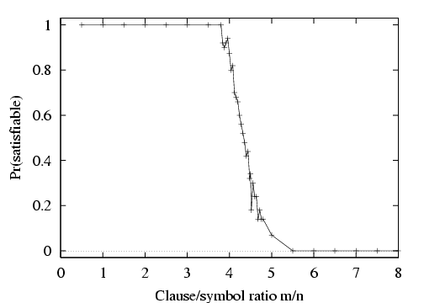
Hard satisfiability problems

Slide 104
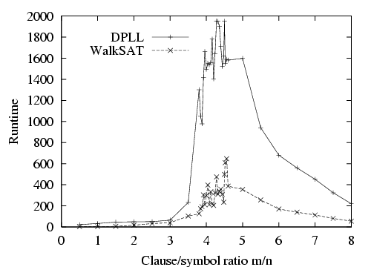
Hard satisfiability problems
Median runtime for 100 satisfiable random 3-CNF sentences, n = 50

Slide 105
Sudoku — Backtracking Search + Forward Checking
R = [number of cells]/[number of filled cells]
R = [number of cells]/[number of filled cells]
R = [number of cells]/[number of filled cells]
Success Rate = P(random puzzle is solvable)
[number of cells] = 81
[number of filled cells] = variable

Slide 106
Graph structure and problem complexity
Solving disconnected subproblems
Suppose each subproblem has c variables out of a total of n.
Worst case solution cost is O(n/c d^{c}), i.e. linear in n
Instead of O(d ^{n}), exponential in n
E.g. n= 80, c= 20, d=2
2⁸⁰ = 4 billion years at 1 million nodes/sec.
4 * 2²⁰= .4 second at 1 million nodes/sec

Slide 107
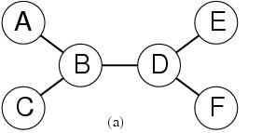
Tree-structured CSPs
Theorem:
if a constraint graph has no loops then the CSP can be solved in O(nd ²) time
linear in the number of variables!
Compare difference with general CSP, where worst case is O(d ^{n})

Slide 108
Summary
CSPs
special kind of problem: states defined by values of a fixed set of variables, goal test defined by constraints on variable values
Backtracking=depth-first search with one variable assigned per node
Heuristics
Variable ordering and value selection heuristics help significantly
Constraint propagation does additional work to constrain values and detect inconsistencies
Works effectively when combined with heuristics
Iterative min-conflicts is often effective in practice.
Graph structure of CSPs determines problem complexity
e.g., tree structured CSPs can be solved in linear time.

