Slide 1
CONNECT K

Slide 2
Available Moves
Use a linked list
Store all available moves
Different for gravity on and off

Slide 3
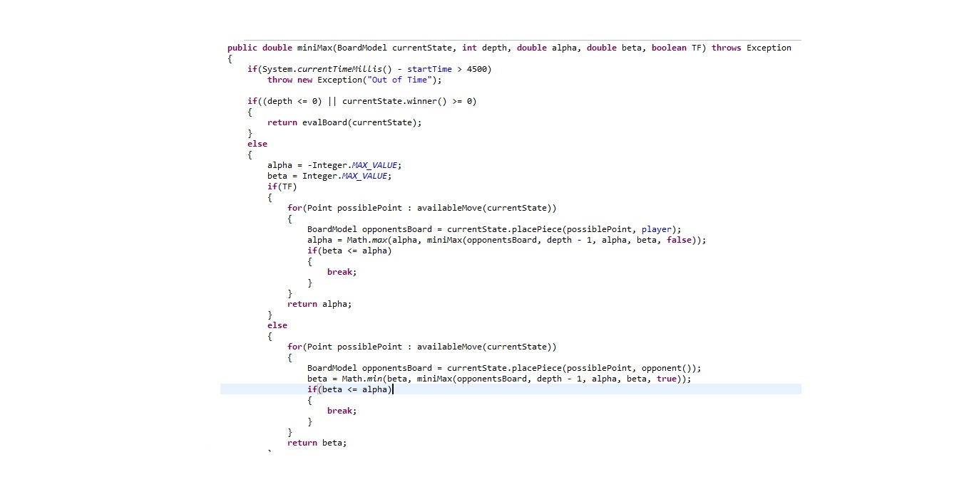
MiniMax with Alpha Beta Pruning
Time limit on the check
Use recursive call for min and max function

Slide 4
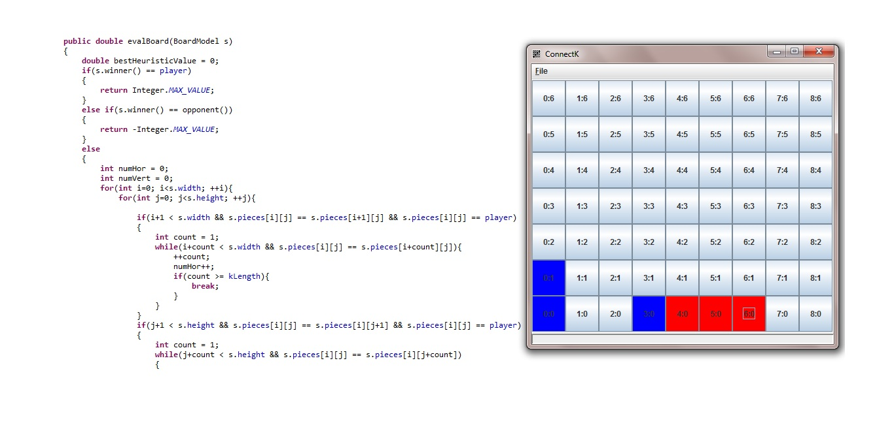
Heuristic Check
Use BoardModel function to check for winner
Check horizontal, vertical, and diagonal

