Slide 1
Probability
CS271P, Winter 2018
Introduction to Artificial Intelligence
Prof. Richard Lathrop
Reading: R&N Ch 13

Slide 2
Outline
Representing uncertainty is useful in knowledge bases
Probability provides a coherent framework for uncertainty
Review of basic concepts in probability
Emphasis on conditional probability & conditional independence
Full joint distributions are intractable to work with
Conditional independence assumptions allow much simpler models
Bayesian networks (next lecture)
A useful type of structured probability distribution
Exploit structure for parsimony, computational efficiency
Rational agents cannot violate probability theory

Slide 3
Uncertainty
Let action At = leave for airport t minutes before flight
Will At get me there on time?
Problems:
1. partial observability (road state, etc.)
2. multi-agent problem (other drivers' plans)
3. noisy sensors (uncertain traffic reports)
4. uncertainty in action outcomes (flat tire, etc.)
5. immense complexity of modeling and predicting traffic
Hence a purely logical approach either
1. risks falsehood: “A25 will get me there on time”, or
2. leads to conclusions that are too weak for decision making:
“A25 will get me there on time if there's no accident on the bridge and it doesn't rain and my tires remain intact, etc., etc.”
“A1440 should get me there on time but I'd have to stay overnight in the airport.”

Slide 4
Propositional Logic and Probability
Their ontological commitments are the same
The world is a set of facts that do or do not hold
Their epistemological commitments differ
Logic agent believes true, false, or no opinion
Probabilistic agent has a numerical degree of belief between 0 (false) and 1 (true)
Ontology is the philosophical study of the nature of being, becoming, existence, or reality; what exists in the world?
Epistemology is the philosophical study of the nature and scope of knowledge; how, and in what way, do we know about the world?

Slide 5
Uncertainty in the world
Uncertainty due to
Randomness
Overwhelming complexity
Lack of knowledge
…
Probability gives
natural way to describe our assumptions
rules for how to combine information
Subjective probability
Relate to agent’s own state of knowledge: P(A25|no accidents)= 0.05
Not assertions about the world; indicate degrees of belief
Change with new evidence: P(A25 | no accidents, 5am) = 0.20

Slide 6
Making decisions under uncertainty
Suppose I believe the following:
P(A25 gets me there on time | …) = 0.04
P(A90 gets me there on time | …) = 0.70
P(A120 gets me there on time | …) = 0.95
P(A1440 gets me there on time | …) = 0.9999
Which action to choose?
Depends on my preferences for missing flight vs. time spent waiting, etc.
Utility theory is used to represent and infer preferences
Decision theory= probability theory + utility theory
Expected utility of action a in state s
= ∑_{outcome in Results(s,a)} P(outcome) * Utility(outcome)
A rational agent acts to maximize expected utility

Slide 7
Ex: Airport
Suppose I believe the following:
P(A25 gets me there on time | …) = 0.04
P(A90 gets me there on time | …) = 0.70
P(A120 gets me there on time | …) = 0.95
P(A1440 gets me there on time | …) = 0.9999
Utility(on time) = $1,000
Utility(not on time) = −$10,000
Expected utility of action a in state s
= ∑_{outcome in Results(s,a)} P(outcome) * Utility(outcome)
E(Utility(A25)) = 0.04*$1,000 + 0.96*(−$10,000) = −$9,560
E(Utility(A90)) = 0.7*$1,000 + 0.3*(−$10,000) = −$2,300
E(Utility(A120)) = 0.95*$1,000 + 0.05*(−$10,000) = $450
E(Utility(A1440)) = 0.9999*$1,000 + 0.0001*(−$10,000) = $998.90
Have not yet accounted for disutility of staying overnight at the airport, etc.

Slide 8
Probability
P(a) is the probability of proposition “a”
E.g., P(it will rain in London tomorrow)
The proposition “a” is actually true or false in the real world
P(a) is our degree of belief that proposition “a” is true in the real world
P(a) = “prior” or marginal or unconditional probability
Assumes no other information is available
Axioms of probability:
0 <= P(a) <= 1
P(NOT(a)) = 1 – P(a)
P(true) = 1
P(false) = 0
P(a OR b) = P(a) + P(b) – P(a AND b)
Any agent that holds degrees of beliefs that contradict these axioms will act sub-optimally in some cases
e.g., de Finetti proved that there will be some combination of bets that forces such an unhappy agent to lose money every time.
Rational agents cannot violate probability theory.

Slide 9
Interpretations of probability
Relative Frequency: Usually taught in school
P(a) represents the frequency that event a will happen in repeated trials.
Requires event a to have happened enough times for data to be collected.
Degree of Belief: A more general view of probability
P(a) represents an agent’s degree of belief that event a is true.
Can predict probabilities of events that occur rarely or have not yet occurred.
Does not require new or different rules, just a different interpretation.
Examples:
a = “life exists on another planet”
What is P(a)? We all will assign different probabilities
a = “California will secede from the US”
What is P(a)?
a = “over 50% of the students in this class will get A’s”
What is P(a)?

Slide 10
Concepts of probability
Unconditional Probability
P(a), the probability of “a” being true, or P(a=True)
Does not depend on anything else to be true (unconditional)
Represents the probability prior to further information that may adjust it (prior)
Also sometimes “marginal” probability (vs. joint probability)
Conditional Probability
P(a|b), the probability of “a” being true, given that “b” is true
Relies on “b” = true (conditional)
Represents the prior probability adjusted based upon new information “b” (posterior)
Can be generalized to more than 2 random variables:
e.g. P(a|b, c, d)
Joint Probability
P(a, b) = P(a ˄ b), the probability of “a” and “b” both being true
Can be generalized to more than 2 random variables:
e.g. P(a, b, c, d)
We often use comma to abbreviate AND.

Slide 11
Random variables
Random Variable:
Basic element of probability assertions
Similar to CSP variable, but values reflect probabilities not constraints.
Variable: A
Domain: {a₁, a₂, a₃} <-- events / outcomes
Types of Random Variables:
Boolean random variables : { true, false }
e.g., Cavity (= do I have a cavity?)
Discrete random variables : one value from a set of values
e.g., Weather is one of {sunny, rainy, cloudy ,snow}
Continuous random variables : a value from within constraints
e.g., Current temperature is bounded by (10°, 200°)
Domain values must be exhaustive and mutually exclusive:
One of the values must always be the case (Exhaustive)
Two of the values cannot both be the case (Mutually Exclusive)

Slide 12
Random variables
Example: Coin flip
Variable = R, the result of the coin flip
Domain = {heads, tails, edge} <-- must be exhaustive
P(R = heads) = 0.4999 }
P(R = tails) = 0.4999 } <-- must be exclusive
P(R = edge) = 0.0002 }
Shorthand is often used for simplicity:
Upper-case letters for variables, lower-case letters for values.
E.g., P(A) ≡ <P(A=a1), P(A=a2), …, P(A=an)> for all n values in Domain(A)
E.g., P(a) ≡ P(A = a)
P(a|b) ≡ P(A = a | B = b)
P(a, b) ≡ P(A = a ∧ B = b)
Two kinds of probability propositions:
Elementary propositions are an assignment of a value to a random variable:
e.g., Weather = sunny; e.g., Cavity = false (abbreviated as ¬cavity)
Complex propositions are formed from elementary propositions and standard logical connectives :
e.g., Cavity = false ∨ Weather = sunny

Slide 13
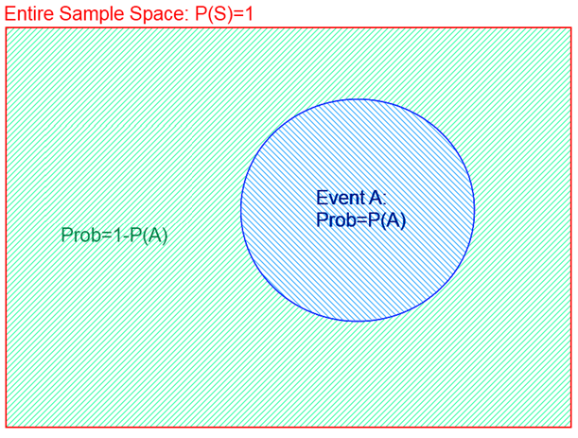
Probability Space
P(A) + P(¬A) = 1
Area = Probability of Event

Slide 14
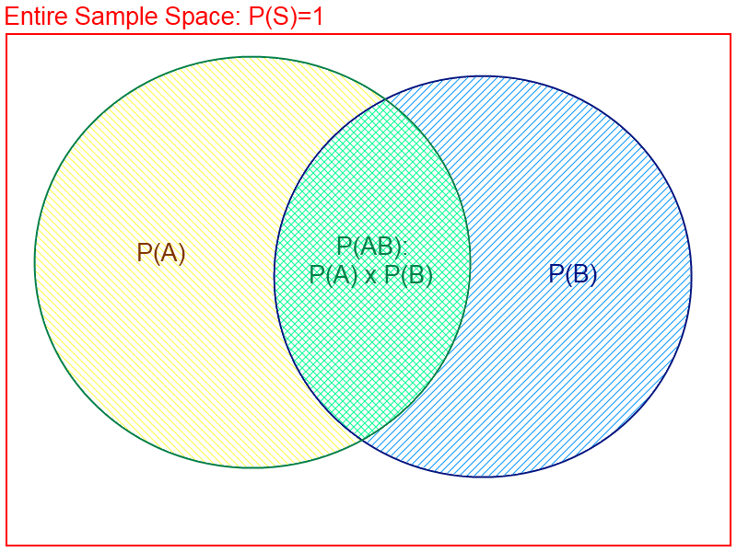
AND Probability
P(A, B) = P(A ˄ B) = P(A) + P(B) − P(A ˅ B)
P(A ˄ B)
= P(A) + P(B)
− P(A ˅ B)
Area = Probability of Event

Slide 15
OR Probability
P(A ˅B) = P(A) + P(B) − P(A ˄ B)
P(A ˅ B)
= P(A) + P(B)
− P(A ˄ B)
Area = Probability of Event

Slide 16
Conditional Probability
We often use comma to abbreviate AND.
P(A | B) = P(A, B) / P(B)
P(A ˄ B) = P(A) + P(B) - P(A ˅ B)
Area = Probability of Event

Slide 17
Product Rule
P(A,B) = P(A|B) P(B)
P(A ˄ B) = P(A) + P(B) - P(A ˅ B)
Area = Probability of Event

Slide 18
Using the Product Rule
Applies to any number of variables:
P(a, b, c) = P(a, b|c) P(c) = P(a|b, c) P(b, c)
P(a, b, c|d, e) = P(a|b, c, d, e) P(b, c|d, e)
Factoring: (AKA Chain Rule for probabilities)
By the product rule, we can always write:
P(a, b, c, … z) = P(a | b, c, …. z) P(b, c, … z)
Repeatedly applying this idea, we can write:
P(a, b, c, … z) = P(a | b, c, …. z) P(b | c,.. z) P(c| .. z)..P(z)
This holds for any ordering of the variables
We often use comma to abbreviate AND.

Slide 19
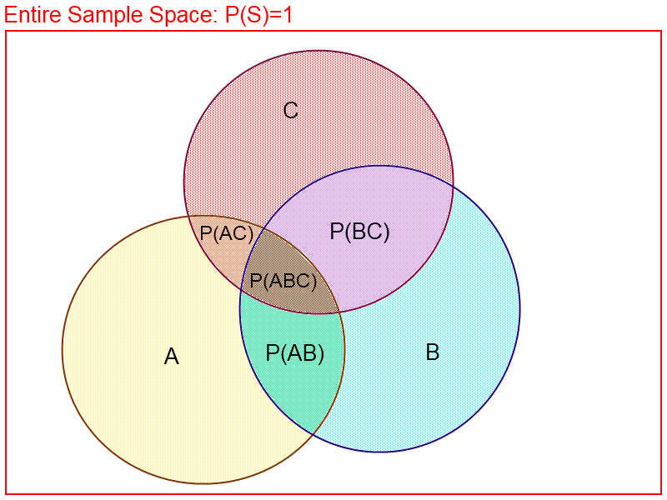
Sum Rule
P(A) = Σ_{B,C} P(A,B,C) = Σ_{b∈B,c∈C} P(A,b,c)
Area = Probability of Event

Slide 20
Using the Sum Rule
We can marginalize variables out of any joint distribution by simply summing over that variable:
P(b) = Σ_{a} Σ_{c} Σ_{d} P(a, b, c, d)
P(a, d) = Σ_{b} Σ_{c} P(a, b, c, d)
For Example: Determine probability of catching a fish
Given a set of probabilities P(CatchFish, Day, Lake)
Where:
CatchFish = {true, false}
Day = {mon, tues, wed, thurs, fri, sat, sun}
Lake = {buel lake, ralph lake, crystal lake}
Need to find P(CatchFish = True):
P(CatchFish = true) = Σ_{day} Σ_{lake} P(CatchFish = true, day, lake)
We often use comma to abbreviate AND.

Slide 21
Bayes’ Rule
P(B|A) = P(A|B) P(B) / P(A)
P(A ˄ B) = P(A) + P(B) - P(A ˅ B)
Area = Probability of Event

Slide 22
Derivation of Bayes’ Rule
Start from Product Rule:
P(a, b) = P(a|b) P(b) = P(b|a) P(a)
Isolate Equality on Right Side:
P(a|b) P(b) = P(b|a) P(a)
Divide through by P(b):
P(a|b) = P(b|a) P(a) / P(b) <-- Bayes’ Rule

Slide 23
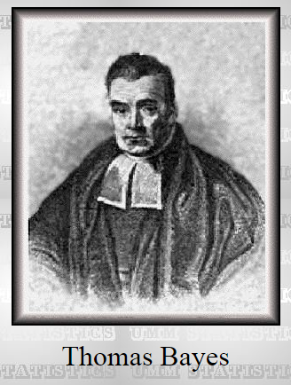
Who’s Bayes?
Reverend Thomas Bayes (c. 1701 – 1761) was an English minister and mathematician. His ideas have created much controversy and debate among statisticians….
The paper that describes Bayes’ Theorem (or Bayes’ Rule) was discovered in his office after his death. Allegedly, he was trying to prove the existence of God by mathematics; though this is not certain and other motives also are alleged. His paper was sent to the Royal Society with a note, “Some of your members may be interested in this.” It was published by, and read to, the Royal Society. Nowadays, it has given rise to an immense body of statistical and probabilistic work.
Portrait purportedly of Bayes used in a 1936 book, but it is doubtful whether the portrait is actually of him. No earlier claimed portrait survives.

Slide 24
Summary of probability rules
Product Rule: (aka Chain Rule)
P(a, b) = P(a|b) P(b) = P(b|a) P(a)Probability of “a” and “b” occurring is the same as probability of “a” occurring given “b” is true, times the probability of “b” occurring.
e.g., P( rain, cloudy ) = P(rain | cloudy) * P(cloudy)
P(a, b, c, …, y, z) = P(a|b, c, …, y, z) P(b|c, …, y, z) … P(y|z)
Sum Rule: (aka Law of Total Probability)
P(a) = Σ_{b} P(a, b) = Σ_{b} P(a|b) P(b), where B is any random variable
Probability of “a” occurring is the same as the sum of all joint probabilities including the event, provided the joint probabilities represent all possible events.
Can be used to “marginalize” out other variables from probabilities, resulting in prior probabilities also being called marginal probabilities.
e.g., P(rain) = Σ_{Windspeed} P(rain, Windspeed)
where Windspeed = {0-10mph, 10-20mph, 20-30mph, etc.}
Bayes’ Rule:
P(b|a) = P(a|b) P(b) / P(a)
Acquired from rearranging the product rule.
Allows conversion between conditionals, from P(b|a) to P(a|b).
e.g., b = disease, a = symptoms
More natural to encode knowledge as P(a|b) than as P(b|a).

Slide 25
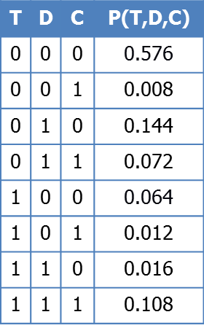
Full Joint Distribution
We can fully specify a probability space by a full joint distribution:
A full joint distribution contains a probability for
every possible combination of variable values. This requires:
Π_{vars} (n_{var}) probabilities
where n_{var} is the number of values in the domain of variable var
E.g. P(A, B, C), where A,B,C have 4 values each;
Full joint distribution specified by 4³ values = 64 values
For n variables each with m values, requires m^{n} probabilities
E.g., a realistic problem of 100 Boolean variables requires > 10³⁰ probabilities (intractable)
Using a full joint distribution, we can use the product rule, sum rule, and Bayes’ rule to create any combination of joint, marginal, and conditional probabilities.

Slide 26
Marginal Probability
Example from Russell & Norvig
Can fully specify a probability space by constructing a full joint distribution
Example: dentist
T: have a toothache
D: dental probe catches
C: have a cavity
Joint distribution
Assigns each event (T=t, D=d, C=c) a probability
Probabilities sum to 1.0
Law of total probability:
= 0.008 + 0.072 + 0.012 + 0.108 = 0.20
Some value of (T,D) must occur; values disjoint
“Marginal probability” of C; “marginalize” or “sum over” T,D
Early actuaries wrote row & column totals in their probability table margins
T | D | C | P(T,D,C)
0 | 0 | 0 | 0.576
0 | 0 | 1 | 0.008
0 | 1 | 0 | 0.144
0 | 1 | 1 | 0.072
1 | 0 | 0 | 0.064
1 | 0 | 1 | 0.012
1 | 1 | 0 | 0.016
1 | 1 | 1 | 0.108
t,d

Slide 27
The effect of evidence
Example from Russell & Norvig
Example: dentist
T: have a toothache
D: dental probe catches
C: have a cavity
Recall p(C=1) = 0.20
Suppose we observe D=0, T=0?
Observe D=1, T=1?
T | D | C | P(T,D,C)
0 | 0 | 0 | 0.576
0 | 0 | 1 | 0.008
0 | 1 | 0 | 0.144
0 | 1 | 1 | 0.072
1 | 0 | 0 | 0.064
1 | 0 | 1 | 0.012
1 | 1 | 0 | 0.016
1 | 1 | 1 | 0.108
0.008
=
0.576 + 0.008
= 0.012
Called posterior probabilities
or conditional probabilities
0.108
=
0.016 + 0.108
= 0.871

Slide 28
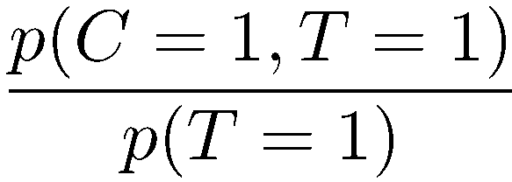
The effect of evidence
Example from Russell & Norvig
Example: dentist
T: have a toothache
D: dental probe catches
C: have a cavity
Combining these rules:
T | D | C | P(T,D,C)
0 | 0 | 0 | 0.576
0 | 0 | 1 | 0.008
0 | 1 | 0 | 0.144
0 | 1 | 1 | 0.072
1 | 0 | 0 | 0.064
1 | 0 | 1 | 0.012
1 | 1 | 0 | 0.016
1 | 1 | 1 | 0.108
0.012 + 0.108
=
= 0.60
0.064 + 0.012 + 0.016 + 0.108
0.20
Called the probability of evidence

Slide 29
Computing posteriors
Sometimes easiest to normalize last
The normalizing constant α is used to abbreviate normalization
T | D | C | P(T,D,C)
0 | 0 | 0 | 0.576
0 | 0 | 1 | 0.008
0 | 1 | 0 | 0.144
0 | 1 | 1 | 0.072
1 | 0 | 0 | 0.064
1 | 0 | 1 | 0.012
1 | 1 | 0 | 0.016
1 | 1 | 1 | 0.108
Assign T=1
Normalize
Sum over D
D | C | F(D,C)
0 | 0 | 0.064
0 | 1 | 0.012
1 | 0 | 0.016
1 | 1 | 0.108
C | G(C)
0 | 0.08
1 | 0.120
C | P(C|T=1)
0 | 0.40
1 | 0.60
p(C|T = 1) = α Σ_{d} p(C, d, T = 1)= Σ_{d} p(C, d, T = 1) / p(T = 1)

Slide 30
Independence
X, Y independent:
p(X=x,Y=y) = p(X=x) p(Y=y) for all x,y
Shorthand: p(X,Y) = P(X) P(Y)
Equivalent: p(X|Y) = p(X) or p(Y|X) = p(Y) (if p(Y), p(X) > 0)
Intuition: knowing X has no information about Y (or vice versa)
Independent probability distributions:
A | P(A)
0 | 0.4
1 | 0.6
B | P(B)
0 | 0.7
1 | 0.3
C | P(C)
0 | 0.1
1 | 0.9
Joint:
A | B | C | P(A,B,C)
0 | 0 | 0 | .4 * .7 * .1
0 | 0 | 1 | .4 * .7 * .9
0 | 1 | 0 | .4 * .3 * .1
0 | 1 | 1 | …
1 | 0 | 0
1 | 0 | 1
1 | 1 | 0
1 | 1 | 1
This can greatly reduce representation size!

Slide 31
Independence
X, Y independent:
p(X=x,Y=y) = p(X=x) p(Y=y) for all x,y
Shorthand: p(X,Y) = P(X) P(Y)
Equivalent: p(X|Y) = p(X) or p(Y|X) = p(Y) (if p(Y), p(X) > 0)
Intuition: knowing X has no information about Y (or vice versa)
Joint probabilities:
Independent probability distributions:
A | P(A)
0 | 0.4
1 | 0.6
B | P(B)
0 | 0.7
1 | 0.3
C | P(C)
0 | 0.1
1 | 0.9
A | B | C | P(A,B,C)
0 | 0 | 0 | 0.028
0 | 0 | 1 | 0.252
0 | 1 | 0 | 0.012
0 | 1 | 1 | 0.108
1 | 0 | 0 | 0.042
1 | 0 | 1 | 0.378
1 | 1 | 0 | 0.018
1 | 1 | 1 | 0.162
This can greatly reduce representation size!
Note: it is hard to “read” independence
from the joint distribution.
We can “test” for it, but to do so requires a number
of tests equal to the size of the joint distribution.

Slide 32
Conditional Independence
X, Y independent given Z
p(X=x,Y=y|Z=z) = p(X=x|Z=z) p(Y=y|Z=z) for all x,y,z
Equivalent: p(X|Y,Z) = p(X|Z) or p(Y|X,Z) = p(Y|Z) (if all > 0)
Intuition: X has no additional info about Y beyond Z’s
Example
X = height p(height|reading, age) = p(height|age)
Y = reading ability p(reading|height, age) = p(reading|age)
Z = age
Height and reading ability are dependent (not independent), but are conditionally independent given age

Slide 33
Conditional Independence
Symptom 2
Different values of C (condition variable)
correspond to different groups/colors
Symptom 1
Symptom 1 and symptom 2 are conditionally independent, given group.
But clearly, symptom 1 and 2 are marginally dependent, unconditionally.

Slide 34
Conditional Independence Example:
X, Y independent given Z
p(X=x,Y=y|Z=z) = p(X=x|Z=z) p(Y=y|Z=z) for all x,y,z
A box contains two coins: one regular coin, P(heads) = .5, and one fake two-headed coin, P(heads)=1. I choose a coin at random and toss it twice. Define the following events.
A = First coin toss results in heads
B= Second coin toss results in heads
C= Coin 1 (regular) has been selected
P(A∧B) = 5/8 ≠ P(A) P(B) = 9/16, so A and B are not independent
Event A makes it more likely I selected the two-headed coin, which makes Event B more likely. Knowing Event A gives information about Event B.
P(A∧B|C) = 1/4 = P(A|C) P(B|C), so A and B are independent given C
Given C, knowing Event A gives no information about Event B.

Slide 35
Conditional Independence Example:
X, Y independent given Z
p(X=x,Y=y|Z=z) = p(X=x|Z=z) p(Y=y|Z=z) for all x,y,z
Consider two brothers John and Joseph, both having a genetic disease. These two events are dependent as they are brothers.
However, given the condition that Joseph is an adopted son of the family makes the events conditionally independent.

Slide 36
Conditional Independence Example:
X, Y independent given Z
p(X=x,Y=y|Z=z) = p(X=x|Z=z) p(Y=y|Z=z) for all x,y,z
Rain causes both increased umbrella usage and worsened road conditions. These events are not independent because seeing lots of umbrellas makes worsened road conditions more likely.
However, given the condition that it is raining makes the events conditionally independent. Once you know it is raining, seeing umbrellas tells you nothing more about road conditions.

Slide 37
Conditional Independence
T | D | C | P(T,D,C)
0 | 0 | 0 | 0.576
0 | 0 | 1 | 0.008
0 | 1 | 0 | 0.144
0 | 1 | 1 | 0.072
1 | 0 | 0 | 0.064
1 | 0 | 1 | 0.012
1 | 1 | 0 | 0.016
1 | 1 | 1 | 0.108
X, Y independent given Z
p(X=x,Y=y|Z=z) = p(X=x|Z=z) p(Y=y|Z=z) for all x,y,z
Equivalent: p(X|Y,Z) = p(X|Z) or p(Y|X,Z) = p(Y|Z)
Intuition: X has no additional info about Y beyond Z’s
Example: Dentist
Conditionally independent distributions:
T | C | P(T|C)
0 | 0 | 0.9
0 | 1 | 0.4
1 | 0 | 0.1
1 | 1 | 0.6
Conditional probabilities:
T | D | C | P(T,D|C)
0 | 0 | 0 | 0.72
0 | 0 | 1 | 0.04
0 | 1 | 0 | 0.18
0 | 1 | 1 | 0.36
1 | 0 | 0 | 0.08
1 | 0 | 1 | 0.06
1 | 1 | 0 | 0.02
1 | 1 | 1 | 0.54
Again, hard to “read” from the
joint probabilities; only from
the conditional probabilities.
Like independence, can greatly
reduce representation size!
D | C | P(D|C)
0 | 0 | 0.8
0 | 1 | 0.1
1 | 0 | 0.2
1 | 1 | 0.9

Slide 38
Conditional Independence
Formal Definition:
2 random variables A and B are conditionally independent given C iff:
P(a, b|c) = P(a|c) P(b|c), for all values a, b, c
Informal Definition:
2 random variables A and B are conditionally independent given C iff:
P(a|b, c) = P(a|c) OR P(b|a, c) = P(b|c), for all values a, b, c
P(a|b, c) = P(a|c) tells us that learning about b, given that we already know c, provides no change in our probability for a, and thus b contains no information about a beyond what c provides.
Naïve Bayes Model:
Often a single variable can directly influence a number of other variables, all of which are conditionally independent, given the single variable.
E.g., k different symptom variables X₁, X₂, … X_{k}, and C = disease, reducing to:
P(X₁, X₂,…. X_{K} | C) = Π P(X_{i} | C)

Slide 39
Full Joint vs Conditional Independence
Example : 4 Binary Random Variable (A,B,C,D)
Full Joint Probability Table
1 Table with 16 rows
Conditional Independence
P(A,B,C,D) = P(A) P(B|A) P(C |A, B) P(D| A,B,C) (no saving yet..)
if… P(D|A, B) = P(C |A), P(D|A,B,C) = P(D|A) [Naïve Bayes Model]
P(A,B,C,D) = P(A) P(B|A) P(C |A) P(D|A)
4 Tables. With at most 4 rows
If we had N Binary Random Variables
Full Joint Probability Table
1 Table with 2^(N) Rows; N = 100, 2^100 ~= 10^30
Naïve Bayes Model (Conditional Independence)
N tables with at most 4 rows!

Slide 40
Conclusions…
Representing uncertainty is useful in knowledge bases.
Probability provides a framework for managing uncertainty.
Using a full joint distribution and probability rules, we can derive any probability relationship in a probability space.
Number of required probabilities can be reduced through independence and conditional independence relationships
Probabilities allow us to make better decisions by using decision theory and expected utilities.
Rational agents cannot violate probability theory.

