Slide 1
Machine Learning Classifiers

Slide 2
Outline
Different types of learning problems
Different types of learning algorithms
Supervised learning
  Decision trees
  Naïve Bayes
  Perceptrons, Multi-layer Neural Networks

Slide 3
You will be expected to know
Classifiers:
  Decision trees
  K-nearest neighbors
  Naïve Bayes
  Perceptrons, Support vector Machines (SVMs), Neural Networks
Decision Boundaries for various classifiers
  What can they represent conveniently? What not?

Slide 4
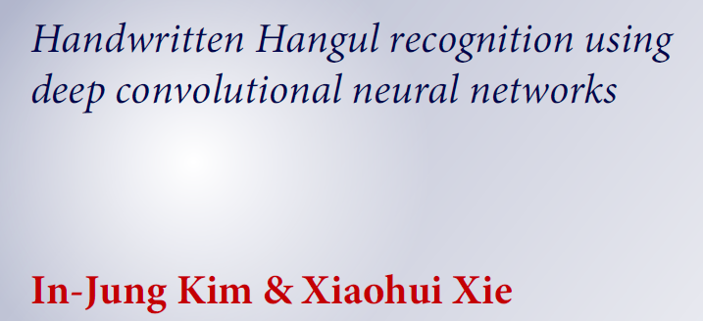
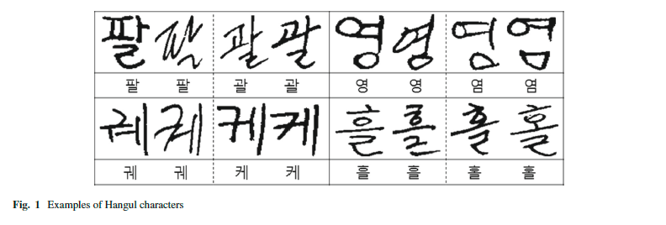
Thanks to Xiaohui Xie

Slide 5
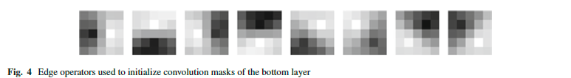
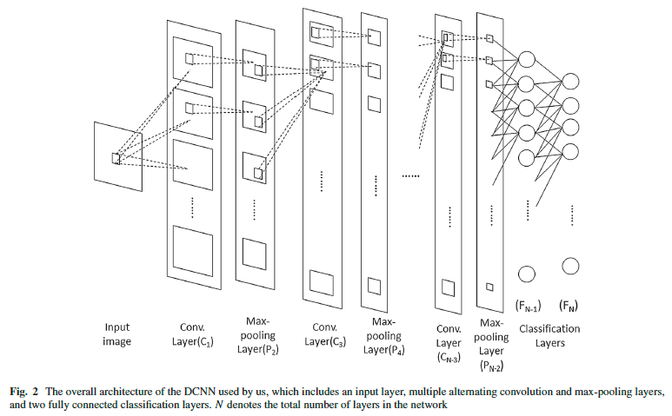
Thanks to Xiaohui Xie

Slide 6
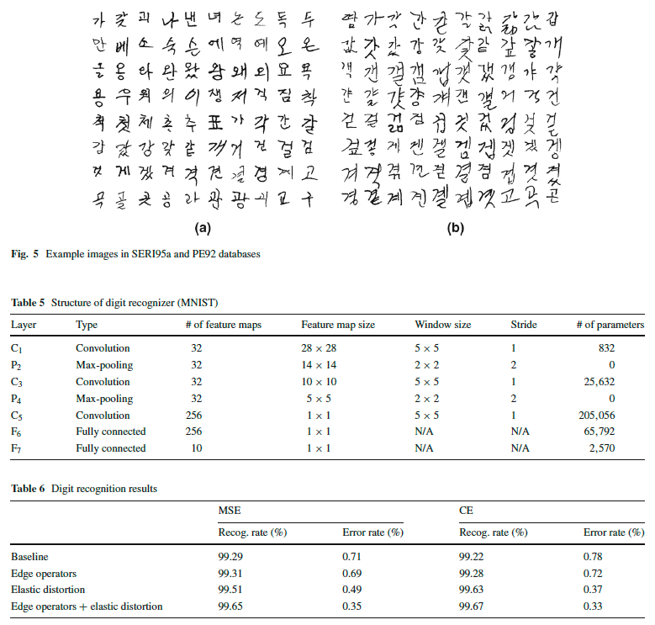
Thanks to Xiaohui Xie

Slide 7
Knowledge-based avoidance of drug-resistant HIV mutants
Physician’s advisor for drug-resistant HIV
Rules link HIV mutations & drug resistance
Rules extracted from literature manually
Patient’s HIV is sequenced
Rules identify patient-specific resistance
Rank approved combination treatments

Slide 8
Input/Output Behavior
INPUT = HIV SEQUENCES FROM PATIENT:
  5 HIV clones (clone = RT + PRO)
  = 5 RT + 5 PRO (RT = 1,299; PRO = 297)
  = 7,980 letters of HIV genome
OUTPUT = RECOMMENDED TREATMENTS:
  12 = 11 approved drugs + 1 humanitarian use
  Some drugs should not be used together
  407 possible approved treatments

Slide 9
Example Patient Sequence of
HIV Reverse Transcriptase (RT)
CCA GTA AAA TTA AAG CCA GGA ATG GAT GGC CCA AAA GTT AAA CAA TGG CCA CCC ATT AGC CCT ATT GAG ACT GTA TTG ACA GAA GAA AAA ATA AAA GCA TTA GTA GAA ATT TGT ACA GAG ATG GAA AAG GAA GGG *AA ATT TCA AAA ATT GGG CCT GAA AAT CCA TAC AAT ACT CCA GTA TTT GCC ATA AAG AAA AAA GAC AGT ACT AAA TGG AGA AAA TTA GTA GAT TTC AGA GAA CTT AAT AAG AGA ACT CAA GAC TTC TGG GAA GTT CAA TTA GGA ATA CCA CAT CCC GCA GGG TAA AAA AAG AAA AAA TCA GTA ACA GTA CTG GAT GTG GGT GAT GCA TAT TTT TCA GTT CCC TTA GAT GAA GAC TTC AGG AAG TAT ACT GCA TTT ACC ATA CCT AGT ATA AAC AAT GAG ACA CCA GGG ATT AGA TAT CAG TAC AAT GTG CTT CCA [CAG] GGA TGG AAA GGA TCA CCA GCA ATA TTC CAA AGT AGC ATG ACA AAA ATC TTA GAG CCT TTT AGA AAA CAA AAT CCA GAC ATA GTT ATC TAT CAA TAC ATG GAT GAT TTG TAT GTA GGA TCT GAC TTA GAA ATA GGG GAG CAT AGA ACA AAA ATA GAG GAG CTG AGA CAA CAT CTG TTG AGG TGG GGA CTT ACC ACA CCA GAC AAA AAA CAT CAG AAA GAA CCT CCA TTC CTT TGG ATG GGT TAT GAA CTC CAT CCT GAT AAA TGG ACA GTA CAG CCT ATA GTG CTG CCA GAA AAA GAC AGC TGG ACT GTC AAT GAC ATA CAG AAG TTA GTG GGG AAA TTG AAT TGG GCA AGT CAG ATT TAC CCA GGG ATT AAA GTA AGG CAA TTA TGT AAA CTC CTT AGA GGA ACC AAA GCA CTA ACA GAA GTA ATA CCA CTA ACA GAA GAA GCA GAG CTA GAA CTG GCA GAA AAC AGA GAG ATT CTA TAA GAA CAA GTA CAT GGA GTG TAT TAT GAC CCA TCA AAA GAC TTA ATA GCA GAA ATA CAG AAG CAG GGG CAA GGC CAA TGG ACA TAT CAA ATT TAT CAA GAG CCA TTT AAA AAT CTG AAA ACA GGA AAA TAT GCA AGA ATG AGG GGT GCC CAC ACT AAT GAT GTA AAA CAA ATA ACA GAG GCA GTG CAA AAA ATA ACC ACA GAA AGC ATA GTA ATA TGG TGA AAG ACT CCT AAA TTT AAA CTG CCC ATA CAA AAG GAA ACA TGG GAA ACA TGG TGG ACA GAG TAT TGG CAA GCC ACC TGG ATT CCT GAG TGG GAG TTT GTT AAT ACC CCT CCC ATA GTG AAA TTA TGG TAC CAG TTA GAG AAA GAA CCC
The bracketed codon [CAG] causes strong resistance to AZT.

Slide 10
Rules represent knowledge about HIV drug resistance
IF <antecedent> THEN <consequent> [weight] (reference).
IF RT codon 151 is ATG
THEN do not use AZT, ddI, d4T, or ddc.
[weight=1.0] (Iversen et al. 1996)
The weight is the degree of resistance,
NOT a confidence or probability.

Slide 11
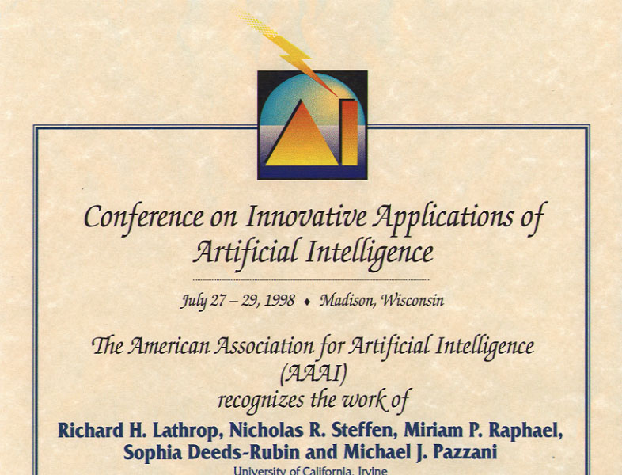
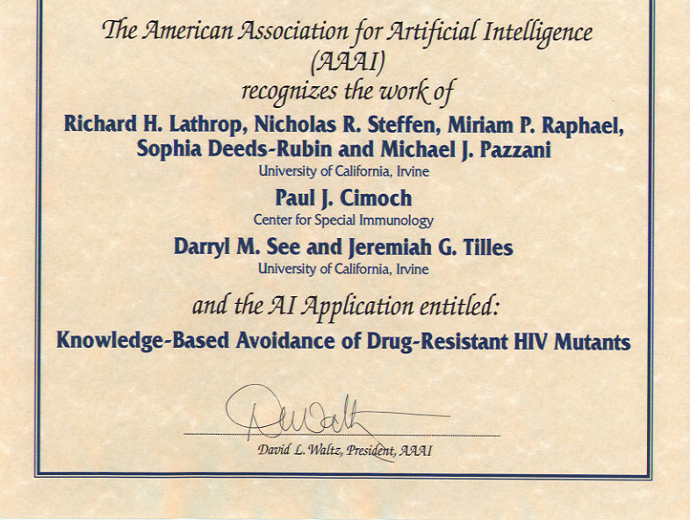
“Knowledge-based avoidance of drug-resistant HIV mutants”
Lathrop, Steffen, Raphael, Deeds-Rubin, Pazzani
Innovative Applications of Artificial Intelligence Conf. Madison, WI, USA, 1998
ICS undergraduate women

Slide 12

“Knowledge-based avoidance of drug-resistant HIV mutants”
Lathrop, Steffen, Raphael, Deeds-Rubin, Pazzani, Cimoch, See, Tilles
AI Magazine 20(1999)13-25
ICS undergraduate women

Slide 13
Inductive learning
Let x represent the input vector of attributes
  x_{j} is the jth component of the vector x
  x_{j} is the value of the jth attribute, j = 1,…d
Let f(x) represent the value of the target variable for x
  The implicit mapping from x to f(x) is unknown to us
  We just have training data pairs, D = {x, f(x)} available
We want to learn a mapping from x to f, i.e.,
h(x; θ) is “close” to f(x) for all training data points x
θ are the parameters of our predictor h(..)
Examples:
  h(x; θ) = sign(w₁x₁ + w₂x₂+ w₃)
  h_{k}(x) = (x1 OR x2) AND (x3 OR NOT(x4))

Slide 14
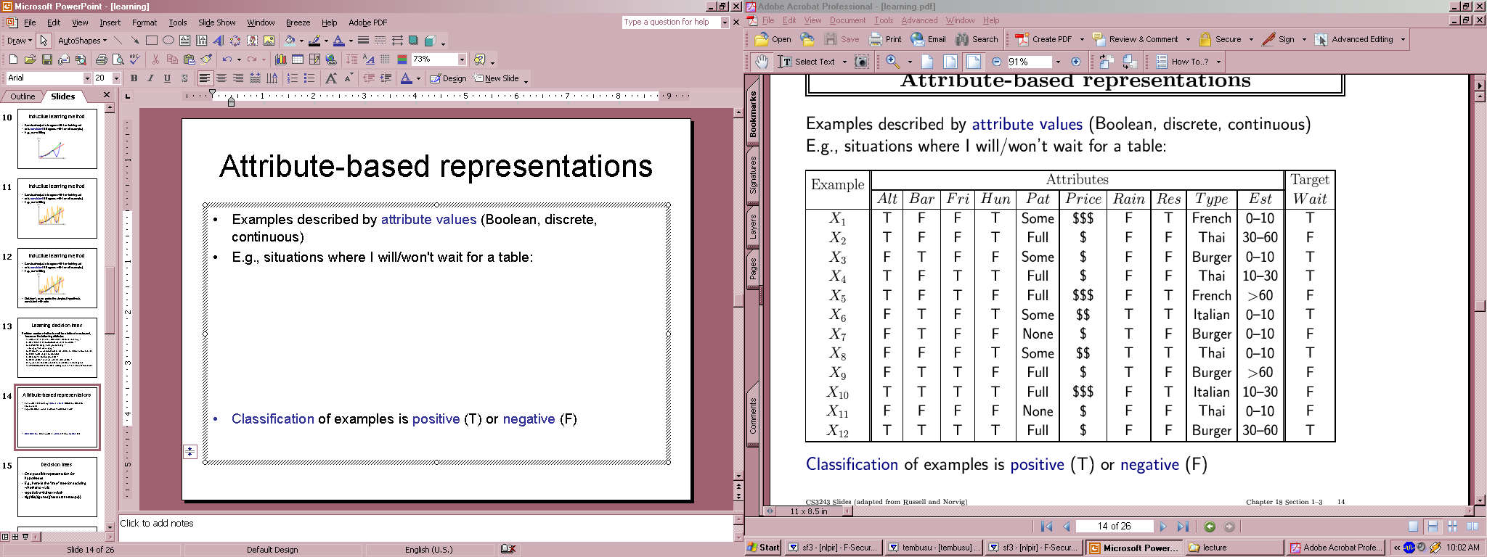
Training Data for Supervised Learning

Slide 15
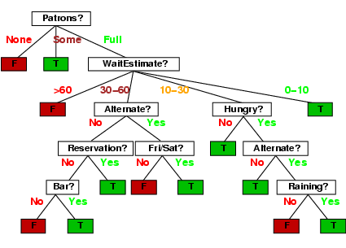
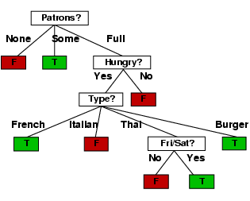
True Tree (left) versus Learned Tree (right)

Slide 16
Classification Problem with Overlap

Slide 17
Decision Boundaries
Decision
Boundary
Decision
Region 1
Decision
Region 2

Slide 18
Classification in Euclidean Space
A classifier is a partition of the space x into disjoint decision regions
  Each region has a label attached
  Regions with the same label need not be contiguous
  For a new test point, find what decision region it is in, and predict the corresponding label
Decision boundaries = boundaries between decision regions
  The “dual representation” of decision regions
We can characterize a classifier by the equations for its decision boundaries
Learning a classifier ⬄ searching for the decision boundaries that optimize our objective function

Slide 19
Example: Decision Trees
When applied to real-valued attributes, decision trees produce “axis-parallel” linear decision boundaries
Each internal node is a binary threshold of the form
x_{j} > t ?
converts each real-valued feature into a binary one
requires evaluation of N-1 possible threshold locations for N data points, for each real-valued attribute, for each internal node

Slide 20
Decision Tree Example
Debt
Income

Slide 21
Decision Tree Example
Debt
Income > t1
??
t1
Income

Slide 22
Decision Tree Example
Debt
Income > t1
t2
Debt > t2
t1
Income
??

Slide 23
Decision Tree Example
Debt
Income > t1
t2
Debt > t2
t3
t1
Income
Income > t3

Slide 24
Decision Tree Example
Debt
Income > t1
t2
Debt > t2
t3
t1
Income
Income > t3
Note: tree boundaries are
linear and axis-parallel

Slide 25
A Simple Classifier: Minimum Distance Classifier
Training
  Separate training vectors by class
  Compute the mean for each class, μ_{k}, k = 1,… m
Prediction
  Compute the closest mean to a test vector x’ (using Euclidean distance)
  Predict the corresponding class
In the 2-class case, the decision boundary is defined by the locus of the hyperplane that is halfway between the 2 means and is orthogonal to the line connecting them
This is a very simple-minded classifier – easy to think of cases where it will not work very well

Slide 26
Minimum Distance Classifier

Slide 27
Another Example: Nearest Neighbor Classifier
The nearest-neighbor classifier
  Given a test point x’, compute the distance between x’ and each input data point
  Find the closest neighbor in the training data
  Assign x’ the class label of this neighbor
  (sort of generalizes minimum distance classifier to exemplars)
If Euclidean distance is used as the distance measure (the most common choice), the nearest neighbor classifier results in piecewise linear decision boundaries
Many extensions
  e.g., kNN, vote based on k-nearest neighbors
  k can be chosen by cross-validation

Slide 28
Local Decision Boundaries
Boundary? Points that are equidistant
between points of class 1 and 2
Note: locally the boundary is linear
1
2
Feature 2
1
2
?
2
1
Feature 1

Slide 29
Finding the Decision Boundaries
1
2
Feature 2
1
2
?
2
1
Feature 1

Slide 30
Finding the Decision Boundaries
1
2
Feature 2
1
2
?
2
1
Feature 1

Slide 31
Finding the Decision Boundaries
1
2
Feature 2
1
2
?
2
1
Feature 1

Slide 32
Overall Boundary = Piecewise Linear
Decision Region
for Class 1
Decision Region
for Class 2
1
2
Feature 2
1
2
?
2
1
Feature 1

Slide 33
Nearest-Neighbor Boundaries on this data set?
Predicts blue
Predicts red

Slide 37
The kNN Classifier
The kNN classifier often works very well.
Easy to implement.
Easy choice if characteristics of your problem are unknown.
Can be sensitive to the choice of distance metric.
  Often normalize feature axis values, e.g., z-score or [0, 1]
    E.g., if one feature runs larger in magnitude than another
  Categorical feature axes are difficult, e.g., Color as Red/Blue/Green
    Maybe use the absolute differences of their wavelengths?
    But what about French/Italian/Thai/Burger?
    Often used: delta(A,B) = {IF (A=B) THEN 0 ELSE 1}
Can encounter problems with sparse training data.
Can encounter problems in very high dimensional spaces.
  Most points are corners.
  Most points are at the edge of the space.
  Most points are neighbors of most other points.

Slide 38
Linear Classifiers
Linear classifier ⬄ single linear decision boundary
(for 2-class case)
We can always represent a linear decision boundary by a linear equation:
w₁ x₁ + w₂ x₂ + … + w_{d} x_{d} = Σ w_{j} x_{j} = w^{t} x = 0
In d dimensions, this defines a (d-1) dimensional hyperplane
  d=3, we get a plane; d=2, we get a line
For prediction we simply see if Σ w_{j} x_{j} > 0
The w_{i} are the weights (parameters)
  Learning consists of searching in the d-dimensional weight space for the set of weights (the linear boundary) that minimizes an error measure
  A threshold can be introduced by a “dummy” feature that is always one; its weight corresponds to (the negative of) the threshold
Note that a minimum distance classifier is a special (restricted) case of a linear classifier

Slide 42
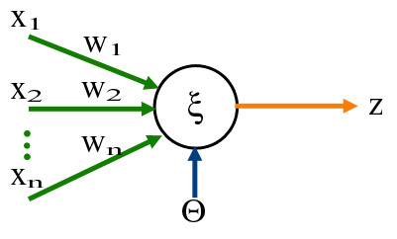
The Perceptron Classifier (pages 729-731 in text)
Transfer Function
Output
Input
Attributes
(Features)
Weights For Input
Attributes
Bias or Threshold

Slide 43
The Perceptron Classifier (pages 729-731 in text)
The perceptron classifier is just another name for a linear classifier for 2-class data, i.e.,
output(x) = sign( Σ w_{j} x_{j} )
Loosely motivated by a simple model of how neurons fire
For mathematical convenience, class labels are +1 for one class and -1 for the other
Two major types of algorithms for training perceptrons
  Objective function = classification accuracy (“error correcting”)
  Objective function = squared error (use gradient descent)
  Gradient descent is generally faster and more efficient – but there is a problem! No gradient!

Slide 44
Two different types of perceptron output
x-axis below is f(x) = f = weighted sum of inputs
y-axis is the perceptron output
o(f)
Thresholded output (step function),
takes values +1 or -1
f
σ(f)
Sigmoid output, takes
real values between -1 and +1
The sigmoid is in effect an approximation
to the threshold function above, but
has a gradient that we can use for learning
f
Sigmoid function is defined as
σ[ f ] = [ 2 / ( 1 + exp[- f ] ) ] - 1
Derivative of sigmoid
∂σ/δf [ f ] = .5 * ( σ[f]+1 ) * ( 1-σ[f] )

Slide 45
Squared Error for Perceptron with Sigmoidal Output
Squared error = E[w] = Σ_{i} [ σ(f[x(i)]) - y(i) ]²
where x(i) is the ith input vector in the training data, i=1,..N
y(i) is the ith target value (-1 or 1)
f[x(i)] = Σ w_{j} x_{j} is the weighted sum of inputs
σ(f[x(i)]) is the sigmoid of the weighted sum
Note that everything is fixed (once we have the training data) except for the weights w
So we want to minimize E[w] as a function of w

Slide 46
Gradient Descent Learning of Weights
Gradient Descent Rule:
w _{new} = w _{old} - η Δ ( E[w] )
where
Δ (E[w]) is the gradient of the error function E wrt weights, and
η is the learning rate (small, positive)
Notes:
1. This moves us downhill in direction Δ ( E[w] ) (steepest downhill)
2. How far we go is determined by the value of η

Slide 47
Gradient Descent Update Equation
From basic calculus, for perceptron with sigmoid, and squared error objective function, gradient for a single input x(i) is
    Δ ( E[w] ) = - ( y(i) – σ[f(i)] ) ∂σ[f(i)] x_{j}(i)
Gradient descent weight update rule:
  w_{j} = w_{j} + η ( y(i) – σ[f(i)] ) ∂σ[f(i)] x_{j}(i)
  can rewrite as:
  w_{j} = w_{j} + η * error * c * x_{j}(i)

Slide 48
Pseudo-code for Perceptron Training
Initialize each w_{j} (e.g.,randomly)
While (termination condition not satisfied)
  for i = 1: N % loop over data points (an iteration)
    for j= 1 : d % loop over weights
      deltawj = η ( y(i) – σ[f(i)] ) ∂σ[f(i)] x_{j}(i)
      w_{j} = w_{j} + deltawj
    end
  calculate termination condition
  end
Inputs: N features, N targets (class labels), learning rate η
Outputs: a set of learned weights

Slide 49
Comments on Perceptron Learning
Iteration = one pass through all of the data
Algorithm presented = incremental gradient descent
  Weights are updated after visiting each input example
  Alternatives
    Batch: update weights after each iteration (typically slower)
    Stochastic: randomly select examples and then do weight updates
A similar iterative algorithm learns weights for thresholded output (step function) perceptrons
Rate of convergence
  E[w] is convex as a function of w, so no local minima
  So convergence is guaranteed as long as learning rate is small enough
    But if we make it too small, learning will be *very* slow
  But if learning rate is too large, we move further, but can overshoot the solution and oscillate, and not converge at all

Slide 50
Support Vector Machines (SVM): “Modern perceptrons”
(section 18.9, R&N)
A modern linear separator classifier
  Essentially, a perceptron with a few extra wrinkles
Constructs a “maximum margin separator”
  A linear decision boundary with the largest possible distance from the decision boundary to the example points it separates
  “Margin” = Distance from decision boundary to closest example
  The “maximum margin” helps SVMs to generalize well
Can embed the data in a non-linear higher dimension space
  Constructs a linear separating hyperplane in that space
    This can be a non-linear boundary in the original space
  Algorithmic advantages and simplicity of linear classifiers
  Representational advantages of non-linear decision boundaries
Currently most popular “off-the shelf” supervised classifier.

Slide 51
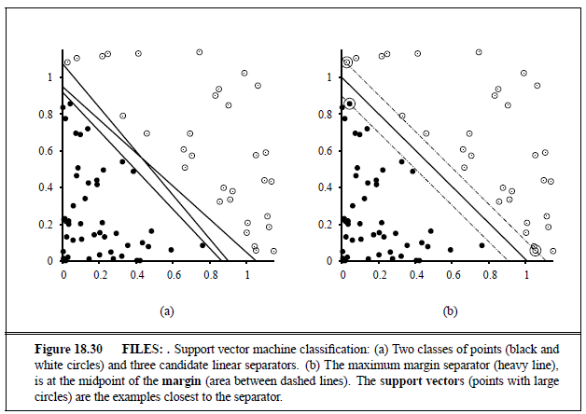
Constructs a “maximum margin separator”

Slide 52
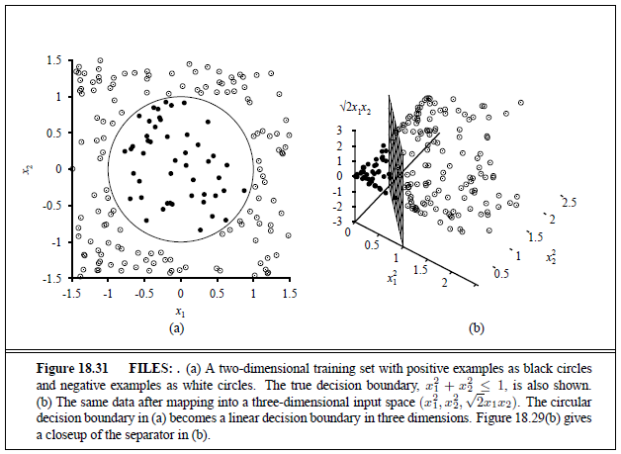
Can embed the data in a non-linear higher dimension space

Slide 53
Multi-Layer Perceptrons (Artificial Neural Networks) (sections 18.7.3-18.7.4 in textbook)
What if we took K perceptrons and trained them in parallel and then took a weighted sum of their sigmoidal outputs?
  This is a multi-layer neural network with a single “hidden” layer (the outputs of the first set of perceptrons)
  If we train them jointly in parallel, then intuitively different perceptrons could learn different parts of the solution
    They define different local decision boundaries in the input space
What if we hooked them up into a general Directed Acyclic Graph?
  Can create simple “neural circuits” (but no feedback; not fully general)
  Often called neural networks with hidden units
How would we train such a model?
  Backpropagation algorithm = clever way to do gradient descent
  Bad news: many local minima and many parameters
    training is hard and slow
  Good news: can learn general non-linear decision boundaries
  Generated much excitement in AI in the late 1980’s and 1990’s
  Techniques like boosting, support vector machines, are often preferred

Slide 54
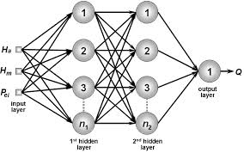
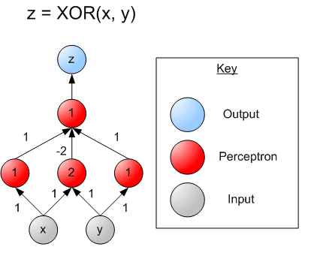
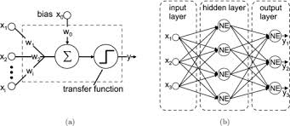
Multi-Layer Perceptrons (Artificial Neural Networks) (sections 18.7.3-18.7.4 in textbook)

Slide 55


Cutting Edge of Machine Learning:
Deep Learning in Neural Networks
Thanks to Pierre Baldi
Thanks to Xiaohui Xie
PRO:
* Good results on hard problems
* Combine feature extraction with classification directly from image
CON:
* Can be difficult to train; gradient descent does not work well
* Can be slow to train; but fast computers and modern techniques help

Slide 56
Naïve Bayes Model (section 20.2.2 R&N 3rd ed.)
X₁
X₂
X₃
X_{n}
C
Basic Idea: We want to estimate P(C | X₁,…X_{n}), but it’s hard to think about computing the probability of a class from input attributes of an example.
Solution: Use Bayes’ Rule to turn P(C | X₁,…X_{n}) into a proportionally equivalent expression that involves only P(C) and P(X₁,…X_{n} | C).
Then assume that feature values are conditionally independent given class, which allows us to turn P(X₁,…X_{n} | C) into Π_{i} P(X_{i} | C).
We estimate P(C) easily from the frequency with which each class appears within our training data, and we estimate P(X_{i} | C) easily from the frequency with which each X_{i} appears in each class C within our training data.

Slide 57
Naïve Bayes Model (section 20.2.2 R&N 3rd ed.)
X₁
X₂
X₃
X_{n}
C
Bayes Rule: P(C | X₁,…X_{n}) is proportional to P (C) Π_{i} P(X_{i} | C)
[note: denominator P(X₁,…X_{n}) is constant for all classes, may be ignored.]
Features Xi are conditionally independent given the class variable C
  choose the class value c_{i} with the highest P(c_{i} | x₁,…, x_{n})
  simple to implement, often works very well
  e.g., spam email classification: X’s = counts of words in emails
Conditional probabilities P(X_{i} | C) can easily be estimated from labeled date
  Problem: Need to avoid zeroes, e.g., from limited training data
  Solutions: Pseudo-counts, beta[a,b] distribution, etc.

Slide 58
Naïve Bayes Model (2)
P(C | X₁,…X_{n}) = α P (C) Π _{i} P(X_{i} | C)
Probabilities P(C) and P(X_{i} | C) can easily be estimated from labeled data
P(C = c_{j}) ≈ #(Examples with class label C = c_{j}) / #(Examples)
P(X_{i} = x_{ik} | C = c_{j})
≈ #(Examples with attribute value X_{i} = x_{ik} and class label C = c_{j})
/ #(Examples with class label C = c_{j})
Usually easiest to work with logs
log [ P(C | X₁,…X_{n}) ]
= log α + log P (C) + Σ log P(X_{i} | C)
DANGER: What if ZERO examples with value X_{i} = x_{ik} and class label C = c_{j} ?
An unseen example with value X_{i} = x_{ik} will NEVER predict class label C = c_{j} !
Practical solutions: Pseudocounts, e.g., add 1 to every #() , etc.
Theoretical solutions: Bayesian inference, beta distribution, etc.

Slide 59
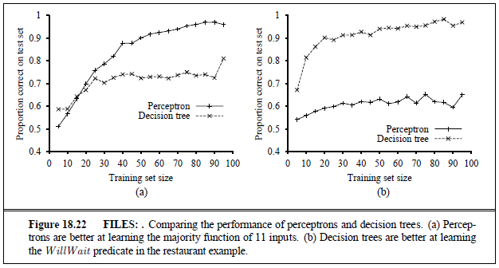
Classifier Bias — Decision Tree or Linear Perceptron?

Slide 60
Classifier Bias — Decision Tree or Linear Perceptron?

Slide 61
Classifier Bias — Decision Tree or Linear Perceptron?

Slide 62
Classifier Bias — Decision Tree or Linear Perceptron?

Slide 63
Classifier Bias — Decision Tree or Linear Perceptron?

Slide 64
Classifier Bias — Decision Tree or Linear Perceptron?

Slide 65
Classifier Bias — Decision Tree or Linear Perceptron?

Slide 66
Classifier Bias — Decision Tree or Linear Perceptron?

Slide 67
Classifier Bias — Decision Tree or Linear Perceptron?

Slide 68
Classifier Bias — Decision Tree or Linear Perceptron?

Slide 69
Classifier Bias — Decision Tree or Linear Perceptron?

Slide 70
Summary
Learning
  Given a training data set, a class of models, and an error function, this is essentially a search or optimization problem
Different approaches to learning
  Divide-and-conquer: decision trees
  Global decision boundary learning: perceptrons
  Constructing classifiers incrementally: boosting
Learning to recognize faces
  Viola-Jones algorithm: state-of-the-art face detector, entirely learned from data, using boosting+decision-stumps

