Slide 1
Introduction to Machine Learning
CS271P, Winter 2018
Introduction to Artificial Intelligence
Prof. Richard Lathrop
Reading: R&N 18.1-18.4
Optional: R&N 18.6-18,9, 18.11, 20.1, 20.2.1-2

Slide 2
Outline
Basics
  The importance of a good representation
  Different types of learning problems
  Different types of learning algorithms
Supervised learning
  Decision trees
  Naïve Bayes
  Perceptrons, Multi-layer Neural Networks
  Boosting
Unsupervised Learning
  K-means
  Latent space representations
Applications: learning to detect faces in images

Slide 3
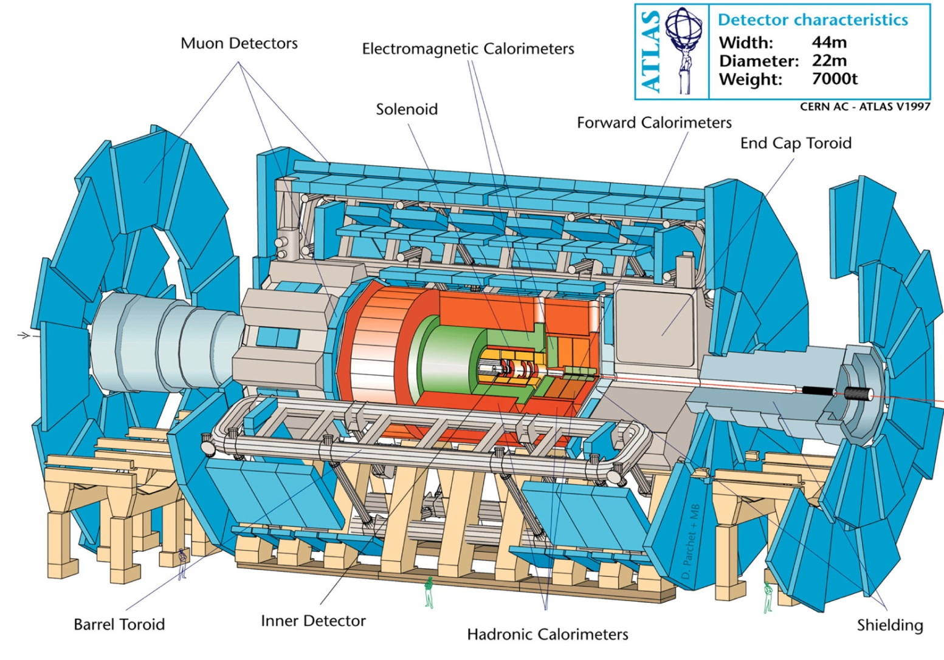
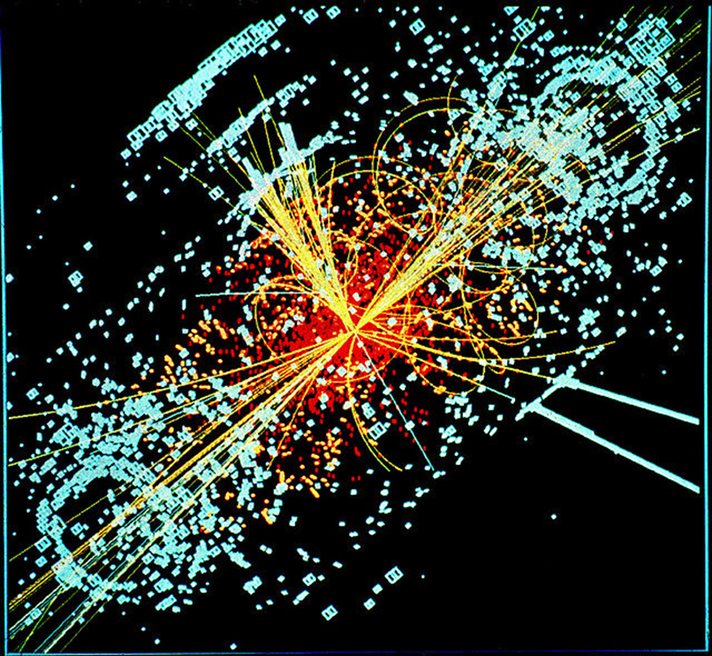
Deep Learning in Physics: Searching for Exotic Particles
Thanks to Pierre Baldi

Slide 4


Thanks to Pierre Baldi

Slide 5

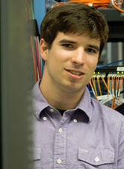
Thanks to Pierre Baldi
Daniel Whiteson
Peter Sadowski

Slide 6
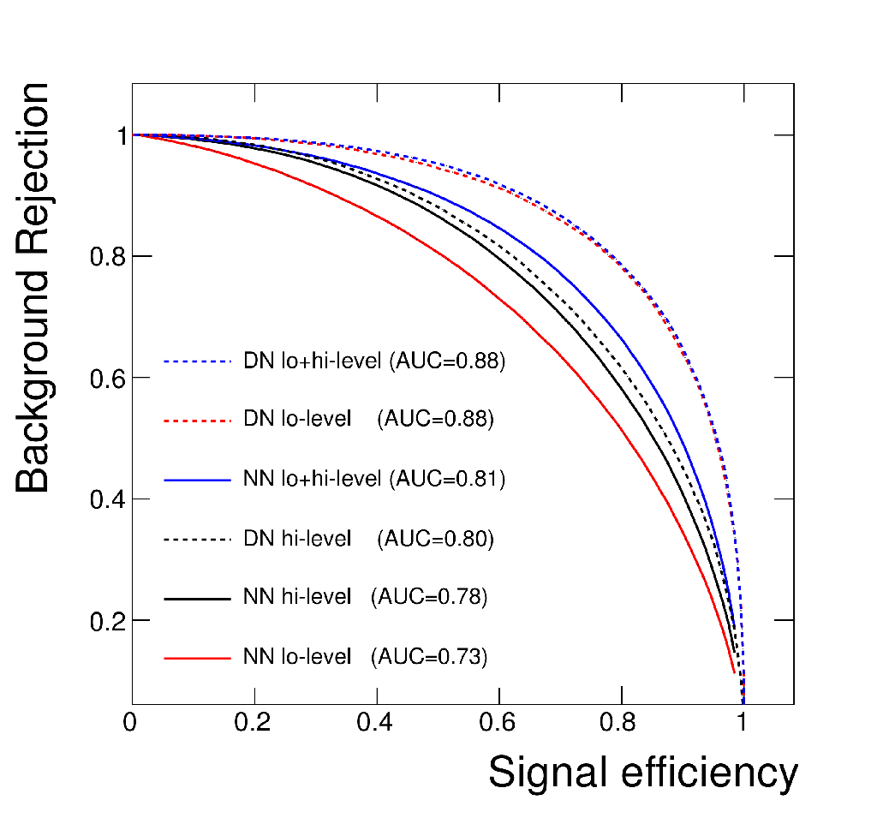
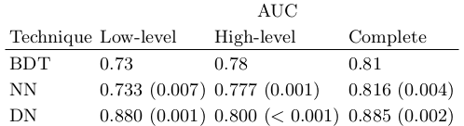
Higgs Boson Detection
Thanks to Pierre Baldi
Deep network improves AUC by 8%
BDT= Boosted Decision Trees in TMVA package
Nature Communications, July 2014
Notes:
BDT=Bayesian Decision Trees used in package TMVA . We also had shallow NNs trained with TMVA but these were not as good as our shallow networks. Same training and test sets. 5 different weight initializations to get stds.

Slide 7
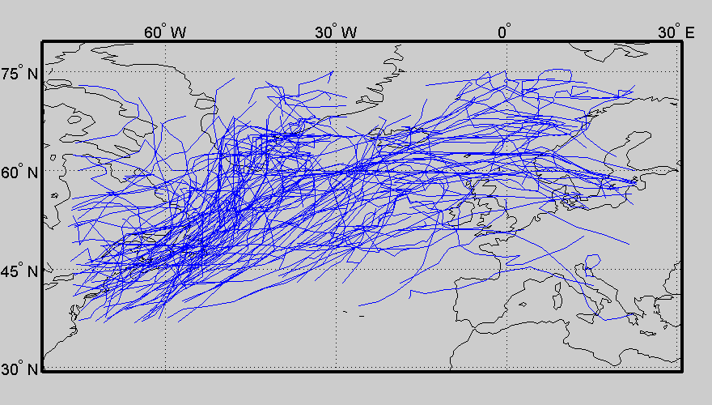
Application to Extra-Tropical Cyclones
Thanks to Padhraic Smyth
Gaffney et al, Climate Dynamics, 2007

Slide 8
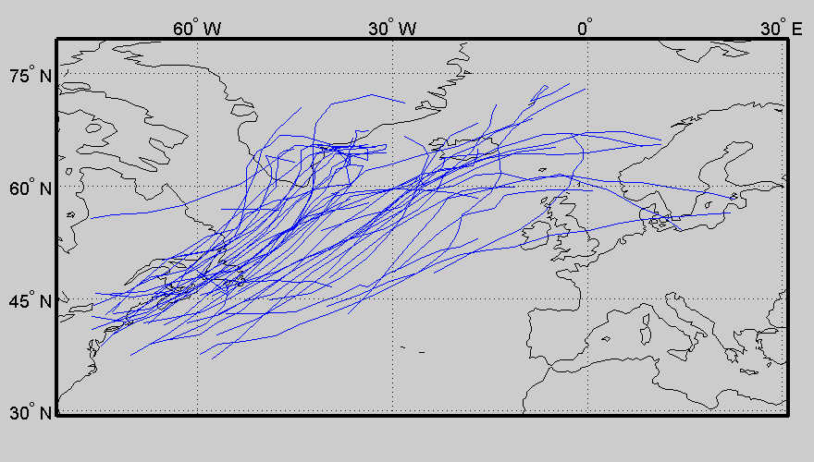
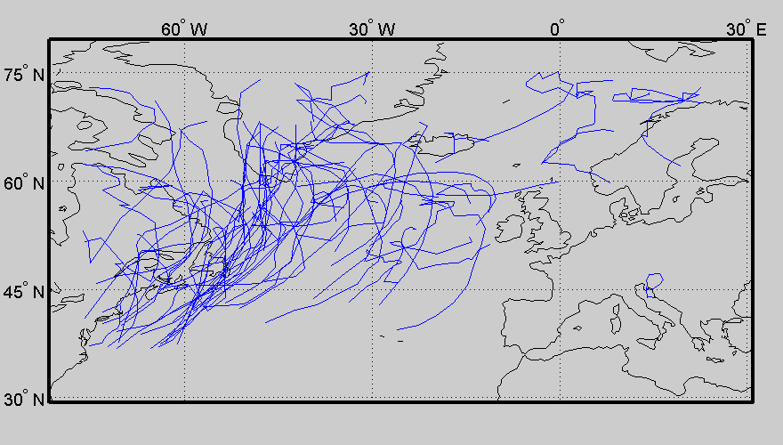
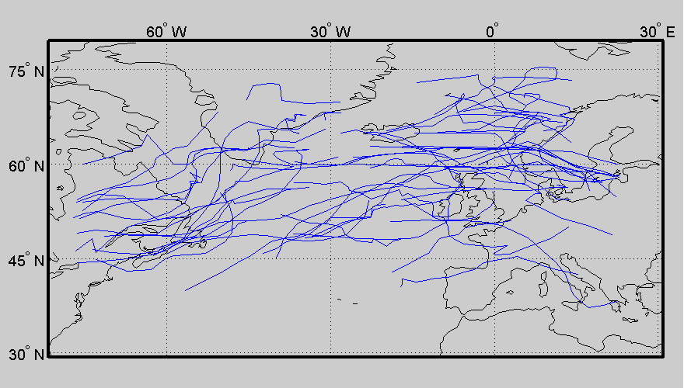
Thanks to Padhraic Smyth
Original Data
Iceland Cluster
Greenland Cluster
Horizontal Cluster

Slide 9
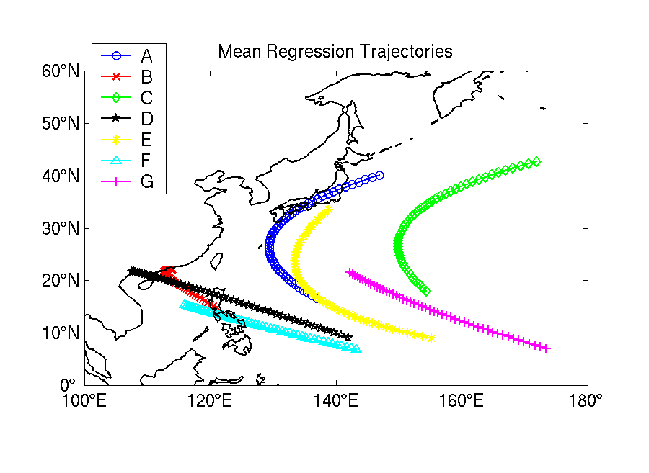
Cluster Shapes for Pacific Typhoon Tracks
Thanks to Padhraic Smyth
Camargo et al, J. Climate, 2007

Slide 10
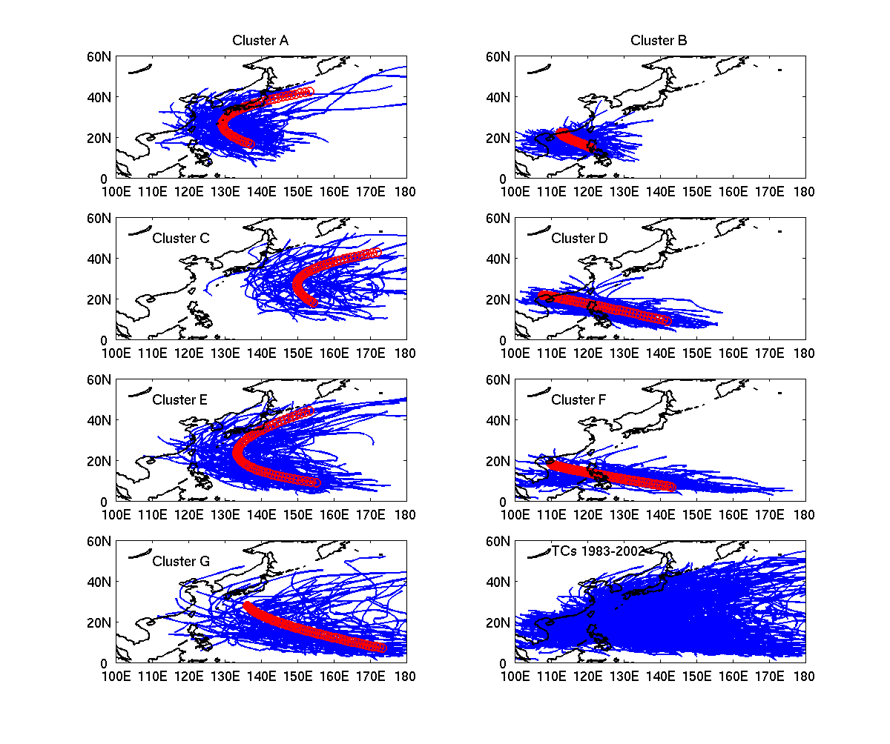
TROPICAL CYCLONES Western North Pacific
Thanks to Padhraic Smyth
Camargo et al, J. Climate, 2007
Notes:
Clusters differ on:
Location of the tracks,
Shape of the tracks,
Extension of the tracks,
Landfall regions.
Clusters D and F – very
Similar regression trajectories,
But distinct, as seen by the tracks.
Cluster G; formation in the central Pacific
(near the date line).
Interest in Philippines, for instance:
Clusters B,D, and F, would be
The ones to look closely.

Slide 11
An ICS Undergraduate Success Story
Thanks to Padhraic Smyth
“The key student involved in this work started out as an ICS undergrad. Scott Gaffney took ICS 171 and 175, got interested in AI, started to work in my group, decided to stay in ICS for his PhD, did a terrific job in writing a thesis on curve-clustering and working with collaborators in climate science to apply it to important scientific problems, and is now one of the leaders of Yahoo! Labs reporting directly to the CEO there, http://labs.yahoo.com/author/gaffney/. Scott grew up locally in Orange County and is someone I like to point as a great success story for ICS.”
--- From Padhraic Smyth

Slide 12
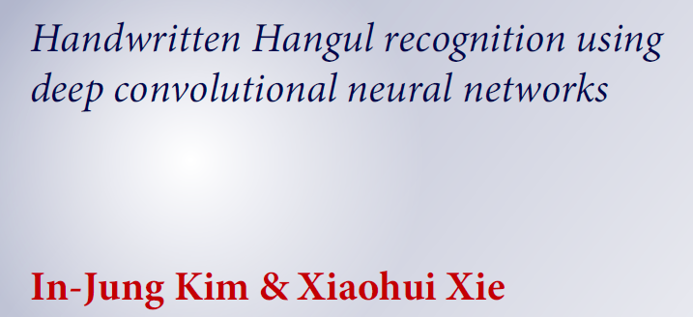
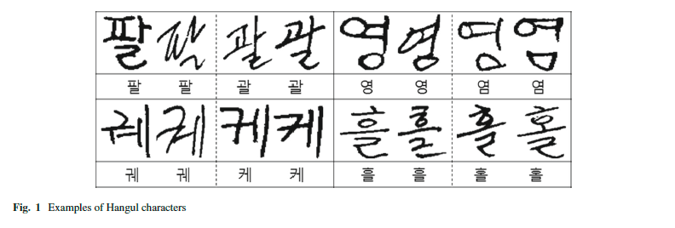
Thanks to Xiaohui Xie

Slide 13
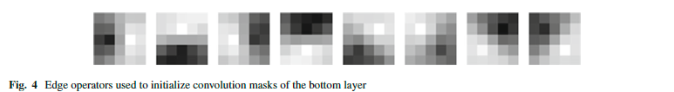
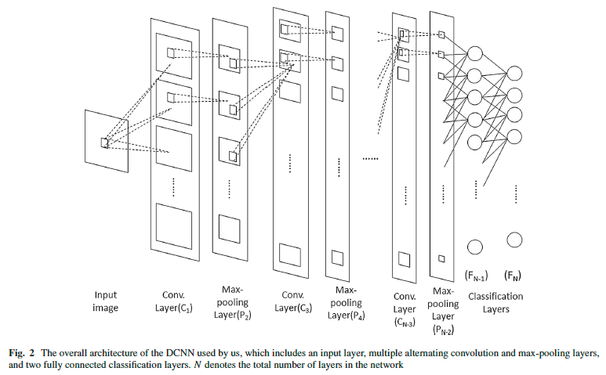
Thanks to Xiaohui Xie

Slide 14
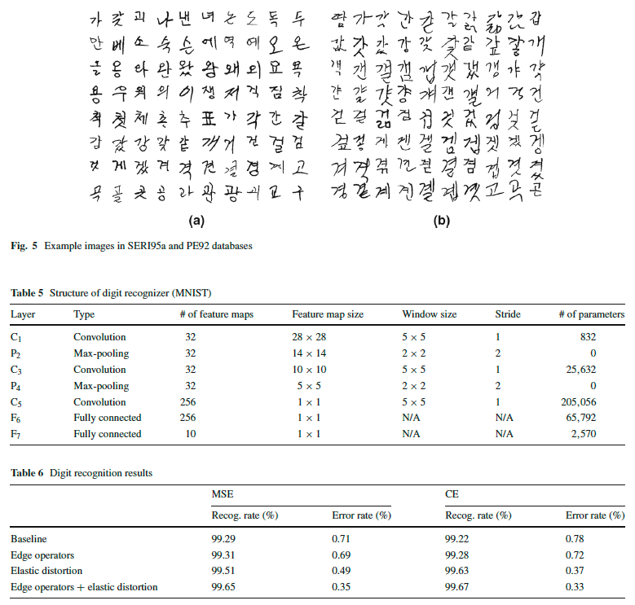
Thanks to Xiaohui Xie

Slide 15
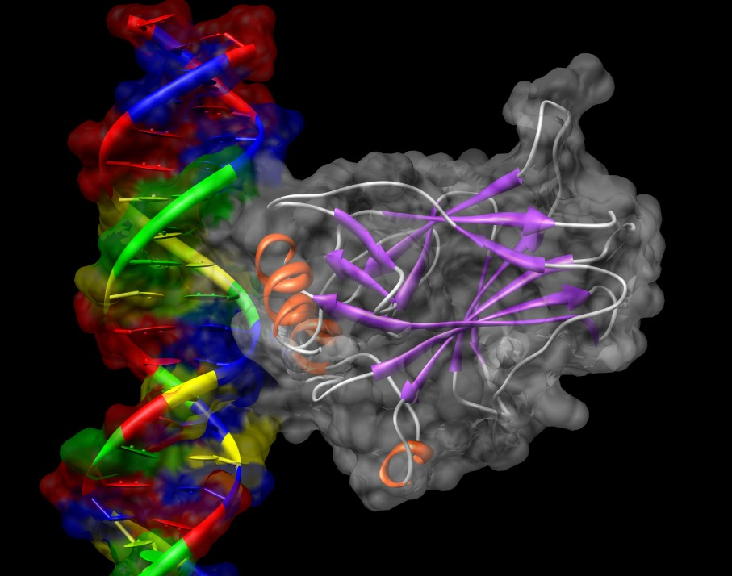
p53 and Human Cancers
Thanks to Richard Lathrop
p53 is a central tumor suppressor protein
“The guardian of the genome”
Cancer Mutants:
About 50% of all human cancers have p53 mutations.
Rescue Mutants:
Several second-site mutations restore functionality to some p53 cancer mutants in vivo.
p53 core domain bound to DNA
Image Generated with UCSF Chimera
Cho, Y., Gorina, S., Jeffrey, P.D., Pavletich, N.P. Crystal structure of a p53 tumor suppressor-DNA complex: understanding tumorigenic mutations. Science v265 pp.346-355 , 1994

Slide 16
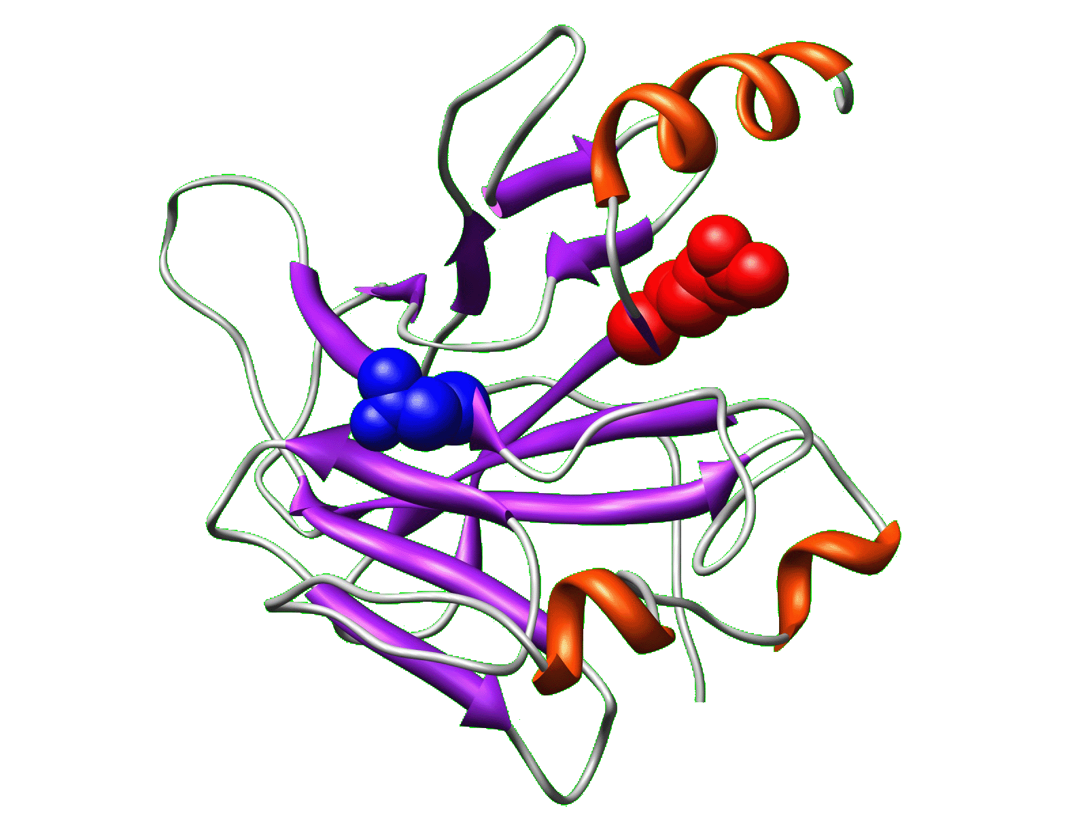
Active Learning for Biological Discovery
Thanks to Richard Lathrop
Find Cancer Rescue Mutants
Knowledge
Theory
Experiment
Notes:
16
So I apply this algorithm to biological experimentation.

Slide 17
Computational Active Learning
Pick the Best (= Most Informative) Unknown Examples to Label
Known
Unknown
Example 1
Example N+1
Train the Classifier
Example 2
Classifier
Example N+2
Example 3
Example N+3
…
Choose Example(s) to Label
Example N+4
Example N
…
Example M
Training Set
Add New Example(s)
To Training Set
Notes:
17

Slide 18
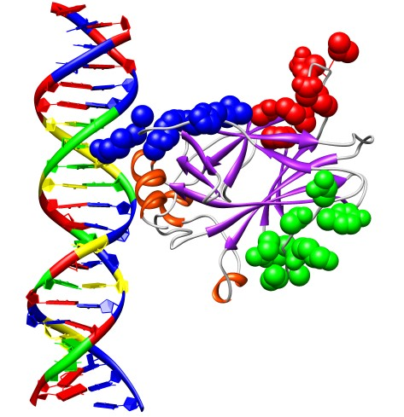
Visualization of Selected Regions
Thanks to Richard Lathrop
Positive Region:
Predicted Active
96-105 (Green)
Negative Region:
Predicted Inactive
223-232 (Red)
Expert Region:
Predicted Active
114-123 (Blue)
Danziger, et al. (2009)
Notes:
18

Slide 19
Novel Single-a.a. Cancer Rescue Mutants
Thanks to Richard Lathrop
 | MIP Positive (96-105) | MIP Negative (223-232) | Expert (114-123)
# Strong Rescue | 8 | 0 (p < 0.008) | 6 (not significant)
# Weak Rescue | 3 | 2 (not significant) | 7 (not significant)
Total # Rescue | 11 | 2 (p < 0.022) | 13 (not significant)
p-Values are two-tailed, comparing Positive to Negative and Expert regions. Danziger, et al. (2009)
No significant differences between the MIP Positive and Expert regions.
Both were statistically significantly better than the MIP Negative region.
The Positive region rescued for the first time the cancer mutant P152L.
No previous single-a.a. rescue mutants in any region.

Slide 20
Complete architectures for intelligence?
Search?
  Solve the problem of what to do.
Learning?
  Learn what to do.
Logic and inference?
  Reason about what to do.
  Encoded knowledge/”expert” systems?
    Know what to do.
Modern view: It’s complex & multi-faceted.

Slide 21
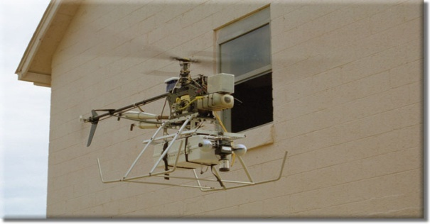
Automated Learning
Why is it useful for our agent to be able to learn?
  Learning is a key hallmark of intelligence
  The ability to take in real data and feedback and improve performance over time
  Check out USC Autonomous Flying Vehicle Project!
Types of learning
  Supervised learning: learn mapping from attributes to “target”
    Classification: target variable is discrete (e.g., spam email)
    Regression: target variable is real-valued (e.g., stock market)
  Unsupervised learning: no target variable; “understand” data structure
    Clustering: grouping data into K groups
    Latent space embeddings: learn “simpler” representation of the data
  Other types of learning
    Reinforcement learning: e.g., game-playing agent
    Learning to rank, e.g., document ranking in Web search
    And many others….
Notes:
21

Slide 22
Importance of representation
Properties of a good representation:
Reveals important features
Hides irrelevant detail
Exposes useful constraints
Makes frequent operations easy-to-do
Supports local inferences from local features
  Called the “soda straw” principle or “locality” principle
  Inference from features “through a soda straw”
Rapidly or efficiently computable
  It’s nice to be fast

Slide 23
Reveals important features / Hides irrelevant detail
“You can’t learn what you can’t represent.” --- G. Sussman
In search: A man is traveling to market with a fox, a goose, and a bag of oats. He comes to a river. The only way across the river is a boat that can hold the man and exactly one of the fox, goose or bag of oats. The fox will eat the goose if left alone with it, and the goose will eat the oats if left alone with it.
A good representation makes this problem easy:
1110
0010
1010
1111
0001
0101
Notes:
23

Slide 24
Simple illustrative learning problem
Problem:
decide whether to wait for a table at a restaurant, based on the following attributes:
  Alternate: is there an alternative restaurant nearby?
  Bar: is there a comfortable bar area to wait in?
  Fri/Sat: is today Friday or Saturday?
  Hungry: are we hungry?
  Patrons: number of people in the restaurant (None, Some, Full)
  Price: price range ($, $$, $$$)
  Raining: is it raining outside?
  Reservation: have we made a reservation?
  Type: kind of restaurant (French, Italian, Thai, Burger)
  WaitEstimate: estimated waiting time (0-10, 10-30, 30-60, >60)
Notes:
24

Slide 25
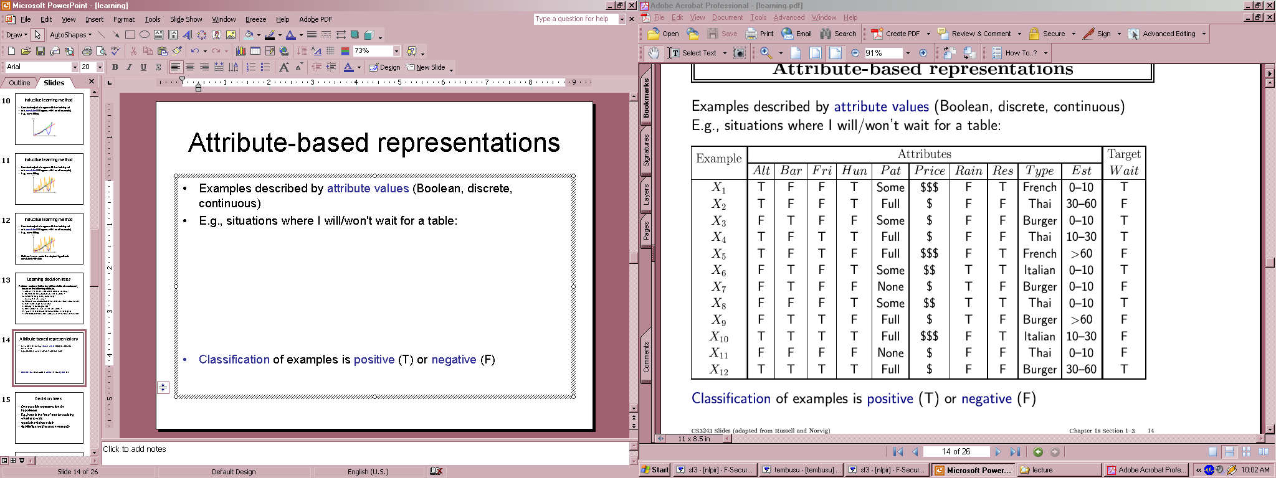
Training Data for Supervised Learning

Slide 26
Terminology
Attributes
  Also known as features, variables, independent variables, covariates
Target Variable
  Also known as goal predicate, dependent variable, …
Classification
  Also known as discrimination, supervised classification, …
Error function
  Objective function, loss function, …
Notes:
26

Slide 27
Inductive learning
Let x represent the input vector of attributes
Let f(x) represent the value of the target variable for x
  The implicit mapping from x to f(x) is unknown to us
  We just have training data pairs, D = {x, f(x)} available
We want to learn a mapping from x to f, i.e.,
h(x; θ) is “close” to f(x) for all training data points x
θ are the parameters of our predictor h(..)
Examples:
  h(x; θ) = sign(w₁x₁ + w₂x₂+ w₃)
  h_{k}(x) = (x1 OR x2) AND (x3 OR NOT(x4))
Notes:
27

Slide 28
Empirical Error Functions
Empirical error function:
  E(h) = Σ_{x} distance[h(x; θ) , f]
  e.g., distance = squared error if h and f are real-valued (regression)
  distance = delta-function if h and f are categorical (classification)
  Sum is over all training pairs in the training data D
  In learning, we get to choose
  1. what class of functions h(..) that we want to learn
  – potentially a huge space! (“hypothesis space”)
  2. what error function/distance to use
  - should be chosen to reflect real “loss” in problem
  - but often chosen for mathematical/algorithmic convenience
Notes:
28

Slide 29
Inductive Learning as Optimization or Search
Empirical error function:
  E(h) = Σ_{x} distance[h(x; θ) , f]
Empirical learning = finding h(x), or h(x; θ) that minimizes E(h)
  In simple problems there may be a closed form solution
    E.g., “normal equations” when h is a linear function of x, E = squared error
  If E(h) is differentiable as a function of q, then we have a continuous optimization problem and can use gradient descent, etc
    E.g., multi-layer neural networks
  If E(h) is non-differentiable (e.g., classification), then we typically have a systematic search problem through the space of functions h
    E.g., decision tree classifiers
Once we decide on what the functional form of h is, and what the error function E is, then machine learning typically reduces to a large search or optimization problem
Additional aspect: we really want to learn an h(..) that will generalize well to new data, not just memorize training data – will return to this later
Notes:
29

Slide 30
Our training data example (again)
If all attributes were binary, h(..) could be any arbitrary Boolean function
Natural error function E(h) to use is classification error, i.e., how many incorrect predictions does a hypothesis h make
Note an implicit assumption:
  For any set of attribute values there is a unique target value
  This in effect assumes a “no-noise” mapping from inputs to targets
    This is often not true in practice (e.g., in medicine). Will return to this later

Slide 31
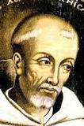
Learning Boolean Functions
Given examples of the function, can we learn the function?
How many Boolean functions can be defined on d attributes?
  Boolean function = Truth table + column for target function (binary)
  Truth table has 2^{d} rows
  So there are 2 to the power of 2^{d} different Boolean functions we can define (!)
  This is the size of our hypothesis space
  E.g., d = 6, there are 18.4 x 10¹⁸ possible Boolean functions
Observations:
  Huge hypothesis spaces –> directly searching over all functions is impossible
  Given a small data (n pairs) our learning problem may be underconstrained
    Ockham’s razor: if multiple candidate functions all explain the data equally well, pick the simplest explanation (least complex function)
    Constrain our search to classes of Boolean functions, e.g.,
      decision trees
      Weighted linear sums of inputs (e.g., perceptrons)
William of
Ockham
c. 1288-1347
Notes:
31

Slide 32
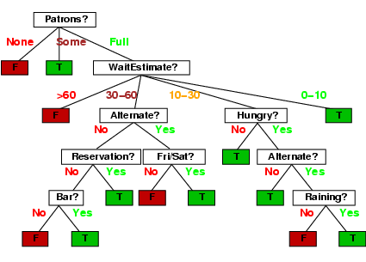
Decision Tree Learning
Constrain h(..) to be a decision tree

Slide 33
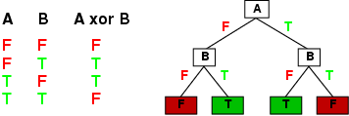
Decision Tree Representations
Decision trees are fully expressive
  can represent any Boolean function
  Every path in the tree could represent 1 row in the truth table
  Yields an exponentially large tree
    Truth table is of size 2^{d}, where d is the number of attributes

Slide 34
Decision Tree Representations
Trees can be very inefficient for certain types of functions
  Parity function: 1 only if an even number of 1’s in the input vector
    Trees are very inefficient at representing such functions
  Majority function: 1 if more than ½ the inputs are 1’s
    Also inefficient
  Simple DNF formulae can be easily represented
    E.g., f = (A AND B) OR (NOT(A) AND D)
    DNF = disjunction of conjunctions
Decision trees are in effect DNF representations
  often used in practice since they often result in compact approximate representations for complex functions
  E.g., consider a truth table where most of the variables are irrelevant to the function
Notes:
34

Slide 35
Decision Tree Learning
Find the smallest decision tree consistent with the n examples
  Unfortunately this is provably intractable to do optimally
Greedy heuristic search used in practice:
  Select root node that is “best” in some sense
  Partition data into 2 subsets, depending on root attribute value
  Recursively grow subtrees
  Different termination criteria
    For noiseless data, if all examples at a node have the same label then declare it a leaf and backup
    For noisy data it might not be possible to find a “pure” leaf using the given attributes
      we’ll return to this later – but a simple approach is to have a depth-bound on the tree (or go to max depth) and use majority vote
We have talked about binary variables up until now, but we can trivially extend to multi-valued variables
Notes:
35

Slide 36
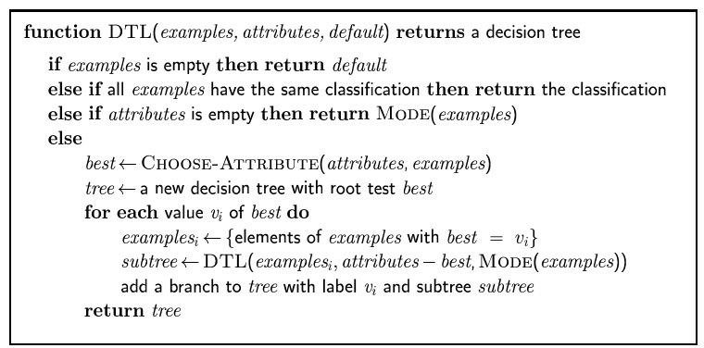
Pseudocode for Decision tree learning
Notes:
36

Slide 37
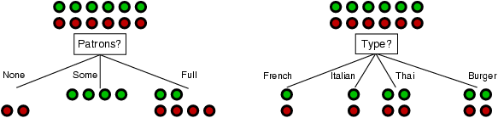
Choosing an attribute
Idea: a good attribute splits the examples into subsets that are (ideally) "all positive" or "all negative"
Patrons? is a better choice
  How can we quantify this?
  One approach would be to use the classification error E directly (greedily)
    Empirically it is found that this works poorly
  Much better is to use information gain (next slides)
Notes:
37

Slide 38
Entropy and Information
“Entropy” is a measure of randomness
  How long a message does it take to communicate a result to you?
  Depends on the probability of the outcomes; more predictable = shorter message
Communicating fair coin tosses
  Output: H H T H T T T H H H H T …
  Sequence takes n bits – each outcome totally unpredictable
Communicating my daily lottery results
  Output: 0 0 0 0 0 0 …
  Most likely to take one bit – I lost every day.
  Small chance I’ll have to send more bits (won & when)
More predictable takes less length to communicate because it’s less random
  Use a few bits for the most likely outcome, more for less likely ones
Lost: 0
Won 1: 1(when)0
Won 2: 1(when)1(when)0
Notes:
Entropy is a quantity that measures randomness or uncertainty in an outcome. It is a fundamental idea to information theory , communications, and data compression, since it encapsulates how difficult it is to communicate a piece of information, which depends on how random it is (a function of the probabilities).
For example, suppose I want to communicate a very long string of random coin tosses. Any sequence of n outcomes is equally likely, and there are 2^n of them, so the best I can do is to represent it as a sequence of n bits.
But, suppose I want to tell you about my last year’s worth of lottery entries. Almost certainly, I lost every day – I can assign this a single bit sequence (“0”). There is some small chance I will have won, and I will need to send more bits to tell you when; an even smaller chance I will have won twice, etc. By using longer strings for unlikely sequences and shorter ones for likely outcomes, on average I will have to communicate far fewer bits.
The second sequence takes fewer bits because it is less random – we can create a representation that exploits the fact that we know that losing is the most likely outcome.

Slide 39
Entropy and Information
Entropy H(X) = E[ log 1/p(X) ] = ∑ _{x∈X} p(x) log 1/p(x)
= −∑ _{x∈X} p(x) log p(x)
  Log base two, units of entropy are “bits”
  If only two outcomes: H = - p log(p) - (1-p) log(1-p)
Examples:
H(x) = .25 log 4 + .25 log 4 +
.25 log 4 + .25 log 4
= log 4 = 2 bits
H(x) = .75 log 4/3 + .25 log 4
= 0.8133 bits
H(x) = 1 log 1
= 0 bits
Max entropy for 4 outcomes
Min entropy
Notes:
If one outcome has probability one, and the others probability zero, we get 1 log 1 = 0 bits of entropy – there is no uncertainty or randomness about the outcome. In general, equally probable (uniform) probabilities result in the maximum possible entropy for a given set of outcomes, while the minimum entropy is zero.

Slide 40
Entropy
H(p) = entropy of distribution p = {p_{i}}
        (called “information” in text)
  = E [p_{i} log (1/p_{i}) ] = - p log p - (1-p) log (1-p)
  Entropy is the expected amount of information we gain, given a probability distribution – its our average uncertainty
  In general, H(p) is
  (a) maximized when all p_{i} are equal, and
  (b) minimized (=0) when one of the p_{i}’s is 1 and all others zero.
Notes:
40

Slide 41
Entropy with only 2 outcomes
  Consider 2 class problem: p = probability of class 1, 1 – p = probability of class 2
  In binary case, H(p) = - p log p - (1-p) log (1-p)
H(p)
1
0
0.5
1
p
Notes:
41

Slide 42
Information Gain
H(p) = entropy of class distribution at a particular node
H(p | A) = conditional entropy = average entropy of conditional class distribution, after we have partitioned the data according to the values in A
Gain(A) = H(p) – H(p | A)
Simple rule in decision tree learning
  At each internal node, split on the node with the largest information gain (or equivalently, with smallest H(p|A))
Note that by definition, conditional entropy can’t be greater than the entropy
Notes:
42

Slide 43
Root Node Example
For the training set, 6 positives, 6 negatives, H(6/12, 6/12) = 1 bit
Consider the attributes Patrons and Type:
Patrons has the highest IG of all attributes and so is chosen by the learning algorithm as the root
Information gain is then repeatedly applied at internal nodes until all leaves contain only examples from one class or the other
positive (p)
negative (1-p)
Notes:
43

Slide 44
Choosing an attribute
IG(Patrons) = 0.541 bits
IG(Type) = 0 bits
Notes:
44

Slide 45
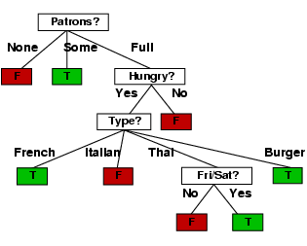
Decision Tree Learned
Decision tree learned from the 12 examples:
Hungry?
…
Notes:
45

Slide 46
True Tree (left) versus Learned Tree (right)

Slide 47
Assessing Performance
Training data performance is typically optimistic
e.g., error rate on training data
Reasons?
- classifier may not have enough data to fully learn the concept (but
on training data we don’t know this)
- for noisy data, the classifier may overfit the training data
In practice we want to assess performance “out of sample”
how well will the classifier do on new unseen data? This is the
true test of what we have learned (just like a classroom)
With large data sets we can partition our data into 2 subsets, train and test
- build a model on the training data
- assess performance on the test data
Notes:
47

Slide 48
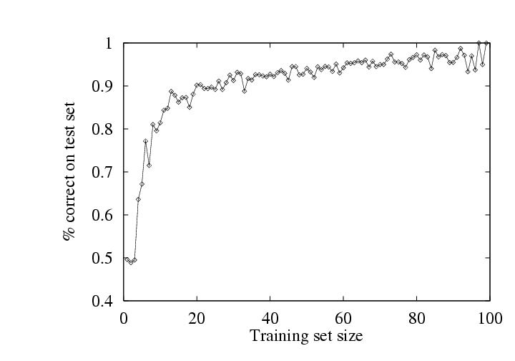
Example of Test Performance
Restaurant problem
- simulate 100 data sets of different sizes
- train on this data, and assess performance on an independent test set
- learning curve = plotting accuracy as a function of training set size
- typical “diminishing returns” effect (some nice theory to explain this)
Notes:
48

Slide 49
Overfitting and Underfitting
Y
X
Notes:
49

Slide 50
A Complex Model
Y = high-order polynomial in X
Y
X
Notes:
50

Slide 51
A Much Simpler Model
Y = a X + b + noise
Y
X
Notes:
51

Slide 52
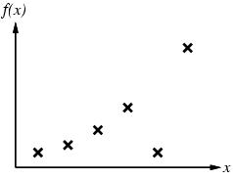
Example 2
Notes:
52

Slide 53
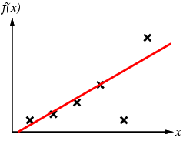
Example 2
Notes:
53

Slide 54
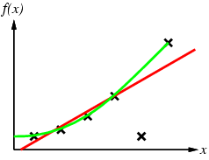
Example 2
Notes:
54

Slide 55
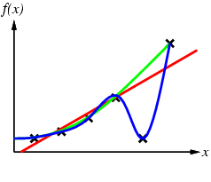
Example 2
Notes:
55

Slide 56
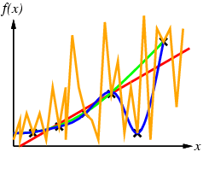
Example 2
Notes:
56

Slide 57
How Overfitting affects Prediction
Predictive
Error
Error on Training Data
Model Complexity
Notes:
57

Slide 58
How Overfitting affects Prediction
Predictive
Error
Error on Test Data
Error on Training Data
Model Complexity
Notes:
58

Slide 59
How Overfitting affects Prediction
Underfitting
Overfitting
Predictive
Error
Error on Test Data
Error on Training Data
Model Complexity
Ideal Range
for Model Complexity
Notes:
59

Slide 60
Training and Validation Data
Full Data Set
Idea: train each
model on the
“training data”
and then test
each model’s
accuracy on
the validation data
Training Data
Validation Data
Notes:
60

Slide 61
The k-fold Cross-Validation Method
Why just choose one particular 90/10 “split” of the data?
  In principle we could do this multiple times
“k-fold Cross-Validation” (e.g., k=10)
  randomly partition our full data set into k disjoint subsets (each roughly of size n/k, n = total number of training data points)
    for i = 1:10 (here k = 10)
      train on 90% of data,
      Acc(i) = accuracy on other 10%
    end
    Cross-Validation-Accuracy = 1/k Σ_{i} Acc(i)
  choose the method with the highest cross-validation accuracy
  common values for k are 5 and 10
  Can also do “leave-one-out” where k = n
Notes:
61

Slide 62
Disjoint Validation Data Sets
Validation Data (aka Test Data)
Full Data Set
1st partition
Training Data
Notes:
62

Slide 63
Disjoint Validation Data Sets
Validation Data (aka Test Data)
Full Data Set
1st partition
2nd partition
Training Data
Notes:
63

Slide 64
Disjoint Validation Data Sets
Validation Data (aka Test Data)
Full Data Set
Validation
Data
1st partition
2nd partition
Training Data
3rd partition
4th partition
5th partition
Notes:
64

Slide 65
More on Cross-Validation
Notes
  cross-validation generates an approximate estimate of how well the learned model will do on “unseen” data
  by averaging over different partitions it is more robust than just a single train/validate partition of the data
  “k-fold” cross-validation is a generalization
    partition data into disjoint validation subsets of size n/k
    train, validate, and average over the v partitions
    e.g., k=10 is commonly used
  k-fold cross-validation is approximately k times computationally more expensive than just fitting a model to all of the data
Notes:
65

Slide 66
You will be expected to know
Understand Attributes, Error function, Classification,
Regression, Hypothesis (Predictor function)
What is Supervised Learning?
Decision Tree Algorithm
Entropy
Information Gain
Tradeoff between train and test with model complexity
Cross validation

Slide 67
Summary
Inductive learning
  Error function, class of hypothesis/models {h}
  Want to minimize E on our training data
  Example: decision tree learning
Generalization
  Training data error is over-optimistic
  We want to see performance on test data
  Cross-validation is a useful practical approach
Learning to recognize faces
  Viola-Jones algorithm: state-of-the-art face detector, entirely learned from data, using boosting+decision-stumps
Notes:
67

