Slide 1
Introduction to Artificial Intelligence
CS 271P, Winter 2018
Introduction to Artificial Intelligence
Prof. Richard Lathrop
Introduction

Slide 2
People
Instructor: Richard Lathrop, <rickl@uci.edu>
Office hours Wednesday 2-3pm, DBH 4224
TAs: (Office hours TBD)
Jia Chen, <jiac5@uci.edu>
Sridevi Maharaj, <sridevi.m@uci.edu>
Readers: (Office hours TBD)
Kyoungwon Kim <wonkim@uci.edu>
Zephyr Yao <zhihaoy1@uci.edu>
Dongxu Zhao <dongxuz1@uci.edu>
Coding Project: Abdullah Younis <younisa@uci.edu>

Slide 3
Course outline
https://canvas.eee.uci.edu/courses/6753
Framed around three pillars of AI
Search
Logic
Learning (see also CS178)
Project:
“Wumpus World” agent & tournament
Tournament Director: Abdullah Younis
Weekly Q&A sessions, Wed 8pm (planned)

Slide 4
Course outline
Collaboration OK
Grading
Optional Homeworks (5), not graded
Discussion participation (10%; 7 of 10)
Quizzes (20%)
Four in-class quizzes: 10/12, 10/26, 11/21, 12/5
Project (20%)
Wumpus World
Teams of 1 or 2
Several milestones through quarter; teams due 10/8
Midterm (25%)
In class, 11/7
Final (25%)
Cumulative
12/15, 10:30-12:30 (note different time!)

Slide 5
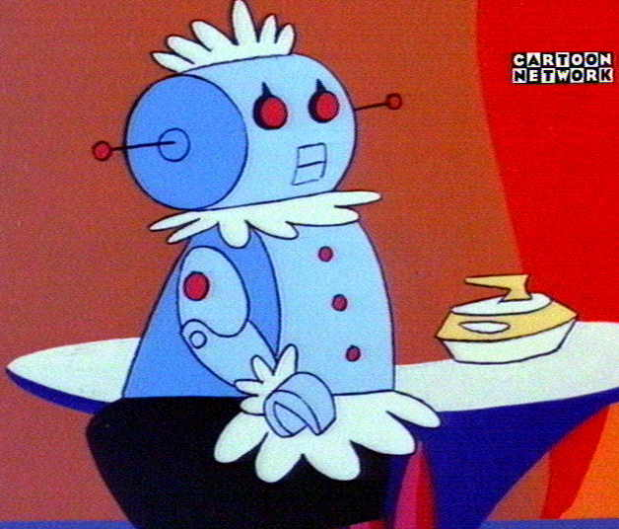
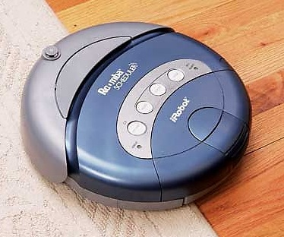
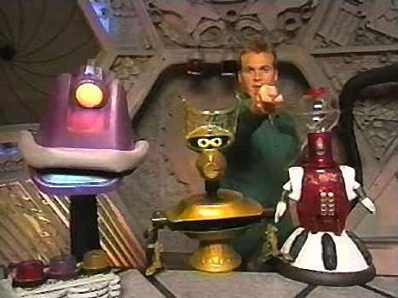
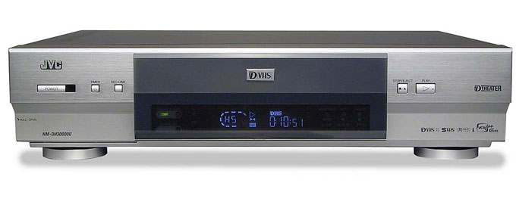
What is AI?
?
=
?
=

Slide 6
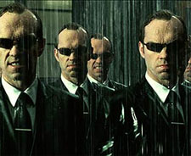
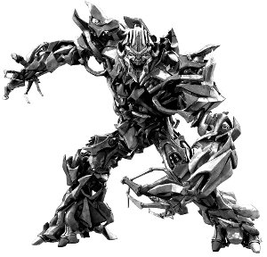
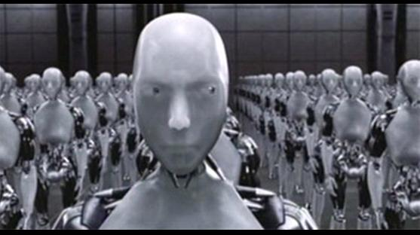
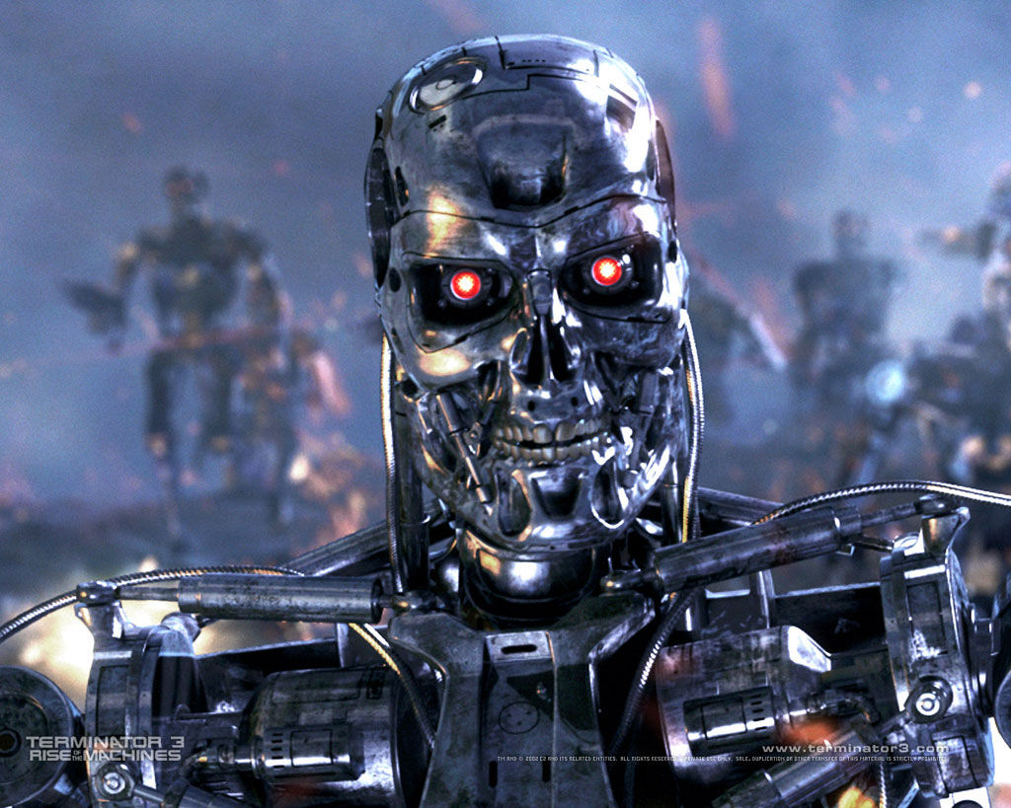
What is AI?

Slide 7
What is AI?
Competing axes of definitions:
Think v. Act
Human-like v. Rational
Often not the same thing
Cognitive science, economics, …
How to simulate human intellect & behavior by machine
Mathematical problems (puzzles, games, theorems)
Common-sense reasoning
Expert knowledge (law, medicine)
Social behavior
Web & online intelligence
Planning, e.g. operations research

Slide 8
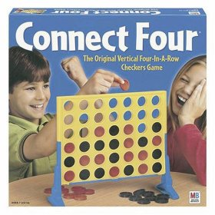
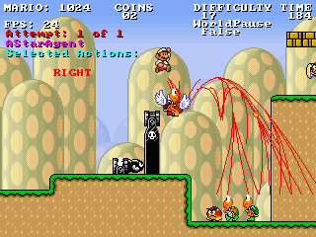
AI and Games
AI as an opponent
Responsive & “realistic” behavior
AI as an assistant
Simplify interface, “do what you want”

Slide 9
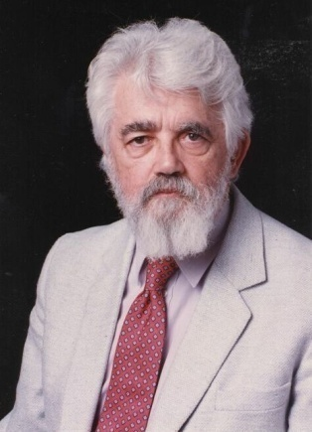
What is Artificial Intelligence (John McCarthy , Basic Questions)
What is artificial intelligence?
It is the science and engineering of making intelligent machines, especially intelligent computer programs. It is related to the similar task of using computers to understand human intelligence, but AI does not have to confine itself to methods that are biologically observable.
Yes, but what is intelligence?
Intelligence is the computational part of the ability to achieve goals in the world. Varying kinds and degrees of intelligence occur in people, many animals and some machines.
Isn't there a solid definition of intelligence that doesn't depend on relating it to human intelligence?
Not yet. The problem is that we cannot yet characterize in general what kinds of computational procedures we want to call intelligent. We understand some of the mechanisms of intelligence and not others.
More in: http://www-formal.stanford.edu/jmc/whatisai/node1.html

Slide 10
What is Artificial Intelligence
Thought processes
“The exciting new effort to make computers think .. Machines with minds, in the full and literal sense” (Haugeland, 1985)
Behavior
“The study of how to make computers do things at which, at the moment, people are better.” (Rich, and Knight, 1991)
Activities
The automation of activities that we associate with human thinking, activities such as decision-making, problem solving, learning… (Bellman)

Slide 11
AI as “Raisin Bread”
Esther Dyson [predicted] AI would [be] embedded in main-stream, strategically important systems, like raisins in a loaf of raisin bread.
Time has proven Dyson's prediction correct.
Emphasis shifts away from replacing expensive human experts with stand-alone expert systems toward main-stream computing systems that create strategic advantage.
Many of today's AI systems are connected to large data bases, they deal with legacy data, they talk to networks, they handle noise and data corruption with style and grace, they are implemented in popular languages, and they run on standard operating systems.
Humans usually are important contributors to the total solution.
Adapted from Patrick Winston, Former Director, MIT AI Laboratory

Slide 12
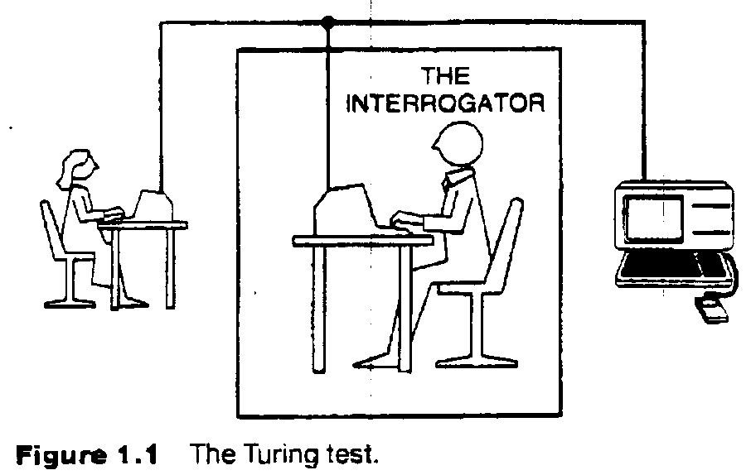
The Turing test
Can Machine think? A. M. Turing, 1950
Test requires computer to “pass itself off” as human
Necessary?
Sufficient?
Requires:
Natural language
Knowledge representation
Automated reasoning
Machine learning
(vision, robotics) for full test

Slide 13
Act/Think Humanly/Rationally
Act Humanly
Turing test
Think Humanly
Introspection; Cognitive science
Think rationally
Logic; representing & reasoning over problems
Acting rationally
Agents; sensing & acting; feedback systems

Slide 14
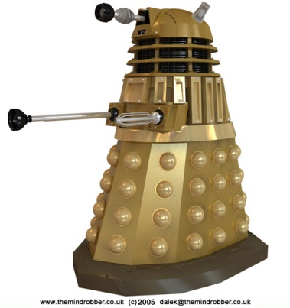
Agents
An agent is anything that can be viewed as perceiving its environment through sensors and acting upon that environment through actuators
Human agent:
Sensors: eyes, ears, …
Actuators: hands, legs, mouth…
Robotic agent
Sensors: cameras, range finders, …
Actuators: motors

Slide 15
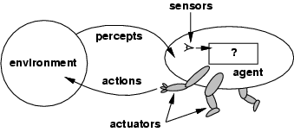
Agents and environments
Compare: Standard Embedded System Structure
sensors
ADC
microcontroller
DAC
actuators
ASIC
FPGA

Slide 16
Agents and environments
The agent function maps from percept histories to actions:
[f: P* → A]
The agent program runs on the physical architecture to produce f
agent = architecture + program

Slide 17
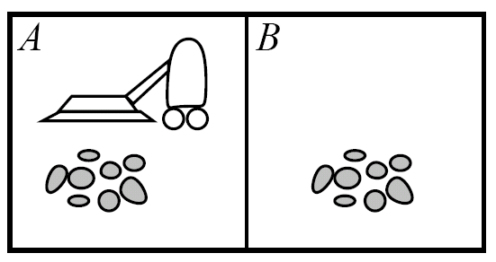
Vacuum World
Percepts: location, contents
e.g., [A, dirty]
Actions: {left, right, vacuum,…}

Slide 18
Rational agents
Rational Agent: For each possible percept sequence, a rational agent should select an action that is expected to maximize its performance measure, based on the evidence provided by the percept sequence and whatever built-in knowledge the agent has.
Performance measure: An objective criterion for success of an agent's behavior (“cost”, “reward”, “utility”)
E.g., performance measure of a vacuum-cleaner agent could be amount of dirt cleaned up, amount of time taken, amount of electricity consumed, amount of noise generated, etc.

Slide 19
Rational agents
Rationality is distinct from omniscience (all-knowing with infinite knowledge)
Agents can perform actions in order to modify future percepts so as to obtain useful information (information gathering, exploration)
An agent is autonomous if its behavior is determined by its own percepts & experience (with ability to learn and adapt) without depending solely on build-in knowledge

Slide 20
Discussion Items
An realistic agent has finite amount of computation and memory available. Suppose an agent is killed because it did not have enough computation resources to calculate some rare event that eventually ended up killing it. Can this agent still be rational?
The Turing test was contested by Searle by using the “Chinese Room” argument. The Chinese Room agent needs an exponential large memory to work. Can we “save” the Turing test from the Chinese Room argument?
Is “being intelligent” different from “having a mind?” Can a machine have a mind? consciousness?
If a machine does something that we would call “intelligent” if we saw a human do it, is the machine intelligent?

Slide 21
Task environment
To design a rational agent, must specify task env.
Example: automated taxi system
Performance measure
Safety, destination, profits, legality, comfort, …
Environment
City streets, freeways; traffic, pedestrians, weather, …
Actuators
Steering, brakes, accelerator, horn, …
Sensors
Video, sonar, radar, GPS / navigation, keyboard, …
“PEAS”

Slide 22
PEAS
Example: Agent = Medical diagnosis system
Performance measure: Healthy patient, minimize costs, lawsuits
Environment: Patient, hospital, staff
Actuators: Screen display (questions, tests, diagnoses, treatments, referrals)
Sensors: Keyboard (entry of symptoms, findings, patient's answers)

Slide 23
PEAS
Example: Agent = Part-picking robot
Performance measure: Percentage of parts in correct bins
Environment: Conveyor belt with parts, bins
Actuators: Jointed arm and hand
Sensors: Camera, joint angle sensors

Slide 24
Environment types
Fully observable (vs. partially observable): An agent's sensors give it access to the complete state of the environment at each point in time.
Deterministic (vs. stochastic): The next state of the environment is completely determined by the current state and the action executed by the agent. (If the environment is deterministic except for the actions of other agents, then the environment is strategic)
Episodic (vs. sequential): An agent’s action is divided into atomic episodes. Decisions do not depend on previous decisions/actions.

Slide 25
Environment types
Static (vs. dynamic): The environment is unchanged while an agent is deliberating. (The environment is semidynamic if the environment itself does not change with the passage of time but the agent's performance score does)
Discrete (vs. continuous): A limited number of distinct, clearly defined percepts and actions.
How do we represent or abstract or model the world?
Single agent (vs. multi-agent): An agent operating by itself in an environment. Does the other agent interfere with my performance measure?

Slide 26
task environm. | observable | determ./ stochastic | episodic/ sequential | static/ dynamic | discrete/ continuous | agents
crossword puzzle | fully | determ. | sequential | static | discrete | single
chess with clock | fully | strategic | sequential | semi | discrete | multi
poker
back gammon
taxi driving | partial | stochastic | sequential | dynamic | continuous | multi
medical diagnosis | partial | stochastic | sequential | dynamic | continuous | single
image analysis | fully | determ. | episodic | semi | continuous | single
partpicking robot | partial | stochastic | episodic | dynamic | continuous | single
refinery controller | partial | stochastic | sequential | dynamic | continuous | single
interact. Eng. tutor | partial | stochastic | sequential | dynamic | discrete | multi

Slide 27
task environm. | observable | determ./ stochastic | episodic/ sequential | static/ dynamic | discrete/ continuous | agents
crossword puzzle | fully | determ. | sequential | static | discrete | single
chess with clock | fully | strategic | sequential | semi | discrete | multi
poker | partial | stochastic | sequential | static | discrete | multi
back gammon
taxi driving | partial | stochastic | sequential | dynamic | continuous | multi
medical diagnosis | partial | stochastic | sequential | dynamic | continuous | single
image analysis | fully | determ. | episodic | semi | continuous | single
partpicking robot | partial | stochastic | episodic | dynamic | continuous | single
refinery controller | partial | stochastic | sequential | dynamic | continuous | single
interact. Eng. tutor | partial | stochastic | sequential | dynamic | discrete | multi

Slide 28
task environm. | observable | determ./ stochastic | episodic/ sequential | static/ dynamic | discrete/ continuous | agents
crossword puzzle | fully | determ. | sequential | static | discrete | single
chess with clock | fully | strategic | sequential | semi | discrete | multi
poker | partial | stochastic | sequential | static | discrete | multi
back gammon | fully | stochastic | sequential | static | discrete | multi
taxi driving | partial | stochastic | sequential | dynamic | continuous | multi
medical diagnosis | partial | stochastic | sequential | dynamic | continuous | single
image analysis | fully | determ. | episodic | semi | continuous | single
partpicking robot | partial | stochastic | episodic | dynamic | continuous | single
refinery controller | partial | stochastic | sequential | dynamic | continuous | single
interact. Eng. tutor | partial | stochastic | sequential | dynamic | discrete | multi

Slide 29
Agent types
Five basic types in order of increasing generality:
Table Driven agents
Simple reflex agents
Model-based reflex agents
Goal-based agents
Utility-based agents

Slide 30
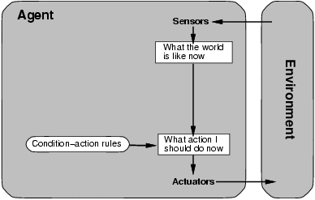
Table Driven Agent.
current state of decision process
Impractical
table lookup
for entire history

Slide 31
Simple reflex agents
Fast but too simple
NO MEMORY
Fails if environment
is partially observable
example: vacuum cleaner world

Slide 32
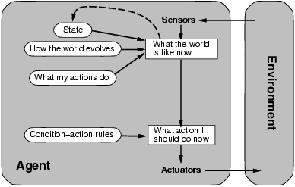
Model-based reflex agents
description of
current world state
Model the state of the world by:
modeling how the world changes
how its actions change the world
This can work even with partial information
It’s is unclear what to do
without a clear goal

Slide 33
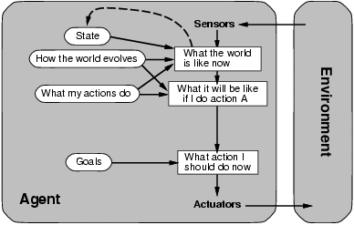
Goal-based agents
Goals provide reason to prefer one action over the other.
We need to predict the future: we need to plan & search

Slide 34
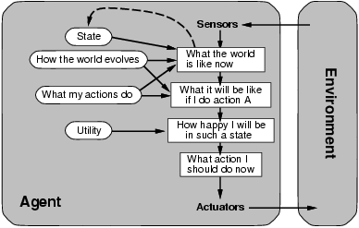
Utility-based agents
Some solutions to goal states are better than others.
Which one is best is given by a utility function.
Which combination of goals is preferred?

Slide 35
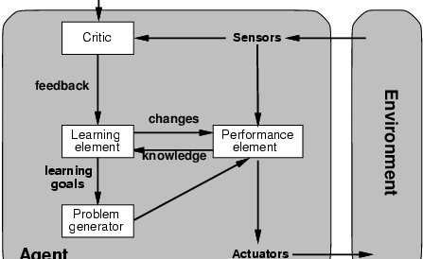
Learning agents
How does an agent improve over time?
By monitoring it’s performance and suggesting
better modeling, new action rules, etc.
Evaluates
current
world
state
changes
action
rules
“old agent”=
model world
and decide on
actions
to be taken
suggests
explorations

Slide 36
Summary
Conceptions of AI span two major axes:
Thinking vs. Acting; Human-like vs. Rational
Textbook (and this course) adopt Acting Rationally
Esther Dyson: AI as raisin bread
Small sweet nuggets of intelligent control points
Embedded in the matrix of an engineered system
“Rational Agent” as the organizing theme
Acts to maximize expected performance measure
Task Environment: PEAS
Environment types: Yield design constraints

Slide 37
Summary
What is Artificial Intelligence?
modeling humans’ thinking, acting, should think, should act.
Intelligent agents
We want to build agents that act rationally
Maximize expected performance measure
Task environment – PEAS
Yield design constraints
Real-World Applications of AI
AI is integrated in a broad range of products & systems
Reading
Today: Ch. 1 & 2 in R&N
For next week: Ch. 3 in R&N (search)

Slide 38
Agent types
Taxi example again…
Simple reflex
Select action based only on the current percept
If car-in-front-is-braking then initiate-braking
Model-based reflex
Agents that keep track of the world
If car-in-front-is-braking and recently-rained then initiate-braking
requires internal state; memory

Slide 39
Agent types
Goal-based
More complex
Attempts to find a way to achieve some state
If car-in-front-is-braking and needs to get to hospital then …
Search and planning: find path to goal state
Utility-based
Most complex
If car-in-front-is-braking and on fwy and needs to get to hospital alive then search of a way to get to the hospital that will make your passengers happy.
Needs utility function : maps state to a real value (am I happy?)
Can trade off: immediate vs future payoffs; risk vs reward

