Slide 1
State Space Representations and Search Algorithms
CS271P, Winter 2018
Introduction to Artificial Intelligence
Prof. Richard Lathrop
Reading: R&N 3.1-3.4

Slide 2
Architectures for Intelligence
Search?
  Determine how to achieve some goal; “what to do”
Logic & inference?
  Reason about what to do
  Encode knowledge / “expert” systems
  Know what to do
Learning?
  Learn what to do
Modern view: complex & multi-faceted

Slide 3
Search
Formulate “what to do” as a search problem
  Solution tells the agent what to do
If no solution in the current search space?
  Find space that does contain a solution (use search!)
  Solve original problem in new search space
Many powerful extensions to these ideas
  Constraint satisfaction; planning; game playing; …
Human problem-solving often looks like search

Slide 4
Why search?
Engaged in bigger, important problem
  Hit a search subproblem we need to solve
  Search, solve it, get back to original problem
Predict the results of our actions in the future
Many sequences of actions, each with some utility
  Maximize performance measure
Want to achieve some goal by some (any?) means
Or, find the best (optimal) way to achieve it

Slide 5
Example: Romania
On holiday in Romania
  Currently in Arad
  Flight leaves tomorrow from Bucharest
Formulate goal:
  Be in Bucharest
Formulate problem:
  States: various cities
  Actions: drive between cities / choose next city
Find a solution:
  Sequence of cities, e.g.: Arad, Sibiu, Fagaras, Bucharest

Slide 6
Example: Romania
Oradea
71
Neamt
87
75
Zerind
151
Iasi
140
92
Arad
Sibiu
Fagaras
99
118
Vaslui
Timisoara
80
Rimnicu Vilcea
97
211
142
111
Lugoj
Pitesti
70
98
Hirsova
Mehadia
146
85
101
Urziceni
86
75
138
Bucharest
120
Dobreta
90
Cralova
Eforie
Giurgiu

Slide 7
Problem types
Classifying the environment:
Static / Dynamic
Previous problem was static: no attention to changes in environment
Deterministic / Stochastic
Previous problem was deterministic: no new percepts
were necessary, we can predict the future perfectly
Observable / Partially Observable / Unobservable
Previous problem was observable: it knew the initial state, &c
Discrete / Continuous
Previous problem was discrete: we can enumerate all possibilities

Slide 8
Why not Dijkstra’s Algorithm?
D’s algorithm inputs the entire graph
  Want to search in unknown spaces
  Combine search with “exploration”
  Ex: autonomous rover on Mars must search an unknown space
D’s algorithm takes connections as given
  Want to search based on agent’s actions, w/ unknown connections
  Ex: web crawler may not know what connections are available on a URL before visiting it
  Ex: agent may not know the result of an action before trying it
D’s algorithm won’t work on infinite spaces
  Many actions spaces are infinite or effectively infinite
  Ex: logical reasoning space is infinite
  Ex: real world is essentially infinite to a human-size agent

Slide 9


Ex: Vacuum World
Observable, start in #5.
Solution?
[Right, Suck]
1
2
3
4
5
6
7
8

Slide 10


Vacuum world state space graph
R
L
R
L
S
S
R
R
L
R
L
R
L
L
S
S
S
S
R
L
R
L
S
S

Slide 11
Ex: Vacuum World
Unobservable,
start in {1,2,3,4,5,6,7,8}
Solution?
[Right, Suck, Left, Suck]
1
2
3
4
5
6
7
8

Slide 12
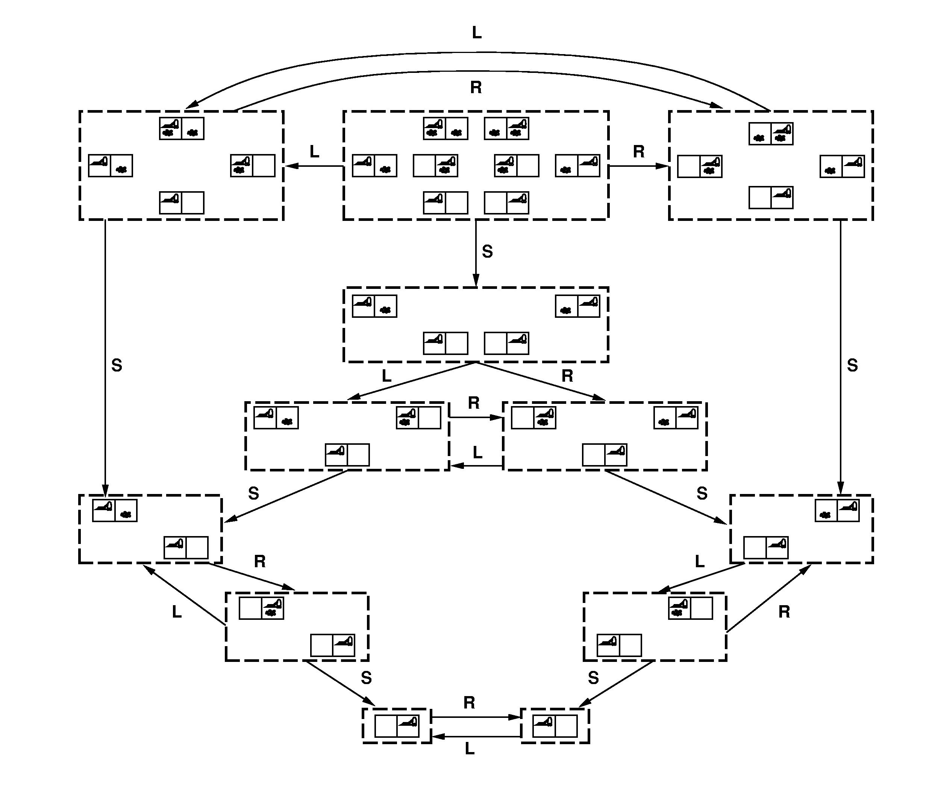
Ex: Vacuum World

Slide 13
State-Space Problem Formulation
71
Oradea
Neamt
A problem is defined by five items:
initial state e.g., "at Arad“
actions Actions(s) = set of actions avail. in state s
transition model Results(s,a) = state that results from action a in states
Alt: successor function S(x) = set of action–state pairs
  e.g., S(Arad) = {<Arad → Zerind, Zerind>, … }
goal test, (or goal state)
e.g., x = "at Bucharest”, Checkmate(x)
path cost (additive)
  e.g., sum of distances, number of actions executed, etc.
  c(x,a,y) is the step cost, assumed to be ≥ 0
A solution is a sequence of actions leading from the initial state to a goal state
75
Zerind
151
87
140
Iasi
Arad
Sibiu
Fagaras
92
99
118
Timisoara
80
Rimnicu Vilcea
Vaslui
111
97
Pitesti
211
142
70
Lugoj
85
98
Mehadia
146
101
Urziceni
Hirsova
75
120
138
Bucharest
86
Dobreta
Cralova
90
Eforie
Giurgiu

Slide 14
Selecting a state space
Real world is absurdly complex
  state space must be abstracted for problem solving
(Abstract) state ← set of real states
(Abstract) action ← complex combination of real actions
  e.g., "Arad → Zerind" represents a complex set of possible routes, detours, rest stops, etc.
For guaranteed realizability, any real state "in Arad” must get to some real state "in Zerind”
(Abstract) solution ← set of real paths that are solutions in the real world
Each abstract action should be "easier" than the original problem

Slide 15
Ex: Vacuum World
States?
  Discrete: dirt, location
Initial state?
  Any
Actions?
  Left, Right, Suck
Goal test?
  No dirt at all locations
Path cost?
  1 per action
1
2
3
4
5
6
7
8

Slide 16
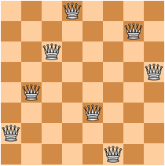
Ex: 8-Queens
Place as many queens as possible
on the chess board without capture
states? - any arrangement of n<=8 queens
- or arrangements of n<=8 queens in leftmost n
columns, 1 per column, such that no queen
attacks any other.
initial state? no queens on the board
actions? - add queen to any empty square
- or add queen to leftmost empty square such
that it is not attacked by other queens.
goal test? 8 queens on the board, none attacked.
path cost? 1 per move

Slide 17
Ex: 8-Queens
Place as many queens as possible
on the chess board without capture
states? - any arrangement of n<=8 queens
- or arrangements of n<=8 queens in leftmost n
columns, 1 per column, such that no queen
attacks any other.
initial state? no queens on the board
actions? - add queen to any empty square
- or add queen to leftmost empty square such
that it is not attacked by other queens.
goal test? 8 queens on the board, none attacked.
path cost? 1 per move (not relevant…)

Slide 18
The Traveling Salesman Problem
Find the shortest tour that visits all cities without visiting any city twice and return to starting point.
States: sequence of cities visited
S₀ = A
C
B
A
D
F
S_{G} = a complete tour
E

Slide 19
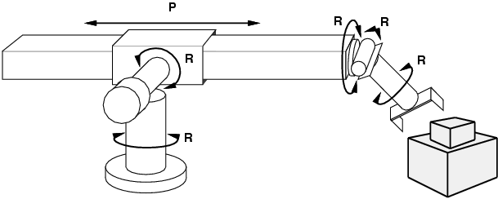
Ex: Robotic assembly
states? Real-valued coordinates of robot joint angles & parts of the object to be assembled
initial state? Rest configuration
actions? Continuous motions of robot joints
goal test? Complete assembly
path cost? Time to execute & energy used

Slide 20
Ex: Sliding tile puzzle
states?
initial state?
actions?
goal test?
path cost?
2
8
3
1
2
3
1
6
4
4
5
6
7
5
7
8
Start State
Goal State
Try it yourselves…

Slide 21
Ex: Sliding tile puzzle
states? Locations of tiles
initial state? Given
actions? Move blank square up / down / left / right
goal test? Goal state (given)
path cost? 1 per move
2
8
3
1
2
3
1
6
4
4
5
6
7
5
7
8
Start State
Goal State
# of states: n+1! / 2
8-puzzle: 181,440 states
15-puzzle: 1.3 trillion
24-puzzle: 10^25
Optimal solution of
n-Puzzle family is NP-hard

Slide 22
On Representations
CS171, Winter 2018
Introduction to Artificial Intelligence
Prof. Richard Lathrop

Slide 23
Importance of representation
Definition of “state” can be very important
A good representation
  Reveals important features
  Hides irrelevant detail
  Exposes useful constraints
  Makes frequent operations easy to do
  Supports local inferences from local features
    Called “soda straw” principle, or “locality” principle
    Inference from features “through a soda straw”
  Rapidly or efficiently computable
    It’s nice to be fast

Slide 24
Reveals important features / Hides irrelevant detail
In search: A man is traveling to market with a fox, a goose, and a bag of oats. He comes to a river. The only way across the river is a boat that can hold the man and exactly one of the fox, goose or bag of oats. The fox will eat the goose if left alone with it, and the goose will eat the oats if left alone with it.
How can the man get all his possessions safely across the river?
A good representation makes this problem easy:
1110
0010
1010
1111
0001
0101
MFGO
M = man
F = fox
G = goose
O = oats
0 = starting side
1 = ending side
Notes:
24

Slide 25
Exposes useful constraints
In logic:
If the unicorn is mythical, then it is immortal, but if it is not mythical, then it is a mortal mammal. If the unicorn is either immortal or a mammal, then it is horned. The unicorn is magical if it is horned.
Prove that the unicorn is both magical and horned.
A good representation makes this problem easy (as we’ll see when we do our unit on logic):
( ¬ Y ˅ ¬ R ) ^ ( Y ˅ R ) ^ ( Y ˅ M ) ^ ( R ˅ H ) ^ ( ¬ M ˅ H ) ^ ( ¬ H ˅ G )
Notes:
25

Slide 26
Makes frequent operations easy-to-do
Roman numerals
  M=1000, D=500, C=100, L=50, X=10, V=5, I=1
  2000 = MM; 1776 = MDCCLXXVI
Long division is very tedious (try MDCCLXXVI / XVI)
Testing for N < 1000 is very easy (first letter is not “M”)
Arabic numerals
  0, 1, 2, 3, 4, 5, 6, 7, 8, 9, “.”
Long division is much easier (try 1776 / 16)
Testing for N < 1000 is slightly harder (have to scan the string)

Slide 27
Local inferences from local features
Linear vector of pixels
= highly non-local inference for vision
Rectangular array of pixels
= local inference for vision
… | … | 0 | 1 | 0 | … | … | 0 | 1 | 1 | … | … | 0 | 0 | 0 | … | …
Corner??
Corner!!
0 | 0 | 0 | 1 | 0 | 0 | 0 | 0 | 0 | 0
0 | 0 | 0 | 1 | 0 | 0 | 0 | 0 | 0 | 0
0 | 0 | 0 | 1 | 0 | 0 | 0 | 0 | 0 | 0
0 | 0 | 0 | 1 | 1 | 1 | 1 | 1 | 1 | 1
0 | 0 | 0 | 0 | 0 | 0 | 0 | 0 | 0 | 0
0 | 0 | 0 | 0 | 0 | 0 | 0 | 0 | 0 | 0

Slide 28
Tree Search Algorithms
CS171, Winter 2018
Introduction to Artificial Intelligence
Prof. Richard Lathrop

Slide 29
Tree search algorithms
Basic idea
  Explore space by generating successors of already-explored states (“expanding” states)
  Evaluate every generated state: is it a goal state?

Slide 30
Example: Romania
Arad
Sibiu
Timisoara
Zerind
Arad
Fagaras
Oradea
Rimnicu…
Arad
Lugoj
Arad
Oradea
71
Oradea
Neamt
75
Zerind
151
87
Iasi
Arad
140
Sibiu
92
99
Fagaras
118
Vaslui
Timisoara
80
Rimnicu Vilcea
97
211
142
111
Lugoj
Pitesti
70
85
98
Hirsova
Mehadia
146
101
Urziceni
75
120
138
Bucharest
86
Dobreta
Cralova
90
Eforie
Giurgiu

Slide 31
Example: Romania
Arad
Arad
Sibiu
Zerind
Sibiu
Sibiu
Timisoara
Zerind
Timisoara
Arad
Fagaras
Oradea
Arad
Fagaras
Oradea
Rimnicu…
Arad
Lugoj
Arad
Oradea
Rimnicu…
71
Oradea
Neamt
75
Zerind
151
87
Iasi
Arad
140
Sibiu
92
99
Fagaras
118
Vaslui
Timisoara
80
Rimnicu Vilcea
97
211
142
111
Lugoj
Pitesti
70
85
98
Hirsova
Mehadia
146
101
Urziceni
75
120
138
Bucharest
86
Dobreta
Cralova
90
Eforie
Giurgiu

Slide 32
Example: Romania
Arad
Arad
Sibiu
Zerind
Sibiu
Sibiu
Timisoara
Zerind
Timisoara
Arad
Fagaras
Oradea
Arad
Fagaras
Oradea
Rimnicu…
Arad
Lugoj
Arad
Oradea
Rimnicu…
Note: we may visit the same node
often, wasting time & work
function TREE-SEARCH (problem, strategy) : returns a solution or failure
initialize the search tree using the initial state of problem
while (true):
if no candidates for expansion: return failure
choose a leaf node for expansion according to strategy
if the node contains a goal state: return the corresponding solution
else: expand the node and add the resulting nodes to the search tree

Slide 33
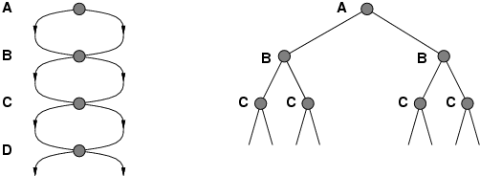
Repeated states
Failure to detect repeated states can turn a linear problem into an exponential one!
Test is often implemented as a hash table.

Slide 34
Solutions to Repeated States
S
B
S
B
C
C
C
S
B
S
State Space
Example of a Search Tree
Graph search
  never generate a state generated before
    must keep track of all possible states (uses a lot of memory)
    e.g., 8-puzzle problem, we have 9!/2 = 181,440 states
    approximation for DFS/DLS: only avoid states in its (limited) memory: avoid infinite loops by checking path back to root.
  “visited?” test usually implemented as a hash table
faster, but memory inefficient

Slide 35
Why Search can be difficult
At the start of the search, the search algorithm does not know
  the size of the tree
  the shape of the tree
  the depth of the goal states
How big can a search tree be?
  say there is a constant branching factor b
  and one goal exists at depth d
  search tree which includes a goal can have
  b^{d} different branches in the tree (worst case)
Examples:
  b = 2, d = 10: b^{d} = 2¹⁰= 1024
  b = 10, d = 10: b^{d} = 10¹⁰= 10,000,000,000

Slide 36
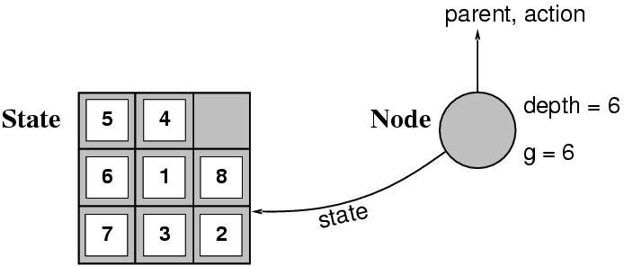
Implementation: states vs. nodes
A state is a (representation of) a physical configuration
A node is a data structure constituting part of a search tree contains info such as: state, parent node, action, path cost g(x), depth
The Expand function creates new nodes, filling in the various fields and using the SuccessorFn of the problem to create the corresponding states.

Slide 37
Search strategies
A search strategy is defined by picking the order of node expansion
Strategies are evaluated along the following dimensions:
  completeness: does it always find a solution if one exists?
  time complexity: number of nodes generated
  space complexity: maximum number of nodes in memory
  optimality: does it always find a least-cost solution?
Time and space complexity are measured in terms of
  b: maximum branching factor of the search tree
  d: depth of the least-cost solution
  m: maximum depth of the state space (may be ∞)

Slide 38
Summary
Generate the search space by applying actions to the initial state and all further resulting states.
Problem: initial state, actions, transition model, goal test, step/path cost
Solution: sequence of actions to goal
Tree-search (don’t remember visited nodes) vs.
Graph-search (do remember them)
Search strategy evaluation: b, d, m
  Complete? Time? Space? Optimal?

Slide 39
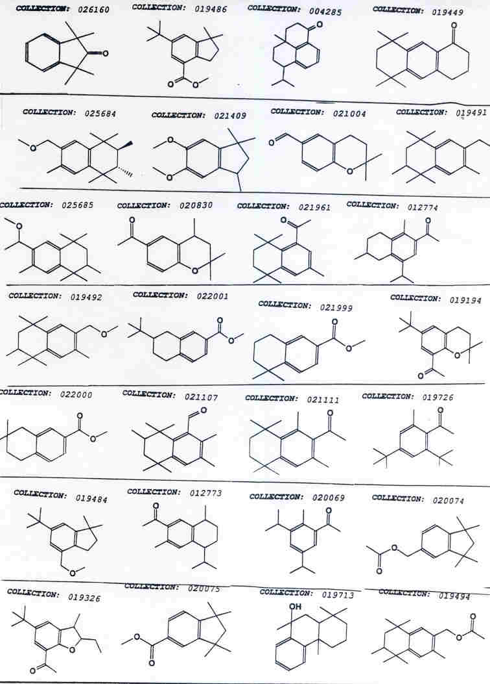

Slide 40
Positive Examples | Negative Examples
*
*
*

Slide 41
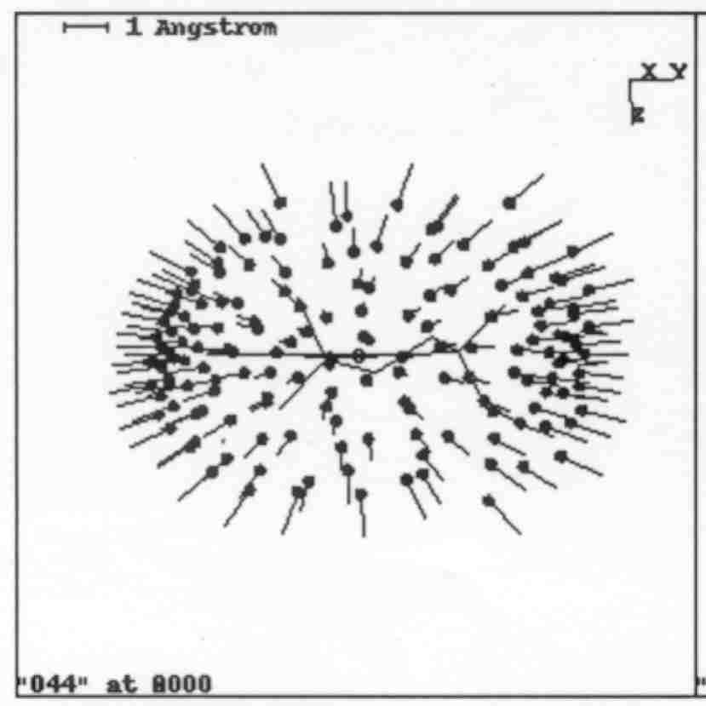
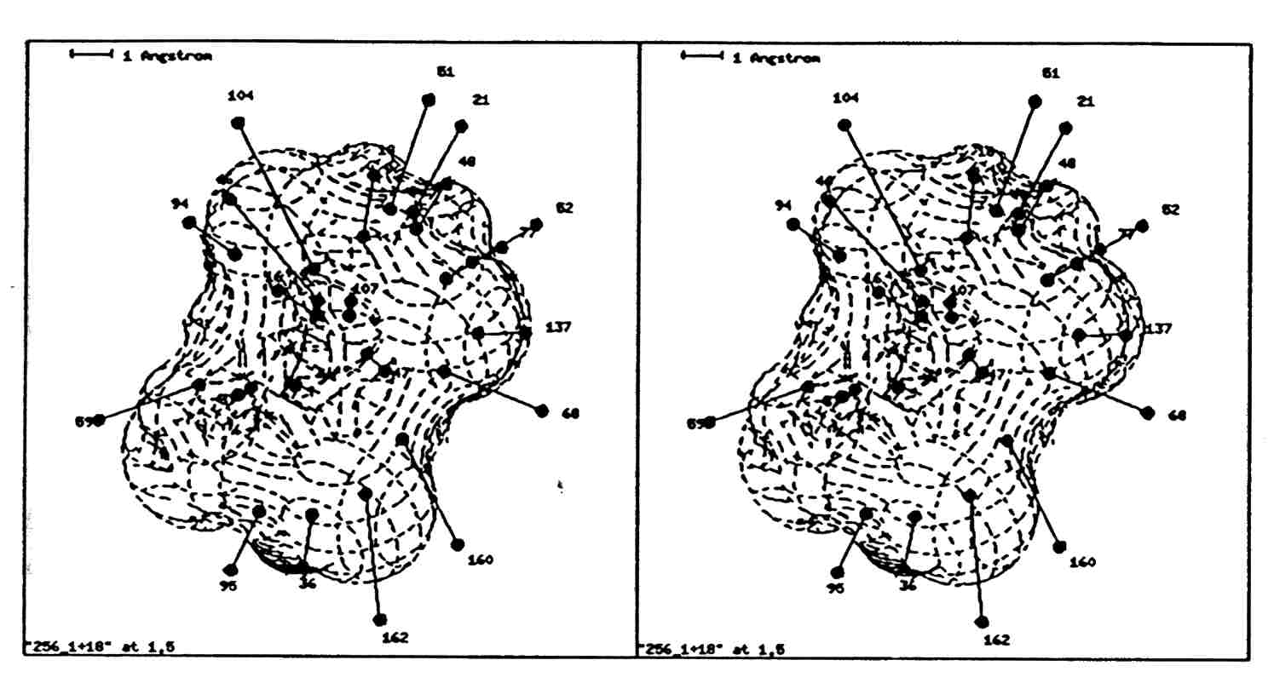
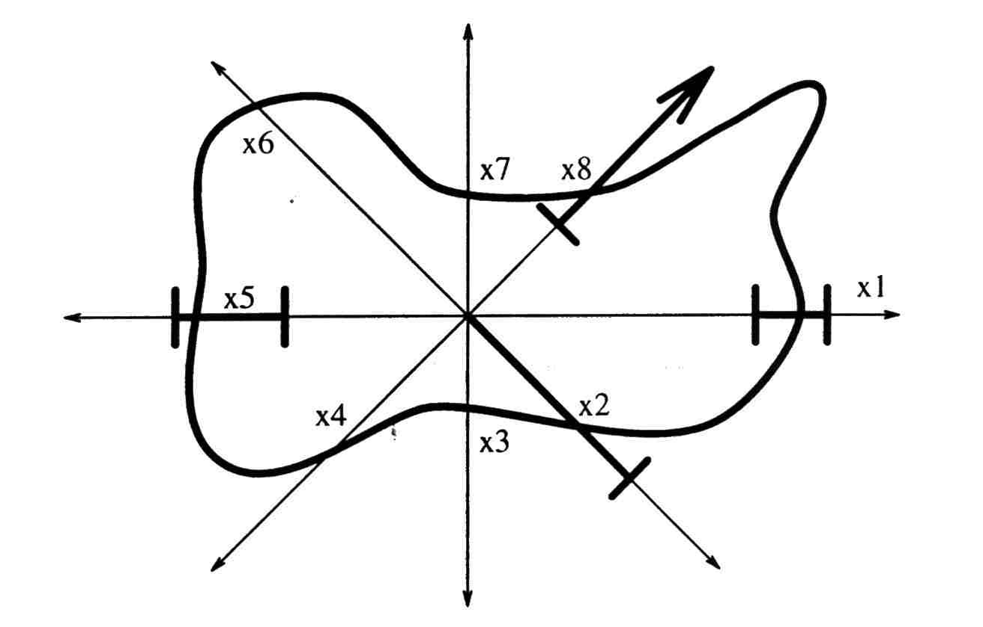
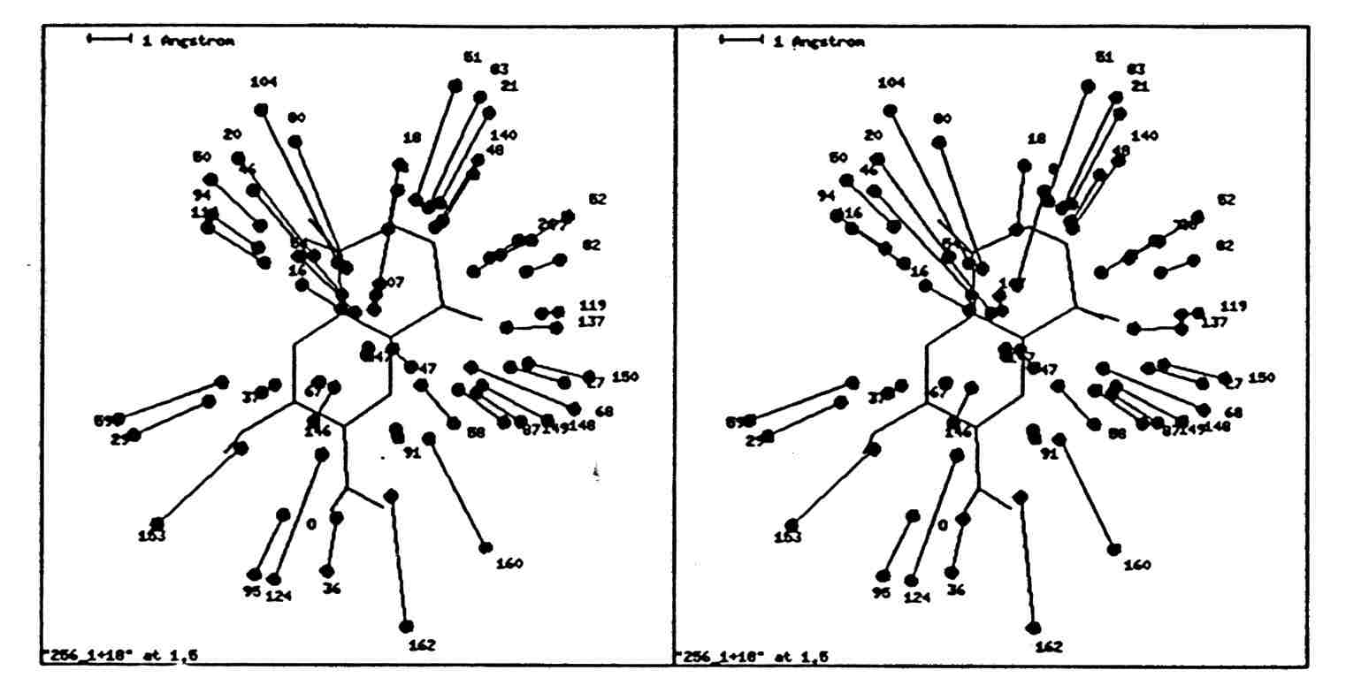
Digital 3D Shape Representation

Slide 42
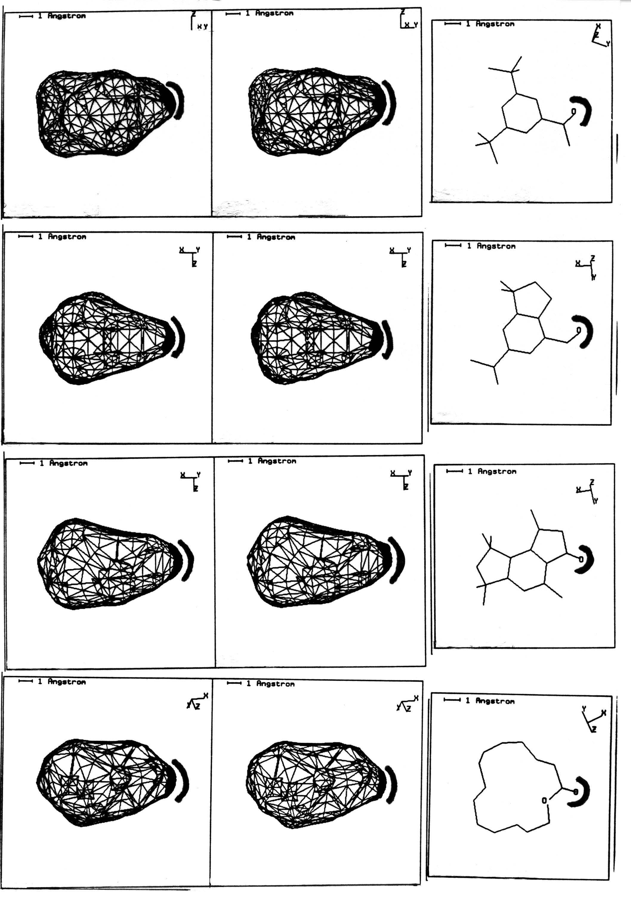
The Power of a Good Representation

Slide 43
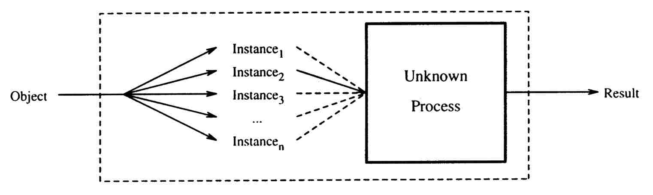
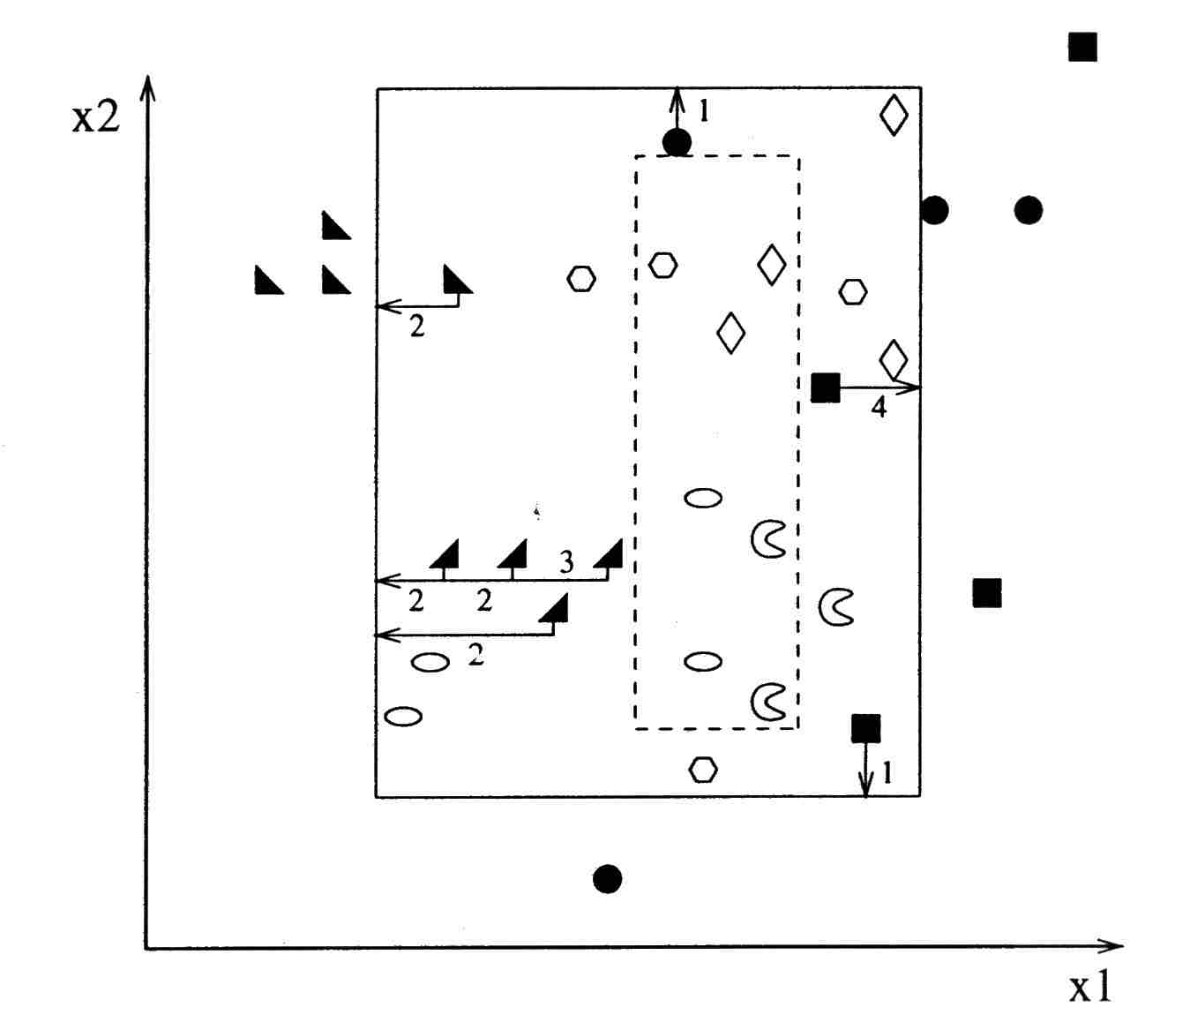
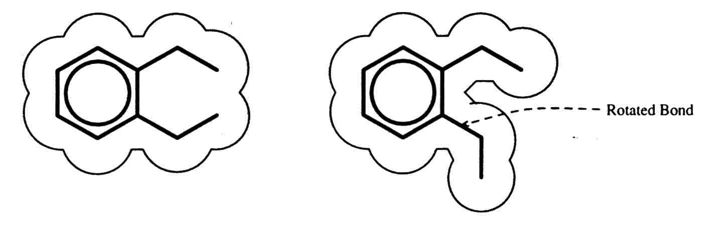
Learning the “Multiple Instance” Problem
“Solving the multiple instance problem with axis-parallel rectangles”
Dietterich, Lathrop, Lozano-Perez, Artificial Intelligence 89(1997) 31-71

Slide 44
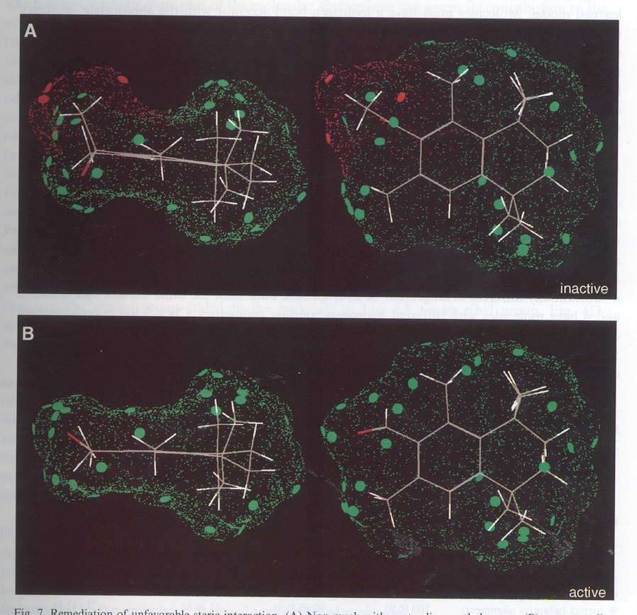
“Compass: A shape-based machine learning tool for drug design,” Jain, Dietterich, Lathrop, Chapman, Critchlow, Bauer, Webster, Lozano-Perez,
J. Of Computer-Aided Molecular Design, 8(1994) 635-652

