Slide 1
Uninformed Search
CS271P, Winter 2018
Introduction to Artificial Intelligence
Prof. Richard Lathrop
Reading: R&N 3.1-3.4

Slide 2
Uninformed search strategies
Uninformed (blind):
  You have no clue whether one non-goal state is better than any other. Your search is blind. You don’t know if your current exploration is likely to be fruitful.
Various blind strategies:
  Breadth-first search
  Uniform-cost search
  Depth-first search
  Iterative deepening search (generally preferred)
  Bidirectional search (preferred if applicable)

Slide 3
Search strategy evaluation
A search strategy is defined by the order of node expansion
Strategies are evaluated along the following dimensions:
  completeness: does it always find a solution if one exists?
  time complexity: number of nodes generated
  space complexity: maximum number of nodes in memory
  optimality: does it always find a least-cost solution?
Time and space complexity are measured in terms of
  b: maximum branching factor of the search tree (always finite)
  d: depth of the least-cost solution
  m: maximum depth of the state space (may be ∞)
  (for UCS: C*: true cost to optimal goal; ε > 0: minimum step cost)

Slide 4
Uninformed search design choices
Queue for Frontier:
  FIFO? LIFO? Priority?
Goal-Test:
  Do goal-test when node inserted into Frontier?
  Do goal-test when node removed?
Tree Search, or Graph Search:
  Forget Expanded (or Explored, Fig. 3.7) nodes?
  Remember them?

Slide 5
Queue for Frontier
FIFO (First In, First Out)
  Results in Breadth-First Search
LIFO (Last In, First Out)
  Results in Depth-First Search
Priority Queue sorted by path cost so far
  Results in Uniform Cost Search
Iterative Deepening Search uses Depth-First
Bidirectional Search can use either Breadth-First or Uniform Cost Search

Slide 6
When to do goal test?
Do Goal-Test when node is popped from queue
IF you care about finding the optimal path
AND your search space may have both short expensive and long cheap paths to a goal.
  Guard against a short expensive goal.
  E.g., Uniform Cost search with variable step costs.
Otherwise, do Goal-Test when is node inserted.
  E.g., Breadth-first Search, Depth-first Search, or Uniform Cost search when cost is a non-decreasing function of depth only (which is equivalent to Breadth-first Search).
REASON ABOUT your search space & problem.
  How could I possibly find a non-optimal goal?

Slide 7
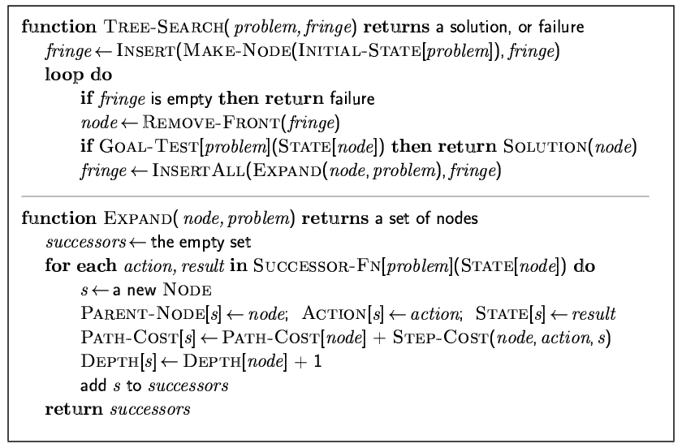
General tree search
Goal test after pop

Slide 8
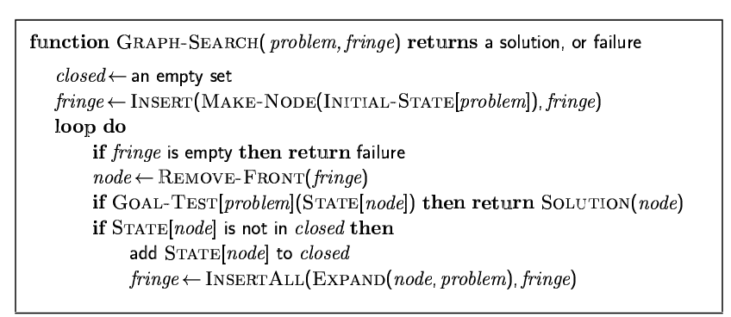
General graph search
Goal test after pop

Slide 9
Breadth-first graph search
Goal test before push

Slide 10
Uniform cost search
UCS: sort by g
GBFS: identical, use h
A*: identical, but use f = g+h
Goal test after pop

Slide 11
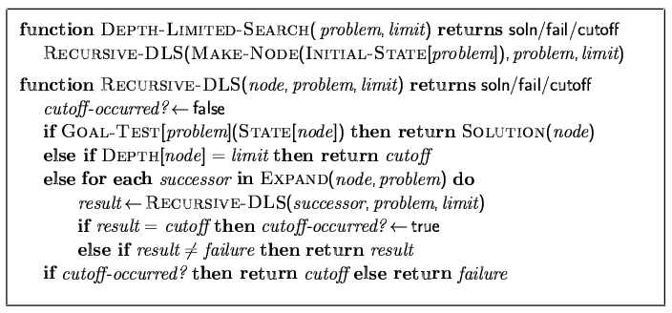
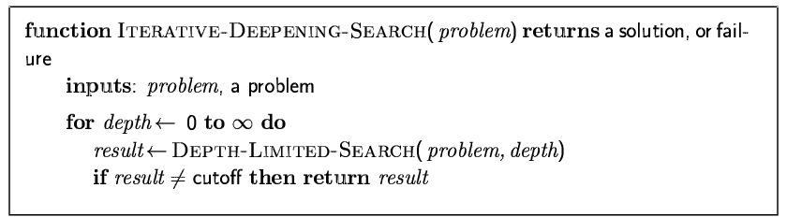
Depth-limited search & IDS
Goal test before push

Slide 12
Checking for identical nodes
It is “easy” to check the fringe/frontier
  Keep a hash table holding all frontier nodes
    Hash size is same O(n) as priority queue, so hash does not increase overall O(n)
  When a node is expanded, remove it from hash
  For each resulting child:
    If child is not in hash, add it to queue and hash
    Else if a lower-score node is in hash, discard the higher-score child
    Else remove the higher-score node from queue and hash, and add the lower-score child to queue and hash
It is memory-intensive to check explored/expanded
  Keep a hash table holding all expanded nodes (may be HUGE!!)
  When a node is expanded, add it to hash
    For optimal searches, if already in hash, retain in hash the lower-score node
  Discard any resulting child already in hash
    For optimal searches, discard only if node in hash has lower score

Slide 13
Checking for search being in a loop
It is “easy” to check for search being in a loop
  When a node is expanded, for each child:
    Trace back through parent pointers from child to root
    If an ancestor is identical to the child, search is looping
      Discard child and fail on that branch
    Time complexity of child loop check is O( depth(child) )
    Memory consumption is zero
      Assuming good garbage collection

Slide 14
When to do Goal-Test? Summary
For DFS, BFS, DLS, and IDS, the goal test is done when the child node is generated.
  These are not optimal searches in the general case.
  BFS and IDS are optimal if cost is a function of depth only; then, optimal goals are also shallowest goals and so will be found first
For GBFS the behavior is the same whether the goal test is done when the node is generated or when it is removed
  h(goal)=0 so any goal will be at the front of the queue anyway.
For UCS and A* the goal test is done when the node is removed from the queue.
  This precaution avoids finding a short expensive path before a long cheap path.

Slide 15
BREADTH-
FIRST
SEARCH

Slide 16
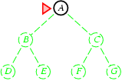
Breadth-first search
Expand shallowest unexpanded node
Frontier: nodes waiting in a queue to be explored
  also called Fringe, or OPEN
Implementation:
  Frontier is a first-in-first-out (FIFO) queue (new successors go at end)
  Goal test when inserted
Future= green dotted circles
Frontier=white nodes
Expanded/active=gray nodes
Forgotten/reclaimed= black nodes
Initial state = A
Is A a goal state?
Put A at end of queue:
Frontier = [A]

Slide 17
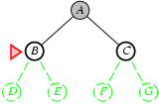
Breadth-first search
Expand shallowest unexpanded node
Frontier: nodes waiting in a queue to be explored
  also called Fringe, or OPEN
Implementation:
  Frontier is a first-in-first-out (FIFO) queue (new successors go at end)
  Goal test when inserted
Future= green dotted circles
Frontier=white nodes
Expanded/active=gray nodes
Forgotten/reclaimed= black nodes
Expand A to B,C
Is B or C a goal state?
Put B,C at end of queue:
Frontier = [B,C]

Slide 18
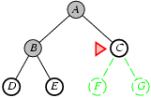
Breadth-first search
Expand shallowest unexpanded node
Frontier: nodes waiting in a queue to be explored
  also called Fringe, or OPEN
Implementation:
  Frontier is a first-in-first-out (FIFO) queue (new successors go at end)
  Goal test when inserted
Future= green dotted circles
Frontier=white nodes
Expanded/active=gray nodes
Forgotten/reclaimed= black nodes
Expand B to D,E
Is D or E a goal state?
Put D,E at end of queue:
Frontier = [C,D,E]

Slide 19
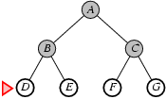
Breadth-first search
Expand shallowest unexpanded node
Frontier: nodes waiting in a queue to be explored
  also called Fringe, or OPEN
Implementation:
  Frontier is a first-in-first-out (FIFO) queue (new successors go at end)
  Goal test when inserted
Future= green dotted circles
Frontier=white nodes
Expanded/active=gray nodes
Forgotten/reclaimed= black nodes
Expand C to F, G
Is F or G a goal state?
Put F,G at end of queue:
Frontier = [D,E,F,G]

Slide 20
Breadth-first search
Expand shallowest unexpanded node
Frontier: nodes waiting in a queue to be explored
  also called Fringe, or OPEN
Implementation:
  Frontier is a first-in-first-out (FIFO) queue (new successors go at end)
  Goal test when inserted
Future= green dotted circles
Frontier=white nodes
Expanded/active=gray nodes
Forgotten/reclaimed= black nodes
Expand D; no children
Forget D
Frontier = [E,F,G]

Slide 21
Breadth-first search
Expand shallowest unexpanded node
Frontier: nodes waiting in a queue to be explored
  also called Fringe, or OPEN
Implementation:
  Frontier is a first-in-first-out (FIFO) queue (new successors go at end)
  Goal test when inserted
Future= green dotted circles
Frontier=white nodes
Expanded/active=gray nodes
Forgotten/reclaimed= black nodes
Expand E; no children
Forget E; B
Frontier = [F,G]

Slide 22
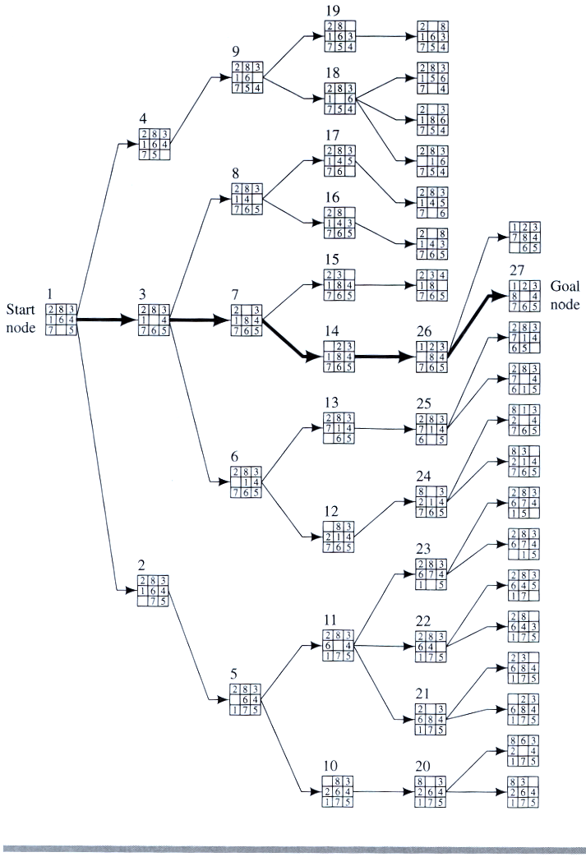
Example
BFS for
8-puzzle

Slide 23
Example: Map Navigation
A
B
C
S
G
D
E
F
S = start, G = goal, other nodes = intermediate states, links = legal transitions

Slide 24
Initial BFS Search Tree
S
A
D
B
D
E
C
E
A
B
C
S
G
D
E
F
Note: this is the search tree at some particular point in
in the search.

Slide 25
Cycles and re-expansion
A
B
C
S
G
D
E
F
S
A
D
B
A
D
E
C
E
E
S
B
S
B
F
Return to an ancestor state (“easy” to detect)

Slide 26
Cycles and re-expansion
A
B
C
S
G
D
E
F
S
A
D
B
A
D
E
C
E
E
S
B
S
B
F
Return to an ancestor state (“easy” to detect)
Return to a previously expanded state (“harder”)
  (requires remembering all previous states)

Slide 27
Properties of breadth-first search
Complete? Yes, it always reaches a goal (if b is finite)
Time? 1 + b + b² + b³ + … + b^{d} = O(b^{d})
(this is the number of nodes we generate)
Space? O(b^{d})
(keeps every node in memory, either in frontier or on a path to frontier).
Optimal? No, for general cost functions.
Yes, if cost is a non-decreasing function only of depth.
  With f(d) ≥ f(d-1), e.g., step-cost = constant:
    All optimal goal nodes occur on the same level
    Optimal goals are always shallower than non-optimal goals
    An optimal goal will be found before any non-optimal goal
Usually Space is the bigger problem (more than time)

Slide 28
BFS: Time & Memory Costs
Depth of Nodes
Solution Expanded Time Memory
0 1 5 microseconds 100 bytes
2 111 0.5 milliseconds 11 kbytes
4 11,111 0.05 seconds 1 megabyte
8 10⁸ 9.25 minutes 11 gigabytes
12 10¹² 64 days 111 terabytes
Assuming b=10; 200k nodes/sec; 100 bytes/node

Slide 29
UNIFORM
COST
SEARCH

Slide 30
Uniform-cost search
Breadth-first is only optimal if path cost is a non-decreasing function of depth, i.e., f(d) ≥ f(d-1); e.g., constant step cost, as in the 8-puzzle.
Can we guarantee optimality for variable positive step costs ≥ε?
(Why ≥ε? To avoid infinite paths w/ step costs 1, ½, ¼, …)
Uniform-cost Search:
Expand node with smallest path cost g(n).
Frontier is a priority queue, i.e., new successors are merged into the queue sorted by g(n).
  Can remove successors already on queue w/higher g(n).
    Saves memory, costs time; another space-time trade-off.
Goal-Test when node is popped off queue.

Slide 31
Uniform-cost search
Implementation: Frontier = queue ordered by path cost.
Equivalent to breadth-first if all step costs all equal.
Complete? Yes, if b is finite and step cost ≥ ε > 0.
(otherwise it can get stuck in infinite loops)
Time? # of nodes with path cost ≤ cost of optimal solution.
O(b^{⎣1+C*/ε⎦}) ≈ O(b^{d+1})
Space? # of nodes with path cost ≤ cost of optimal solution.
O(b^{⎣1+C*/ε⎦}) ≈ O(b^{d+1}).
Optimal? Yes, for any step cost ≥ ε > 0.
Notes:
b^(d+1); compare to BFS, O(b^d) because goal test when generated; waiting until expanded means one more level of generated nodes before finishing.

Slide 32
Uniform-cost search
Proof of Completeness:
Assume (1) finite max branching factor = b; (2) min step cost ≥ ε > 0; (3) cost to optimal goal = C*. Then a node at depth ⎣ 1+C*/ε ⎦ must have a path cost > C*. There are O( b^( ⎣ 1+C*/ε ⎦ ) such nodes, so a goal will be found.
Proof of Optimality (given completeness):
Suppose that UCS is not optimal. Then there must be an (optimal) goal state with path cost smaller than the found (suboptimal) goal state (invoking completeness). However, this is impossible because UCS would have expanded that node first, by definition.
Contradiction.

Slide 33
Ex: Uniform-cost search
(Search tree version)
1
A
10
Order of node expansion:
Path found: Cost of path found:
5
5
S
B
G
15
C
5
Route finding problem. Steps labeled w/cost.
S
g=0

Slide 34
Ex: Uniform-cost search
(Search tree version)
1
A
10
Order of node expansion: S
Path found: Cost of path found:
5
5
S
B
G
15
C
5
Route finding problem. Steps labeled w/cost.
S
g=0
A
g=1
B
g=5
C
g=15

Slide 35
Ex: Uniform-cost search
(Search tree version)
1
A
10
Order of node expansion: S A
Path found: Cost of path found:
5
5
S
B
G
15
C
5
Route finding problem. Steps labeled w/cost.
S
g=0
This early expensive goal node will go back onto the queue until after the later cheaper goal is found.
A
g=1
B
g=5
C
g=15
G
g=11

Slide 36
Ex: Uniform-cost search
(Search tree version)
1
A
10
Order of node expansion: S A B
Path found: Cost of path found:
5
5
S
B
G
15
C
5
Route finding problem. Steps labeled w/cost.
S
g=0
A
g=1
B
g=5
C
g=15
G
g=11
G
g=10
Remove the higher-cost of identical nodes and save memory. However, UCS is optimal even if this is not done, since lower-cost nodes sort to the front.

Slide 37
Ex: Uniform-cost search
(Search tree version)
1
A
10
Order of node expansion: S A B G
Path found: S B G Cost of path found: 10
5
5
S
B
G
15
C
5
Route finding problem. Steps labeled w/cost.
S
g=0
A
g=1
B
g=5
C
g=15
G
g=11
G
g=10
Technically, the goal node is not really expanded, because we do not generate the children of a goal node. It is listed in “Order of node expansion” only for your convenience, to see explicitly where it was found.

Slide 38
Ex: Uniform-cost search
(Virtual queue version)
1
A
10
Order of node expansion:
Path found: Cost of path found:
5
5
S
B
G
15
C
5
Route finding problem. Steps labeled w/cost.
Expanded:
Next:
Children:
Queue: S/g=0

Slide 39
Ex: Uniform-cost search
(Virtual queue version)
1
A
10
Order of node expansion: S
Path found: Cost of path found:
5
5
S
B
G
15
C
5
Route finding problem. Steps labeled w/cost.
Expanded: S/g=0
Next: S/g=0
Children: A/g=1, B/g=5, C/g=15
Queue: S/g=0, A/g=1, B/g=5, C/g=15

Slide 40
Ex: Uniform-cost search
(Virtual queue version)
1
A
10
Order of node expansion: S A
Path found: Cost of path found:
5
5
S
B
G
15
C
5
Route finding problem. Steps labeled w/cost.
Expanded: S/g=0, A/g=1
Next: A/g=1
Children: G/g=11
Queue: S/g=0, A/g=1, B/g=5, C/g=15, G/g=11
Note that in a proper priority queue in a computer system, this queue would be sorted by g(n). For hand-simulated search it is more convenient to write children as they occur, and then scan the current queue to pick the highest-priority node on the queue.

Slide 41
Ex: Uniform-cost search
(Virtual queue version)
1
A
10
Order of node expansion: S A B
Path found: Cost of path found:
5
5
S
B
G
15
C
5
Route finding problem. Steps labeled w/cost.
Expanded: S/g=0, A/g=1, B/g=5
Next: B/g=5
Children: G/g=10
Queue: S/g=0, A/g=1, B/g=5, C/g=15, G/g=11, G/g=10
Remove the higher-cost of identical nodes and save memory. However, UCS is optimal even if this is not done, since lower-cost nodes sort to the front.

Slide 42
Ex: Uniform-cost search
(Virtual queue version)
1
A
10
Order of node expansion: S A B G
Path found: S B G Cost of path found: 10
5
5
S
B
G
15
C
5
Route finding problem. Steps labeled w/cost.
The same “Order of node expansion”, “Path found”, and “Cost of path found” is obtained by both methods. They are formally equivalent to each other in all ways.
Expanded: S/g=0, A/g=1, B/g=5, G/g=10
Next: G/g=10
Children: none
Queue: S/g=0, A/g=1, B/g=5, C/g=15, G/g=11, G/g=10
Technically, the goal node is not really expanded, because we do not generate the children of a goal node. It is listed in “Order of node expansion” only for your convenience, to see explicitly where it was found.

Slide 43
A
6
D
1
F
3
1
S
2
4
8
G
B
E
1
20
C
The graph above shows the step-costs for different paths going from the start (S) to
the goal (G).
Use uniform cost search to find the optimal path to the goal.
Exercise for home

Slide 44
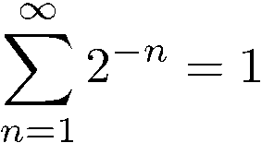
Uniform cost search
Why require step cost ≥ ε > 0?
  Otherwise, an infinite regress is possible.
  Recall:
S is the start node.
S
cost(S,A) = 1/2
g(A) = 1/2
A
cost(A,B) = 1/4
g(B) = 3/4
cost(S,G) = 1
cost(B,C) = 1/8
g(C) = 7/8
B
cost(C,D) = 1/16
g(C) = 15/16
G
g(G) = 1
C
...
G is the only goal node in the search space.
D
No return from this branch.
G will never be popped.

Slide 45
DEPTH-FIRST
SEARCH

Slide 46
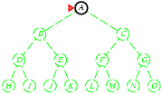
Depth-first search
Expand deepest unexpanded node
Frontier = Last In First Out (LIFO) queue, i.e., new successors go at the front of the queue.
Goal-Test when inserted.
Future= green dotted circles
Frontier=white nodes
Expanded/active=gray nodes
Forgotten/reclaimed= black nodes
Initial state = A
Is A a goal state?
Put A at front of queue.
frontier = [A]

Slide 47
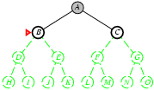
Depth-first search
Expand deepest unexpanded node
  Frontier = LIFO queue, i.e., put successors at front
Expand A to B, C.
Is B or C a goal state?
Put B, C at front of queue.
frontier = [B,C]
Future= green dotted circles
Frontier=white nodes
Expanded/active=gray nodes
Forgotten/reclaimed= black nodes
Note: Can save a space factor of b by generating successors one at a time.
See backtracking search in your book, p. 87 and Chapter 6.

Slide 48
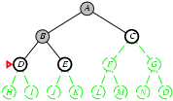
Depth-first search
Expand deepest unexpanded node
  Frontier = LIFO queue, i.e., put successors at front
Expand B to D, E.
Is D or E a goal state?
Put D, E at front of queue.
frontier = [D,E,C]
Future= green dotted circles
Frontier=white nodes
Expanded/active=gray nodes
Forgotten/reclaimed= black nodes

Slide 49
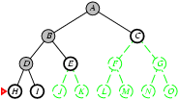
Depth-first search
Expand deepest unexpanded node
  Frontier = LIFO queue, i.e., put successors at front
Expand D to H, I.
Is H or I a goal state?
Put H, I at front of queue.
frontier = [H,I,E,C]
Future= green dotted circles
Frontier=white nodes
Expanded/active=gray nodes
Forgotten/reclaimed= black nodes

Slide 50
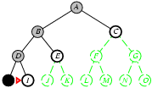
Depth-first search
Expand deepest unexpanded node
  Frontier = LIFO queue, i.e., put successors at front
Expand H to no children.
Forget H.
frontier = [I,E,C]
Future= green dotted circles
Frontier=white nodes
Expanded/active=gray nodes
Forgotten/reclaimed= black nodes

Slide 51
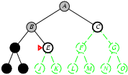
Depth-first search
Expand deepest unexpanded node
  Frontier = LIFO queue, i.e., put successors at front
Expand I to no children.
Forget D, I.
frontier = [E,C]
Future= green dotted circles
Frontier=white nodes
Expanded/active=gray nodes
Forgotten/reclaimed= black nodes

Slide 52
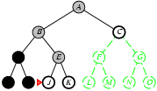
Depth-first search
Expand deepest unexpanded node
  Frontier = LIFO queue, i.e., put successors at front
Expand E to J, K.
Is J or K a goal state?
Put J, K at front of queue.
frontier = [J,K,C]
Future= green dotted circles
Frontier=white nodes
Expanded/active=gray nodes
Forgotten/reclaimed= black nodes

Slide 53
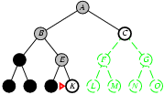
Depth-first search
Expand deepest unexpanded node
  Frontier = LIFO queue, i.e., put successors at front
Expand J to no children.
Forget J.
frontier = [K,C]
Future= green dotted circles
Frontier=white nodes
Expanded/active=gray nodes
Forgotten/reclaimed= black nodes

Slide 54
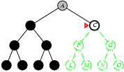
Depth-first search
Expand deepest unexpanded node
  Frontier = LIFO queue, i.e., put successors at front
Expand K to no children.
Forget B, E, K.
frontier = [C]
Future= green dotted circles
Frontier=white nodes
Expanded/active=gray nodes
Forgotten/reclaimed= black nodes

Slide 55
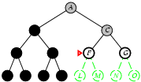
Depth-first search
Expand deepest unexpanded node
  Frontier = LIFO queue, i.e., put successors at front
Future= green dotted circles
Frontier=white nodes
Expanded/active=gray nodes
Forgotten/reclaimed= black nodes
Expand C to F, G.
Is F or G a goal state?
Put F, G at front of queue.
frontier = [F,G]

Slide 56
Properties of depth-first search
A
Complete? No: fails in loops/infinite-depth spaces
  Can modify to avoid loops/repeated states along path
    check if current nodes occurred before on path to root
  Can use graph search (remember all nodes ever seen)
    problem with graph search: space is exponential, not linear
  Still fails in infinite-depth spaces (may miss goal entirely)
Time? O(b^{m}) with m =maximum depth of space
  Terrible if m is much larger than d
  If solutions are dense, may be much faster than BFS
Space? O(bm), i.e., linear space!
  Remember a single path + expanded unexplored nodes
Optimal? No: It may find a non-optimal goal first
B
C

Slide 57
ITERATIVE
DEEPENING
SEARCH

Slide 58
Iterative Deepening Search
To avoid the infinite depth problem of DFS:
  Only search until depth L
  i.e, don’t expand nodes beyond depth L
  Depth-Limited Search
What if solution is deeper than L?
  Increase depth iteratively
  Iterative Deepening Search
IDS
  Inherits the memory advantage of depth-first search
  Has the completeness property of breadth-first search

Slide 59
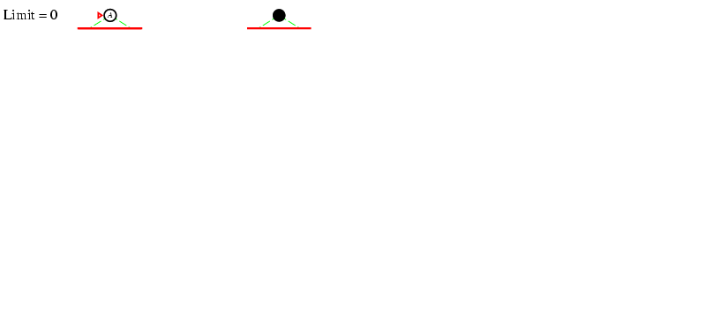
Iterative Deepening Search, L=0

Slide 60
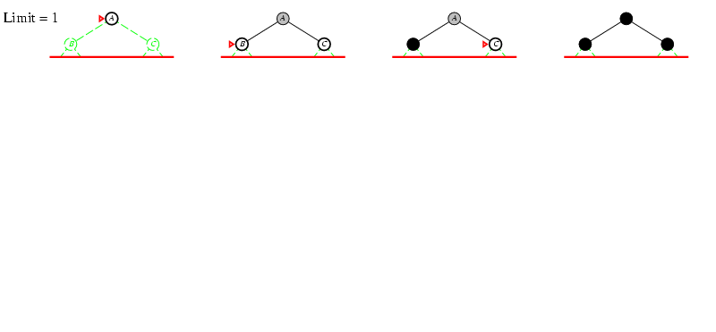
Iterative Deepening Search, L=1

Slide 61
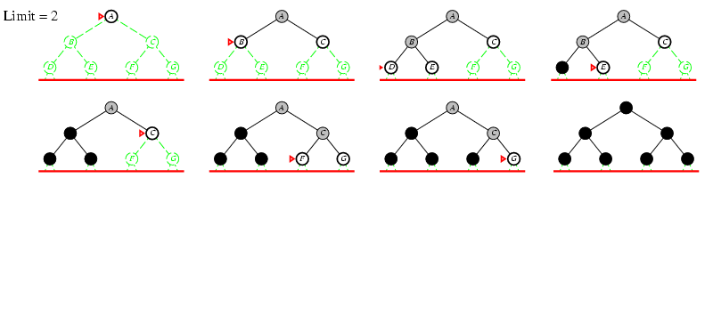
Iterative Deepening Search, L=2

Slide 62
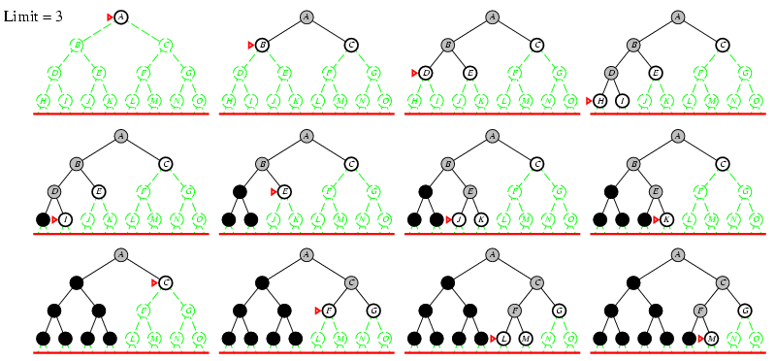
Iterative Deepening Search, L=3

Slide 63
Iterative Deepening Search
Number of nodes generated in a depth-limited search to depth d with branching factor b:
N_{DLS} = b⁰ + b¹ + b² + … + b^{d-2} + b^{d-1} + b^{d}
Number of nodes generated in an iterative deepening search to depth d with branching factor b:
N_{IDS} = (d+1)b⁰ + d b¹ + (d-1)b² + … + 3b^{d-2} +2b^{d-1} + 1b^{d}
= O(b^{d})
For b = 10, d = 5,
  N_{DLS} = 1 + 10 + 100 + 1,000 + 10,000 + 100,000 = 111,111
  N_{IDS} = 6 + 50 + 400 + 3,000 + 20,000 + 100,000 = 123,450
[ Ratio: b/(b-1) ]

Slide 64
Properties of iterative deepening search
Complete? Yes
Time? O(b^{d})
Space? O(bd)
Optimal? No, for general cost functions.
Yes, if cost is a non-decreasing function only of depth.
Generally the preferred uninformed search strategy.

Slide 65
BI-DIRECTIONAL
SEARCH

Slide 66
Bidirectional Search
Idea
  simultaneously search forward from S and backwards from G
  stop when both “meet in the middle”
  need to keep track of the intersection of 2 open sets of nodes
What does searching backwards from G mean
  need a way to specify the predecessors of G
    this can be difficult,
    e.g., predecessors of checkmate in chess?
  what if there are multiple goal states?
  what if there is only a goal test, no explicit list?
Complexity
  time complexity is best: O(2 b^{(d/2)}) = O(b ^{(d/2)})
  memory complexity is the same as time complexity

Slide 67
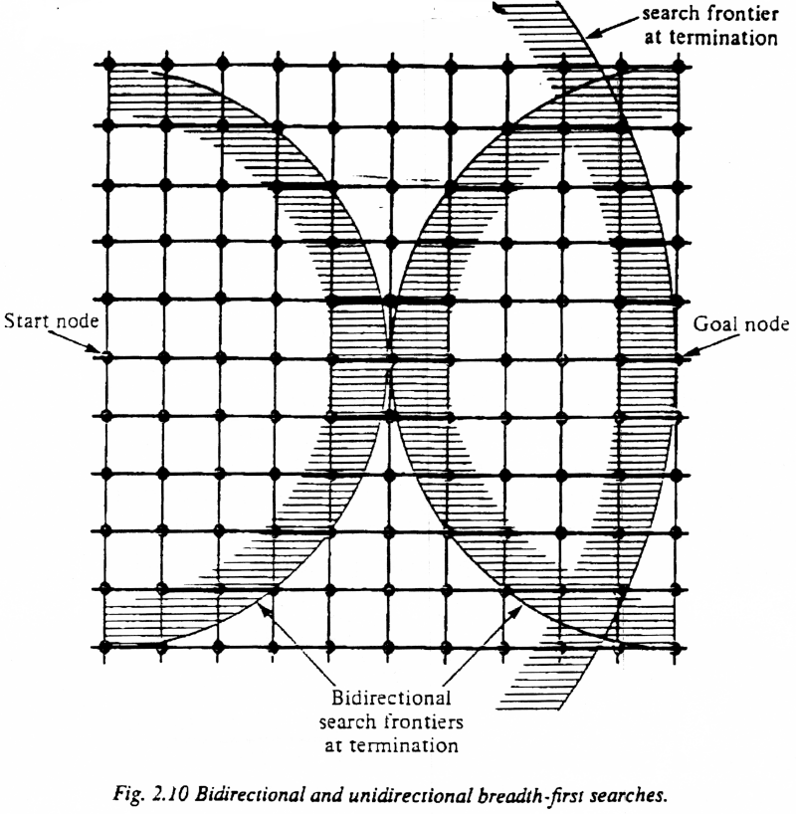
Bi-Directional Search

Slide 68
Summary of algorithms
Criterion | Breadth-First | Uniform-Cost | Depth-First | Depth-Limited | Iterative Deepening DLS | Bidirectional (if applicable)
Complete? | Yes[a] | Yes[a,b] | No | No | Yes[a] | Yes[a,d]
Time | O(b^{d}) | O(b^{⎣1+C*/ε⎦}) | O(b^{m}) | O(b^{l}) | O(b^{d}) | O(b^{d/2})
Space | O(b^{d}) | O(b^{⎣1+C*/ε⎦}) | O(bm) | O(bl) | O(bd) | O(b^{d/2})
Optimal? | Yes[c] | Yes | No | No | Yes[c] | Yes[c,d]
There are a number of footnotes, caveats, and assumptions.
See Fig. 3.21, p. 91.
[a] complete if b is finite
[b] complete if step costs ≥ ε > 0
[c] optimal if step costs are all identical
(also if path cost non-decreasing function of depth only)
[d] if both directions use breadth-first search
(also if both directions use uniform-cost search with step costs ≥ ε > 0)
Note that d ≤ ⎣1+C*/ε⎦
Generally the preferred
uninformed search strategy

Slide 69
You should know…
Overview of uninformed search methods
Search strategy evaluation
  Complete? Time? Space? Optimal?
  Max branching (b), Solution depth (d), Max depth (m)
  (for UCS: C*: true cost to optimal goal; ε > 0: minimum step cost)
Search Strategy Components and Considerations
  Queue? Goal Test when? Tree search vs. Graph search?
Various blind strategies:
  Breadth-first search
  Uniform-cost search
  Depth-first search
  Iterative deepening search (generally preferred)
  Bidirectional search (preferred if applicable)

Slide 70
Summary
Problem formulation usually requires abstracting away real-world details to define a state space that can feasibly be explored
Variety of uninformed search strategies
Iterative deepening search uses only linear space and not much more time than other uninformed algorithms
http://www.cs.rmit.edu.au/AI-Search/Product/
http://aima.cs.berkeley.edu/demos.html (for more demos)

