Slide 1
Heuristic search, A*
CS271P, Winter 2018
Introduction to Artificial Intelligence
Prof. Richard Lathrop
Reading: R&N 3.5-3.7

Slide 2
Outline
Review limitations of uninformed search methods
Informed (or heuristic) search
Problem-specific heuristics to improve efficiency
Best-first, A* (and if needed for memory limits, RBFS, SMA*)
Techniques for generating heuristics
A* is optimal with admissible (tree)/consistent (graph) heuristics
A* is quick and easy to code, and often works *very* well
Heuristics
A structured way to add “smarts” to your solution
Provide *significant* speed-ups in practice
Still have worst-case exponential time complexity
In AI, “NP-Complete” means “Formally interesting”

Slide 3
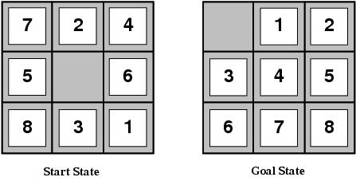
Limitations of uninformed search
Search space size makes search tedious
Combinatorial explosion
Ex: 8-Puzzle
Average solution cost is ~ 22 steps
Branching factor ~ 3
Exhaustive search to depth 22: 3.1x10¹⁰ states
24-Puzzle: 10²⁴ states (much worse!)

Slide 4
Recall: tree search
Arad
Sibiu
Timisoara
Zerind
Arad
Fagaras
Oradea
Rimnicu…
Arad
Lugoj
Arad
Oradea
This “strategy” is what differentiates different search algorithms
function TREE-SEARCH (problem, strategy) : returns a solution or failure
initialize the search tree using the initial state of problem
while (true):
if no candidates for expansion: return failure
choose a leaf node for expansion according to strategy
if the node contains a goal state: return the corresponding solution
else: expand the node and add the resulting nodes to the search tree

Slide 5
Heuristic function
Idea: use a heuristic function h(n) for each node
g(n) = known path cost so far to node n
h(n) = estimate of (optimal) cost to goal from node n
f(n) = g(n)+h(n) = estimate of total cost to goal through n
f(n) provides an estimate for the total cost
“Best first” search implementation
Order the nodes in frontier by an evaluation function
Greedy Best-First: order by h(n)
A* search: order by f(n)
Search efficiency depends on heuristic quality!
The better your heuristic, the faster your search!

Slide 6
Heuristic function
Heuristic
Definition: a commonsense rule or rules intended to increase the probability of solving some problem
Same linguistic root as “Eureka” = “I have found it”
Using rules of thumb to find answers
Heuristic function h(n)
Estimate of (optimal) remaining cost from n to goal
Defined using only the state of node n
h(n) = 0 if n is a goal node
Example: straight line distance from n to Bucharest
Not true state space distance, just estimate! Actual distance can be higher
Provides problem-specific knowledge to the search algorithm

Slide 7
Example: 8-Puzzle
8-Puzzle
Avg solution cost is about 22 steps
Branching factor ~ 3
Exhaustive search to depth 22 = 3.1 x 10^10 states
A good heuristic function can reduce the search process
Two commonly used heuristics
h₁: the number of misplaced tiles
h₂: sum of the distances of the tiles from their goal (“Manhattan distance”)
h₁(s) = 8
h₂(s) = 3+1+2+2+2+3+3+2
= 18

Slide 8
Example: Romania, straight-line distance
Straight-line dist to goal
Arad 366
Bucharest 0
Craiova 160
Drobeta 242
Eforie 161
Fagaras 176
Giurgiu 77
Hirsova 151
Iasi 226
Lugoj 244
Mehadia 241
Neamt 234
Oradea 380
Pitesti 100
Rimnicu Vilcea 193
Sibiu 253
Timisoara 329
Urziceni 80
Vaslui 199
Zerind 374
Oradea
71
Neamt
75
Zerind
151
87
Iasi
Arad
140
Sibiu
92
99
Fagaras
118
Vaslui
Timisoara
80
Rimnicu Vilcea
97
211
142
111
Lugoj
Pitesti
70
85
98
Hirsova
Mehadia
146
101
Urziceni
75
120
138
Bucharest
86
Dobreta
90
Cralova
Giurgiu
Eforie

Slide 9
Relationship of search algorithms
Notation
g(n) = known cost so far to reach n
h(n) = estimated (optimal) cost from n to goal
f(n) = g(n)+h(n) = estimated (optimal) total cost through n
Uniform cost search: sort frontier by g(n)
Greedy best-first search: sort frontier by h(n)
A* search: sort frontier by f(n)
Optimal for admissible / consistent heuristics
Generally the preferred heuristic search framework
Memory-efficient versions of A* are available: RBFS, SMA*

Slide 10
Greedy best-first search
(sometimes just called “best-first”)
h(n) = estimate of cost from n to goal
Ex: h(n) = straight line distance from n to Bucharest
Greedy best-first search expands the node that appears to be closest to goal
Priority queue sort function = h(n)

Slide 11
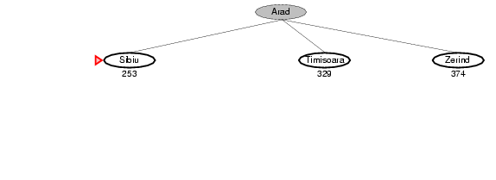
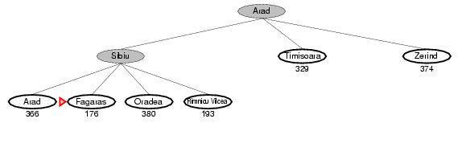
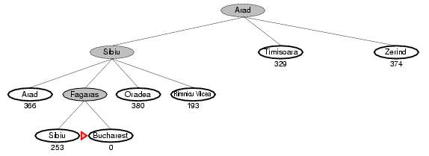
Example: GBFS for Romania
Straight-line dist to goal
Arad 366
Bucharest 0
Craiova 160
Drobeta 242
Eforie 161
Fagaras 176
Giurgiu 77
Hirsova 151
Iasi 226
Lugoj 244
Mehadia 241
Neamt 234
Oradea 380
Pitesti 100
Rimnicu Vilcea 193
Sibiu 253
Timisoara 329
Urziceni 80
Vaslui 199
Zerind 374
71
Oradea
Neamt
75
Zerind
151
87
Iasi
Arad
140
Sibiu
92
99
Fagaras
118
Vaslui
Timisoara
80
Rimnicu Vilcea
97
211
142
111
Lugoj
Pitesti
70
85
98
Hirsova
Mehadia
146
101
Urziceni
75
120
138
Bucharest
86
Dobreta
Cralova
90
Eforie
Giurgiu

Slide 12
Example: GBFS for Romania
GBFS path: 450km
Optimal path: 418 km
Straight-line dist to goal
Arad 366
Bucharest 0
Craiova 160
Drobeta 242
Eforie 161
Fagaras 176
Giurgiu 77
Hirsova 151
Iasi 226
Lugoj 244
Mehadia 241
Neamt 234
Oradea 380
Pitesti 100
Rimnicu Vilcea 193
Sibiu 253
Timisoara 329
Urziceni 80
Vaslui 199
Zerind 374
71
Oradea
Neamt
75
Zerind
151
87
Iasi
Arad
140
Sibiu
92
99
Fagaras
118
Vaslui
Timisoara
80
Rimnicu Vilcea
97
211
142
111
Lugoj
Pitesti
70
85
98
Hirsova
Mehadia
146
101
Urziceni
75
120
138
Bucharest
86
Dobreta
Cralova
90
Eforie
Giurgiu

Slide 13
Greedy best-first search
With tree-search, will become stuck in this loop:
Order of node expansion: S A D S A D S A D …
Path found: none
Cost of path found: none
h=5
D
S
h=6
h=7
A
B
h=8
C
h=9
G
h=0

Slide 14
Properties of greedy best-first search
Complete?
Tree version can get stuck in loops
Graph version is complete in finite spaces
Time? O(b^{m})
A good heuristic can give dramatic improvement
Space? O(b^{m})
Keeps all nodes in memory
Optimal? No
Example:
Arad – Sibiu – Rimnicu Vilcea – Pitesti – Bucharest is shorter!

Slide 15
A* search
Idea: avoid expanding paths that are already expensive
Generally the preferred (simple) heuristic search
Optimal if heuristic is:
admissible (tree search) / consistent (graph search)
Evaluation function f(n) = g(n) + h(n)
g(n) = cost so far to reach n
h(n) = estimated cost from n to goal
f(n) = g(n)+h(n) = estimated total cost of path through n to goal
A* algorithm is identical to UCS except priority queue sort function = f(n)

Slide 16
Admissible heuristics
A heuristic h(n) is admissible if, for every node n,
h(n) ≤ h*(n)
h*(n) = the true cost to reach the goal state from n
An admissible heuristic never overestimates the cost to reach the goal, i.e., it is never pessimistic
Ex: straight-line distance never overestimates road distance
Theorem:
if h(n) is admissible, A* using Tree-Search is optimal

Slide 17
Example: Admissible heuristics
Two commonly used admissible heuristics
h₁: the number of misplaced tiles
h₂: sum of the distances of the tiles from their goal (“Manhattan distance”)
h₁(s) = 8
h₂(s) = 3+1+2+2+2+3+3+2
= 18

Slide 18
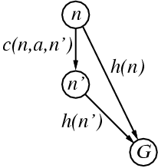
Consistent heuristics
A heuristic is consistent (or monotone) if for every node n, every successor n' of n generated by any action a,
h(n) ≤ c(n,a,n') + h(n')
If h is consistent, we have
f(n') = g(n') + h(n')
= g(n) + c(n,a,n') + h(n')
≥ g(n) + h(n)
= f(n)
i.e., f(n) is non-decreasing along any path.
Consistent ) admissible (stronger condition)
Theorem: If h(n) is consistent, A* using Graph-Search is optimal
(Triangle inequality)

Slide 19
Optimality conditions
A* Tree Search is optimal if heuristic is admissible
A* Graph Search is optimal if heuristic is consistent
Why two different conditions?
In graph search you often find a long cheap path to a node after a short expensive one, so you might have to update all of its descendants to use the new cheaper path cost so far
A consistent heuristic avoids this problem (it can’t happen)
Consistent is slightly stronger than admissible
Almost all admissible heuristics also are consistent
Could we do optimal A* Graph Search with an admissible heuristic?
Yes, but we would have to do additional work to update descendants when a cheaper path to a node is found
A consistent heuristic avoids this problem

Slide 20
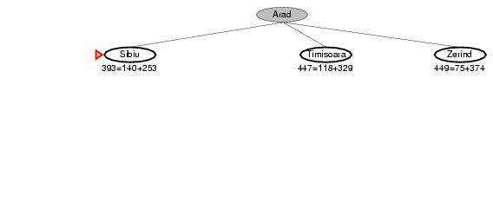
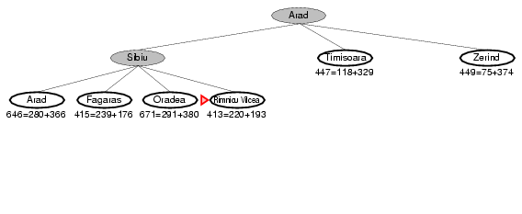
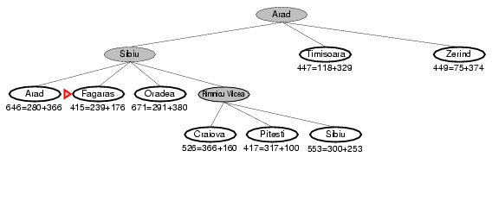
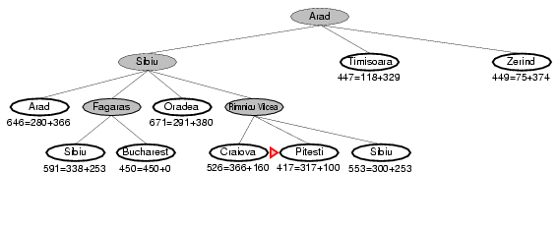
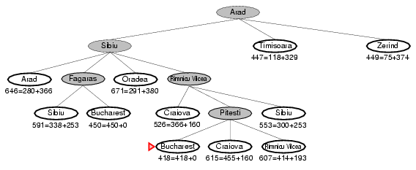
Ex: A* Tree Search for Romania
Straight-line dist to goal
Arad 366
Bucharest 0
Craiova 160
Drobeta 242
Eforie 161
Fagaras 176
Giurgiu 77
Hirsova 151
Iasi 226
Lugoj 244
Mehadia 241
Neamt 234
Oradea 380
Pitesti 100
Rimnicu Vilcea 193
Sibiu 253
Timisoara 329
Urziceni 80
Vaslui 199
Zerind 374
71
Oradea
Neamt
Note: search does not “backtrack”;
both routes are pursued at once.
75
Zerind
151
87
Iasi
Arad
140
Sibiu
92
99
Fagaras
118
Vaslui
Timisoara
80
Rimnicu Vilcea
97
211
142
111
Lugoj
Pitesti
70
85
98
Hirsova
Mehadia
146
101
Urziceni
75
120
138
Bucharest
86
Dobreta
Cralova
90
Eforie
Giurgiu

Slide 21
Ex: A* Tree Search for Romania
Red triangle:
Node to expand next
Straight-line dist to goal
Arad 366
Bucharest 0
Craiova 160
Drobeta 242
Fagaras 176
Lugoj 244
Mehadia 241
Oradea 380
Pitesti 100
Rimnicu Vilcea 193
Sibiu 253
Timisoara 329
Zerind 374
…
71
Oradea
Neamt
75
Zerind
151
87
Iasi
Arad
140
Sibiu
92
99
Fagaras
118
Vaslui
Timisoara
80
Rimnicu Vilcea
97
211
142
111
Lugoj
Pitesti
70
85
98
Hirsova
Mehadia
146
101
Urziceni
75
120
138
Bucharest
86
Dobreta
Cralova
90
Eforie
Giurgiu

Slide 22
Ex: A* Tree Search for Romania
(Simulated queue)
Expanded: None
Children: None
Frontier: Arad/366 (0+366),
Red name:
Node to expand next
Straight-line dist to goal
Arad 366
Bucharest 0
Craiova 160
Drobeta 242
Fagaras 176
Lugoj 244
Mehadia 241
Oradea 380
Pitesti 100
Rimnicu Vilcea 193
Sibiu 253
Timisoara 329
Zerind 374
…
71
Oradea
Neamt
75
Zerind
151
87
Iasi
Arad
140
Sibiu
92
99
Fagaras
118
Vaslui
Timisoara
80
Rimnicu Vilcea
97
211
142
111
Lugoj
Pitesti
70
85
98
Hirsova
Mehadia
146
101
Urziceni
75
120
138
Bucharest
86
Dobreta
Cralova
90
Eforie
Giurgiu

Slide 23
Ex: A* Tree Search for Romania
Straight-line dist to goal
Arad 366
Bucharest 0
Craiova 160
Drobeta 242
Fagaras 176
Lugoj 244
Mehadia 241
Oradea 380
Pitesti 100
Rimnicu Vilcea 193
Sibiu 253
Timisoara 329
Zerind 374
…
71
Oradea
Neamt
75
Zerind
151
87
Iasi
Arad
140
Sibiu
92
99
Fagaras
118
Vaslui
Timisoara
80
Rimnicu Vilcea
97
211
142
111
Lugoj
Pitesti
70
85
98
Hirsova
Mehadia
146
101
Urziceni
75
120
138
Bucharest
86
Dobreta
Cralova
90
Eforie
Giurgiu

Slide 24
Ex: A* Tree Search for Romania
(Simulated queue)
Expanded: Arad/366 (0+366)
Children: Sibiu/393 (140+253), Timisoara/447 (118+329), Zerind/449 (75+374)
Frontier: Arad/366 (0+366), Sibiu/393 (140+253), Timisoara/447 (118+329), Zerind/449 (75+374)
Underlined node:
Last node expanded
Straight-line dist to goal
Arad 366
Bucharest 0
Craiova 160
Drobeta 242
Fagaras 176
Lugoj 244
Mehadia 241
Oradea 380
Pitesti 100
Rimnicu Vilcea 193
Sibiu 253
Timisoara 329
Zerind 374
…
71
Oradea
Neamt
75
Zerind
151
87
Iasi
Arad
140
Sibiu
92
99
Fagaras
118
Vaslui
Timisoara
80
Rimnicu Vilcea
97
211
142
111
Lugoj
Pitesti
70
85
98
Hirsova
Mehadia
146
101
Urziceni
75
120
138
Bucharest
86
Dobreta
Cralova
90
Eforie
Giurgiu

Slide 25
Ex: A* Tree Search for Romania
Straight-line dist to goal
Arad 366
Bucharest 0
Craiova 160
Drobeta 242
Fagaras 176
Lugoj 244
Mehadia 241
Oradea 380
Pitesti 100
Rimnicu Vilcea 193
Sibiu 253
Timisoara 329
Zerind 374
…
71
Oradea
Neamt
75
Zerind
151
87
Iasi
Arad
140
Sibiu
92
99
Fagaras
118
Vaslui
Timisoara
80
Rimnicu Vilcea
97
211
142
111
Lugoj
Pitesti
70
85
98
Hirsova
Mehadia
146
101
Urziceni
75
120
138
Bucharest
86
Dobreta
Cralova
90
Eforie
Giurgiu

Slide 26
Ex: A* Tree Search for Romania
(Simulated queue)
Expanded: Arad/366 (0+366), Sibiu/393 (140+253)
Children: Arad/646 (280+366), Fagaras/415 (239+176), Oradea/671 (291+380), RimnicuVilcea/413 (220+193)
Frontier: Arad/366 (0+366), Sibiu/393 (140+253), Timisoara/447 (118+329), Zerind/449 (75+374), Arad/646 (280+366), Fagaras/415 (239+176), Oradea/671 (291+380), RimnicuVilcea/413 (220+193)
Straight-line dist to goal
Arad 366
Bucharest 0
Craiova 160
Drobeta 242
Fagaras 176
Lugoj 244
Mehadia 241
Oradea 380
Pitesti 100
Rimnicu Vilcea 193
Sibiu 253
Timisoara 329
Zerind 374
…
71
Oradea
Neamt
75
Zerind
151
87
Iasi
Arad
140
Sibiu
92
99
Fagaras
118
Vaslui
Timisoara
80
Rimnicu Vilcea
97
211
142
111
Lugoj
Pitesti
70
85
98
Hirsova
Mehadia
146
101
Urziceni
75
120
138
Bucharest
86
Dobreta
Cralova
90
Eforie
Giurgiu

Slide 27
Ex: A* Tree Search for Romania
The loop at Sibiu could be detected by noticing the other Sibiu on the path from child to root.
Straight-line dist to goal
Arad 366
Bucharest 0
Craiova 160
Drobeta 242
Fagaras 176
Lugoj 244
Mehadia 241
Oradea 380
Pitesti 100
Rimnicu Vilcea 193
Sibiu 253
Timisoara 329
Zerind 374
…
71
Oradea
Neamt
75
Zerind
151
87
Iasi
Arad
140
Sibiu
92
99
Fagaras
118
Vaslui
Timisoara
80
Rimnicu Vilcea
97
211
142
111
Lugoj
Pitesti
70
85
98
Hirsova
Mehadia
146
101
Urziceni
75
120
138
Bucharest
86
Dobreta
Cralova
90
Eforie
Giurgiu

Slide 28
Ex: A* Tree Search for Romania
(Simulated queue)
Expanded: Arad/366 (0+366), Sibiu/393 (140+253), RimnicuVilcea/413 (220+193)
Children: Craiova/526 (366+160), Pitesti/417 (317+100), Sibiu/553 (300+253)
Frontier: Arad/366 (0+366), Sibiu/393 (140+253), Timisoara/447 (118+329), Zerind/449 (75+374), Arad/646 (280+366), Fagaras/415 (239+176), Oradea/671 (291+380), RimnicuVilcea/413 (220+193), Craiova/526 (366+160), Pitesti/417 (317+100), Sibiu/553 (300+253)
Straight-line dist to goal
Arad 366
Bucharest 0
Craiova 160
Drobeta 242
Fagaras 176
Lugoj 244
Mehadia 241
Oradea 380
Pitesti 100
Rimnicu Vilcea 193
Sibiu 253
Timisoara 329
Zerind 374
…
71
Oradea
Neamt
75
Zerind
151
87
Iasi
Arad
140
Sibiu
92
99
Fagaras
118
Vaslui
Timisoara
80
Rimnicu Vilcea
97
211
142
111
Lugoj
Pitesti
70
85
98
Hirsova
Mehadia
146
101
Urziceni
75
120
138
Bucharest
86
Dobreta
Cralova
90
Eforie
Giurgiu

Slide 29
Ex: A* Tree Search for Romania
Remove the higher-cost of identical nodes.
Straight-line dist to goal
Arad 366
Bucharest 0
Craiova 160
Drobeta 242
Fagaras 176
Lugoj 244
Mehadia 241
Oradea 380
Pitesti 100
Rimnicu Vilcea 193
Sibiu 253
Timisoara 329
Zerind 374
…
71
Oradea
Neamt
Note: search does not “backtrack”;
both routes are pursued at once.
75
Zerind
151
87
Iasi
Arad
140
Sibiu
92
99
Fagaras
118
Vaslui
Timisoara
80
Rimnicu Vilcea
97
211
142
111
Lugoj
Pitesti
70
85
98
Hirsova
Mehadia
146
101
Urziceni
75
120
138
Bucharest
86
Dobreta
Cralova
90
Eforie
Giurgiu

Slide 30
Ex: A* Tree Search for Romania
(Simulated queue)
Expanded: Arad/366 (0+366), Sibiu/393 (140+253), RimnicuVilcea/413 (220+193), Fagaras/415 (239+176)
Children: Bucharest/450 (450+0), Sibiu/591 (338+253)
Frontier: Arad/366 (0+366), Sibiu/393 (140+253), Timisoara/447 (118+329), Zerind/449 (75+374), Arad/646 (280+366), Fagaras/415 (239+176), Oradea/671 (291+380), RimnicuVilcea/413 (220+193), Craiova/526 (366+160), Pitesti/417 (317+100), Sibiu/553 (300+253), Bucharest/450 (450+0), Sibiu/591 (338+253)
Remove the higher-cost of identical nodes.
Straight-line dist to goal
Arad 366
Bucharest 0
Craiova 160
Drobeta 242
Fagaras 176
Lugoj 244
Mehadia 241
Oradea 380
Pitesti 100
Rimnicu Vilcea 193
Sibiu 253
Timisoara 329
Zerind 374
…
71
Oradea
Neamt
75
Zerind
151
87
Iasi
Arad
140
Sibiu
92
99
Fagaras
118
Vaslui
Timisoara
80
Rimnicu Vilcea
97
211
142
111
Lugoj
Pitesti
70
85
98
Hirsova
Mehadia
146
101
Urziceni
75
120
138
Bucharest
86
Dobreta
Cralova
90
Eforie
Giurgiu

Slide 31
Ex: A* Tree Search for Romania
Remove the higher-cost of identical nodes.
Straight-line dist to goal
Arad 366
Bucharest 0
Craiova 160
Drobeta 242
Fagaras 176
Lugoj 244
Mehadia 241
Oradea 380
Pitesti 100
Rimnicu Vilcea 193
Sibiu 253
Timisoara 329
Zerind 374
…
71
Oradea
Neamt
75
Zerind
151
87
Iasi
Arad
140
Sibiu
92
99
Fagaras
118
Vaslui
Timisoara
80
Rimnicu Vilcea
97
211
142
111
Lugoj
Pitesti
70
85
98
Hirsova
Mehadia
146
101
Urziceni
75
120
138
Bucharest
86
Dobreta
Cralova
90
Eforie
Giurgiu

Slide 32
Ex: A* Tree Search for Romania
(Simulated queue)
Expanded: Arad/366 (0+366), Sibiu/393 (140+253), RimnicuVilcea/413 (220+193), Fagaras/415 (239+176), Pitesti/417 (317+100),
Children: Bucharest/418 (418+0), Craiova/615 (455+160), RimnicuVilcea/607 (414+193),
Frontier: Arad/366 (0+366), Sibiu/393 (140+253), Timisoara/447 (118+329), Zerind/449 (75+374), Arad/646 (280+366), Fagaras/415 (239+176), Oradea/671 (291+380), RimnicuVilcea/413 (220+193), Craiova/526 (366+160), Pitesti/417 (317+100), Sibiu/553 (300+253), Bucharest/450 (450+0), Sibiu/591 (338+253), Bucharest/418 (418+0), Craiova/615 (455+160), RimnicuVilcea/607 (414+193)
Remove the higher-cost of identical nodes.
Straight-line dist to goal
Arad 366
Bucharest 0
Craiova 160
Drobeta 242
Fagaras 176
Lugoj 244
Mehadia 241
Oradea 380
Pitesti 100
Rimnicu Vilcea 193
Sibiu 253
Timisoara 329
Zerind 374
…
71
Oradea
Neamt
75
Zerind
151
87
Iasi
Arad
140
Sibiu
92
99
Fagaras
118
Vaslui
Timisoara
80
Rimnicu Vilcea
97
211
142
111
Lugoj
Pitesti
70
85
98
Hirsova
Mehadia
146
101
Urziceni
75
120
138
Bucharest
86
Dobreta
Cralova
90
Eforie
Giurgiu

Slide 33
Ex: A* Tree Search for Romania
Straight-line dist to goal
Arad 366
Bucharest 0
Craiova 160
Drobeta 242
Fagaras 176
Lugoj 244
Mehadia 241
Oradea 380
Pitesti 100
Rimnicu Vilcea 193
Sibiu 253
Timisoara 329
Zerind 374
…
71
Oradea
Neamt
75
Zerind
151
87
Iasi
Arad
140
Sibiu
92
99
Fagaras
118
Vaslui
Timisoara
80
Rimnicu Vilcea
97
211
142
111
Lugoj
Pitesti
70
85
98
Hirsova
Mehadia
146
101
Urziceni
75
120
138
Bucharest
86
Dobreta
Cralova
90
Eforie
Giurgiu

Slide 34
Ex: A* Tree Search for Romania
(Simulated queue)
Expanded: Arad/366 (0+366), Sibiu/393 (140+253), RimnicuVilcea/413 (220+193), Fagaras/415 (239+176), Pitesti/417 (317+100), Bucharest/418 (418+0)
Children: None (goal test succeeds)
Frontier: Arad/366 (0+366), Sibiu/393 (140+253), Timisoara/447 (118+329), Zerind/449 (75+374), Arad/646 (280+366), Fagaras/415 (239+176), Oradea/671 (291+380), RimnicuVilcea/413 (220+193), Craiova/526 (366+160), Pitesti/417 (317+100), Sibiu/553 (300+253), Bucharest/450 (450+0), Sibiu/591 (338+253), Bucharest/418 (418+0), Craiova/615 (455+160), RimnicuVilcea/607 (414+193)
Shorter, more expensive path was removed
Longer, cheaper path will be found and returned
Straight-line dist to goal
Arad 366
Bucharest 0
Craiova 160
Drobeta 242
Fagaras 176
Lugoj 244
Mehadia 241
Oradea 380
Pitesti 100
Rimnicu Vilcea 193
Sibiu 253
Timisoara 329
Zerind 374
…
71
Oradea
Neamt
75
Zerind
151
87
Iasi
Arad
140
Sibiu
92
99
Fagaras
118
Vaslui
Timisoara
80
Rimnicu Vilcea
97
211
142
111
Lugoj
Pitesti
70
85
98
Hirsova
Mehadia
146
101
Urziceni
75
120
138
Bucharest
86
Dobreta
Cralova
90
Eforie
Giurgiu

Slide 35
Contours of A* search
For consistent heuristic, A* expands in order of increasing f value
Gradually adds “f-contours” of nodes
Contour i has all nodes with f(n) ≤ f_{i} , where f_{i} < f_{i+1}
Oradea
Neamt
Zerind
Iasi
Arad
Sibiu
Fagaras
Vaslui
Timisoara
Rimnicu Vilcea
Lugoj
Pitesti
85
Hirsova
Mehadia
Urziceni
Bucharest
Dobreta
Cralova
Eforie
Giurgiu

Slide 36
Properties of A* search
Complete? Yes
Unless infinitely many nodes with f < f(G)
Cannot happen if step-cost ≥ ε > 0
Time/Space? O(b^{m})
Except if |h(n) – h*(n)| ≤ O( log h*(n) )
Unlikely to have such an excellent heuristic function
Optimal? Yes
With: Tree-Search, admissible heuristic; Graph-Search, consistent heuristic
Optimally efficient? Yes
No optimal algorithm with same heuristic is guaranteed to expand fewer nodes

Slide 37
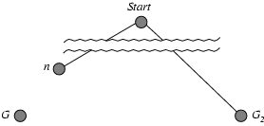
Optimality of A*
Proof:
Suppose some suboptimal goal G₂ has been generated & is on the frontier. Let n be an unexpanded node on the path to an optimal goal G
Show: f(n) < f(G₂) (so, n is expanded before G₂)
f(G₂) = g(G₂) since h(G₂) = 0
f(G) = g(G) since h(G) = 0
g(G₂) > g(G) since G₂ is suboptimal
f(G₂) > f(G) from above, with h=0
h(n) ≤ h*(n) since h is admissible (under-estimate)
g(n) + h(n) ≤ g(n) + h*(n) from above
f(n) ≤ f(G) since g(n)+h(n)=f(n) & g(n)+h*(n)=f(G)
f(n) < f(G2) from above

Slide 38
Memory-bounded heuristic search
Memory is a major limitation of A*
Usually run out of memory before run out of time
How can we solve the memory problem?
Idea: recursive best-first search (RBFS)
Try something like depth-first search, but don’t forget everything about the branches we have partially explored
Remember the best f(n) value we have found so far in the branch we’re deleting

Slide 39
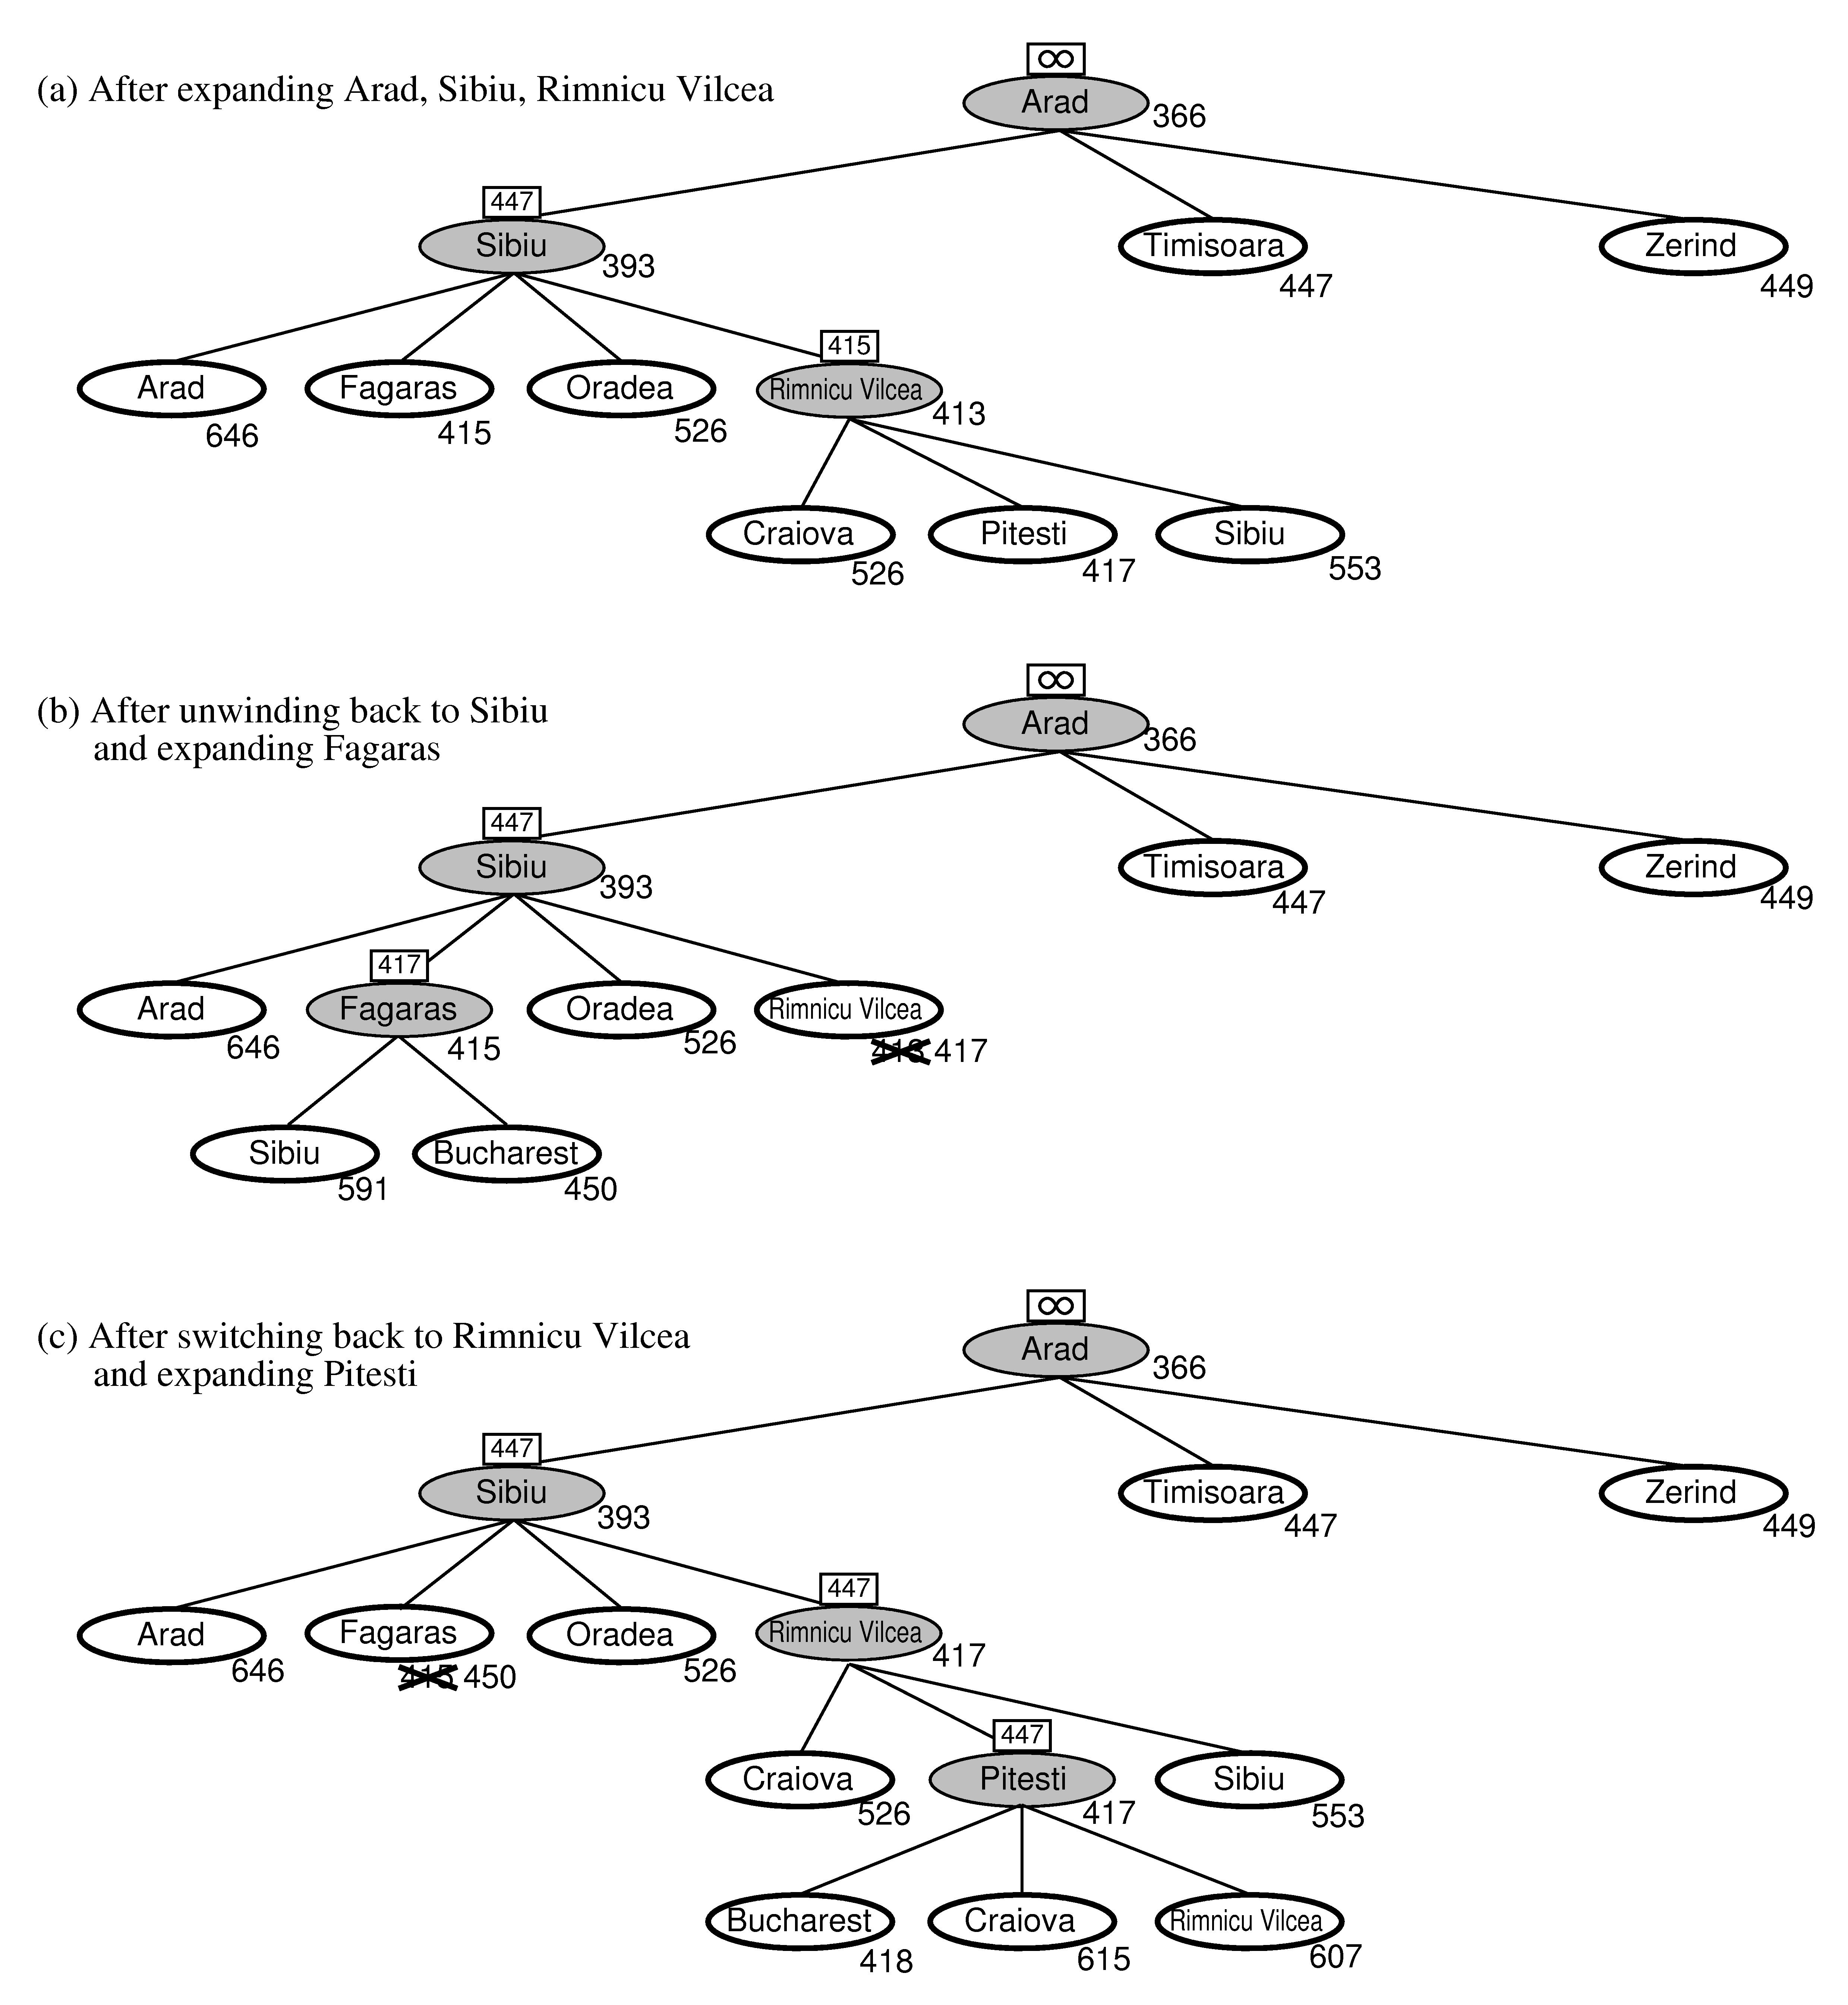
RBFS:
best alternative
over frontier nodes,
which are not children:
i.e. do I want to back up?
RBFS changes its mind
very often in practice.
This is because the
f=g+h become more
accurate (less optimistic)
as we approach the goal.
Hence, higher level nodes
have smaller f-values and
will be explored first.
Problem: We should keep
in memory whatever we can.

Slide 40
Simple Memory Bounded A* (SMA*)
Memory limited, but uses available memory well:
Like A*, but if memory full: delete the worst node (largest f-val)
Like RBFS, remember the best descendent in deleted branch
If there is a tie (equal f-values) we delete the oldest nodes first.
SMA* finds the optimal reachable solution given memory constraint.
Time can still be exponential.
Best of search algorithms we’ve seen
Using memory avoids double work; heuristic guides exploration
If memory is not a problem, basic A* is easy to code & performs well
A solution is not reachable if
a single path from root to goal
does not fit in memory

Slide 41
SMA* Pseudocode
function SMA*(problem) returns a solution sequence
inputs: problem, a problem
static: Queue, a queue of nodes ordered by f-cost
Queue ← MAKE-QUEUE({MAKE-NODE(INITIAL-STATE[problem])})
loop do
if Queue is empty then return failure
n ← deepest least-f-cost node in Queue
if GOAL-TEST(n) then return success
s ← NEXT-SUCCESSOR(n)
if s is not a goal and is at maximum depth then
f(s) ← ∞
else
f(s) ← MAX(f(n),g(s)+h(s))
if all of n’s successors have been generated then
update n’s f-cost and those of its ancestors if necessary
if SUCCESSORS(n) all in memory then remove n from Queue
if memory is full then
delete shallowest, highest-f-cost node in Queue
remove it from its parent’s successor list
insert its parent on Queue if necessary
insert s in Queue
end
Note: not in 2nd edition of R&N

Slide 42
Simple memory-bounded A* (SMA*)
(Example with 3-node memory)
maximal depth is 3, since
memory limit is 3. This
branch is now useless.
Progress of SMA*. Each node is labeled with its current f-cost. Values in parentheses show the value of the best forgotten descendant.
best forgotten node
Search space
best estimated solution
so far for that node
g+h = f
☐ = goal
A
A
13[15]
0+12=12
A
A
A
10
8
12
12
13
B
G
G
10+5=15
8+5=13
13
10
10
8
16
15
B
B
G
15
13
18
H
C
D
H
I
∞
20+5=25
16+2=18
20+0=20
24+0=24
A
A
A
10
10
8
8
15[15]
15[24]
20[24]
E
F
J
K
A
8
30+5=35
30+0=30
24+0=24
24+5=29
15
B
B
G
15
20[∞]
24[∞]
B
G
I
15
24
C
25
D
24
∞
20
Algorithm can tell you when best solution found within memory constraint is optimal or not.

Slide 43
Heuristic functions
8-Puzzle
Avg solution cost is about 22 steps
Branching factor ~ 3
Exhaustive search to depth 22 = 3.1 x 10^10 states
A good heuristic f’n can reduce the search process
True cost for this start & goal: 26
Two commonly used heuristics
h₁: the number of misplaced tiles
h₂: sum of the distances of the tiles from their goal (“Manhattan distance”)
h₁(s) = 8
h₂(s) = 3+1+2+2+2+3+3+2
= 18

Slide 44
Dominance
Definition:
If h₂(n) ≥ h₁(n) for all n
then h₂ dominates h₁
h₂ is almost always better for search than h₁
h₂ is guaranteed to expand no more nodes than h₁
h₂ almost always expands fewer nodes than h₁
Not useful unless are h₁ , h₂ are admissible / consistent
Ex: 8-Puzzle / sliding tiles
h₁: the number of misplaced tiles
h₂: sum of the distances of the tiles from their goal
h₂ dominates h₁

Slide 45
Ex: 8-Puzzle
Average number of nodes expanded
d IDS A*(h1) A*(h2)
2 10 6 6
4 112 13 12
8 6384 39 25
12 364404 227 73
14 3473941 539 113
------------ 7276 676
24 ------------ 39135 1641
Average over 100 randomly generated 8-puzzle problems
h1 = number of tiles in the wrong position
h2 = sum of Manhattan distances

Slide 46
Effective branching factor, b*
Let A* generate N nodes to find a goal at depth d
Effective branching b* is the branching factor a uniform tree of depth d would have in order to contain N+1 nodes:
For sufficiently hard problems, b* is often fairly constant across different problem instances
A good guide to the heuristic’s overall usefulness
A good way to compare different heuristics

Slide 47
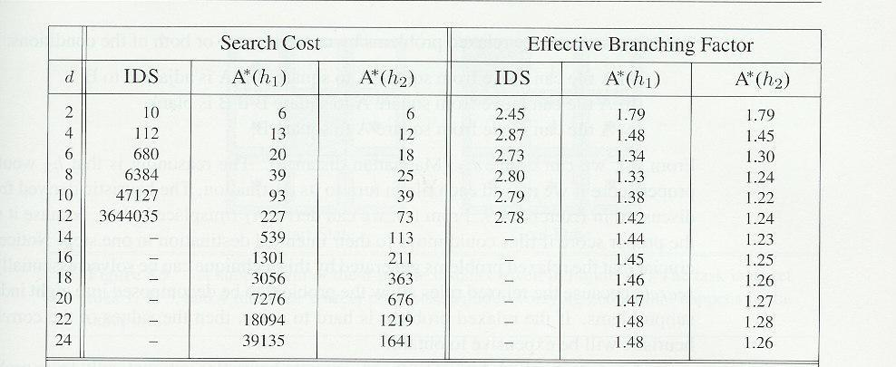
Effectiveness of heuristics
Branching factors for 8-Puzzle heuristics

Slide 48
Designing heuristics
Often constructed via problem relaxations
A problem with fewer restrictions on actions
Cost of an optimal solution to a relaxed problem is an admissible heuristic for the original problem
Ex: 8-Puzzle
Relax rules so a tile can move anywhere: h₁(n)
Relax rules so tile can move to any adjacent square: h₂(n)
A useful way to generate heuristics
Ex: ABSOLVER (Prieditis 1993) discovered the first useful heuristic for the Rubik’s cube

Slide 49
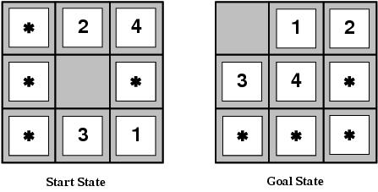
More on heuristics
Combining heuristics
H(n) = max { h1(n), h2(n), … , hk(n) }
“max” chooses the least optimistic heuristic at each node
Pattern databases
Solve a subproblem of the true problem
( = a lower bound on the cost of the true problem)
Store the exact solution for each possible subproblem

Slide 50
Pseudocode: (“Simple”) Branch and Bound
(an informed depth-first search)
Initialize: Let Q = {S}
while Q is not empty {
pull Q1, the first element in Q
if Q1 is a goal compute the cost of the solution and update
L ← minimum between new cost and old cost
else {
child_nodes = expand(Q1),
<eliminate child_nodes which represent simple loops>,
For each child node n do {
evaluate f(n).
if f(n) is greater than L discard n.
}
Put remaining child_nodes on top of queue in the order of their
evaluation function, f.
}
}

Slide 51
1
4
A
B
C
2
S
2
5
G
5
3
2
4
D
E
F
A
10.4
B
C
6.7
4.0
11.0
G
S
8.9
3.0
6.9
D
E
F

Slide 52
Branch and Bound in action
S
5 + 8.9 = 13.9
2 +10.4 = 12.4
A
D
3 + 6.7 = 9.7
B
D
4 + 8.9 = 12.9
8 + 6.9 = 14.9
C
E
E
6 + 6.9 = 12.9
Dead End
F
B
F
10 + 3.0 = 13
12 + 3.0 = 15
11 + 6.7 = 17.7
G
G
15 + 0 = 15
13 + 0 = 13

Slide 53
Properties of Branch-and-Bound
Not guaranteed to terminate unless has depth-bound
Optimal:
finds an optimal solution
Time complexity: exponential
Space complexity: can be linear

Slide 54
Pattern Databases
For sliding tiles and Rubik’s cube
For a subset of the tiles compute shortest path to the goal using breadth-first search
For 15 puzzles, if we have 7 fringe tiles and one blank, the number of patterns to store are 16!/(16-8)! = 518,918,400.
For each table entry we store the shortest number of moves to the goal from the current location.
Use different subsets of tiles and take the max heuristic during IDA* search. The number of nodes to solve 15 puzzles was reduced by a factor of 346 (Culberson and Schaeffer)
How can this be generalized?

Slide 55
Summary
Uninformed search has uses but also severe limitations
Heuristics are a structured way to make search smarter
Informed (or heuristic) search uses problem-specific heuristics to improve efficiency
Best-first, A* (and if needed for memory, RBFS, SMA*)
Techniques for generating heuristics
A* is optimal with admissible (tree) / consistent (graph heuristics
Can provide significant speed-ups in practice
Ex: 8-Puzzle, dramatic speed-up
Still worst-case exponential time complexity (NP-complete)
Next: local search techniques (hill climbing, GAs, annealing…)
Read R&N Ch 4 before next lecture

Slide 56
You should know…
evaluation function f(n) and heuristic function h(n) for each node n
g(n) = known path cost so far to node n.
h(n) = estimate of (optimal) cost to goal from node n.
f(n) = g(n)+h(n) = estimate of total cost to goal through node n.
Heuristic searches: Greedy-best-first, A*
A* is optimal with admissible (tree)/consistent (graph) heuristics
Prove that A* is optimal with admissible heuristic for tree search
Recognize when a heuristic is admissible or consistent
h₂ dominates h₁ iff h₂(n) ≥ h₁(n) for all n
Effective branching factor: b*
Inventing heuristics: relaxed problems; max or convex combination

