Slide 1
First-Order Logic Semantics & Inference
Review Chapters 8.3-8.5,
Read 9.1-9.2 (optional: 9.5)
Next Lecture
Read Chapters 13, 14.1-14.5

Slide 2
You will be expected to know
Semantics, Worlds, and Interpretations
Nested quantifiers
Difference between “∀ x ∃ y P(x, y)” and “∃ x ∀ y P(x, y)”
∀ x { ∃ y Person(x) ⇒ Likes(x, y) }
= Every person (every person x) likes something (likes some y).
Can be a different y for each x (think about variable scope!)
∃ x { ∀ y Person(x) ∧ Likes(x, y) }
= There is some person (some x) that likes everything (every y).
Must be the same x for every y (think about variable scope!)
Translate simple English sentences to FOPC and back
∀ x ∃ y Likes(x, y) = “Every person has some person that they like.”
∃ x ∀ y Likes(x, y) = “There is some person who likes every person.”
Technically, there should be Person(x) & Person(y) predicates above
Unification: Given two FOL terms containing variables
Find the most general unifier if one exists.
Else, explain why no unification is possible.
See Section 9.2 and Figure 9.1 in your textbook.

Slide 3
Outline
Review: KB |= S is equivalent to |= (KB ⇒ S)
So what does {} |= S mean?
Review: Follows, Entails, Derives
Follows: “Is it the case?”
Entails: “Is it true?”
Derives: “Is it provable?”
Semantics of FOL (FOPC)
Model, Interpretation
Unification

Slide 4
FOL (or FOPC) Ontology:
What kind of things exist in the world?
What do we need to describe and reason about?
Objects --- with their relations, functions, predicates, properties, and general rules.
Reasoning
Representation
-------------------
A Formal Symbol System
Inference
---------------------
Formal Pattern Matching
Syntax
---------
What is said
Semantics
-------------
What it means
Schema
-------------
Rules of Inference
Execution
-------------
Search Strategy
Previous lecture

Slide 5
Review: KB |= S means |= (KB ⇒ S)
KB |= S is read “KB entails S.”
Means “S is true in every world (model) in which KB is true.”
Means “In the world, S follows from KB.”
KB |= S is equivalent to |= (KB ⇒ S)
Means “(KB ⇒ S) is true in every world (i.e., is valid).”
And so: {} |= S is equivalent to |= ({} ⇒ S)
So what does ({} ⇒ S) mean?
Means “True implies S.”
Means “S is valid.”
In Horn form, means “S is a fact.” p. 256 (R&N 3rd ed..)

Slide 6
Review: (True ⇒ S) means “S is a fact.”
By convention,
The null conjunct is “syntactic sugar” for True.
The null disjunct is “syntactic sugar” for False.
Each is assigned the truth value of its identity element.
For conjuncts, True is the identity: (A ∧ True) ≡ A
For disjuncts, False is the identity: (A ∨ False) ≡ A
A KB is the conjunction of all of its sentences.
So in the expression: {} |= S
We see that {} is the null conjunct and means True.
The expression means “S is true in every world where True is true.”
I.e., “S is valid.”
Better way to think of it: {} does not exclude any worlds (models).
In Conjunctive Normal Form each clause is a disjunct.
So in, say, KB = { (P Q) (¬Q R) ( ) (X Y ¬Z) }
We see that ( ) is the null disjunct and means False.

Slide 7
Side Trip: Functions AND, OR, and null values (Note: These are “syntactic sugar” in logic.)
function AND(arglist) returns a truth-value
return ANDOR(arglist, True)
function OR(arglist) returns a truth-value
return ANDOR(arglist, False)
function ANDOR(arglist, nullvalue) returns a truth-value
/* nullvalue is the identity element for the caller. */
if (arglist = {})
then return nullvalue
if ( FIRST(arglist) = NOT(nullvalue) )
then return NOT(nullvalue)
return ANDOR( REST(arglist), nullvalue )

Slide 8
Side Trip: We only need one logical connective. (Note: AND, OR, NOT are “syntactic sugar” in logic.)
Both NAND and NOR are logically complete.
NAND is also called the “Sheffer stroke”
NOR is also called “Pierce’s arrow”
(NOT A) = (NAND A TRUE) = (NOR A FALSE)
(AND A B) = (NAND TRUE (NAND A B))
= (NOR (NOR A FALSE) (NOR B FALSE))
(OR A B) = (NAND (NAND A TRUE) (NAND B TRUE))
=(NOR FALSE (NOR A B))
This fact is exploited by, e.g., VLSI semiconductor fabrication, which often provide a single NAND/NOR gate for efficiency.

Slide 9
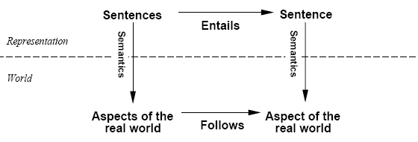
Review: Schematic for Follows, Entails, and Derives
Derives
Inference
Sentences
Sentence
If KB is true in the real world,
then any sentence α entailed by KB
and any sentence α derived from KB
by a sound inference procedure
is also true in the real world.

Slide 10
Schematic Example: Follows, Entails, and Derives
“Mary is Sue’s sister and Sue is Amy’s parent.”
Derives
We can generate a proof:
“Mary is Amy’s aunt.”
Inference
“An aunt is a sister of a parent.”
Is it provable?
“Mary is Sue’s sister and Sue is Amy’s parent.”
Entails
It is necessarily true:
“Mary is Amy’s aunt.”
Representation
“An aunt is a sister of a parent.”
Is it true?
Mary
Sister
Sue
Mary
Follows
World
Parent
Is it the case?
Aunt
Amy
Amy

Slide 11
Building a more expressive language
Want to develop a better, more expressive language:
Needs to refer to objects in the world,
Needs to express general rules
On(x,y) à ~ clear(y)
All men are mortal
Everyone over age 21 can drink
One student in this class got a perfect score
Etc….
First order logic, or “predicate calculus” allows more expressiveness

Slide 12
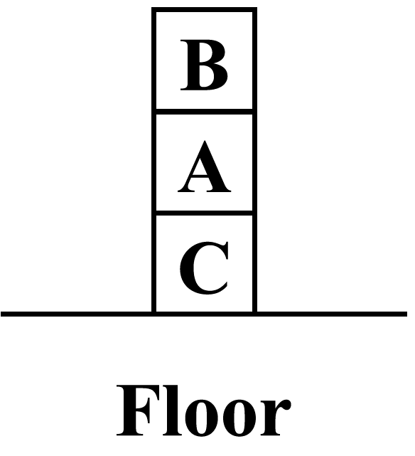
Example: “Blocks World” (abbreviated)
This is the world of children’s alphabet blocks. A robot may stack a clear block on top of a another clear block, or move a clear block to the floor
This is an abbreviated example, meant only to present the main ideas as a sketch of First Order Logic in action, so as to motivate intuitions. Several important frame and background axioms are omitted, for clarity.

Slide 13
Example: “Blocks World” (abbreviated)
This example is abbreviated because it omits the axiom that states
x Clear(x) ⇔
y ¬ On(y, x)
Ontology
Object constants: Floor; blocks A, B, C
Timestep integer t
Predicates: On(x,y, t), Clear(x, t), Block(x), Move(x, y, t)
This example is abbreviated because it omits the “frame axioms” that state that anything not changed by the action at time=t persists unchanged into time =t+1.

Slide 14
Example: “Blocks World” (abbreviated)
This example is abbreviated for the reasons mentioned above It is only a cartoon sketch, in order to motivate intuition.
Ontology
Object constants: Floor; blocks A, B, C
Timestep integer t
Predicates: On(x,y, t), Clear(x, t), Block(x), Move(x, y, t)
Laws of Physics” (abbreviated)
∀ t Clear(Floor, t)
∀ x, y, z, t Clear(x, t) ^ On(x, y, t)
^ Clear(z, t) ^ Block(z) ^ Move(x, z, t)
⇒ On(x, z, t+1) ^ ¬ On(x, y, t+1) ^ Clear(x, t+1)
^ Clear (y, t+1)^ ¬ Clear(z, t+1)
∀ x, y, t Clear(x, t) ^ On(x, y, t) ^ Block(y)
^ Move(x, Floor, t)
⇒ On(x, Floor, t+1) ^ Clear(x, t+1) ^ Clear (y, t+1)
^ ¬ On(x, y, t+1)
These axioms are set up to prevent the system from moving a block from the Floor to another place on the Floor, which would be a useless action.

Slide 15
Example: “Blocks World” (abbreviated)
This example is abbreviated for the reasons mentioned above It is only a cartoon sketch, in order to motivate intuition.
Ontology
Object constants: Floor; blocks A, B, C
Timestep integer t
Predicates: On(x,y, t), Clear(x, t), Block(x), Move(x, y, t)
Laws of Physics” (abbreviated)
∀ t Clear(Floor, t)
∀ x, y, z, t Clear(x, t) ^ On(x, y, t)
^ Clear(z, t) ^ Block(z) ^ Move(x, z, t)
⇒ On(x, z, t+1) ^ ¬ On(x, y, t+1) ^ Clear(x, t+1)
^ Clear (y, t+1)^ ¬ Clear(z, t+1)
∀ x, y, t Clear(x, t) ^ On(x, y, t) ^ Block(y)
^ Move(x, Floor, t)
⇒ On(x, Floor, t+1) ^ Clear(x, t+1) ^ Clear (y, t+1)
^ ¬ On(x, y, t+1)
Specific Problem Instance
On(B, A, 0) ^ On(A, C, 0) ^ On(C, Floor, 0) ^ (Clear(B, 0)

Slide 16
Example: “Blocks World” (abbreviated)
Start State
On(C, Floor, 0) ^ On(A, C, 0) ^ On(B, A, 0) ^ (Clear(B, 0)
Goal State
∃ t On(A, Floor, t) ^ On(B, A, t) ^ On(C, B, t) ^ Clear(C, t)
C
This example is abbreviated for the reasons mentioned above It is only a cartoon sketch, in order to motivate intuition.
B
A
Floor
Start State
Goal State

Slide 17
Example: “Blocks World” (abbreviated)
This example is abbreviated for the reasons mentioned above. It is only a cartoon sketch, in order to motivate intuition.
B
A
A
C
C
B
Floor
(t=0)
Floor (t=1)
Start State (t=0)
On(B, A, 0) ^ On(A, C, 0) ^ On(C, Floor, 0) ^ Clear(B, 0)
Action = Move(B, Floor, 0) [assume derived as part of some proof]
“Laws of Physics” after unification {x/B, y/A, t/0}
Clear(B, 0) ^ On(B, A, 0) ^ Block(A) ^ Move(B, Floor, 0)
⇒ On(B, Floor, 1) ^ Clear(B, 1) ^ Clear (A, 1) ^ ¬ On(B, A, 1)
Resulting State (t=1)
On(B, Floor, 1) ^ On(A, C, 1) ^ On(C, Floor, 1) ^ (Clear(B, 1)
^ (Clear(A, 1) ^ ¬ On(B, A, 1)

Slide 18
Example: “Blocks World” (abbreviated)
This example is abbreviated for the reasons mentioned above. It is only a cartoon sketch, in order to motivate intuition.
A
C
B
C
B
A
Floor (t=1)
Floor (t=2)
Previous State (t=1)
On(B, Floor, 1) ^ On(A, C, 1) ^ On(C, Floor, 1) ^ (Clear(B, 1)^ (Clear(A, 1) ^ ¬ On(B, A, 1)
Action = Move(A, Floor, 1) [assume derived as part of some proof]
“Laws of Physics” after unification {x/A, y/C, t/1}
Clear(A, 1) ^ On(A, C, 1) ^ Block(A) ^ Move(A, Floor, 1)
On(A, Floor, 2) ^ Clear(C, 2) ^ Clear (B, 2)^ Clear (A, 2)
^ ¬ On(A, C, 2)
Resulting State (t=2)
On(A, Floor, 2) ^ On(B, Floor, 2) ^ On(C, Floor, 2) ^ (Clear(A, 2)
^ (Clear(B, 2) ^ (Clear(C, 2) ^ ¬ On(B, A, 2) ^ ¬ On(A, C, 2)

Slide 19
Example: “Blocks World” (abbreviated)
This example is abbreviated for the reasons mentioned above. It is only a cartoon sketch, in order to motivate intuition.
B
C
B
A
A
C
Floor (t=2)
Floor (t=3)
Previous State (t=2)
On(A, Floor, 2) ^ On(B, Floor, 2) ^ On(C, Floor, 2)^ (Clear(A, 2) ^ (Clear(B, 2) ^ (Clear(C, 2) ^ ¬ On(B, A, 2) ^ ¬ On(A, C, 2)
Action = Move(B, A, 2) [assume derived as part of some proof]
“Laws of Physics” after unification {x/B, y/Floor, z/A, t/2}
Clear(B, 2) ^ On(A, Floor, 2) ^ Clear(A, 2) ^ Block(A) ^ Move(B, A, 2)
⇒ On(B, A, 3) ^ ¬ On(B, Floor, 3) ^ Clear(B. 3)
^ Clear (Floor, 3)^ ¬ Clear(A, 3)
Resulting State (t=3)
On(A, Floor, 3) ^ On(B, A, 3) ^ On(C, Floor, 3) ^ ¬(Clear(A, 3)
^ (Clear(B, 3) ^ (Clear(C, 3)

Slide 20
Example: “Blocks World” (abbreviated)
This example is abbreviated for the reasons mentioned above. It is only a cartoon sketch, in order to motivate intuition.
B
C
A
C
B
A
Floor (t=3)
Floor (t=4)
Previous State (t=3)
On(A, Floor, 3) ^ On(B, A, 3) ^ On(C, Floor, 3) ^ ¬(Clear(A, 3)
^ (Clear(B, 3) ^ (Clear(C, 3)
Action = Move(C, B, 3) [assume derived as part of some proof]
“Laws of Physics” after unification {x/C, y/Floor, z/B, t/3}
Clear(C, 3) ^ On(C, Floor, 3) ^ Clear(B, 3) ^ Block(B) ^ Move(C, B, 3)
⇒ On(C, B, 4) ^ ¬ On(C, Floor, 4) ^ Clear(C. 4)
^ Clear (Floor, 4)^ ¬ Clear(B, 4)
Resulting State (t=4)
On(A, Floor, 4) ^ On(B, A, 4) ^ On(C, B, 4) ^ ¬(Clear(A, 4)
^ ¬(Clear(B, 4) ^ (Clear(C, 4) ^ (Clear(Floor, 4)

Slide 21
Semantics: Worlds
The world consists of objects that have properties.
There are relations and functions between these objects
Objects in the world, individuals: people, houses, numbers, colors, baseball games, wars, centuries
Clock A, John, 7, the-house in the corner, Tel-Aviv
Functions on individuals:
father-of, best friend, third inning of, one more than
Relations:
brother-of, bigger than, inside, part-of, has color, occurred after
Properties (a relation of arity 1):
red, round, bogus, prime, multistoried, beautiful

Slide 22
Semantics: Interpretation
An interpretation of a sentence (wff) is an assignment that maps
Object constants to objects in the worlds,
n-ary function symbols to n-ary functions in the world,
n-ary relation symbols to n-ary relations in the world
Given an interpretation, an atomic sentence has the value “true” if it denotes a relation that holds for those individuals denoted in the terms. Otherwise it has the value “false”
Example: Block world:
A,B,C,floor, On, Clear
World:
On(A,B) is false, Clear(B) is true, On(C,Floor) is true…

Slide 23
Truth in first-order logic
Sentences are true with respect to a model and an interpretation
Model contains objects (domain elements) and relations among them
Interpretation specifies referents for
constant symbols → objects
predicate symbols → relations
function symbols → functional relations
An atomic sentence predicate(term₁,...,term_{n}) is true
iff the objects referred to by term₁,...,term_{n}
are in the relation referred to by predicate

Slide 24
FOL Models and Interpretations
We say m is a model given an interpretation i of a sentence α if and only if α is true in the world m under the mapping i.
Your job, as knowledge engineers, is to ensure that *only* your intended worlds and interpretations make your KB true.
In the circuit world, you Tell it: “(1 not= 0)”.
In the biology world, you Tell it : “∀x (Cat(x) ⇒ Mammal(x) )”
If you fail to Tell it these facts, then it will make stupid inferences that you will have to come back later and debug, to fix your KB.
You know *all* these things. KB only knows what you Tell it.

Slide 25
Review: Models (and in FOL, Interpretations)
Models are formal worlds within which truth can be evaluated
Interpretations map symbols in the logic to the world
Constant symbols in the logic map to objects in the world
n-ary functions/predicates map to n-ary functions/predicates in the world
We say m is a model given an interpretation i of a sentence α if and only if α is true in the world m under the mapping i.
M(α) is the set of all models of α
Then KB ╞ α iff M(KB) ⊆ M(α)
E.g. KB, = “Mary is Sue’s sister and Amy is Sue’s daughter.”
α = “Mary is Amy’s aunt.” (Must Tell it about mothers/daughters)
Think of KB and α as constraints, and models as states.
M(KB) are the solutions to KB and M(α) the solutions to α.
Then, KB ╞ α, i.e., ╞ (KB ⇒ a) ,
when all solutions to KB are also solutions to α.

Slide 26
Review: Semantics of Worlds
The world consists of objects that have properties.
There are relations and functions between these objects
Objects in the world, individuals: people, houses, numbers, colors, baseball games, wars, centuries
Clock A, John, 7, the-house in the corner, Tel-Aviv, Ball43
Functions on individuals:
father-of, best-friend, third-inning-of, one-more-than
Relations:
brother-of, bigger-than, inside, part-of, has-color,
occurred-after
Properties (a relation of arity 1):
red, round, bogus, prime, multistoried, beautiful

Slide 27
Semantics: Interpretation
An interpretation of a sentence (wff) is an assignment that maps
Object constant symbols to objects in the world,
n-ary function symbols to n-ary functions in the world,
n-ary relation symbols to n-ary relations in the world
Given an interpretation, an atomic sentence has the value “true” if it denotes a relation that holds for those individuals denoted in the terms. Otherwise it has the value “false.”
Example: Kinship world:
Symbols = Ann, Bill, Sue, Married, Parent, Child, Sibling, …
World consists of individuals in relations:
Married(Ann,Bill) is false, Parent(Bill,Sue) is true, …
Your job, as a Knowledge Engineer, is to construct KB so it is true *exactly* for your world and intended interpretation.

Slide 28
Truth in first-order logic
Sentences are true with respect to a model and an interpretation
Model contains objects (domain elements) and relations among them
Interpretation specifies referents for
constant symbols → objects
predicate symbols → relations
function symbols → functional relations
An atomic sentence predicate(term₁,...,term_{n}) is true
iff the objects referred to by term₁,...,term_{n}
are in the relation referred to by predicate

Slide 29
Semantics: Models and Definitions
An interpretation and possible world satisfies a wff (sentence) if the wff has the value “true” under that interpretation in that possible world.
Model: A domain and an interpretation that satisfies a wff is a model of that wff
Validity: Any wff that has the value “true” in all possible worlds and under all interpretations is valid.
Any wff that does not have a model under any interpretation is inconsistent or unsatisfiable.
Any wff that is true in at least one possible world under at least one interpretation is satisfiable.
If a wff w has a value true under all the models of a set of sentences KB then KB logically entails w.

Slide 30
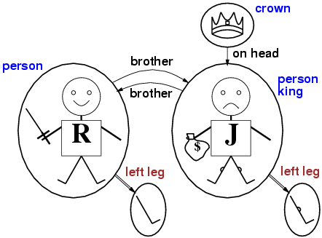
Models for FOL: Example
All possible interpretations will map all of these symbols in the logic onto symbols in the domain in all possible ways.
An interpretation maps all symbols in KB onto matching symbols in a possible world. All possible interpretations gives a combinatorial explosion of mappings. Your job, as a Knowledge Engineer, is to write the axioms in KB so they are satisfied only under the intended interpretation in your own real world.

Slide 31
Summary of FOL Semantics
A well-formed formula (“wff”) FOL is true or false with respect to a world and an interpretation (a model).
The world has objects, relations, functions, and predicates.
The interpretation maps symbols in the logic to the world.
The wff is true if and only if (iff) its assertion holds among the objects in the world under the mapping by the interpretation.
Your job, as a Knowledge Engineer, is to write sufficient KB axioms that ensure that KB is true in your own real world under your own intended interpretation.
The KB axioms must rule out other worlds and interpretations.

Slide 32
Conversion to CNF
Everyone who loves all animals is loved by someone:
∀x [∀y Animal(y) ⇒ Loves(x,y)] ⇒ [∃y Loves(y,x)]
Eliminate biconditionals and implications
∀x [¬∀y ¬Animal(y) ∨ Loves(x,y)] ∨ [∃y Loves(y,x)]
2. Move ¬ inwards:
¬∀x p ≡ ∃x ¬p, ¬ ∃x p ≡ ∀x ¬p
∀x [∃y ¬(¬Animal(y) ∨ Loves(x,y))] ∨ [∃y Loves(y,x)]
∀x [∃y ¬¬Animal(y) ∧ ¬Loves(x,y)] ∨ [∃y Loves(y,x)]
∀x [∃y Animal(y) ∧ ¬Loves(x,y)] ∨ [∃y Loves(y,x)]

Slide 33
Conversion to CNF contd.
Standardize variables: each quantifier should use a different variable
∀x [∃y Animal(y) ∧ ¬Loves(x,y)] ∨ [∃z Loves(z,x)]
Skolemize: a more general form of existential instantiation. Each existential variable is replaced by a Skolem function of the enclosing universally quantified variables:
∀x [Animal(F(x)) ∧ ¬Loves(x,F(x))] ∨ Loves(G(x),x)
Drop universal quantifiers:
[Animal(F(x)) ∧ ¬Loves(x,F(x))] ∨ Loves(G(x),x)
Distribute ∨ over ∧ :
[Animal(F(x)) ∨ Loves(G(x),x)] ∧ [¬Loves(x,F(x)) ∨ Loves(G(x),x)]

Slide 34
Unification
Recall: Subst(θ, p) = result of substituting θ into sentence p
Unify algorithm: takes 2 sentences p and q and returns a unifier if one exists
Unify(p,q) = θ where Subst(θ, p) = Subst(θ, q)
Example:
p = Knows(John,x)
q = Knows(John, Jane)
Unify(p,q) = {x/Jane}

Slide 35
Unification examples
simple example: query = Knows(John,x), i.e., who does John know?
p q θ
Knows(John,x) Knows(John,Jane) {x/Jane}
Knows(John,x) Knows(y,OJ) {x/OJ,y/John}
Knows(John,x) Knows(y,Mother(y)) {y/John,x/Mother(John)}
Knows(John,x) Knows(x,OJ) {fail}
Last unification fails: only because x can’t take values John and OJ at the same time
But we know that if John knows x, and everyone (x) knows OJ, we should be able to infer that John knows OJ
Problem is due to use of same variable x in both sentences
Simple solution: Standardizing apart eliminates overlap of variables, e.g., Knows(z,OJ)

Slide 36
Unification
To unify Knows(John,x) and Knows(y,z),
θ = {y/John, x/z } or θ = {y/John, x/John, z/John}
The first unifier is more general than the second.
There is a single most general unifier (MGU) that is unique up to renaming of variables.
MGU = { y/John, x/z }
General algorithm in Figure 9.1 in the text

Slide 37
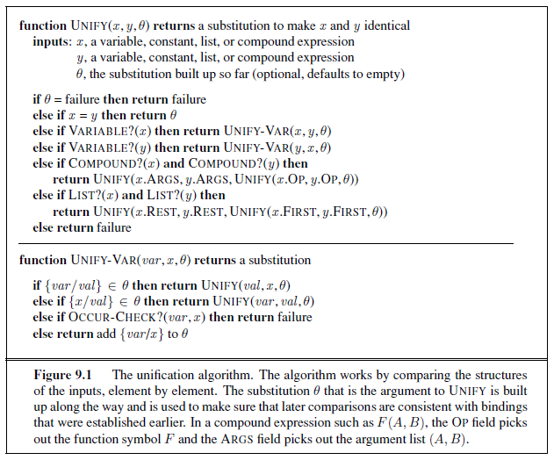
Unification Algorithm

Slide 38
Unification Algorithm
If we have failed or succeeded, then fail or succeed.

Slide 39
Unification Algorithm
If we can unify a variable
then do so.

Slide 40
Unification Algorithm
If we already have bound variable var to a value, try to continue on that basis.
There is an implicit assumption that “{var/val} ∈ θ”, if it succeeds, binds val to the value that allowed it to succeed,

Slide 41
Unification Algorithm
If we already have bound x to a value, try to continue on that basis.

Slide 42
Unification Algorithm
If var occurs anywhere within x, then no substitution will succeed.

Slide 43
Unification Algorithm
Else, try to bind var to x, and recurse.

Slide 44
Unification Algorithm
If a predicate/function,
unify the arguments.

Slide 45
Unification Algorithm
If unifying arguments,
unify the remaining arguments.

Slide 46
Unification Algorithm
Otherwise, fail.

Slide 47
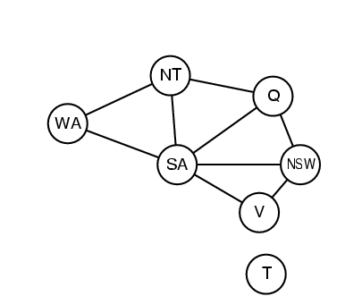
Hard matching example
Diff(wa,nt) ∧ Diff(wa,sa) ∧ Diff(nt,q) ∧ Diff(nt,sa) ∧ Diff(q,nsw) ∧ Diff(q,sa) ∧ Diff(nsw,v) ∧ Diff(nsw,sa) ∧ Diff(v,sa) ⇒ Colorable()
Diff(Red,Blue) Diff (Red,Green) Diff(Green,Red) Diff(Green,Blue) Diff(Blue,Red) Diff(Blue,Green)
To unify the grounded propositions with premises of the implication you need to solve a CSP!
Colorable() is inferred iff the CSP has a solution
CSPs include 3SAT as a special case, hence matching is NP-hard

Slide 48
Resolution: brief summary
Full first-order version:
l₁ ∨ ··· ∨ l_{k}, m₁ ∨ ··· ∨ m_{n}
(l₁ ∨ ··· ∨ l_{i-1} ∨ l_{i+1} ∨ ··· ∨ l_{k} ∨ m₁ ∨ ··· ∨ m_{j-1} ∨ m_{j+1} ∨ ··· ∨ m_{n})θ
where Unify(l_{i}, ¬m_{j}) = θ.
The two clauses are assumed to be standardized apart so that they share no variables.
For example,
¬Rich(x) ∨ Unhappy(x)
Rich(Ken)
Unhappy(Ken)
with θ = {x/Ken}
Apply resolution steps to CNF(KB ∧ ¬α); complete for FOL

Slide 49
Example knowledge base
The law says that it is a crime for an American to sell weapons to hostile nations. The country Nono, an enemy of America, has some missiles, and all of its missiles were sold to it by Colonel West, who is American.
Prove that Col. West is a criminal

Slide 50
Example knowledge base (Horn clauses)
... it is a crime for an American to sell weapons to hostile nations:
American(x) ∧ Weapon(y) ∧ Sells(x,y,z) ∧ Hostile(z) ⇒ Criminal(x)
Nono … has some missiles, i.e., ∃x Owns(Nono,x) ∧ Missile(x):
Owns(Nono,M₁) ∧ Missile(M₁)
… all of its missiles were sold to it by Colonel West
Missile(x) ∧ Owns(Nono,x) ⇒ Sells(West,x,Nono)
Missiles are weapons:
Missile(x) ⇒ Weapon(x)
An enemy of America counts as "hostile“:
Enemy(x,America) ⇒ Hostile(x)
West, who is American …
American(West)
The country Nono, an enemy of America …
Enemy(Nono,America)

Slide 51
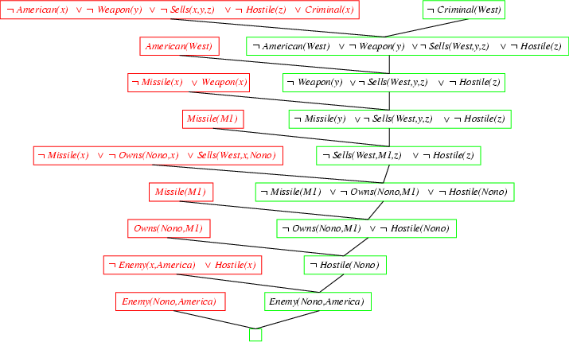
Resolution proof:
~

Slide 52
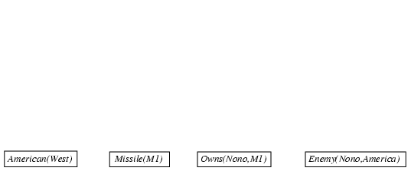
Forward chaining proof: (Horn clauses)

Slide 53
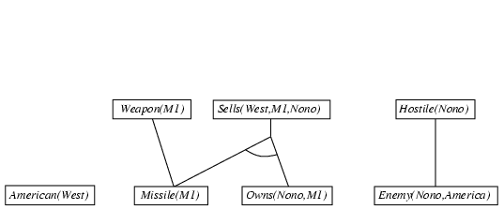
Forward chaining proof (Horn clauses)
Enemy(x,America) ⇒ Hostile(x)
Missile(x) ∧ Owns(Nono,x) ⇒ Sells(West,x,Nono)
Missile(x) ⇒ Weapon(x)

Slide 54
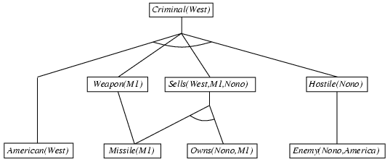
Forward chaining proof (Horn clauses)
American(x) ∧ Weapon(y) ∧ Sells(x,y,z) ∧ Hostile(z) ⇒ Criminal(x)

Slide 55
Forward chaining proof (Horn clauses)
*American(x) ∧ Weapon(y) ∧ Sells(x,y,z) ∧ Hostile(z) ⇒ Criminal(x)
*Owns(Nono,M1) and Missile(M1)
*Missile(x) ∧ Owns(Nono,x) ⇒ Sells(West,x,Nono)
*Missile(x) ⇒ Weapon(x)
*Enemy(x,America) ⇒ Hostile(x)
*American(West)
*Enemy(Nono,America)

Slide 56
Backward chaining example (Horn clauses)

Slide 57
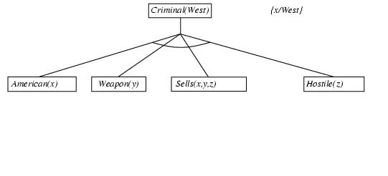
Backward chaining example (Horn clauses)

Slide 58
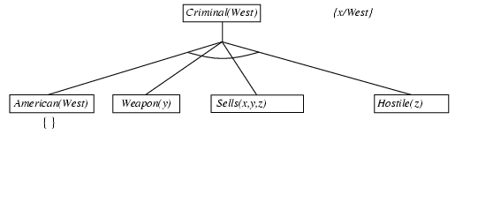
Backward chaining example (Horn clauses)

Slide 59
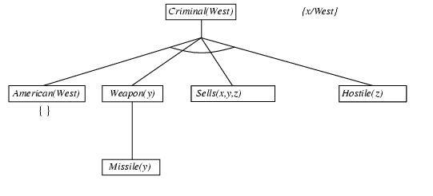
Backward chaining example (Horn clauses)

Slide 60
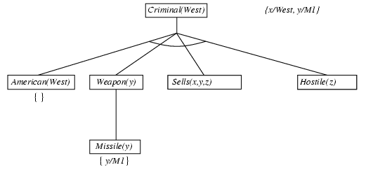
Backward chaining example (Horn clauses)

Slide 61
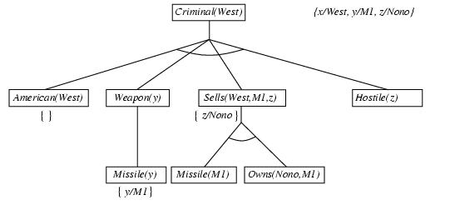
Backward chaining example (Horn clauses)

Slide 62
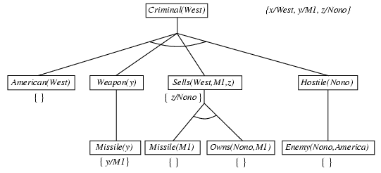
Backward chaining example (Horn clauses)

Slide 63
FOL (or FOPC) Ontology:
What kind of things exist in the world?
What do we need to describe and reason about?
Objects --- with their relations, functions, predicates, properties, and general rules.
Reasoning
Representation
-------------------
A Formal Symbol System
Inference
---------------------
Formal Pattern Matching
Syntax
---------
What is said
Semantics
-------------
What it means
Schema
-------------
Rules of Inference
Execution
-------------
Search Strategy

Slide 64
Summary
First-order logic:
Much more expressive than propositional logic
Allows objects and relations as semantic primitives
Universal and existential quantifiers
Syntax: constants, functions, predicates, equality, quantifiers
Nested quantifiers
Translate simple English sentences to FOPC and back
Semantics: correct under any interpretation and in any world
Unification: Making terms identical by substitution
The terms are universally quantified, so substitutions are justified.

