Slide 1
Mid-term Review
Chapters 2-5, 13, 14
Review Agents (2.1-2.3)
Review State Space Search
  Problem Formulation (3.1, 3.3)
  Blind (Uninformed) Search (3.4)
  Heuristic Search (3.5)
  Local Search (4.1, 4.2)
Review Adversarial (Game) Search (5.1-5.4)
Review Probability & Bayesian Networks (13, 14.1-14.5)
Please review your quizzes and old CS-171 tests
  At least one question from a prior quiz or old CS-171 test will appear on the mid-term (and all other tests)

Slide 2
Review Agents
Chapter 2.1-2.3
Agent definition (2.1)
Rational Agent definition (2.2)
  Performance measure
Task evironment definition (2.3)
  PEAS acronym

Slide 3
Agents
An agent is anything that can be viewed as perceiving its environment through sensors and acting upon that environment through actuators
Human agent:
eyes, ears, and other organs for sensors;
hands, legs, mouth, and other body parts for
actuators
Robotic agent:
cameras and infrared range finders for sensors; various motors for actuators

Slide 4
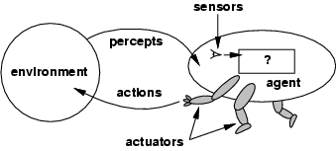
Agents and environments
Percept: agent’s perceptual inputs at an instant
The agent function maps from percept sequences to actions: [f: P* → A]
The agent program runs on the physical architecture to produce f
agent = architecture + program

Slide 5
Rational agents
Rational Agent: For each possible percept sequence, a rational agent should select an action that is expected to maximize its performance measure, based on the evidence provided by the percept sequence and whatever built-in knowledge the agent has.
Performance measure: An objective criterion for success of an agent's behavior (“cost”, “reward”, “utility”)
E.g., performance measure of a vacuum-cleaner agent could be amount of dirt cleaned up, amount of time taken, amount of electricity consumed, amount of noise generated, etc.

Slide 6
Task Environment
Before we design an intelligent agent, we must specify its “task environment”:
PEAS:
Performance measure
Environment
Actuators
Sensors

Slide 7
PEAS
Example: Agent = Part-picking robot
Performance measure: Percentage of parts in correct bins
Environment: Conveyor belt with parts, bins
Actuators: Jointed arm and hand
Sensors: Camera, joint angle sensors

Slide 8
Environment types
Fully observable (vs. partially observable): An agent's sensors give it access to the complete state of the environment at each point in time.
Deterministic (vs. stochastic): The next state of the environment is completely determined by the current state and the action executed by the agent. (If the environment is deterministic except for the actions of other agents, then the environment is strategic)
Episodic (vs. sequential): An agent’s action is divided into atomic episodes. Decisions do not depend on previous decisions/actions.
Known (vs. unknown): An environment is considered to be "known" if the agent understands the laws that govern the environment's behavior.

Slide 9
Environment types
Static (vs. dynamic): The environment is unchanged while an agent is deliberating. (The environment is semidynamic if the environment itself does not change with the passage of time but the agent's performance score does)
Discrete (vs. continuous): A limited number of distinct, clearly defined percepts and actions.
  How do we represent or abstract or model the world?
Single agent (vs. multi-agent): An agent operating by itself in an environment. Does the other agent interfere with my performance measure?

Slide 10
Review State Space Search
Chapters 3-4
  Problem Formulation (3.1, 3.3)
  Blind (Uninformed) Search (3.4)
    Depth-First, Breadth-First, Iterative Deepening
    Uniform-Cost, Bidirectional (if applicable)
    Time? Space? Complete? Optimal?
  Heuristic Search (3.5)
    A*, Greedy-Best-First
  Local Search (4.1, 4.2)
    Hill-climbing, Simulated Annealing, Genetic Algorithms
    Gradient descent

Slide 11
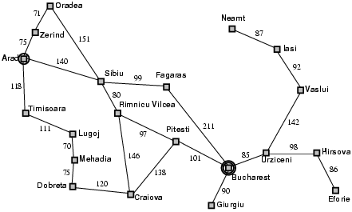
Problem Formulation
A problem is defined by five items:
initial state, e.g., "at Arad“
actions
  Actions(X) = set of actions available in State X
transition model
  Result(S,A) = state resulting from doing action A in state S
goal test, e.g., x = "at Bucharest”, Checkmate(x)
path cost (additive, i.e., the sum of the step costs)
  c(x,a,y) = step cost of action a in state x to reach state y
    assumed to be ≥ 0
A solution is a sequence of actions leading from the initial state to a goal state

Slide 12
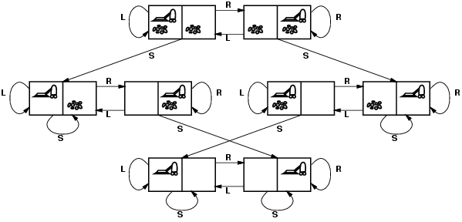
Vacuum world state space graph
states? discrete: dirt and robot locations
initial state? any
actions? Left, Right, Suck
transition model? as shown on graph
goal test? no dirt at all locations
path cost? 1 per action

Slide 13
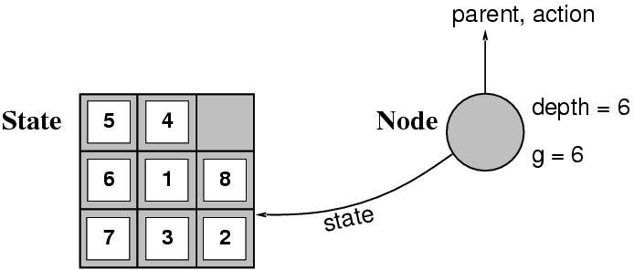
Implementation: states vs. nodes
A state is a (representation of) a physical configuration
A node is a data structure constituting part of a search tree
A node contains info such as:
  state, parent node, action, path cost g(x), depth, etc.
The Expand function creates new nodes, filling in the various fields using the Actions(S) and Result(S,A)functions associated with the problem.

Slide 14
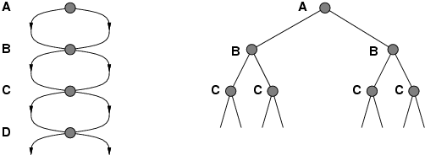
Tree search vs. Graph search
Review Fig. 3.7, p. 77
Failure to detect repeated states can turn a linear problem into an exponential one!
Test is often implemented as a hash table.

Slide 15
Solutions to Repeated States
S
B
S
B
C
C
C
S
B
S
State Space
Example of a Search Tree
Graph search
  never generate a state generated before
    must keep track of all possible states (uses a lot of memory)
    e.g., 8-puzzle problem, we have 9! = 362,880 states
    approximation for DFS/DLS: only avoid states in its (limited) memory: avoid infinite loops by checking path back to root.
  “visited?” test usually implemented as a hash table
faster, but memory inefficient

Slide 16
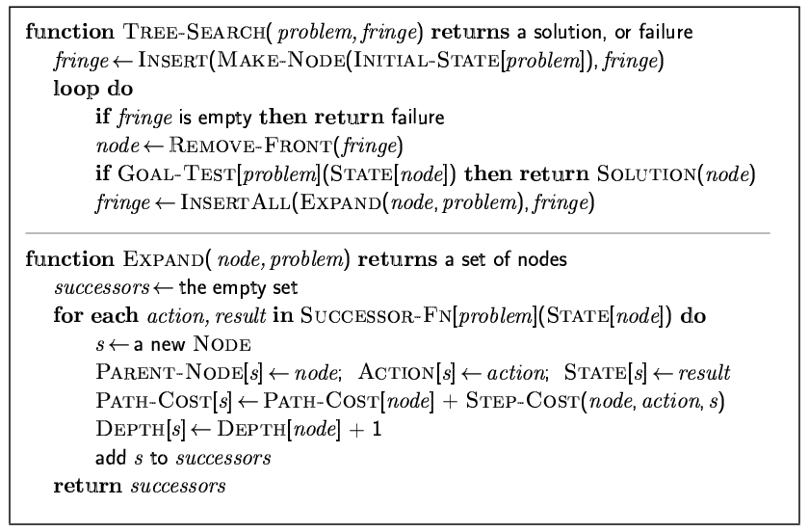
General tree search
Do not remember visited nodes
Goal test after pop

Slide 17
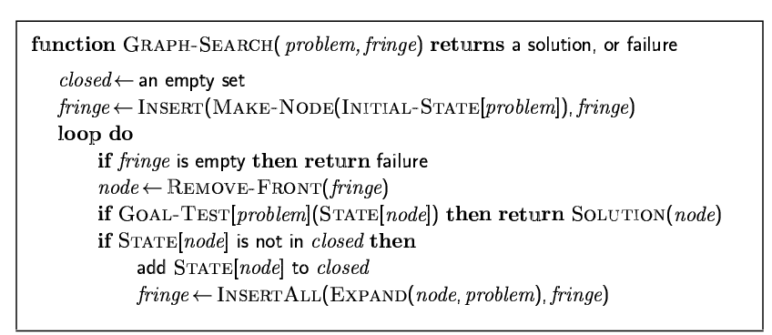
General graph search
Do remember visited nodes
Goal test after pop

Slide 18
Breadth-first graph search
Goal test before push

Slide 19
Uniform cost graph search: sort by g
A* is identical but uses f=g+h
Greedy best-first is identical but uses h
Goal test after pop

Slide 20
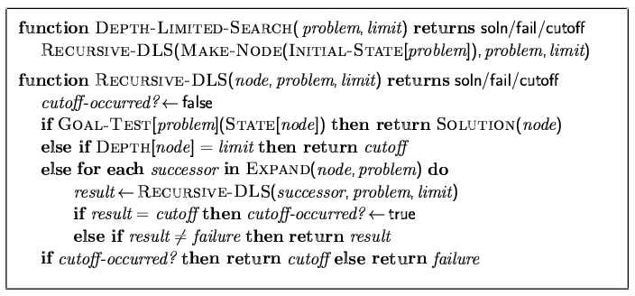
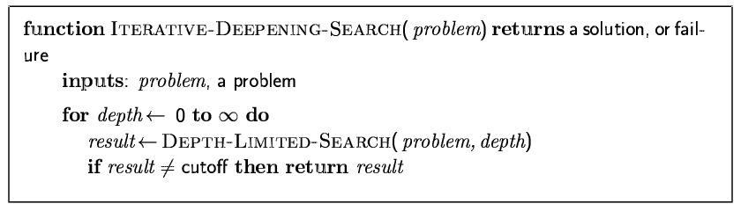
Depth-limited search & IDS
Iterate over successors,
call recursively on each.
Goal test at head of call.

Slide 21
When to do Goal-Test? Summary
For DFS, BFS, DLS, and IDS, the goal test is done when the child node is generated.
  These are not optimal searches in the general case.
  BFS and IDS are optimal if cost is a function of depth only; then, optimal goals are also shallowest goals and so will be found first
For GBFS the behavior is the same whether the goal test is done when the node is generated or when it is removed
  h(goal)=0 so any goal will be at the front of the queue anyway.
For UCS and A* the goal test is done when the node is removed from the queue.
  This precaution avoids finding a short expensive path before a long cheap path.

Slide 22
Blind Search Strategies (3.4)
Depth-first: Add successors to front of queue
Breadth-first: Add successors to back of queue
Uniform-cost: Sort queue by path cost g(n)
Depth-limited: Depth-first, cut off at limit l
Iterated-deepening: Depth-limited, increasing l
Bidirectional: Breadth-first from goal, too.
Review “Example hand-simulated search”
  Slides 29-38, Lecture on “Uninformed Search”

Slide 23
Search strategy evaluation
A search strategy is defined by the order of node expansion
Strategies are evaluated along the following dimensions:
  completeness: does it always find a solution if one exists?
  time complexity: number of nodes generated
  space complexity: maximum number of nodes in memory
  optimality: does it always find a least-cost solution?
Time and space complexity are measured in terms of
  b: maximum branching factor of the search tree
  d: depth of the least-cost solution
  m: maximum depth of the state space (may be ∞)
  (UCS: C*: true cost to optimal goal; ε > 0: minimum step cost)

Slide 24
Summary of algorithms
Fig. 3.21, p. 91
Criterion | Breadth-First | Uniform-Cost | Depth-First | Depth-Limited | Iterative Deepening DLS | Bidirectional (if applicable)
Complete? | Yes[a] | Yes[a,b] | No | No | Yes[a] | Yes[a,d]
Time | O(b^{d}) | O(b^{⎣1+C*/ε⎦}) | O(b^{m}) | O(b^{l}) | O(b^{d}) | O(b^{d/2})
Space | O(b^{d}) | O(b^{⎣1+C*/ε⎦}) | O(bm) | O(bl) | O(bd) | O(b^{d/2})
Optimal? | Yes[c] | Yes | No | No | Yes[c] | Yes[c,d]
There are a number of footnotes, caveats, and assumptions.
See Fig. 3.21, p. 91.
[a] complete if b is finite
[b] complete if step costs ≥ ε > 0
[c] optimal if step costs are all identical
(also if path cost non-decreasing function of depth only)
[d] if both directions use breadth-first search
(also if both directions use uniform-cost search with step costs ≥ ε > 0)
Generally the preferred
uninformed search strategy

Slide 25
Summary
Generate the search space by applying actions to the initial state and all further resulting states.
Problem: initial state, actions, transition model, goal test, step/path cost
Solution: sequence of actions to goal
Tree-search (don’t remember visited nodes) vs.
Graph-search (do remember them)
Search strategy evaluation: b, d, m (UCS: C*, ε)
  Complete? Time? Space? Optimal?

Slide 26
Heuristic function (3.5)
Heuristic:
  Definition: a commonsense rule (or set of rules) intended to increase the probability of solving some problem
  “using rules of thumb to find answers”
Heuristic function h(n)
  Estimate of (optimal) cost from n to goal
  Defined using only the state of node n
  h(n) = 0 if n is a goal node
  Example: straight line distance from n to Bucharest
    Note that this is not the true state-space distance
    It is an estimate – actual state-space distance can be higher
  Provides problem-specific knowledge to the search algorithm

Slide 27
Greedy best-first search
h(n) = estimate of cost from n to goal
  e.g., h(n) = straight-line distance from n to Bucharest
Greedy best-first search expands the node that appears to be closest to goal.
  Sort queue by h(n)
Not an optimal search strategy
  May perform well in practice

Slide 28

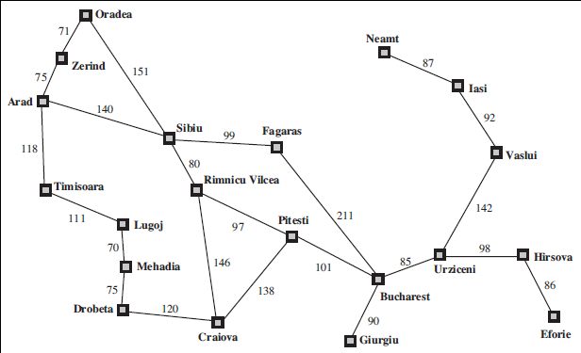
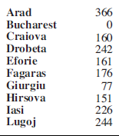
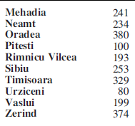
Greedy best-first search example

Slide 29
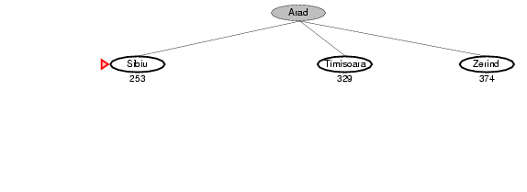
Greedy best-first search example

Slide 30
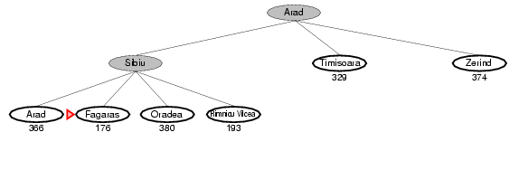
Greedy best-first search example

Slide 31
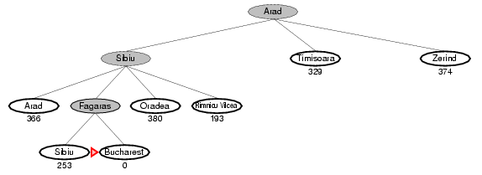
Greedy best-first search example

Slide 32
Optimal Path

Slide 33
Greedy Best-first Search
With tree search, will become stuck in this loop
Order of node expansion: S A D S A D S A D. . . .
Path found: none Cost of path found: none .
h=5
D
S
h=6
h=7
A
B
h=8
C
h=9
G
h=0

Slide 34
Properties of greedy best-first search
Complete?
  Tree version can get stuck in loops.
  Graph version is complete in finite spaces.
Time? O(b^{m})
  A good heuristic can give dramatic improvement
Space? O(1) tree search, O(b^{m}) graph search
  Graph search keeps all nodes in memory
  A good heuristic can give dramatic improvement
Optimal? No
  E.g., Arad → Sibiu → Rimnicu Vilcea → Pitesti → Bucharest is shorter!

Slide 35
A* search
Idea: avoid paths that are already expensive
  Generally the preferred simple heuristic search
  Optimal if heuristic is:
  admissible (tree search)/consistent (graph search)
Evaluation function f(n) = g(n) + h(n)
  g(n) = known path cost so far to node n.
  h(n) = estimate of (optimal) cost to goal from node n.
  f(n) = g(n)+h(n)
  = estimate of total cost to goal through node n.
Priority queue sort function = f(n)

Slide 36

A* tree search example

Slide 37
A* tree search example:
Simulated queue. City/f=g+h
Next:
Children:
Expanded:
Frontier: Arad/366=0+366

Slide 38
A* tree search example:
Simulated queue. City/f=g+h
Arad/ 366=0+366

Slide 39
A* tree search example:
Simulated queue. City/f=g+h
Arad/ 366=0+366

Slide 40
A* tree search example:
Simulated queue. City/f=g+h
Next: Arad/366=0+366
Children: Sibiu/393=140+253, Timisoara/447=118+329, Zerind/449=75+374
Expanded: Arad/366=0+366
Frontier: Arad/366=0+366, Sibiu/393=140+253, Timisoara/447=118+329, Zerind/449=75+374

Slide 41
A* tree search example:
Simulated queue. City/f=g+h
Arad/ 366=0+366
Sibiu/
393=140+253
Timisoara/
447=118+329
Zerind/
449=75+374

Slide 42
A* tree search example:
Simulated queue. City/f=g+h
Arad/ 366=0+366
Sibiu/
393=140+253
Timisoara/
447=118+329
Zerind/
449=75+374

Slide 43
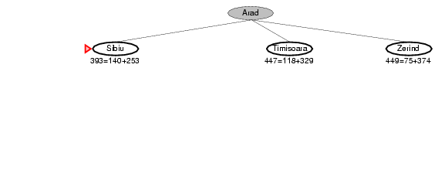
A* tree search example

Slide 44
A* tree search example:
Simulated queue. City/f=g+h
Next: Sibiu/393=140+253
Children: Arad/646=280+366, Fagaras/415=239+176, Oradea/671=291+380, RimnicuVilcea/413=220+193
Expanded: Arad/366=0+366, Sibiu/393=140+253
Frontier: Arad/366=0+366, Sibiu/393=140+253, Timisoara/447=118+329, Zerind/449=75+374, Arad/646=280+366, Fagaras/415=239+176, Oradea/671=291+380, RimnicuVilcea/413=220+193

Slide 45
A* tree search example:
Simulated queue. City/f=g+h
Arad/ 366=0+366
Sibiu/
393=140+253
Timisoara/
447=118+329
Zerind/
449=75+374
Arad/ 646=280+366
Fagaras/
415=239+176
Oradea/
671=291+380
RimnicuVilcea/
413=220+193

Slide 46
A* tree search example:
Simulated queue. City/f=g+h
Arad/ 366=0+366
Sibiu/
393=140+253
Timisoara/
447=118+329
Zerind/
449=75+374
Arad/ 646=280+366
Fagaras/
415=239+176
Oradea/
671=291+380
RimnicuVilcea/
413=220+193

Slide 47
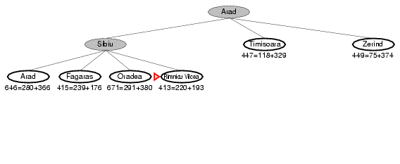
A* tree search example

Slide 48
A* tree search example:
Simulated queue. City/f=g+h
Next: RimnicuVilcea/413=220+193
Children: Craiova/526=366+160, Pitesti/417=317+100, Sibiu/553=300+253
Expanded: Arad/366=0+366, Sibiu/393=140+253, RimnicuVilcea/413=220+193
Frontier: Arad/366=0+366, Sibiu/393=140+253, Timisoara/447=118+329, Zerind/449=75+374, Arad/646=280+366, Fagaras/415=239+176, Oradea/671=291+380, RimnicuVilcea/413=220+193, Craiova/526=366+160, Pitesti/417=317+100, Sibiu/553=300+253

Slide 49
A* tree search example:
Simulated queue. City/f=g+h
Arad/ 366=0+366
Sibiu/
393=140+253
Timisoara/
447=118+329
Zerind/
449=75+374
Arad/ 646=280+366
Fagaras/
415=239+176
Oradea/
671=291+380
RimnicuVilcea/
413=220+193
Craiova/
526=366+160
Pitesti/
417=317+100
Sibiu/
553=300+253

Slide 50
A* search example:
Simulated queue. City/f=g+h
Arad/ 366=0+366
Sibiu/
393=140+253
Timisoara/
447=118+329
Zerind/
449=75+374
Arad/ 646=280+366
Fagaras/
415=239+176
Oradea/
671=291+380
RimnicuVilcea/
413=220+193
Craiova/
526=366+160
Pitesti/
417=317+100
Sibiu/
553=300+253

Slide 51
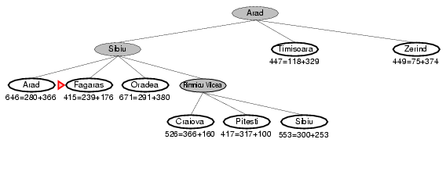
A* tree search example
Note: The search below did not “back track.” Rather, both arms are being pursued in parallel on the queue.

Slide 52
A* tree search example:
Simulated queue. City/f=g+h
Next: Fagaras/415=239+176
Children: Bucharest/450=450+0, Sibiu/591=338+253
Expanded: Arad/366=0+366, Sibiu/393=140+253, RimnicuVilcea/413=220+193, Fagaras/415=239+176
Frontier: Arad/366=0+366, Sibiu/393=140+253, Timisoara/447=118+329, Zerind/449=75+374, Arad/646=280+366, Fagaras/415=239+176, Oradea/671=291+380, RimnicuVilcea/413=220+193, Craiova/526=366+160, Pitesti/417=317+100, Sibiu/553=300+253, Bucharest/450=450+0, Sibiu/591=338+253

Slide 53
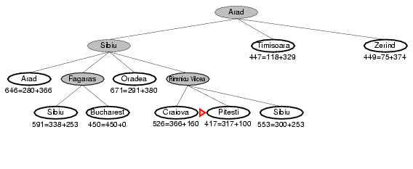
A* tree search example
Note: The search below did not “back track.” Rather, both arms are being pursued in parallel on the queue.

Slide 54
A* tree search example:
Simulated queue. City/f=g+h
Next: Pitesti/417=317+100
Children: Bucharest/418=418+0, Craiova/615=455+160, RimnicuVilcea/607=414+193
Expanded: Arad/366=0+366, Sibiu/393=140+253, RimnicuVilcea/413=220+193, Fagaras/415=239+176, Pitesti/417=317+100
Frontier: Arad/366=0+366, Sibiu/393=140+253, Timisoara/447=118+329, Zerind/449=75+374, Arad/646=280+366, Fagaras/415=239+176, Oradea/671=291+380, RimnicuVilcea/413=220+193, Craiova/526=366+160, Pitesti/417=317+100, Sibiu/553=300+253, Bucharest/450=450+0, Sibiu/591=338+253, Bucharest/418=418+0, Craiova/615=455+160, RimnicuVilcea/607=414+193

Slide 55
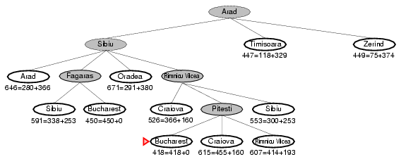
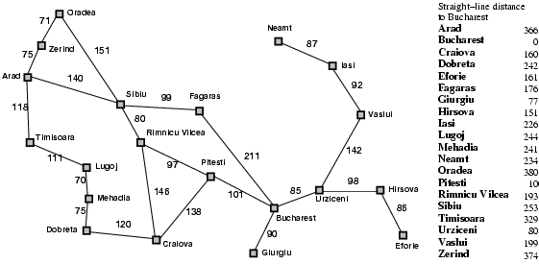
A* tree search example

Slide 56
A* tree search example:
Simulated queue. City/f=g+h
Next: Bucharest/418=418+0
Children: None; goal test succeeds.
Expanded: Arad/366=0+366, Sibiu/393=140+253, RimnicuVilcea/413=220+193, Fagaras/415=239+176, Pitesti/417=317+100, Bucharest/418=418+0
Frontier: Arad/366=0+366, Sibiu/393=140+253, Timisoara/447=118+329, Zerind/449=75+374, Arad/646=280+366, Fagaras/415=239+176, Oradea/671=291+380, RimnicuVilcea/413=220+193, Craiova/526=366+160, Pitesti/417=317+100, Sibiu/553=300+253, Bucharest/450=450+0, Sibiu/591=338+253, Bucharest/418=418+0, Craiova/615=455+160, RimnicuVilcea/607=414+193
Note that the short expensive path stays on the queue. The long cheap path is found and returned.

Slide 57
A* tree search example:
Simulated queue. City/f=g+h
Arad/ 366=0+366
Sibiu/
393=140+253
Timisoara/
447=118+329
Zerind/
449=75+374
Arad/ 646=280+366
Fagaras/
415=239+176
Oradea/
671=291+380
RimnicuVilcea/
413=220+193
…
Craiova/
526=366+160
Pitesti/
417=317+100
Sibiu/
553=300+253
…
Bucharest/
418=418+0

Slide 58
A* tree search example:
Simulated queue. City/f=g+h
Arad/ 366=0+366
Sibiu/
393=140+253
Timisoara/
447=118+329
Zerind/
449=75+374
Arad/ 646=280+366
Fagaras/
415=239+176
Oradea/
671=291+380
RimnicuVilcea/
413=220+193
…
Craiova/
526=366+160
Pitesti/
417=317+100
Sibiu/
553=300+253
…
Bucharest/
418=418+0

Slide 59
Properties of A*
Complete? Yes
(unless there are infinitely many nodes with f ≤ f(G);
can’t happen if step-cost ≥ ε > 0)
Time/Space? Exponential O(b^{d})
except if:
Optimal? Yes
(with: Tree-Search, admissible heuristic;
Graph-Search, consistent heuristic)
Optimally Efficient? Yes
(no optimal algorithm with same heuristic is guaranteed to expand fewer nodes)

Slide 60
Admissible heuristics
A heuristic h(n) is admissible if for every node n,
h(n) ≤ h*(n), where h*(n) is the true cost to reach the goal state from n.
An admissible heuristic never overestimates the cost to reach the goal, i.e., it is optimistic
Example: h_{SLD}(n) (never overestimates the actual road distance)
Theorem: If h(n) is admissible, A* using TREE-SEARCH is optimal

Slide 61
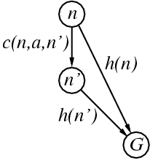
Consistent heuristics
(consistent => admissible)
A heuristic is consistent if for every node n, every successor n' of n generated by any action a,
h(n) ≤ c(n,a,n') + h(n')
If h is consistent, we have
f(n’) = g(n’) + h(n’) (by def.)
= g(n) + c(n,a,n') + h(n’) (g(n’)=g(n)+c(n.a.n’))
≥ g(n) + h(n) = f(n) (consistency)
f(n’) ≥ f(n)
i.e., f(n) is non-decreasing along any path.
Theorem:
If h(n) is consistent, A* using GRAPH-SEARCH is optimal
It’s the triangle
inequality !
keeps all checked nodes in memory to avoid repeated states

Slide 62
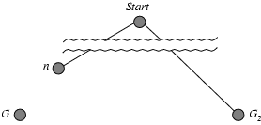
Optimality of A* (proof)
Tree Search, where h(n) is admissible
Suppose some suboptimal goal G₂ has been generated and is in the frontier. Let n be an unexpanded node in the frontier such that n is on a shortest path to an optimal goal G.
f(G₂) = g(G₂) since h(G₂) = 0
f(G) = g(G) since h(G) = 0
g(G₂) > g(G) since G₂ is suboptimal
f(G₂) > f(G) from above, with h=0
h(n) ≤ h*(n) since h is admissible (under-estimate)
g(n) + h(n) ≤ g(n) + h*(n) from above
f(n) ≤ f(G) since g(n)+h(n)=f(n) & g(n)+h*(n)=f(G)
f(n) < f(G2) from above
We want to prove:
f(n) < f(G2)
(then A* will expand n before G2)

Slide 63
Dominance
IF h₂(n) ≥ h₁(n) for all n
THEN h₂ dominates h₁
  h₂ is almost always better for search than h₁
  h₂ guarantees to expand no more nodes than does h₁
  h₂ almost always expands fewer nodes than does h₁
  Not useful unless both h₁ & h₂ are admissible/consistent
Typical 8-puzzle search costs
(average number of nodes expanded):
  d=12 IDS = 3,644,035 nodes
  A*(h₁) = 227 nodes
  A*(h₂) = 73 nodes
  d=24 IDS = too many nodes
  A*(h₁) = 39,135 nodes
  A*(h₂) = 1,641 nodes

Slide 64
Local search algorithms (4.1, 4.2)
In many optimization problems, the path to the goal is irrelevant; the goal state itself is the solution
State space = set of "complete" configurations
Find configuration satisfying constraints, e.g., n-queens
In such cases, we can use local search algorithms
keep a single "current" state, try to improve it.
Very memory efficient (only remember current state)

Slide 65
Random Restart Wrapper
These are stochastic local search methods
  Different solution for each trial and initial state
Almost every trial hits difficulties (see below)
  Most trials will not yield a good result (sadly)
Many random restarts improve your chances
  Many “shots at goal” may, finally, get a good one
Restart a random initial state; many times
  Report the best result found; across many trials

Slide 66
Random Restart Wrapper
BestResultFoundSoFar <- infinitely bad;
UNTIL ( you are tired of doing it ) DO {
  Result <- ( Local search from random initial state );
  IF ( Result is better than BestResultFoundSoFar )
    THEN ( Set BestResultFoundSoFar to Result );
    }
  RETURN BestResultFoundSoFar;
Typically, “you are tired of doing it” means that some resource limit is exceeded, e.g., number of iterations, wall clock time, CPU time, etc. It may also mean that Result improvements are small and infrequent, e.g., less than 0.1% Result improvement in the last week of run time.

Slide 67
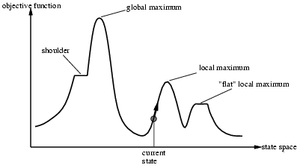
Local Search Difficulties
These difficulties apply to ALL local search algorithms, and become MUCH more difficult as the dimensionality of the search space increases to high dimensions.
Problems: depending on state, can get stuck in local maxima
  Many other problems also endanger your success!!

Slide 68
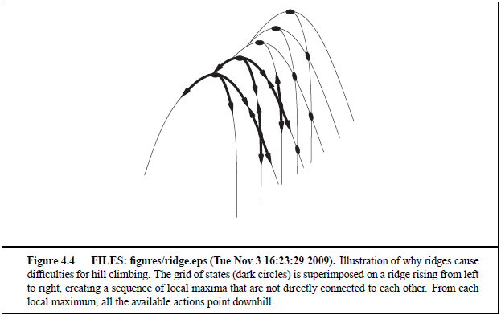
Local Search Difficulties
These difficulties apply to ALL local search algorithms, and become MUCH more difficult as the dimensionality of the search space increases to high dimensions.
Ridge problem: Every neighbor appears to be downhill
  But the search space has an uphill!! (worse in high dimensions)
Ridge:
Fold a piece of paper and hold it tilted up at an unfavorable angle to every possible search space step. Every step leads downhill; but the ridge leads uphill.

Slide 69
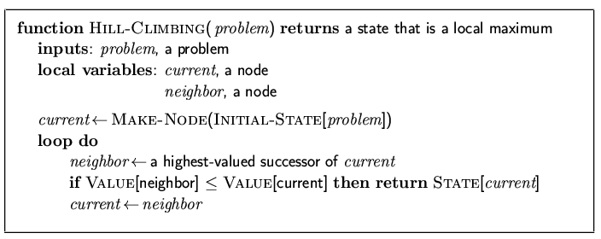
Hill-climbing search
"Like climbing Everest in thick fog with amnesia"

Slide 70
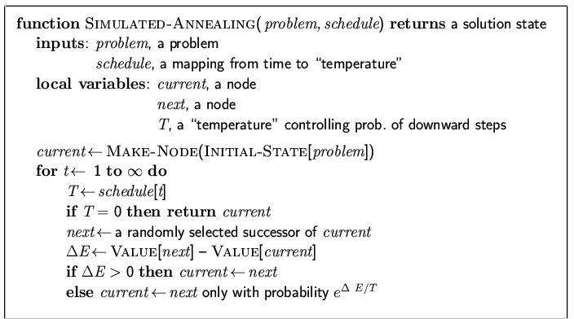
Simulated annealing search
Idea: escape local maxima by allowing some "bad" moves but gradually decrease their frequency
Improvement: Track the BestResultFoundSoFar. Here, this slide follows Fig. 4.5 of the textbook, which is simplified.

Slide 71
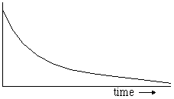
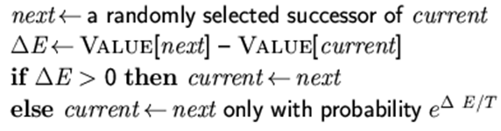
P(accepting a worse successor)
Decreases as Temperature T decreases
Increases as | Δ E | decreases
(Sometimes step size also decreases with T)
e^( ΔE / T ) |  | Temperature T
 |  | High | Low
|ΔE | | High | Medium | Low
 | Low | High | Medium
Temperature

Slide 72
Goal: “Ratchet” up a jagged slope
(see HW #2, prob. #5; here T = 1; cartoon is NOT to scale)
C
Value=45
E
Value=48
Value
G
Value=51
A
Value=42
F
Value=47
D
Value=44
B
Value=41
Arbitrary (Fictitious) Search Space Coordinate
Your “random restart wrapper” starts here.
You want to get here. HOW??
This is an illustrative cartoon.

Slide 73
Goal: “Ratchet” up a jagged slope
(see HW #2, prob. #5; here T = 1; cartoon is NOT to scale)
C
Value=45
ΔE(CB)=-4
ΔE(CD)=-1
P(CB) ≈.018
P(CD)≈.37
E
Value=48
ΔE(ED)=-4
ΔE(EF)=-1
P(ED) ≈.018
P(EF)≈.37
A
Value=42
ΔE(AB)=-1
P(AB) ≈.37
G
Value=51
ΔE(GF)=-4
P(GF) ≈.018
B
Value=41
ΔE(BA)=1
ΔE(BC)=4
P(BA)=1
P(BC)=1
D
Value=44
ΔE(DC)=1
ΔE(DE)=4
P(DC)=1
P(DE)=1
F
Value=47
ΔE(FE)=1
ΔE(FG)=4
P(FE)=1
P(FG)=1
This is an illustrative cartoon.
Your “random restart wrapper” starts here.
From A you will accept a move to B with P(AB) ≈.37.
From B you are equally likely to go to A or to C.
From C you are ≈20X more likely to go to D than to B.
From D you are equally likely to go to C or to E.
From E you are ≈20X more likely to go to F than to D.
From F you are equally likely to go to E or to G.
Remember best point you ever found (G or neighbor?).
x | -1 | -4
e^{x} | ≈.37 | ≈.018

Slide 74
Genetic algorithms (Darwin!!)
A state = a string over a finite alphabet (an individual)
Start with k randomly generated states (a population)
Fitness function (= our heuristic objective function).
  Higher fitness values for better states.
Select individuals for next generation based on fitness
  P(individual in next gen.) = individual fitness/Σ population fitness
Crossover fit parents to yield next generation (off-spring)
Mutate the offspring randomly with some low probability

Slide 75
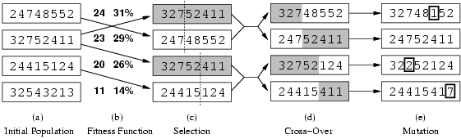
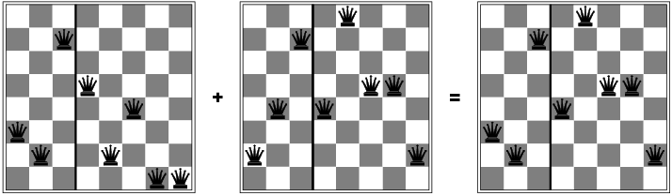
Fitness function: #non-attacking queen pairs
  min = 0, max = 8 × 7/2 = 28
Σ_i fitness_i = 24+23+20+11 = 78
P(child_1 in next gen.) = fitness_1/(Σ_i fitness_i) = 24/78 = 31%
P(child_2 in next gen.) = fitness_2/(Σ_i fitness_i) = 23/78 = 29%; etc
fitness =
#non-attacking
queens
probability of being
in next generation =
fitness/(Σ_i fitness_i)
How to convert a fitness value into a probability of being in the next generation.

Slide 76
Review Adversarial (Game) Search
Chapter 5.1-5.4
Minimax Search with Perfect Decisions (5.2)
  Impractical in most cases, but theoretical basis for analysis
Minimax Search with Cut-off (5.4)
  Replace terminal leaf utility by heuristic evaluation function
Alpha-Beta Pruning (5.3)
  The fact of the adversary leads to an advantage in search!
Practical Considerations (5.4)
  Redundant path elimination, look-up tables, etc.

Slide 77
Games as Search
Two players: MAX and MIN
MAX moves first and they take turns until the game is over
  Winner gets reward, loser gets penalty.
  “Zero sum” means the sum of the reward and the penalty is a constant.
Formal definition as a search problem:
  Initial state: Set-up specified by the rules, e.g., initial board configuration of chess.
  Player(s): Defines which player has the move in a state.
  Actions(s): Returns the set of legal moves in a state.
  Result(s,a): Transition model defines the result of a move.
  (2nd ed.: Successor function: list of (move,state) pairs specifying legal moves.)
  Terminal-Test(s): Is the game finished? True if finished, false otherwise.
  Utility function(s,p): Gives numerical value of terminal state s for player p.
    E.g., win (+1), lose (-1), and draw (0) in tic-tac-toe.
    E.g., win (+1), lose (0), and draw (1/2) in chess.
MAX uses search tree to determine “best” next move.

Slide 78
An optimal procedure:
The Min-Max method
Will find the optimal strategy and best next move for Max:
1. Generate the whole game tree, down to the leaves.
2. Apply utility (payoff) function to each leaf.
3. Back-up values from leaves through branch nodes:
  a Max node computes the Max of its child values
  a Min node computes the Min of its child values
4. At root: choose move leading to the child of highest value.

Slide 79
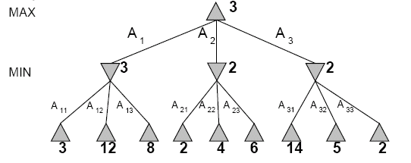
Two-Ply Game Tree

Slide 80
Two-Ply Game Tree
Minimax maximizes the utility of
the worst-case outcome for Max
The minimax decision

Slide 81
Pseudocode for Minimax Algorithm
function MINIMAX-DECISION(state) returns an action
inputs: state, current state in game
return arg max_{a∈Actions(state)} Min-Value(Result(state,a))
function MAX-VALUE(state) returns a utility value
if TERMINAL-TEST(state) then return UTILITY(state)
v ← −∞
for a in ACTIONS(state) do
v ← MAX(v,MIN-VALUE(Result(state,a)))
return v
function MIN-VALUE(state) returns a utility value
if TERMINAL-TEST(state) then return UTILITY(state)
v ← +∞
for a in ACTIONS(state) do
v ← MIN(v,MAX-VALUE(Result(state,a)))
return v

Slide 82
Properties of minimax
Complete?
  Yes (if tree is finite).
Optimal?
  Yes (against an optimal opponent).
  Can it be beaten by an opponent playing sub-optimally?
    No. (Why not?)
Time complexity?
  O(b^{m})
Space complexity?
  O(bm) (depth-first search, generate all actions at once)
  O(m) (backtracking search, generate actions one at a time)

Slide 83
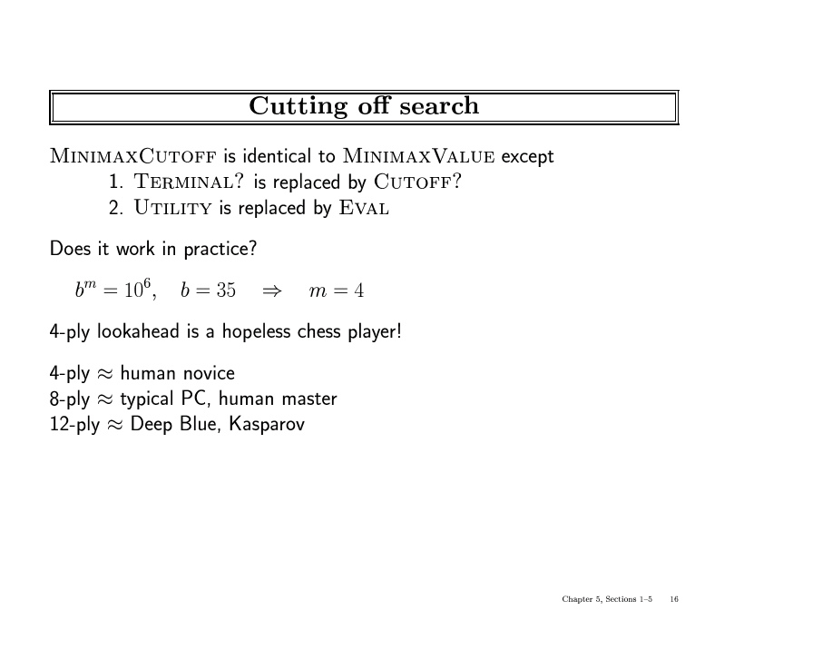

Slide 84
Static (Heuristic) Evaluation Functions
An Evaluation Function:
  Estimates how good the current board configuration is for a player.
  Typically, evaluate how good it is for the player, how good it is for the opponent, then subtract the opponent’s score from the player’s.
  Othello: Number of white pieces - Number of black pieces
  Chess: Value of all white pieces - Value of all black pieces
Typical values from -infinity (loss) to +infinity (win) or [-1, +1].
If the board evaluation is X for a player, it’s -X for the opponent
  “Zero-sum game”

Slide 85
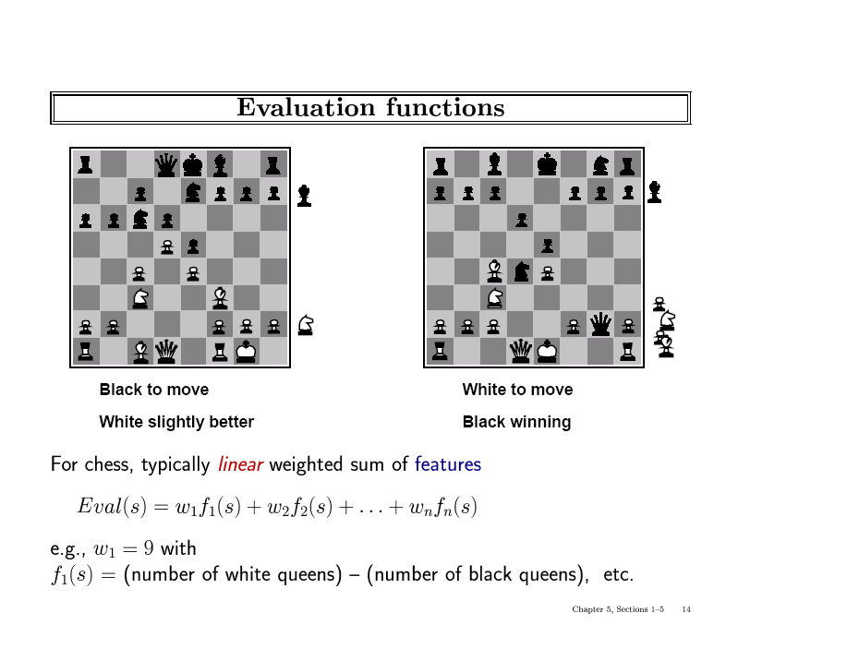

Slide 86
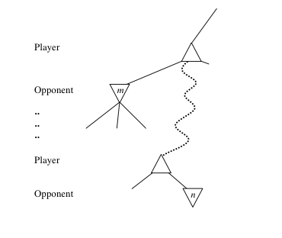
General alpha-beta pruning
Consider a node n in the tree ---
If player has a better choice at:
  Parent node of n
  Or any choice point further up
Then n will never be reached in play.
Hence, when that much is known about n, it can be pruned.

Slide 87
Alpha-beta Algorithm
Depth first search
  only considers nodes along a single path from root at any time
α = highest-value choice found at any choice point of path for MAX
(initially, α = −infinity)
β = lowest-value choice found at any choice point of path for MIN
(initially, β = +infinity)
Pass current values of α and β down to child nodes during search.
Update values of α and β during search:
  MAX updates α at MAX nodes
  MIN updates β at MIN nodes
Prune remaining branches at a node when α ≥ β

Slide 88
Pseudocode for Alpha-Beta Algorithm
function ALPHA-BETA-SEARCH(state) returns an action
inputs: state, current state in game
v←MAX-VALUE(state, - ∞ , +∞)
return the action in ACTIONS(state) with value v
function MAX-VALUE(state,α , β) returns a utility value
if TERMINAL-TEST(state) then return UTILITY(state)
v ← - ∞
for a in ACTIONS(state) do
v ← MAX(v, MIN-VALUE(Result(s,a), α , β))
if v ≥ β then return v
α ← MAX(α ,v)
return v
(MIN-VALUE is defined analogously)

Slide 89
When to Prune?
Prune whenever α ≥ β.
  Prune below a Max node whose alpha value becomes greater than or equal to the beta value of its ancestors.
    Max nodes update alpha based on children’s returned values.
  Prune below a Min node whose beta value becomes less than or equal to the alpha value of its ancestors.
    Min nodes update beta based on children’s returned values.

Slide 90
α/β Pruning vs. Returned Node Value
Some students are confused about the use of α/β pruning vs. the returned value of a node
α/β are used ONLY FOR PRUNING
  α/β have no effect on anything other than pruning
  IF (α >= β) THEN prune & return current node value
Returned node value = “best” child seen so far
  Maximum child value seen so far for MAX nodes
  Minimum child value seen so far for MIN nodes
  If you prune, return to parent “best” child so far
Returned node value is received by parent

Slide 91
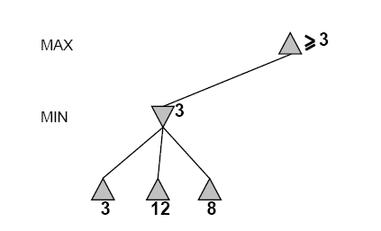
Alpha-Beta Example Revisited
Do DF-search until first leaf
α, β, initial values
α=−∞
β =+∞
α, β, passed to kids
α=−∞
β =+∞
Review Detailed Example of Alpha-Beta Pruning in lecture slides.

Slide 92
Alpha-Beta Example (continued)
α=−∞
β =+∞
α=−∞
β =3
MIN updates β, based on kids

Slide 93
Alpha-Beta Example (continued)
α=−∞
β =+∞
α=−∞
β =3
MIN updates β, based on kids.
No change.

Slide 94
Alpha-Beta Example (continued)
MAX updates α, based on kids.
α=3
β =+∞
3 is returned
as node value.

Slide 95
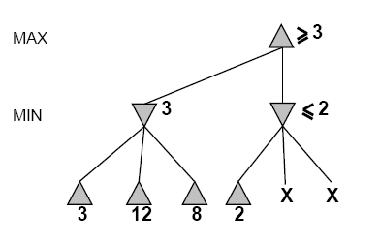
Alpha-Beta Example (continued)
α=3
β =+∞
α, β, passed to kids
α=3
β =+∞

Slide 96
Alpha-Beta Example (continued)
α=3
β =+∞
MIN updates β,
based on kids.
α=3
β =2

Slide 97
Alpha-Beta Example (continued)
α=3
β =+∞
α=3
β =2
α ≥ β,
so prune.

Slide 98
Alpha-Beta Example (continued)
MAX updates α, based on kids.
No change.
α=3
β =+∞
2 is returned
as node value.

Slide 99
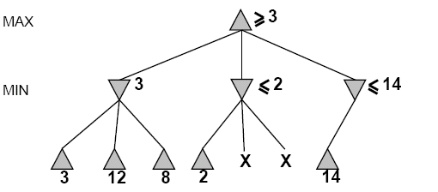
Alpha-Beta Example (continued)
α=3
β =+∞
,
α, β, passed to kids
α=3
β =+∞

Slide 100
Alpha-Beta Example (continued)
α=3
β =+∞
,
MIN updates β,
based on kids.
α=3
β =14

Slide 101
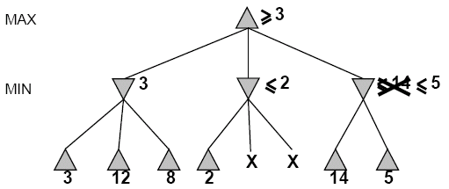

Alpha-Beta Example (continued)
α=3
β =+∞
,
MIN updates β,
based on kids.
α=3
β =5

Slide 102
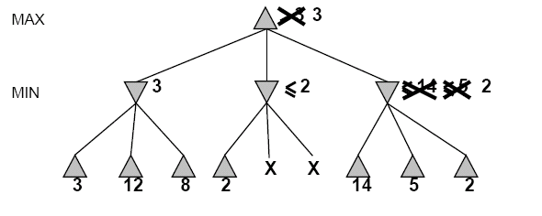
Alpha-Beta Example (continued)
α=3
β =+∞
2 is returned
as node value.
2

Slide 103
Alpha-Beta Example (continued)
Max calculates the same node value, and makes the same move!
2
Review Detailed Example of Alpha-Beta Pruning in lecture slides.

Slide 104
Review Probability (Chapter 13)
You will be expected to know
Basic probability notation/definitions:
  Probability model, unconditional/prior and conditional/posterior probabilities, factored representation (= variable/value pairs), random variable, (joint) probability distribution, probability density function (pdf), marginal probability, (conditional) independence, normalization, etc.
Basic probability formulae:
  Probability axioms, sum rule, product rule, Bayes’ rule.
How to use Bayes’ rule:
  Naïve Bayes model (naïve Bayes classifier)

Slide 105
Syntax
•Basic element: random variable
•Similar to propositional logic: possible worlds defined by assignment of values to random variables.
•Booleanrandom variables
e.g., Cavity (= do I have a cavity?)
•Discreterandom variables
e.g., Weather is one of <sunny,rainy,cloudy,snow>
•Domain values must be exhaustive and mutually exclusive
•Elementary proposition is an assignment of a value to a random variable:
e.g., Weather = sunny; Cavity = false(abbreviated as ¬cavity)
•Complex propositions formed from elementary propositions and standard logical connectives :
e.g., Weather = sunny ∨ Cavity = false

Slide 106
Probability
P(a) is the probability of proposition “a”
  e.g., P(it will rain in London tomorrow)
  The proposition a is actually true or false in the real-world
Probability Axioms:
  0 ≤ P(a) ≤ 1
  P(NOT(a)) = 1 – P(a) => Σ_{A} P(A) = 1
  P(true) = 1
  P(false) = 0
  P(A OR B) = P(A) + P(B) – P(A AND B)
Any agent that holds degrees of beliefs that contradict these axioms will act irrationally in some cases
Rational agents cannot violate probability theory.
  Acting otherwise results in irrational behavior.

Slide 107
Conditional Probability
P(a|b) is the conditional probability of proposition a, conditioned on knowing that b is true,
  E.g., P(rain in London tomorrow | raining in London today)
  P(a|b) is a “posterior” or conditional probability
  The updated probability that a is true, now that we know b
  P(a|b) = P(a ∧ b) / P(b)
  Syntax: P(a | b) is the probability of a given that b is true
    a and b can be any propositional sentences
    e.g., p( John wins OR Mary wins | Bob wins AND Jack loses)
P(a|b) obeys the same rules as probabilities,
  E.g., P(a | b) + P(NOT(a) | b) = 1
  All probabilities in effect are conditional probabilities
    E.g., P(a) = P(a | our background knowledge)

Slide 108
Concepts of Probability
Unconditional Probability
  P(a), the probability of “a” being true, or P(a=True)
  Does not depend on anything else to be true (unconditional)
  Represents the probability prior to further information that may adjust it (prior)
Conditional Probability
  P(a|b), the probability of “a” being true, given that “b” is true
  Relies on “b” = true (conditional)
  Represents the prior probability adjusted based upon new information “b” (posterior)
  Can be generalized to more than 2 random variables:
    e.g. P(a|b, c, d)
Joint Probability
  P(a, b) = P(a ˄ b), the probability of “a” and “b” both being true
  Can be generalized to more than 2 random variables:
    e.g. P(a, b, c, d)

Slide 109
Random Variables
Random Variable:
  Basic element of probability assertions
  Similar to CSP variable, but values reflect probabilities not constraints.
    Variable: A
    Domain: {a₁, a₂, a₃} <-- events / outcomes
Types of Random Variables:
  Boolean random variables = { true, false }
    e.g., Cavity (= do I have a cavity?)
  Discrete random variables = One value from a set of values
    e.g., Weather is one of <sunny, rainy, cloudy ,snow>
  Continuous random variables = A value from within constraints
    e.g., Current temperature is bounded by (10°, 200°)
Domain values must be exhaustive and mutually exclusive:
  One of the values must always be the case (Exhaustive)
  Two of the values cannot both be the case (Mutually Exclusive)

Slide 110
Basic Probability Relationships
P(A) + P(¬ A) = 1
  Implies that P(¬ A) = 1 ─ P(A)
  P(A, B) = P(A ˄ B) = P(A) + P(B) ─ P(A ˅ B)
  Implies that P(A ˅ B) = P(A) + P(B) ─ P(A ˄ B)
P(A | B) = P(A, B) / P(B)
  Conditional probability; “Probability of A given B”
P(A, B) = P(A | B) P(B)
  Product Rule (Factoring); applies to any number of variables
  P(a, b, c,…z) = P(a | b, c,…z) P(b | c,...z) P(c|...z)...P(z)
  P(A) = Σ_{B,C} P(A, B, C) = Σ_{b∈B,c∈C} P(A, b, c)
  Sum Rule (Marginal Probabilities); for any number of variables
  P(A, D) = Σ_{B} Σ_{C} P(A, B, C, D) = Σ_{b∈B} Σ_{c∈C} P(A, b, c, D)
P(B | A) = P(A | B) P(B) / P(A)
  Bayes’ Rule; for any number of variables
You need to
know these !

Slide 111
Summary of Probability Rules
Product Rule:
  P(a, b) = P(a|b) P(b) = P(b|a) P(a)
  Probability of “a” and “b” occurring is the same as probability of “a” occurring given “b” is true, times the probability of “b” occurring.
    e.g., P( rain, cloudy ) = P(rain | cloudy) * P(cloudy)
Sum Rule: (AKA Law of Total Probability)
  P(a) = Σ_{b} P(a, b) = Σ_{b} P(a|b) P(b), where B is any random variable
  Probability of “a” occurring is the same as the sum of all joint probabilities including the event, provided the joint probabilities represent all possible events.
  Can be used to “marginalize” out other variables from probabilities, resulting in prior probabilities also being called marginal probabilities.
    e.g., P(rain) = Σ_{Windspeed} P(rain, Windspeed)
    where Windspeed = {0-10mph, 10-20mph, 20-30mph, etc.}
Bayes’ Rule:
  P(b|a) = P(a|b) P(b) / P(a)
  Acquired from rearranging the product rule.
  Allows conversion between conditionals, from P(a|b) to P(b|a).
    e.g., b = disease, a = symptoms
  More natural to encode knowledge as P(a|b) than as P(b|a).

Slide 112
Full Joint Distribution
We can fully specify a probability space by constructing a full joint distribution:
  A full joint distribution contains a probability for every possible combination of variable values.
  E.g., P( J=f, M=t, A=t, B=t, E=f )
From a full joint distribution, the product rule, sum rule, and Bayes’ rule can create any desired joint and conditional probabilities.

Slide 113
Computing with Probabilities: Law of Total Probability
Law of Total Probability (aka “summing out” or marginalization)
P(a) = Σ_{b} P(a, b)
= Σ_{b} P(a | b) P(b) where B is any random variable
Why is this useful?
Given a joint distribution (e.g., P(a,b,c,d)) we can obtain any “marginal” probability (e.g., P(b)) by summing out the other variables, e.g.,
P(b) = Σ_{a} Σ_{c} Σ_{d} P(a, b, c, d)
We can compute any conditional probability given a joint distribution, e.g.,
P(c | b) = Σ_{a} Σ_{d} P(a, c, d | b)
= Σ_{a} Σ_{d} P(a, c, d, b) / P(b)
where P(b) can be computed as above

Slide 114
Computing with Probabilities:
The Chain Rule or Factoring
We can always write
P(a, b, c, … z) = P(a | b, c, …. z) P(b, c, … z)
(by definition of joint probability)
Repeatedly applying this idea, we can write
P(a, b, c, … z) = P(a | b, c, …. z) P(b | c,.. z) P(c| .. z)..P(z)
This factorization holds for any ordering of the variables
This is the chain rule for probabilities

Slide 115
Independence
Formal Definition:
  2 random variables A and B are independent iff:
  P(a, b) = P(a) P(b), for all values a, b
Informal Definition:
  2 random variables A and B are independent iff:
  P(a | b) = P(a) OR P(b | a) = P(b), for all values a, b
  P(a | b) = P(a) tells us that knowing b provides no change in our probability for a, and thus b contains no information about a.
Also known as marginal independence, as all other variables have been marginalized out.
In practice true independence is very rare:
  “butterfly in China” effect
  Conditional independence is much more common and useful

Slide 116
Conditional Independence
Formal Definition:
  2 random variables A and B are conditionally independent given C iff:
P(a, b|c) = P(a|c) P(b|c), for all values a, b, c
Informal Definition:
  2 random variables A and B are conditionally independent given C iff:
  P(a|b, c) = P(a|c) OR P(b|a, c) = P(b|c), for all values a, b, c
  P(a|b, c) = P(a|c) tells us that learning about b, given that we already know c, provides no change in our probability for a, and thus b contains no information about a beyond what c provides.
Naïve Bayes Model:
  Often a single variable can directly influence a number of other variables, all of which are conditionally independent, given the single variable.
  E.g., k different symptom variables X₁, X₂, … X_{k}, and C = disease, reducing to:
  P(X₁, X₂,…. X_{K} | C) = P(C) Π P(X_{i} | C)

Slide 117
Examples of Conditional Independence
H=Heat, S=Smoke, F=Fire
  P(H, S | F) = P(H | F) P(S | F)
  P(S | F, S) = P(S | F)
  If we know there is/is not a fire, observing heat tells us no more information about smoke
F=Fever, R=RedSpots, M=Measles
  P(F, R | M) = P(F | M) P(R | M)
  P(R | M, F) = P(R | M)
  If we know we do/don’t have measles, observing fever tells us no more information about red spots
C=SharpClaws, F=SharpFangs, S=Species
  P(C, F | S) = P(C | S) P(F | S)
  P(F | S, C) = P(F | S)
  If we know the species, observing sharp claws tells us no more information about sharp fangs

Slide 118
Review Bayesian Networks (Chapter 14.1-5)
You will be expected to know:
Basic concepts and vocabulary of Bayesian networks.
  Nodes represent random variables.
  Directed arcs represent (informally) direct influences.
  Conditional probability tables, P( Xi | Parents(Xi) ).
Given a Bayesian network:
  Write down the full joint distribution it represents.
  Inference by Variable Elimination
Given a full joint distribution in factored form:
  Draw the Bayesian network that represents it.
Given a variable ordering and background assertions of conditional independence among the variables:
  Write down the factored form of the full joint distribution, as simplified by the conditional independence assertions.

Slide 119
Bayesian Networks
Represent dependence/independence via a directed graph
  Nodes = random variables
  Edges = direct dependence
Structure of the graph ⬄ Conditional independence
Recall the chain rule of repeated conditioning:
Requires that graph is acyclic (no directed cycles)
2 components to a Bayesian network
  The graph structure (conditional independence assumptions)
  The numerical probabilities (of each variable given its parents)
The full joint distribution
The graph-structured approximation
Notes:
Each node is associated with a conditional probability distribution, with conditioning being on the parents of the node.

Slide 120


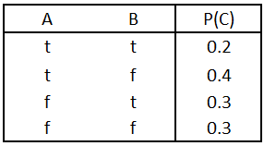
Bayesian Network
A Bayesian network specifies a joint distribution in a structured form:
Dependence/independence represented via a directed graph:
  Node = random variable
  Directed Edge = conditional dependence
  Absence of Edge = conditional independence
Allows concise view of joint distribution relationships:
  Graph nodes and edges show conditional relationships between variables.
  Tables provide probability data.
Full factorization
A
B
p(A,B,C) = p(C|A,B)p(A|B)p(B)
= p(C|A,B)p(A)p(B)
After applying conditional independence from the graph
C

Slide 121
Examples of 3-way Bayesian Networks
Independent Causes:
p(A,B,C) = p(C|A,B)p(A)p(B)
“Explaining away” effect:
Given C, observing A makes B less likely
e.g., earthquake/burglary/alarm example
A and B are (marginally) independent
but become dependent once C is known
You heard alarm, and observe Earthquake
…. It explains away burglary
Independent Causes
A Earthquake
B Burglary
C Alarm
A
B
C
Nodes: Random Variables
A, B, C
Edges: P(Xi | Parents) → Directed edge from parent nodes to Xi
A → C
B → C

Slide 122
Examples of 3-way Bayesian Networks
A
B
C
Marginal Independence:
p(A,B,C) = p(A) p(B) p(C)
Nodes: Random Variables
A, B, C
Edges: P(Xi | Parents) → Directed edge from parent nodes to Xi
No Edge!

Slide 123
Extended example of 3-way Bayesian Networks
Common Cause
A : Fire
B: Heat
C: Smoke
Conditionally independent effects:
p(A,B,C) = p(B|A)p(C|A)p(A)
B and C are conditionally independent
Given A
“Where there’s Smoke, there’s Fire.”
If we see Smoke, we can infer Fire.
If we see Smoke, observing Heat tells
us very little additional information.
A
B
C

Slide 124
Examples of 3-way Bayesian Networks
Markov dependence:
p(A,B,C) = p(C|B) p(B|A)p(A)
A affects B and B affects C
Given B, A and C are independent
e.g.
If it rains today, it will rain tomorrow with 90%
On Wed morning…
If you know it rained yesterday,
it doesn’t matter whether it rained on Mon
Markov Dependence
A Rain on Mon
B Ran on Tue
C Rain on Wed
A
B
C
Nodes: Random Variables
A, B, C
Edges: P(Xi | Parents) → Directed edge from parent nodes to Xi
A → B
B → C

Slide 125
Naïve Bayes Model (section 20.2.2 R&N 3rd ed.)
X₁
X₂
X₃
X_{n}
C
Basic Idea: We want to estimate P(C | X₁,…X_{n}), but it’s hard to think about computing the probability of a class from input attributes of an example.
Solution: Use Bayes’ Rule to turn P(C | X₁,…X_{n}) into a proportionally equivalent expression that involves only P(C) and P(X₁,…X_{n} | C).
Then assume that feature values are conditionally independent given class, which allows us to turn P(X₁,…X_{n} | C) into Π_{i} P(X_{i} | C).
We estimate P(C) easily from the frequency with which each class appears within our training data, and we estimate P(X_{i} | C) easily from the frequency with which each X_{i} appears in each class C within our training data.

Slide 126
Naïve Bayes Model (section 20.2.2 R&N 3rd ed.)
X₁
X₂
X₃
X_{n}
C
Bayes Rule: P(C | X₁,…X_{n}) is proportional to P (C) Π_{i} P(X_{i} | C)
[note: denominator P(X₁,…X_{n}) is constant for all classes, may be ignored.]
Features Xi are conditionally independent given the class variable C
  choose the class value c_{i} with the highest P(c_{i} | x₁,…, x_{n})
  simple to implement, often works very well
  e.g., spam email classification: X’s = counts of words in emails
Conditional probabilities P(X_{i} | C) can easily be estimated from labeled date
  Problem: Need to avoid zeroes, e.g., from limited training data
  Solutions: Pseudo-counts, beta[a,b] distribution, etc.

Slide 127
Naïve Bayes Model (2)
P(C | X₁,…X_{n}) = α P (C) Π _{i} P(X_{i} | C)
Probabilities P(C) and P(X_{i} | C) can easily be estimated from labeled data
P(C = c_{j}) ≈ #(Examples with class label C = c_{j}) / #(Examples)
P(X_{i} = x_{ik} | C = c_{j})
≈ #(Examples with attribute value X_{i} = x_{ik} and class label C = c_{j})
/ #(Examples with class label C = c_{j})
Usually easiest to work with logs
log [ P(C | X₁,…X_{n}) ]
= log α + log P (C) + Σ log P(X_{i} | C)
DANGER: What if ZERO examples with value X_{i} = x_{ik} and class label C = c_{j} ?
An unseen example with value X_{i} = x_{ik} will NEVER predict class label C = c_{j} !
Practical solutions: Pseudocounts, e.g., add 1 to every #() , etc.
Theoretical solutions: Bayesian inference, beta distribution, etc.

Slide 128
Bigger Example
Consider the following 5 binary variables:
  B = a burglary occurs at your house
  E = an earthquake occurs at your house
  A = the alarm goes off
  J = John calls to report the alarm
  M = Mary calls to report the alarm
Sample Query: What is P(B|M, J) ?
Using full joint distribution to answer this question requires
  2⁵ - 1= 31 parameters
Can we use prior domain knowledge to come up with a Bayesian network that requires fewer probabilities?

Slide 129
Constructing a Bayesian Network: Step 1
Order the variables in terms of influence (may be a partial order), e.g., {E, B} -> {A} -> {J, M}
P(J, M, A, E, B) = P(J, M | A, E, B) P(A| E, B) P(E, B)
≈ P(J, M | A) P(A| E, B) P(E) P(B)
≈ P(J | A) P(M | A) P(A| E, B) P(E) P(B)
These conditional independence assumptions are reflected in the graph structure of the Bayesian network

Slide 130
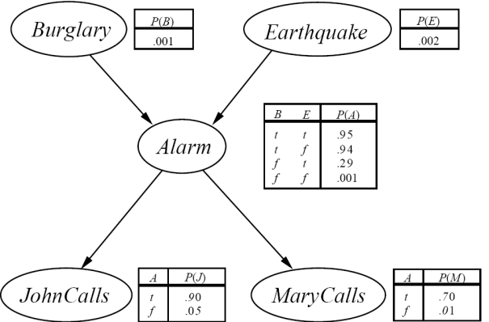
Constructing this Bayesian Network: Step 2
P(J, M, A, E, B) =
P(J | A) P(M | A) P(A | E, B) P(E) P(B)
There are 3 conditional probability tables (CPDs) to be determined:
P(J | A), P(M | A), P(A | E, B)
  Requiring 2 + 2 + 4 = 8 probabilities
And 2 marginal probabilities P(E), P(B) -> 2 more probabilities
Where do these probabilities come from?
  Expert knowledge
  From data (relative frequency estimates)
  Or a combination of both - see discussion in Section 20.1 and 20.2 (optional)

Slide 131

The Resulting Bayesian Network

Slide 132
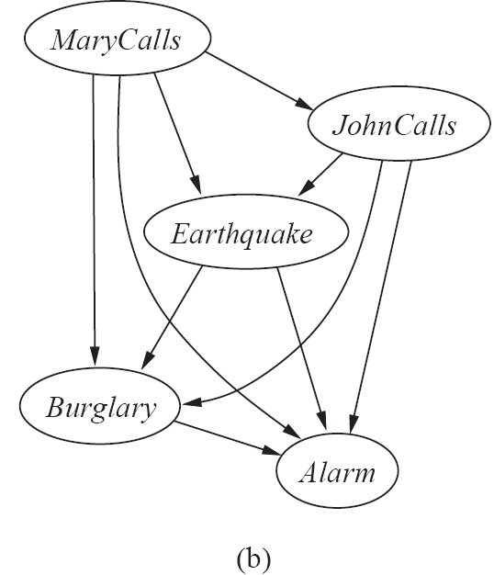
The Bayesian Network from a different Variable Ordering

Slide 133
Computing Probabilities from a Bayesian Network
Shown below is the Bayesian network for the Burglar Alarm problem, i.e.,
P(J,M,A,B,E) = P(J | A) P(M | A) P(A | B, E) P(B) P(E).
Suppose we wish to compute P( J=f ∧ M=t ∧ A=t ∧ B=t ∧ E=f ):
P( J=f ∧ M=t ∧ A=t ∧ B=t ∧ E=f )
    = P( J=f | A=t ) * P( M=t | A=t ) * P( A=t | B=t ∧ E=f ) * P( B=t ) * P( E=f )
= .10 * .70 * .94 * .001 * .998
Note: P( E=f ) = [ 1 ─ P( E=t ) ] = [ 1 ─ .002 ) ] = .998
P( J=f | A=t ) = [ 1 ─ P( J=t | A=t ) ] = .10

Slide 134
Inference in Bayesian Networks
Simple Example
P(A)
.05
Disease1
P(B)
.02
Disease2
}
A
B
Query Variables A, B
A B P(C|A,B)
t t .95
t f .90
f t .90
f f .005
TempReg
}
C
Hidden Variable C
C P(D|C)
t .95
f .002
Fever
}
Evidence Variable D
D
(A=True, B=False | D=True) : Probability of getting Disease1 when we observe Fever
Note: Not an anatomically correct model of how diseases cause fever!
Suppose that two different diseases influence some imaginary internal body temperature regulator, which in turn influences whether fever is present.

Slide 135
Inference in Bayesian Networks
X = { X1, X2, …, Xk } = query variables of interest
E = { E1, …, El } = evidence variables that are observed
Y = { Y1, …, Ym } = hidden variables (nonevidence, nonquery)
What is the posterior distribution of X, given E?
  P( X | e ) = α Σ _{y} P( X, y, e )
What is the most likely assignment of values to X, given E?
  argmax _{x} P( x | e ) = argmax _{x} Σ _{y} P( x, y, e )
Normalizing constant α = Σ_{x} Σ _{y} P( X, y, e )

Slide 136
Inference by Variable Elimination
P(A)
.05
Disease1
P(B)
.02
Disease2
What is the posterior conditional distribution of our query variables, given that fever was observed?
P(A,B|d) = α Σ _{c} P(A,B,c,d)
= α Σ _{c} P(A)P(B)P(c|A,B)P(d|c)
= α P(A)P(B) Σ _{c} P(c|A,B)P(d|c)
A
B
A B P(C|A,B)
t t .95
t f .90
f t .90
f f .005
TempReg
C
C P(D|C)
t .95
f .002
Fever
D
P(a,b|d) = α P(a)P(b) Σ _{c} P(c|a,b)P(d|c) = α P(a)P(b){ P(c|a,b)P(d|c)+P(¬c|a,b)P(d|¬c) }
= α .05x.02x{.95x.95+.05x.002} ≈ α .000903 ≈ .014
P(¬a,b|d) = α P(¬a)P(b) Σ _{c} P(c|¬a,b)P(d|c) = α P(¬a)P(b){ P(c|¬a,b)P(d|c)+P(¬c|¬a,b)P(d|¬c) }
= α .95x.02x{.90x.95+.10x.002} ≈ α .0162 ≈ .248
P(a,¬b|d) = α P(a)P(¬b) Σ _{c} P(c|a,¬b)P(d|c) = α P(a)P(¬b){ P(c|a,¬b)P(d|c)+P(¬c|a,¬b)P(d|¬c) }
= α .05x.98x{.90x.95+.10x.002} ≈ α .0419 ≈ .642
P(¬a,¬b|d) = α P(¬a)P(¬b) Σ _{c} P(c|¬a,¬b)P(d|c) = α P(¬a)P(¬b){ P(c|¬a,¬b)P(d|c)+P(¬c|¬a,¬b)P(d|¬c) }
= α .95x.98x{.005x.95+.995x.002} ≈ α .00627 ≈ .096
α ≈ 1 / (.000903+.0162+.0419+.00627) ≈ 1 / .06527 ≈ 15.32 [Note: α = normalization constant, p. 493]

Slide 137
Mid-term Review
Chapters 2-5, 13, 14
Review Agents (2.1-2.3)
Review State Space Search
  Problem Formulation (3.1, 3.3)
  Blind (Uninformed) Search (3.4)
  Heuristic Search (3.5)
  Local Search (4.1, 4.2)
Review Adversarial (Game) Search (5.1-5.4)
Review Probability & Bayesian Networks (13, 14.1-14.5)
Please review your quizzes and old CS-171 tests
  At least one question from a prior quiz or old CS-171 test will appear on the mid-term (and all other tests)

