Slide 1
CS-271P Final Review
Propositional Logic
  (7.1-7.5)
First-Order Logic, Knowledge Representation
  (8.1-8.5, 9.1-9.2)
Constraint Satisfaction Problems
  (6.1-6.4, except 6.3)
Machine Learning
  (18.1-18.4)
Questions on any topic
Pre-mid-term material if time and class interest
Please review your quizzes, mid-term, & old tests
  At least one question from a prior quiz or test will appear on the Final Exam (and all other tests)

Slide 2
Review Propositional Logic
Chapter 7.1-7.5
Definitions:
  Syntax, Semantics, Sentences, Propositions, Entails, Follows, Derives, Inference, Sound, Complete, Model, Satisfiable, Valid (or Tautology)
Syntactic Transformations:
  E.g., (A ⇒ B) ⇔ (¬A ∨ B)
Semantic Transformations:
  E.g., (KB |= α) ≡ (|= (KB ⇒ α)
Truth Tables:
  Negation, Conjunction, Disjunction, Implication, Equivalence (Biconditional)
Inference:
  By Model Enumeration (truth tables)
  By Resolution

Slide 3
Recap propositional logic: Syntax
Propositional logic is the simplest logic – illustrates basic ideas
The proposition symbols P₁, P₂ etc are sentences
  If S is a sentence, ¬S is a sentence (negation)
  If S₁ and S₂ are sentences, S₁ ∧ S₂ is a sentence (conjunction)
  If S₁ and S₂ are sentences, S₁ ∨ S₂ is a sentence (disjunction)
  If S₁ and S₂ are sentences, S₁ ⇒ S₂ is a sentence (implication)
  If S₁ and S₂ are sentences, S₁ ⇔ S₂ is a sentence (biconditional)

Slide 4
Recap propositional logic: Semantics
Each model/world specifies true or false for each proposition symbol
  E.g., P_{1,2} P_{2,2} P_{3,1}
  false true false
  With these symbols, 8 possible models can be enumerated automatically.
Rules for evaluating truth with respect to a model m:
¬S is true iff S is false
S₁ ∧ S₂ is true iff S₁ is true and S₂ is true
S₁ ∨ S₂ is true iff S₁is true or S₂ is true
S₁ ⇒ S₂ is true iff S₁ is false or S₂ is true
(i.e., is false iff S₁ is true and S₂ is false)
S₁ ⇔ S₂ is true iff S₁⇒S₂ is true and S₂⇒S₁ is true
Simple recursive process evaluates an arbitrary sentence, e.g.,
¬P_{1,2} ∧ (P_{2,2} ∨ P_{3,1}) = true ∧ (true ∨ false) = true ∧ true = true

Slide 5
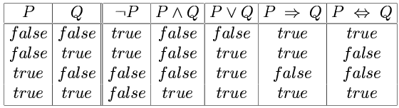
Recap propositional logic:
Truth tables for connectives
OR: P or Q is true or both are true.
XOR: P or Q is true but not both.
Implication is always true
when the premises are False!

Slide 6
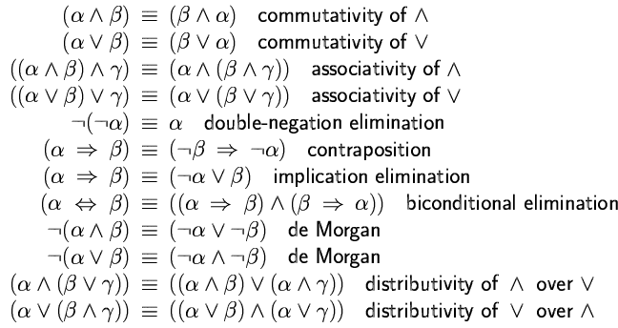
Recap propositional logic:
Logical equivalence and rewrite rules
To manipulate logical sentences we need some rewrite rules.
Two sentences are logically equivalent iff they are true in same models: α ≡ ß iff α╞ β and β╞ α
You need to
know these !

Slide 7
Recap propositional logic: Entailment
Entailment means that one thing follows from another:
KB ╞ α
Knowledge base KB entails sentence α if and only if α is true in all worlds where KB is true
  E.g., the KB containing “the Giants won and the Reds won” entails “The Giants won”.
  E.g., x+y = 4 entails 4 = x+y
  E.g., “Mary is Sue’s sister and Amy is Sue’s daughter” entails “Mary is Amy’s aunt.”

Slide 8
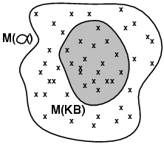
Review: Models (and in FOL, Interpretations)
Models are formal worlds in which truth can be evaluated
We say m is a model of a sentence α if α is true in m
M(α) is the set of all models of α
Then KB ╞ α iff M(KB) ⊆ M(α)
  E.g. KB, = “Mary is Sue’s sister
  and Amy is Sue’s daughter.”
  α = “Mary is Amy’s aunt.”
Think of KB and α as constraints,
  and of models m as possible states.
M(KB) are the solutions to KB
and M(α) the solutions to α.
Then, KB ╞ α, i.e., ╞ (KB ⇒ a) ,
when all solutions to KB are also solutions to α.

Slide 9
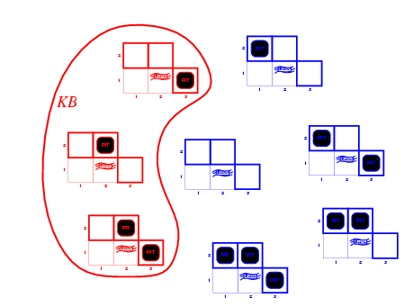
Review: Wumpus models
KB = all possible wumpus-worlds consistent with the observations and the “physics” of the Wumpus world.

Slide 10
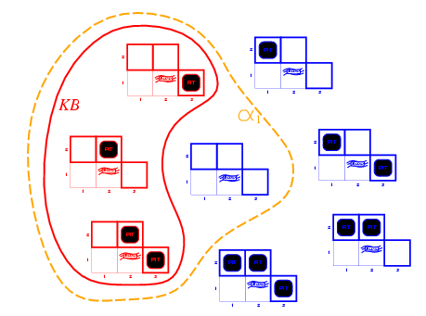
Review: Wumpus models
α₁ = "[1,2] is safe", KB ╞ α₁, proved by model checking.
Every model that makes KB true also makes α₁ true.

Slide 11
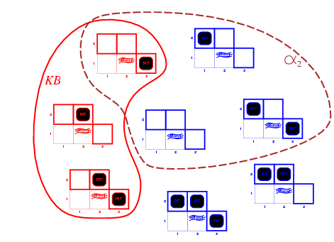
Wumpus models
α₂ = "[2,2] is safe", KB ╞ α₂

Slide 12
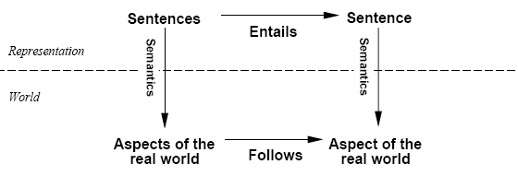
Review: Schematic for Follows, Entails, and Derives
Derives
Inference
Sentences
Sentence
If KB is true in the real world,
then any sentence α entailed by KB
and any sentence α derived from KB
by a sound inference procedure
is also true in the real world.

Slide 13
Schematic Example: Follows, Entails, and Derives
“Mary is Sue’s sister and Amy is Sue’s daughter.”
Derives
“Mary is Amy’s aunt.”
Inference
“An aunt is a sister of a parent.”
Is it provable?
“Mary is Sue’s sister and Amy is Sue’s daughter.”
Entails
“Mary is Amy’s aunt.”
Representation
“An aunt is a sister of a parent.”
Is it true?
Mary
Sister
Sue
Mary
Follows
World
Daughter
Is it the case?
Aunt
Amy
Amy

Slide 14
Recap propositional logic: Validity and satisfiability
A sentence is valid if it is true in all models,
  e.g., True, A ∨¬A, A ⇒ A, (A ∧ (A ⇒ B)) ⇒ B
Validity is connected to inference via the Deduction Theorem:
  KB ╞ α if and only if (KB ⇒ α) is valid
A sentence is satisfiable if it is true in some model
  e.g., A∨ B, C
A sentence is unsatisfiable if it is false in all models
  e.g., A∧¬A
Satisfiability is connected to inference via the following:
  KB ╞ A if and only if (KB ∧¬A) is unsatisfiable
  (there is no model for which KB is true and A is false)

Slide 15
Inference Procedures
KB ├ _{i} A means that sentence A can be derived from KB by procedure i
Soundness: i is sound if whenever KB ├_{i} α, it is also true that KB╞ α
  (no wrong inferences, but maybe not all inferences)
Completeness: i is complete if whenever KB╞ α, it is also true that KB ├_{i} α
  (all inferences can be made, but maybe some wrong extra ones as well)
Entailment can be used for inference (Model checking)
  enumerate all possible models and check whether α is true.
  For n symbols, time complexity is O(2^{n})...
Inference can be done directly on the sentences
  Forward chaining, backward chaining, resolution (see FOPC, later)

Slide 16
Resolution = Efficient Implication
Recall that (A => B) = ( (NOT A) OR B)
and so:
(Y OR X) = ( (NOT X) => Y)
( (NOT Y) OR Z) = (Y => Z)
which yields:
( (Y OR X) AND ( (NOT Y) OR Z) ) = ( (NOT X) => Z) = (X OR Z)
(OR A B C D)
(OR ¬A E F G)
-----------------------------
(OR B C D E F G)
->Same ->
->Same ->
(NOT (OR B C D)) => A
A => (OR E F G)
----------------------------------------------------
(NOT (OR B C D)) => (OR E F G)
----------------------------------------------------
(OR B C D E F G)
Recall: All clauses in KB are conjoined by an implicit AND (= CNF representation).

Slide 17
Resolution Examples
Resolution: inference rule for CNF: sound and complete! *
“If A or B or C is true, but not A, then B or C must be true.”
“If A is false then B or C must be true, or if A is true
then D or E must be true, hence since A is either true or
false, B or C or D or E must be true.”
* Resolution is “refutation complete”
in that it can prove the truth of any entailed sentence by refutation.
“If A or B is true, and
not A or B is true, then B must be true.”
Simplification
is done always.

Slide 18
Only Resolve ONE Literal Pair!
If more than one pair, result always = TRUE.
Useless!! Always simplifies to TRUE!!
No!
(OR A B C D)
(OR ¬A ¬B F G)
-----------------------------
(OR C D F G)
No! This is wrong!
No!
(OR A B C D)
(OR ¬A ¬B ¬C )
-----------------------------
(OR D)
No! This is wrong!
Yes! (but = TRUE)
(OR A B C D)
(OR ¬A ¬B F G)
-----------------------------
(OR B ¬B C D F G)
Yes! (but = TRUE)
Yes! (but = TRUE)
(OR A B C D)
(OR ¬A ¬B ¬C )
-----------------------------
(OR A ¬A B ¬B D)
Yes! (but = TRUE)

Slide 19
Resolution Algorithm
The resolution algorithm tries to prove:
Generate all new sentences from KB and the (negated) query.
One of two things can happen:
We find which is unsatisfiable. I.e. we can entail the query.
We find no contradiction: there is a model that satisfies the sentence
(non-trivial) and hence we cannot entail the query.

Slide 20
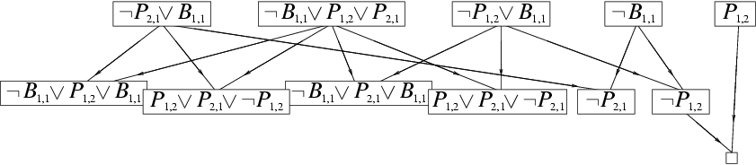
Resolution example
KB = (B_{1,1} ⇔ (P_{1,2}∨ P_{2,1})) ∧¬ B_{1,1}
α = ¬P_{1,2}
¬P_{2,1}
True!
False in
all worlds

Slide 21
Detailed Resolution Proof Example
In words: If the unicorn is mythical, then it is immortal, but if it is not mythical, then it is a mortal mammal. If the unicorn is either immortal or a mammal, then it is horned. The unicorn is magical if it is horned.
  Prove that the unicorn is both magical and horned.
  ( (NOT Y) (NOT R) ) (M Y) (R Y) (H (NOT M) )
  (H R) ( (NOT H) G) ( (NOT G) (NOT H) )
Fourth, produce a resolution proof ending in ( ):
Resolve (¬H ¬G) and (¬H G) to give (¬H)
Resolve (¬Y ¬R) and (Y M) to give (¬R M)
Resolve (¬R M) and (R H) to give (M H)
Resolve (M H) and (¬M H) to give (H)
Resolve (¬H) and (H) to give ( )
Of course, there are many other proofs, which are OK iff correct.

Slide 22
Propositional Logic --- Summary
Logical agents apply inference to a knowledge base to derive new information and make decisions
Basic concepts of logic:
  syntax: formal structure of sentences
  semantics: truth of sentences wrt models
  entailment: necessary truth of one sentence given another
  inference: deriving sentences from other sentences
  soundness: derivations produce only entailed sentences
  completeness: derivations can produce all entailed sentences
  valid: sentence is true in every model (a tautology)
Logical equivalences allow syntactic manipulations
Propositional logic lacks expressive power
  Can only state specific facts about the world.
  Cannot express general rules about the world
  (use First Order Predicate Logic instead)

Slide 23
CS-271P Final Review
Propositional Logic
  (7.1-7.5)
First-Order Logic, Knowledge Representation
  (8.1-8.5, 9.1-9.2)
Constraint Satisfaction Problems
  (6.1-6.4, except 6.3)
Machine Learning
  (18.1-18.4)
Questions on any topic
Pre-mid-term material if time and class interest
Please review your quizzes, mid-term, & old tests
  At least one question from a prior quiz or test will appear on the Final Exam (and all other tests)

Slide 24
Knowledge Representation using First-Order Logic
Propositional Logic is Useful --- but has Limited Expressive Power
First Order Predicate Calculus (FOPC), or First Order Logic (FOL).
  FOPC has greatly expanded expressive power, though still limited.
New Ontology
  The world consists of OBJECTS (for propositional logic, the world was facts).
  OBJECTS have PROPERTIES and engage in RELATIONS and FUNCTIONS.
New Syntax
  Constants, Predicates, Functions, Properties, Quantifiers.
New Semantics
  Meaning of new syntax.
Knowledge engineering in FOL

Slide 25
Review: Syntax of FOL: Basic elements
Constants KingJohn, 2, UCI,...
Predicates Brother, >,...
Functions Sqrt, LeftLegOf,...
Variables x, y, a, b,...
Connectives ¬, ⇒, ∧, ∨, ⇔
Equality =
Quantifiers ∀, ∃

Slide 26
Syntax of FOL: Basic syntax elements are symbols
Constant Symbols:
  Stand for objects in the world.
    E.g., KingJohn, 2, UCI, ...
Predicate Symbols
  Stand for relations (maps a tuple of objects to a truth-value)
    E.g., Brother(Richard, John), greater_than(3,2), ...
  P(x, y) is usually read as “x is P of y.”
    E.g., Mother(Ann, Sue) is usually “Ann is Mother of Sue.”
Function Symbols
  Stand for functions (maps a tuple of objects to an object)
    E.g., Sqrt(3), LeftLegOf(John), ...
Model (world) = set of domain objects, relations, functions
Interpretation maps symbols onto the model (world)
  Very many interpretations are possible for each KB and world!
  Job of the KB is to rule out models inconsistent with our knowledge.

Slide 27
Syntax of FOL: Terms
Term = logical expression that refers to an object
There are two kinds of terms:
  Constant Symbols stand for (or name) objects:
    E.g., KingJohn, 2, UCI, Wumpus, ...
  Function Symbols map tuples of objects to an object:
    E.g., LeftLeg(KingJohn), Mother(Mary), Sqrt(x)
    This is nothing but a complicated kind of name
      No “subroutine” call, no “return value”

Slide 28
Syntax of FOL: Atomic Sentences
Atomic Sentences state facts (logical truth values).
  An atomic sentence is a Predicate symbol, optionally followed by a parenthesized list of any argument terms
  E.g., Married( Father(Richard), Mother(John) )
  An atomic sentence asserts that some relationship (some predicate) holds among the objects that are its arguments.
An Atomic Sentence is true in a given model if the relation referred to by the predicate symbol holds among the objects (terms) referred to by the arguments.

Slide 29
Syntax of FOL: Connectives & Complex Sentences
Complex Sentences are formed in the same way, and are formed using the same logical connectives, as we already know from propositional logic
The Logical Connectives:
  ⇔ biconditional
  ⇒ implication
  ∧ and
  ∨ or
  ¬ negation
Semantics for these logical connectives are the same as we already know from propositional logic.

Slide 30
Syntax of FOL: Variables
Variables range over objects in the world.
A variable is like a term because it represents an object.
A variable may be used wherever a term may be used.
  Variables may be arguments to functions and predicates.
A term with NO variables is called a ground term.
All variables must be bound by a quantifier, ∀ or ∃
(A variable not bound by a quantifier is called free.)
  Used by mathematicians, not used in this class

Slide 31
Syntax of FOL: Logical Quantifiers
There are two Logical Quantifiers:
  Universal: ∀ x P(x) means “For all x, P(x).”
    The “upside-down A” reminds you of “ALL.”
  Existential: ∃ x P(x) means “There exists x such that, P(x).”
    The “upside-down E” reminds you of “EXISTS.”
Syntactic “sugar” --- we really only need one quantifier.
  ∀ x P(x) ≡ ¬∃ x ¬P(x)
  ∃ x P(x) ≡ ¬∀ x ¬P(x)
  You can ALWAYS convert one quantifier to the other.
RULES: ∀ ≡ ¬∃¬ and ∃ ≡ ¬∀¬
RULE: To move negation “in” across a quantifier,
    change the quantifier to “the other quantifier”
    and negate the predicate on “the other side.”
  ¬∀ x P(x) ≡ ∃ x ¬P(x)
  ¬∃ x P(x) ≡ ∀ x ¬P(x)

Slide 32
Universal Quantification ∀
∀ means “for all”
Allows us to make statements about all objects that have certain properties
Can now state general rules:
  ∀ x King(x) => Person(x) “All kings are persons.”
  ∀ x Person(x) => HasHead(x) “Every person has a head.”
  i Integer(i) => Integer(plus(i,1)) “If i is an integer then i+1 is an integer.”
  Note that
  x King(x) ∧ Person(x) is not correct!
  This would imply that all objects x are Kings and are People
  x King(x) => Person(x) is the correct way to say this
  Note that => is the natural connective to use with ∀ .

Slide 33
Existential Quantification ∃
∃ x means “there exists an x such that….” (at least one object x)
Allows us to make statements about some object without naming it
Examples:
  ∃ x King(x) “Some object is a king.”
  ∃ x Lives_in(John, Castle(x)) “John lives in somebody’s castle.”
  ∃ i Integer(i) ∧ GreaterThan(i,0) “Some integer is greater than zero.”
  Note that ∧ is the natural connective to use with ∃
  (And remember that => is the natural connective to use with ∀ )

Slide 34
Combining Quantifiers --- Order (Scope)
The order of “unlike” quantifiers is important.
∀ x ∃ y Loves(x,y)
  For everyone (“all x”) there is someone (“exists y”) whom they love
y ∀ x Loves(x,y)
- there is someone (“exists y”) whom everyone loves (“all x”)
Clearer with parentheses: ∃ y ( ∀ x Loves(x,y) )
The order of “like” quantifiers does not matter.
∀x ∀y P(x, y) ≡ ∀y ∀x P(x, y)
∃x ∃y P(x, y) ≡ ∃y ∃x P(x, y)

Slide 35
De Morgan’s Law for Quantifiers
De Morgan’s Rule
Generalized De Morgan’s Rule
Rule is simple: if you bring a negation inside a disjunction or a conjunction,
always switch between them (or →and, and → or).

Slide 36
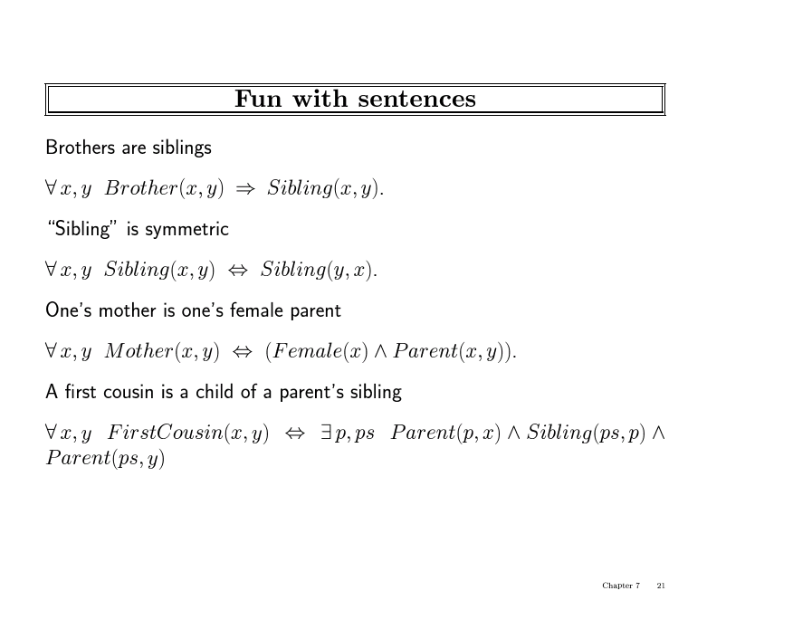

Slide 37
More fun with sentences
“All persons are mortal.”
[Use: Person(x), Mortal (x) ]
∀x Person(x) ⇒ Mortal(x)
∀x ¬Person(x) ˅ Mortal(x)
Common Mistakes:
∀x Person(x) ∧ Mortal(x)
  Note that => is the natural connective to use with ∀ .

Slide 38
More fun with sentences
“Fifi has a sister who is a cat.”
[Use: Sister(Fifi, x), Cat(x) ]
∃x Sister(Fifi, x) ∧ Cat(x)
Common Mistakes:
∃x Sister(Fifi, x) ⇒ Cat(x)
  Note that ∧ is the natural connective to use with ∃

Slide 39
More fun with sentences
“For every food, there is a person who eats that food.”
[Use: Food(x), Person(y), Eats(y, x) ]
All are correct:
∀x ∃y Food(x) ⇒ [ Person(y) ∧ Eats(y, x) ]
∀x Food(x) ⇒ ∃y [ Person(y) ∧ Eats(y, x) ]
∀x ∃y ¬Food(x) ˅ [ Person(y) ∧ Eats(y, x) ]
∀x ∃y [ ¬Food(x) ˅ Person(y) ] ∧ [¬ Food(x) ˅ Eats(y, x) ]
∀x ∃y [ Food(x) ⇒ Person(y) ] ∧ [ Food(x) ⇒ Eats(y, x) ]
Common Mistakes:
∀x ∃y [ Food(x) ∧ Person(y) ] ⇒ Eats(y, x)
∀x ∃y Food(x) ∧ Person(y) ∧ Eats(y, x)

Slide 40
More fun with sentences
“Every person eats every food.”
[Use: Person (x), Food (y), Eats(x, y) ]
∀x ∀y [ Person(x) ∧ Food(y) ] ⇒ Eats(x, y)
∀x ∀y ¬Person(x) ˅ ¬Food(y) ˅ Eats(x, y)
∀x ∀y Person(x) ⇒ [ Food(y) ⇒ Eats(x, y) ]
∀x ∀y Person(x) ⇒ [ ¬Food(y) ˅ Eats(x, y) ]
∀x ∀y ¬Person(x) ˅ [ Food(y) ⇒ Eats(x, y) ]
Common Mistakes:
∀x ∀y Person(x) ⇒ [Food(y) ∧ Eats(x, y) ]
∀x ∀y Person(x) ∧ Food(y) ∧ Eats(x, y)

Slide 41
More fun with sentences
“All greedy kings are evil.”
[Use: King(x), Greedy(x), Evil(x) ]
∀x [ Greedy(x) ∧ King(x) ] ⇒ Evil(x)
∀x ¬Greedy(x) ˅ ¬King(x) ˅ Evil(x)
∀x Greedy(x) ⇒ [ King(x) ⇒ Evil(x) ]
Common Mistakes:
∀x Greedy(x) ∧ King(x) ∧ Evil(x)

Slide 42
More fun with sentences
“Everyone has a favorite food.”
[Use: Person(x), Food(y), Favorite(y, x) ]
∀x ∃y Person(x) ⇒ [ Food(y) ∧ Favorite(y, x) ]
∀x Person(x) ⇒ ∃y [ Food(y) ∧ Favorite(y, x) ]
∀x ∃y ¬Person(x) ˅ [ Food(y) ∧ Favorite(y, x) ]
∀x ∃y [ ¬Person(x) ˅ Food(y) ] ∧ [ ¬Person(x) ˅ Favorite(y, x) ]
∀x ∃y [Person(x) ⇒ Food(y) ] ∧ [ Person(x) ⇒ Favorite(y, x) ]
Common Mistakes:
∀x ∃y [ Person(x) ∧ Food(y) ] ⇒ Favorite(y, x)
∀x ∃y Person(x) ∧ Food(y) ∧ Favorite(y, x)

Slide 43
Semantics: Interpretation
An interpretation of a sentence (wff) is an assignment that maps
  Object constant symbols to objects in the world,
  n-ary function symbols to n-ary functions in the world,
  n-ary relation symbols to n-ary relations in the world
Given an interpretation, an atomic sentence has the value “true” if it denotes a relation that holds for those individuals denoted in the terms. Otherwise it has the value “false.”
  Example: Kinship world:
    Symbols = Ann, Bill, Sue, Married, Parent, Child, Sibling, …
  World consists of individuals in relations:
    Married(Ann,Bill) is false, Parent(Bill,Sue) is true, …
Your job, as a Knowledge Engineer, is to construct KB so it is true *exactly* for your world and intended interpretation.

Slide 44
Semantics: Models and Definitions
An interpretation and possible world satisfies a wff (sentence) if the wff has the value “true” under that interpretation in that possible world.
A domain and an interpretation that satisfies a wff is a model of that wff
Any wff that has the value “true” in all possible worlds and under all interpretations is valid.
Any wff that does not have a model under any interpretation is inconsistent or unsatisfiable.
Any wff that is true in at least one possible world under at least one interpretation is satisfiable.
If a wff w has a value true under all the models of a set of sentences KB then KB logically entails w.

Slide 45
Conversion to CNF
Everyone who loves all animals is loved by someone:
  ∀x [∀y Animal(y) ⇒ Loves(x,y)] ⇒ [∃y Loves(y,x)]
Eliminate biconditionals and implications
  ∀x [¬∀y ¬Animal(y) ∨ Loves(x,y)] ∨ [∃y Loves(y,x)]
2. Move ¬ inwards:
¬∀x p ≡ ∃x ¬p, ¬ ∃x p ≡ ∀x ¬p
  ∀x [∃y ¬(¬Animal(y) ∨ Loves(x,y))] ∨ [∃y Loves(y,x)]
  ∀x [∃y ¬¬Animal(y) ∧ ¬Loves(x,y)] ∨ [∃y Loves(y,x)]
  ∀x [∃y Animal(y) ∧ ¬Loves(x,y)] ∨ [∃y Loves(y,x)]

Slide 46
Conversion to CNF contd.
Standardize variables: each quantifier should use a different one
  ∀x [∃y Animal(y) ∧ ¬Loves(x,y)] ∨ [∃z Loves(z,x)]
Skolemize: a more general form of existential instantiation.
  Each existential variable is replaced by a Skolem function of the enclosing universally quantified variables:
  ∀x [Animal(F(x)) ∧ ¬Loves(x,F(x))] ∨ Loves(G(x),x)
Drop universal quantifiers:
  [Animal(F(x)) ∧ ¬Loves(x,F(x))] ∨ Loves(G(x),x)
Distribute ∨ over ∧ :
  [Animal(F(x)) ∨ Loves(G(x),x)] ∧ [¬Loves(x,F(x)) ∨ Loves(G(x),x)]

Slide 47
Unification
Recall: Subst(θ, p) = result of substituting θ into sentence p
Unify algorithm: takes 2 sentences p and q and returns a unifier if one exists
Unify(p,q) = θ where Subst(θ, p) = Subst(θ, q)
Example:
p = Knows(John,x)
q = Knows(John, Jane)
Unify(p,q) = {x/Jane}

Slide 48
Unification examples
simple example: query = Knows(John,x), i.e., who does John know?
p q θ
Knows(John,x) Knows(John,Jane) {x/Jane}
Knows(John,x) Knows(y,OJ) {x/OJ,y/John}
Knows(John,x) Knows(y,Mother(y)) {y/John,x/Mother(John)}
Knows(John,x) Knows(x,OJ) {fail}
Last unification fails: only because x can’t take values John and OJ at the same time
  But we know that if John knows x, and everyone (x) knows OJ, we should be able to infer that John knows OJ
Problem is due to use of same variable x in both sentences
Simple solution: Standardizing apart eliminates overlap of variables, e.g., Knows(z,OJ)

Slide 49
Unification
To unify Knows(John,x) and Knows(y,z),
θ = {y/John, x/z } or θ = {y/John, x/John, z/John}
The first unifier is more general than the second.
There is a single most general unifier (MGU) that is unique up to renaming of variables.
  MGU = { y/John, x/z }
General algorithm in Figure 9.1 in the text

Slide 50
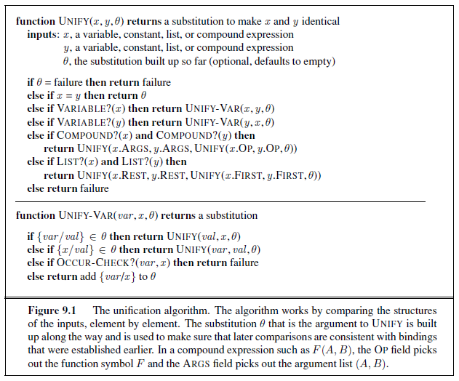
Unification Algorithm

Slide 51
Knowledge engineering in FOL
Identify the task
Assemble the relevant knowledge
Decide on a vocabulary of predicates, functions, and constants
Encode general knowledge about the domain
Encode a description of the specific problem instance
Pose queries to the inference procedure and get answers
Debug the knowledge base

Slide 52
The electronic circuits domain
Identify the task
  Does the circuit actually add properly?
Assemble the relevant knowledge
  Composed of wires and gates; Types of gates (AND, OR, XOR, NOT)
  Irrelevant: size, shape, color, cost of gates
Decide on a vocabulary
  Alternatives:
    Type(X₁) = XOR (function)
    Type(X₁, XOR) (binary predicate)
    XOR(X₁)
    (unary predicate)

Slide 53
The electronic circuits domain
Encode general knowledge of the domain
  ∀t₁,t₂ Connected(t₁, t₂) ⇒ Signal(t₁) = Signal(t₂)
  ∀t Signal(t) = 1 ∨ Signal(t) = 0
  1 ≠ 0
  ∀t₁,t₂ Connected(t₁, t₂) ⇒ Connected(t₂, t₁)
  ∀g Type(g) = OR ⇒ Signal(Out(1,g)) = 1 ⇔ ∃n Signal(In(n,g)) = 1
  ∀g Type(g) = AND ⇒ Signal(Out(1,g)) = 0 ⇔ ∃n Signal(In(n,g)) = 0
  ∀g Type(g) = XOR ⇒ Signal(Out(1,g)) = 1 ⇔ Signal(In(1,g)) ≠ Signal(In(2,g))
  ∀g Type(g) = NOT ⇒ Signal(Out(1,g)) ≠ Signal(In(1,g))

Slide 54
The electronic circuits domain
Encode the specific problem instance
  Type(X₁) = XOR Type(X₂) = XOR
  Type(A₁) = AND Type(A₂) = AND
  Type(O₁) = OR
  Connected(Out(1,X₁),In(1,X₂)) Connected(In(1,C₁),In(1,X₁))
  Connected(Out(1,X₁),In(2,A₂)) Connected(In(1,C₁),In(1,A₁))
  Connected(Out(1,A₂),In(1,O₁)) Connected(In(2,C₁),In(2,X₁))
  Connected(Out(1,A₁),In(2,O₁)) Connected(In(2,C₁),In(2,A₁))
  Connected(Out(1,X₂),Out(1,C₁)) Connected(In(3,C₁),In(2,X₂))
  Connected(Out(1,O₁),Out(2,C₁)) Connected(In(3,C₁),In(1,A₂))

Slide 55
The electronic circuits domain
Pose queries to the inference procedure
  What are the possible sets of values of all the terminals for the adder circuit?
∃i₁,i₂,i₃,o₁,o₂ Signal(In(1,C₁)) = i₁ ∧ Signal(In(2,C₁)) = i₂ ∧ Signal(In(3,C₁)) = i₃ ∧ Signal(Out(1,C₁)) = o₁ ∧ Signal(Out(2,C₁)) = o₂
Debug the knowledge base
  May have omitted assertions like 1 ≠ 0

Slide 56
CS-271P Final Review
Propositional Logic
  (7.1-7.5)
First-Order Logic, Knowledge Representation
  (8.1-8.5, 9.1-9.2)
Constraint Satisfaction Problems
  (6.1-6.4, except 6.3)
Machine Learning
  (18.1-18.4)
Questions on any topic
Pre-mid-term material if time and class interest
Please review your quizzes, mid-term, & old tests
  At least one question from a prior quiz or test will appear on the Final Exam (and all other tests)

Slide 57
Review Constraint Satisfaction
Chapter 6.1-6.4, except 6.3.3
What is a CSP
Backtracking for CSP
Local search for CSPs

Slide 58
Constraint Satisfaction Problems
What is a CSP?
  Finite set of variables X₁, X₂, …, X_{n}
  Nonempty domain of possible values for each variable
  D₁, D₂, …, D_{n}
  Finite set of constraints C₁, C₂, …, C_{m}
    Each constraint C_{i} limits the values that variables can take,
    e.g., X₁ ≠ X₂
  Each constraint C_{i} is a pair <scope, relation>
    Scope = Tuple of variables that participate in the constraint.
    Relation = List of allowed combinations of variable values.
    May be an explicit list of allowed combinations.
    May be an abstract relation allowing membership testing and listing.
CSP benefits
  Standard representation pattern
  Generic goal and successor functions
  Generic heuristics (no domain specific expertise).

Slide 59
CSPs --- what is a solution?
A state is an assignment of values to some or all variables.
  An assignment is complete when every variable has a value.
  An assignment is partial when some variables have no values.
Consistent assignment
  assignment does not violate the constraints
A solution to a CSP is a complete and consistent assignment.
Some CSPs require a solution that maximizes an objective function.

Slide 60
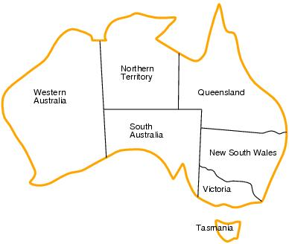
CSP example: map coloring
Variables: WA, NT, Q, NSW, V, SA, T
Domains: D_{i}={red,green,blue}
Constraints:adjacent regions must have different colors.
    E.g. WA ≠ NT

Slide 61
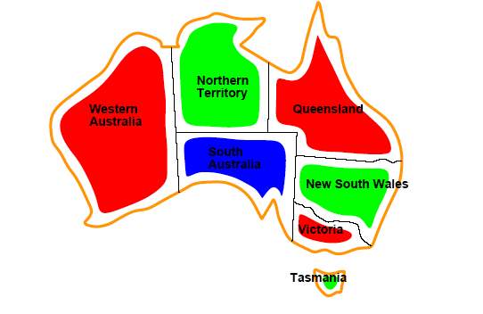
CSP example: map coloring
Solutions are assignments satisfying all constraints, e.g.
{WA=red,NT=green,Q=red,NSW=green,V=red,SA=blue,T=green}

Slide 62
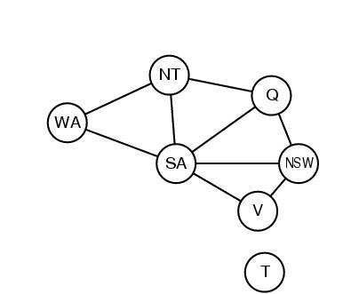
Constraint graphs
Constraint graph:
  nodes are variables
  arcs are binary constraints
Graph can be used to simplify search
e.g. Tasmania is an independent subproblem
(will return to graph structure later)

Slide 63
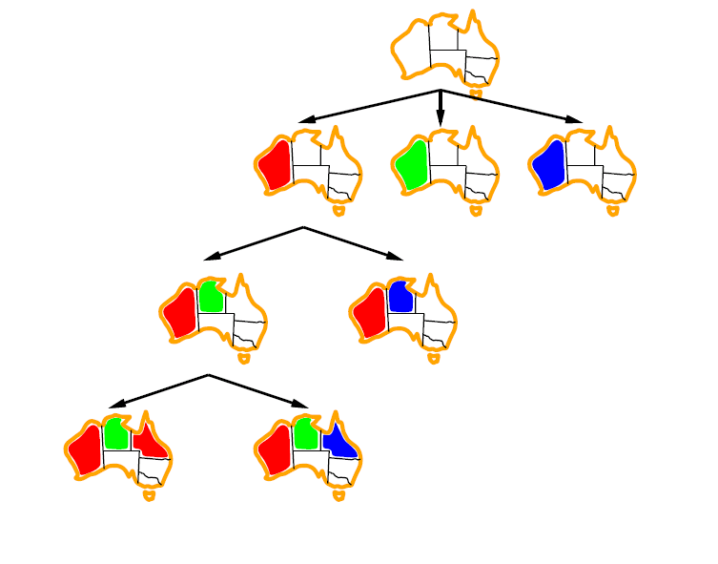
Backtracking example

Slide 64
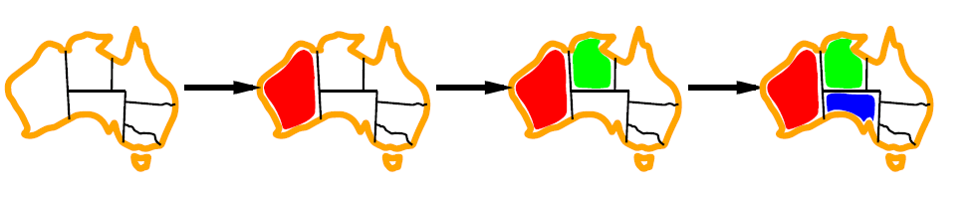
Minimum remaining values (MRV)
var ← SELECT-UNASSIGNED-VARIABLE(VARIABLES[csp],assignment,csp)
A.k.a. most constrained variable heuristic
Heuristic Rule: choose variable with the fewest legal moves
  e.g., will immediately detect failure if X has no legal values

Slide 65

Degree heuristic for the initial variable
Heuristic Rule: select variable that is involved in the largest number of constraints on other unassigned variables.
Degree heuristic can be useful as a tie breaker.
In what order should a variable’s values be tried?

Slide 66
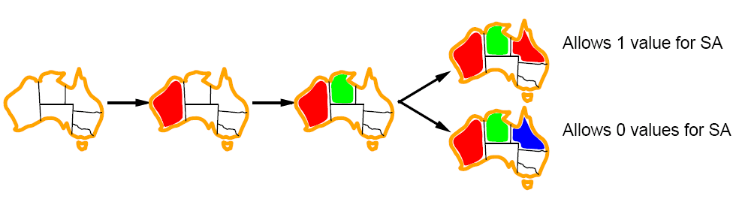
Least constraining value for value-ordering
Least constraining value heuristic
Heuristic Rule: given a variable choose the least constraining value
  leaves the maximum flexibility for subsequent variable assignments

Slide 67
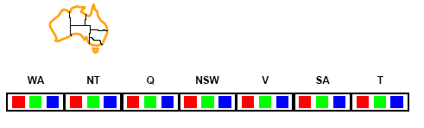
Forward checking
Can we detect inevitable failure early?
  And avoid it later?
Forward checking idea: keep track of remaining legal values for unassigned variables.
When a variable is assigned a value, update all neighbors in the constraint graph.
Forward checking stops after one step and does not go beyond immediate neighbors.
Terminate search when any variable has no legal values.

Slide 68
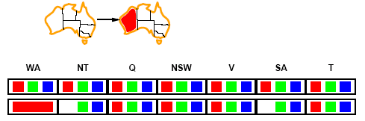
Forward checking
Assign {WA=red}
Effects on other variables connected by constraints to WA
  NT can no longer be red
  SA can no longer be red

Slide 69
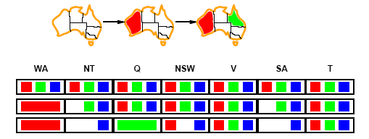
Forward checking
Assign {Q=green}
Effects on other variables connected by constraints with WA
  NT can no longer be green
  NSW can no longer be green
  SA can no longer be green
MRV heuristic would automatically select NT or SA next

Slide 70
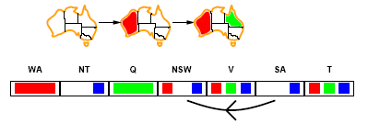
Arc consistency
An Arc X → Y is consistent if
for every value x of X there is some value y consistent with x
(note that this is a directed property)
Put all arcs X → Y onto a queue (X → Y and Y → X both go on, separately)
Pop one arc X → Y and remove any inconsistent values from X
If any change in X, then put all arcs Z → X back on queue, where Z is a neighbor of X
Continue until queue is empty

Slide 71
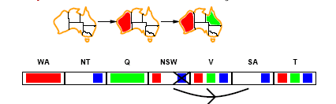
Arc consistency
X → Y is consistent if
for every value x of X there is some value y consistent with x
NSW → SA is consistent if
NSW=red and SA=blue
NSW=blue and SA=???

Slide 72
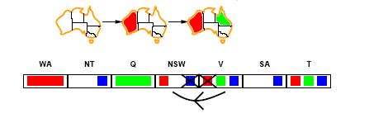
Arc consistency
Can enforce arc-consistency:
Arc can be made consistent by removing blue from NSW
Continue to propagate constraints….
  Check V → NSW
  Not consistent for V = red
  Remove red from V

Slide 73
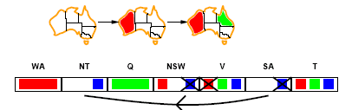
Arc consistency
Continue to propagate constraints….
SA → NT is not consistent
  and cannot be made consistent
Arc consistency detects failure earlier than FC

Slide 74
Local search for CSPs
Use complete-state representation
  Initial state = all variables assigned values
  Successor states = change 1 (or more) values
For CSPs
  allow states with unsatisfied constraints (unlike backtracking)
  operators reassign variable values
  hill-climbing with n-queens is an example
Variable selection: randomly select any conflicted variable
Value selection: min-conflicts heuristic
  Select new value that results in a minimum number of conflicts with the other variables

Slide 75
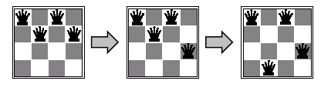
Min-conflicts example 1
h=5
h=3
h=1
Use of min-conflicts heuristic in hill-climbing.

Slide 76
CS-271P Final Review
Propositional Logic
  (7.1-7.5)
First-Order Logic, Knowledge Representation
  (8.1-8.5, 9.1-9.2)
Constraint Satisfaction Problems
  (6.1-6.4, except 6.3)
Machine Learning
  (18.1-18.4)
Questions on any topic
Pre-mid-term material if time and class interest
Please review your quizzes, mid-term, & old tests
  At least one question from a prior quiz or test will appear on the Final Exam (and all other tests)

Slide 77
The importance of a good representation
Properties of a good representation:
Reveals important features
Hides irrelevant detail
Exposes useful constraints
Makes frequent operations easy-to-do
Supports local inferences from local features
  Called the “soda straw” principle or “locality” principle
  Inference from features “through a soda straw”
Rapidly or efficiently computable
  It’s nice to be fast

Slide 78
Reveals important features / Hides irrelevant detail
“You can’t learn what you can’t represent.” --- G. Sussman
In search: A man is traveling to market with a fox, a goose, and a bag of oats. He comes to a river. The only way across the river is a boat that can hold the man and exactly one of the fox, goose or bag of oats. The fox will eat the goose if left alone with it, and the goose will eat the oats if left alone with it.
A good representation makes this problem easy:
1110
0010
1010
1111
0001
0101
Notes:
78

Slide 79
Terminology
Attributes
  Also known as features, variables, independent variables, covariates
Target Variable
  Also known as goal predicate, dependent variable, …
Classification
  Also known as discrimination, supervised classification, …
Error function
  Objective function, loss function, …

Slide 80
Inductive learning
Let x represent the input vector of attributes
Let f(x) represent the value of the target variable for x
  The implicit mapping from x to f(x) is unknown to us
  We just have training data pairs, D = {x, f(x)} available
We want to learn a mapping from x to f, i.e.,
h(x; θ) is “close” to f(x) for all training data points x
θ are the parameters of our predictor h(..)
Examples:
  h(x; θ) = sign(w₁x₁ + w₂x₂+ w₃)
  h_{k}(x) = (x1 OR x2) AND (x3 OR NOT(x4))

Slide 81
Empirical Error Functions
Empirical error function:
  E(h) = Σ_{x} distance[h(x; θ) , f]
  e.g., distance = squared error if h and f are real-valued (regression)
  distance = delta-function if h and f are categorical (classification)
  Sum is over all training pairs in the training data D
  In learning, we get to choose
  1. what class of functions h(..) that we want to learn
  – potentially a huge space! (“hypothesis space”)
  2. what error function/distance to use
  - should be chosen to reflect real “loss” in problem
  - but often chosen for mathematical/algorithmic convenience
Notes:
81

Slide 82
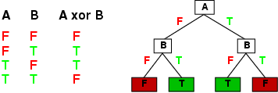
Decision Tree Representations
Decision trees are fully expressive
  can represent any Boolean function
  Every path in the tree could represent 1 row in the truth table
  Yields an exponentially large tree
    Truth table is of size 2^{d}, where d is the number of attributes

Slide 83
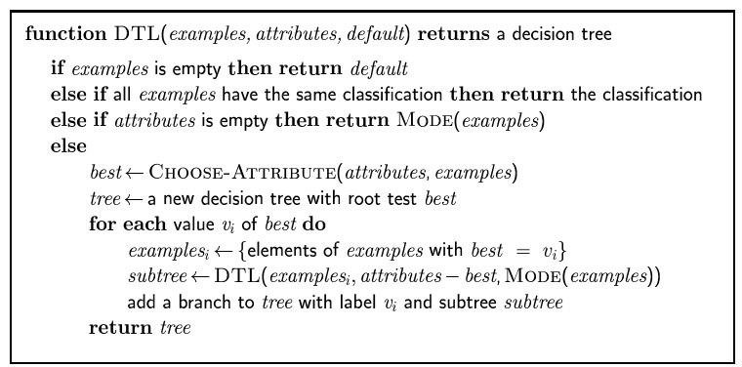
Pseudocode for Decision tree learning

Slide 84
Entropy with only 2 outcomes
  Consider 2 class problem: p = probability of class 1, 1 – p = probability of class 2
  In binary case, H(p) = - p log p - (1-p) log (1-p)
H(p)
1
0
0.5
1
p
Notes:
84

Slide 85
Information Gain
H(p) = entropy of class distribution at a particular node
H(p | A) = conditional entropy = average entropy of conditional class distribution, after we have partitioned the data according to the values in A
Gain(A) = H(p) – H(p | A)
Simple rule in decision tree learning
  At each internal node, split on the node with the largest information gain (or equivalently, with smallest H(p|A))
Note that by definition, conditional entropy can’t be greater than the entropy

Slide 86
Overfitting and Underfitting
Y
X
Notes:
86

Slide 87
A Complex Model
Y = high-order polynomial in X
Y
X
Notes:
87

Slide 88
A Much Simpler Model
Y = a X + b + noise
Y
X
Notes:
88

Slide 89
How Overfitting affects Prediction
Underfitting
Overfitting
Predictive
Error
Error on Test Data
Error on Training Data
Model Complexity
Ideal Range
for Model Complexity

Slide 90
Training and Validation Data
Full Data Set
Idea: train each
model on the
“training data”
and then test
each model’s
accuracy on
the validation data
Training Data
Validation Data
Notes:
90

Slide 91
The k-fold Cross-Validation Method
Why just choose one particular 90/10 “split” of the data?
  In principle we could do this multiple times
“k-fold Cross-Validation” (e.g., k=10)
  randomly partition our full data set into k disjoint subsets (each roughly of size n/k, n = total number of training data points)
    for i = 1:10 (here k = 10)
      train on 90% of data,
      Acc(i) = accuracy on other 10%
    end
    Cross-Validation-Accuracy = 1/k Σ_{i} Acc(i)
  choose the method with the highest cross-validation accuracy
  common values for k are 5 and 10
  Can also do “leave-one-out” where k = n
Notes:
91

Slide 92
Disjoint Validation Data Sets
Validation Data (aka Test Data)
Full Data Set
Validation
Data
1st partition
2nd partition
Training Data
3rd partition
4th partition
5th partition
Notes:
92

Slide 93
Classification in Euclidean Space
A classifier is a partition of the space x into disjoint decision regions
  Each region has a label attached
  Regions with the same label need not be contiguous
  For a new test point, find what decision region it is in, and predict the corresponding label
Decision boundaries = boundaries between decision regions
  The “dual representation” of decision regions
We can characterize a classifier by the equations for its decision boundaries
Learning a classifier ⬄ searching for the decision boundaries that optimize our objective function

Slide 94
Decision Tree Example
Debt
Income > t1
t2
Debt > t2
t3
t1
Income
Income > t3
Note: tree boundaries are
linear and axis-parallel

Slide 95
Another Example: Nearest Neighbor Classifier
The nearest-neighbor classifier
  Given a test point x’, compute the distance between x’ and each input data point
  Find the closest neighbor in the training data
  Assign x’ the class label of this neighbor
  (sort of generalizes minimum distance classifier to exemplars)
If Euclidean distance is used as the distance measure (the most common choice), the nearest neighbor classifier results in piecewise linear decision boundaries
Many extensions
  e.g., kNN, vote based on k-nearest neighbors
  k can be chosen by cross-validation

Slide 96
Overall Boundary = Piecewise Linear
Decision Region
for Class 1
Decision Region
for Class 2
1
2
Feature 2
1
2
?
2
1
Feature 1

Slide 100
Linear Classifiers
Linear classifier ⬄ single linear decision boundary
(for 2-class case)
We can always represent a linear decision boundary by a linear equation:
w₁ x₁ + w₂ x₂ + … + w_{d} x_{d} = Σ w_{j} x_{j} = w^{t} x = 0
In d dimensions, this defines a (d-1) dimensional hyperplane
  d=3, we get a plane; d=2, we get a line
For prediction we simply see if Σ w_{j} x_{j} > 0
The w_{i} are the weights (parameters)
  Learning consists of searching in the d-dimensional weight space for the set of weights (the linear boundary) that minimizes an error measure
  A threshold can be introduced by a “dummy” feature that is always one; it weight corresponds to (the negative of) the threshold
Note that a minimum distance classifier is a special (restricted) case of a linear classifier

Slide 102
The Perceptron Classifier (pages 729-731 in text)
The perceptron classifier is just another name for a linear classifier for 2-class data, i.e.,
output(x) = sign( Σ w_{j} x_{j} )
Loosely motivated by a simple model of how neurons fire
For mathematical convenience, class labels are +1 for one class and -1 for the other
Two major types of algorithms for training perceptrons
  Objective function = classification accuracy (“error correcting”)
  Objective function = squared error (use gradient descent)

Slide 103
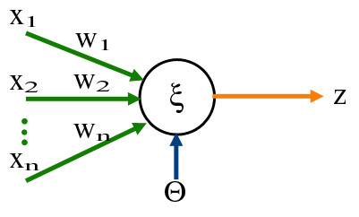
The Perceptron Classifier (pages 729-731 in text)
Transfer Function
Output
Input
Attributes
(Features)
Weights For Input
Attributes
Bias or Threshold

Slide 104
Two different types of perceptron output
x-axis below is f(x) = f = weighted sum of inputs
y-axis is the perceptron output
Thresholded output,
takes values +1 or -1
o(f)
f
σ(f)
Sigmoid output, takes
real values between -1 and +1
The sigmoid is in effect an approximation
to the threshold function above, but
has a gradient that we can use for learning
f

Slide 105
Pseudo-code for Perceptron Training
Initialize each w_{j} (e.g.,randomly)
While (termination condition not satisfied)
  for i = 1: N % loop over data points (an iteration)
    for j= 1 : d % loop over weights
      deltawj = η ( y(i) – σ[f(i)] ) ∂σ[f(i)] x_{j}(i)
      w_{j} = w_{j} + deltawj
    end
  calculate termination condition
  end
Inputs: N features, N targets (class labels), learning rate η
Outputs: a set of learned weights

Slide 106
Support Vector Machines (SVM): “Modern perceptrons”
(section 18.9, R&N)
A modern linear separator classifier
  Essentially, a perceptron with a few extra wrinkles
Constructs a “maximum margin separator”
  A linear decision boundary with the largest possible distance from the decision boundary to the example points it separates
  “Margin” = Distance from decision boundary to closest example
  The “maximum margin” helps SVMs to generalize well
Can embed the data in a non-linear higher dimension space
  Constructs a linear separating hyperplane in that space
    This can be a non-linear boundary in the original space
  Algorithmic advantages and simplicity of linear classifiers
  Representational advantages of non-linear decision boundaries
Currently most popular “off-the shelf” supervised classifier.

Slide 107
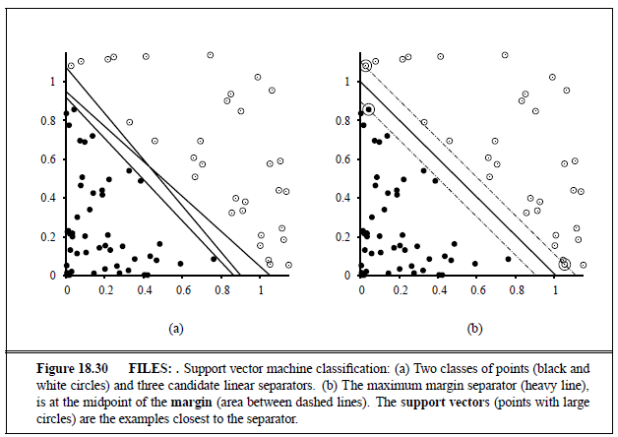
Constructs a “maximum margin separator”

Slide 108
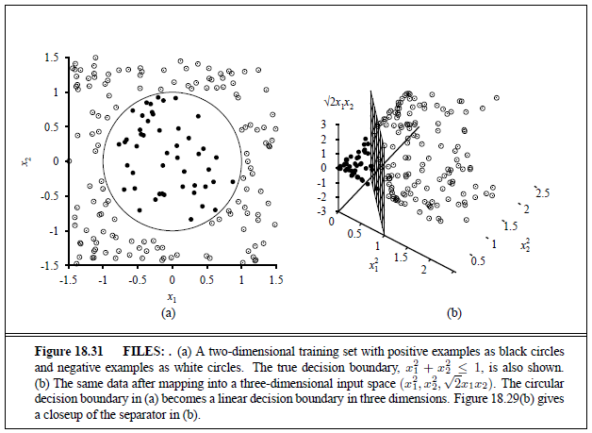
Can embed the data in a non-linear higher dimension space

Slide 109
Multi-Layer Perceptrons (p744-747 in text)
What if we took K perceptrons and trained them in parallel and then took a weighted sum of their sigmoidal outputs?
  This is a multi-layer neural network with a single “hidden” layer (the outputs of the first set of perceptrons)
  If we train them jointly in parallel, then intuitively different perceptrons could learn different parts of the solution
    Mathematically, they define different local decision boundaries in the input space, giving us a more powerful model
How would we train such a model?
  Backpropagation algorithm = clever way to do gradient descent
  Bad news: many local minima and many parameters
    training is hard and slow
  Neural networks generated much excitement in AI research in the late 1980’s and 1990’s
    But now techniques like boosting and support vector machines are often preferred

Slide 110
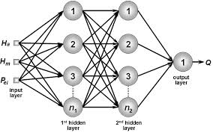
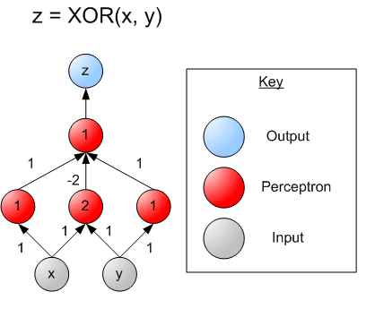
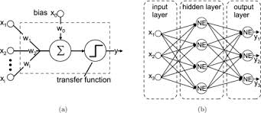
Multi-Layer Perceptrons (Artificial Neural Networks) (sections 18.7.3-18.7.4 in textbook)

Slide 111
Naïve Bayes Model (section 20.2.2 R&N 3rd ed.)
X₁
X₂
X₃
X_{n}
C
Basic Idea: We want to estimate P(C | X₁,…X_{n}), but it’s hard to think about computing the probability of a class from input attributes of an example.
Solution: Use Bayes’ Rule to turn P(C | X₁,…X_{n}) into an equivalent expression that involves only P(C) and P(X_{i} | C).
We can estimate P(C) easily from the frequency with which each class appears within our training data, and P(X_{i} | C) from the frequency with which each X_{i} appears in each class C within our training data.

Slide 112
Naïve Bayes Model (section 20.2.2 R&N 3rd ed.)
X₁
X₂
X₃
X_{n}
C
Bayes Rule: P(C | X₁,…X_{n}) is proportional to P (C) Π_{i} P(X_{i} | C)
[note: denominator P(X₁,…X_{n}) is constant for all classes, may be ignored.]
Features Xi are conditionally independent given the class variable C
  choose the class value c_{i} with the highest P(c_{i} | x₁,…, x_{n})
  simple to implement, often works very well
  e.g., spam email classification: X’s = counts of words in emails
Conditional probabilities P(X_{i} | C) can easily be estimated from labeled date
  Problem: Need to avoid zeroes, e.g., from limited training data
  Solutions: Pseudo-counts, beta[a,b] distribution, etc.

Slide 113
Naïve Bayes Model (2)
P(C | X₁,…X_{n}) = α Π P(X_{i} | C) P (C)
Probabilities P(C) and P(Xi | C) can easily be estimated from labeled data
P(C = cj) ≈ #(Examples with class label cj) / #(Examples)
P(Xi = xik | C = cj)
≈ #(Examples with Xi value xik and class label cj)
/ #(Examples with class label cj)
Usually easiest to work with logs
log [ P(C | X₁,…X_{n}) ]
= log α + Σ [ log P(X_{i} | C) + log P (C) ]
DANGER: Suppose ZERO examples with Xi value xik and class label cj ?
An unseen example with Xi value xik will NEVER predict class label cj !
Practical solutions: Pseudocounts, e.g., add 1 to every #() , etc.
Theoretical solutions: Bayesian inference, beta distribution, etc.

Slide 114
CS-271P Final Review
Propositional Logic
  (7.1-7.5)
First-Order Logic, Knowledge Representation
  (8.1-8.5, 9.1-9.2)
Constraint Satisfaction Problems
  (6.1-6.4, except 6.3)
Machine Learning
  (18.1-18.4)
Questions on any topic
Pre-mid-term material if time and class interest
Please review your quizzes, mid-term, & old tests
  At least one question from a prior quiz or test will appear on the Final Exam (and all other tests)

