Slide 1
Dynamic Slicing
Khanh Nguyen
Donald Bren School of Information & Computer Science
University of California, Irvine

Slide 2
Outline
Introduction
4 approaches to conduct dynamic slicing
Jikes RVM

Slide 3
Dynamic Slicing
Introduction
4 approaches to conduct dynamic slicing
Jikes RVM

Slide 4
Introduction
Program slicing:
Divide into set of statements with regard to a specific variable
Must give the identical result as original program
Benefits:
Testing
Understanding - Verification
Performance improvement
Debugging
etc...
Program
Slicing

Slide 5
Static & Dynamic Slicing
Static Slice: the set of all statements that might affect the value of a given variable occurrence
Dynamic Slice: all statements that actually affect the value of a variable occurrence for a given program input

Slide 6
Dynamic Slice
More helpful than static slice
The process:
Inputs → execution history: all statements executed based on the inputs
Build Dynamic Dependence Graph
Construct the slice using Dynamic Dependence Graph

Slide 7
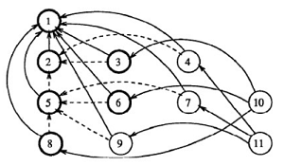
Dynamic Dependence Graph
A set of <V,E> such that
Vertices are statements
Edges
Control Dependence
dashed line
if, while, for, etc...
Data Dependence
regular line
definition and usage

Slide 8
Dynamic Slicing
Introduction
4 approaches to conduct dynamic slicing
Jikes RVM

Slide 9
Example: Static Slicing
S1: |  | read(X);
S2: |  | if (X < 0)
 |  | then
S3: |  |  | Y := a(X);
S4: |  |  | Z := b(X);
 |  | else
S5: |  |  | if (X = 0)
 |  |  | then
S6: |  |  |  | Y := c(X);
S7: |  |  |  | Z := d(X);
 |  |  | else
S8: |  |  |  | Y := e(X);
S9: |  |  |  | Z := f(X);
 |  |  | end_if;
 |  | end_if;
S10: |  | write(Y);
S11: |  | write(Z);

Slide 10
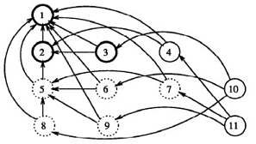
1st Approach
S1: |  | read(X);
S2: |  | if (X < 0)
 |  | then
S3: |  |  | Y := a(X);
S4: |  |  | Z := b(X);
 |  | else
S5: |  |  | if (X = 0)
 |  |  | then
S6: |  |  |  | Y := c(X);
S7: |  |  |  | Z := d(X);
 |  |  | else
S8: |  |  |  | Y := e(X);
S9: |  |  |  | Z := f(X);
 |  |  | end_if;
 |  | end_if;
S10: |  | write(Y);
S11: |  | write(Z);
Input X = -1 : Execution history = <1, 2, 3, 4, 10, 11>

Slide 11
Sounds good?
- No! - What went wrong?
A statement may have multiple reaching definitions of the same variable, hence it may have multiple out-going data dependence edges for the same variable
Selection of such a node triggers domino effect in which all nodes to which it has out-going data-dependence edges also be selected regardless

Slide 12
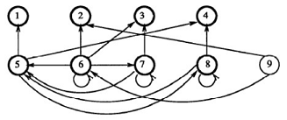
That means...
S1: | read(N);
S2: | Z := 0;
S3: | Y := 0;
S4: | I := 1;
S5: | while (I <= N)
 | do
S6: |  | Z := f(Z,Y)
S7: |  | Y := g(Y);
S8: |  | I := I + 1;
 | end_while;
S9: | write(Z);
Input N = 1 : Execution history = <1, 2, 3, 4, 5¹, 6, 7, 8, 5², 9>

Slide 13
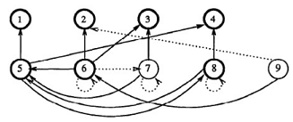
2nd Approach
S1: | read(N);
S2: | Z := 0;
S3: | Y := 0;
S4: | I := 1;
S5: | while (I <= N)
 | do
S6: |  | Z := f(Z,Y)
S7: |  | Y := g(Y);
S8: |  | I := I + 1;
 | end_while;
S9: | write(Z);
Input N = 1 : Execution history = <1, 2, 3, 4, 5¹, 6, 7, 8, 5², 9>

Slide 14
- It works? - No!
A statement may have multiple occurrences in an execution history
Different occurrences may have different reaching definitions thus different dependencies
It is possible that one occurrence contributes to the slice and another does not.

Slide 15
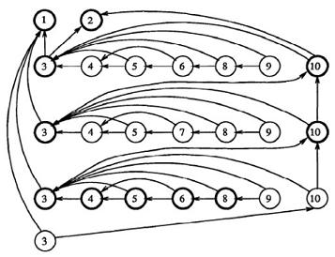
3rd Try
S1: | read(N);
S2: | I := 1;
S3: | while (I <= N)
 | do
S4: |  | read(X);
S5: |  | if (X < 0)
 |  | then
S6: |  |  | Y := f(X);
 |  | else
S7: |  |  | Y := g(X);
 |  | end_if;
S8: |  | Z := h(Y);
S9: |  | write(Z);
S10: |  | I := I +1;
 | end_while;
Input N = 3, X = -4, 3, -2
Execution history = <1, 2, 3¹, 4¹, 5¹, 6¹, 8¹, 9¹, 10¹, 3², 4², 5², 7¹, 8², 9², 10², 3³, 4³, 5³, 6², 8³, 9³, 10³, 3⁴>

Slide 16
There is still a problem!
What is the problem? STORAGE! STORAGE! STORAGE!
The size of the graph is unbounded!
Number of nodes in the graph = number of statements in the execution history = values of run-time inputs = n

Slide 17
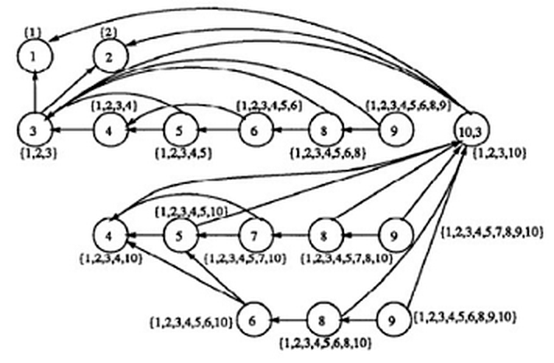
4th Approach Reduced Dynamic Dependence Graph:
S1: | read(N);
S2: | I := 1;
S3: | while (I <= N)
 | do
S4: |  | read(X);
S5: |  | if (X < 0)
 |  | then
S6: |  |  | Y := f(X);
 |  | else
S7: |  |  | Y := g(X);
 |  | end_if;
S8: |  | Z := h(Y);
S9: |  | write(Z);
S10: |  | I := I +1;
 | end_while;

Slide 18
Dynamic Slicing
Introduction
4 approaches to conduct dynamic slicing
Jikes RVM

Slide 19
http://jikesrvm.org
Research Virtual Machine
Written in Java
Originally under control of IBM - Now open source
Hack/Modify Jikes RVM to extract runtime information

Slide 20
Conclusion
The first two approaches: are extension of Static Slicing: simple but yield bigger slice than necessary.
The third approach: depends on the length of execution history.
The forth approach: is proportional to actual number of dynamic slices that arose during execution history

Slide 21
Conclusion
Dynamic Slicing is helpful and effective while debugging, testing and understanding
Despite various approaches, optimal dynamic slicing has not been discovered yet!
Always consider trade offs: precision, speed, storage.

Slide 22
Reference
Agrawal, Hiralal and Joseph R. Horgan. “Dynamic Program Slicing”. Proceedings of the ACM SIGPLAN’90 Conference. White Plains, New York. June 20-22, 1990

Slide 23
THANK YOU!

