Slide 1
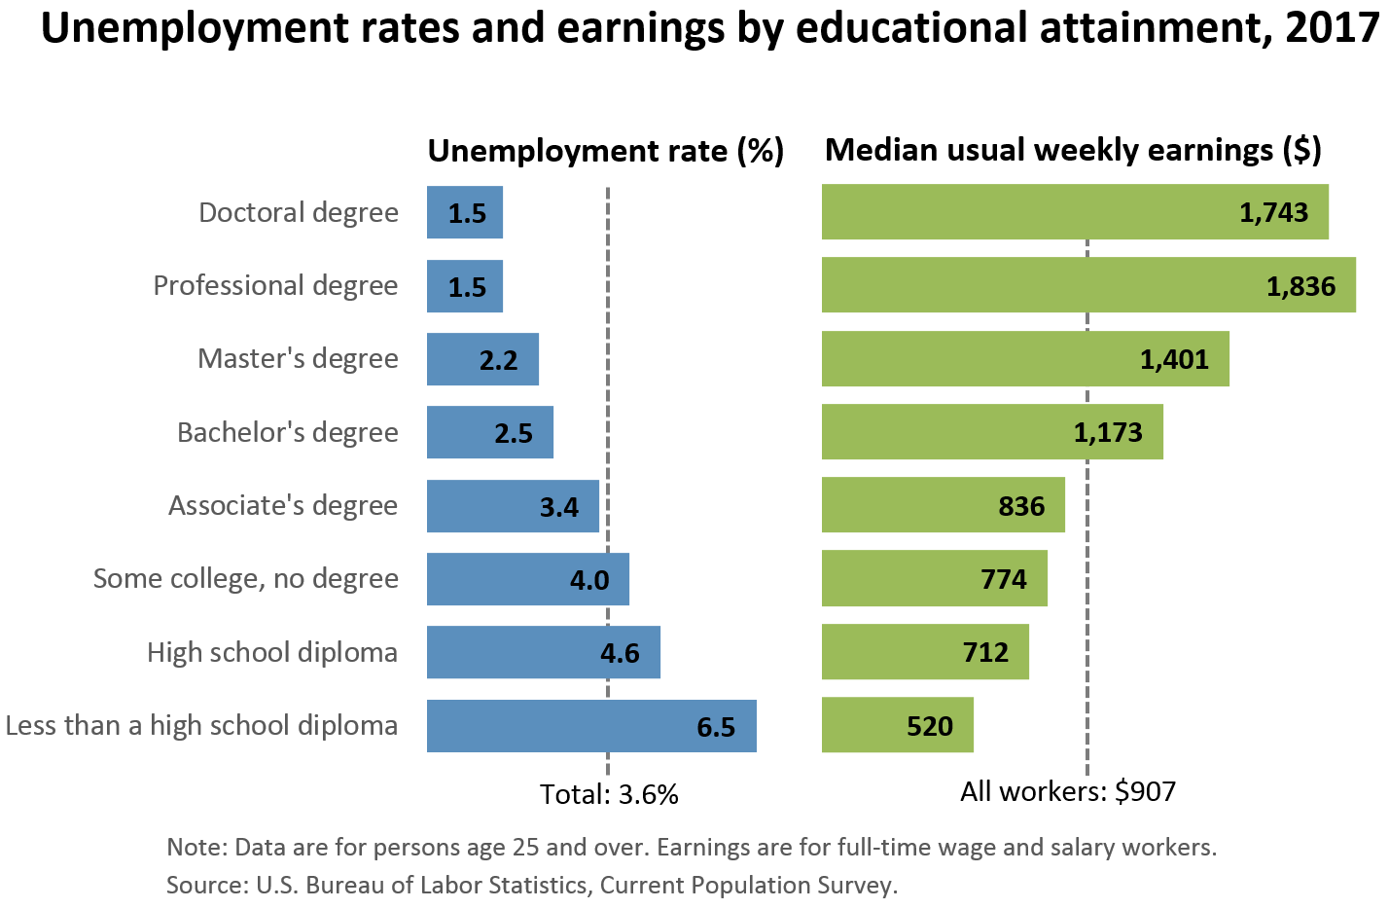
Source: US Bureau of Labor Statistics
https://www.bls.gov/emp/chart-unemployment-earnings-education.htm
This chart does NOT indicate the best reason to go to graduate school.
It DOES show that your time and effort in grad school will not be wasted.
Professional degrees include MD, DDS, DVM, LLB, JD.
(Physicians, dentists, veterinarians, lawyers; the US has not offered the LLB since 1971.)

