Slide 1
ICS FACULTY PANEL ON IMPROVING YOUR GRADUATE SCHOOL APPLICATION Wednesday, 24 Oct., 2018, 9:00am-10:50pm, in DBH-6011 **** Soft drinks and light refreshments will be served. ****
Wondering what to do to improve your graduate school application?
Wondering how the process "really works," and what they look for?
Come to this ICS FACULTY PANEL to hear direct advice from the ICS faculty.
The very people who admit students into the ICS graduate programs
will give advice and answer questions about graduate school applications.
Next, a panel of current ICS graduate students will discuss their
experiences in successfully navigating graduate school admission.
Sophomores, Juniors, and Masters students are especially encouraged
to attend so that they may begin planning for graduate school now.
For students unable to attend the event, a video of the discussion
subsequently will be posted on the ICS SAO web page.

Slide 2
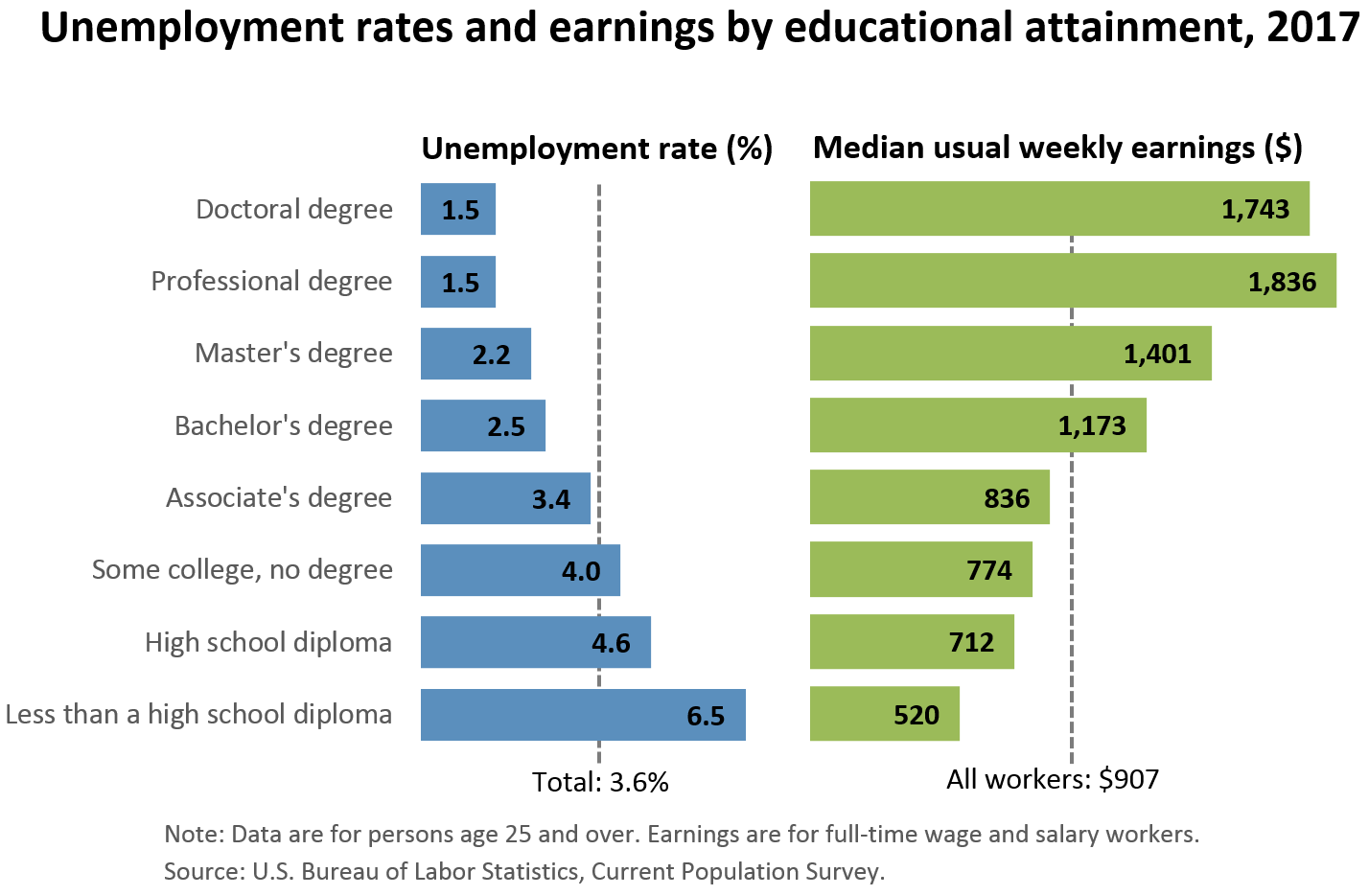
Source: US Bureau of Labor Statistics
https://www.bls.gov/emp/chart-unemployment-earnings-education.htm
This chart does NOT indicate the best reason to go to graduate school.
It DOES show that your time and effort in grad school will not be wasted.
Professional degrees include MD, DDS, DVM, LLB, JD.
(Physicians, dentists, veterinarians, lawyers; the US has not offered the LLB since 1971.)

