Slide 1
ICS FACULTY PANEL ON IMPROVING YOUR GRADUATE SCHOOL APPLICATION Friday, 1 Nov., 2019, 9:00am-10:50pm, in DBH 4011 **** Soft drinks and light refreshments will be served. ****
Wondering what to do to improve your graduate school application?
Wondering how the process "really works," and what they look for?
Come to this ICS FACULTY PANEL to hear advice from ICS faculty members, all of whom were on last year’s ICS Graduate Admission Committees.
The very people who admit students into the ICS graduate programs
will give advice and answer questions about graduate school applications.
Next, a panel of current ICS graduate students will discuss their
experiences in successfully navigating graduate school admission.
Sophomores, Juniors, Seniors, and Masters students are especially encouraged to attend, to help them plan for graduate school in their future.
For students unable to attend the event, a video of the discussion
subsequently will be posted on the ICS SAO web page.

Slide 2
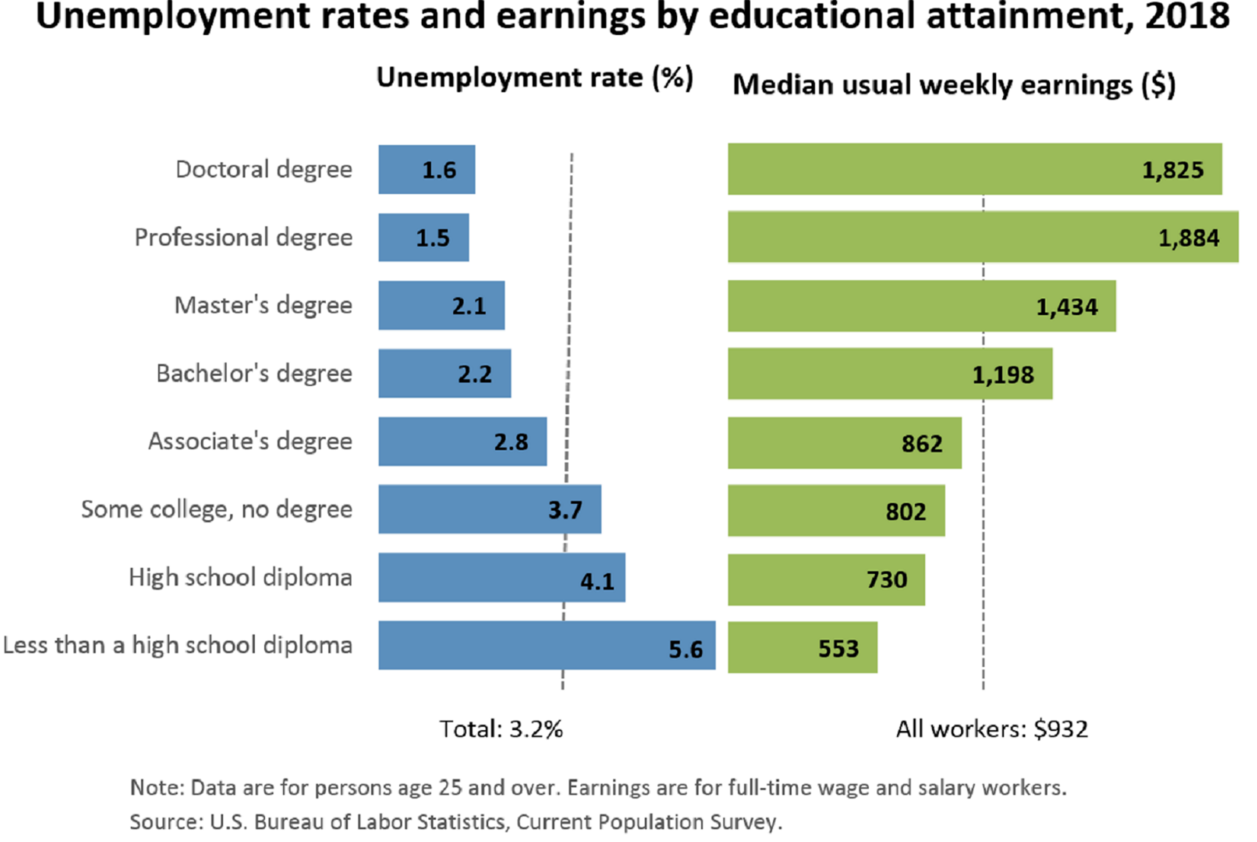
Source: US Bureau of Labor Statistics
https://www.bls.gov/emp/chart-unemployment-earnings-education.htm
This chart does NOT indicate the best reason to go to graduate school.
It DOES show that your time and effort in grad school will not be wasted.
Professional degrees include MD, DDS, DVM, LLB, JD.
(Physicians, dentists, veterinarians, lawyers; the US has not offered the LLB since 1971.)

Slide 3
ICS FACULTY PANEL ON IMPROVING YOUR GRADUATE SCHOOL APPLICATION Friday, Nov. 1, 2019, 9:00-10:50am, in DBH 4011 **** Soft drinks and light refreshments will be served. ****
Wondering what to do to improve your graduate school application?
Come to this ICS FACULTY PANEL to hear direct advice from the ICS faculty.
Daniel Fabrega, Special Guest
UCI Graduate Division, Manager, Outreach, Recruitment and Retention
All ICS Faculty Panelists were on last year’s ICS Graduate Admission Committees
Joshua Garcia, Professor of Informatics
Daniel Gillen, Professor and Chair of Statistics
Sang-Woo Jun, Professor of Computer Science
Stephan Mandt, Professor of Computer Science
Kylie Peppler, Professor of Informatics
Bonnie Ruberg, Professor of Informatics
Isaac Scherson, Professor of Computer Science
Following the faculty, a panel of current ICS graduate students will discuss their experiences in how they successfully navigated graduate school admission.

