Slide 1
Intelligent Systems and Molecular Biology
Richard H. Lathrop
Dept. of Computer Science
Univ. of California, Irvine
rickl@uci.edu
Donald Bren Hall 4224
949-824-4021
Notes:
Hi everyone, the title of my presentation is …………………………………….
Today I will be describing a novel Gene Synthesis technique discovered by Dr. Hatfield, my PI, in the department of microbiology and molecular genetics and Dr. Lathrop in the school of information and computer science.

Slide 2
“Computers are to Biology as Mathematics is to Physics.”
--- Harold Morowitz
(spiritual father of BioMatrix, and Intelligent Systems for Molecular Biology Conference)
Goal of talk: The power of information science to influence molecular science and technology

Slide 3
Intelligent Systems and Molecular Biology
Artificial Intelligence for Biology and Medicine
  Biology is data-rich and knowledge-hungry
  AI is well suited to biomedical problems
Examples (omitted for brevity)
  Machine learning -- drug discovery
  Rule-based systems – drug-resistant HIV
  Heuristic search -- protein structure prediction
  Constraints – design of large synthetic genes
Current Project
  Machine learning and p53 cancer rescue mutants
Goal of talk: The power of information science to influence molecular science and technology

Slide 4
Biology has become Data Rich
Massively Parallel Data Generation
  Genome-scale sequencing
  High-throughput drug screening
  Micro-array “gene chips”
  Combinatorial chemical synthesis
  “Shotgun” mutagenesis
  Directed protein evolution
  Two-hybrid protocols for protein interaction
  A million biomedical articles per year

Slide 5
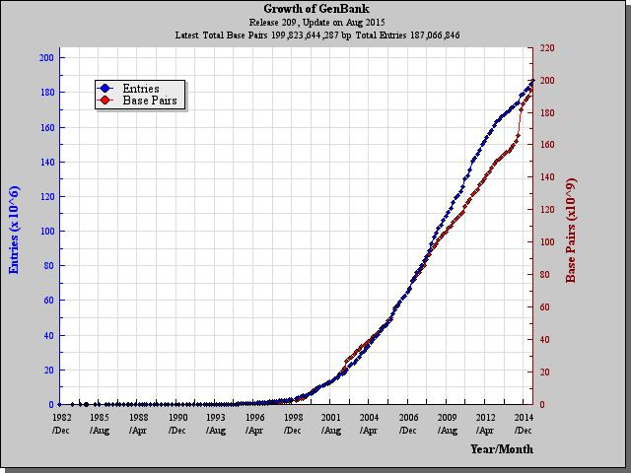
“Data Rich”
GenBank Genomic Sequence Data

Slide 6

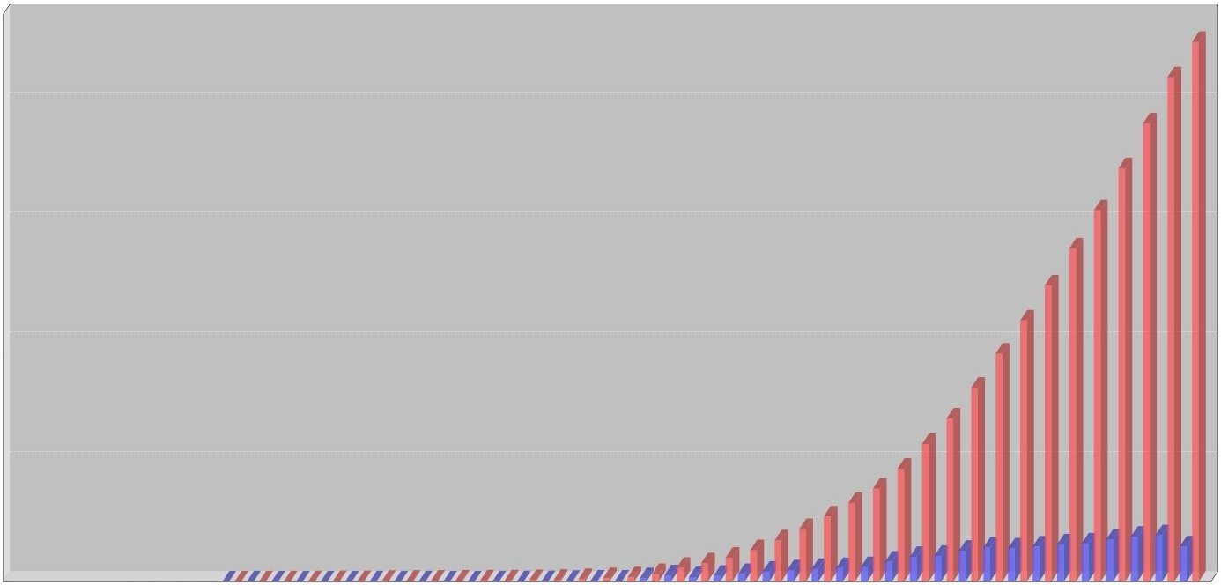
“Data Rich”
PDB Protein 3D Structure Data

Slide 7
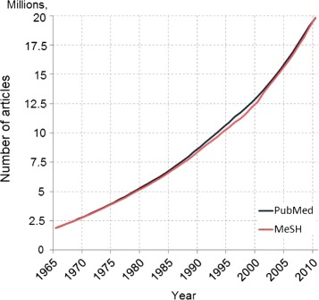
“Data Rich”
PubMed Biomedical Literature

Slide 8
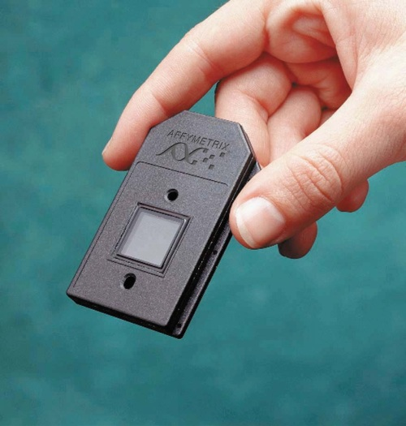
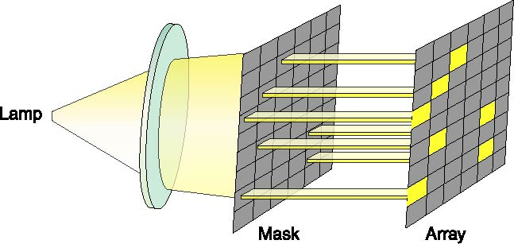
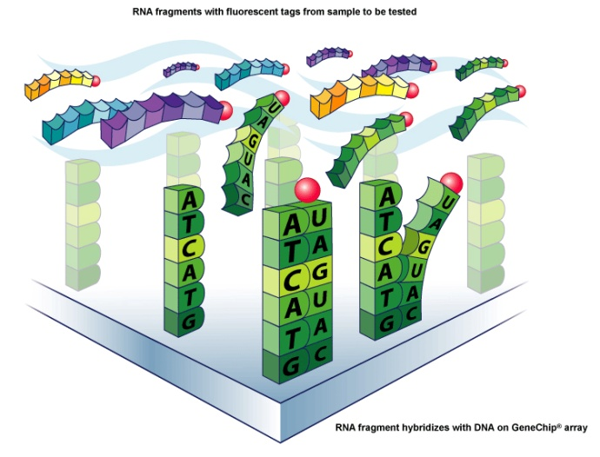
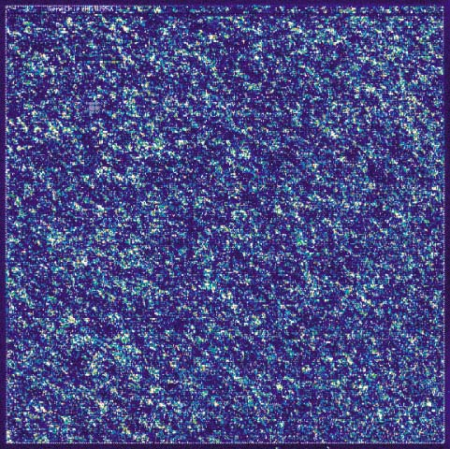
“Data Rich”
10-100K data points per gene chip

Slide 9
Characteristics of Biomedical Data
Noise!!
  => need robust analysis methods
Little or no theory.
  => need statistics, probability
Multiple scales, tightly linked.
  => need cross-scale data integration
Specialized (“boutique”) databases
  => need heterogeneous data integration

Slide 10
Intelligent Systems are well suited to biology and medicine
Robust in the face of inherent complexity
Extract trends and regularities from data
Provide models for complex processes
Cope with uncertainty and ambiguity
Content-based retrieval from literature
Ontologies for heterogeneous databases
Machine learning and data mining
Intelligent systems handle complexity with grace

Slide 11
Intelligent Systems and Molecular Biology
Artificial Intelligence for Biology and Medicine
  Biology is data-rich and knowledge-hungry
  AI is well suited to biomedical problems
Examples
  Machine learning -- drug discovery
  Rule-based systems – drug-resistant HIV
  Heuristic search -- protein structure prediction
  Constraints – design of large synthetic genes
Current Project
  Machine learning and p53 cancer rescue mutants
Goal of talk: The power of information science to influence molecular science and technology

Slide 12
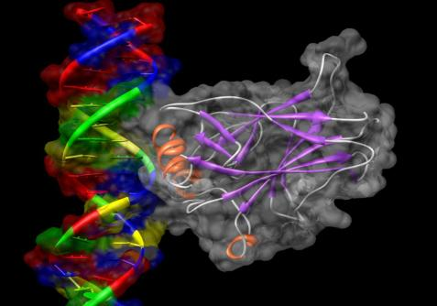
p53 and Human Cancers
p53 is a central tumor suppressor protein
“The guardian of the genome”
Controls many tumor suppression functions
Monitors cellular distress
The most-mutated gene in human cancers
All cancers must disable the p53 apoptosis pathway.
p53 core domain bound to DNA
Image generated with UCSF Chimera
Cho, Y., Gorina, S., Jeffrey, P.D., Pavletich, N.P.
Crystal structure of a p53 tumor suppressor-DNA complex: understanding tumorigenic mutations.
Science v265 pp.346-355, 1994
Notes:
12

Slide 13
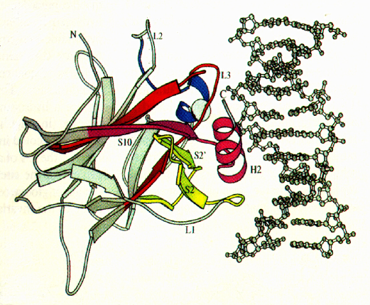
Consequences of p53 mutations
~250,000 US deaths/year
Loss of DNA contact
Disruption of
local structure
Denaturation of
entire core domain
Over 1/3 of all human cancers express full-length p53 with only one a.a. change
Cho et al., Science 265, 346-355 (1994)

Slide 14
Mutations Rescue Cancerous p53
Cancer
Wild Type
Active p53
Cancer Mutation
Inactive p53
Cancer+Rescue Mutations
Active p53
Ultimate Goal
Cancer
+
=
Anti-Cancer Drug
Cancer Mutation
Inactive p53
Active p53
Notes:
14

Slide 15
Suppressor Mutations
Several second-site mutations restore functionality to some p53 cancer mutants in vivo.
248
249
273
175
245
282
N
S
C
C
1-42
102-292
324-355
Transactivation
Core domain for DNA binding
Tetramerization

Slide 16
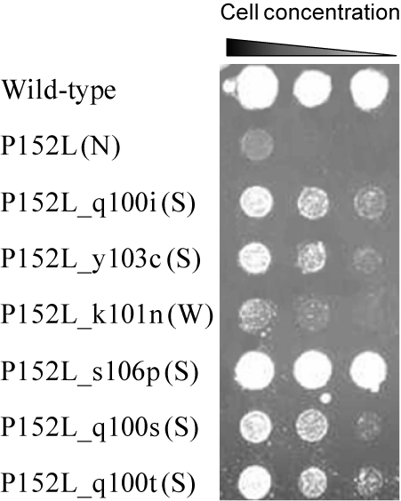
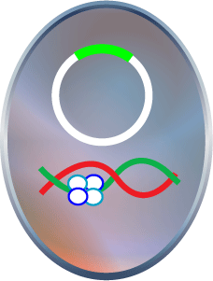
Class Labels: Active/+ or Inactive/-
p53 Transcription Assay
Initial: Yeast Growth Selection, Sequencing
Confirm: Human 1299 Cell-based Luciferase
ACTIVE (+)
First measurement
Firefly luciferase
p53 dependent
Will grow.
Human p53
consensus
URA−
Will not grow.
Second measurement
Renilla luciferase
p53 independent
(S) = Strong
(W) = Weak
(N) = Negative
INACTIVE (-)
Baroni, T.E., et al., 2004
Danziger, S.D., et al., 2009
Baronio, R., et al., 2010
Notes:
16
Fix the second picture. The tetramer binds to the p53 DNA

Slide 17
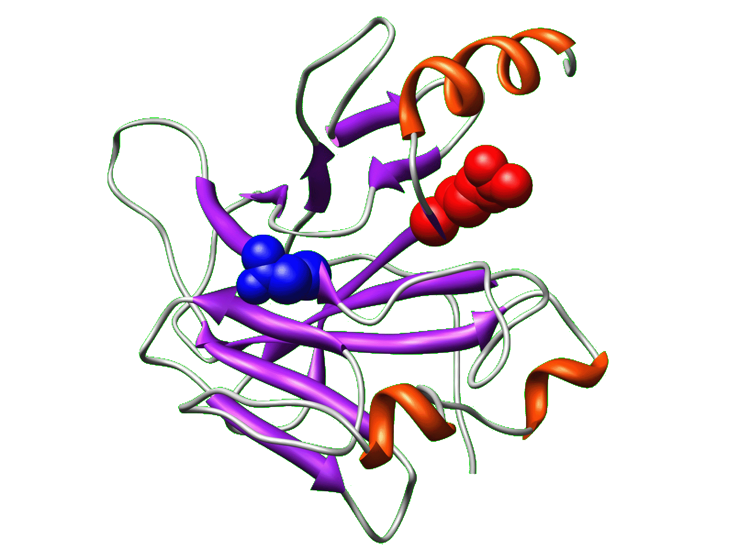
Active Machine Learning for Biological Discovery
Find New Cancer Rescue Mutants
Knowledge
Theory
Experiment
Notes:
17
So I apply this algorithm to biological experimentation.

Slide 18
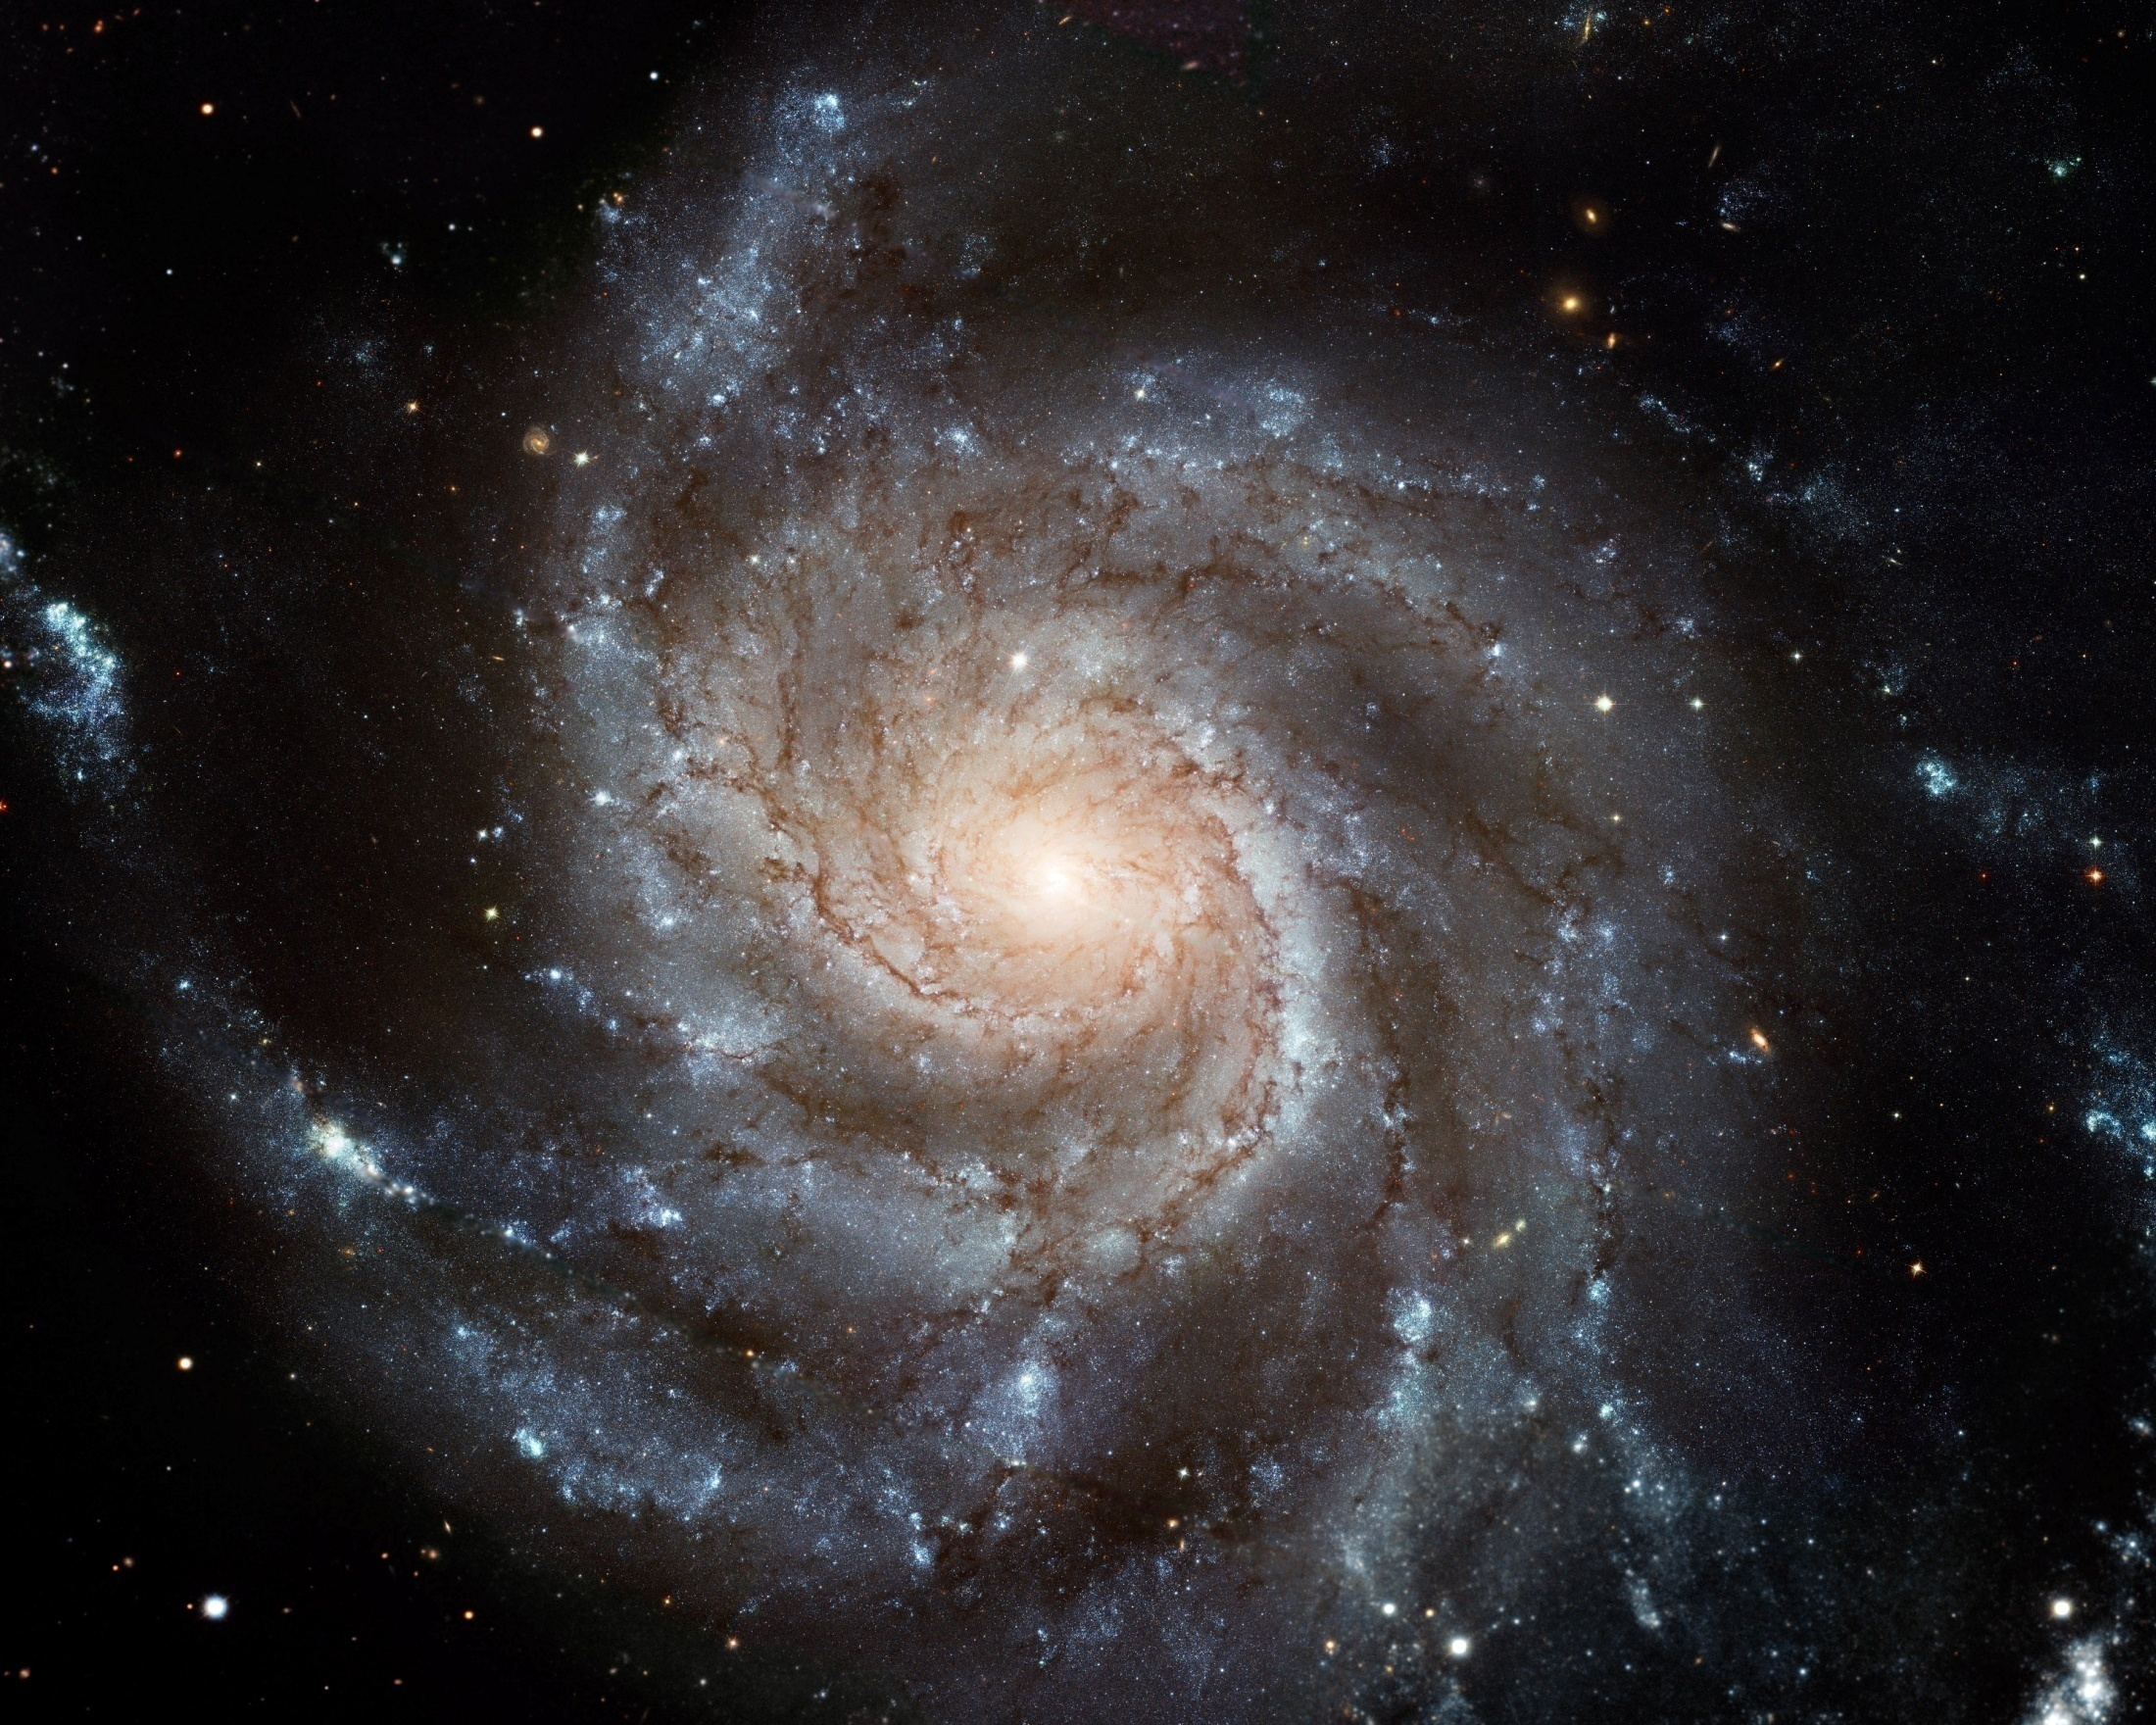
How Big is The Problem?
Known Mutants: 31,200
Known Actives: 150
Assuming up to 5 mutations in 200 residues
How Many Mutants are There?: ~10^11
Known Mutants
~312 stars
Known Actives
~1.5 stars
Spiral Galaxy M101
http://hubblesite.org/
~10^9 stars.
Notes:
18

Slide 19
Computational Active Learning
Pick the Best (= Most Informative) Unknown Examples to Label
Known
Unknown
Example 1
Example N+1
Train the Classifier
Example 2
Classifier
Example N+2
Example 3
Example N+3
…
Choose Examples to Label
Example N+4
Example N
…
Example M
Training Set
Add New Examples
To Training Set
Notes:
19

Slide 20
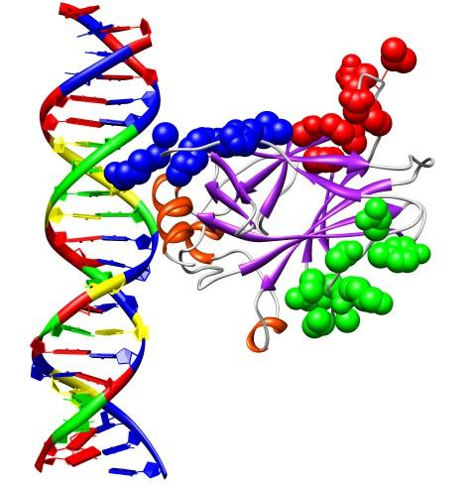
Visualization of Selected Regions
Positive Region:
Predicted Active
96-105 (Green)
Negative Region:
Predicted Inactive
223-232 (Red)
Expert Region:
Predicted Active
114-123 (Blue)
Danziger, et al. (2009)
Notes:
20

Slide 21
Novel Single-a.a. Cancer Rescue Mutants
 | MIP Positive (96-105) | MIP Negative (223-232) | Expert (114-123)
# Strong Rescue | 8 | 0 (p < 0.008) | 6 (not significant)
# Weak Rescue | 3 | 2 (not significant) | 7 (not significant)
Total # Rescue | 11 | 2 (p < 0.022) | 13 (not significant)
p-Values are two-tailed, comparing Positive to Negative and Expert regions. Danziger, et al. (2009)
No significant differences between the MIP Positive and Expert regions.
Both were statistically significantly better than the MIP Negative region.
The Positive region rescued for the first time the cancer mutant P152L.
No previous single-a.a. rescue mutants in any region.

Slide 22
A Long-held Goal of Anti-cancer Therapy
Restore p53 function
by a drug compound
p53
active
inactive
cancer mutant
reactivation
compound
Restore p53 tumor suppressor
pathways in tumor cells
reactivated

Slide 23
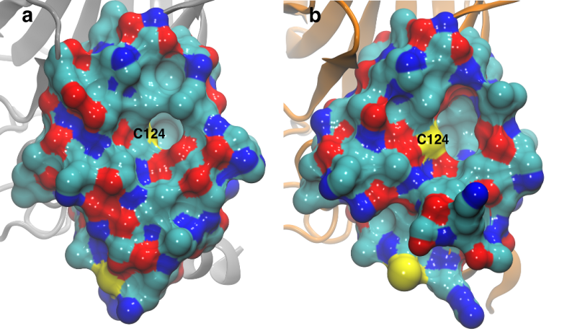
A Serendipitous Discovery
(With a Great Deal of Support)
Cys124 (yellow) is occluded in “closed” PDB structure.
(b) Cys124 structural “breathing” in “open” MD geometry.
(Wassman, et al., 2013)

Slide 24
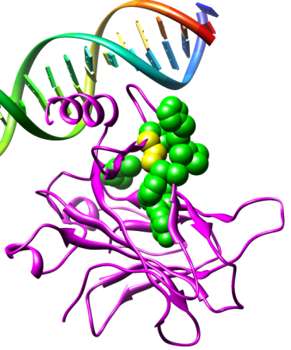
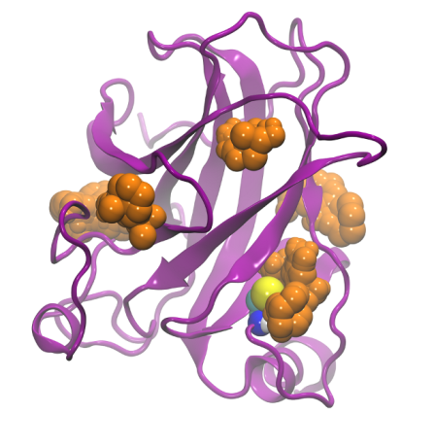
Other Computational Support
c
d
(c) Cys 124 (yellow) is surrounded by p53 reactivation (“rescue”) mutations (green) (Wassman, et al., 2013)
(d) “Druggable” pockets in p53 from FTMAP (orange)
(Brenke, et al., 2009)

Slide 25
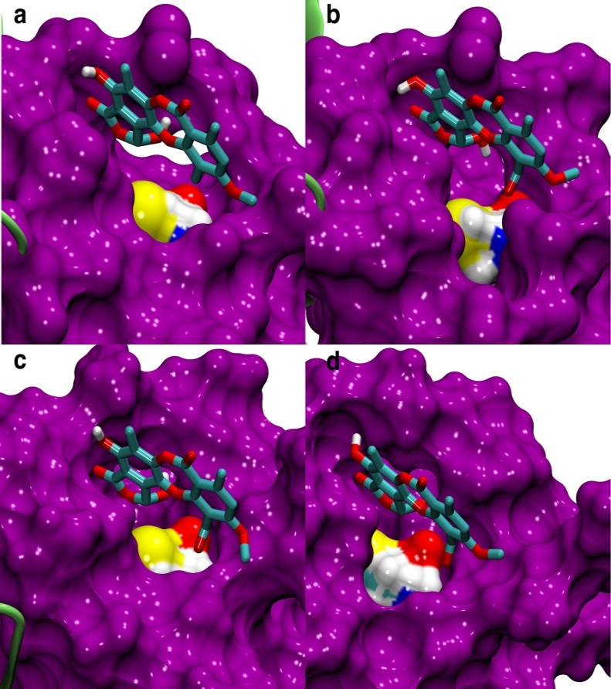
Stictic acid docked into open L1/S3 pocket of p53 variants
wt p53; (b) R175H; (c) R273H; (d) G245S.
(Wassman, et al., 2013)

Slide 26
14 Actives in first 91 assayed
1
Saos-2
(p53^{null})
0.8
0.6
R175H
0.4
G245S
0.2
0
22LSV
28NZ6
32LDE
Vehicle
25KKL
26RQZ
33BAZ
27VFS
35ZWF
32CTM
33AG6
PRIMA-1
27WT9
27TGR
Stictic acid
Soas2, Soas2-p53-R175H or Soas2-G245S cells plated at 10000 per well with the different compounds. Samples are collected after 72 hours and tested for cell viability (Cell-titer Glo, promega). Selective inhibition of R175H (red) or G245S (blue) cells versus p53null cells (black) identifies a compound that potentially reactivates p53.

Slide 27
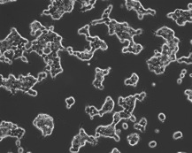
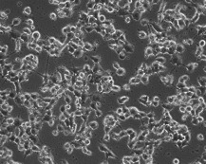
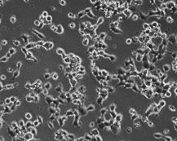
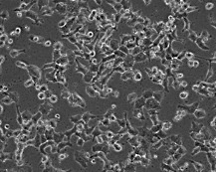
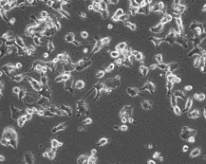
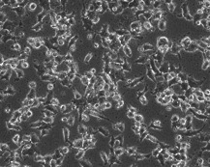
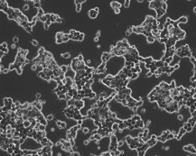
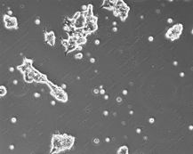
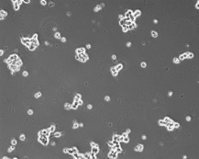
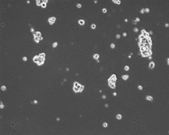
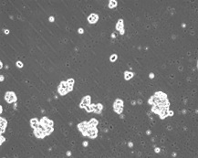
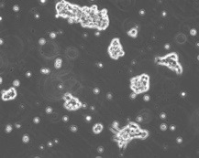
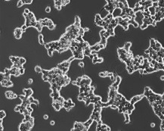
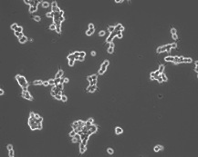
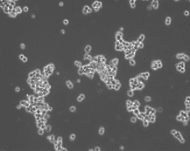
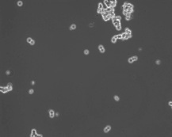
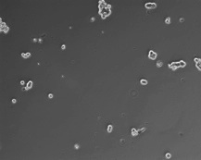
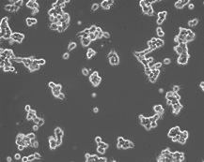
Photomicrograph of cell viability
(of 91 compounds assayed)
DMSO
26RQZ
27WT9
33AG6
33BAZ
35ZWF
p53-null
R175H
G245S
Compounds induced cell death in cells expressing p53 cancer mutants but not p53^{null} cells. Cells were cultured with vehicle (DMSO) or the compounds indicated (concentrations as above) for 24 h and micrographs were taken.

Slide 28

The long road to a future anti-cancer drug
Peter Kaiser
Rommie Amaro
Dick Chamberlin
Melanie Cocco
Hudel Luecke
Wes Hatfield
Chris Wassman
Roberta Baronio
Ozlem Demir
Faezeh Salehi
Edwin Vargas
Da-Wei Lin
Scott Rychnovsky
Michael Holzwarth
Geoff Tucker
Feng Qiao
N
I
II
S
III
C
C
drug
IV
V
N
I
II
S
III
C
IV
V
C
N
I
II
S
III
C
IV
V
C
N
I
II
S
III
IV
C
V
C
N
I
II
S
III
C
IV
V
C
N
I
II
S
III
C
IV
V
C
N
I
II
S
III
C
C
N
S
IV
V
C
C
I
II
III
IV
V
N
I
II
S
III
C
IV
V
C
N
I
C
II
S
III
IV
V
C
N
I
C
S
C
II
III
IV
V
N
I
II
S
III
C
C
N
S
C
IV
V
C
I
II
III
IV
V
C
N
I
II
S
III
IV
V
C
N
I
II
S
III
C
IV
V
C
N
I
C
S
C
N
II
III
S
IV
V
C
C
I
II
III
IV
V
N
I
II
S
III
C
IV
V
C
N
I
II
S
III
C
IV
V
C

Slide 29
Intelligent Systems and Molecular Biology
Artificial Intelligence for Biology and Medicine
  Biology is data-rich and knowledge-hungry
  AI is well suited to biomedical problems
Examples
  Machine learning -- drug discovery
  Rule-based systems – drug-resistant HIV
  Heuristic search -- protein structure prediction
  Constraints – design of large synthetic genes
  DNA nanotechnology and space-filling DNA tetrahedra
Current Project
  Machine learning and p53 cancer rescue mutants
Goal of talk: The power of information science to influence molecular science and technology

Slide 30
p53 Cancer Rescue Acknowledgments
Rainer Brachmann (discovered p53 cancer rescue mutants)
Peter Kaiser (co-PI for biology)
Rommie Amaro (UCSD, molecular dynamics, virtual screening, docking)
Scott Rychnovsky (current synthetic chemistry work)
Wes Hatfield (Director, Computational Biology Research Lab)
Hartmut (“Hudel”) Luecke (DSF and other structural biology work)
Feng Qiao (protein structural biology work)
Chris Wassman (then post-doc, now at Google; L1/S3 pocket)
Roberta Baronio (then esearch scientist, now at Oxford; biology work)
Ozlem Demir (UCSD, molecular dynamics, virtual screening & docking)
Faezeh Salehi (then graduate student, now data science researcher)
Other Colleagues: Linda Hall, Melanie Cocco, Pierre Baldi, Richard Chamberlin, Jonathan Chen, Ray Luo, Edwin Vargas, Geoff Tucker
Funding: UCI Chao Cancer Center, UCI Medical Scientist Training Program, UCI Office of Research and Graduate Studies, UCI Institute for Genomics and Bioinformatics, Harvey Fellowship, US National Science Foundation,
US National Institutes of Health (National Cancer Institute)

