Slide 1
Requirements Quality Assurance
Ch. 5 Lecture Notes
IN4MTX 113
January 2010

Slide 2
Chapter 5 Topics
Inspections and Reviews
Queries using a Requirements Database
Validation by Specification Animation
Verification through Formal Checks

Slide 3
Congrats. You wrote your first RD.
… but who checked it?

Slide 4
Why Have Inspections and Reviews?
Validate that the RD:
Reflects stakeholder needs
Explains the system accurately
Get feedback
Progress
Customer feedback
Subject matter experts that can catch your mistakes
End goal: have an accurate, complete, and consolidated RD

Slide 5
Requirements Inspection Process

Slide 6
Requirements Inspection Process

Slide 7
Inspection Planning
Different terms: Walkthroughs, Colleague Reviews, Peer Reviews
Subtle differences involving scope and format of these reviews
Which one to use?
Planning involves the basics: schedule, scope, have your document ready to review, decide who is getting invited, find a conference room, etc

Slide 8
Some Guidance to Inspection Planning
Time it well
Limit the number of people attending: key experts and stakeholders only (max: 7, min: 3)
Don’t invite any manager
Give your reviewers enough time
Get your comments ahead of time
Customers are tricky

Slide 9
Requirements Inspection Process

Slide 10
Individual Reviewing
Free Form/Free Style
No direction given
Find what you can
Checklist-based
Specifics you want your reviewers to provide feedback: format, readability, clarity, consistency (defects), language and semantics
Process-based
Assign roles
Seek different perspectives from specific disciplines: safety, design, test, quality

Slide 11
Example: Defect-based Checklist
Omission: Was something greatly missed?
Contradiction: Consistent with other requirements/concepts?
Inadequacy: Did this meet the stakeholders needs?
Ambiguity: Too many interpretations?
Immeasurability: Are these requirements verifiable?
Noise: Are these statements relevant?
Over specification Do these requirements add any value to verify?
Unfeasibility Is this possible?
Unintelligibility Why is this statement/requirement here?
Poor Structuring Bad wording?
Forward Reference Is the concept defined later in the document?
Remorse Has the concept been used before definition?
Propagated Changes Would a change here propagate elsewhere?
Opacity Are the dependencies visible?

Slide 12
Some Guidance to Individual Reviewing
Ask yourself: what are you seeking?
Technical accuracy?
Clarity in wording?
… then ask your reviewers for the same.
Providing direction will yield the best results: go with checklist-based or process-based reviews.

Slide 13
Requirements Inspection Process

Slide 14
Defect Evaluation at Review Meetings
Have the inspection review meeting, collect comments.
Tips:
Excel is very powerful / matrix comments, resolution, action items
Document the problem … analyze later.

Slide 15
Defect Evaluation at Review Meetings
an example

Slide 16
Requirements Inspection Process

Slide 17
RD Consolidation
Consolidate comments
Tip: decide your next action
Resolve conflicting comments
Defer if the conflict gets out of hand
Disagreeing with a comment
Reconcile comments with your updated RD

Slide 18
Requirements Inspection Process

Slide 19
Queries on a Database
A
B
√ Consistency Checks
√ Metrics
√ Deltas
Requirements
Database
Data/Models In
Outputs

Slide 20
Queries on a Database
Full Inspection Review of Version A
Delta Inspection Review of Version B
A
B
√Deltas

Slide 21
Queries on a Database
Queries can be made to determine consistency in wording and assigned entities
Queries for metrics:
# of requirements: Volatile requirements comparison (Version A vs Version B)
# of specific requirements: i.e. how many requirements related to interfaces? Safety requirements?
Traceability: finding orphaned requirements, childless parents
Deltas from one baseline of an RD to the next

Slide 22
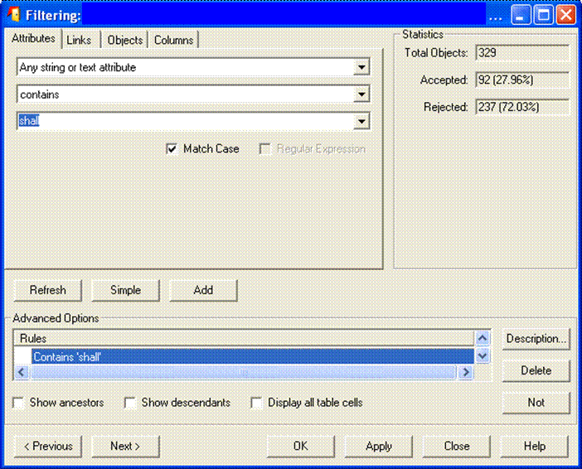

Slide 23
Validation by Specification Animation
The point: to check the adequacy of requirements and the assumptions you’ve made
Extracting an executable model from the specification: what perspective do we want to animate?
Validation Scenarios
Does the system behave as expected?
Mimic possible behaviors of the environment
Demonstrate that the software can respond to outside events

Slide 25
Pitfalls using Animation/Simulation
You still need a formal specification
Tricky things can happen in the environment
Simulated models will not catch these anomalies
Experts are needed
Not everything can be represented
Gaps will exist between animated model and original specification
Adequacy of model vs inadequacy of what was specified

Slide 26
Verification through Formal Checks
Language Checks
Dedicated Consistency and Completeness Checks
Model Checking
Theorem Proving

Slide 27
Model Checking

Slide 28
Proof by Counterexample
init: (doorsClosed, trainStopped)
start: (doorsClosed, trainMoving)
[speed = 0]: (doorsClosed, trainStopped)
opening: (doorsOpen, trainStopped)
start: (doorsOpen, trainMoving)
Missing from
DoorsState = ‘closed’

