Slide 1
Progressive Approach to Relational Entity Resolution
Yasser Altowim, Dmitri Kalashnikov, Sharad Mehrotra

Slide 2

Progressive ER
Progressive ER

Slide 3
Relational Dataset
Paper
Id | Title | Authors | Venue
p₁ | Transaction Support in Read Optimized … | {a₁, a₂} | u₁
p₂ | Read Optimized File System Designs: … | {a₁} | u₂
p₃ | Transaction Support in Read Optimized … | {a₃, a₄} | u₃
p₄ | Berkeley DB: A Retrospective .. | {a₃} | u₄
Author Venue
Id | Name | Papers
a₁ | Marge Seltzer | {p₁, p₂}
a₂ | Michael Stonebraker | {p₁}
a₃ | Margo I. Seltzer | {p₃, p₄}
a₄ | M. Stonebraker | {p₃}
Id | Name | Papers
u₁ | Very Large Data Bases | {p₁}
u₂ | ICDE Conference | {p₂}
u₃ | VLDB | {p₃}
u₄ | IEEE Data Eng. Bull | {p₄}

Slide 4

Graph Representation
p₁, p₃
u₁, u₃
duplicate
Resolve
duplicate

Slide 5
Problem Definition
Given a relational dataset D, and a cost budget BG,
Our goal is to develop a progressive approach that produces a high-quality result using BG units of cost.
Notes:
5

Slide 6

ER Graph
R₁ S₁
T₁
S₂
R₂ T₂
Notes:
6

Slide 7
ER Graph
v₁
v₅
v₉
v₂
v₆
v₁₀
v₃
v₇
v₁₁
R₁ S₁
T₁
v₄
v₈
v₁₂
S₂
R₂ T₂
Notes:
7

Slide 8
Partially Constructed Graph
v₁
v₅
v₉
v₂
v₆
v₁₀
v₃
v₇
v₁₁
R₁ S₁
T₁
v₄
v₈
v₁₂
S₂
R₂ T₂
Notes:
8

Slide 9



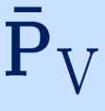
Resolution Windows
BG
Window 1
Window 2
…
Window n
Plan Generation.
Plan Execution ( ).
Resolution Plan ( )
Set of blocks ( ) to be instantiated.
Set of nodes ( ) to be resolved.
Lazy Resolution Strategy
Notes:
9

Slide 10
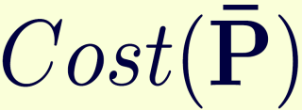

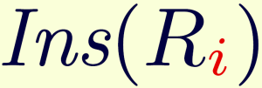
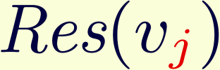




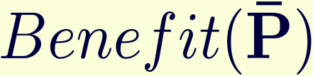


Plan Cost and Benefit
Notes:
10

Slide 11


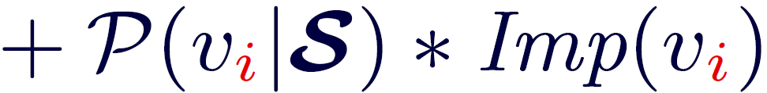
Node Benefit
State
v₃
…
…
v₁
v₅
…
v₄
…
v₂
v₆
…
…
Direct Benefit
Indirect
Benefit
Notes:
11

Slide 12


Plan Generation Phase
Benefit-vs-Cost Analysis:
  Each node and block has an updated cost and benefit.
Generate a plan such that:
  h .
  is maximized.
NP-hard
Oregon-Trail Knapsack
Notes:
12

Slide 13


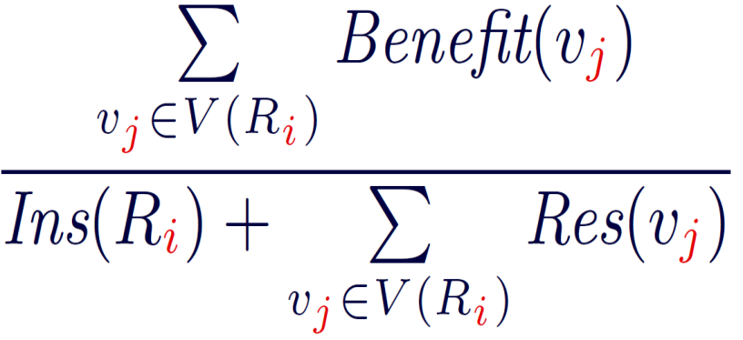
Plan Generation Algorithm
Instantiated
Unresolved Nodes
Step#1
v₁
v₂
v₄
v₁
v₂
v₆
v₆
v₇
v₁₀
v₁₃
v₁₀
v₁₆
v₁₅
v₁₆
v₂₁
Uninstantiated Blocks
Step#2
R₁
R₂
R₄
R₅
R₆
R₈
R₉
Notes:
13

Slide 14









Plan Generation Algorithm
R₁
…
R₈
R₆
R₂
Step#3
v₃₀
v₃₂
v₃₄
v₁
v₂
v₄₀
v₄₂
v₄₅
v₃₆
v₃₈
v₁₀
v₃₀
v₄₇
v₄₈
v₁
v₂
v₆
  If >
  else
  return and
v₁₀
v₁₆
Notes:
14

Slide 15
Experimental Evaluation
CiteSeerX Dataset
    Papers (P)
    Authors (A)
    Venues (U)
    = (Title, Abstract, Keywords, Authors, Venue).
    = (Name, Email, Affiliation, Address, Paper).
    = (Name, Year, Pages, Papers).
 | Number of Entities | Blocking Functions | Similarity Functions | Resolve Function
P | 30,000 | 2 | 3 | Naïve Bayes
A | 83,152 | 1 | 4 | Naïve Bayes
U | 30,000 | 1 | 3 | Naïve Bayes

Slide 16
Experimental Evaluation
Algorithms:
  DepGraph.
    X. Dong et al. Reference reconciliation in complex information spaces. SIGMOD.
  Static.
  S. E. Whang et al. Joint entity resolution. ICDE.
  Full:
  No lazy resolution strategy.
  Random:
  Lazy resolution strategy but with random order.
R
T
S
S₂
…
S₆
S₅
T₆
…
T₁
T₃
R₁
…
R₄
R₅

Slide 17
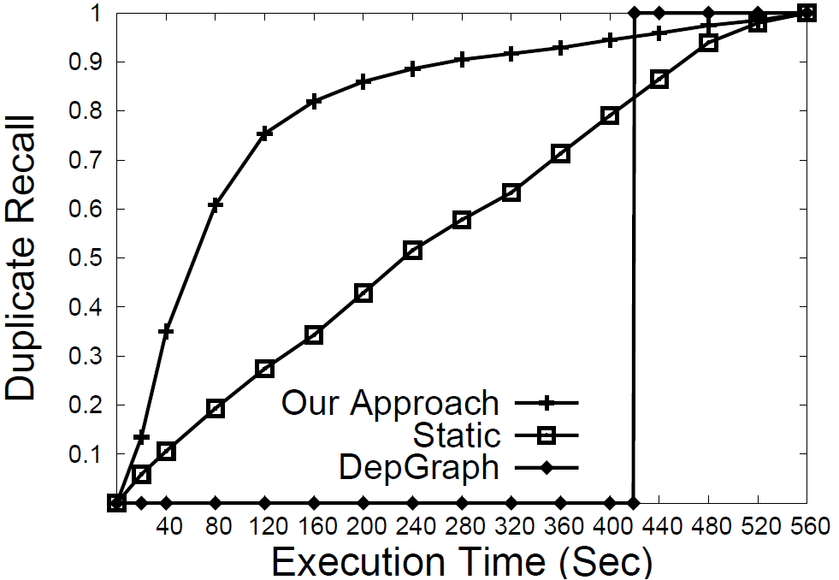
Time vs. Recall

Slide 18

Lazy Resolution with Workflow
 | Our Approach | Random | Full
Execution Time (sec) | 300.33 | 396.55 | 542.43
Plan Generation | 4.76% | 3.81% | 2.58%
Plan Execution | 95.11% | 96.17% | 97.40
 | Our Approach | Random | Full
Execution Time (sec) | 300.33 | 396.55 | 542.43
Plan Generation | 4.76% | 3.81% | 2.58%
Reading Blocks | 4.70% | 3.75% | 2.90%
Graph Creation | 8.40% | 6.25% | 4.72%
Node Resolution | 82.01% | 86.17% | 89.78%
Reading Blocks.
Creating Nodes.
Resolving Nodes.

Slide 19
Conclusion
    Progressive Approach to Relational ER.
    Cost and benefit model for generating a resolution plan.
    Lazy resolution strategy to resolve nodes with the least amount of cost.
    Experiments on publication and synthetic datasets to demonstrate the efficiency of our approach.

Slide 20
Questions
☺

