Slide 1
Progressive Approach to Relational Entity Resolution
Yasser Altowim, Dmitri Kalashnikov, Sharad Mehrotra

Slide 2

Data Processing Flow
Analysis
Decision
Quality of Analysis
Quality of Decision
Quality of Data
Data
    Data Cleaning Accounts For:
    80%
    Data Quality Challenges
    Erroneous Values.
    Missing Values.
    Duplication.
    …

Slide 3



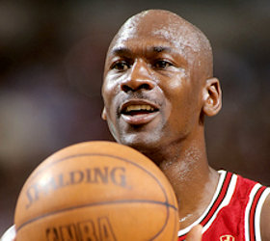

Entity Resolution (ER)
Michael Jordan Basketball Player
Michael Jordan Professor @ UCB
Real
World
Objects
Digital
World
Entities

Slide 4
Entity Resolution (ER)
Id | Product Name | Price
p₁ | IPad Two 16GB WiFi | $490
p₂ | IPad 2nd Generatation 16GB WiFi | $469
p₃ | Apple Phone 4 32 GB | $545
p₄ | Apple iPod Shuffle 2GB | $49
p₅ | IPhone 4th Generation 32GB | $520
P₁
P₄
P₃
P₂
P₅

Slide 5
Blocking
Id | Product Name | Price
p₁ | IPad Two 16GB WiFi | $490
p₂ | IPad 2nd Generatation 16GB WiFi | $469
p₃ | Apple Phone 4 32 GB | $545
p₄ | Apple iPod Shuffle 2GB | $49
p₅ | IPhone 4th Generation 32GB | $520
Dataset
BF
BF₁
…
BF = 1st char of product name
Blocks
BF₂
p₁
p₂
p₃
…
p₅
p₄
Blocks
Blocks

Slide 6

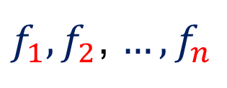



Similarity Computation
Id | Product Name | Price
p₃ | Apple Phone 4 32 GB | $545
p₄ | Apple iPod Shuffle 2GB | $49
Similarity Functions:
$f_{1},f_{2}$, ${…,f}_{n}$
$f_{1}($) = 0.125
$$\text{“}\text{Apple} \text{Phone} \text{4 32 }\text{GB}\text{”, “}\text{Apple} \text{iPod} \text{Shuffle} \text{2}\text{GB}\text{”}$$
Resolve Function:
Resolve( )
= duplicate, distinct, or uncertain
$$f_{1}$$
$$f_{2}$$
$$f_{n}$$
$$out\left( \right), out\left( \right), …, out\left( \right)$$

Slide 7

Progressive ER
Progressive ER

Slide 8










Real-time Analysis of Big Data
Applications
Event Monitoring Situational Awareness
Real-time Alerts Semantic Search Anti-terrorism
Data Cleaning
Notes:
- Often, such an offline approach does work well under standard settings.
- However, cleaning the entire data warehouse will require a considerable amount of time and significant computing resources
- Hence, such an approach is often suboptimal for many modern query-driven applications (green box)
- In fact, ER in the context of online analytics applications over web data requires a paradigm shift in how we approach the data cleaning problem

Slide 9



How Progressive ER Helps
Continually Refined Results
Progressive Analysis
Progressive Data Cleaning

Slide 10
Relational Dataset
Paper
Id | Title | Authors | Venue
p₁ | Transaction Support in Read Optimized … | {a₁, a₂} | u₁
p₂ | Read Optimized File System Designs: … | {a₁} | u₂
p₃ | Transaction Support in Read Optimized … | {a₃, a₄} | u₃
p₄ | Berkeley DB: A Retrospective .. | {a₃} | u₄
Author Venue
Id | Name | Papers
a₁ | Marge Seltzer | {p₁, p₂}
a₂ | Michael Stonebraker | {p₁}
a₃ | Margo I. Seltzer | {p₃, p₄}
a₄ | M. Stonebraker | {p₃}
Id | Name | Papers
u₁ | Very Large Data Bases | {p₁}
u₂ | ICDE Conference | {p₂}
u₃ | VLDB | {p₃}
u₄ | IEEE Data Eng. Bull | {p₄}

Slide 11

Graph Representation
p₁, p₃
u₁, u₃
duplicate
Resolve
duplicate

Slide 12
Problem Definition
Given a relational dataset D, and a cost budget BG,
Our goal is to develop a progressive approach that produces a high-quality result using BG units of cost.
Notes:
12

Slide 13

ER Graph
R₁ S₁
T₁
S₂
R₂ T₂
Notes:
13

Slide 14
ER Graph
v₁
v₅
v₉
v₂
v₆
v₁₀
v₃
v₇
v₁₁
R₁ S₁
T₁
v₄
v₈
v₁₂
S₂
R₂ T₂
Notes:
14

Slide 15
Partially Constructed Graph
v₁
v₅
v₉
v₂
v₆
v₁₀
v₃
v₇
v₁₁
R₁ S₁
T₁
v₄
v₈
v₁₂
S₂
R₂ T₂
Notes:
15

Slide 16




Overview
BG
Window 1
Window 2
…
Window n
Plan Generation.
Plan Execution ( ).
Resolution Plan ( )
Set of blocks ( ) to be instantiated.
Set of nodes ( ) to be resolved.
Notes:
16

Slide 17
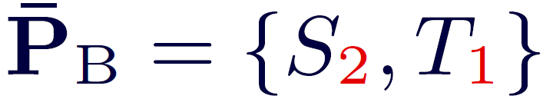

Plan Execution Phase
v₁
v₅
v₉
v₂
v₆
v₁₀
v₃
v₇
v₁₁
R₁ S₁
T₁
v₄
v₈
v₁₂
R₂ T₂
S₂
Notes:
17

Slide 18
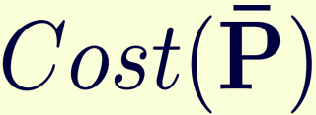

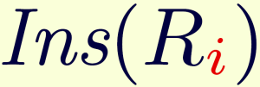
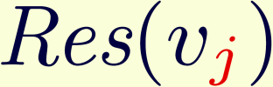




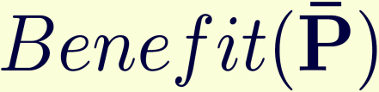


Plan Cost and Benefit
Notes:
18

Slide 19


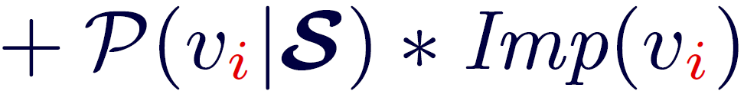
Node Benefit
State
v₃
…
…
v₁
v₅
…
v₄
…
v₂
v₆
…
…
Direct Benefit
Indirect
Benefit
Notes:
19

Slide 20

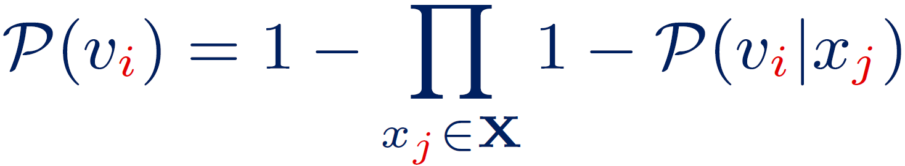
Probability Estimation
Noisy-OR Model
Effect:
Node being duplicate.
Causes:
Influencing duplicate nodes of .
Block to which belongs.
v_{i}
Cause
Cause
…
Cause
v_{i}
Effect
v_{i}
Fraction of duplicate pairs in the block.
Notes:
20

Slide 21

Example
v₁
v₅
v₉
duplicate
v₂
v₆
v₁₀
duplicate
duplicate
v₃
v₇
v₁₁
distinct
R₁ S₁
T₁
v₄
v₈
v₁₂
S₂
R₂ T₂
v₁
v₂
S₁
Notes:
21

Slide 22
Node Impact
v₄
…
…
…
…
v₂
v₅
v₁
Dependent Nodes
v₆
v₃
v₇
Nearest Nodes (K=2)
    Why?
    Belief Update ➔ NP-hard.
    The Nearest Nodes are not always instantiated.
Notes:
22

Slide 23
Impact Model
v₄
v₄
v₄
v₂
v₂
v₂
v₅
v₅
v₅
v₁
v₁
v₁
v₆
v₆
v₆
v₃
v₃
v₃
v₇
v₇
v₇
    Case#1 Case#2 Case#3
Notes:
23

Slide 24


Plan Generation Phase
Benefit-vs-Cost Analysis:
  Each node and block has an updated cost and benefit.
Generate a plan such that:
  h .
  is maximized.
NP-hard
Oregon-Trail Knapsack
Notes:
24

Slide 25


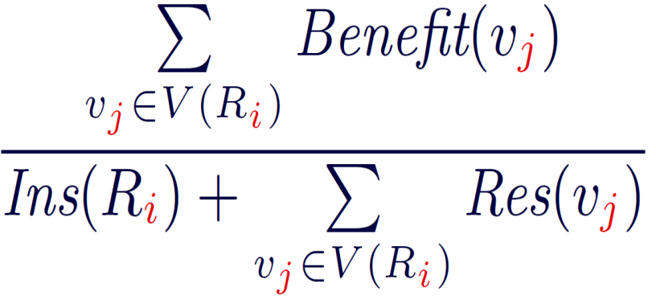
Plan Generation Algorithm
Instantiated
Unresolved Nodes
Step#1
v₁
v₂
v₄
v₁
v₂
v₆
v₆
v₇
v₁₀
v₁₃
v₁₀
v₁₆
v₁₅
v₁₆
v₂₁
Uninstantiated Blocks
Step#2
R₁
R₂
R₄
R₅
R₆
R₈
R₉
Notes:
25

Slide 26









Plan Generation Algorithm
R₁
…
R₈
R₆
R₂
Step#3
v₃₀
v₃₂
v₃₄
v₁
v₂
v₄₀
v₄₂
v₄₅
v₃₆
v₃₈
v₁₀
v₃₀
v₄₇
v₄₈
v₁
v₂
v₆
  If >
  else
  return and
v₁₀
v₁₆
Notes:
26

Slide 27


Lazy Resolution with Workflow
v₁
How to
resolve ?
v₁
Resolve
Resolve
…
duplicate
or distinct
duplicate
or distinct
v₁
Workflow of
Notes:
27

Slide 28
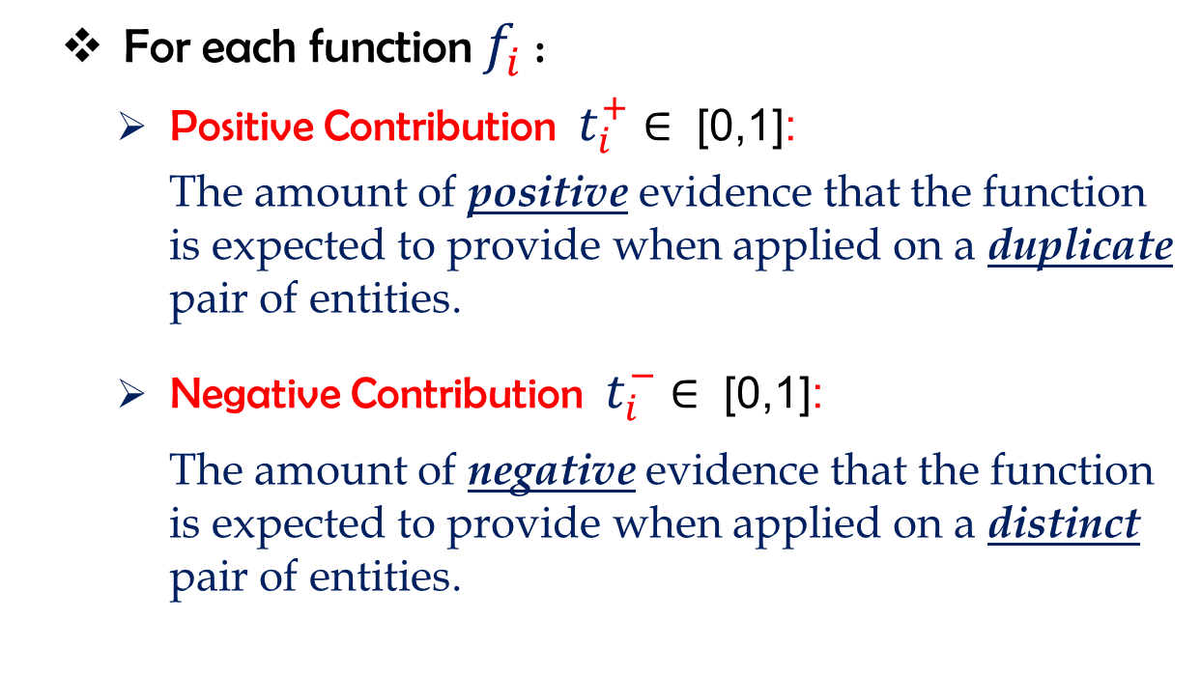
Contribution of Functions
    For each function $f_{i}^{}$:
    Positive Contribution $t_{i}^{+}$∈ [0,1]:
      The amount of positive evidence that the function is expected to provide when applied on a duplicate pair of entities.
    Negative Contribution $t_{i}^{−}$∈ [0,1]:
      The amount of negative evidence that the function is expected to provide when applied on a distinct pair of entities.

Slide 29
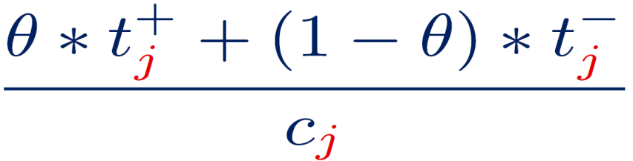
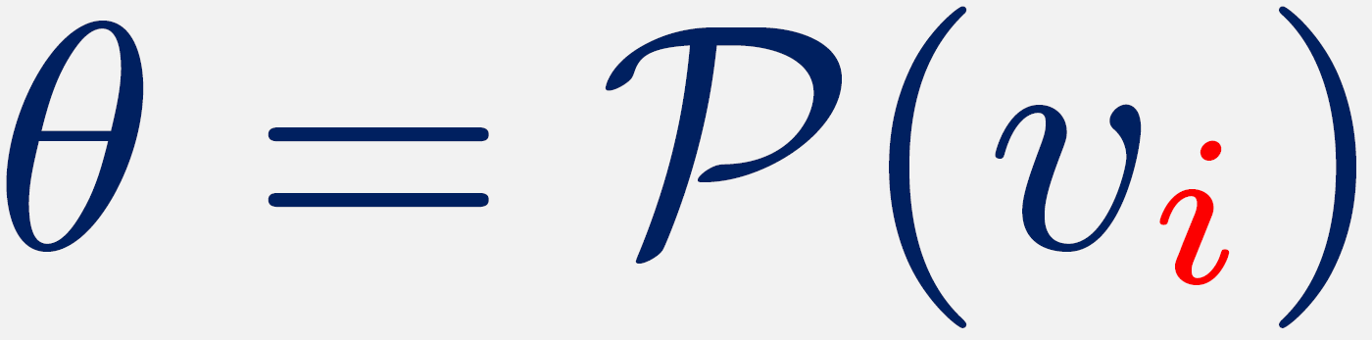
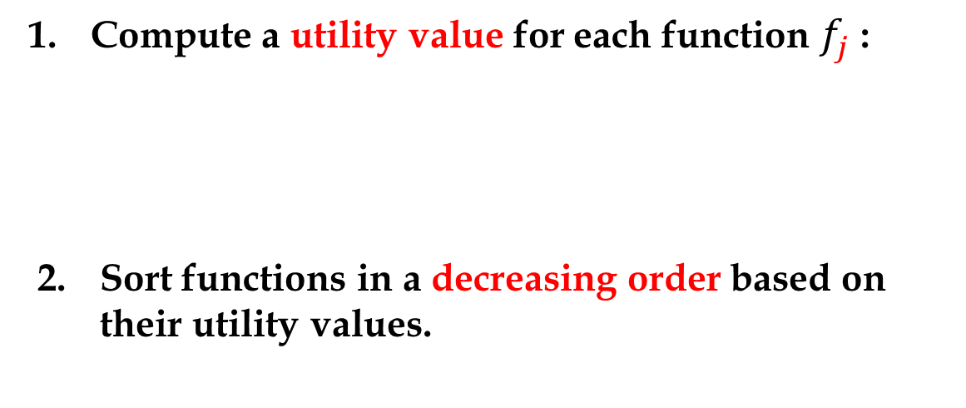
Workflow Generation
v_{i}
    Compute a utility value for each function $f_{j}^{}$ :
  Sort functions in a decreasing order based on their utility values.

Slide 30
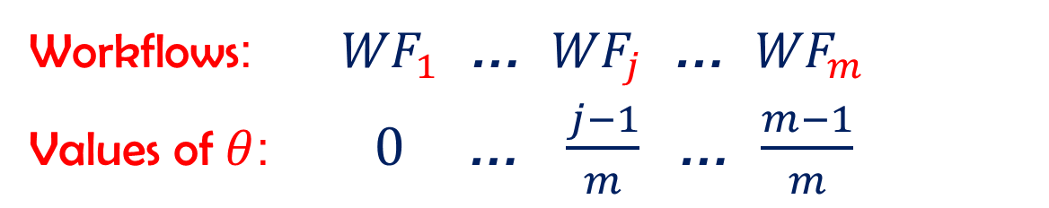
Workflow Generation
    Pre-generate $m$ workflows:
      Workflows: ${WF}_{1}$ … ${WF}_{j}$ … ${WF}_{m}$
      Values of $θ$: $0$ … $\frac{j−1}{m}$… $\frac{m−1}{m}$
v_{i}

Slide 31
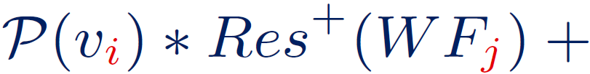
Resolution Cost
v_{i}
    Given a node and workflow ${WF}_{j}$
    Resolution Cost when
    Resolution Cost when
v_{i}
v_{i}
    is duplicate.
    is distinct.

Slide 32
Experimental Evaluation
CiteSeerX Dataset
    Papers (P)
    Authors (A)
    Venues (U)
    = (Title, Abstract, Keywords, Authors, Venue).
    = (Name, Email, Affiliation, Address, Paper).
    = (Name, Year, Pages, Papers).
 | Number of Entities | Blocking Functions | Similarity Functions | Resolve Function
P | 30,000 | 2 | 3 | Naïve Bayes
A | 83,152 | 1 | 4 | Naïve Bayes
U | 30,000 | 1 | 3 | Naïve Bayes

Slide 33
CiteSeerX - Blocking
    Papers (P)
    First three characters of title.
    Last three characters of title.
  Authors (A)
    First one character of first name appended with the first two characters of last name.
  Venues (U)
    First two characters of name appended with the first two digits of year.

Slide 34
Experimental Evaluation
Algorithms:
  DepGraph.
    X. Dong et al. Reference reconciliation in complex information spaces. SIGMOD.
  Static.
  S. E. Whang et al. Joint entity resolution. ICDE.
  Full:
  No lazy resolution strategy.
  Random:
  Lazy resolution strategy but with random order.
R
T
S
S₂
…
S₆
S₅
T₆
…
T₁
T₃
R₁
…
R₄
R₅

Slide 35
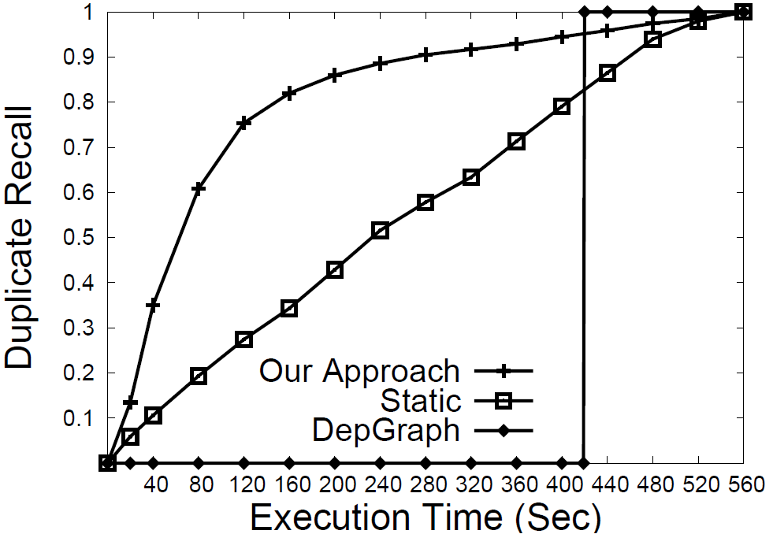
Time vs. Recall

Slide 36

Lazy Resolution with Workflow
 | Our Approach | Random | Full
Execution Time (sec) | 300.33 | 396.55 | 542.43
Plan Generation | 4.76% | 3.81% | 2.58%
Plan Execution | 95.11% | 96.17% | 97.40
 | Our Approach | Random | Full
Execution Time (sec) | 300.33 | 396.55 | 542.43
Plan Generation | 4.76% | 3.81% | 2.58%
Reading Blocks | 4.70% | 3.75% | 2.90%
Graph Creation | 8.40% | 6.25% | 4.72%
Node Resolution | 82.01% | 86.17% | 89.78%
Reading Blocks.
Creating Nodes.
Resolving Nodes.

Slide 37
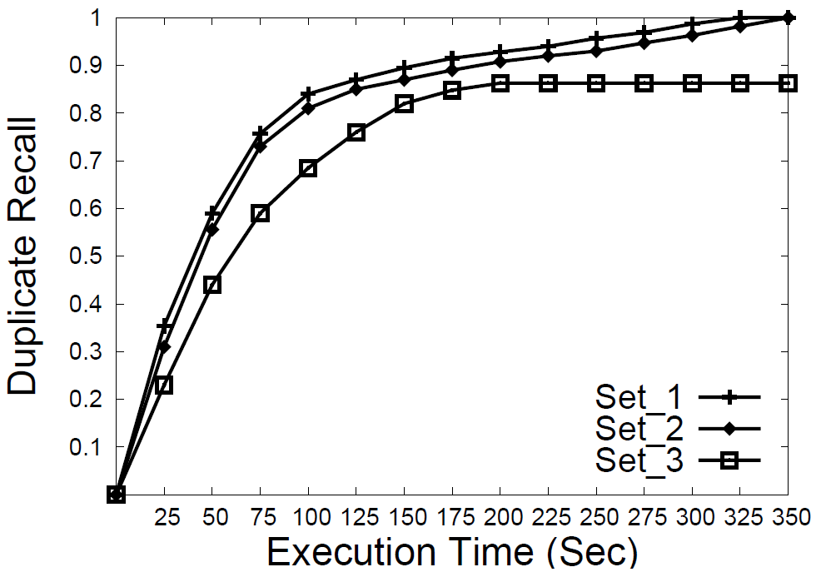
Lazy Resolution with Workflow #2
 | Number of Sim Functions
 | P | A | U
Set_1 | 3 | 4 | 3
Set_2 | 2 | 2 | 2
Set_3 | 1 | 1 | 1

Slide 38
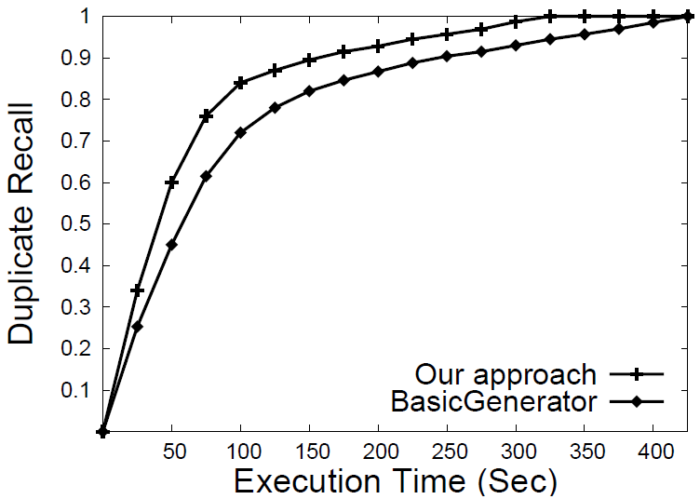
Correlation Among Sim Functions

Slide 39
Synthetic Dataset
Parameter | Description | Value
n | Number of entity-sets | 4
s | Number of entities per entity-set | 20,000
b | Number of blocks per entity-set | 100
d | Fraction of duplicate pairs in each entity-set | 0.2
z | Zipfian distribution exponent | 0.15
l | Probability of generating an influence | 0.3

Slide 40
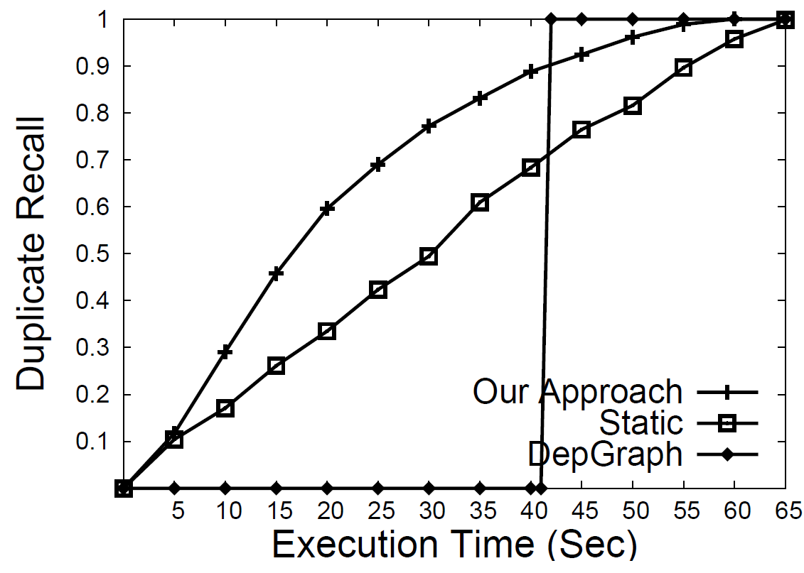
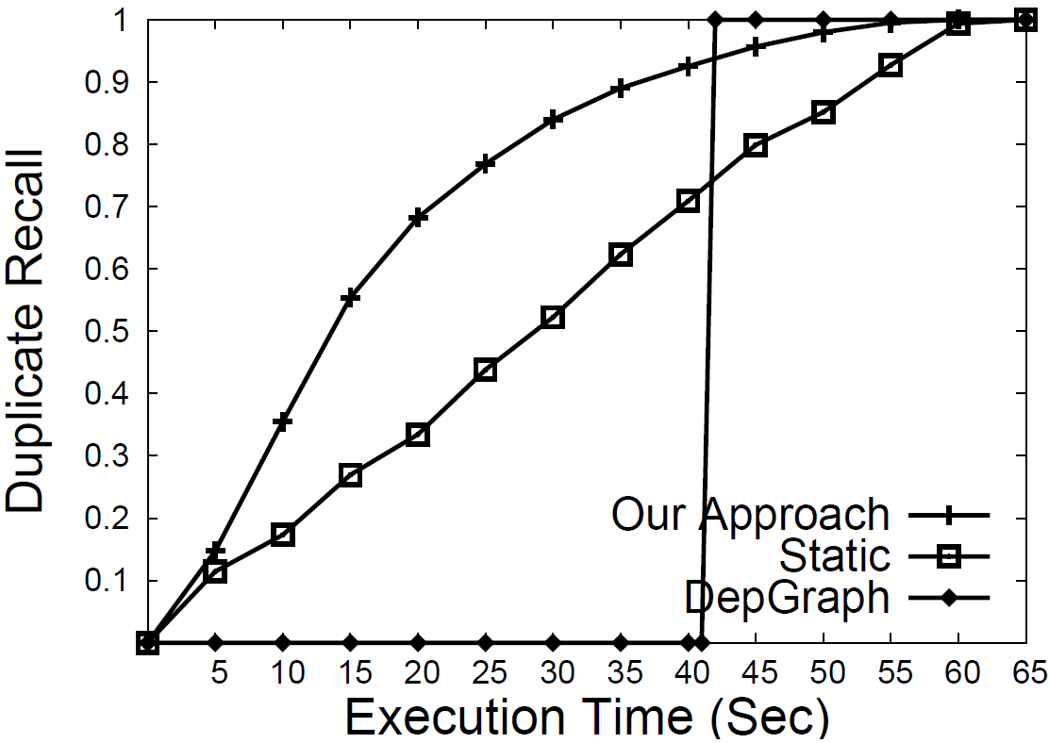
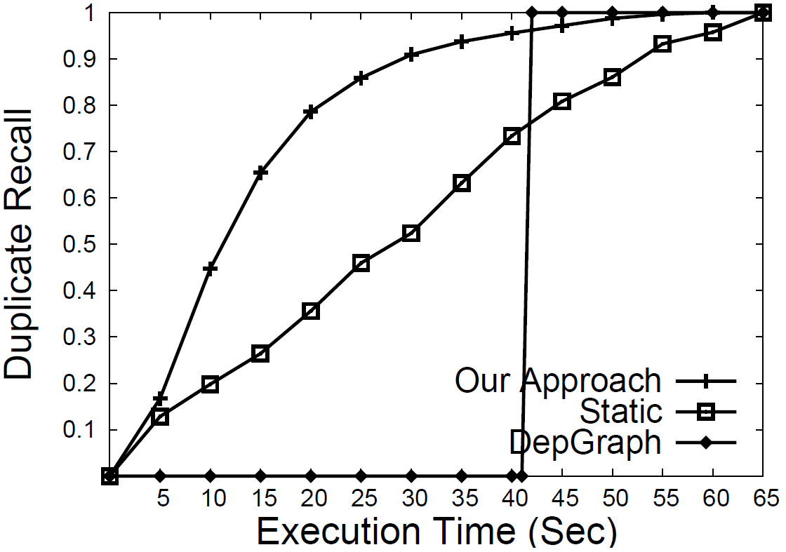
Duplicate Distribution
Z = 0.15
Z = 0.00
Z = 0.30

Slide 41
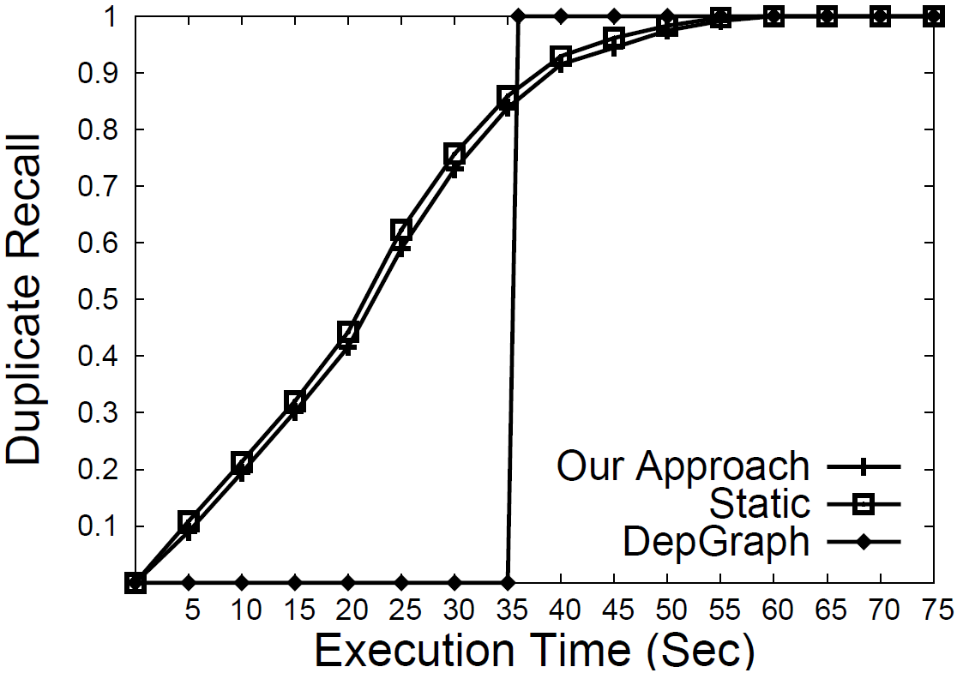
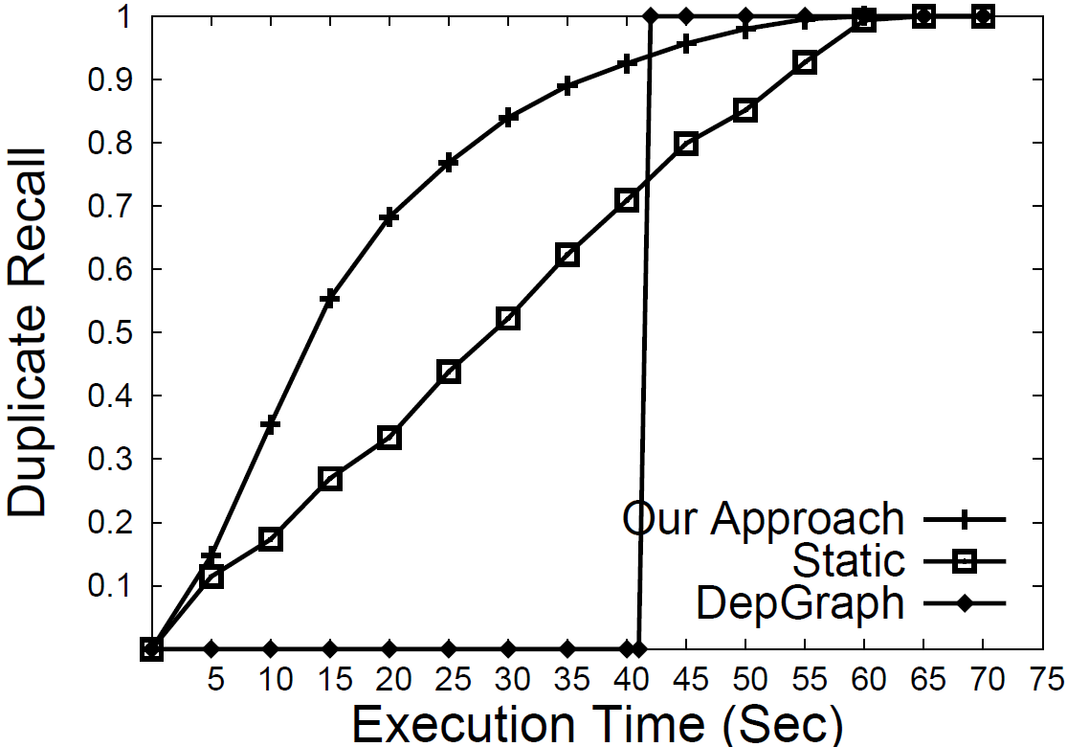
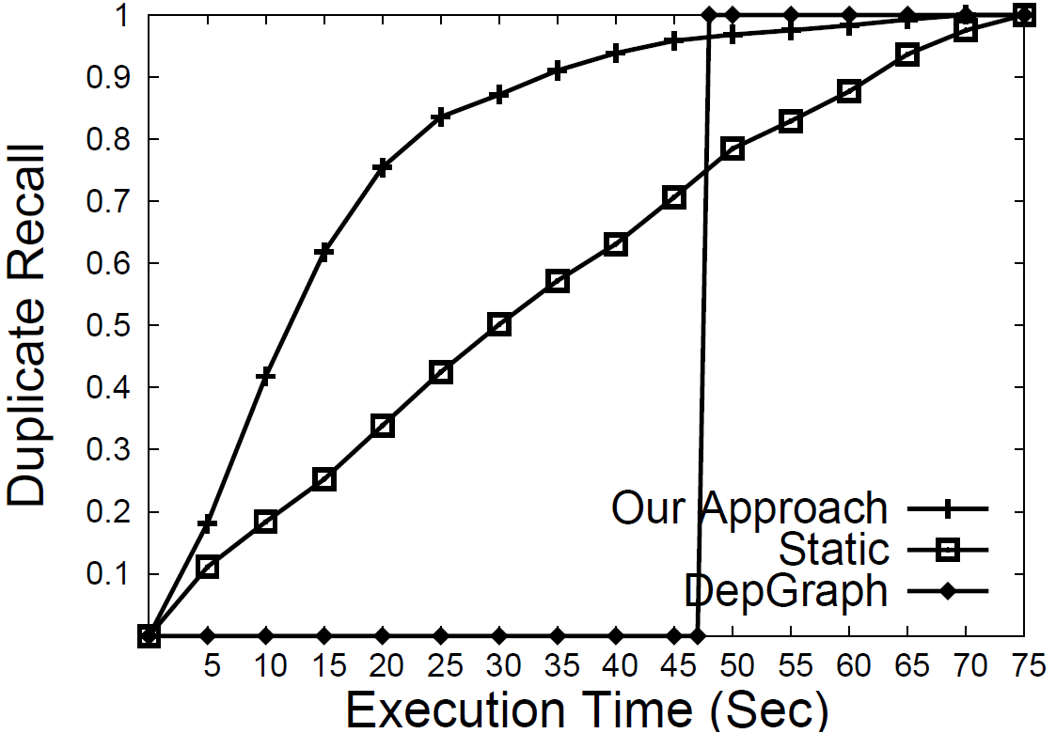
Number Of Influences
l = 0.0
l = 0.3
l = 0.6

Slide 42
Conclusion
    Progressive Approach to Relational ER.
    Cost and benefit model for generating a resolution plan.
    Lazy resolution strategy to resolve nodes with the least amount of cost.
    Experiments on publication and synthetic datasets to demonstrate the efficiency of our approach.

Slide 43
Questions
☺

