Slide 1
CS 295: Modern Systems Modern Processors – SIMD Extensions
Sang-Woo Jun
Spring, 2019

Slide 2
Modern Processor Topics
Transparent Performance Improvements
Pipelining, Caches
Superscalar, Out-of-Order, Branch Prediction, Speculation, …
Covered in CS250A and others
Explicit Performance Improvements
SIMD extensions, AES extensions, …
…
Non-Performance Topics
Virtualization extensions, secure enclaves, transactional memory, …

Slide 3
Flynn Taxonomy (1966) Recap
 |  | Data Stream
 |  | Single | Multi
Instruction Stream | Single | SISD (Single-Core Processors) | SIMD (GPUs, Intel SSE/AVX extensions, …)
 | Multi | MISD (Systolic Arrays, …) | MIMD (VLIW, Parallel Computers)

Slide 4
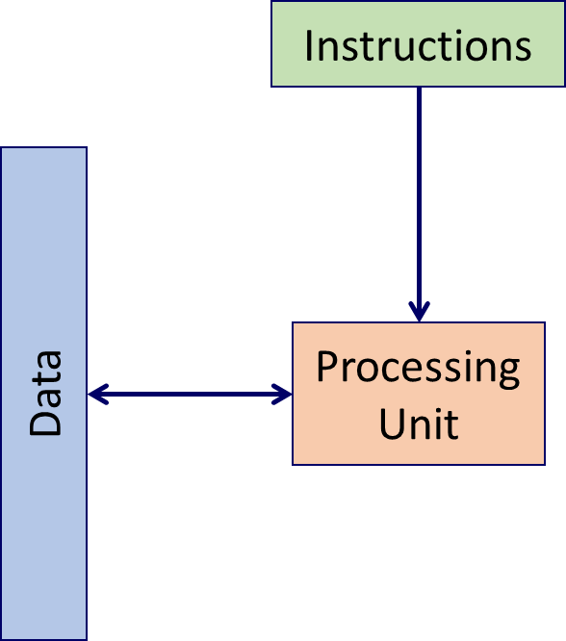
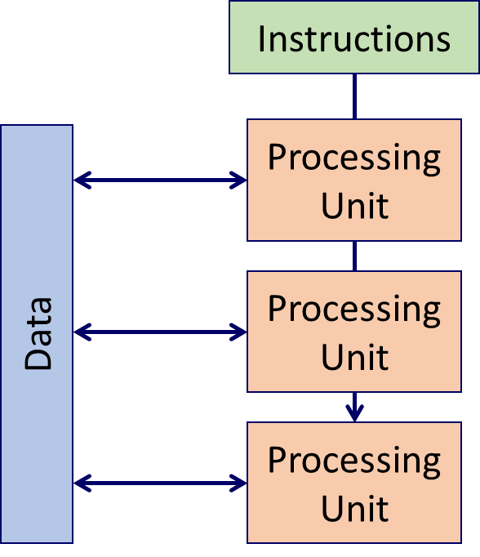
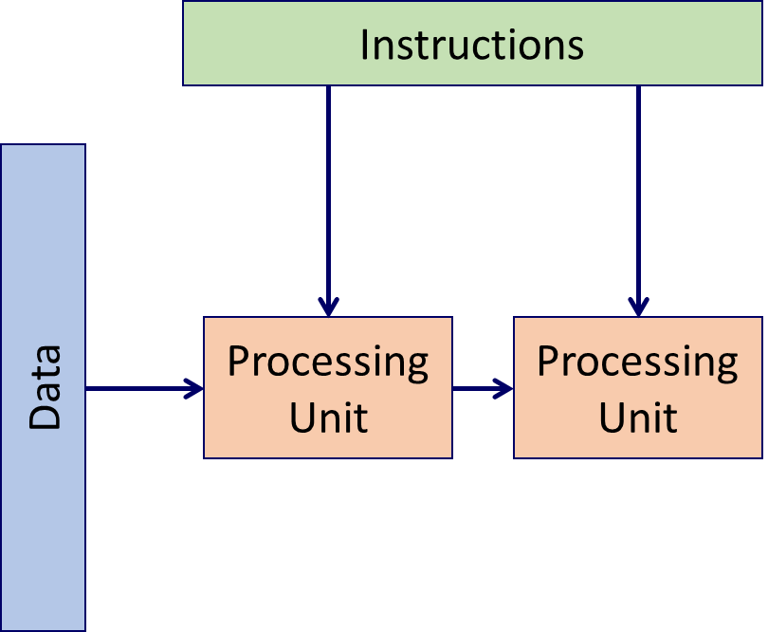
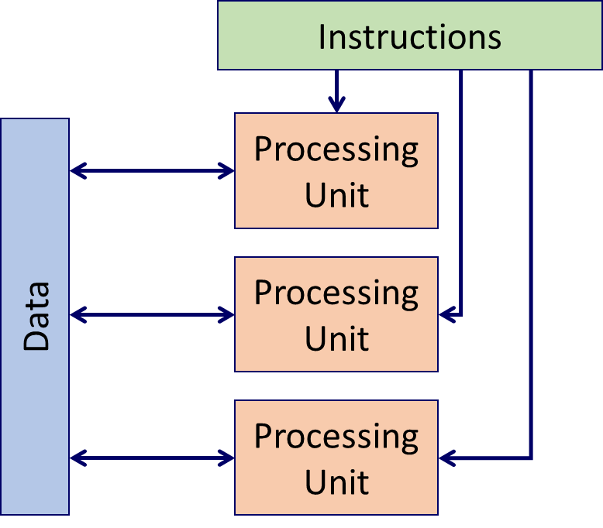
Flynn Taxonomy Recap
Single-Instruction
Single-Data
(Single-Core Processors)
Single-Instruction
Multi-Data
(GPUs, Intel SIMD Extensions)
Multi-Instruction
Single-Data
(Systolic Arrays,…)
Multi-Instruction
Multi-Data
(Parallel Computers)

Slide 5
Intel SIMD Extensions
New instructions, new registers
Introduced in phases/groups of functionality
SSE – SSE4 (1999 –2006)
128 bit width operations
AVX, FMA, AVX2, AVX-512 (2008 – 2015)
256 – 512 bit width operations
AVX-512 chips not available yet (as of Spring, 2019), but soon!
F16C, and more to come?

Slide 6
Intel SIMD Registers (AVX-512)
XMM0 – XMM15
128-bit registers
SSE
YMM0 – YMM15
256-bit registers
AVX, AVX2
ZMM0 – ZMM31
512-bit registers
AVX-512
XMM0
YMM0
ZMM0
XMM1
YMM1
ZMM1
…
XMM31
YMM31
ZMM31

Slide 7
SSE/AVX Data Types
255
0
YMM0
float
float
float
float
float
float
float
float
double
double
double
double
int32
int32
int32
int32
int32
int32
int32
int32
16
16
16
16
16
16
16
16
16
16
16
16
16
16
16
16
8
8
8
8
8
8
8
8
8
8
8
8
8
8
8
8
8
8
8
8
8
8
8
8
8
8
8
8
8
8
8
8
Operation on 32 8-bit values in one instruction!

Slide 8
Sandy Bridge Microarchitecture
e.g., “Port 5 pressure” when code uses too much shuffle operations

Slide 9
Skylake Die Layout

Slide 10
Aside: Do I Have SIMD Capabilities?
less /proc/cpuinfo

Slide 11
Processor Microarchitectural Effects on Power Efficiency
The majority of power consumption of a CPU is not from the ALU
Cache management, data movement, decoding, and other infrastructure
Adding a few more ALUs should not impact power consumption
Indeed, 4X performance via AVX does not add 4X power consumption
FromiI7 4770K measurements:
Idle: 40 W
Under load : 117 W
Under AVX load : 128 W
Aside: Not all AVX operations are active at the same time – “Specialization horseman”?

Slide 12
Compiler Automatic Vectorization
In gcc, flags “-O3 –mavx –mavx2” attempts automatic vectorization
Works pretty well for simple loops
But not for anything complex
E.g., naïve bubblesort code not parallelized at all
Generated using GCC explorer: https://gcc.godbolt.org/

Slide 13
Intel SIMD Intrinsics
Use C functions instead of inline assembly to call AVX instructions
Compiler manages registers, etc
Intel Intrinsics Guide
https://software.intel.com/sites/landingpage/IntrinsicsGuide
One of my most-visited pages…
e.g.,
__m256 a, b, c;
__m256 d = _mm256_fmadd_ps(a, b, c); // d[i] = a[i]*b[i]+c[i] for i = 0 …7

Slide 14
Data Types in AVX/AVX2
Type | Description
__m128 | 128-bit vector containing 4 floats
__m128d | 128-bit vector containing 2 doubles
__m128i | 128-bit vector containing integers
__m256 | 256-bit vector containing 8 floats
__m256d | 256-bit vector containing 4 doubles​
__m256i | 256-bit vector containing integers
1~16 signed/unsigned integers
1~32 signed/unsigned integers
__m512 variants in the future for AVX-512

Slide 15
Intrinsic Naming Convention
_mm<width>_[function]_[type]
E.g., _mm256_fmadd_ps : perform fmadd (floating point multiply-add) on 256 bits of packed single-precision floating point values (8 of them)
Width | Prefix
128 | _mm_
256 | _mm256_
512 | _mm512_
Type | Postfix
Single precision | _ps
Double precision | _pd
Packed signed integer | _epiNNN (e.g., epi256)
Packed unsigned integer | _epuNNN (e.g., epu256)
Scalar integer | _siNNN (e.g., si256)
Not all permutations exist! Check guide

Slide 16
Load/Store/Initialization Operations
Initialization
_mm256_setzero_ps/pd/epi32/…
_mm256_set_...
…
Load/Store : Address MUST be aligned by 256-bit
_mm256_load_...
_mm256_store_...
And many more! (Masked read/write, strided reads, etc…)
e.g.,
__mm256d t = _mm256_load_pd(double const * mem); // loads 4 double values from mem to t
__mm256i v = _mm256_set_epi32(h,g,f,e,d,c,b,a); // loads 8 integer values to v

Slide 17
Vertical Vector Instructions
Add/Subtract/Multiply
_mm256_add/sub/mul/div_ps/pd/epi
Mul only supported for epi32/epu32/ps/pd
Div only supported for ps/pd
Consult the guide!
Max/Min/GreaterThan/Equals
Sqrt, Reciprocal, Shift, etc…
FMA (Fused Multiply-Add)
(a*b)+c, -(a*b)-c, -(a*b)+c, and other permutations!
Consult the guide!
…
a
×
×
×
×
b
+
+
+
+
c
=
=
=
=
d
__m256 a, b, c;
__m256 d = _mm256_fmadd_pd(a, b, c);

Slide 18
Integer Multiplication Caveat
Integer multiplication of two N bit values require 2N bits
E.g., __mm256_mul_epi32 and __mm256_mul_epu32
Only use the lower 4 32 bit values
Result has 4 64 bit values
E.g., __mm256_mullo_epi32 and __mm256_mullo_epu32
Uses all 8 32 bit values
Result has 8 truncated 32 bit values
And more options!
Consult the guide…

Slide 19
Horizontal Vector Instructions
Horizontal add/subtraction
Adds adjacent pairs of values
E.g., __m256d _mm256_hadd_pd (__m256d a, __m256d b)
a
b
+
+
+
+
c

Slide 20
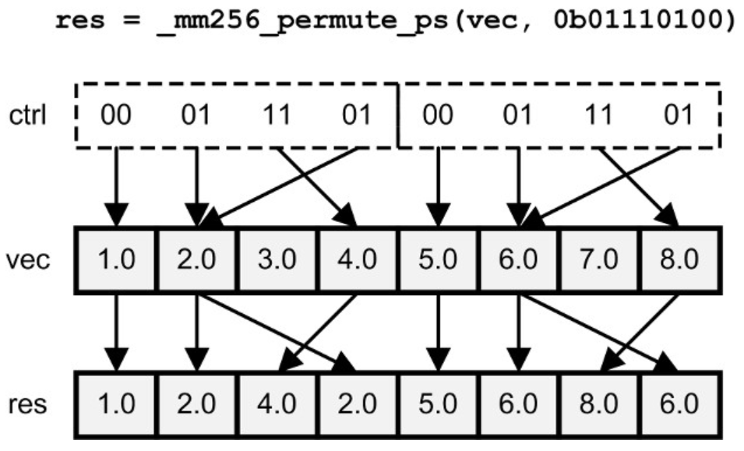
Shuffling/Permutation
Within 128-bit lanes
_mm256_shuffle_ps/pd/… (a,b, imm8)
_mm256_permute_ps/pd
_mm256_permutevar_ps/…
Across 128-bit lanes
_mm256_permute2x128/4x64 : Uses 8 bit control
_mm256_permutevar8x32/… : Uses 256 bit control
Not all type permutations exist, but variables can be cast back and forth
Matt Scarpino, “Crunching Numbers with AVX and AVX2,” 2016

Slide 21
Blend
Merges two vectors using a control
_mm256_blend_... : Uses 8 bit control
e.g., _mm256_blend_epi32
_mm256_blendv_... : Uses 256 bit control
e.g., _mm256_blendv_epi8
a
b
?
?
?
?
c

Slide 22
Alignr
Right-shifts concatenated value of two registers, by byte
Often used to implement circular shift by using two same register inputs
_mm256_alignr_epi8 (a, b, count)
Example of 64-bit values being shifted by 8
a
b
c

Slide 23
Helper Instructions
Cast
__mm256i <-> __mm256, etc…
Syntactic sugar -- does not spend cycles
Convert
4 floats <-> 4 doubles, etc…
Movemask
__mm256 mask to -> int imm8
And many more…

Slide 24
Case Study: Sorting
Important, fundamental application!
Can be parallelized via divide-and-conquer
How can SIMD help?

Slide 25
Reminder: Sorting Network
Network structure for sorting fixed number of values
Type of a “comparator network”
comparators perform compare-and-swap
Easily pipelined and parallelized
Example 4-element sorting network
5 comparators, 3 cycle pipelined

Slide 26
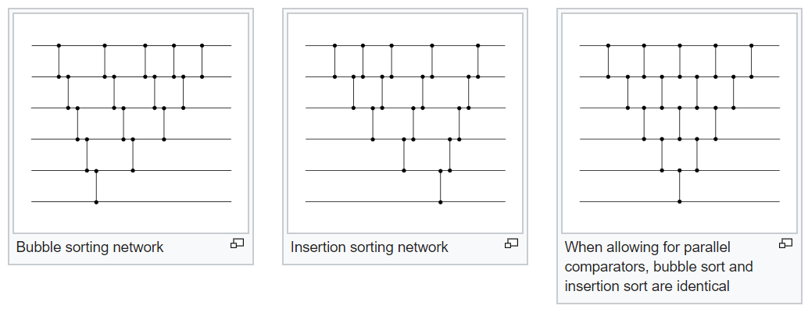
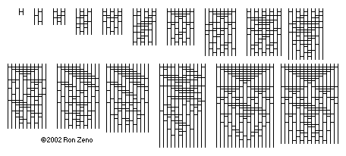
Remind: Sorting Network
Simple to generate correct sorting networks, but optimal structures are not well-known
Source: Wikipedia (Sorting Network)
Some known optimal sorting networks

Slide 27
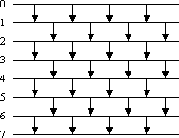
SIMD And Sorting Networks
AVX compare/max/min instructions do not work internally to a register
Typically same values copied to two different registers, permuted, compared
Or, “two register trick”, and many more optimizations
In this case, optimal sorting networks are typically not very helpful
Irregular computation means bubbles in the compute structure
Simple, odd-even sorting network works well
What if I want to sort more than 8 values?
8-element odd-even sorting network

Slide 28
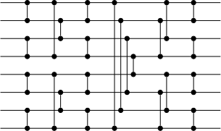
SIMD And Sorting Networks
Typically, we are sorting more than one set of tuples
If we have multiple tasks, we can have task-level parallelism – Optimized networks!
Sort multiple tuples at the same time
Then we need to transpose the 8 8-element variables
Each variable has a value for each sorting network instance
Non-SIMD works, or a string of unpackhi/unpacklo/blend
Instruction 1, 2 (min, max)
…
Instruction 3, 4 (min, max)

Slide 29
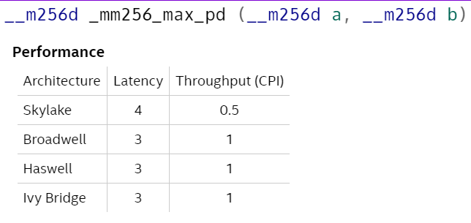
SIMD And Sorting Networks
Some SIMD instructions have high throughput, but high latency
Data dependency between two consecutive max instructions can take 8 cycles on Skylake
If each parallel stage has less than 4 operations, pipeline may stall
Solution: Interleave two sets of parallel 8-tuple sorting
In reality, min/max means even for 4-tuples, pipeline is still filled
Source: Instrinsics guide

Slide 30
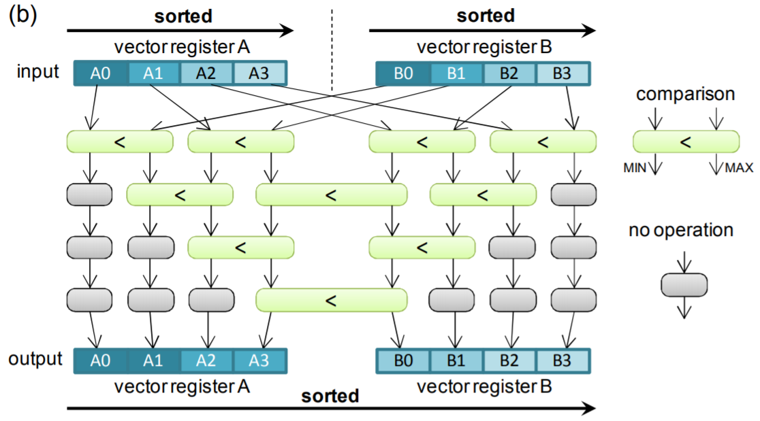
The Two Register Merge
Sort units of two pre-sorted registers, K elements
minv = A, maxv = B
// Repeat K times
minv = min(minv,maxv)
maxv = max(minv,maxv)
// circular shift one value down
minv = alignr(minv,minv,imm)
Inoue et.al., “SIMD- and Cache-Friendly Algorithm for Sorting an Array of Structures,” VLDB 2015

Slide 31
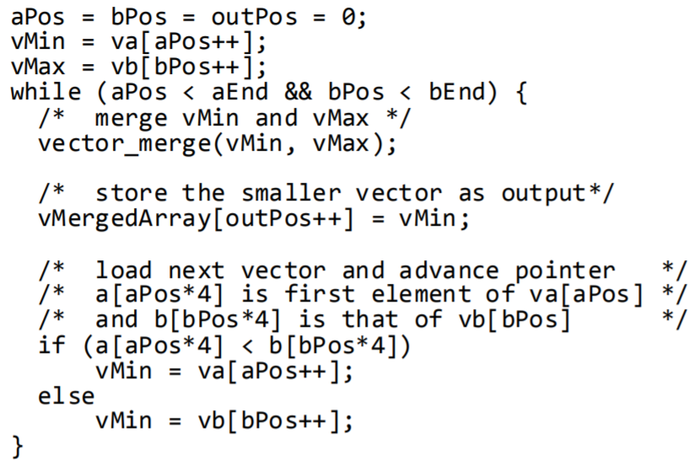
SIMD And Merge Sort
Hierarchically merged sorted subsections
Using the SIMD merger for sorting
vector_merge is the two-register sorter from before
What if we want to sort structs?
Instead of min/max, use cmpgt, followed by permute for both key and values
For large values, use <key, index>
Typically reports 2x + performance!
Inoue et.al., “SIMD- and Cache-Friendly Algorithm for Sorting an Array of Structures,” VLDB 2015

Slide 32
Topic Under Active Research!
Papers being written about…
Architecture-optimized matrix transposition
Register-level sorting algorithm
Merge-sort
… and more!
Good find can accelerate your application kernel 2x

Slide 33
Case Study: Matrix Multiply
Branch : Boser & Katz, “CS61C: Great Ideas In Computer Architecture” Lecture 18 – Parallel Processing – SIMD

Slide 34
https://www.intel.com/content/dam/www/public/us/en/documents/manuals/64-ia-32-architectures-optimization-manual.pdf

Slide 35
SIMD Recap
Instructions
Instructions
Processing
Unit
Processing
Unit
Processing
Unit
Data
Data
Processing
Unit

Slide 36
SIMD Recap
Instructions
Instructions
Processing
Unit
Processing
Unit
Processing
Unit
Processing
Unit
Data
Data
Processing
Unit

