Slide 1
Informatics 121 Software Design I
Lecture 7
Duplication of course material for any commercial purpose without the explicit written permission of the professor is prohibited.

Slide 2
Today’s lecture
Design studio 2 continued

Slide 3
Design studio 2 – original
Design an educational traffic flow simulation program
A 2-page briefing is provided, listing the main requirements for the system
You will produce the design over a number of weeks, through a variety of structured exercises and arguments
This will be an individual assignment, with group exercises worked in

Slide 4
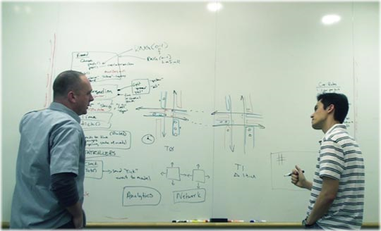
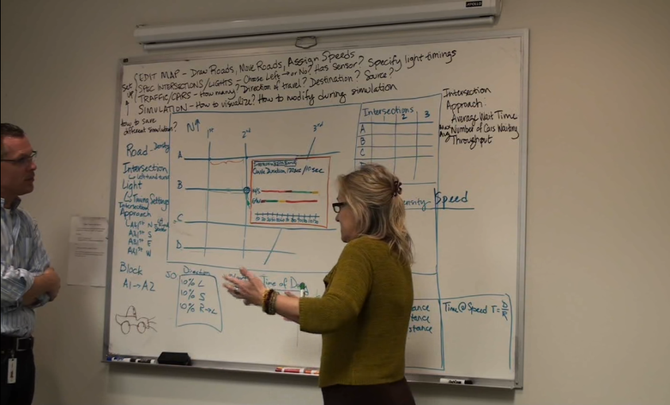
Design studio 2 – original
This exact same design prompt was given to professional software designers
1 hour and 50 minutes at the regular whiteboard

Slide 5
Design studio 2 – original
Watch the video, carefully
Identify…
…five key decisions that the designers made
…options (ideas) that they considered when making these decisions
…mark the time(s) when these decisions points are discussed
Focus on essence

Slide 6
Design studio 2 – today
Half of the teams
design three alternative user interfaces (60 min)
what does it look like, how does the user control the experience, …
Half of the teams
design three alternative simulators (60 min)
how does it work “on the inside”

Slide 7
Design studio 2 – continued
Read Michael Jackson’s “Representing structure in a software system design” and Mary Shaw’s “The role of design spaces in software design”

