Slide 1
Informatics 121 Software Design I
Lecture 9
Duplication of course material for any commercial purpose without the explicit written permission of the professor is prohibited.

Slide 2
Today’s lecture
Design artifacts
Abstractions
Design notations
Vocabulary
Design tools

Slide 3
Design
designer
plan
maker
change in the world
other stakeholders
audience
experiences

Slide 4
A design artifact
An externalized representation used to further a design project
design problem, design solution, or both
partial or complete
fluid or frozen

Slide 5
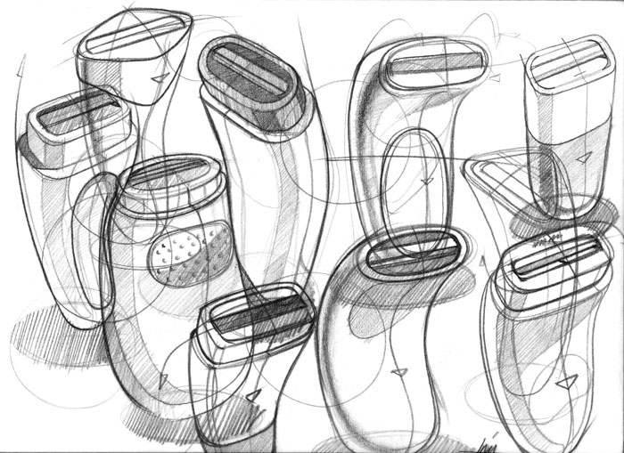
Example

Slide 6
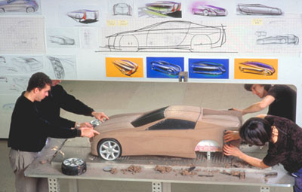
Example

Slide 7
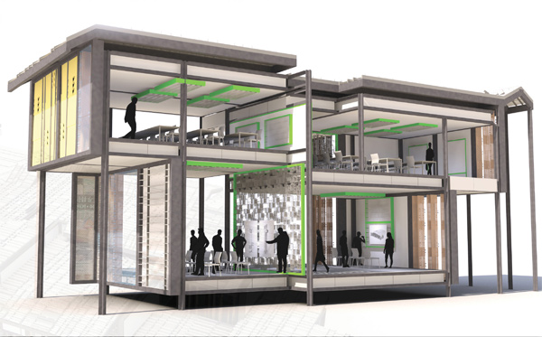
Example

Slide 8
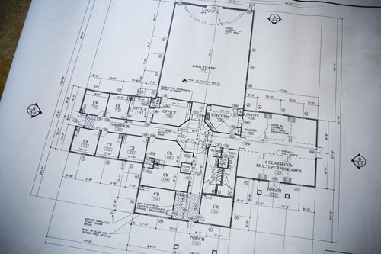
Example

Slide 9
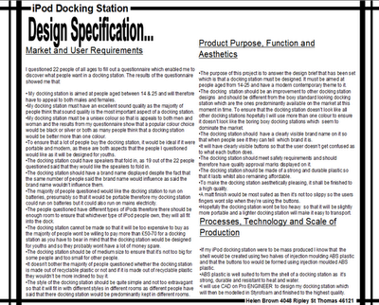
Example

Slide 10
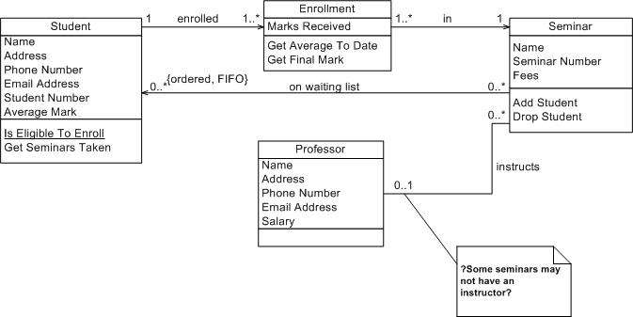
Example

Slide 11
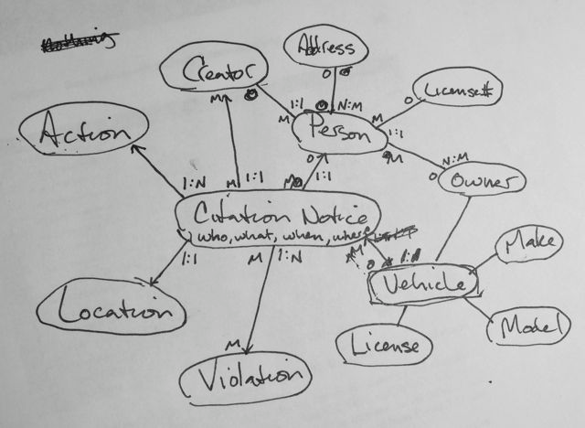
Example

Slide 12
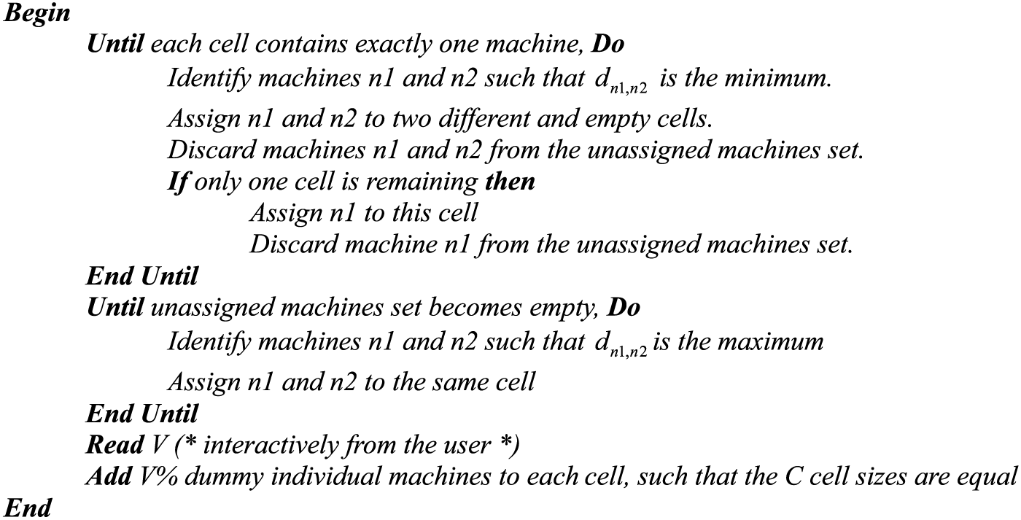
Example

Slide 13
Purpose of design artifacts
Design artifacts to think
Design artifacts to talk
Design artifacts to prescribe

Slide 14
Thinking design artifact

Slide 15
Thinking design artifact

Slide 16
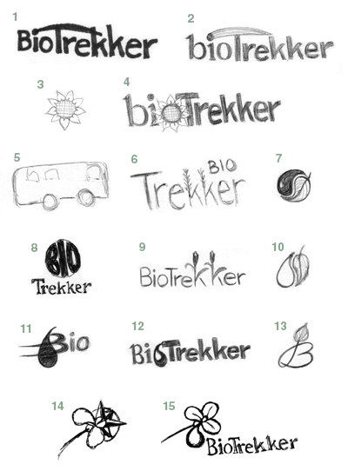
Thinking design artifact

Slide 17
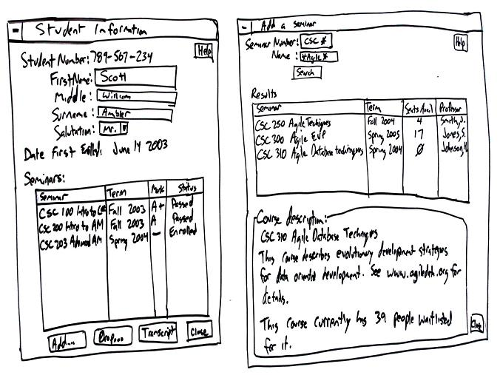
Thinking design artifact

Slide 18
Talking design artifact

Slide 19
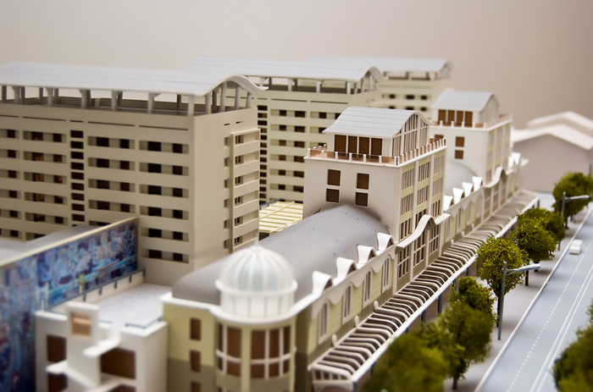
Talking design artifact

Slide 20
Talking design artifact

Slide 21
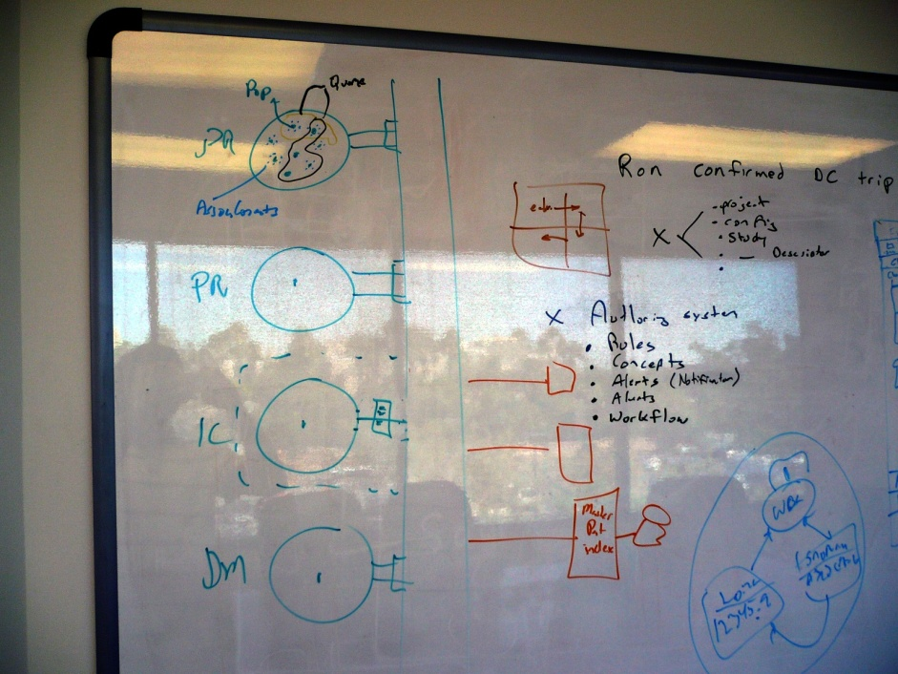
Talking design artifact

Slide 22
Prescribing design artifact

Slide 23
Prescribing design artifact

Slide 24
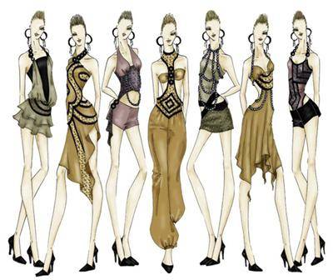
Prescribing design artifact

Slide 25
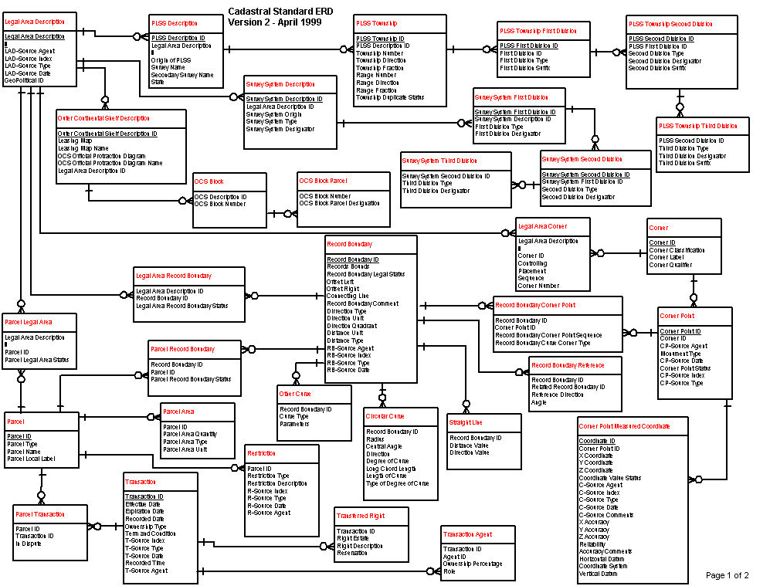
Prescribing design artifact

Slide 26
Abstraction
An abstraction is formed by reducing the information content of a concept or an observable phenomenon, typically to retain only information which is relevant for a particular purpose
choice of what to include
choice of what not to include
Each abstraction makes some information readily available at the expense of obscuring or removing other information

Slide 27
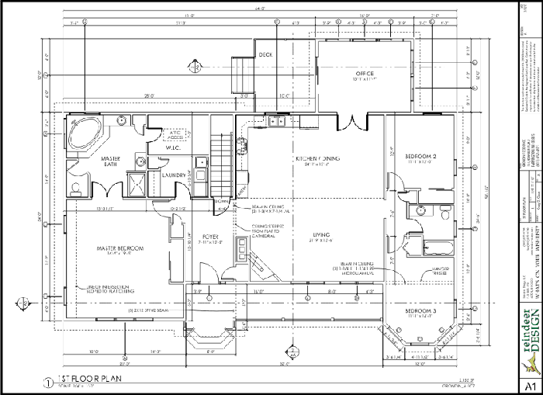
Floor plan

Slide 28
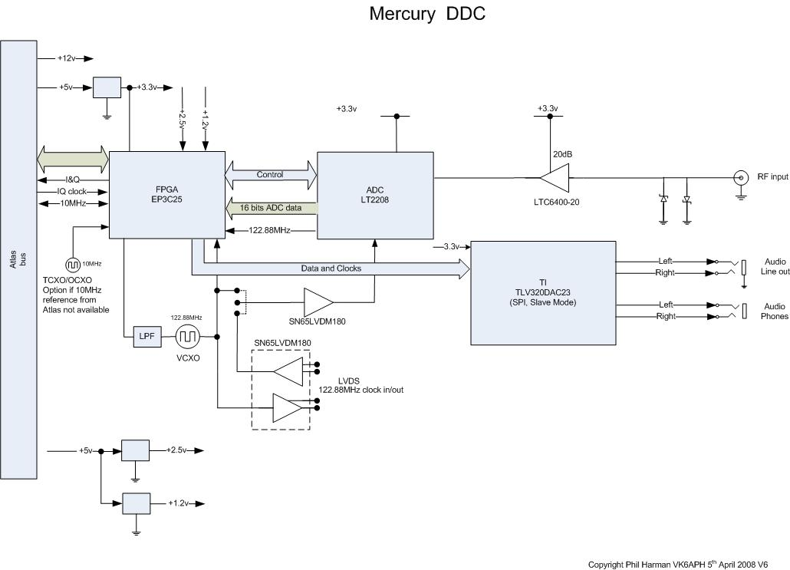
Verilog

Slide 29
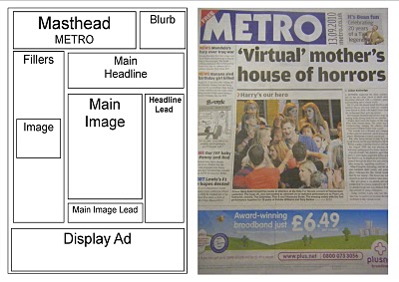
Page layout

Slide 30
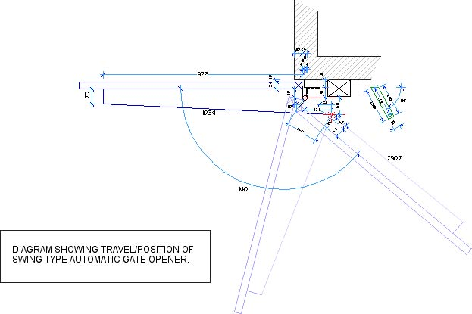
Mechanical engineering diagram

Slide 31
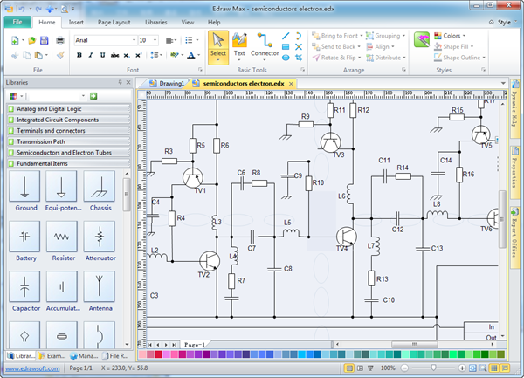
Schematic

Slide 32
Product sketch

Slide 33
Model

Slide 34
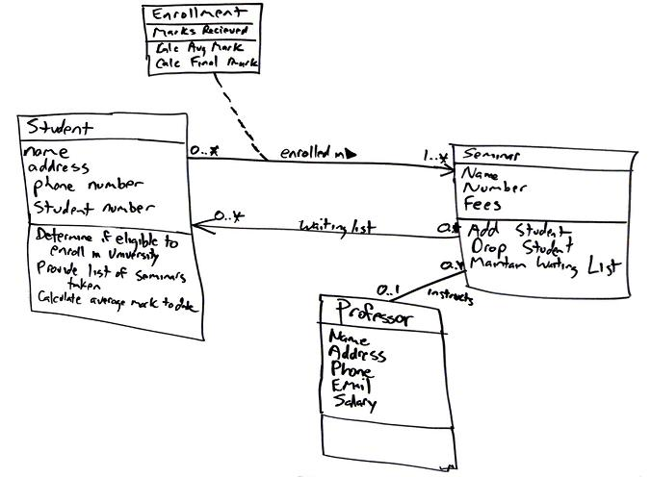
Class diagram

Slide 35
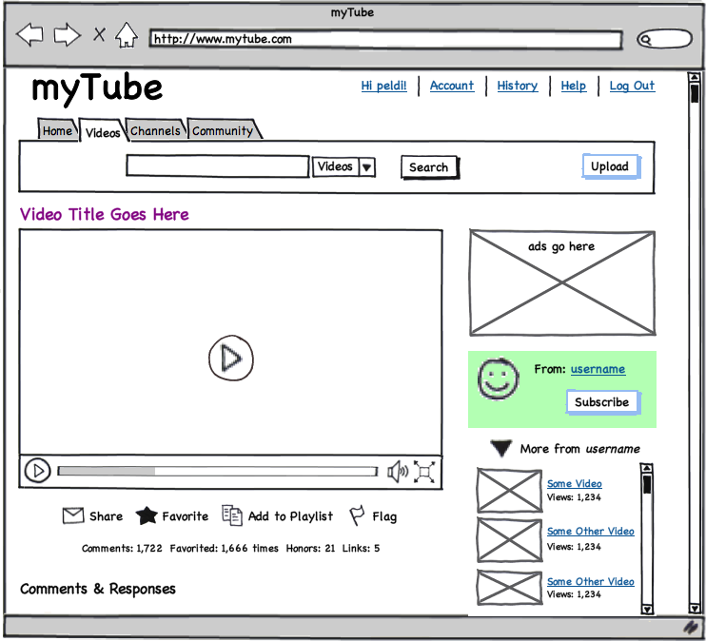
User interface mock-up
[balsamiq]

Slide 36
Entity relationship diagram

Slide 37
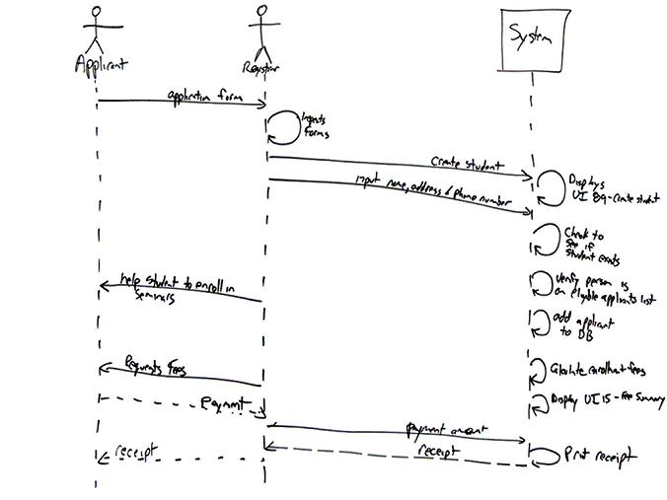
Sequence diagram

Slide 38
Design notation
A design notation offers a language for specifying certain aspects of a design artifact
textual and/or graphical vocabulary for specifying individual and composite elements
rules governing how individual elements can be combined into composite elements
implicit and/or explicit semantics for giving meaning
Each design notation is typically suited for a particular domain and a particular purpose
Every design notation invariably introduces abstraction

Slide 39
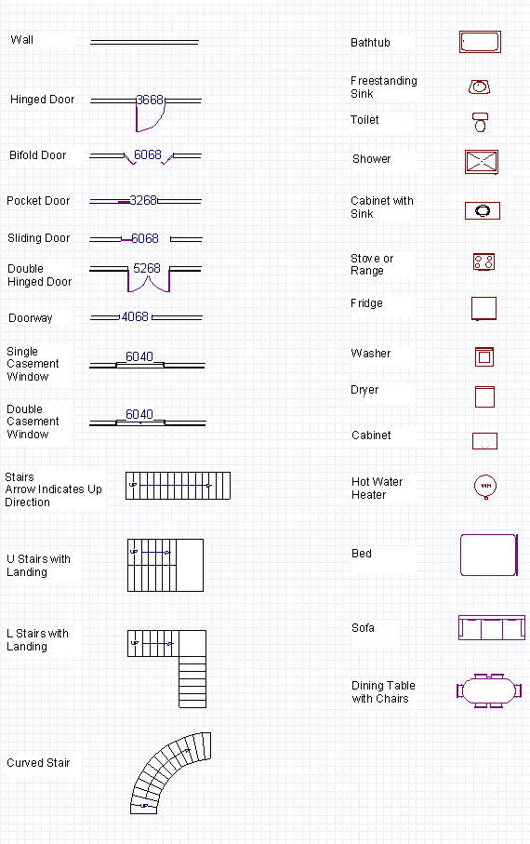
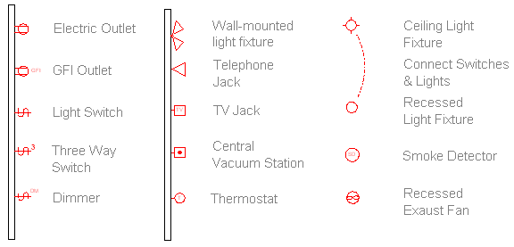
Example notation

Slide 40
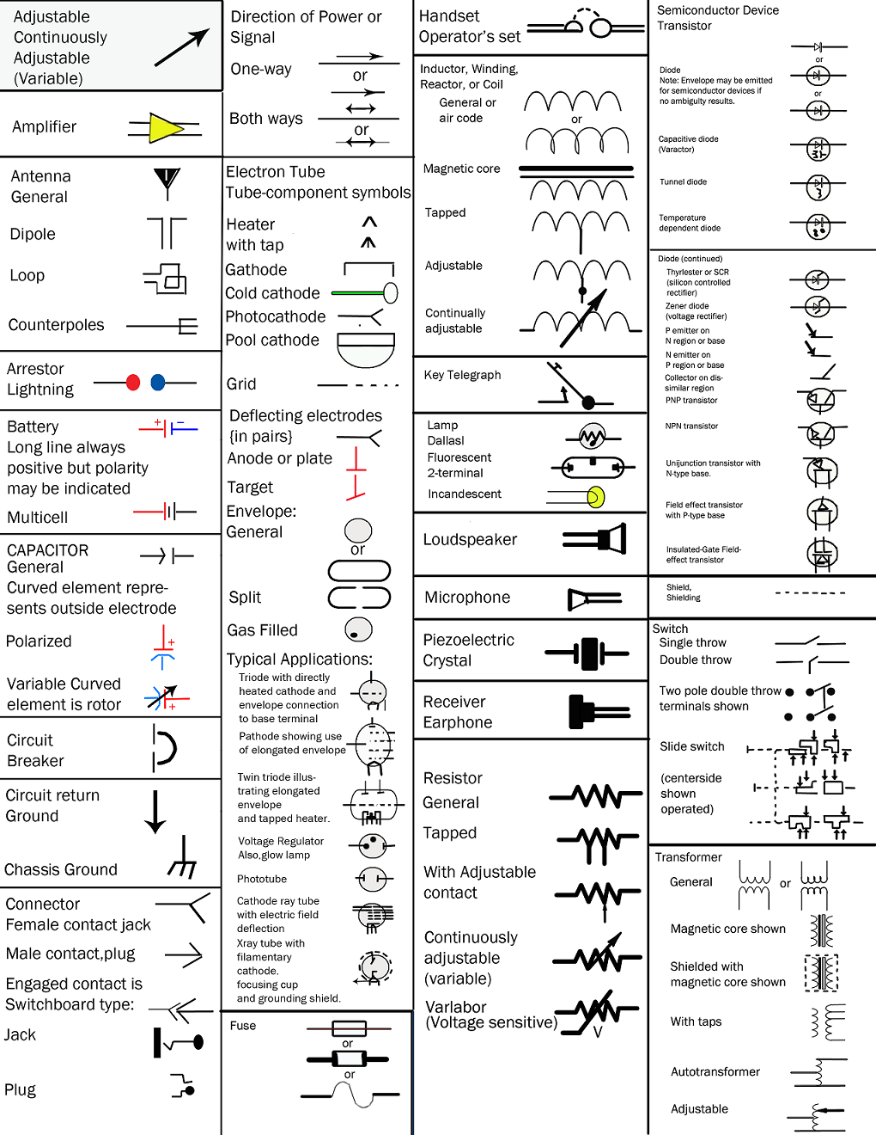
Example notation

Slide 41
Example notation

Slide 42
Example notation

Slide 43
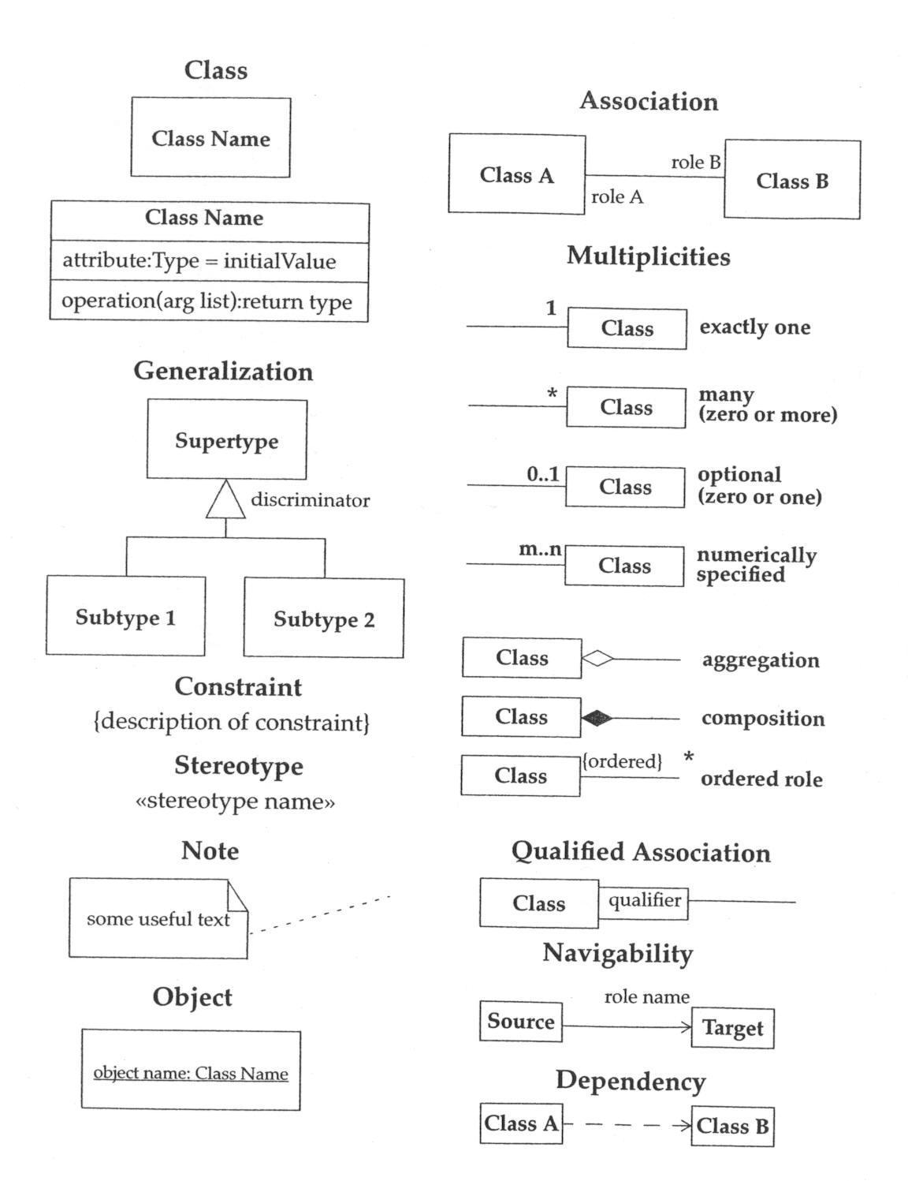
Example notation

Slide 44
Example notation

Slide 45
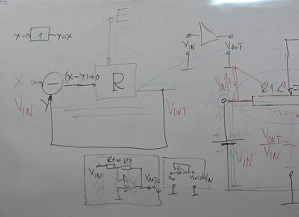
Types of notation
Formal notation
Semi-formal notation
Informal notation
No notation

Slide 46
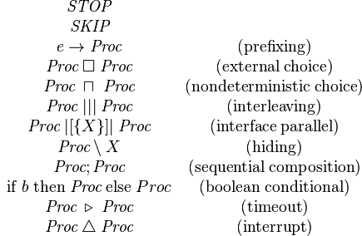
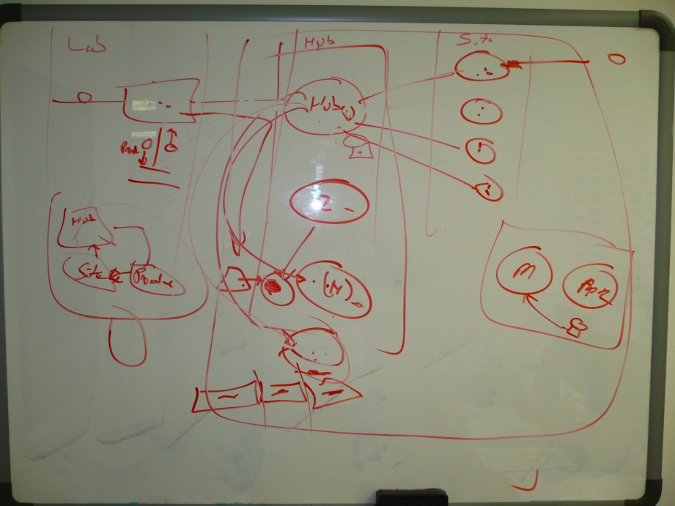
Types of notation
Formal notation
Semi-formal notation
Informal notation
No notation

Slide 47
Vocabulary may exist independent of notation

Slide 48
Vocabulary may exist independent of notation

Slide 49
Vocabulary may exist independent of notation

Slide 50
Notation or just a vocabulary?

Slide 51
Considerations in choosing a design notation
Who is the audience?
What is the objective?
What is the timeframe?

Slide 52
Expressiveness versus usability
high
low
expressiveness
usability

Slide 53
Cognitive dimensions of notations
Abstraction | types and availability of abstraction mechanisms
Hidden dependencies | important links between entities are not visible
Premature commitment | constraints on the order of doing things
Secondary notation | extra information in means other than formal syntax
Viscosity | resistance to change
Visibility | ability to view components easily
Closeness of mapping | closeness of representation to domain
Consistency | similar semantics are expressed in similar syntactic forms
Diffuseness | verbosity of language
Error-proneness | notation invites mistakes
Hard mental operations | high demand on cognitive resources
Progressive evaluation | work-to-date can be checked at any time
Provisionality | degree of commitment to actions or marks
Role-expressiveness | the purpose of a component is readily inferred

Slide 54
Design tools
Design tools assist the designer in creating and interpreting design artifacts
Ideally, design tools…
…decrease the burden of creating design artifacts
…increase the ability of interpreting design artifacts
static form
dynamic behavior
Design tools may be individual or collaborative in nature

Slide 55
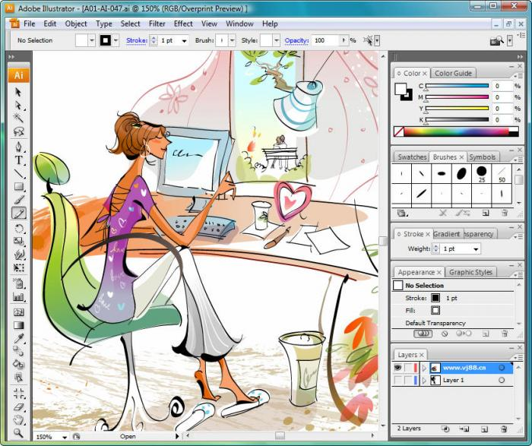
Adobe Illustrator

Slide 56
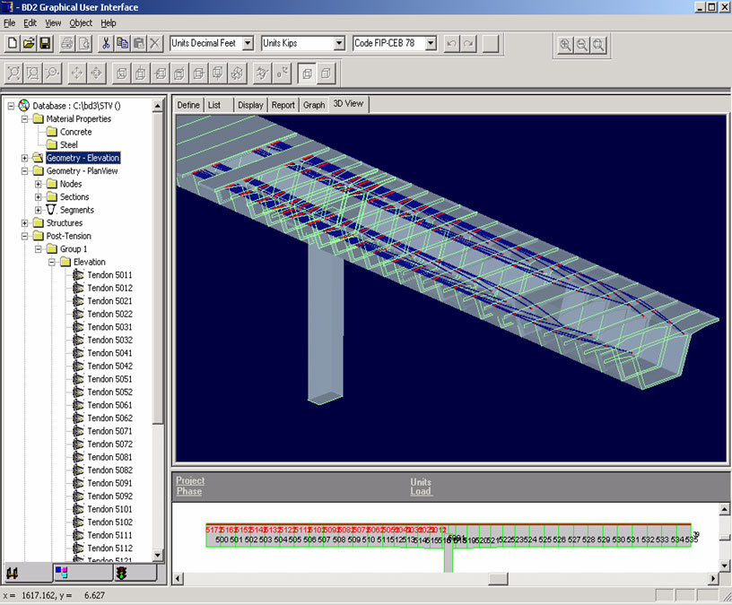
Bridge design

Slide 57
Bridge design

Slide 58
AutoCAD

Slide 59
Capital Logic

Slide 60
Whiteboard

Slide 61
Pen and paper

Slide 62
Enterprise Architect

Slide 63
Balsamiq

Slide 64
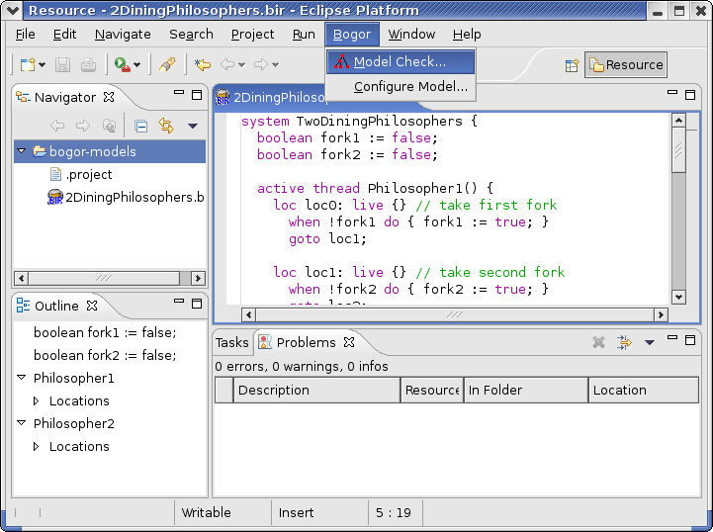
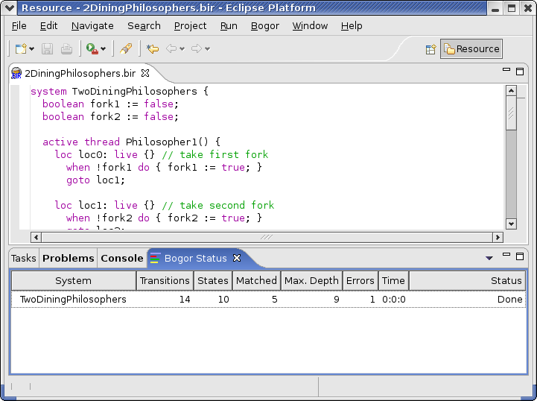
Bogor

Slide 65
Whiteboard

Slide 66
Pen & paper

Slide 67
Flow
A state of ‘flow’ is achieved when the designer seamlessly engages with the design artifact, rapidly and fluidly moving among the various parts of the design cycle
design notations may or may not hinder flow
design tools may or may not hinder flow
Merging of action and awareness
Loss of reflective self-consciousness

Slide 68
Reflection-in-action versus reflection-on-action
Reflection-in-action takes places during design work, and is typified by the designer feeling as if the design artifact itself provides important new clues
crucial element of flow
Reflection-on-action steps out of design work, and is typified by the designer explicitly reflecting on their design work and overall progress and approach
crucial element of design process

