Slide 1
Informatics 121 Software Design I
Lecture 6
Duplication of course material for any commercial purpose without the explicit written permission of the professor is prohibited.

Slide 2
Today’s lecture
Design methods
Practice

Slide 3
Design cycle
synthesize
goals
constraints
assumptions
decisions
ideas
analyze
evaluate

Slide 4
Backtracking
unexplored idea
previous decision
explored idea
current decision

Slide 5
Backtracking
what is it to accomplish?
satisfactory experience
how does one interact with it?
change in the world
what is its conceptual core?
plan for realization
what are its implementation details?

Slide 6
Realistic design process
what is it to accomplish?
satisfactory experience
how does one interact with it?
change in the world
what is its conceptual core?
plan for realization
what are its implementation details?

Slide 7
Realistic design process
what is it to accomplish?
satisfactory experience
how does one interact with it?
change in the world
what is its conceptual core?
plan for realization
what are its implementation details?
What happens here?

Slide 8
Realistic design process
what is it to accomplish?
satisfactory experience
how does one interact with it?
change in the world
what is its conceptual core?
plan for realization
what are its implementation details?
Or here?

Slide 9
Design process
A design process represents a planned course of action as to how to tackle a design problem to arrive at a design solution
where to focus effort
what methods to use
whom to involve
A design process may be defined up-front in its entirety, or defined in increments as the design project unfolds

Slide 10
Design method
A self-contained, structured technique that guides a designer in advancing some aspect of the design project at hand
Serves as a bridge from the overall process of design to actual individual and collaborative design work

Slide 11
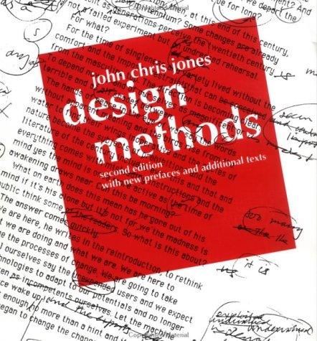
Origin

Slide 12
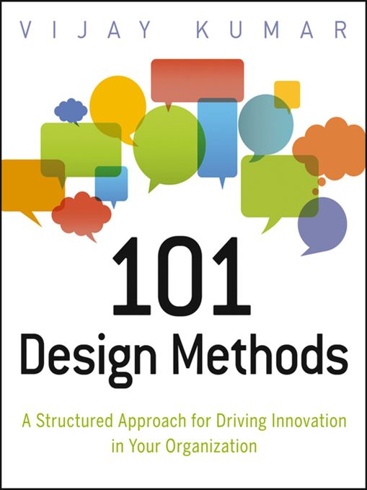
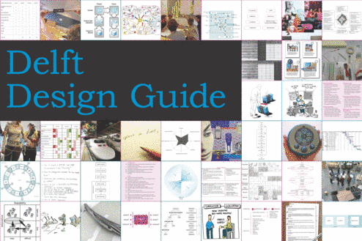
Today

Slide 13
Example

Slide 14
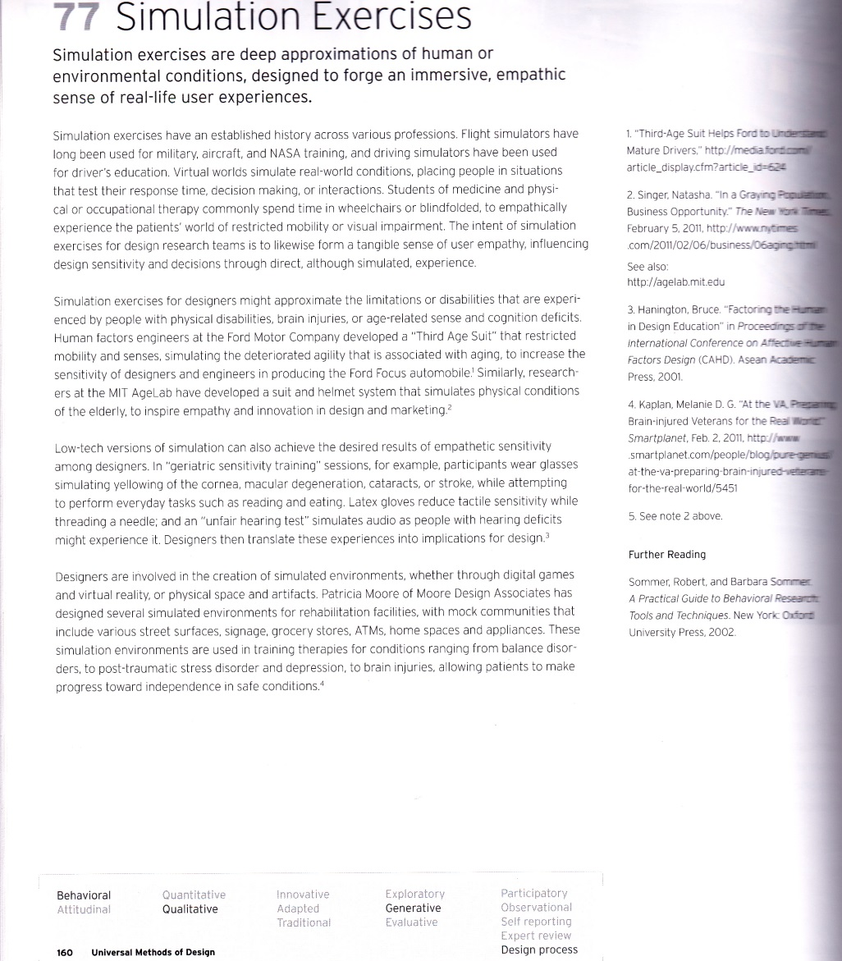
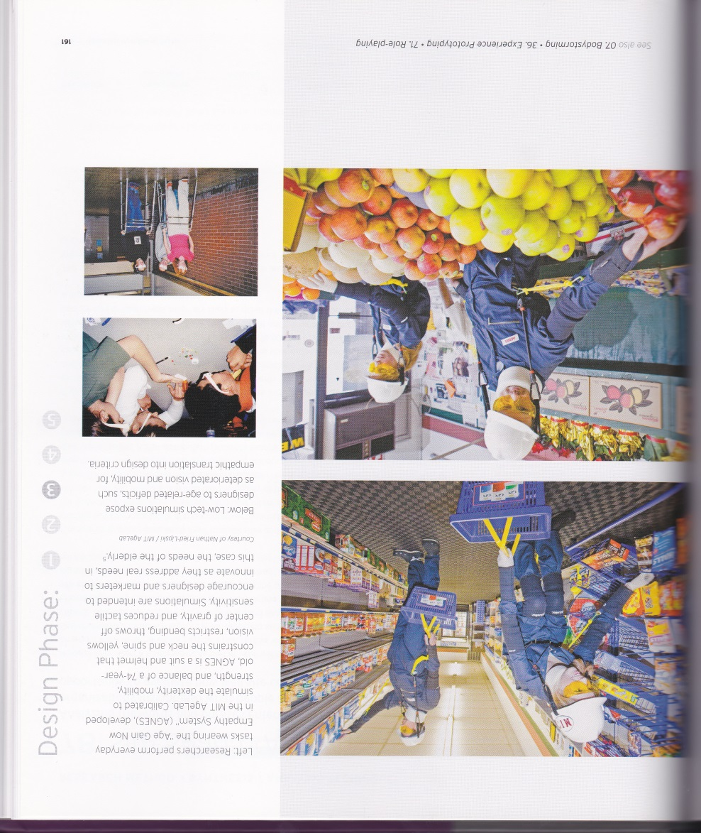
Example

Slide 15
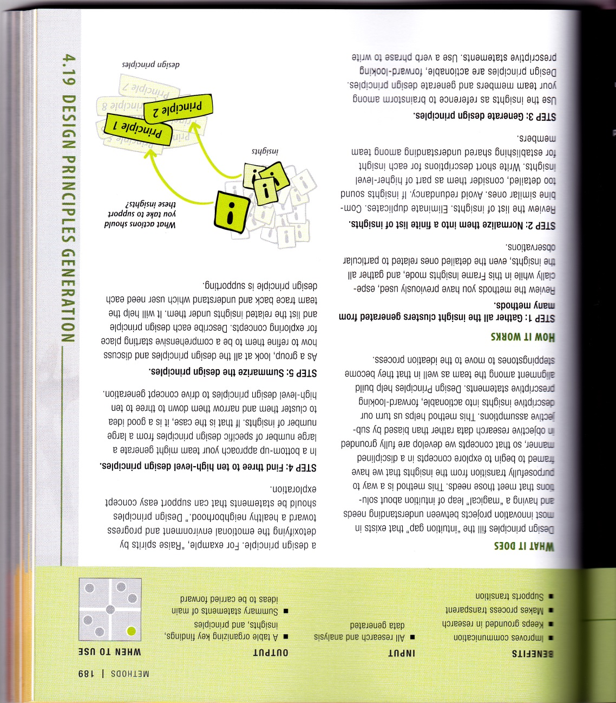
Example

Slide 16
Example

Slide 17
Characteristics of design methods
Each design method suits a specific purpose with respect to the design cycle and overall design project
Each design method expects a certain context for it to lead to optimal results
Applying just one design method rarely suffices (but still may help)

Slide 18
Example – decision making

Slide 19
Example – unearthing assumptions

Slide 20
Example – generating ideas

Slide 21
Example – identifying goals

Slide 22
Software design methods
 | Application design | Interaction design | Architecture design | Implementation design
Analysis | competitive testing contextual inquiry feature comparison stakeholder analysis task analysis | critical incident technique interaction logging personas scenarios | framework assessment model-driven engineering quality-function-deployment reverse engineering world modeling | release planning summarization test-driven design visualization
Synthesis | affinity diagramming concept mapping mind mapping morphological chart | design/making participatory design prototyping storyboarding | architectural styles generative programming component reuse decomposition | pair programming refactoring search software patterns
Evaluation | requirements review role playing wizard of oz | cognitive walkthrough evaluative research heuristic evaluation think-aloud protocol | formal verification simulation weighted objectives | correctness proofs inspections/reviews parallel deployment testing

Slide 23
Choosing design methods to apply
Focus on essence
Focus on the unknown
Focus on making progress

Slide 24
Focus on essence
Every design problem has an essence, the key – and often most difficult – part that must be understood and addressed ‘right’ for the design solution (plan for change in the world) to satisfy the stakeholders
Postponing understanding and addressing the essence of a design problem incurs a significant risk of rework at a later time

Slide 25
Focus on the unknown
Every design problem involves knowledge deficiencies – gaps in the understanding of the design problem and its possible solutions – that must be addressed for the design solution (plan for change in the world) to satisfy the stakeholders
Postponing understanding and addressing knowledge deficiencies incurs a significant risk of rework at a later time

Slide 26
Focus on making progress
Every design problem involves times during which the design project gets stuck; focusing effort elsewhere and continuing to make progress is often the right approach in response
Continuing to focus on a stuck issue for extended periods of time tends to be effort that is wasted

Slide 27
Practice
Virtual campus visit
Disney electronic queue management system
Mountain climbing 3D guide system
Social restaurant table

